Slide 1
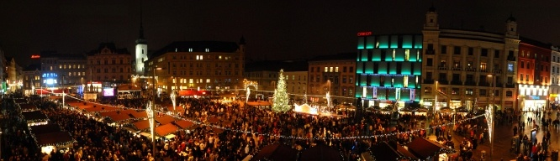

Kateřina Tomková, Brno, CZ
Tomkova@Accents 2012

Slide 2
Tomkova@Accents2012
Perceptions of Non-Native Pronunciation of English by Native Speakers

Slide 3
Tomkova@Accents2012
EXPERIENCE AND MOTIVATION
Teaching English since 1986
Specializing in Phonetics since 1991
Running the TomCat Playgroup since 1993
Adrian Underhill: Sound Foundations (1996)
J.C.Wells: Summer Course of English Phonetics at UCL(1996)

Slide 4
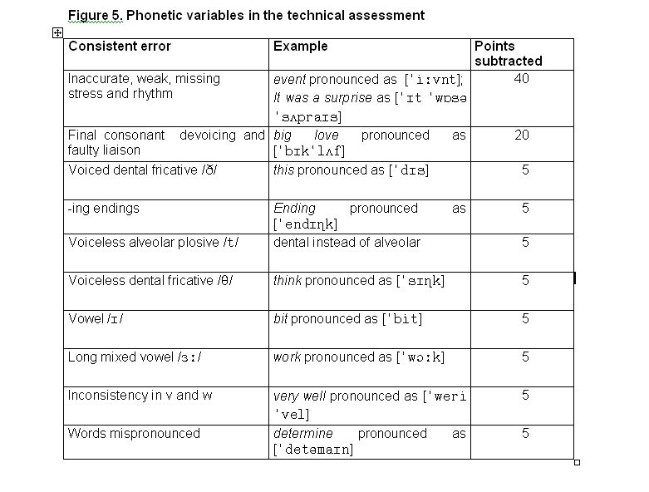

Slide 5
Tomkova@Accents2012
What next ???
Rhetorics ?
Elocution ?
        NO !!!

Slide 6
Tomkova@Accents2012
Instead, by studying the PERCEPTIONS of non-native pronunciation of English, to find out which aspects of pronunciation are vital for positive/negative personality perception.

Slide 7
Tomkova@Accents2012
THE CORPUS
15 non-native speakers of English
Texts for them to read; a question to answer
Recordings
5+1 assessors, native speakers of English
Questionnaires

Slide 8
Tomkova@Accents2012
EVALUATION
Phonetic assessment
based on the system devised in 1996.
Sociolinguistic assessment based on Questionnaires; criteria: intelligibility, confidence speaking English, elligibility for a childminding job, appropriateness of speech behaviour. Other criteria (secondary) not fully used.
Correlations between them

Slide 9
Tomkova@Accents2012
CORRELATIONS
The group of 4 best speakers by phonetic criteria remained unchanged.
Two shifts occurred between the 5 average speakers and 6 inferior speakers. Speakers 11 and 3 obtained much better results by perception than by phonetic criteria.

Slide 10
Tomkova@Accents2012
COMMON FEATURES
Their speech is appropriately loud.
Their speech is appropriately slow.
In other words, their loudness is sufficient for being comfortably heard,
and their tempo is sufficiently moderate for their pronunciation mistakes to be decoded.

Slide 11
Tomkova@Accents2012
CONCLUSIONS AND PRACTICAL IMPLICATIONS
In teaching, appropriate LOUDNESS and TEMPO must be emphasized.
ECHOING is to be avoided.

Slide 12
Tomkova@Accents2012
AUTHENTIC COMMENTS on the author’s pronunciation
A) Nemluvíš jako Angličanka. Mluvíš
jiným tónem.
    [You don’t speak as if you were English. You use a different tone.]

Slide 13
Tomkova@Accents2012
AUTHENTIC COMMENTS on the author’s pronunciation
B) I didn’t know you were foreign.
C) I knew at once you were foreign.
D) How many O-levels have you got?
E) You speak like an upper-middle class person.
F) Mrs. Tomkova’s accent is better than mine.

Slide 14
Tomkova@Accents2012
AUTHENTIC COMMENTS on the author’s pronunciation
F) Mrs. Tomkova’s accent is better than mine.
G) You speak a bit American.
H) You sound very British, we’ll work on that.
I) I don’t usually understand a word of what the British say but you’re very intelligible.

Slide 15
Tomkova@Accents2012
AUTHENTIC COMMENTS on other foreign pronunciation
J) I’ll turn the volume up for you.
K) Someone speaks with an Irish accent here. Keep it!
L) Your accent is charming.
M) You sound like a Russian spy in a James Bond movie.

Slide 16
Tomkova@Accents2012
AUTHENTIC COMMENTS on other foreign pronunciation
N) ………. – Pardon me?
O) My name’s Tom. – Dominic?
P) Camden Town, please. – Kensington?
Q) The one with the Czech accent?

Slide 17
Tomkova@Accents2012
AUTHENTIC COMMENTS made among native speakers
R) When did you first become aware of the special rhythmicality of English? - Not until I started Spanish.
S) Never mind Phil’s accent, he’s O.K.
T) Oh? You’re Canadian, aren’t you?

Slide 18
Tomkova@Accents2012
AUTHENTIC COMMENTS made by Czech speakers
U) My name’s David Konečný.
V) Těm Angličanům se vůbec nedá rozumět. Víc toho neřeknou než řeknou.
[It’s ever so hard to understand the English. They swallow more than they say.

Slide 19
Tomkova@Accents2012
AUTHENTIC COMMENTS made by Czech speakers
W) Já jsem té Angličance říkal všechno tak zřetelně a ona dělala, že mi nerozumí.
[I was so distinct speaking to the English person and she pretended not to understand me.]
X) Té angličtiny jsem nechala. Připadalo mi, že ze sebe dělám šaška.
[I quit English classes. I felt I was making a fool of myself.]

Slide 20
Tomkova@Accents2012
AUTHENTIC COMMENTS made by Czech speakers
Y) Otevři hubu, vole.
[Open your yapper, man.]
Z) Čeština mě namáhá víc.
[Czech requires more of my effort.]

Slide 21
Tomkova@Accents2012
CONCLUSIONS
QUESTIONS
INVITATION TO DISCUSSION SESSION ON EURO-ENGLISH THIS AFTERNOON

Slide 22

Tomkova@Accents2012
Thank you for your attention and have a
Meowy Christmas !

Slide 23
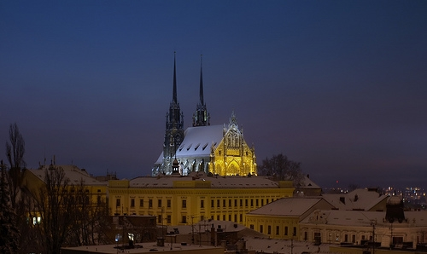
Brno again…

