Slide 1
Czech New Wave
CZS36 + CMA018
Dr. Šárka Jelínek Gmiterková
Fall 2023
12. 10. 2023

Slide 2

Loves of a Blonde
(dir. Miloš Forman)
1965
Screenplay: Miloš Forman, Ivan Passer, Jaroslav Papoušek
Cinematography: Miroslav Ondříček
Music: Evžen Illín
Starring: Hana Brejchová, Vladimír Pucholt, Vladimír Menšík, Josef Šebánek, Jan Vostrčil, Milada Ježková
„The film starring Jana Brejchová‘s sister“

Slide 3
Loves of a Blonde
Background and questions
„It was a late night in Prague, I saw a young girl. She was draging a heavy suitcase, but she didn‘t seem in a hurry, not asking anything from anyone and she clearly wasn‘t a prostitute. She seemed lost. And she clearly didn‘t mind. I was curious, so I started talking to her and persuaded her to go home with me.“
  (Miloš FORMAN, 1994)
Starting from the title and from the story above, how does this film portray romance (and sexuality)? What are the ideals, what are the goals and obstacles of coupling in the early 1960s Czechoslovakia?
Since you know Forman‘s previous film Black Peter, what kind of emotions he is best in portraying and communicating? How do you think he achieves that?

Slide 4

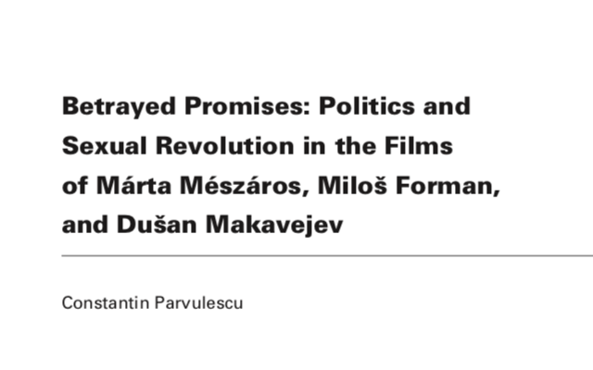
Reading L3
In: Camera Obscura: Feminism, culture and Media Studies. 2009, vol. 24, no. 2, pp. 77– 105.
KOVÁCS, András Bálint. Screening Modernism. European Art Cinema, 1950–1980. Chicago and London: Chicago University Press, 2007, pp. 322–329.

Slide 5
1960s as an era of a cultural renaissance
Relatively stable and prosperous decade
New impulses and experiments with form can be found not only in various national cinemas but in other artistic forms as well (nouveau roman, absurd theater, art informel) >> the effort to break with the stereotypes and the search for new conceptions and solutions
A similar atmosphere to be found in the 1920s – an era full of optimism and faith in the possibility to realize the utopian visions + 1960s as a period full of technical and scientific progress, as well as the rise of a living standard X sceptical take on human being (his or her possiblities, desires and aims) and the idea of progress

Slide 6
Modern / Modernism / Avantgarde
„Modern“
  Meaning „new“, but also „actual“ >> older or previous forms are irrelevant.
  The cult of modernity ends with postmodernism in the 1970s
  Against the idea that art continually undergoes and aesthetic revolution, pushing it towards new aestehtic visions and forms
„Modernism“
  An artistic movement able to express the experiences and feelings of contemporary world.
  Key concepts are authenticity and actuality rather than difference or invention.
„Avantgarde“
  A gesture towards the future, “avant“ meaning forward.
  This is an artistic movement oriented towards futurity.

Slide 7
Modern film / Modernist cinema
In the 1920s, cinema couldn‘t yet innovate its onw traditions, while in the 1960s the canon is already established
Is modernist cinema a break or a continuity with classical film? Two opposing ideas:
  The era of classical cinema is followed by the era of modernist cinema
  Both modes of cinema coexist >> modernist cinema is perceived as a subversive form and as a contrast to classical cinema
Modern films are „semi-comercial“ – their success as works of art is not tied together with their commercial success
  Specialized distribution and exhibition circuits (festivals, film clubs, art cinemas)
  “By the second half of the 1950s, the art film in Europe was more than a theory, a prospect, or a critical category – it has become a strong institution backed by tax laws, professional associations, production and distribution networks, film festivals and prestigious magazines.“ (KOVÁCS, p. 27)

Slide 8
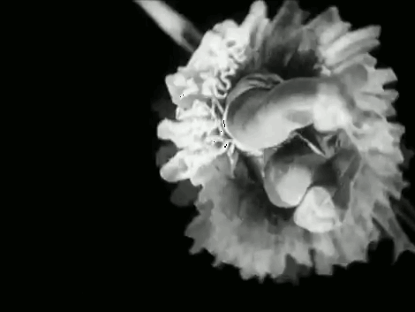
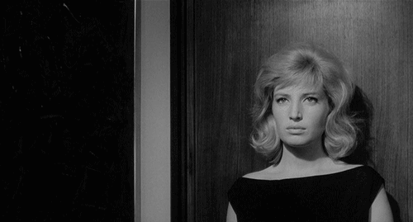
Cinema pur (1920s) X Modernist cinema (1960s)

Slide 9
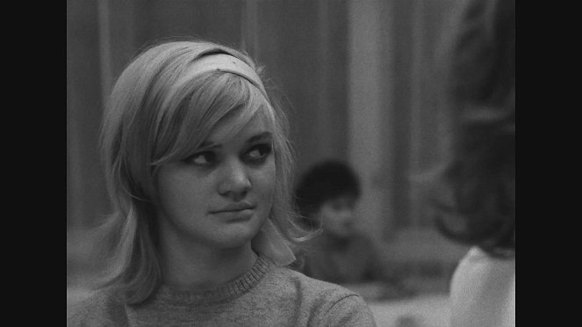
Narration as character-driven
„[…] characteristic traits of modern art-cinema narration: lack of deadlines in the plot, episodic structures, and representation of different mental states are all consequences of the concentration on the character rather than on the plot.“ (KOVÁCS, p. 63)

Slide 10
Storytelling and characters
Lack of psychological depth in characters >> wider existential portraits of a generation/class rather than a tight story of one protagonist in a particular surrounding
Male figures dominate
Accidents and improvisations >> not only during the production, but accident is frequently used as a storytelling device
Open endings, stories without conclusions and/or status quo reinstalled
Circular narratives – in contrast to classical storytelling these ones are more descriptive. It provides us with insight into the problems the hero faces, but it lacks solutions.

Slide 11
In the second half of the 1950s…
The peak of cinemagoing >> more than 35 films between the years 1954 and 1959 attracted more than two million viewers
  Demografical reasons (audiences born after the war), economical reasons (not many households equipped with tv), distribution of films from Western Europe
Local films – most succesfull are comedies with male stars from prewar years
  Satire – helps to infuse lighthearted films with serious message, as it should adress shortcomings of socialist society X shoud leave out political issues => impossible genre?
  Three Wishes (1958, dir. Ján Kadár, Elmar Klos)
Also psychological (intimate) dramas
  House at the Terminus (1958, dir. Ján Kadár, Elmar Klos)
  September Nights (1957, dir. Vojtěch Jasný)
  School for Fathers (1957, dir. Ladislav Helge)
  Scars of the Past (1957, dir. Václav Krška)

Slide 12
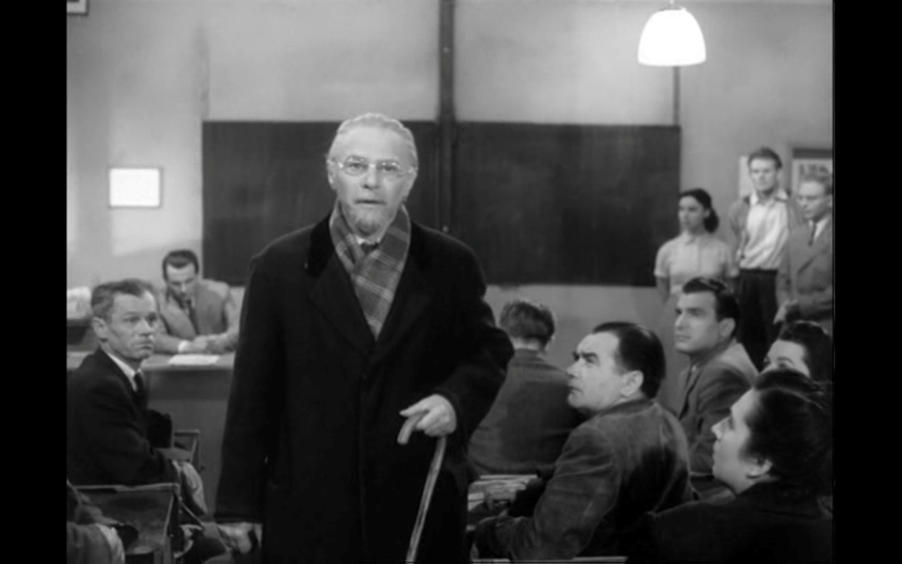
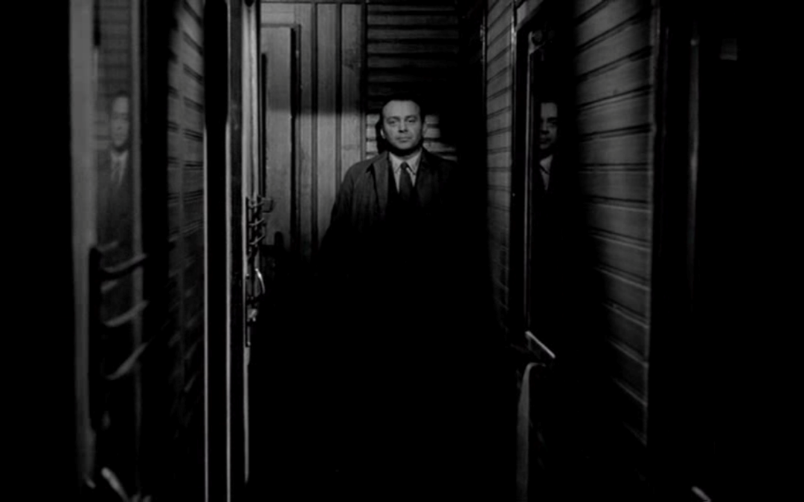
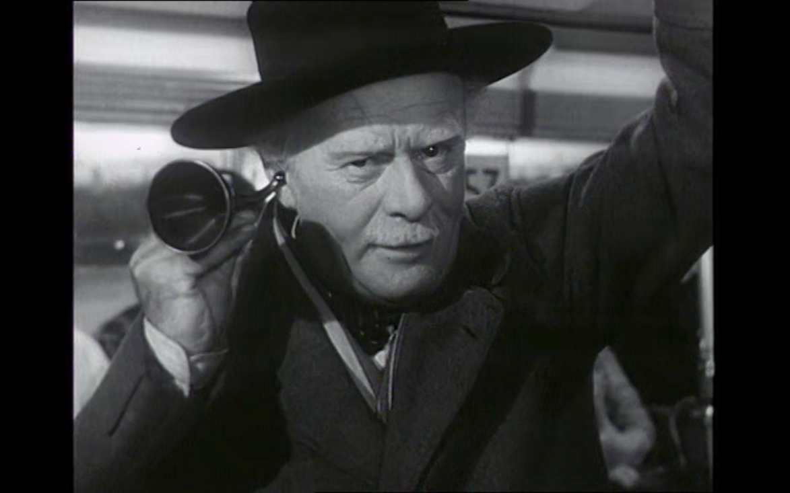
Direct address:
Speaking directly
to the audience

Slide 13
The Fist Festival of Czechoslovak Cinema in Banská Bystrica (BB), February 1959
BB in the context of other cultural events, aiming to manifest the progress in this sphere and how tightly is culture directed by the Communist party
The minister of culture ad education František Kahuda harshly criticized the aforementioned films as prime examples of unwelcomed tendencies in socialist cinema
„ […] main topics of our films […] are still limited to Prague, to stories of private lives and of pessimistic nature, adressing issues of certain youth groups only. […] Does healthy family still exist, are new appartments under construction, do we associate teenagers solely with gangsters, is alcoholism such an important part of life?“

Slide 14
The Consequences of BB
The proces of decentralization and gradual liberalization was defered for two years
Personal changes on top of Barrandov studios (BS) and Czechoslovak State Films (CSF)
Stricter censorship >> in the future not only the story should be considered, but political profiles of its authors and casting as well
Some directors were banned from filmmaking for two years; production Creative Group (CG) Feix-Daniel was cancelled
CSF lost the right to greenlight films for distribution on its own in favor of the ministry of culture and education
BS willing to cooperate with next generation of filmmakers (the older directors lost trust of the studio leadership)

