Slide 1
Academic skills
Week Ten, 23. 11. 2023
Analysis Refresher Seminar II
Dr. Šárka Jelínek Gmiterková

Slide 2
Agenda
Structure
Discussing your approaches to reading scholarship and going through your resumés
Targeted Learning Outcome
Identifying effective ways of reading academic output

Slide 3
On reading scholarship
Do you enjoy reading academic output?
What do you like about it and what is there NOT to like?
What is your favorite academic piece to date?
How frequently do you read such pieces?
How do you find what to read? (do you actively search for this kind of content you would like to read?)

Slide 4
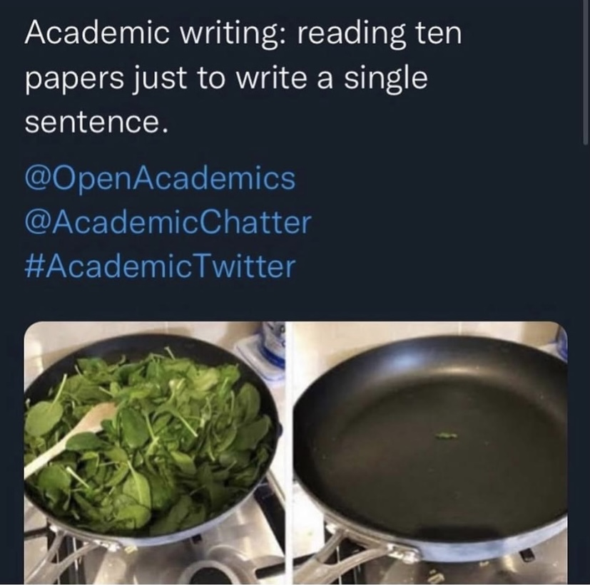
Academic reading and writing can a lot of times look like this…

Slide 5
Note on reading
Academic output is not the most exciting thing to read, however it is necessary for our own relevant academic papers. Therefore we should be able to approach it in an organized, systematic way.
In order to navigate ourselves in our area of interest for (future) research, we have to be acquinted with knowledge and key arguments existing in the field.
Your first year of university studies is a good time to do a lot of reading; ideally three to five pieces of scholarship a week (chapter/papers/articles); combining both your obligatory reading for courses/seminars on weekly/biweekly basis with an active research of your own in the areas of your interest.
Look through reading lists of the courses similar to your research interests (either topically or methodologically); check bibliography lists at the end of academic books, chapters and articles; search through various electronical databases.

Slide 6
Miranda Banks: Gender Below the Line
How did you find this article topic/language/argumentation/examples wise?
How did you approach writting the resumé? Take me step by step through your process.
- - - - - - - - - - - - - - - - - - - - - - - - - - - - - - - - - - - - - - - - - - - - - - - - -
„The author explains how previous feminist production studies, which focused on percentages of women in above-the-line roles, have overlooked the fact that women dominate many behind-the-scenes roles (below-the-line roles). […] By focusing on costume designers, the study aims to remind everyone that even working backstage plays a huge role in shaping the visual aspects of production or contributing to the storytelling process by creating wardrobes for actors.“
“Miranda J. Banks examines the complexities of gender dynamics in film and television production, urging for a more nuanced approach than simply relying on statistics. Her research delves into the gendering of specific professions, particularly those often overlooked in industry studies, such as below-the-line workers.”
„The author sheds light on the interpretation of professions "below the line" and how gender stereotypes and biases impact them: "For film and television practitioners in Hollywood, the gender gap becomes a question not only of who is hired, but what work they are asked to do.““

Slide 7
“The answer is built upon concrete example of professional position of a costume designer which by goal of its labour is always erased from our sight. This analyse unwraps main details and even more about not just designing and creating of characters’ costumes, but also about other roles which costume designers play and issues they face every day working as below-the-line craftspeople in film and television industry.”
„In contrast to the prevailing current research methodologies that concentrate on the work of above-the-line practitioners like auteurs and executives, this chapter centers on the perspectives of female practitioners working below the line, who are often seen as craftspeople or technicians, working with their hands and possessing specialized trade knowledge acquired through apprenticeships or on-the-job experience.“
“It adds to feminist production studies and sets itself apart from the methods used by researchers like Julie D'Acci and Elana Levine, who look at cultural capital and power relations in media production communities using a variety of approaches. […] This research highlights the misconstrued line that separates fashion from costume, mentioning the gendered nature of costume designers' work and their underappreciated labor.”
„Cited authors, including Arlie Russell Hochschild, Stephanie Shields, Vicki Mayer, Brian Moeran, Graeme Turner, Murray, and Ouellette, contribute insights into emotions' commercialization, authenticity, and the influence of celebrity culture across various media.“

Slide 8
Miranda Banks: Gender Below the Line
My resumé:
This chapter argues for a feminist perspective in production studies. Although data covering employment of women and female labor in the cinematic industry do exist, persisting gendered labelling of certain below-the-line professions has not yet been analysed. Banks focuses on costumes designers, whose work is traditionally perceived as feminine (crafty, invisible, subservient, diplomatic). This is partly due to the relative invisibility of film costumes, which should work for the image and character, not beyond the film narrative itself. Also, costume design should not be confused with fashion, although many film costumes are assembled from pre-existing clothing.
Important topics and perspectives:
Useful elaboration of existing knowledge on costumes based on textual and narrative analysis
In order to understand gender dynamics within cinema studies we should not focus solely on the works made by women and targeted at women, but we should also look into wider gender gaps and biases of film production in general
Different notions of creativity (recycling, upcycling, assembling costumes from ready-to-wear fashion designer collections), the concept of emotional labour can be used for analysing other BTL professions (make-up artistry, casting, acting coaches)

Slide 9
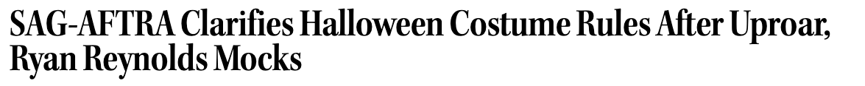
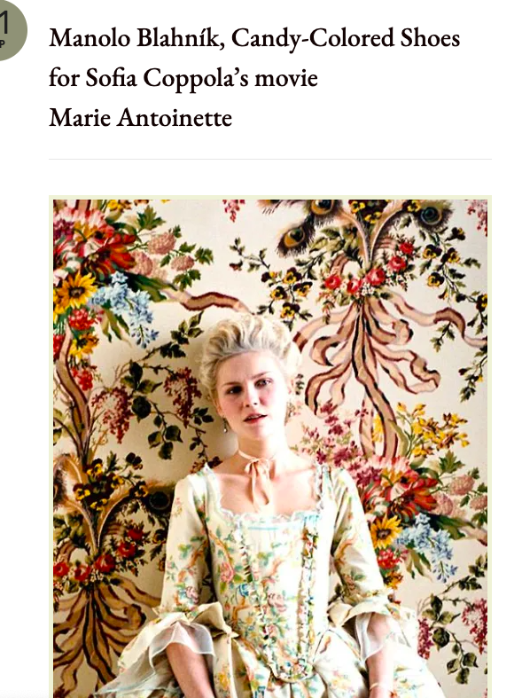

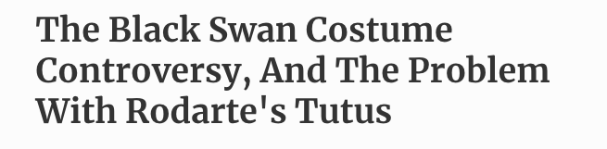
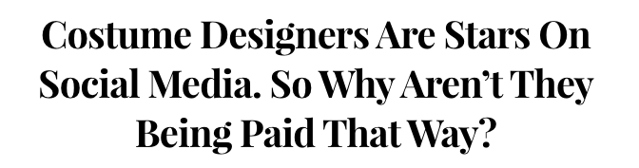

Slide 10
Take-aways
There is no exhausting and final resumé of every text we have read.
However, we have to make note of every scholarship piece we have read and might/will need in the future.
Make a note/resumé (one paragraph) out of every chapter/paper/article you read. From which perspective each item approaches the topic? What arguments does it present? Which primary and secondary materials are used? Are there any examples you would like to use for the sake of your own argument?
Key arguments should be compressed into two or three sentences. If needed, note down specific examples or case studies; sometimes a topic for which a similar perspective might be fitting
Use your own words! Paraphrase the key arguments, do not just copy and paste (with the exception when you know, you are going to quote the sentence directly).

Slide 11
Next time
Date: 30. 11.
Instructor: Richard
Topic: Project Execution Seminar II: Organization
Outcome:Argument-driven paragraphs and evidence-based sections
Prepare: Think about how to break down your paper into 3-4 sections.

