Slide 1
Academic skills
Week Fourteen, 21. 12. 2023
Project Presentation Seminar II: Referencing
Dr. Šárka Jelínek Gmiterková

Slide 2
Agenda
Structure
The importance of referencing
Learning how to reference at MUNI (Faculty of Arts)
Targeted Learning Outcome
Why, when and how we reference our work

Slide 3
Why do we reference our work?
What do you reference?
Where in your paper would you put references to the work/sources you have used?
Is there something which does not need referencing?
Is there something like „over-referencing“?

Slide 4
What are you referencing?
Monography is a non-serial publicaton, which systematically and in detail investigates a narrow topic (or an aspect of a topic); it is thoroughly documented.
Edited volume/edited collection does not investigate the topic in such detail, with individual contributions being only loosely connected and could exist as pieces/articles/chapters on their own. In contrast to collective monography, this is not a joint piece of work by multiple authors, but a collection of contributions signed by authors, who did not cooperate on the outcome.
Readers do not bring original research outcome as well as previously unpublished work. They are compillations of previously published papers (or extracts thereof).
Academic articles are to be found in scholarly, peer-reviewed journals.

Slide 5

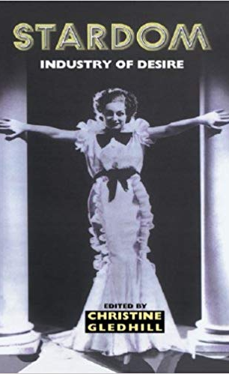


Slide 6
How do we reference?
Direct quotation, paraphrasing, summarising
Direct quotation – transfering the original words of the author and organicaly incorporating them into your explanation.
Paraphrasing – expressing the original idea of the author with our own words.
Summarising – expressing the original idea of the author with our own words while shortening and concentrating the original length (leting out specific details and examples).
Whatever style we choose, we always have to reference the author and his/her ideas we used for the purposes of our own investigation and explanation!

Slide 7
Examples: direct quotation
Original text:
  „The importance of publicity is that, in its apparent or actual escape from the image that Hollywood is trying to promote, it seems more ‚authentic‘. It is thus often taken to give a privileged access to the real person of the star. It is also the place where one can read tensions between the star-as-person and her/his image, tensions which at another level become themselves crucial to the image (e.g. Marilyn Monroe’s attempts to be considered something other than a dumb blonde sex object, Robert Redford’s ,loner‘ shunning of the attention his star status attracts.“¹
    DYER, Richard. Stars. London: BFI, 1998, p. 61.
Incorporating Dyer’s words into my writing:
  In contrast to promotion, managed by studio or the star herself, publicity exists outside of these official discourses. According to Richard Dyer it can provide us with a „[…] privileged access to the real person of the star.”¹ Publicity stems from unauthorized articles and images, scandals, discussions on social media both on the celebrity profiles or outside of them, or websites or blogs dedicated to nudity, sexual misconducts, power abuse or so-called blind items (in fact gossips).
    DYER, Richard. Stars. London: BFI, 1998, p. 61.

Slide 8
Examples: Summarising
Original text:
  „The importance of publicity is that, in its apparent or actual escape from the image that Hollywood is trying to promote, it seems more ‚authentic‘. It is thus often taken to give a privileged access to the real person of the star. It is also the place where one can read tensions between the star-as-person and her/his image, tensions which at another level become themselves crucial to the image (e.g. Marilyn Monroe’s attempts to be considered something other than a dumb blonde sex object, Robert Redford’s ,loner‘ shunning of the attention his star status attracts.“¹
    DYER, Richard. Stars. London: BFI, 1998, p. 61.
Incorporating Dyer’s words into my writing:
  Publicity can, but does not have to, offer insight into the real star, outside of the official promotional activities or discourses. According to Dyer, its main point is to expose the tensions between the constructed star image and the more or less authentic person behind the image.¹
    DYER, Richard. Stars. London: BFI, 1998, p. 61.

Slide 9
Examples: Paraphrasing
Original text:
  „The importance of publicity is that, in its apparent or actual escape from the image that Hollywood is trying to promote, it seems more ‚authentic‘. It is thus often taken to give a privileged access to the real person of the star. It is also the place where one can read tensions between the star-as-person and her/his image, tensions which at another level become themselves crucial to the image (e.g. Marilyn Monroe’s attempts to be considered something other than a dumb blonde sex object, Robert Redford’s ,loner‘ shunning of the attention his star status attracts.“¹
    DYER, Richard. Stars. London: BFI, 1998, p. 61.
Incorporating Dyer’s words into my writing:
  Publicity is crucial, because it can (although not always does) provide us with access to the person behind the image. Through publicity we are able to see celebrity persona as a genuine human. But not only that, it also allows us to see contradictory forces operating at the core of the image. For example in Marilyn Monroe‘s parallel existence as a sex object and an ambitious actress, as well as in Robert Redford‘s regular escapes from public visibility.¹
    DYER, Richard. Stars. London: BFI, 1998, p. 61.

Slide 10
And also…
… you need to provide bibliograpfical reference when quoting facts, statistics, dates and information.
Indebtedness? … In case a text contributed to your understanding of the material or in the formulation of your arguments, you must cite the source even if you do not directly reference it in the text. However! This can be sorted out in bibliography or in the acknowledgments section.
When you do NOT need provide the reader with a bibliographical reference:
  Common knowledge: In February 1948, there was a communist putsch in Czechoslovakia.
  Generally accepted or observable facts: In Czechoslovakia in the 1960s, the Communist party ruled over the country.
  Original ideas and lived experiences: when you are writing about yourself or your lived experience; or the results of your own research or projects.

Slide 11
Do not forget!
You should not only provide bibliographical references throughout your paper.
At the end of your essays, you have to include a complete bibliography: a list of all the monographs, chapters from edited volumes, articles, reviews, profiles or other materials you have used and referenced throughout your paper.
The list should be in alphabetical order, each bibliogrpahical record starting with author‘s surname.

Slide 12
Bibliography referencing system
MUNI, Faculty of Arts
Variation of Harvard Referencing system, with footnotes/endnotes and a bibliography list consistiong of primary and secondary sources used, analyzed or consulted while working on the thesis and then the paper
In case of monographies you need to include name of the author, full name of the book, city of publishing, name of the publisher and year of the publishing. In case you are referencing only certain pages or parts of the book, always include a page (pages).
Examples:
  KOVÁCS, András Bálint. Screening Modernism. European Art Cinema, 1950–1980. Chicago and London: Chicago University Press, 2007, pp. 322–329.
  OWEN, Jonathan L. Avant-Garde to New Wave. Czechoslovak Cinema, Surrealism and the Sixties. New York and Oxford: Berghahn books, 2011.

Slide 13
Bibliography referencing system
MUNI, Faculty of Arts
In case of chapters from edited collections you need to include name of the author, name of the chapter, but also name of the editor of the collection, full name of the book, city of publishing, name of the publishing house and year of the publishing. You always include paging.
Example:
  YU, Sabrina Qiong. Dancing With Hollywood: Re-Defining Transnational Chinese Stardom. In: Andrea Bandhauer a Michelle Royer (eds.): Stars in World Cinema: Screen Icons and Star Systems Across Cultures. London and New York: I. B. Tauris, 2015, pp. 104–116.

Slide 14
Bibliography referencing system
MUNI, Faculty of Arts
In case of articles from (not only) peer-reviewed journals you need to include name of the author, name of the article, but also name of the journal, its volume, number, year of publishing the article and paging.
Example:
    GMITERKOVÁ, Šárka (2016): Betrayed by Blondness: Jiřina Štěpničková between authenticity and excess. Journal of Celebrity Studies. 2016, vol. 7, no. 1 (The Blonde Issue), pp. 45–57.

Slide 15
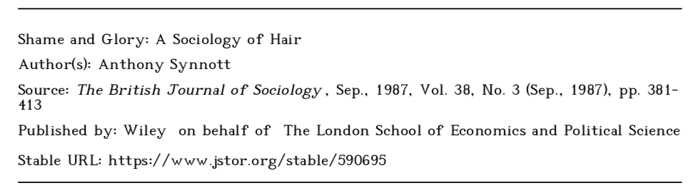

Slide 16
Take-aways
When writing any academic output, we always build upon, argue with or employ the work of other scholars.Therefore we should continuously reference our sources and make a list of all those we have used at the end of our essay.
Why do we reference?
  We prove, that we have consulted, used and analysed primary and secondary sources and our claims are based upon existing material.
  We can orient ourselves in the academic field of our choosing.
  Anyone can trace back all of our primary and secondary sources.
  If we use any primary and/or secondary sources without properly referencing them, our work risks being labelled as plagiarized.

Slide 17
