Slide 1
Czech theatre during WWII strategies of survival and resistance
Extremely short case studies ;)

Slide 2
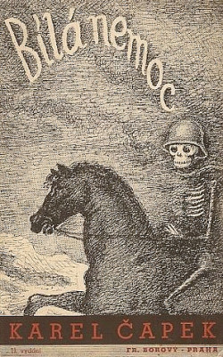
Karel Čapek (1890-1938)
Liberal, antifasistic author (from circle of T.G.M)
In 30ties more and more explicitly politically active
Two antifasictis play: The White Plague (1937) ad The Mother (1938)

Slide 3
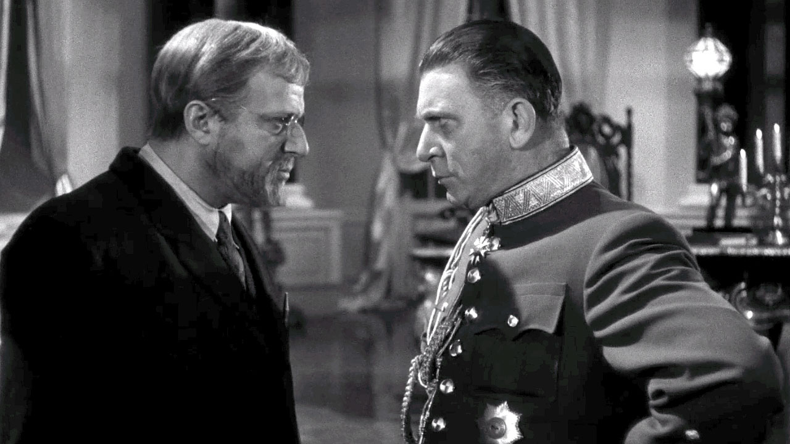
Hugo Haas (1901-1968), theatre and film actor, director
He was sacked from Prague National Theatre in February 1939 because of his Jewish origin.
Trailer

Slide 4
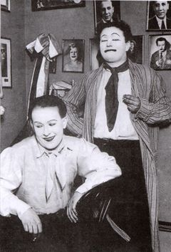
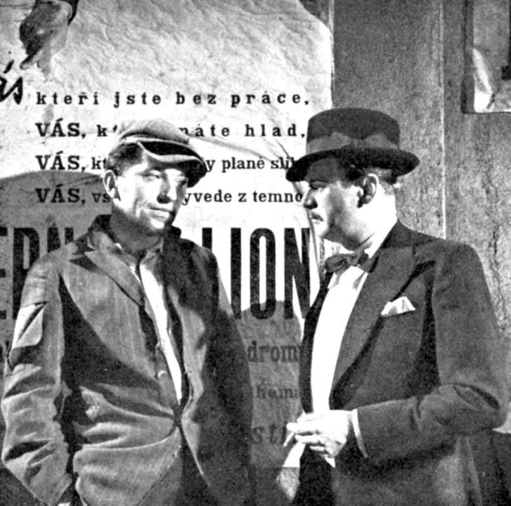
Voskovec and Werich – Liberated theatre
Svět patří nám
The World belongs to Us 1937

Slide 5
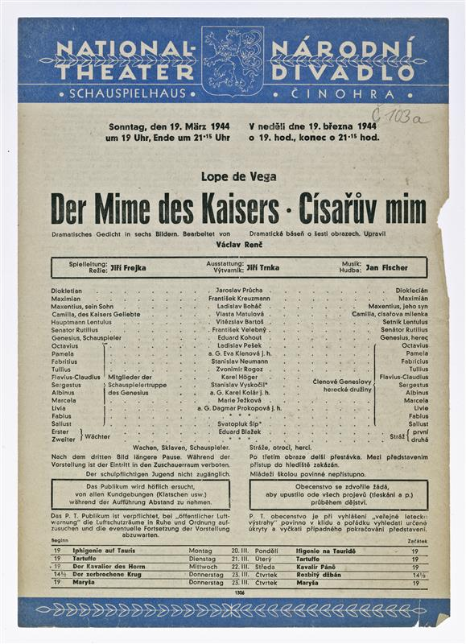
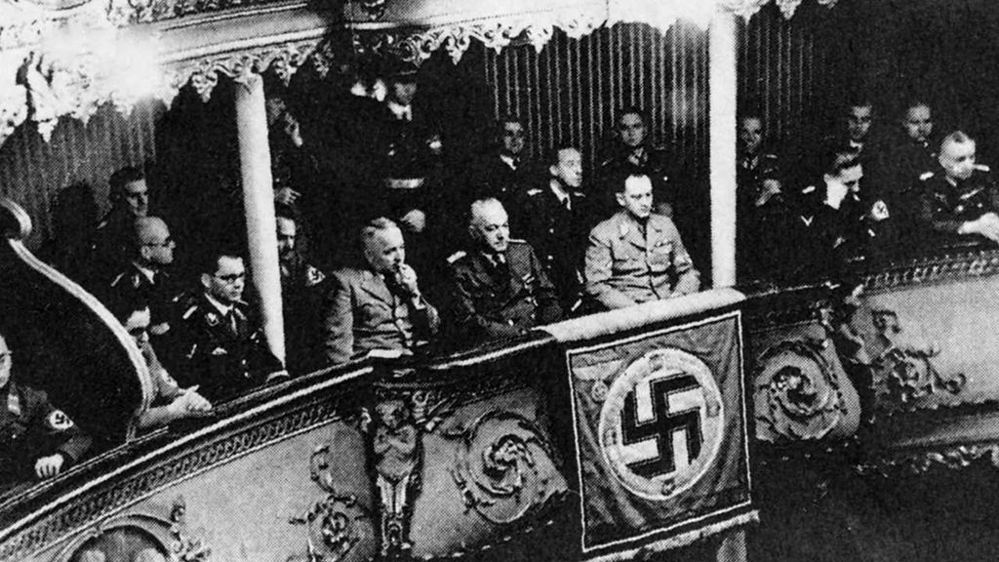

Slide 6
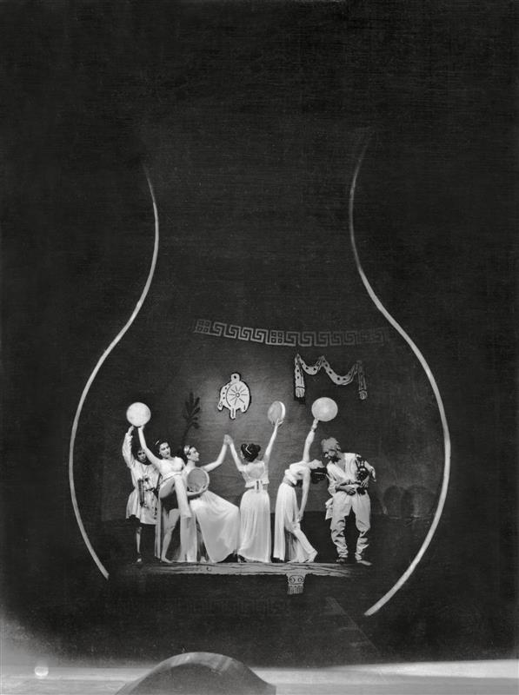
Jiří Frejka (1904-1952)
Avant-garde director (in Prague National theatre since 1930)
Search for actual message in Czech or world classical drama
Plautus: Pseudolus

Slide 7
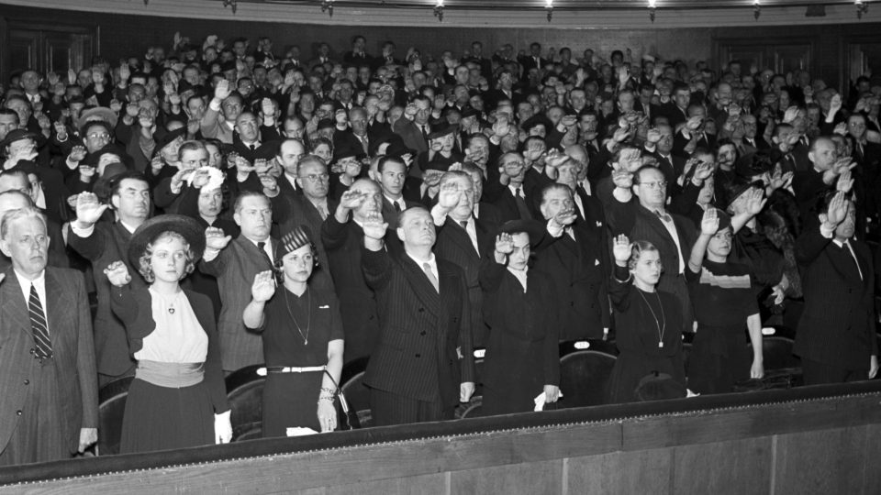
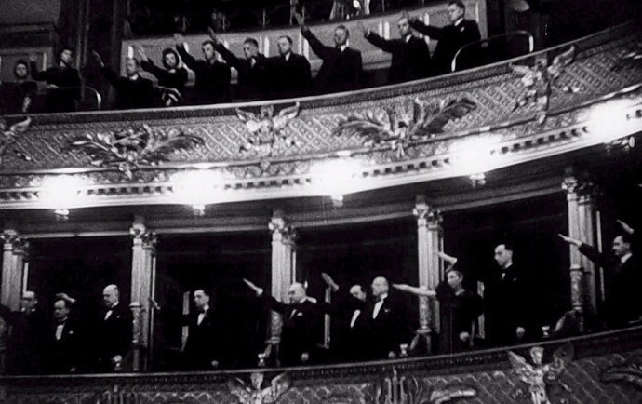
Demonstration of loyality to Reich after assasination of Reinhardt Heidrich (1942)

Slide 8
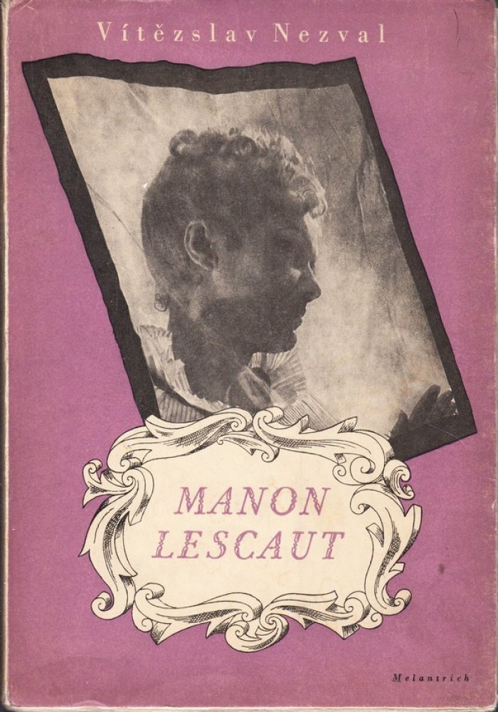
Emil František Burian (1904-1959) and D 40
Support new Czech writing
Founds a school
Club of supporters (lectures and other public activities)
Theatre officially closed down 1941
1941 – Manon Lescaut – play by Vítězslav Nezval
based on the novel of the same name

Slide 9
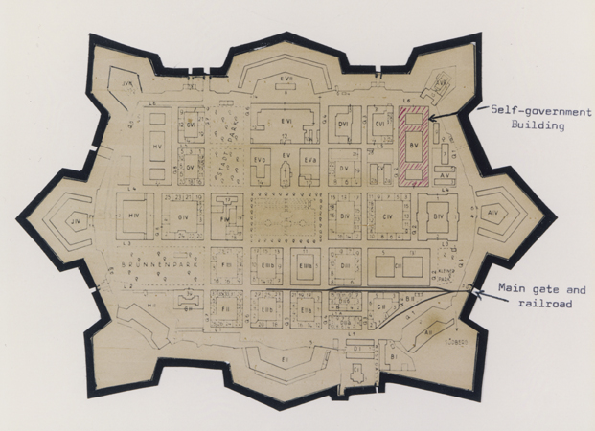
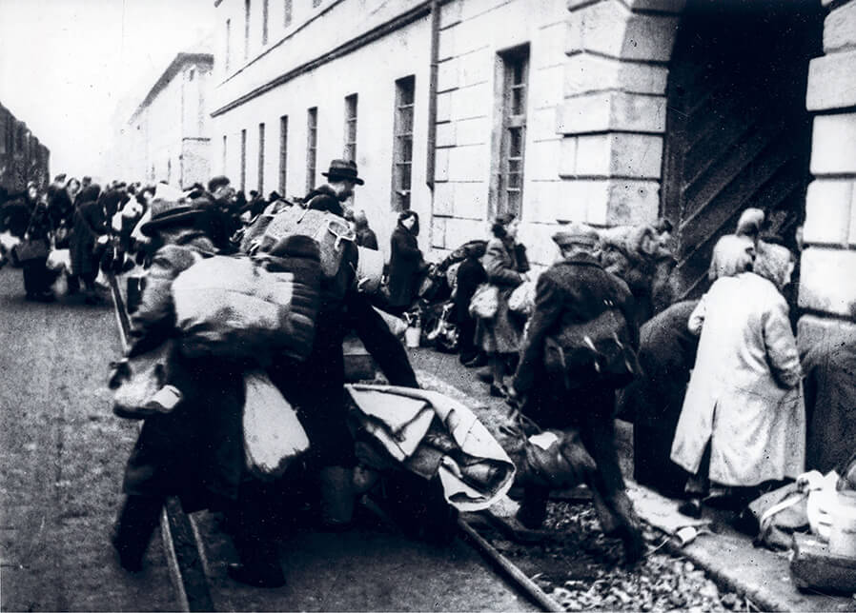
Theatre in Terezín (Theresienstadt) ghetto / transit camp
1941-1945

Slide 10
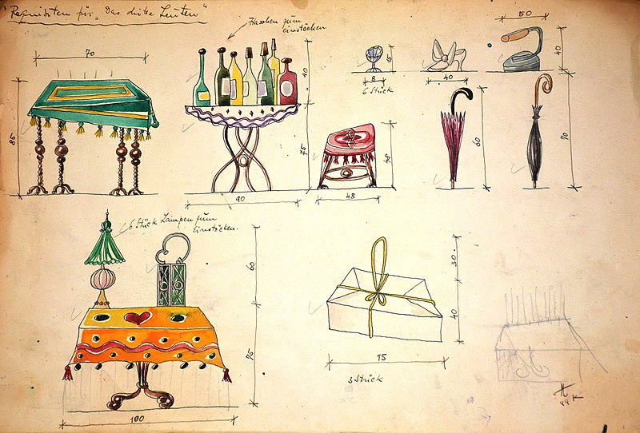
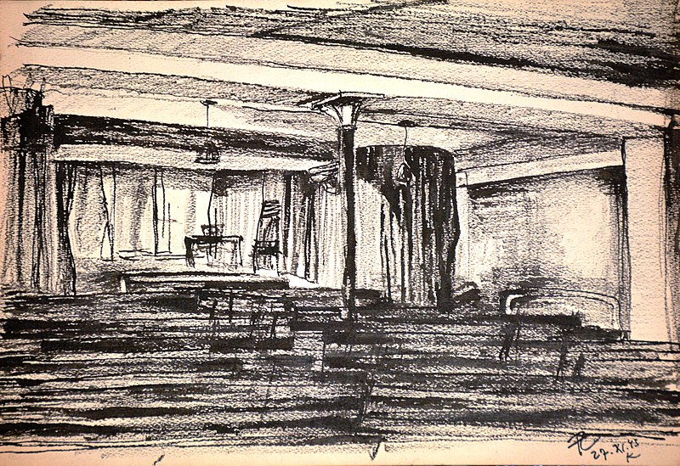
František Zelenka
(1904-1944) stage designer
Cabarets – concerts – theatre performances (opera and drama) ….

Slide 11
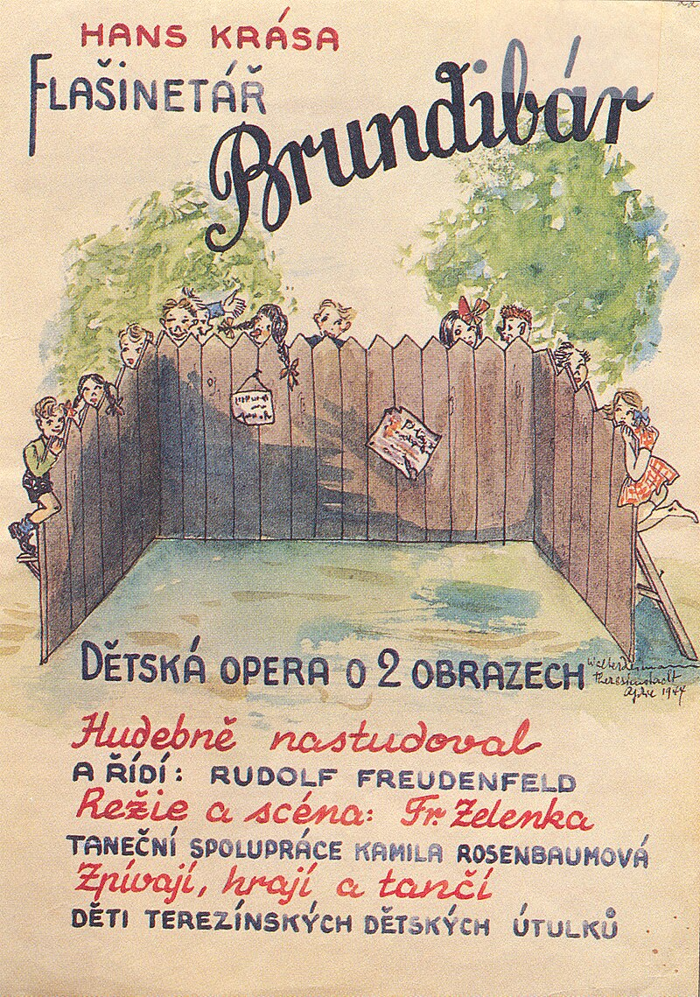
Hans Krása – Adolf Hoffmeister… opera for children
Composed 1938 for goverment competition
Break of 1942/43- performed by childern chorus in Jewish orphanage in Prague přelom
September 1943, in Terezín, about 55 performances in years 1943–1944

Slide 12
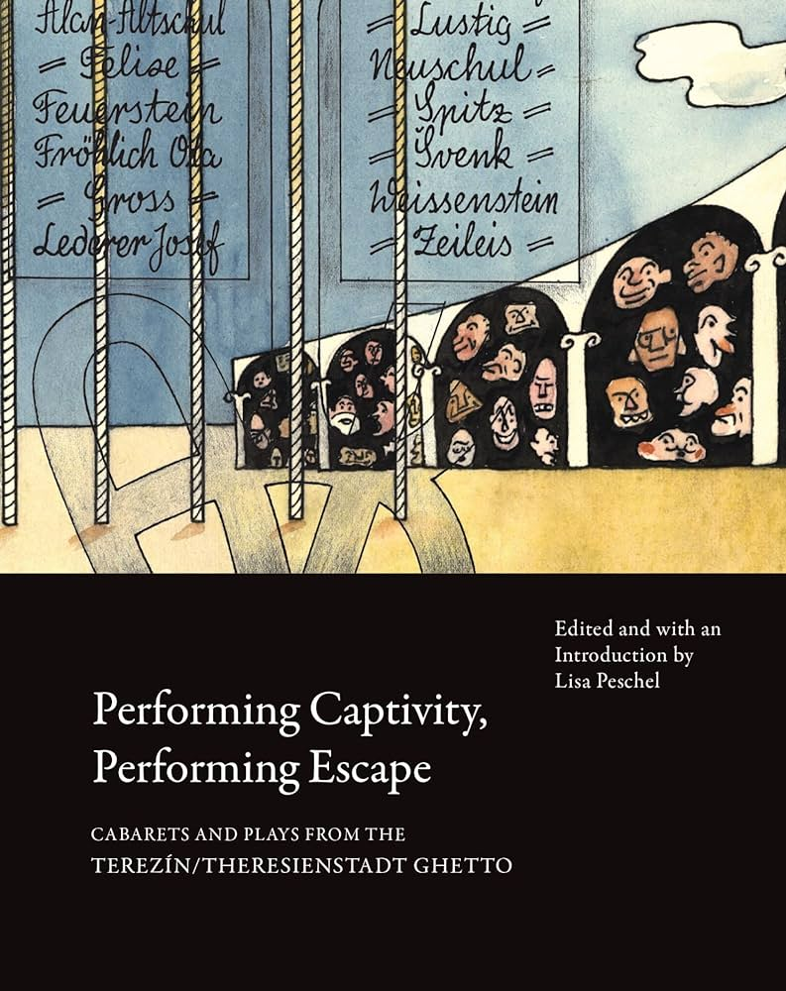

Further reading
Jarka M. Burian
Modern Czech theatre: reflector and consience of a nation. Iowa City : Universtity of Iowa Press, 2000.
Leading creators of twentieth-century Czech theatre. London : Routledge, 2002.
Performing Captivity, Performing Escape: Cabarets and Plays from the Terezín/Theresienstadt Ghetto. Calcutta: Seagull Press, 2014.
A Holocaust Cabaret: Remaking Theatre from a Jewish Ghetto. Bristol: Intellect, 2023.

