Slide 1


A (Post)National Mainstream Industry
Lecture 2: Franco-US Dialogue and ‘Inclusive’ Casting
Intouchables/Untouchable (Olivier Nakache and Eric Toledano, 2011) and Lupin (Series 1, Episode 1)

Slide 2
Structure of the Lecture
Intouchables as/and culture clash and buddy comedy
Gender, class and ethnicity in recent French film comedy
Close analysis of Intouchables
key visual and thematic motifs
key areas for discussion
The Netflix era in France
- French TV history
- recent developments
Lupin
localisation and ‘inclusive’ casting
historical revisionism

Slide 3
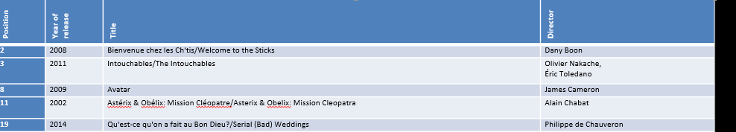




The Best-selling Films on the French Market since 2000
Extracted from a list of the 100 best-sellers, Internet Movie Database, www.imdb.com
Trailer: Bienvenue Chez Les Ch'tis Trailer - In UK Cinemas 1st April - Bing video
See also M. Harrod and P. Powrie (2018) on ‘New directions in contemporary French comedies’
Notes:
Film plots! At least of other two.

Slide 4


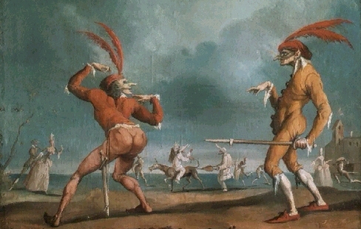


INTOUCHABLES AS COMEDY
Comic Buddy Duos
A transnational, transhistorical phenomenon.
La Commedia dell’Arte

Slide 5
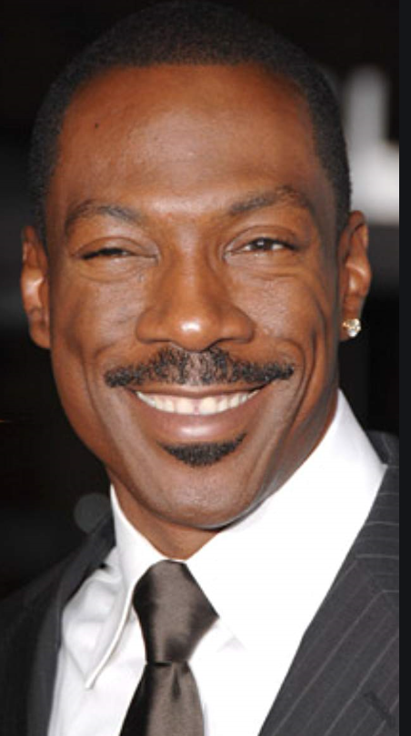
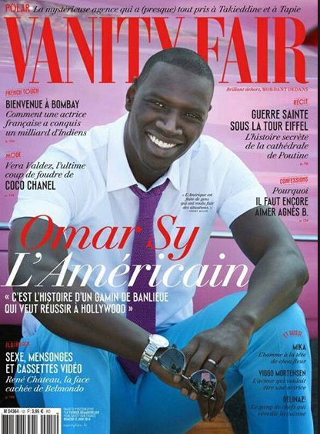
Sy and Murphy
-
See also Raphaëlle Moine (2007, 165-7).
Notes:
But come back to race – and this multi-dimensional article - later.

Slide 6
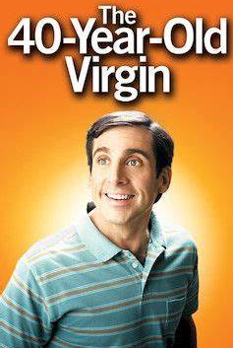
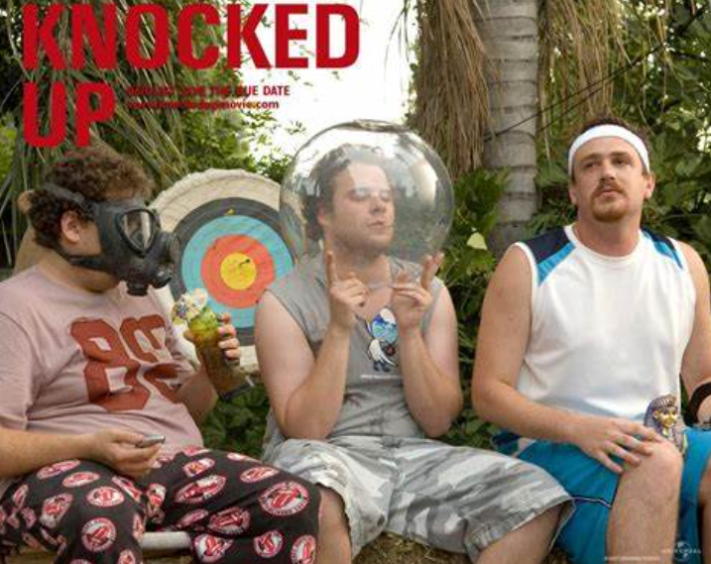
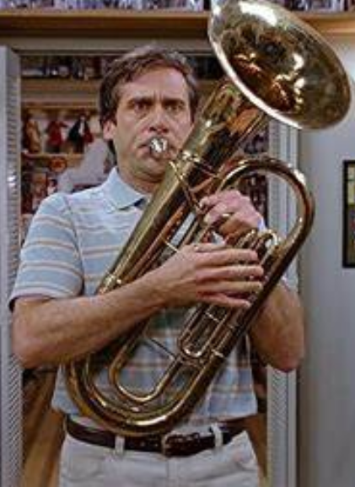
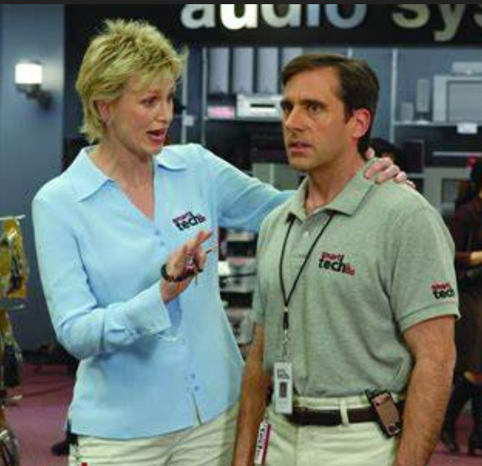
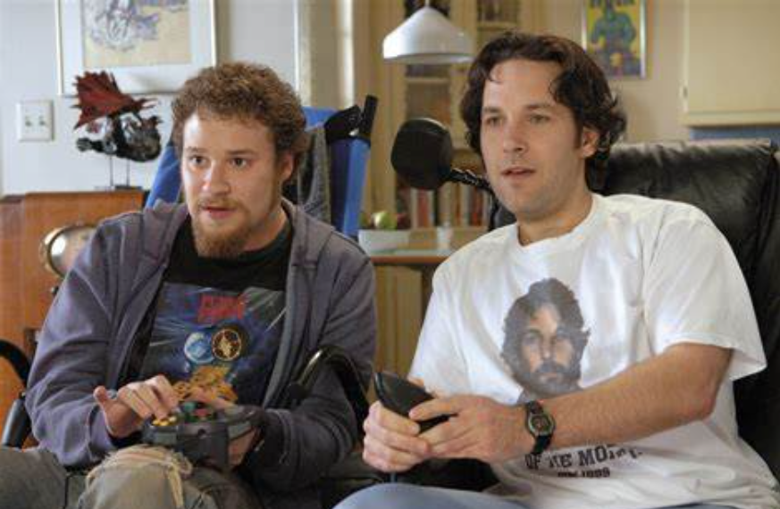
Gender Politics and Comic Buddy Duos
A transnational, transhistorical phenomenon.
See also Alberti (2013), Masculinity in the Contemporary Romantic Comedy

Slide 7
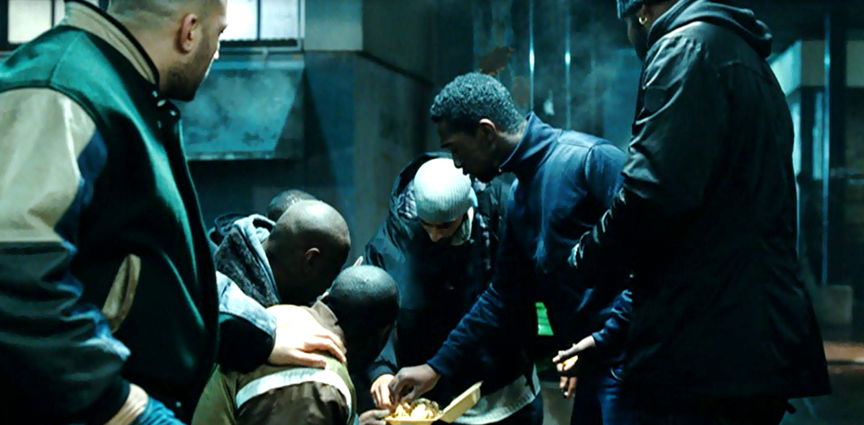
Class and Other Stereotypes in Comedy
What about intersectionality?
See Moine (2010), ‘Bienvenue chez les Cht’is: la région ou la classe?’/ ‘Region or Class in Bienvenue…’

Slide 8
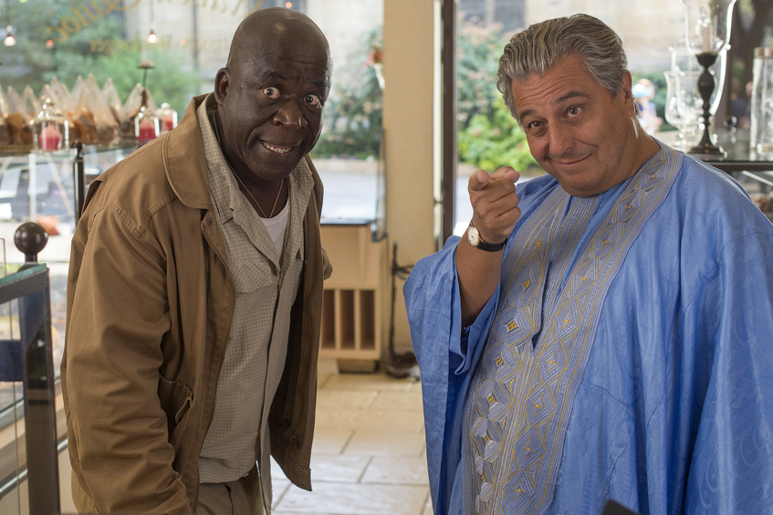

INTOUCHABLES AS COMEDY
The Comedy of Ethnic Integration
See Ginette Vincendeau on a recent French trend for comedies in which ‘identity is affirmed and exaggerated stereotypically, provoking conflicts that are then resolved in a tale of social harmony’
in ‘Minority Report,’ Sight and Sound, June 2015, 24-25.
CLIP: Qu’est-ce qu’on a fait au Bon Dieu?
Cf. Stuart Hall (1996) has noted that there is ‘always a price of incorporation to be paid when the cutting edge of difference […] is blunted into spectacularisation’

Slide 9

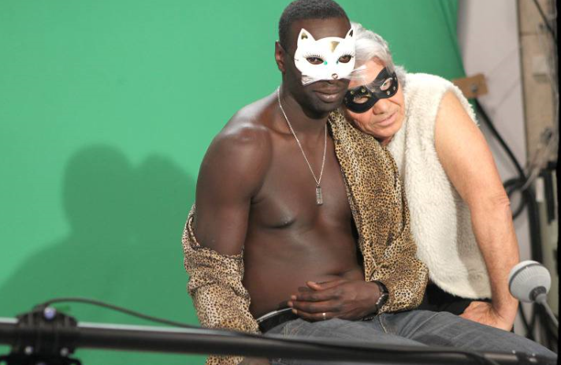


INTOUCHABLES AND REPRESENTATION
Minority Visibility and Stardom: the Omar Sy Phenomenon
Service après vente des émissions
2005-2012
2012
2014

Slide 10

Barriers to Diversity in Film Industries
Aïssa Maïga, Editions du Seuil, 2018.

Slide 11
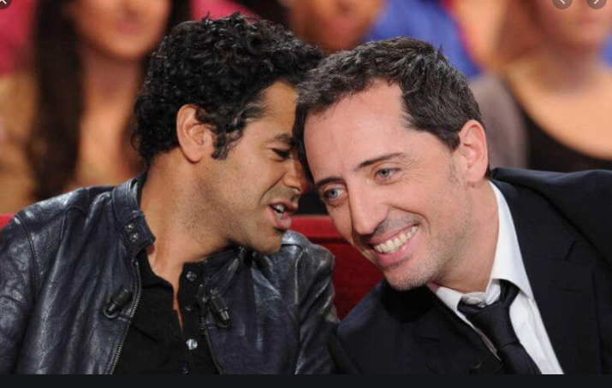
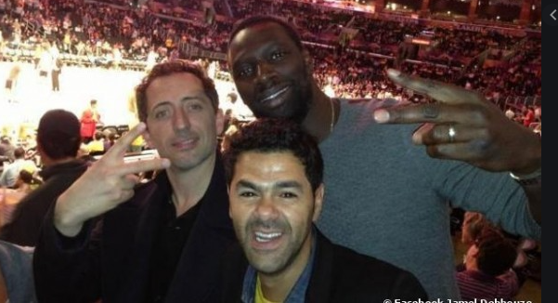


Comedian Comedy and/as Ethnic Minority Celebrity

Slide 12
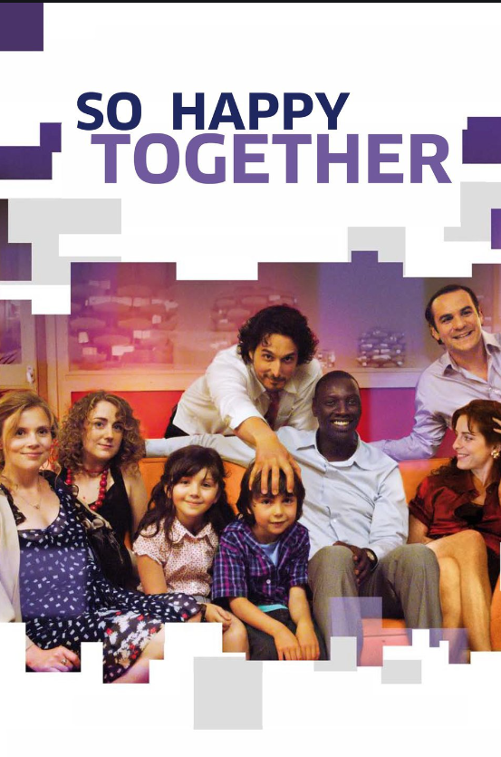
The Impossibility of Colour-Blind Casting?
Notes:
Remember to say somewhere about him being made black – just wanted to us Sy. OK but shows they know stakes of visual appearances.

Slide 13
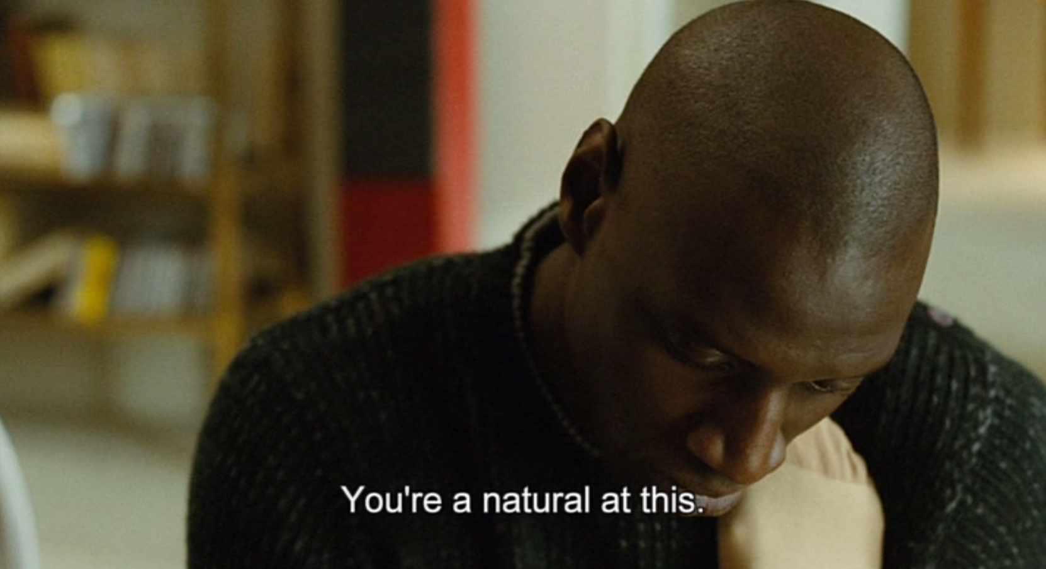
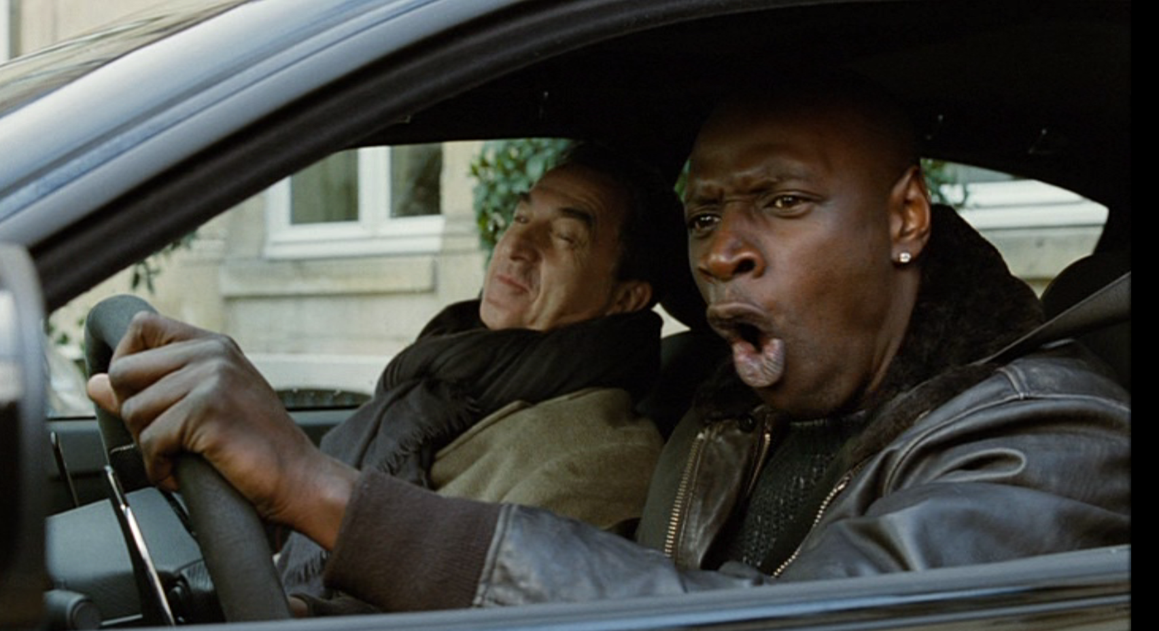
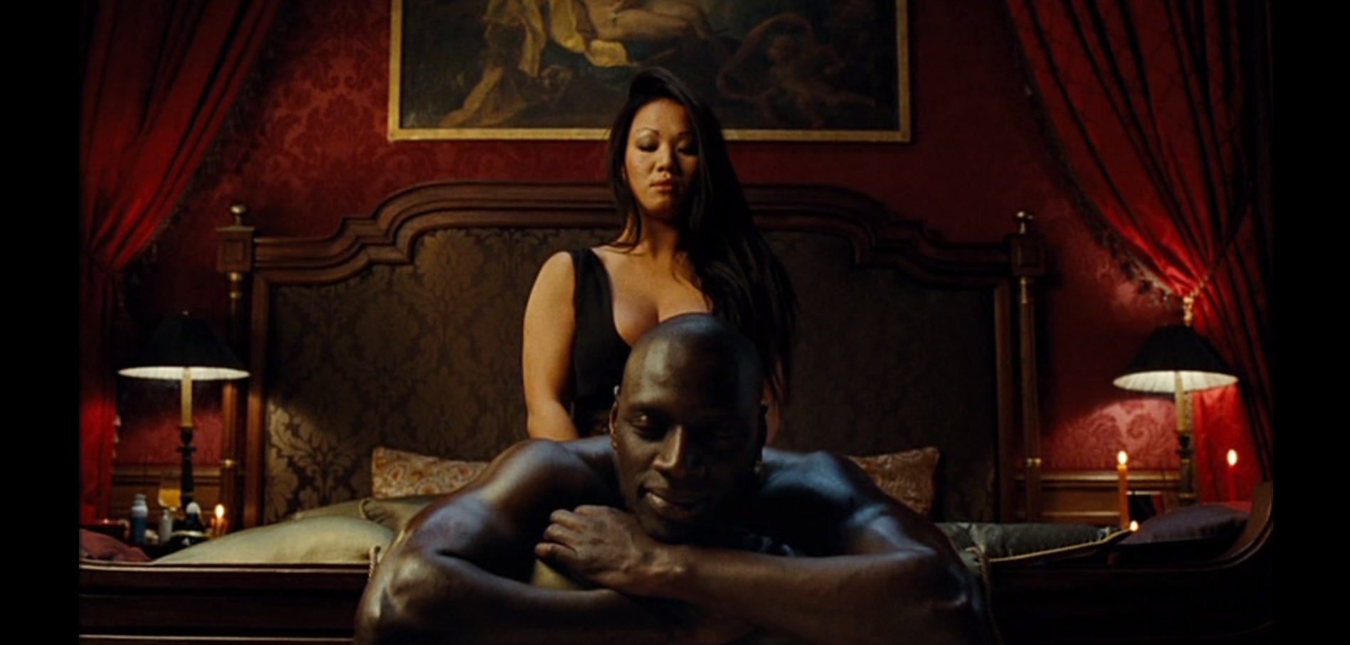
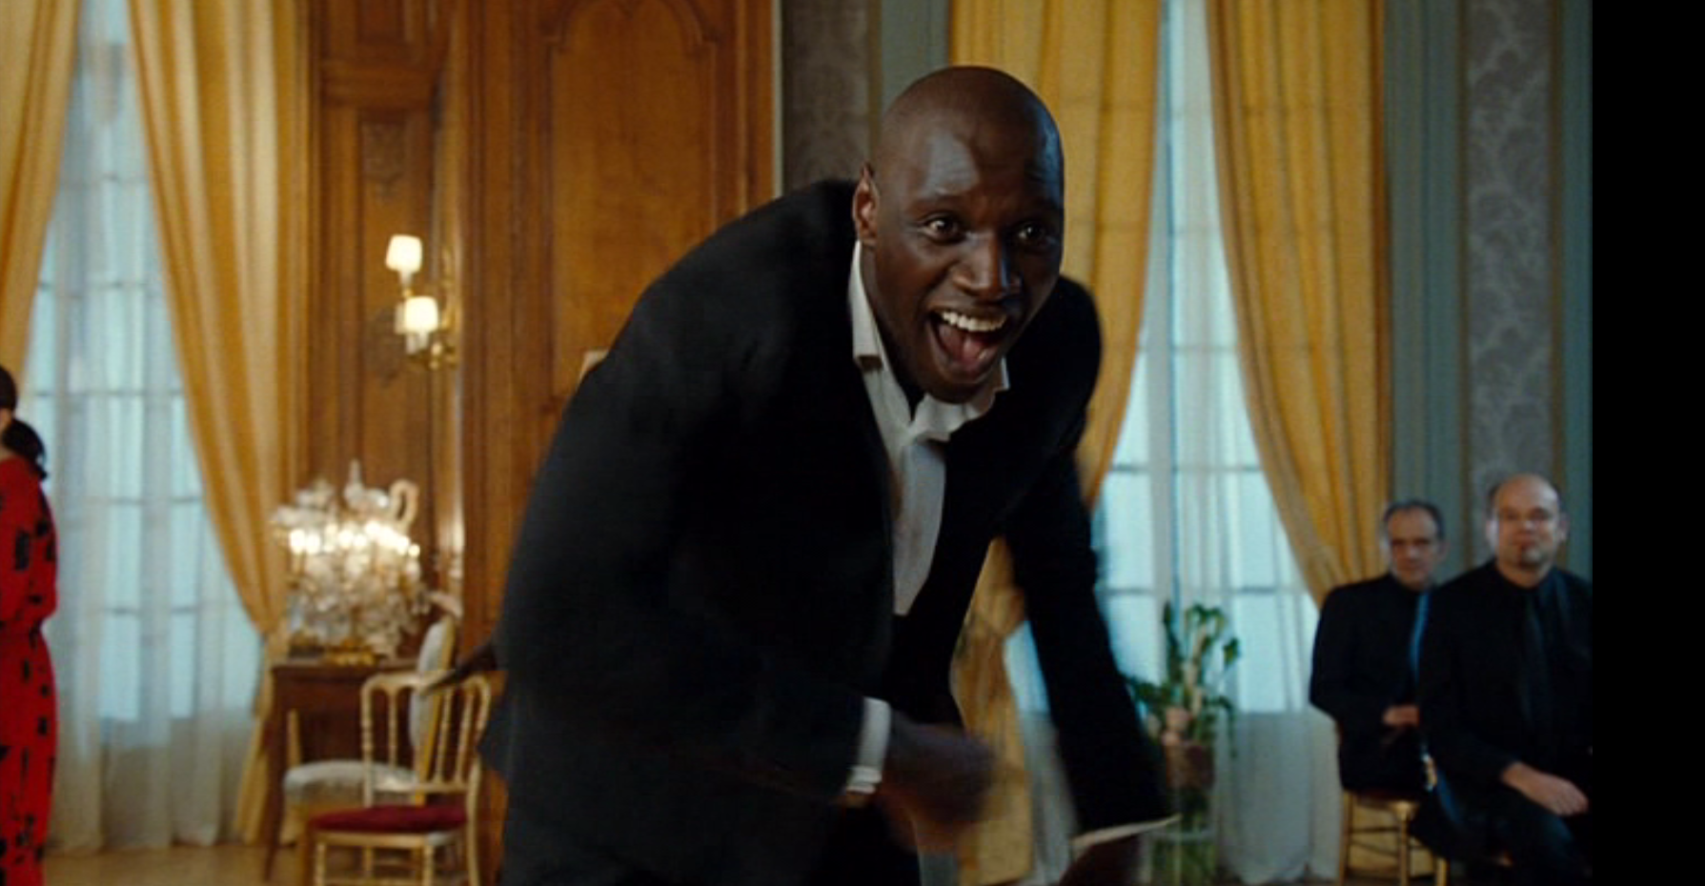

Intouchables
Visual and Performative Stereotyping?

Slide 14
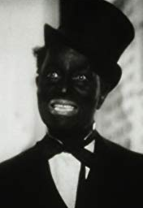
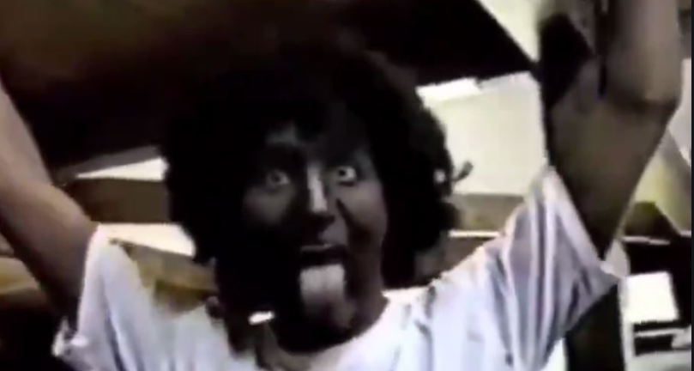
Blackface (and) Minstrelsy

Slide 15
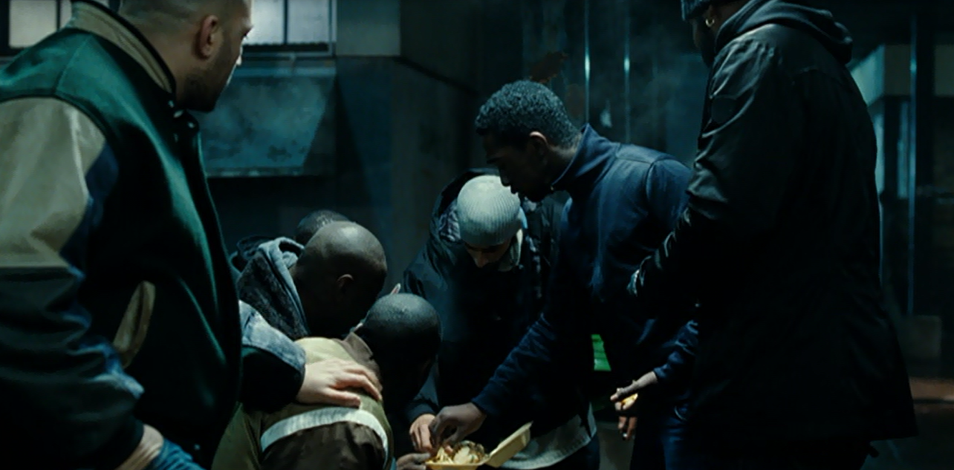
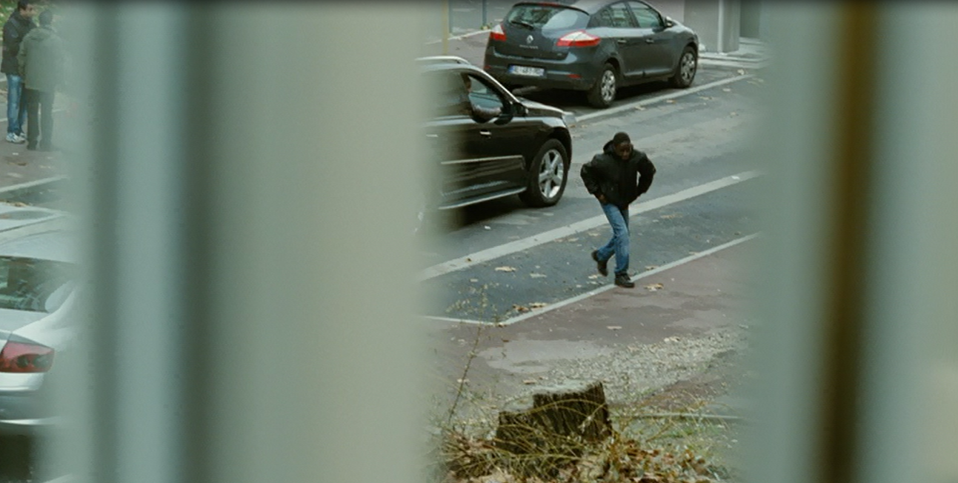
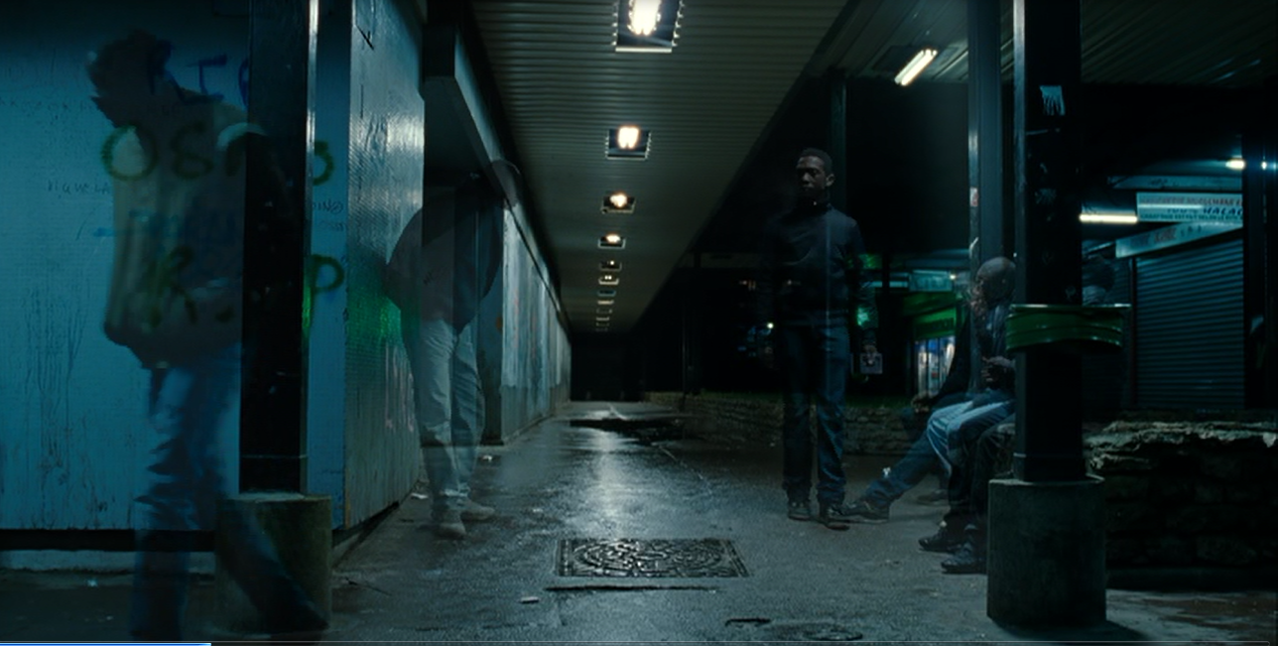
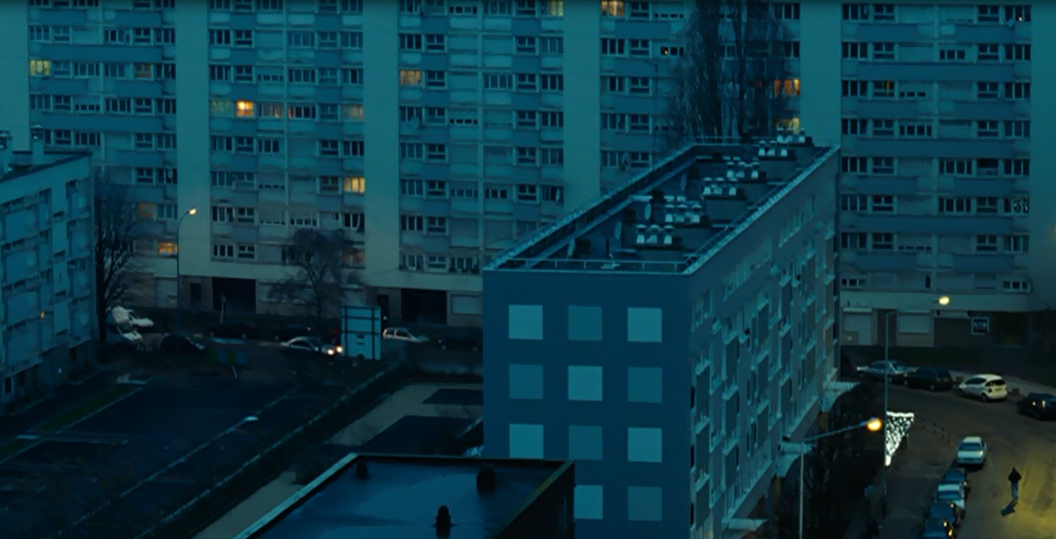
Stereotype and Exaggeration: Spatial Oppositions in the Film
a)la banlieue

Slide 16

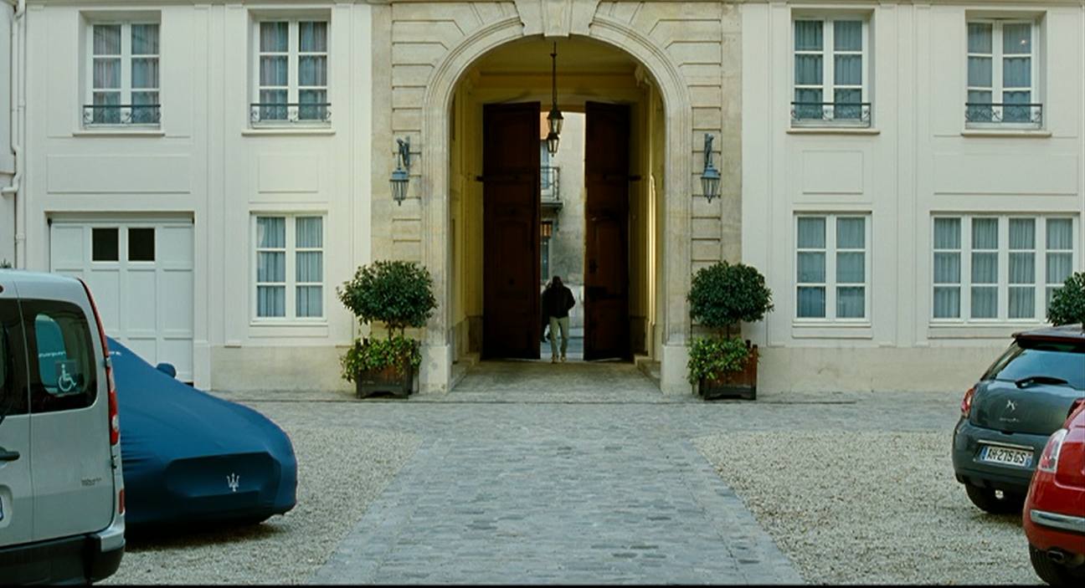
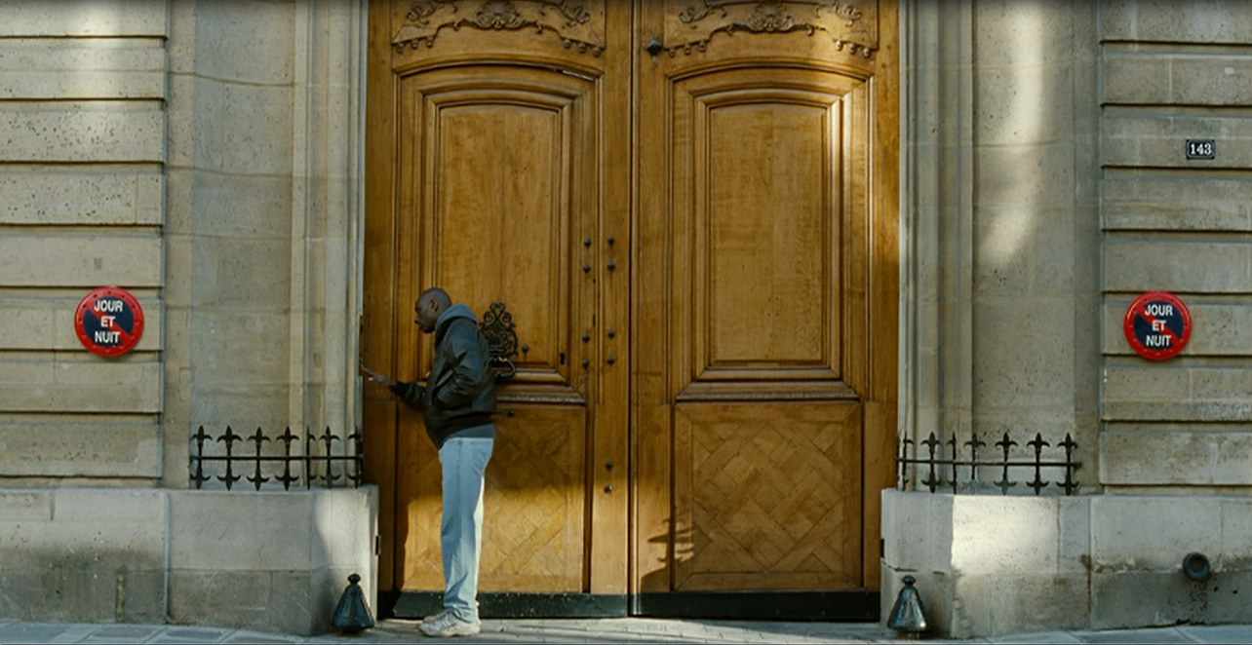
… versus Paris

Slide 17
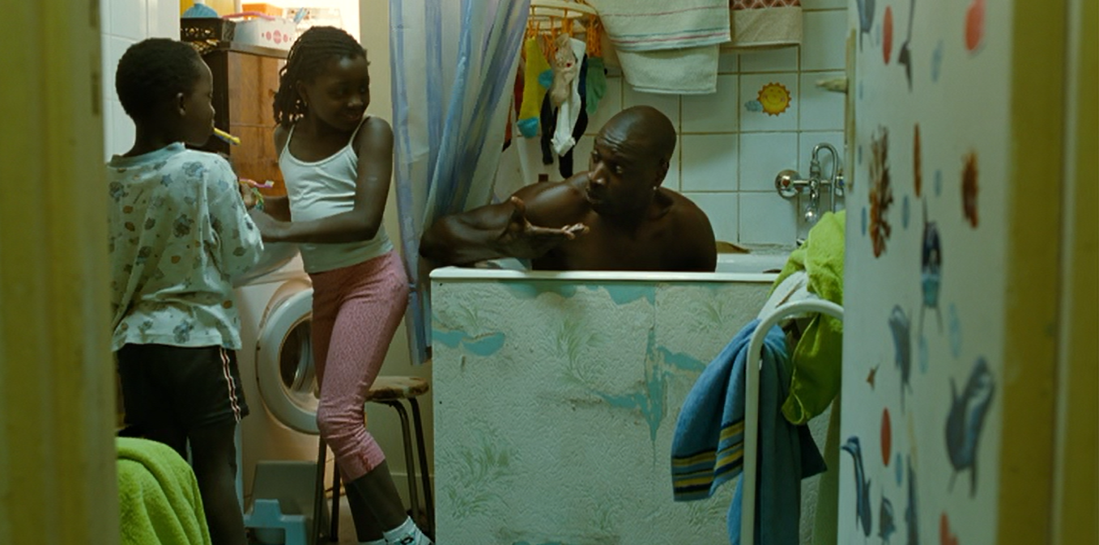
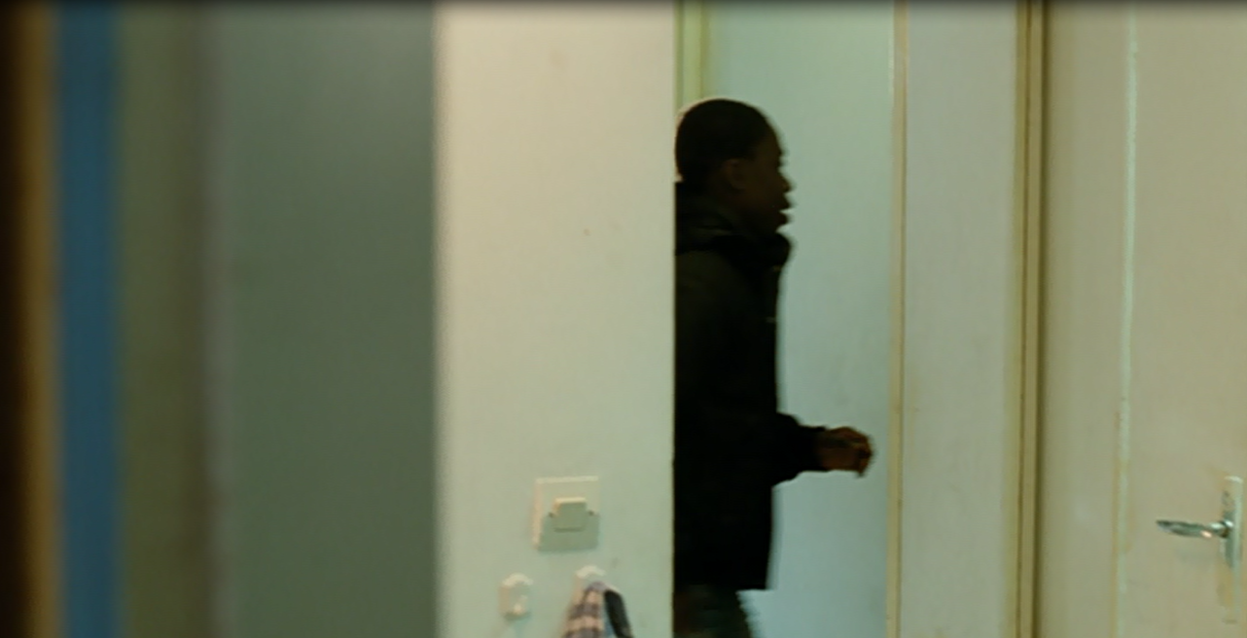
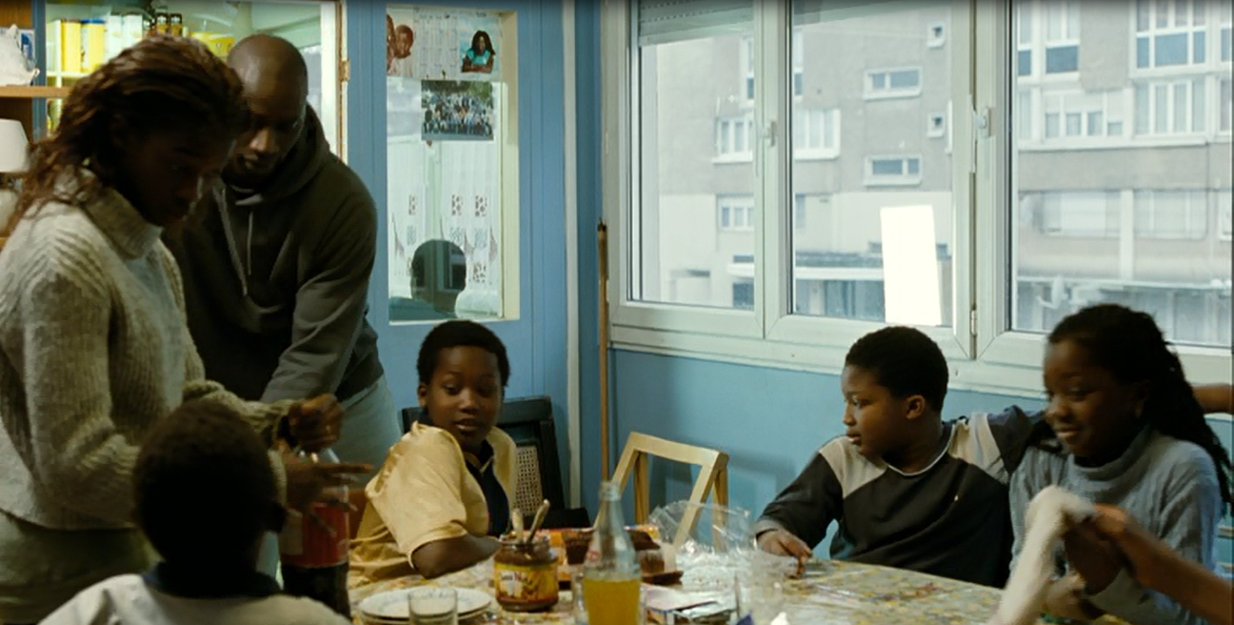
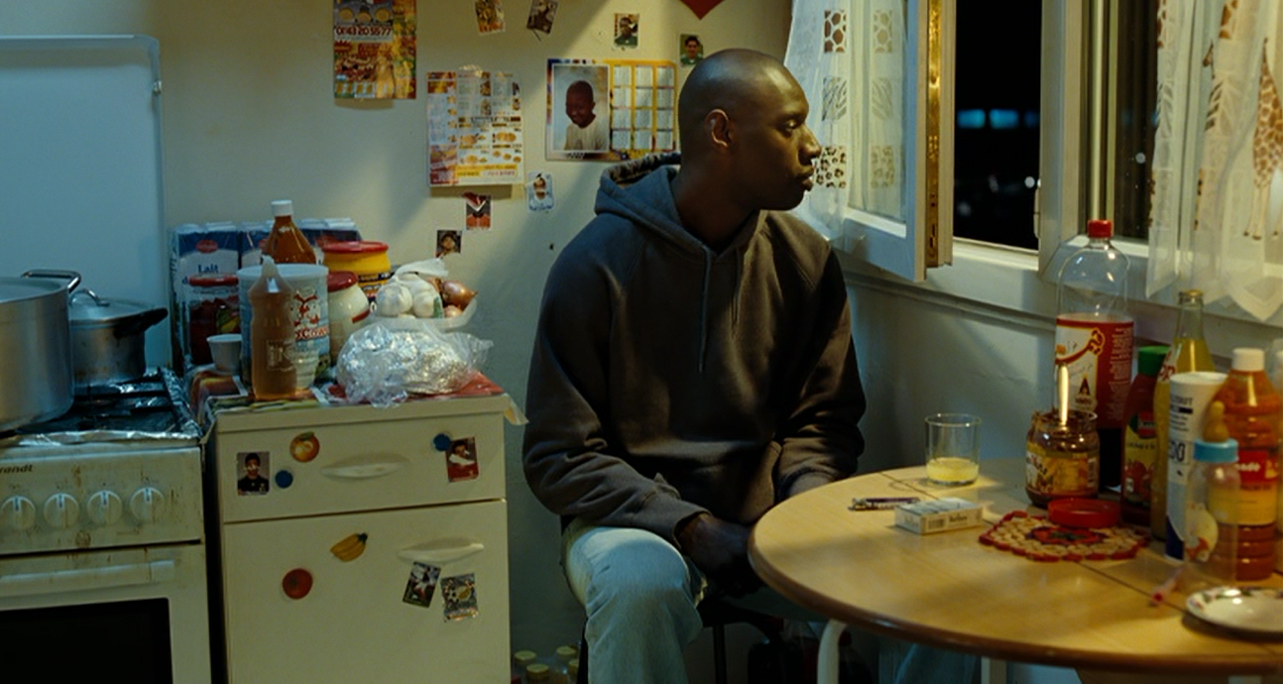
b) Driss’ house

Slide 18
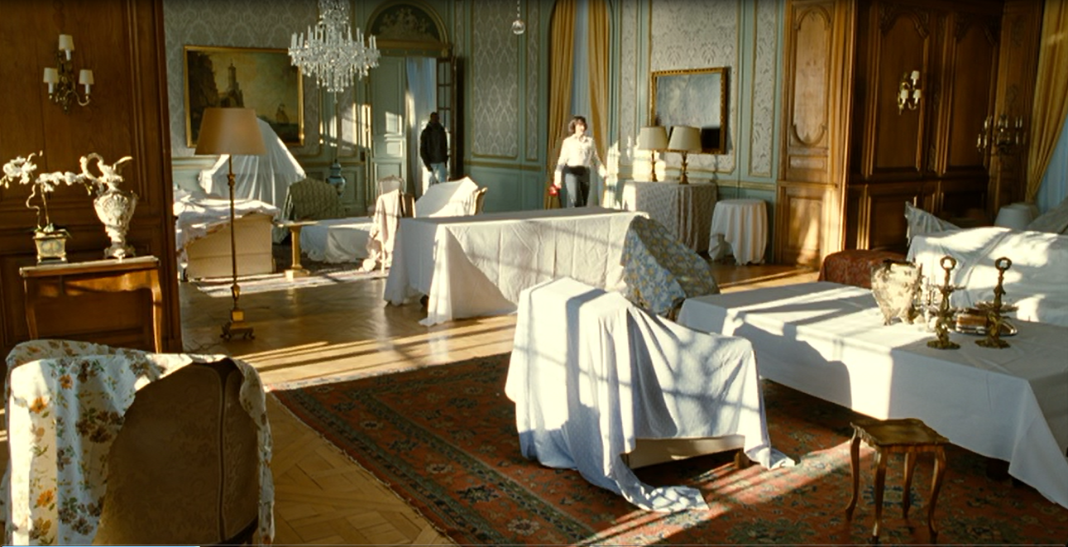
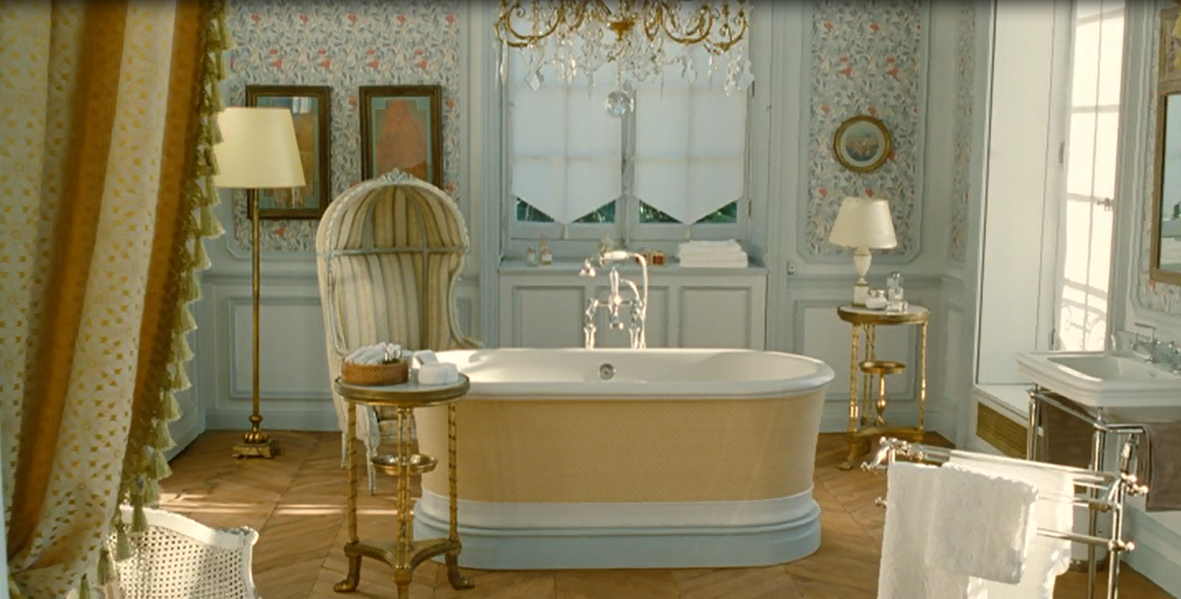
…versus Philippe’s house

Slide 19
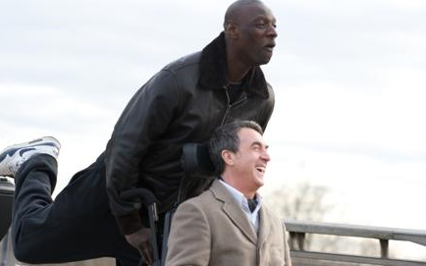
Inter-generational Dialogue
Do you agree with Jacques Mandelbaum’s comments in Le Monde that Intouchables figures the possible benefits of contact between old and newer, more multicultural French generations? (in Michael 2013, p. 131, extra rdg.).

Slide 20
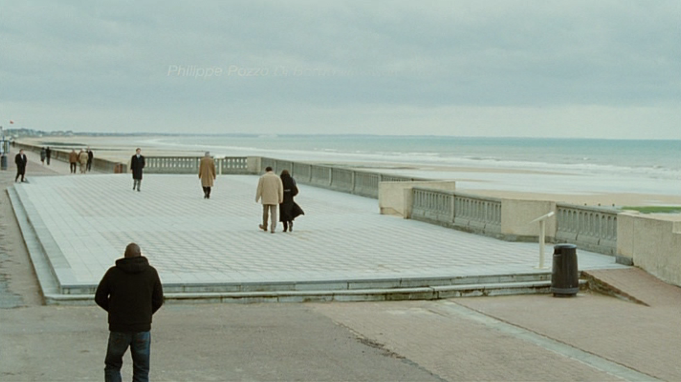
Ambivalence and Liminality

Slide 21
Additional Bibliography (Part 1 – pre-break)
John Alberti, Masculinity in the Contemporary Romantic Comedy: Gender as Genre London and New York: Routledge, 2013.
Stuart Hall, Questions of Cultural Identity, London: Sage, 1996.
Mary Harrod and Phil Powrie, ‘New directions in contemporary French comedies: from nation, sex and class to ethnicity, community and the vagaries of the postmodern,’ Special Issue of Studies in French Cinema on contemporary French comedy, vol. 18, issue 1 (2018).
Andrew Higson, ‘The Limiting Imagination of National Cinema,’ in M. Hjort and S. Mackenzie (eds), Cinema and Nation, edited by London and New York: Routledge, 2011, pp. 63-74.
Raphaëlle Moine, Remakes: les films français à Hollywood, Paris: CNRS Editions, 2007.
---------------------, ‘Bienvenue chez les Cht’is: la région ou la classe?’ Poli-Politique de l'image, 2 (2010).
Steve Seidman, Comedian Comedy: a Tradition in Hollywood Film, Ann Arbor: UMI Research Press, 1981.

Slide 22

Introduction to Streamed ‘Television’

Slide 23
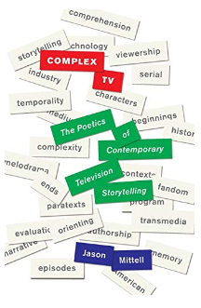

‘Not-Television’
(Brunsdon 2018)
Mittel (2017)
HBO, 2002-2008

Slide 24


Television in France
The medium holds a different, lower status than in Anglo-American nations thanks to the links between French national identity and high intellectual culture.
After a slow start in the early 1950s, 1958-64: ownership went from 10% to over 40%; it was a truly mass medium by the end of the 1960s.

Slide 25
Television in France
‘Television in France is at once more adult and more amateurish than in Britain or some other countries. A relatively high intellectual level in programmes goes hand in hand with clumsy technical blunders of presentation due to lack of discipline or preparation.’
Charles Hildesley, Sight and Sound, 1958.
July 1982: Broadcasting Bill – end of State monopoly control of television.
See Mazdon, ‘Contemporary French Television, the Nation, and the Family: Continuity and Change.’ Television and New Media 2, pp.335-339 (2001).

Slide 26
1990s
1.‘The demise of the state monopoly, the advent of cable and satellite television, coupled with the development of new terrestrial channels and the privatization of TF1 have caused a fragmentation of the French televisual landscape and undermined the apparent certainties of the national broadcast to a national audience carried out by a state-controlled public television.’
Mazdon 2001, p.338.
Competition
‘Dumbing down’ for mass appeal and due to
The globalisation of culture…

Slide 27



Changing Landscapes
2010s: the transnationalisation of television, notably through streaming platforms
And more global circulation.
French programmes popular internationally, 2010s – and many more, including later Lupin preeminently above all of them
Auteurism in TV
Dense storytelling
Less reliance on stars
‘French touch’ European TV
A generation of ‘telephiles’
See Benjo in Durand (2012)
2001
1997-2003
1998-2004

Slide 28

Lupin and French Cultural Localisation

Slide 29
Netflix and Localisation as Internationalisation
‘Broadcasting was a national industry that progressively internationalised[, while streaming is essentially a global industry that is progressively localising].’ Chalaby (2023, 1)
Netflix Originals planned by locally embedded producers
But in consultation with internationally-oriented market research teams
Exportability has a bearing on budget
                (Taillibert and Cailler 2022)

Slide 30
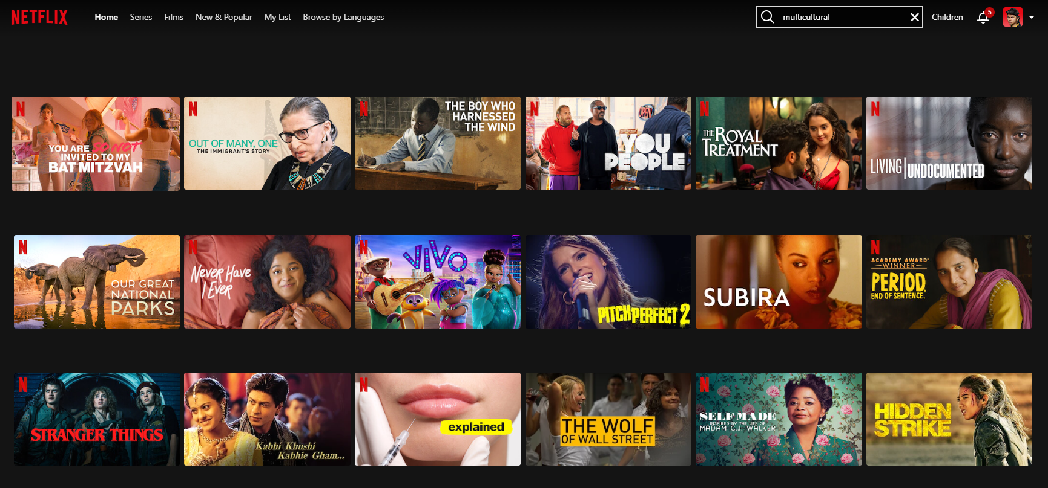
‘Inclusive’ Netflix
See also Scarlata, Lobato and Cunningham (2021, 145) on ‘circulation-based casting’

Slide 31
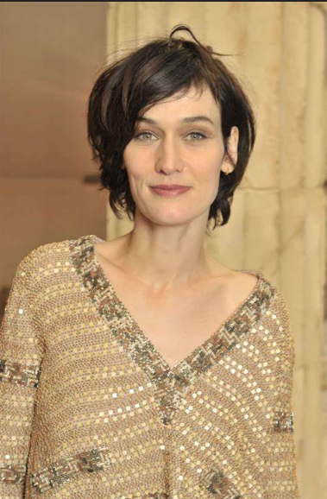

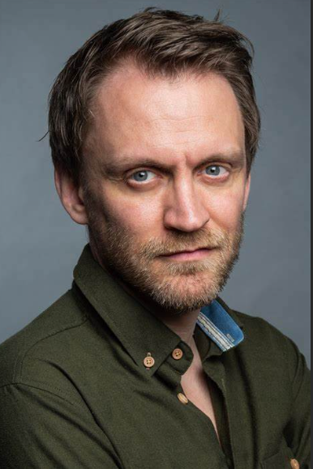

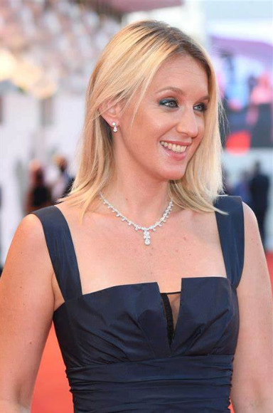
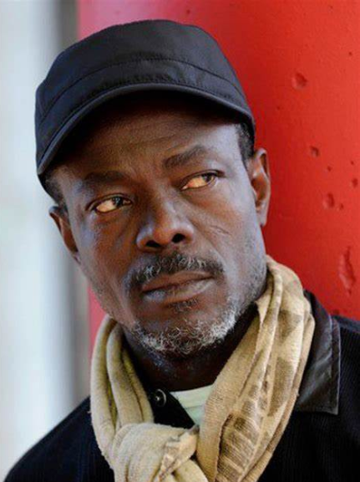
Images of (Relative) Ethnic Diversity

Slide 32

‘Postcard Aesthetics’
Behlil, Sánchez Prado and Verheul (2020, 96–97)

Slide 33
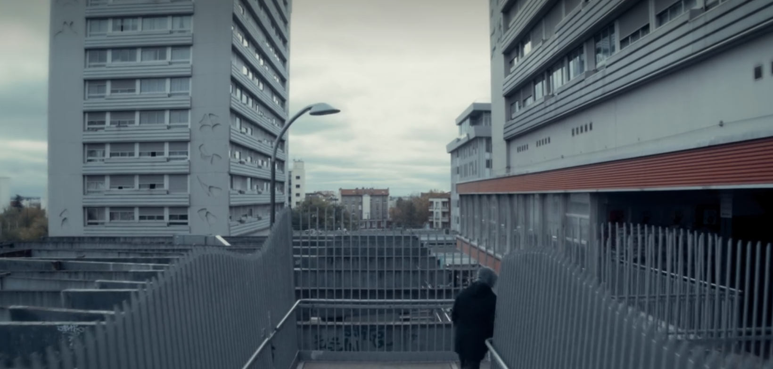
Other Clichés

Slide 34
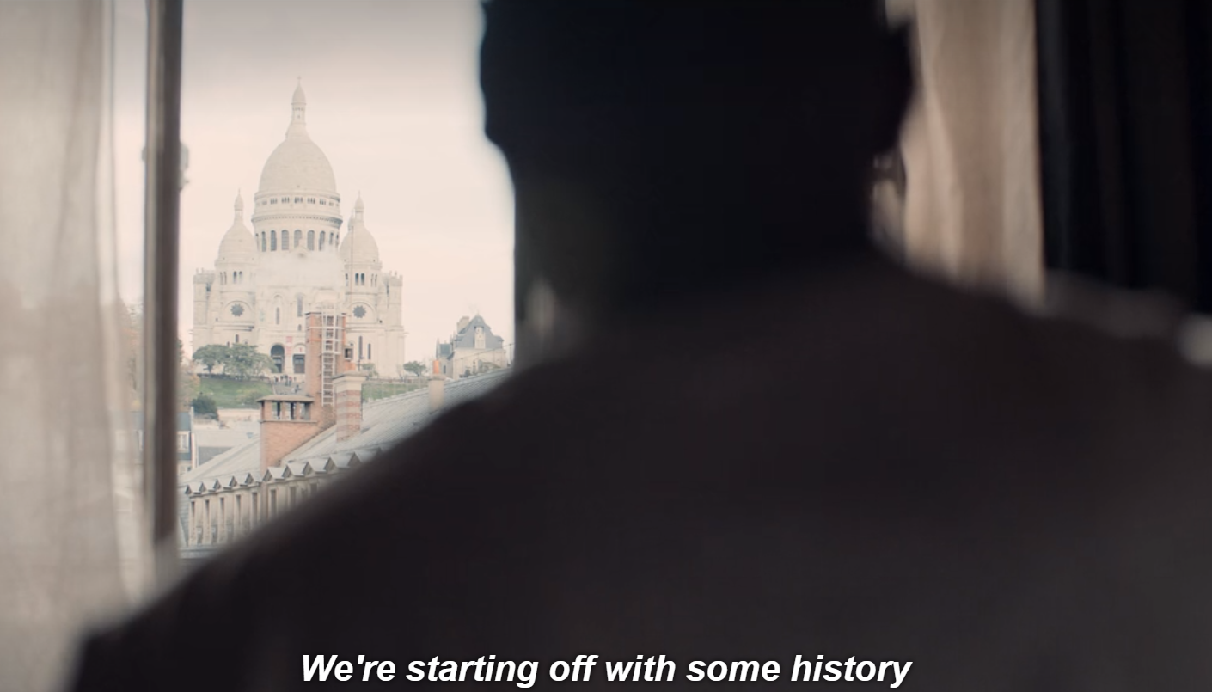

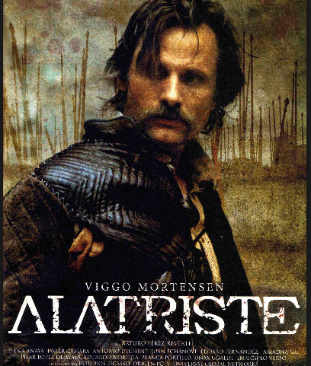


European Heritage Films since the 1980s
… and Lupin

Slide 35

Modelling Fandom

Slide 36
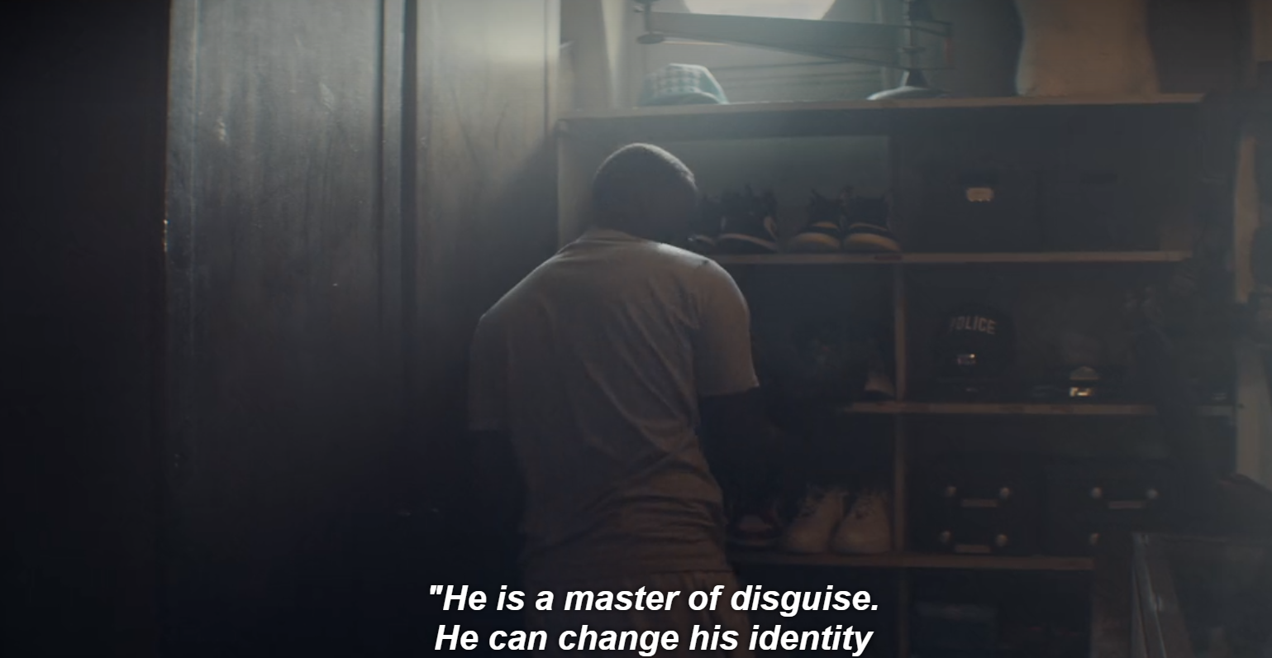
Rewriting Identities and (French and Postcolonial) Histories

Slide 37
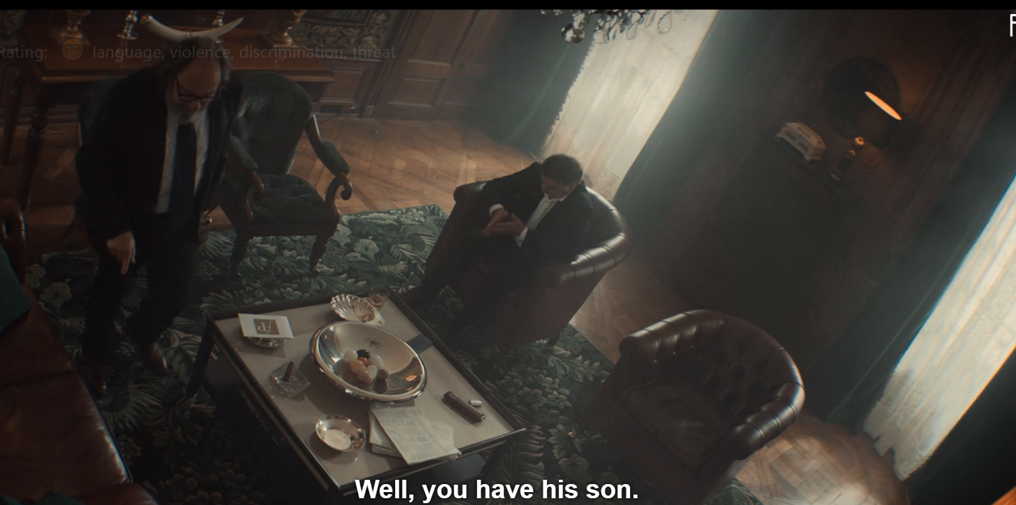
Upper-class Decadence and Corruption

Slide 38

The Fetishisation of Le Blanc’s books

Slide 39

The Legitimation of Leblanc’s Books

Slide 40

Having the Last (Elite?) Laugh

Slide 41
Additional Bibliography (Part 2)
Melis Behlil, Ignacio M. Sánchez Prado and Jaap Verheul, ‘The Dead are Alive: The Exotic Non-place of the Bondian Runaway Production,’ in The Cultural Life of James Bond: Specters of 007, edited by Jaap Verheul, Amsterdam: Amsterdam University Press, 2020, pp. 81-102.
Charlotte Brunsdon, Television Cities: Paris, London, Baltimore, Durham, NC: Duke University Press, 2018.
Jean K. Chalaby, Television in the Streaming Era: The Global Shift, Cambridge: Cambridge University Press, 2023.
Bruce Crumley, ‘French TV’s reputation spirals upwards,’ The Guardian, 19 February 2020.
Jean-Marie Durand, ‘Les Revenants, Ainsi soient-ils, Opérateurs…séries françaises: la resurrection,’ Les Inrockuptibles, 25 November 2012. Les Revenants, Ainsi soient-ils, Opérateurs... séries françaises : la résurrection | Les Inrocks
Lee Hyo-won, ‘Ted Sarandos: Netflix’s Global Platform Will Bring Diversity to Hollywood,’ Hollywood Reporter, 30 June 2016. https://www.hollywoodreporter.com/news/ted-%20sarandos-netflixs-global-platform-907558.
Lucy Mazdon, 'French Television: Negotiating the National Popular,' in D. Holmes and D. Loosely (eds), Imagining the Popular in Contemporary French Culture, pp. 162-94. Manchester: Manchester University Press, 2013.
Alexa Scarlata, Ramon Lobato and Stuart Cunningham,‘Producing Local Content in International Waters: The Case of Netflix’s Tidelands,’ Continuum 35 (1): 137–150 (2021). https://doi.org/10.1080/10304312.2021.1884654.

Slide 42


Television Studies in France
Denigration of the medium from cinephilic critics e.g. see critic René Prédal, who often writes for Cahiers du cinéma, on the small screen’s ‘vampirisation’ of cinema.
(Prédal Le Cinéma français depuis 2000, 2008, p. 36)
Slow progress e.g. works by Geneviève Sellier; forthcoming Special Issue of the journal French Screen Studies (vol. 24, issue 1)
See instead Anglo-American works e.g. John Fiske’s Television Culture, 1987, a useful introduction.
N.B. The feminine gendering of early anglophone TV Studies (e.g. Modleski, pictured; Annette Kuhn; Ien Ang).

