Slide 1
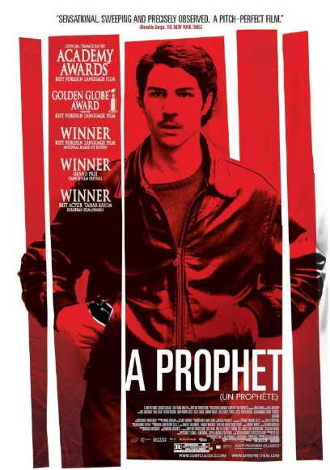
New Iterations of the Auteur
Lecture 3: Neo-auteurism, multi-racial France and neo-noir
Un prophète (Audiard 2009)

Slide 2
STRUCTURE OF THE LECTURE
(Neo-)auteurism
French (descendants of) North Africans in France and French cinema
(French) (Neo-)noir in a historical context
Noir films, US and French
Gendering the genre
Marginality in the neo-noir
Situating Audiard’s cinema
- Space in Un prophète
Gender, biology and culture in Audiard
The dialogue with contemporary US genres
Close analysis of UP + Malik’s characterisation
Notes:
Audiard and screening the outsider

Slide 3
Conceptualising the Film Author/Auteur
1950s/60s France: The New Wave and the politique des auteurs – Truffaut, Godard, Chabrol et al
‘I say no! Cinema is not a craftsman’s trade: it’s an art. It’s not teamwork. You’re always as alone on set, as you are before a blank page.’
Jean-Luc Godard, ‘Bergmanorama,’ Cahiers du cinéma no. 85, January 1958
Then exported to the USA by the film critic Andrew Sarris in particular.
See also:
- Pam Cook, ‘Authorship and Cinema,’ in P. Cook and M. Bernink (Eds), The Cinema Book (2nd. Edition, BFI, 1999)
- Andrew Sarris, ‘’Notes on the Auteur Theory in 1962,’ in L. Braudy and M. Cohen (eds), Film Theory and Criticism (5th edition, Oxford University Press, 1998), 515-18.

Slide 4
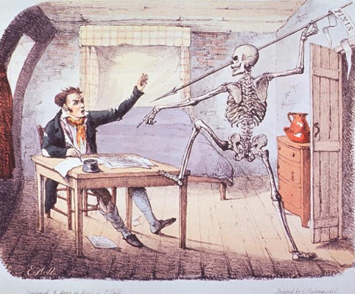
Conceptualising the Film Author/Auteur
DEATH….
Roland Barthes, ‘The Death of the Author’ (1967)
AND REBIRTH
Michel Foucault’s ‘author function’ (1969)
1980s in Film Studies: an industrial concept of authorship e.g. Bordwell, Staiger & Thompson, The Classical Hollywood Cinema: Film Style and Mode of Production to 1960

Slide 5
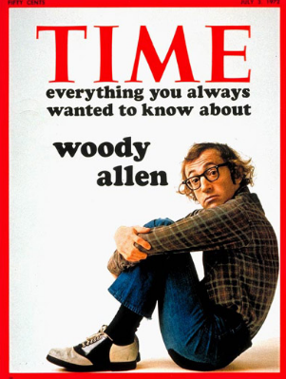
Conceptualising the Film Author/Auteur
Timothy Corrigan, ‘The Commerce of Auteurism,’ in A Cinema Without Walls (1991)
‘[The auteur] has rematerialized in the eighties and nineties as an agent of a commercial performance of the business of being an auteur’ (p. 42)
See also Noël King and Toby Miller, ‘Auteurism in the 1990s,’ in The Cinema Book (2nd edition), 311-14.
Timothy Corrigan, ‘Auteurs and the New Hollywood,’, in J. Lewis (ed.), The New American Cinema (Duke UP, 1998), 38-63.

Slide 6
Origins of the term Beur
Beur = Arabe in verlan
Second/third-generation children of North African immigrants to France
Most of Algerian extraction although some Moroccan or Tunisian
Provocative as almost all Moroccans and a majority of Algerians are or Berber origin, only ‘Arabized’ through language and religion.

Slide 7
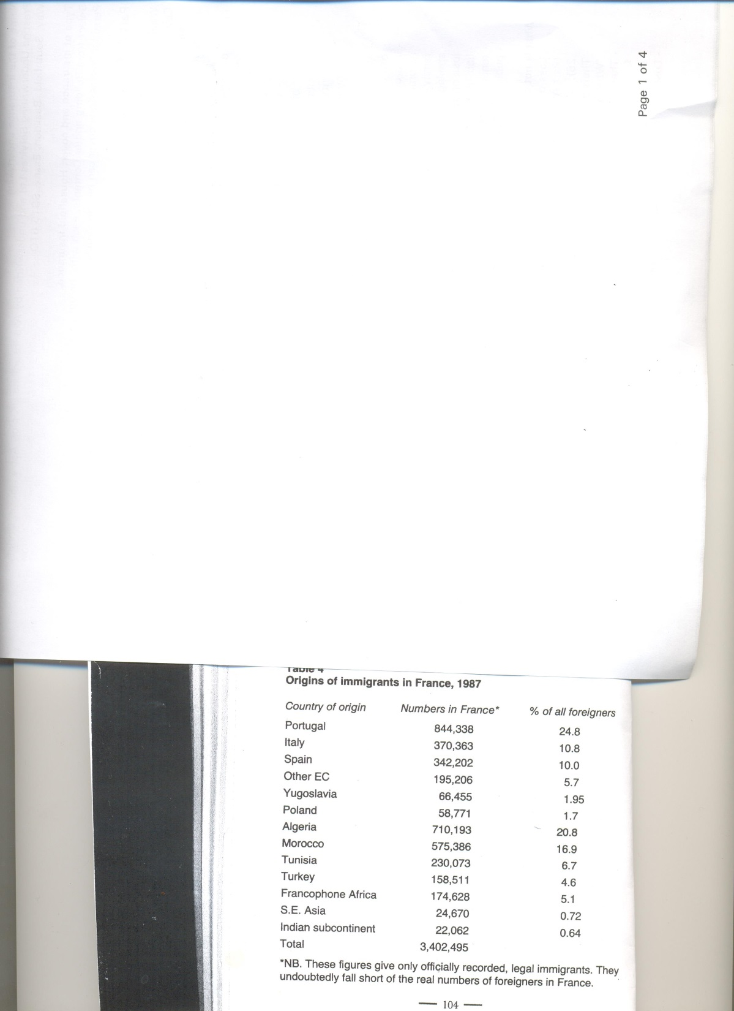
John Flowers, France Today (1998).
By the 1980s, there were 1.5m immigrants from the North Western African region known as the Maghreb, or 44% of France’s total immigrant population (Flowers p. 103)
By 2016, Muslims make up around 8% of the total population of France (Fenby, The History of Modern France, 2015, reprinted 2016, xii-xiii).

Slide 8
Background to Contemporary Immigration Politics in France
1970s – Introduction of measures designed to prevent unchecked immigration into France
1980s – Mitterrand first introduces in earnest the policy of assimilation
For Flowers and others, this can be linked to fact that France has two very strong traditions that have shaped the concept of citizenship:
- rational philosophical universalism
- the Christian Right’s notion of a patrie based on blood soil and ancient rights

Slide 9
Immigration in Popular Attitudes and Media
1990s surveys by newspaper Le Nouvel observateur found 70% of French people thought there were too many immigrants (p. 117 Flowers).
Rise of the Front national since 1980s.
Sarkozy’s inflammatory public attacks on the banlieue cités as Ministre de l’intérieur following 2005 riots.
2000/2010s: aggravated by high unemployment and the radicalisation of some Muslims: Islamophobic attacks went up by over 300% in the first half of 2015 compared with the same period the previous year (p. xii Fenby).
In 2015, according to Reuters News Agency, Muslims might make up as much as 60% of France’s prison population (p. xii Fenby).

Slide 10
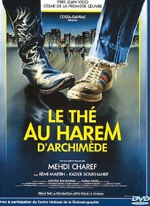
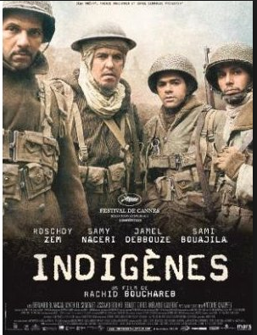

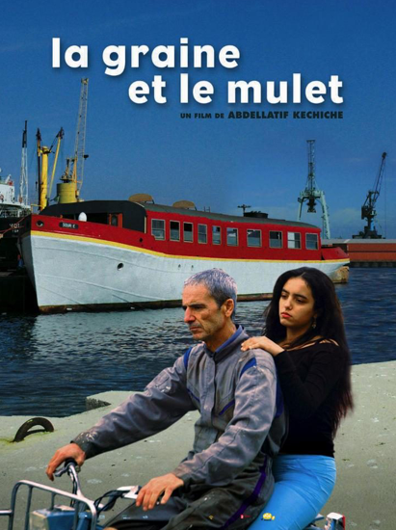
‘Beur’ cinema
To prominence in 1980s and 1990s, especially following Le Thé au harem d’Archimède (Charef, 1985)
1995
2007
2006
1985
Christian Bosséno, ‘The Case of Beur Cinema,’ in R. Dyer and G. Vincendeau (eds), Popular European Cinema (1992).

Slide 11
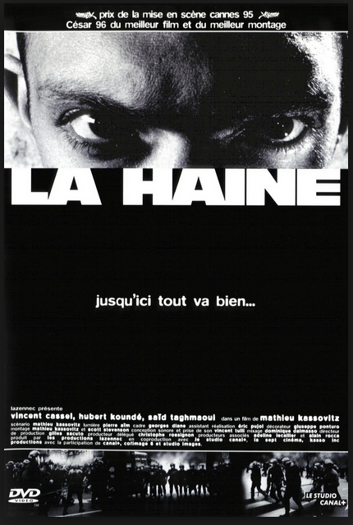
Troubling the Limits of ‘Beur’ Cinema as a Genre
Famous use of the tagline ‘black-blanc-beur’ in advertising the film.
Yet director Kassovitz is not North African.
Carrie Tarr (2005) and Ginette Vincendeau (2005), however, do suggest the non-white identites are side-lined in the film.

Slide 12
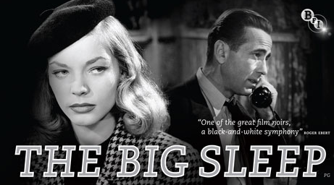
Classic US Noir
Howard Hawks, 1946

Slide 13
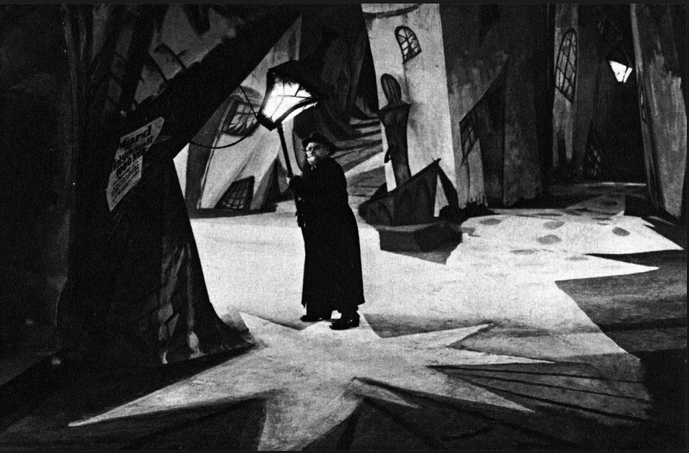
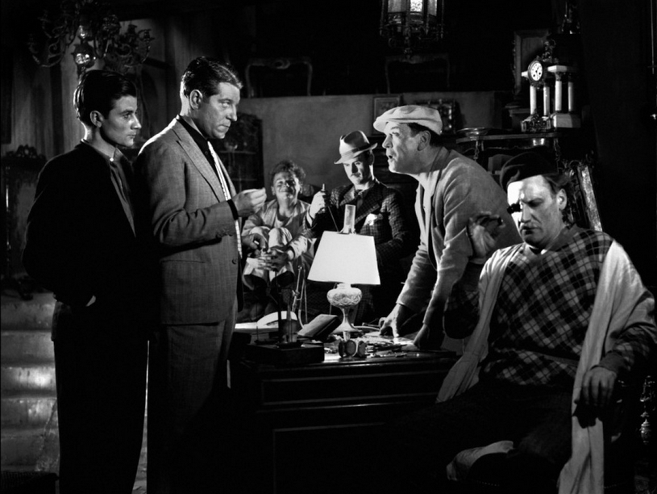
European Antecedents to US Film Noir: From German Expressionism to French Poetic Realism
Das Cabinet des Dr. Caligari/The Cabinet of Dr. Caligari (Wiene, Germany 1920)
Pépé le Moko (Julien Duvivier, France 1938)

Slide 14
Vincendeau, ‘French Film Noir’ (2007)
(on extra reading list)
On Classic French Noir (heyday in 1950s)
Two forms:
The ‘policier/polar’: crime films that were visually ‘noir’ but narratively upbeat.
‘Social noir’: not crime films proper but urban dramas that were more truly ‘noir’ in narrative, mood and visual style.
On Neo-Noir
Since the mid-1990s, in a period that has seen more genre-blurring in French cinema as a whole, social commentary and [inherently generic] crime narratives have tended to mix [e.g. La Haine] and ‘neo-noir’ can refer to any crime film or urban drama.

Slide 15
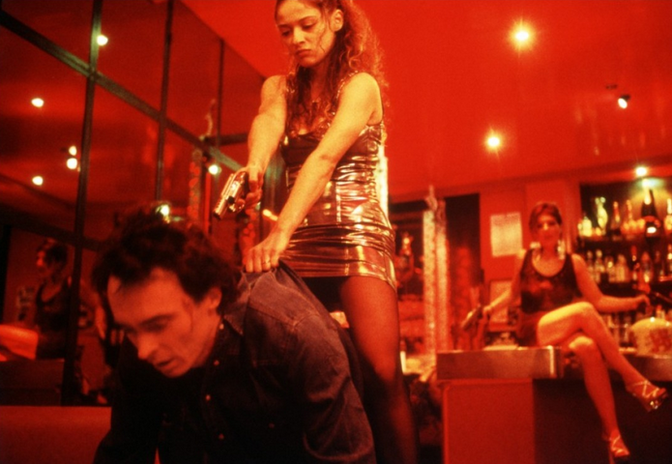
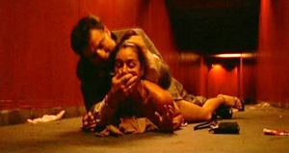
1980s – cinéma du look included police films e.g. Diva
1990s/2000s:
More social issue films, by both established directors e.g. Bertrand Tavernier’s L.627 (clip to follow) and linked to the jeune cinéma français or French New Realism, of which Audiard [like Kassovitz] is on the margins.
‘Extreme’ films like Baise-moi (2000) and Irréversible (2002) feature violent crimes
3. A return to the classic policier e.g. 36 Quai des Orfèvres (2004; clip)
Vincendeau Cont.

Slide 16

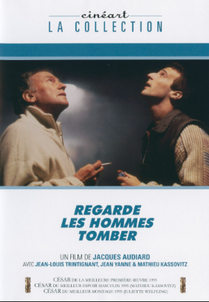
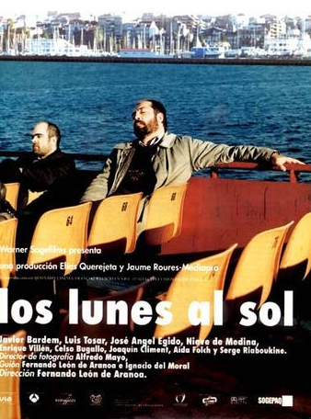

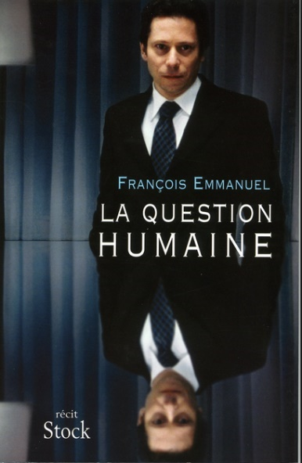
Masculinity under Postmodernity
- 1960? onwards: late capitalism and increasing technological advancement: post-Fordism; the technological (digital, information…) revolution – thematised in (post-)1990s cinema especially.

Slide 17
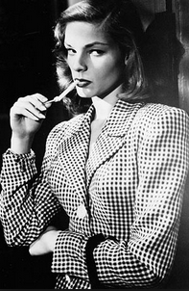
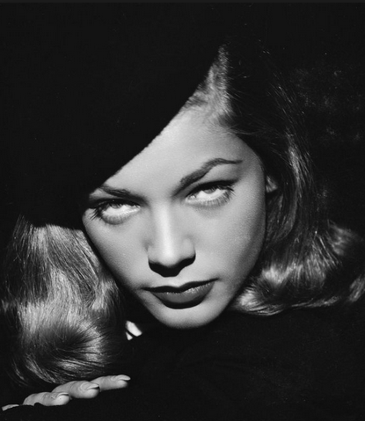
The Femme Fatale
Disavowing the threat of castration in US noir?
See Laura Mulvey, “Visual Pleasure and Narrative Cinema” (1975)
Fetishism and voyeurism as two possible strategies for dealing with women’s fear-provoking difference in male-authored classical cinema.

Slide 18
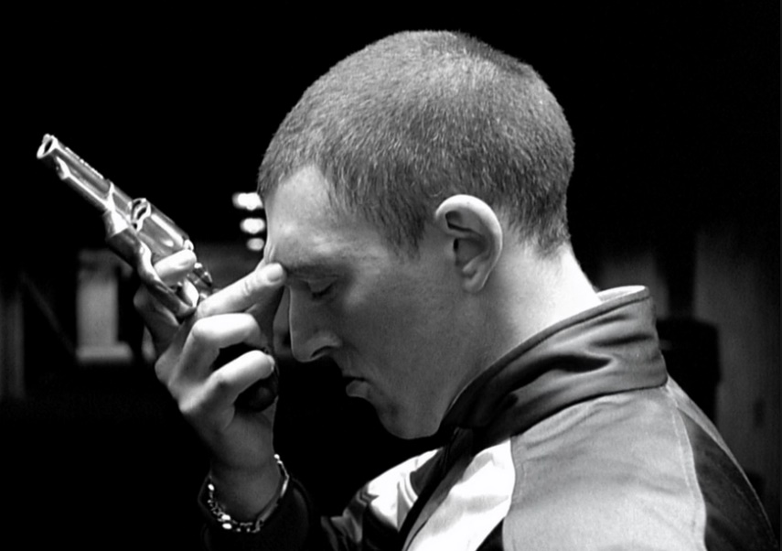
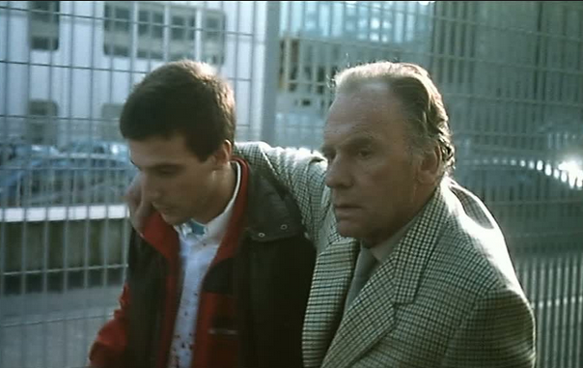
Situating Audiard’s Cinema
Equally but differently beleaguered masculinity in French neo-noir
La Haine (Kassovitz 1995)
Regarde les hommes tomber (Audiard 1993, starring Kassovitz)
- Women less disavowed than simply absent - equality less of a ‘problem’ for French men?
- A greater climate of moral relativism nonetheless poses questions about the meaning of masculinity – traditional ideals of power and assertiveness are no longer viable.

Slide 19
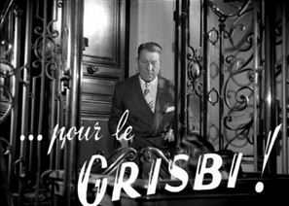
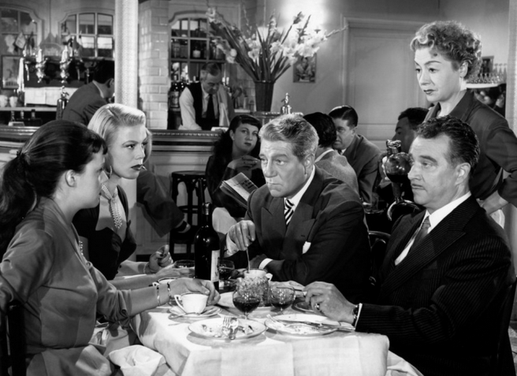
Vincendeau Cont.
The ‘lower depths’ in which these films are set moves from the classical ‘metonymic city’, populist microcosms of the French community e.g. Touchez pas au grisbi (Becker 1954) …
… to increasingly peripheral and/or anonymous locations since the 1990s – Marc Augé’s ‘non-places’: underpasses, car-parks, the banlieue in general, the postmodern office and other dreary public spaces, typified by sterility or chaos and squalor.
CLIP(S): Sur mes lèvres/Read My Lips (Audiard 2001)

Slide 20
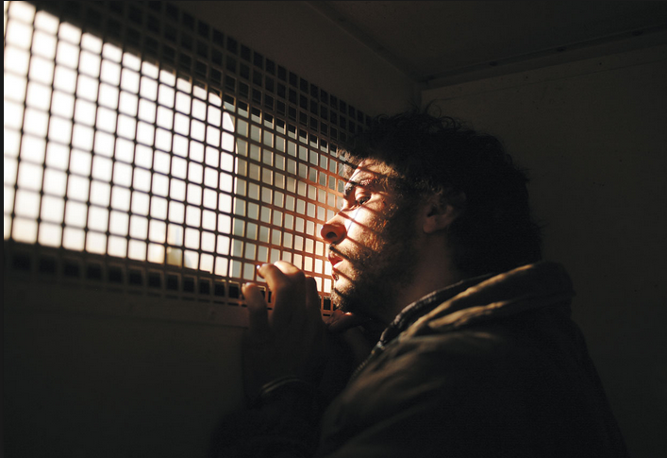
Space and (Non-)Place
See also De battre mon coeur s’est arrêté/The Beat that My Heart Skipped (Audiard 2005).

Slide 21

Filmography - and Gender
Regarde les hommes tomber/See How They Fall (1994)
Un héros très discret/A Self-Made Hero (1996)
Sur mes lèvres/Read My Lips (2001)
De battre mon coeur s’est arrêté/The Beat that my Heart Skipped (2005)
Un prophète (2009)
De rouille et d’os/Rust and Bone (2012)
Dheepan (2015)
(Slightly different: The Brothers Sisters/Les Frères Sisters [2018], an English-language, Hollywood film; Paris Les Olympiades, 13e [2021], principally scripted by Céline Sciamma.)

Slide 22
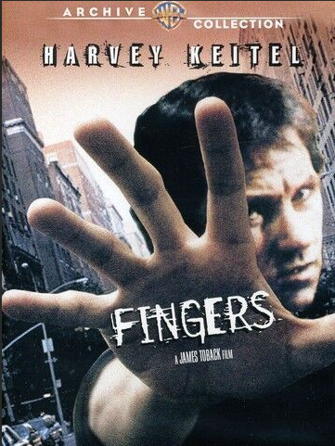
Audiard’s Ambivalent Relationship with US models
Son of highly respected screenwriter Michel Audiard
Immediately inscribed in a relatively high art cinema tradition – an auteur cf. films critically rated, Un prophète awarded Grand Jury Prize at Cannes film festival and a BAFTA.
But also popular e.g. UP took around $20m worldwide
De battre remakes Fingers but heavily reworks; Audiard rejects the label ‘remake’.

Slide 23
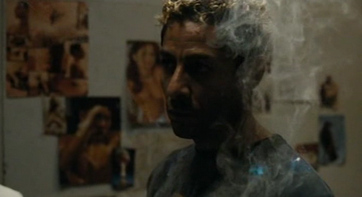
Audiard Beyond ‘Realist’ Social Issues OR Mainstream Genre
Powrie (2007) argues that a truly ‘noir’ sensibility resides in recent French cinema in oneiric elements.

Slide 24
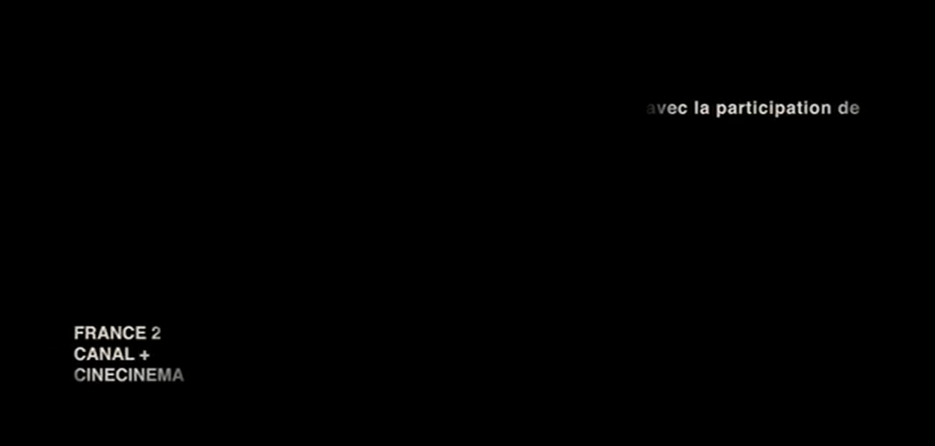
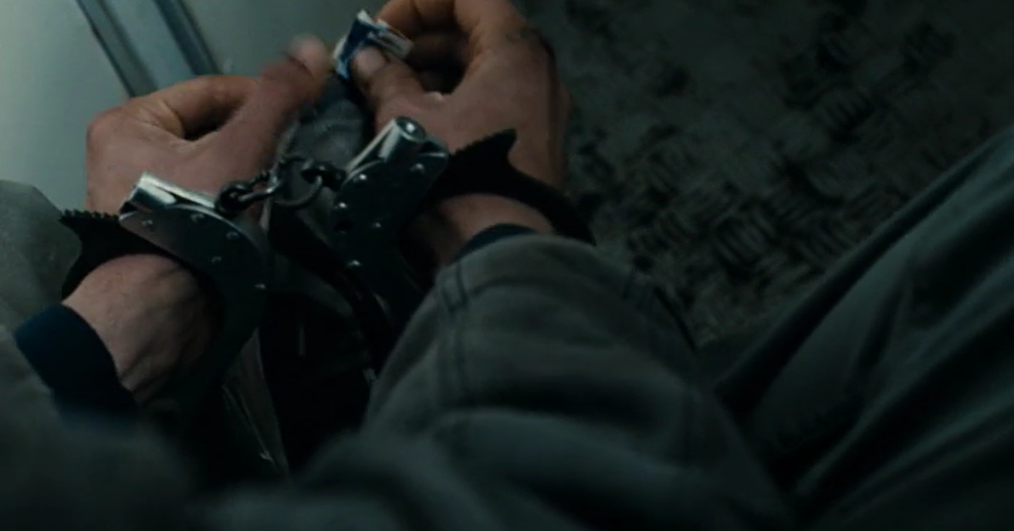
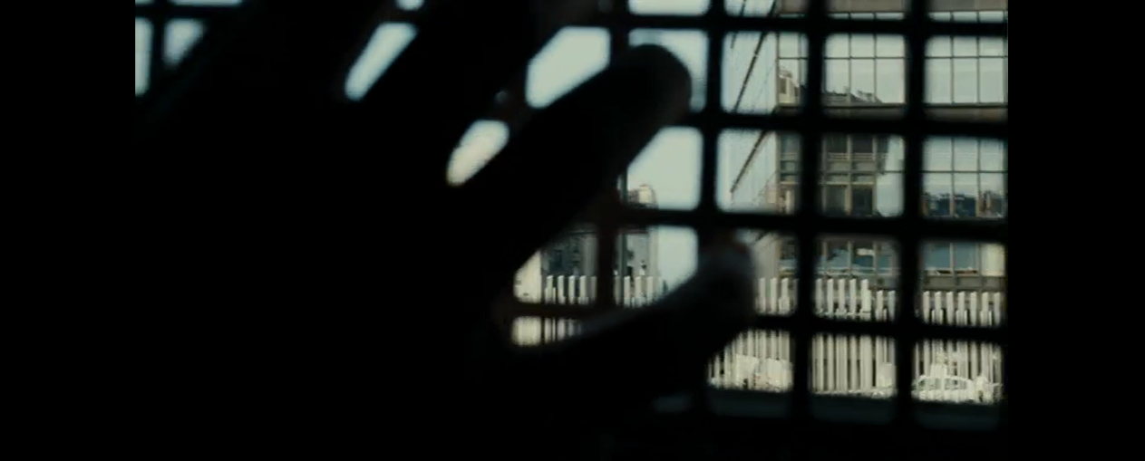
Un prophète
Cinematography

Slide 25
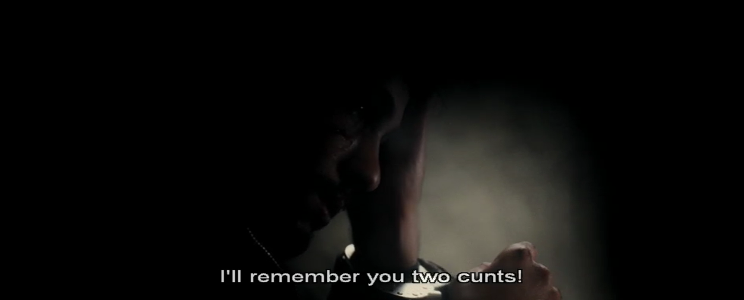
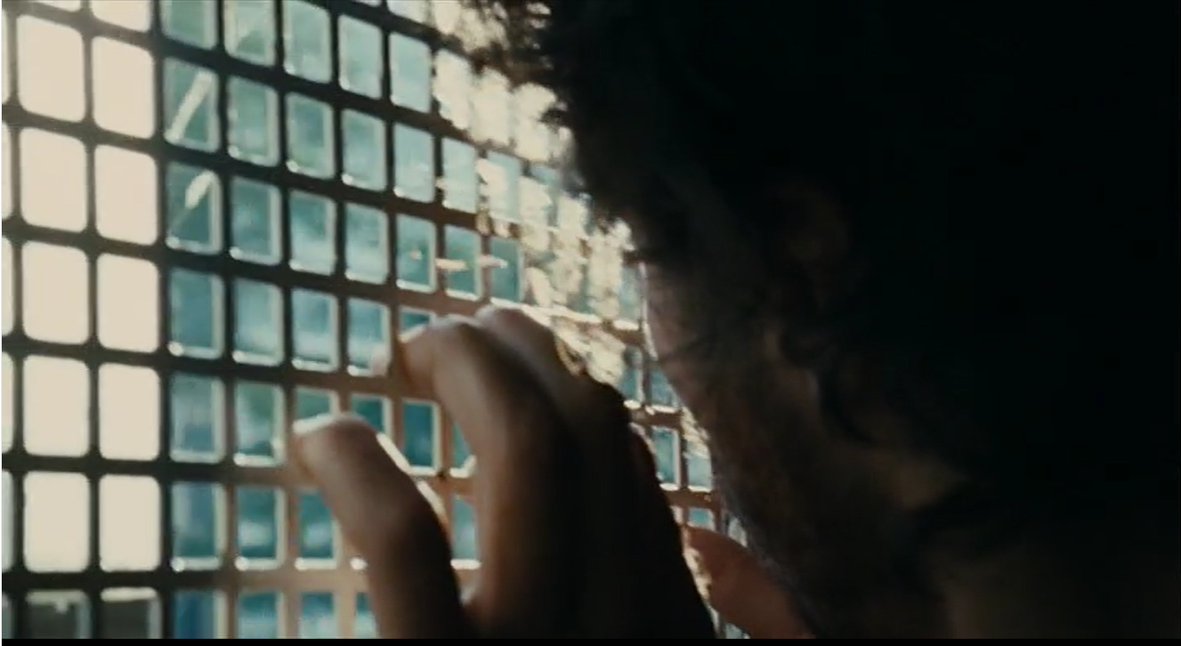
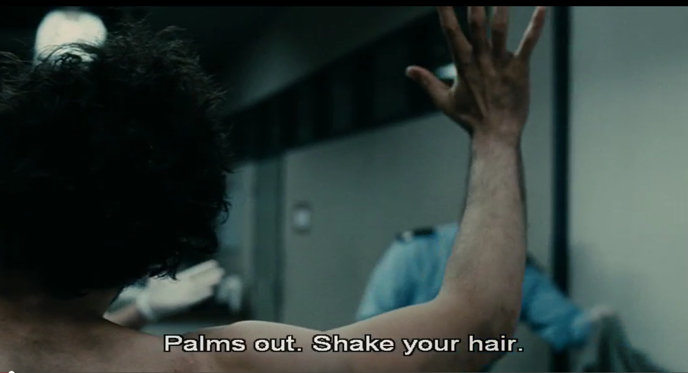
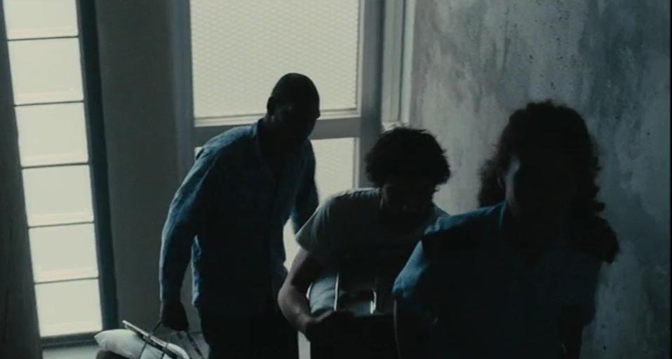
Mise en scène

Slide 26
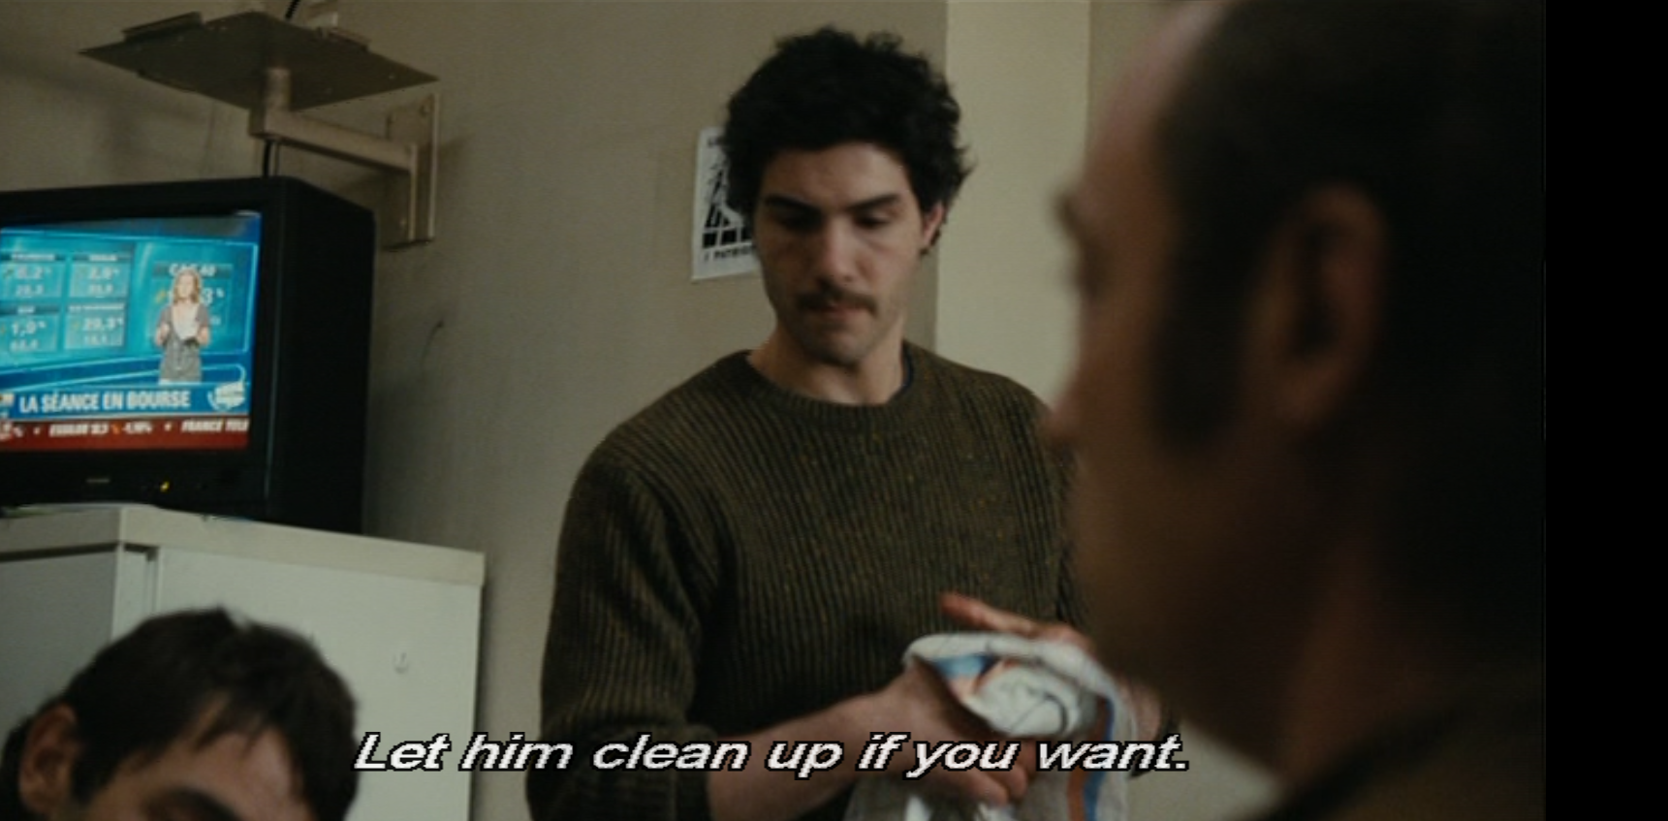
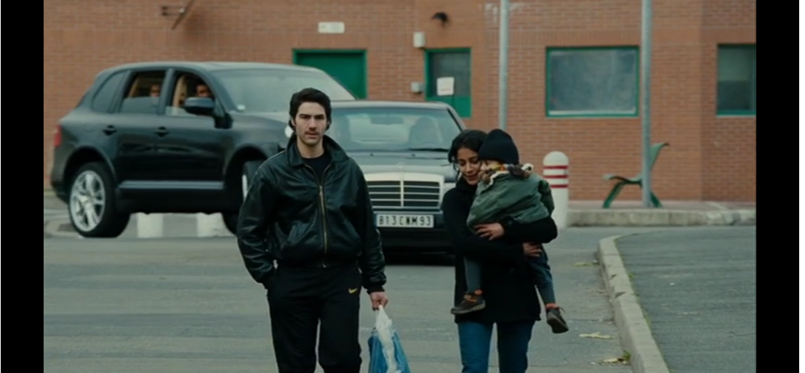
Intersectional (‘Beur’) Masculinity
Consider the portrayal of masculinity and of cultural identity more generally, including linguistic.
How do these relate to one another?
How is the prison’s status as a purely homosocial environment seen to impact on available performances of masculine identities?
How much importance should we attribute to Malik’s ethnicity in his characterisation?

Slide 27
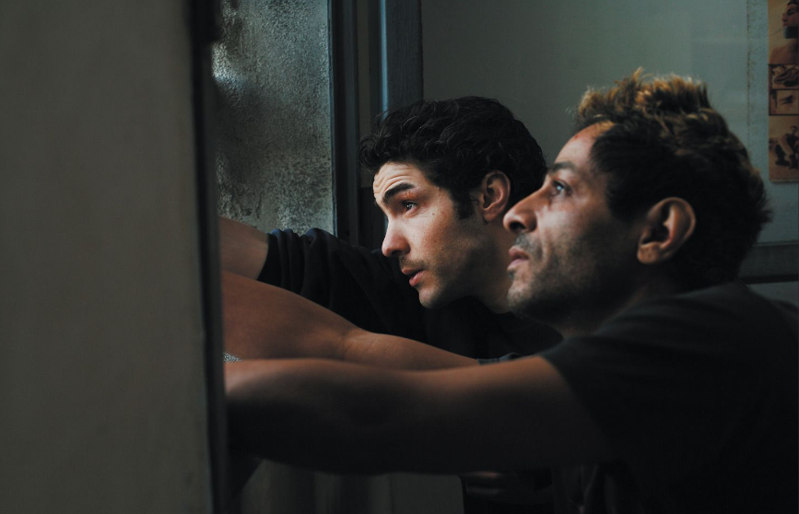
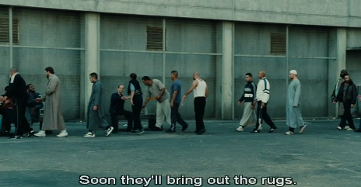
Racial Politics
Does the film propagate, cite or denounce stereotypes about second-generation French Arabs, or immigrants more generally?
‘The stereotype is a form of enunciation that thrives on […] the death of irony’ (Rosello 1998, 36).
- Questions of authorship – again!

Slide 28
ADDITIONAL BIBLIOGRAPHY
Marc Augé, Non-places: Introduction to an Anthology of Supermodernity, trans. John Howe (London: Verso, 1995).
Will Higbee, Post-Beur Cinema: North African Emigré and Maghrebi-French Filmmaking in France Since 2000 (Edinburgh UP, 2013).
Laura Mulvey, “Visual Pleasure and Narrative Cinema.” (originally published in Screen, 1975). In B. Nichols (ed.), Movies and Methods. Volume II, pp. 303-315. Berkeley: University of California Press, 1985
Phil Powrie, ‘French Neo-Noir to hyper-noir,’ in A. Spicer (ed.), European Film Noir (Manchester: Manchester University Press, 2007), pp. 55-83.
Mireille Rosello, Declining the Stereotype: Ethnicity and Representation in French Cultures, Dartmouth, 1998.
Ginette Vincendeau, ‘From the Margins to the Centre: French Stardom and Ethnicity,’ in Raphaelle Moine, Hilary Radner, Alistair Fox & Michel Marie (eds), A New Companion to Contemporary French Cinema (Chichester: John Wiley: 2014), pp. 547-69.

