Slide 1
New Iterations of the Auteur
Lecture 4: 21st-century ‘European’ art cinema
Personal Shopper (Assayas, 2017)

Slide 2
Structure of the Lecture
From the national to transnational
The transnational (again)
European art cinema in context
Personal Shopper as ‘European’ art cinema
Assayas as auteur
Borders and liminality
- From the postnational to the posthuman (and post- cinematic themes?)

Slide 3
Transnational Film Studies
1990s: from the national to the transnational
‘Transnational film studies approaches the cycle of film production, dissemination and reception as a dynamic process that transcends national borders and reflects the mobility of human existence in the global age;
it explores the narrative and stylistic features of films that come about as a result of this supranational cycle of film-making and reception’
(Dina Iordanova, ‘Transnational Film Studies,’ in Pam Cook (ed) The Cinema Book. 3rd Edition, p. 508. London: BFI, 2007)
France/Italy/Canada/West Germany/UK (1989)
France/Spain (2002)
Notes:
The model of study of national cinemas undergoes revision to account for modes of film production and consumption across borders:

Slide 4
Elements highlighted by transnational film studies
The transnational critique explores the ‘contingency or instability of the national’’ and favours readings that stress ‘hybrid’ and ‘impure’ elements.
Places stress on 1) new identities 2) new economic processes
(See Andrew Higson, ‘The Limiting Imagination of National Cinema’, in Hjort and McKenzie (eds) Cinema and Nation, pp. 63-74. London: Routledge, 2000)

Slide 5
1) New multicultural realities resuting in composite identities
Patterns of migration: diasporic cultures; multiculturalism within the nation state
Gurinder Chadha, director of mainstream hits Bend it like Beckham (2002) and Bride and Prejudice (2004)
‘Beur’ cinema but also other ‘accented cinemas’ (Naficy)
Gegen die Wand/Head-On (Fatih Akin, 2004)
La graine et le mulet/Couscous (Abdellatif Kechiche, France 2007)

Slide 6
2) Impact of the economic processes of globalisation.
- IN films
- And at the level of PRODUCTION:
Mobility of funds and personnel across the globe
De-centered structures of multi-national corporations: e.g. entertainment conglomerates
Supra-national character of funding bodies e.g. the Eurimages and Media European programmes
Globalisation of film culture: digital formats allow for the circulation of previously inaccessible national traditions: landmarks in film history co-exist with current releases in theatres, DVD, internet...
Powerful popular cinema industries: France but also Bollywood (India); Nollywood (Nigeria).

Slide 7
Transnational trends and film history
Film history looks at the way successive waves of cosmopolitanism throw into question the idea of a purely national cinema
From the mid-1920s to the early 1930s: the possibility of a pan-European cinema, or ‘Film Europe’
After the coming of sound, multi-language versions of films
Contribution to British and Hollywood cinema by European émigrés:
eg. Billy Wilder (director; born in Austria), (Audrey Hepburn (star; born in Belgium) – developing their careers in Hollywood.
Hungarians Emeric Pressburger (director); Alexander Korda (producer) - key figures in British cinema.

Slide 8
Mette Hjort:, ‘On the plurality of cinematic transnationalism’
Hjort locates value in transnational practices that:
-resist “globalization as cultural homogenization” and
-pursue and promote “aesthetic, artistic, social and political values” (p. 15)
Types proposed by Hjort:
Epiphanic transnationalism: shared cultural space; ‘deep transnational belonging’
Affinitive: based on cultural similarities
Milieu-building: cultural similarities lead to industrial initiatives for collaboration
Opportunistic: economic-driven collaboration
Cosmopolitan: mobility of directors
Globalizing: genre and star-based vehicles seeking to compete with Hollywood
Auteurist: established national cinema auteurs set up collaborative projects
Modernizing: supporting industrial development
Experimental: non-fiction films that reflect on the formation of identities; expanding the possibilities of collaboration.
C

Slide 9
Hjort’s Categories
Affinitive & milieu-building transnationalism: Red Road (Andrea Arnold, UK/Denmark 2006): alliances between agents from small nations: The Advance Party initiative – Producers: Sigma Films (Scotland) & Zentropa (Denmark). Cities (Glasgow) become creative hubs.
Epiphanic & auteurist transnationalism: Auteur film directed by Ken Loach, which seeks to unearth a shared history and ideals, and put forward a message of transnational belonging.
Ken Loach (UK/Spain/Germany/Italy/France, 1995) - CLIP

Slide 10
‘On the plurality of cinematic transnationalism’
Hjort locates value in transnational practices that:
-resist “globalization as cultural homogenization” and
-pursue and promote “aesthetic, artistic, social and political values” (p. 15)
Types proposed by Hjort:
Epiphanic transnationalism: shared cultural space; ‘deep transnational belonging’
Affinitive: based on cultural similarities
Milieu-building: cultural similarities lead to industrial initiatives for collaboration
Opportunistic: economic-driven collaboration
Cosmopolitan: mobility of directors
Globalizing: genre and star-based vehicles seeking to compete with Hollywood
Auteurist: established national cinema auteurs set up collaborative projects
Modernizing: supporting industrial development
Experimental: non-fiction films that reflect on the formation of identities; expanding the possibilities of collaboration.
In practice: films may fit more than one category; critical readings can activate diverse types of transnationalism.

Slide 11
‘On the plurality of cinematic transnationalism’
Hjort attaches critical value to practices that show the progressive potential of transnationalism - e.g. Red Road, Land and Freedom: art films that escape traditional national classifications.
A model that stresses the value of auteur intentionality and production arrangements that reflect a philosophy of collaboration (‘strong’ forms of transnationality). Less value attached to globalised productions driven by economic opportunity, on a par with Hollywood: e.g. Bride and Prejudice.

Slide 12
Diluting specificity?
Cf. Danan (extra reading)
‘These stars are turned into images of themselves just as French history itself is turned into a series of beautiful images’ (p. 240)

Slide 13
Classical Film Theory
A multi-volume collection of the writings of highly influential post-World War II film theorist Bazin.
A focus on cinema’s ability to capture objective reality.
Develops pioneer analyses of the work of auteur filmmakers, prominently including Italian ‘neo-realists’ such as Luchino Visconti and Vittorio de Sica, as well as the French Jean Renoir and some US filmmakers such as Orson Welles.

Slide 14
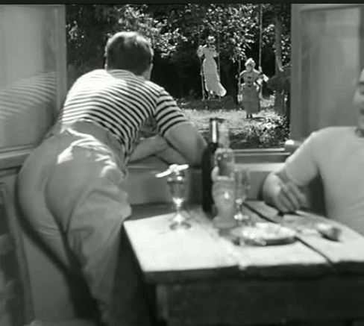
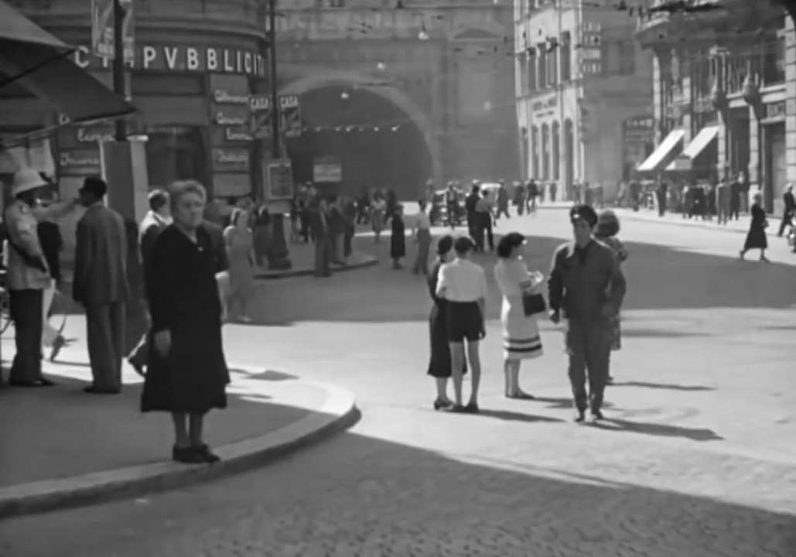
Une partie de campagne/A Day in the Country (Jean Renoir, 1936)
Realism as an effect of form e.g.
- wide screen composition
- deep focus (contrast e.g.
The Battle of
Algiers [Gillo
Pontecorvo, 1966]
And an effect of
theme
- focus on ordinary people
Ladri di biciclette/Bicycle Thieves (Vittorio de Sica 1948, CLIP))

Slide 15
1960 (and ‘70s) Theory:
Contesting the cinema’s direct link to reality
A turn to TEXTUALITY: media as a complex system of meanings.
Roland Barthes, ‘Rhétorique de l’image’. In: Communications, 4, 1964. pp. 40-51.
See also:
‘La Mort de l’auteur’, 1967

Slide 16
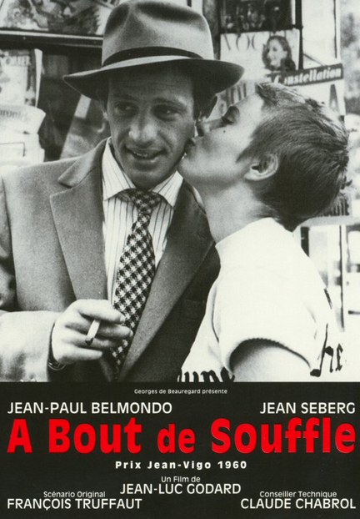
Auteur film as point of European distinction
From the post-war years….
… to the contemporary period
See Thomas Elsaesser:
European Cinema: Face to Face with Hollywood, Amsterdam: Amsterdam University Press (2005).

Slide 17
Auteurism beyond Europe
‘Proto-Europeans’ like Abbas Kiarostami (Iranian)
See also Vincendeau (2014, week 8 extra reading) on Binoche as ‘the perfect European star’.
US ‘indie’ auteurs like David Fincher
See also Mazdon, ‘Hollywood and Europe: Remaking The Girl with the Dragon Tattoo,’ in Harrod, Liz and Timoshkina, The Europeanness of European Cinema (2014).
Cf. Elsaesser (2005) on European cinema as just another category in world cinema?
OR (2015) something else again…

Slide 18
Assayas as auteur
Observable stylistic and thematic consistencies across his oeuvre (albeit following two strands – ‘people chasing each other across the globe with guns and expense accounts’ (Jones p. 34) in globalised (erotic) thrillers with English-language titles (demonlover, (2002), Boarding Gate (2007), we can add Personal Shopper) v. ‘people talking in cafes’ in other films
Enigmatic films that invite hermeneutic readings/decoding
Profound questions; a social message? Not ‘only entertainment’. E.g. a critique of mass media and the breakdown of communication – a theme with a pedigree in critical theory, notably through Jean Baudrillard’s concept of ‘simulacra’ as well as ‘Situationist’ work by Guy Debord and others.
A marketable brand? Including festival accolades e.g. Prix de la mise-en-scène for Personal Shopper at Cannes.

Slide 19
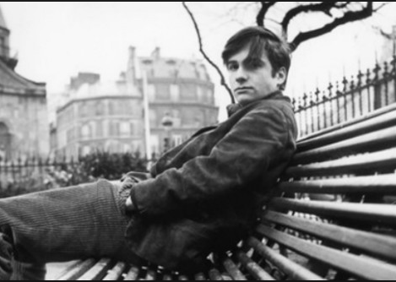
The auteur brand
depicts the remaking of….
by
starring
1915
Lettrism

Slide 20
From situationism to globalisation
Situationism – an avant-garde movement from late 1950s to early 1970s with links to Marxism
suspicious of the growing role of objects in mediating social relations
Emphasised the immediate presence of interpersonal dynamics (contrast post-Structuralist ideas)
In Assayas’ interpretation, attributes importance to human agency (including collective) and even responsibility cf. Jones p. 22 on ‘the sense of personal agency shared between characters, the phantom awareness of how one measures up against other people, within society, as a citizen of the world.’
= the definition of cosmopolitanism, linked to transnational identity formation
Assayas, 2007

Slide 21
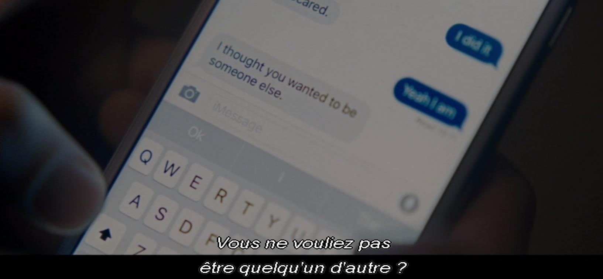
Technology in Personal Shopper

Slide 22
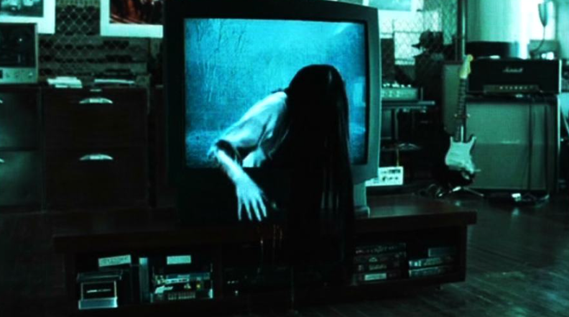
Gendered fear of technological change
Ringu/The Ring
(Hideo Nakata, Japan 1998)

Slide 23
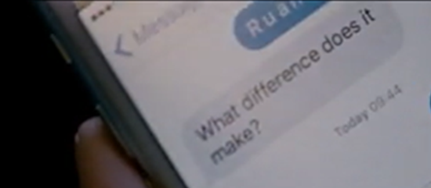
Slavoj Žižek, “No Sex, Please! We’re Post-Human.” (2000) http://www.lacan.com/nosex.htm
Personal Shopper
‘What if […] once sexual difference is abolished, a human being effectively becomes indistinguishable from a machine? […]
The end of sexuality […] will simultaneously signal the end of what is traditionally designated as the uniquely human spiritual transcendence.’
See also Haraway (2000).

Slide 24
‘Continental’ Humanist Thought
Cf. Baudrillard’s fear of cloning (Screened Out, 2002).
Zygmunt Bauman’s critique of ‘subjectivity fetishism’ connected to electronic media (Consuming Life, 2007).
For Rosi Braidotti
Humanism is a ‘Eurocentric paradigm’.
(The Posthuman, 2013: 15)

Slide 25
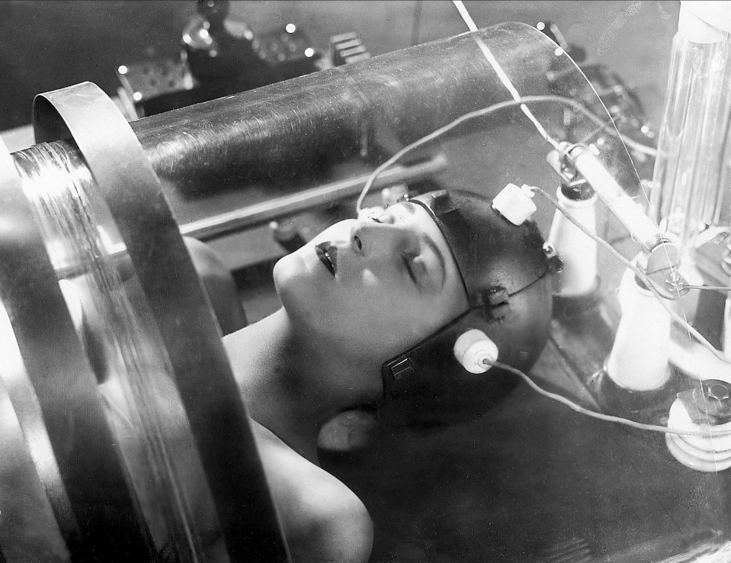
Gendered fear of technological change
See Andreas Huyssen (1982), ‘The vamp and the machine: Technology and sexuality in Fritz Lang’s Metropolis’

Slide 26
Gendered fear of technological change
‘Both L’Herbier’s character Claire in L’Inhumaine and Lang’s Maria express the highly sexualised and deeply gendered relationship of the twentieth century to its industrial technology and machinery.’
Braidotti, The Posthuman, p. 106
1924

Slide 27
Maureen’s queer associations

Slide 28
Maureen’s queer associations

Slide 29
The Carpenter’s Song
You often hear folks squabble over what good fortune means:
One fellow calls the other “fool”, but neither knows the truth.
The very meanest pauper seems to others far too rich.
Fate clamps them all into its vice and planes them equally.
The young forever strive with might for constant happiness
But once you age a little bit, you settle for much less.
My wife oft nags me woefully, but I don’t turn a hair;
I knock the shavings from my plane and let her grumble on!
And when Death shows up one fine day and beckons, brother – come!
I’ll act a little deaf at first, and simply look away.
But when he says: dear Valentine, don’t give me trouble, go!
I’ll lay my plane down on my bench and bid the world farewell!

Slide 30
Maureen’s ‘posthuman’ erotic disembodiment
See also Steven Shaviro on Boarding Gate in ‘Post-Cinematic Affect’, Film Philosophy 4 (1).

Slide 31
Maureen as ghost?
See Mijovic extra rdg.

Slide 32
Lewis as ghost?

Slide 33
Troubling sex and gender in recent auteur films
Spring Breakers
Personal Shopper
The Bling Ring
Happy End

Slide 34
Additional Bibliography
Richard Grusin, The Nonhuman Turn (Minneapolis: University of Minnesota Press, 2015).
Donna Haraway, ‘A Cyborg Manifesto: Science, Technology and Socialist-Feminism in the Late Twentieth Century,’ in The Cybercultures Reader, ed. David Bell and Barbara M. Kennedy (New York: Routledge, 2000), 294-312.
Katherine Hayles, How We Became Posthuman: Virtual Bodies in Cybernetics, Literature, and Informatics (Chicago: University of Chicagop Press, 1999).
Mette Hjort: ‘On the plurality of cinematic transnationalism,’ in N. Ďurovičová and K. Newman (eds), World Cinemas, TransnationalPerspectives (New York: Routledge/AFI, 2010), 12-33.

