Slide 1
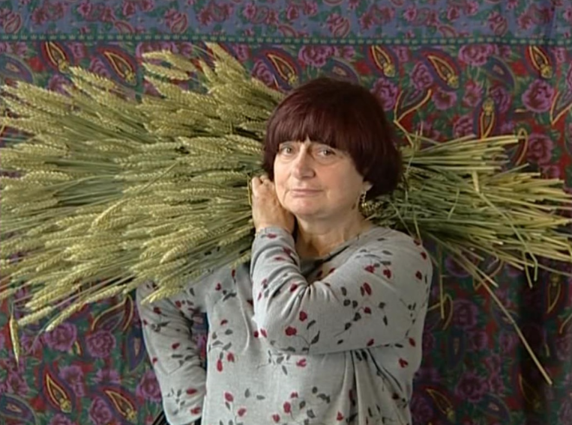
Women Filmmakers
Lecture 5: Feminist Documentary
Les Glaneurs et la glaneuse/The Gleaners and I (Varda 2000)

Slide 2
STRUCTURE OF THE LECTURE
Overview of women’s filmmaking
Women’s auteur filmmaking
Introduction to Agnès Varda
Background and relationship to the Nouvelle Vague
Varda’s relationship with feminism
Les Glaneurs et la glaneuse as/and (feminist) documentary
Notes:
Point 2 e.g. (e.g. the relationship with literature and art, the treatment of time and the body)

Slide 3
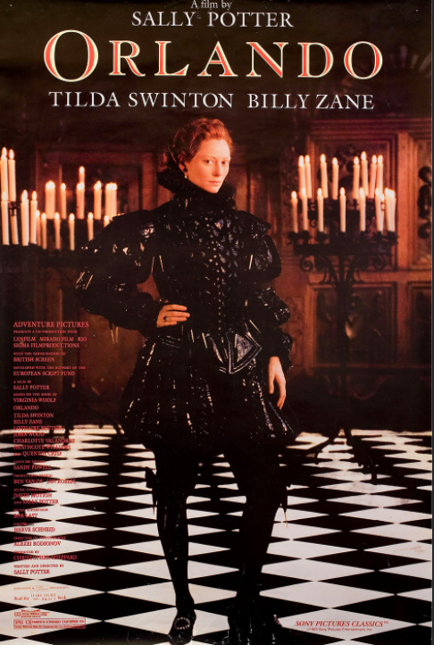
WOMEN’S FILMMAKING
Women and the Arthouse
In cinema in the 1970s, ‘women’s filmmaking’ reflected a schism in feminism itself to be split between ‘two types of film work that seemed to be at odds with one another:
one called for immediate documentation for purposes of political activism, consciousness-raising, self-expression, or the search for “positive images” of women;
the other insisted on rigorous, formal work on the medium […] in order to analyse and disengage the ideological codes of representation.’ Teresa de Lauretis, ‘Rethinking women’s Cinema,’ 1987.
Laura Mulvey (1975) played a key role in the latter trend.

Slide 4
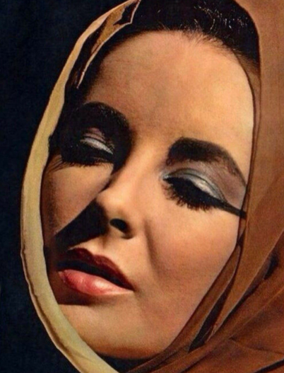
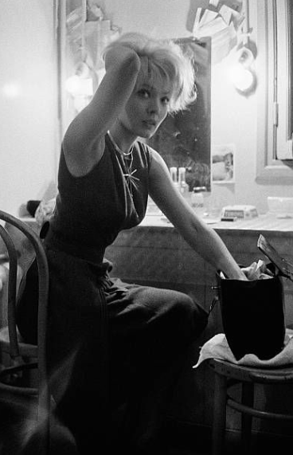
Mulvey, ‘Visual Pleaure and Narrative Cinema’
The presence of woman is an indispensable element of spectacle in a normal narrative film, yet her visual presence tends to work against the development of a story line, to freeze the flow of action in moments of erotic contemplation […]
[Women’s appearance] is coded for strong visual and erotic impact so that they can be said to connote to-be-looked-at-ness.
(Mulvey, Section III.A, ‘Woman as Image, Man as Bearer of the Look’)
Comparisons with French context of Continental feminist philosophers such as Cixous, Kristeva and Irigaray e.g. Cixous’ call for women to adopt an ‘écriture féminine’.
Prescribes a feminist ‘cinema of unpleasure’ > e.g. Jeanne Dielman, 23 Quai du commerce, 1080 Bruxelles

Slide 5
The French Feminist Tradition of Excluding the Mainstream
‘For Cixous, the heart of écriture féminine is a relinquishing of the (masculine) self, and an acceptance and inclusion of the other in ways which will necessarily call into question the prevailing ideology and its mode of perception and expression, and hence create a new “order” to replace the patriarchal and capitalist hegemony. Like Julia Kristeva, Cixous sees writing as the locus and means of this revolution; like Irigaray, she gives women the key (though not exclusive) role in bringing this new into being.’
Susan Sellers, ‘Towards an écriture féminine.’ In Language and Sexual Difference: Feminist Writing in France, p. 139.

Slide 6
French Women Filmmakers
Mid-1990s-mid-2010s: female directors have been responsible for between 14 and 25% of overall production during the period, compared with 7% in Hollywood in 2017, rising to 17/18% in the 2020s*.
More specifically, for France, Carrie Tarr with Brigitte Rollet cite 14% for the 1990s (Tarr with Rollet, 2001. Cinema and the Second Sex: Women’s Filmmaking in France in the1980s and 1990s. London and New York: Continuum, p.1);
and Fanny Beuré finds this to rise to a maximum of 25% in subsequent years to 2013 (‘Bilan 2004-2013 de la production et du financement des films réalisés ou co réalisés par des femmes,’ Studies in French Cinema 16:2, pp. 134-151) but also fairly steady since then Number of Women Directors in France Is Increasing, Study Finds | Women and Hollywood.
See CNC for detailed French statistics
*For Hollywood, see https://variety.com/2017/film/news/female-directors-hollywood-diversity-1201958694/
Number of Female Directors on Top Hollywood Films Declines in 2021 - Variety
and publications by Melisa Silverstein and/or the Geena Davis Institute on Gender in Media.

Slide 7
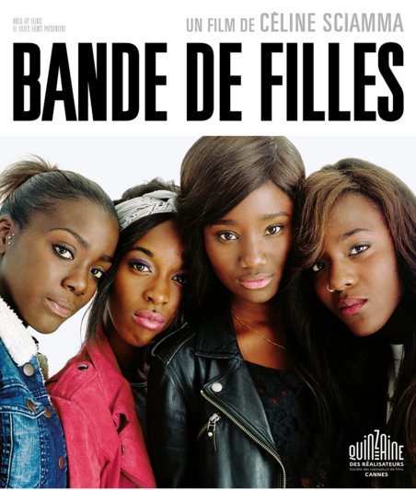
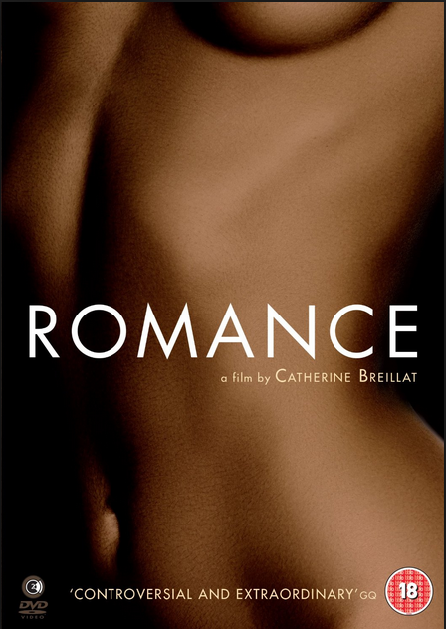
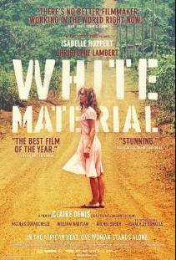
French Women Auteurs
Some prominent names include Varda, Chantal Akerman (who is Belgian), Marion Vernoux, Laetitia Masson, Claire Denis, Catherine Breillat, Céline Sciamma and many more.
Girlhood
- An intellectually elite target audience and market positioning (through publicity materials, festival exhibition, awards, type of cinema run)

Slide 8

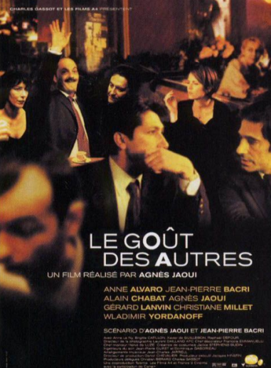
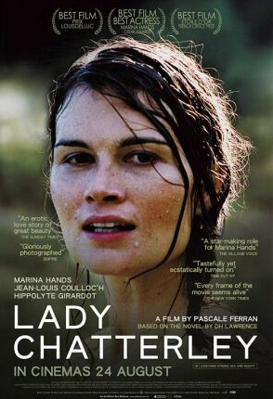
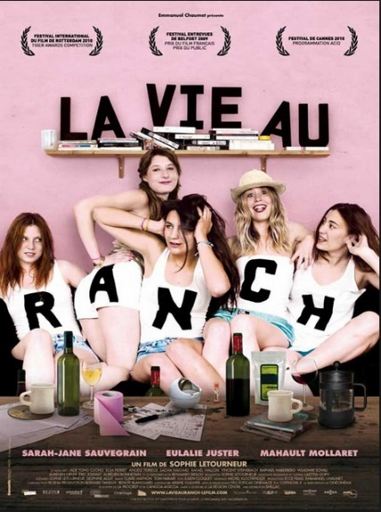
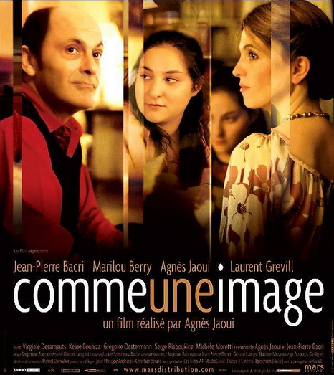
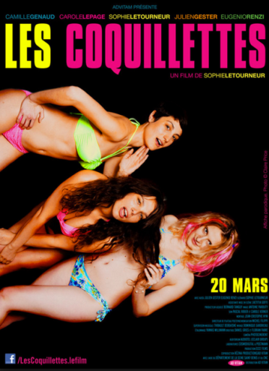
What about the Middlebrow?
Or cult successes?
The Taste of Others, Agnès Jaoui, 2000
Sophie Letourneur
Pascale Ferran
2006
2009
See Ferran’s controversial claims about the ‘cinéma du milieu’ discussed by Vanderschelden (2009)
Look at Me, Jaoui, 2004
2012

Slide 9
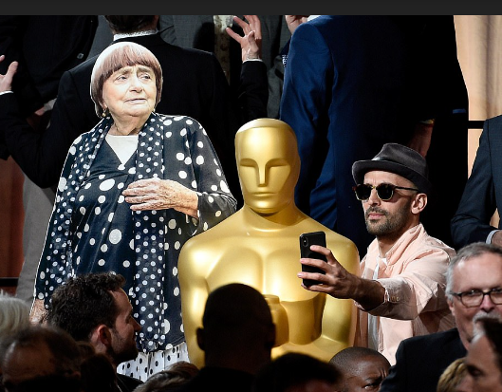
Varda at the Oscars

Slide 10
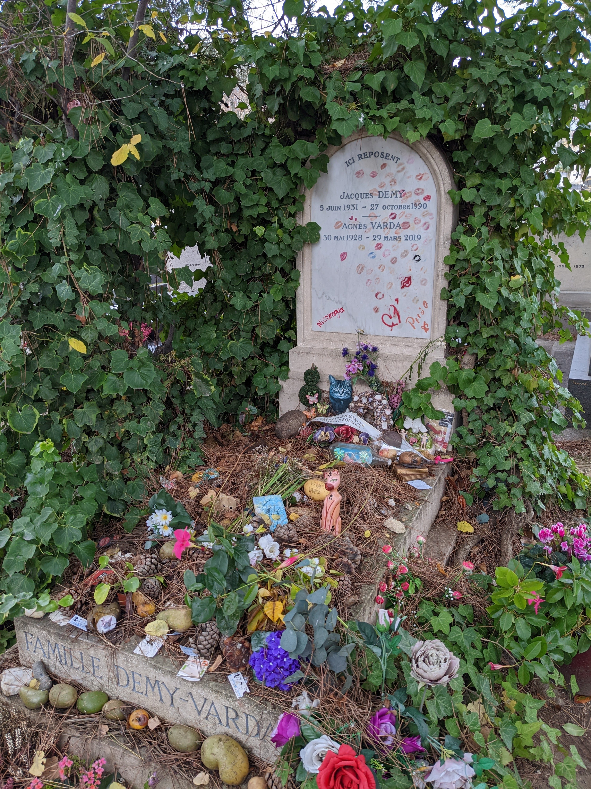

Slide 11
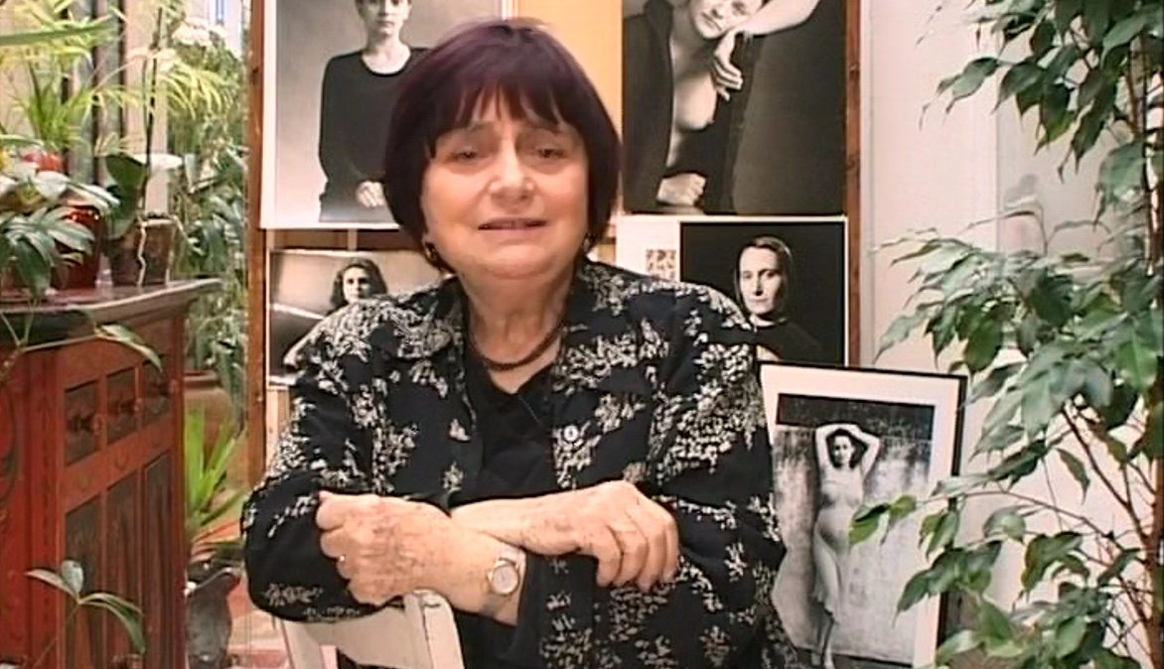
Agnès Varda, born 1928 (Brussels)
Background in philosophy, history of art and photography

Slide 12
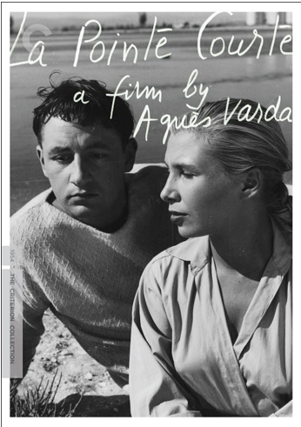
The First Film of the New Wave?
La Nouvelle vague
Varda linked to more politicised ‘Left Bank’ strand (cf. Alain Resnais and Chris Marker)
La Pointe courte
Structure borrowed from Faulkner’s novel The Wild Palms
Cultural eclecticism: focus on the realism of the everyday (difficulties faced by fishermen) alongside modernist formal organisation
Marginal exhibition and positioning
1955

Slide 13
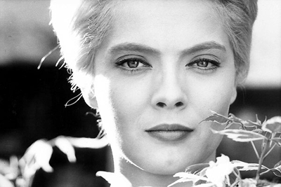
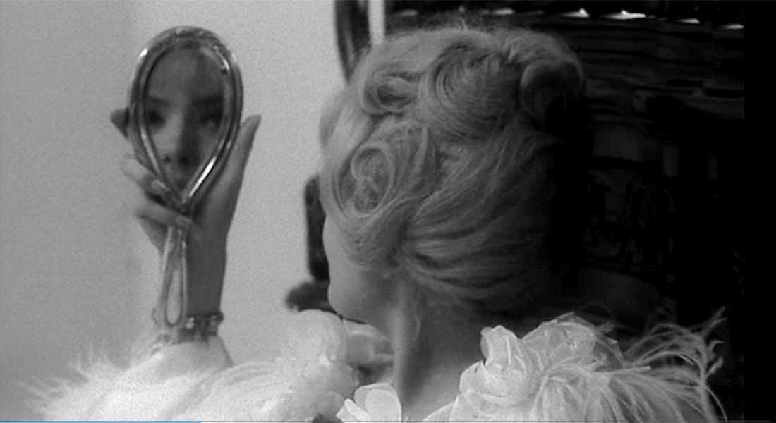
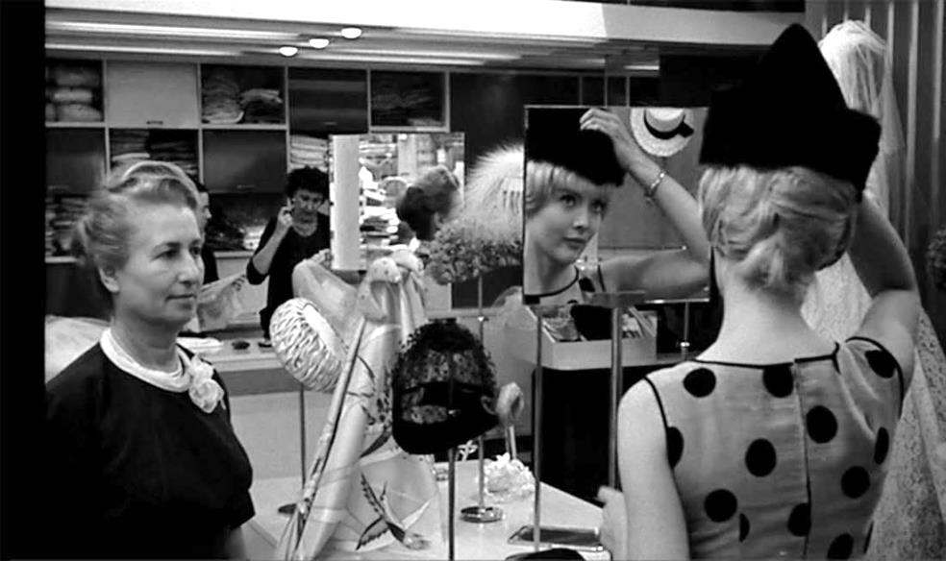
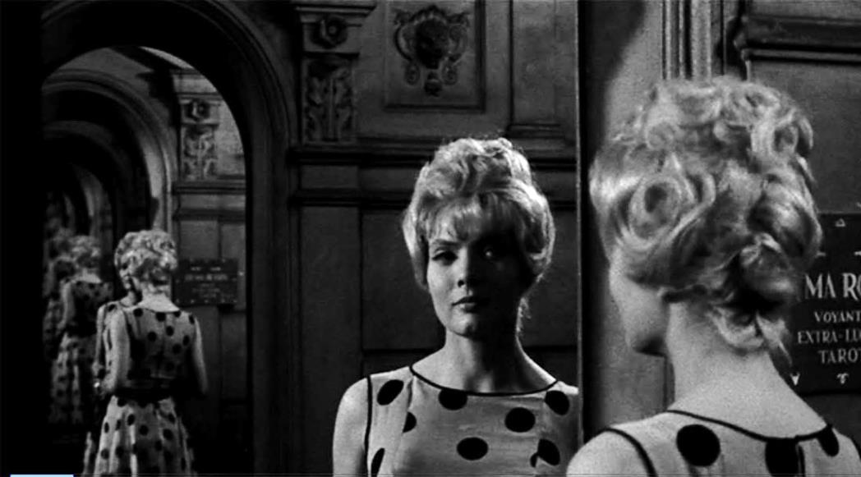
Cléo de 5 à 7 (1962): Varda’s interest in Gender Politics (cf. Flitterman-Lewis)
See clip

Slide 14
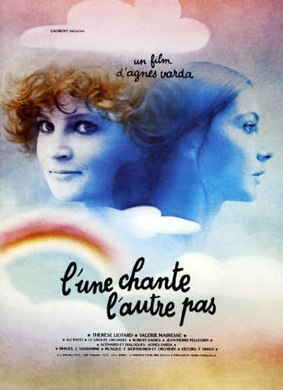
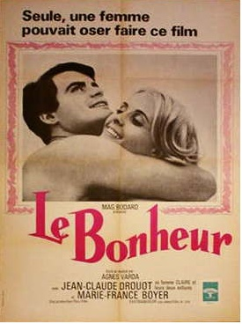
A ‘committed rather than militant’ feminist? (Smith 1998: 8) Films Typified by Apparent Contradiction
1977 – see clip
1965

Slide 15
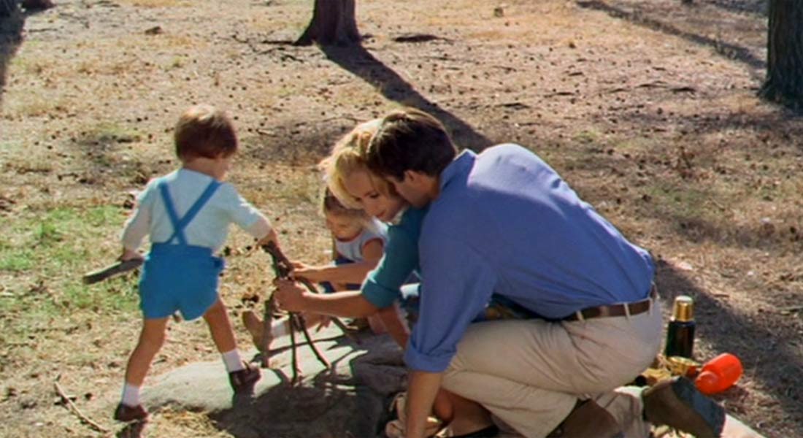
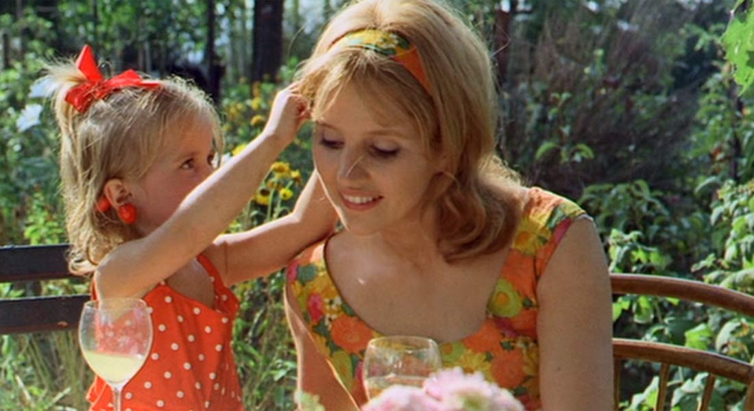
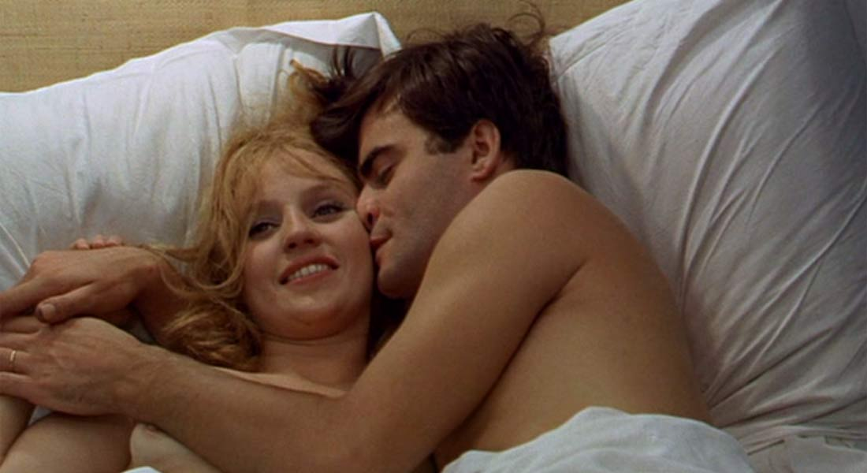
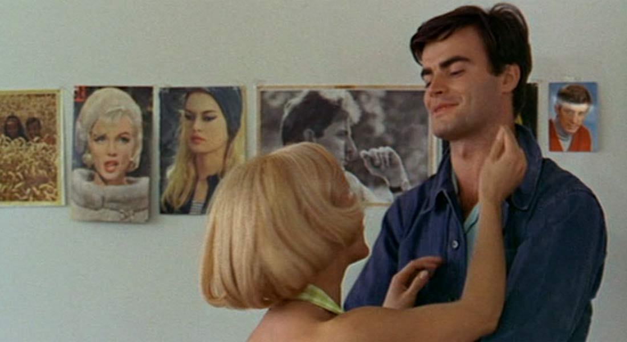
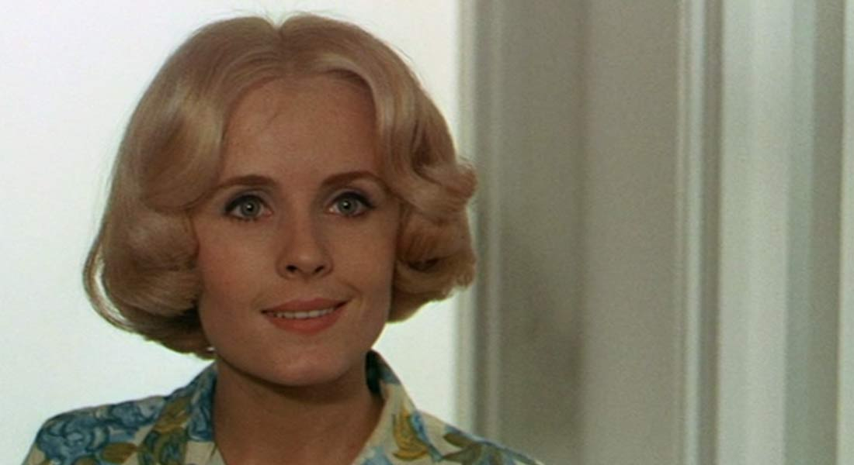
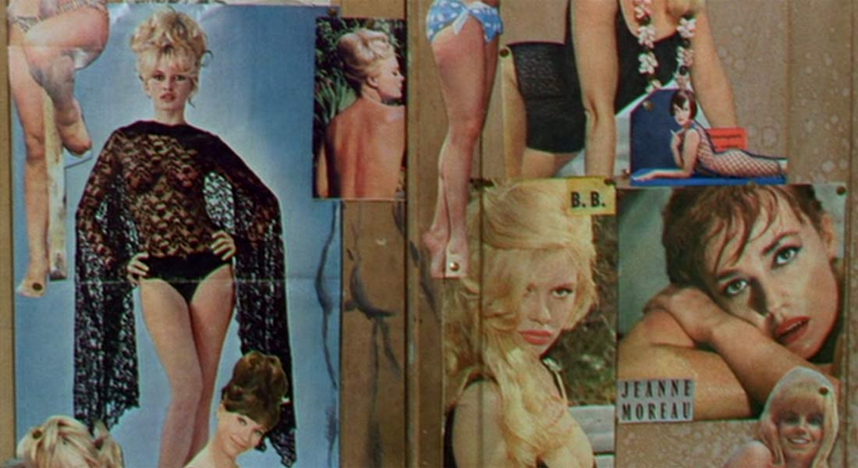
The Ambivalence of Varda’s Mise-en-Scène: Le Bonheur

Slide 16
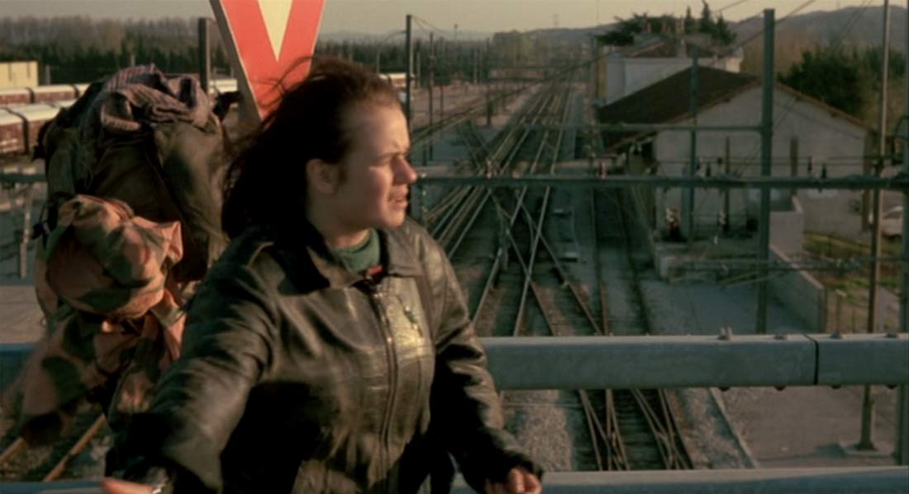
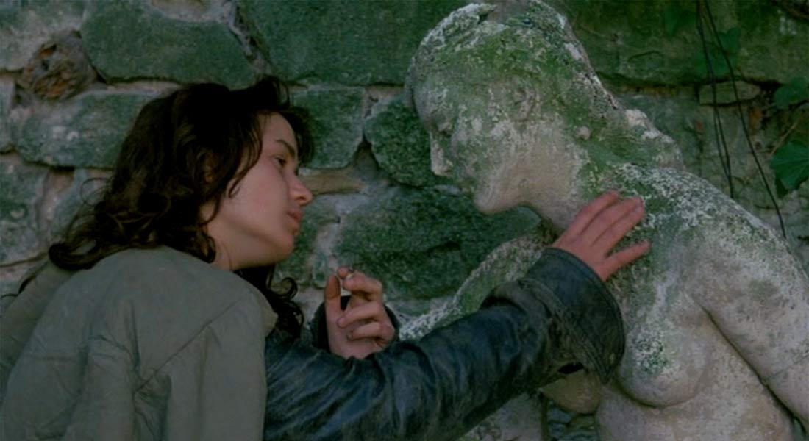
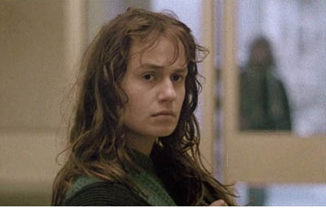
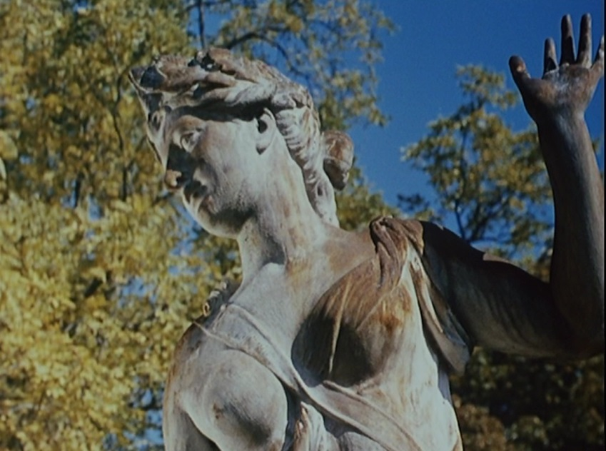
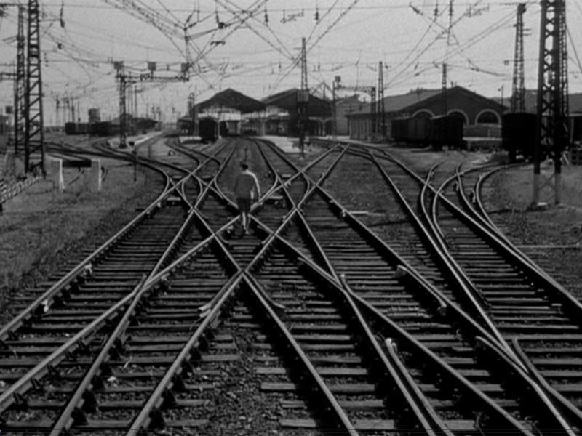
The Focus on Women’s Relationships and Experience
Sans toit ni loi (1985)
… and some aesthetic particularities
O saisons, ȏ châteaux
(1958, documentary short for Tourist Board)
La Pointe courte, 1955

Slide 17
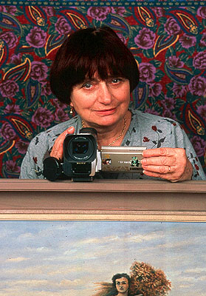

Varda and Documentary Aesthetics
Style characterised by ‘poetry of the everyday’
‘cinécriture’ = writing directly in images
Incorporation of documentary into fiction films: Pointe courte, Cléo de 5 à 7, L’une chante, Sans toit…
Political documentaries: early factual film for French tourist board, Salut les Cubains (1963), Loin du Vietnam (1967), Black Panthers (1968)
Fiction-documentary pairs: Mur murs + Documenteur (1981); Kung Fu Master + Jane B. par par Agnès V. (1987)
Personal documentaries: L’Opéra-Mouffe (1958), Daguerréotypes (1975), Jacquot de Nantes, Les Glaneurs et la glaneuse, Les Plages d’Agnès

Slide 18

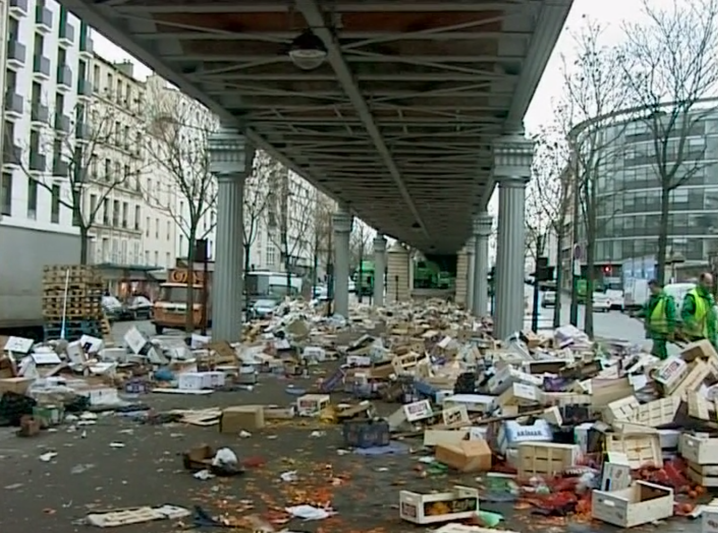
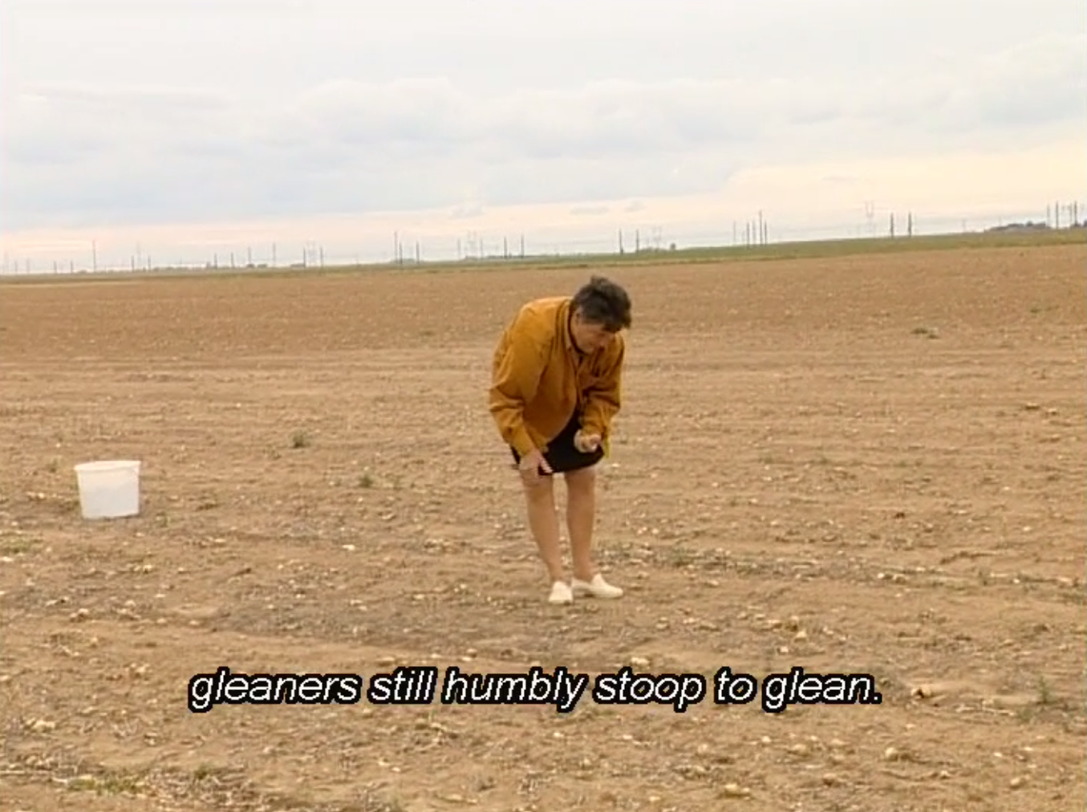
Les Glaneurs et le glaneuse
Varda as early ecofeminist?
ECOFEMINISM
Grown up since the 1970s/80s; key figures Rosi Braidotti, Maria Mies, Vandana Shiva
Theoretical stream within (especially ‘fourth-wave’) feminism reacting to: patriarchal control of development planning in an age of environmental decline
Underlines resultant destruction of relationship between community, women and nature

Slide 19
The Focus on Women’s Relationships and Experience
Sans toit ni loi (1985)
… and some aesthetic particularities
O saisons, ȏ châteaux
(1958, documentary short for Tourist Board)
La Pointe courte, 1955

Slide 20
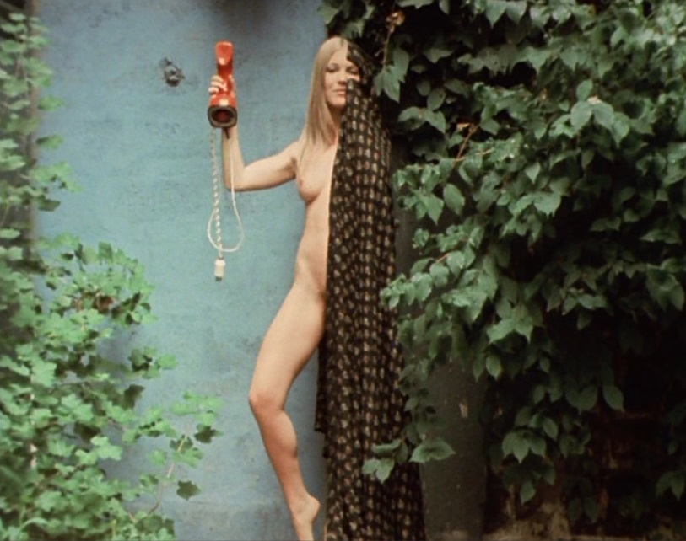
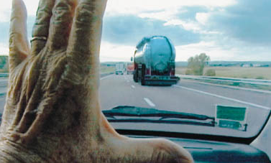
Filming the (Ageing) Female Body
L’Une chante, l’autre pas
Les Glaneurs et la glaneuse
‘[W]e keep hidden from view the grotesque, fearful and laughable signs of female ageing.’ (Wearing 2007: 290).

Slide 21
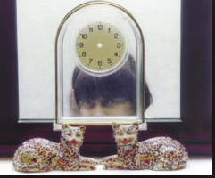
Les Glaneurs: Formal Innovation at a Structural Level
Episodic architecture, akin to Julia Kristeva’s ‘women’s time’.
Self-reflexivity: Cf. Jane B par Agnès V (1988) (, Jacquot de Nantes (1991)?), Les Plages d’Agnès (2008), Visages, Villages (2017)
Beyond the (male) voiceover.
Varda reversing Mulvey’s well-known description of classical narrative cinema as making woman the bearer, not the maker, of meaning.

Slide 22
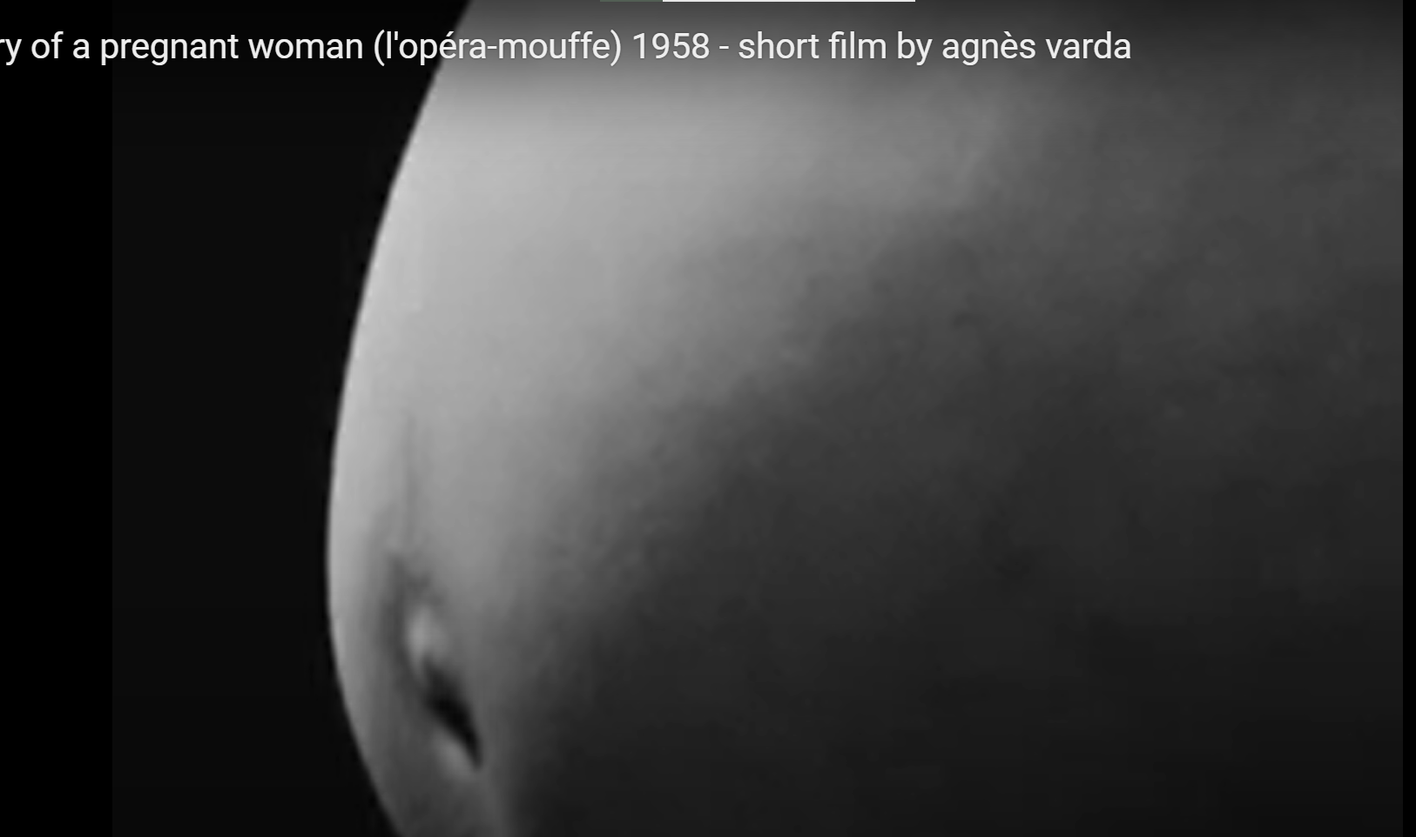
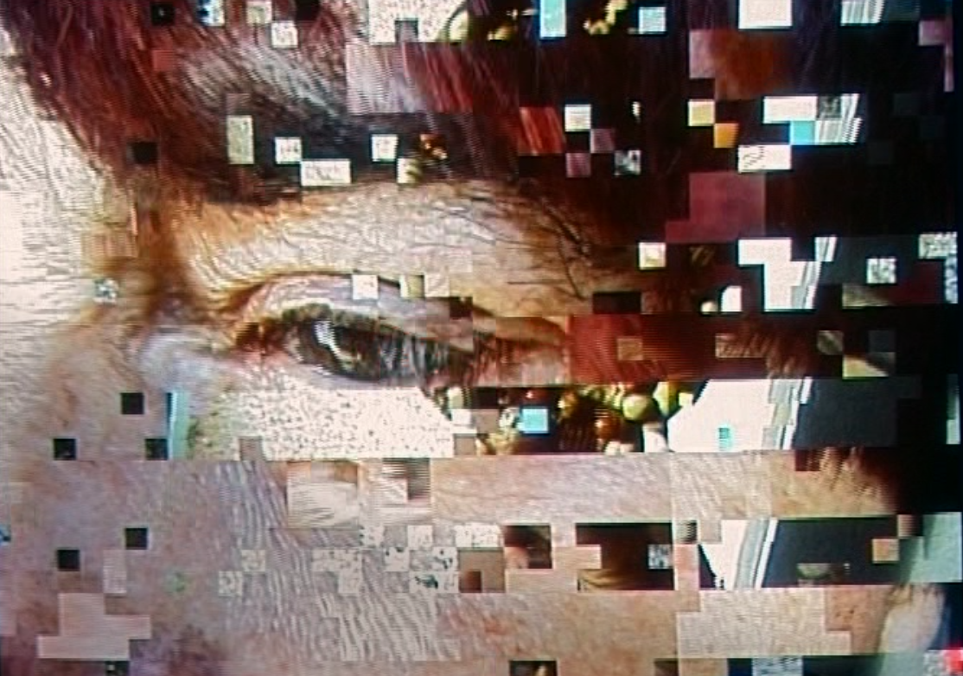
Essentialist or Poststructuralist?
Digital images as ‘the most radical instance yet of an old Cartesian dream: [that] the best representations are the most immaterial ones, because they seem to free the mind from the body and the world of substance (Rodowick in King 421)

Slide 23
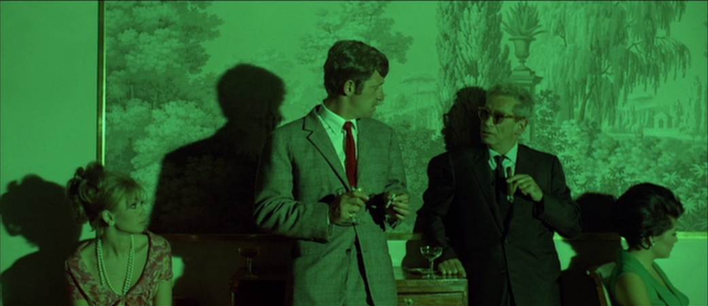
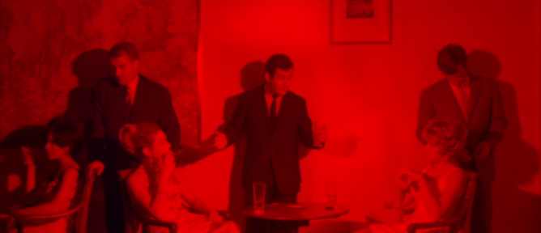
Pierrot le fou (Jean-Luc Godard, 1965) Departing from the conventions of classical cinema
- Eschewal of editing conventions such as shot-reverse shot conversation shooting
- The use of different coloured filters across edits in one space

Slide 24
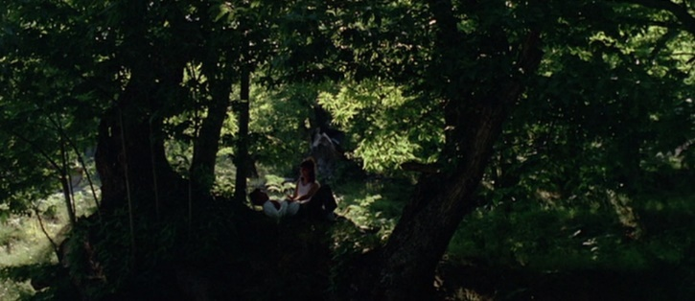
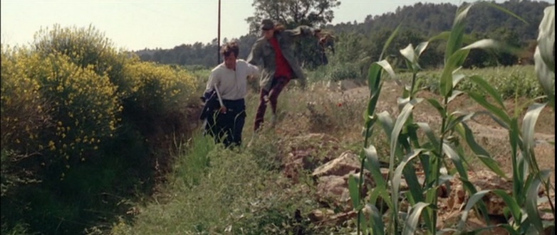
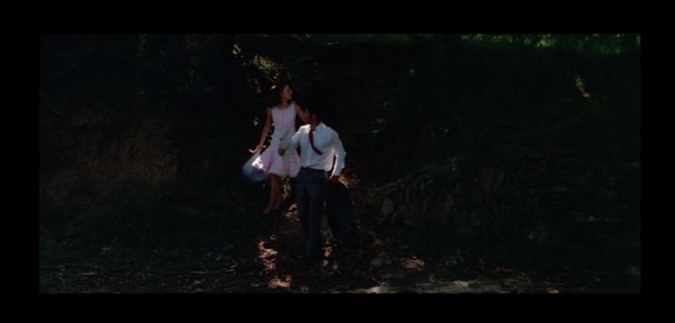
Pierrot le fou
Departing from the conventions of classical cinema
Extremely low-key lighting, obscuring vision… followed by bright lighting – and an unmotivated costume change

Slide 25
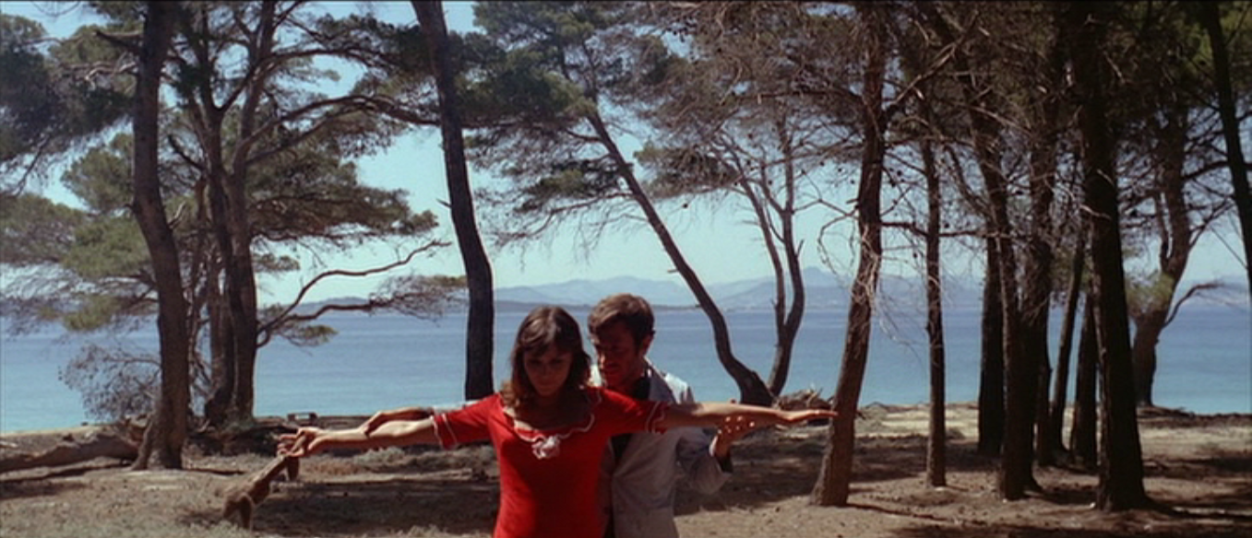
Pierrot le fou
Departing from the conventions of classical cinema
Framing either off-centre or cutting off parts of the body we
would expect to see with this composition

Slide 26
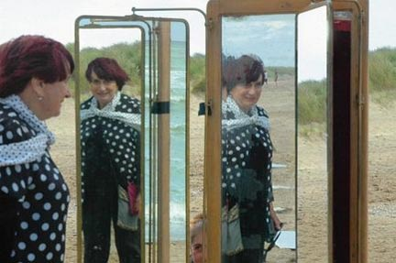
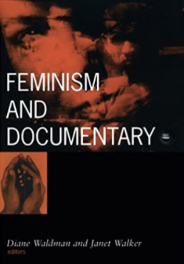
The Personal as Political in Documentary
Increasing interpenetration of autobiography and other forms – especially in media?
Likewise, an increasing dispersal of ‘documentary’ into other forms e.g. rise of the docudrama format (see for example Derek Paget, Steven Lipkin).
Difficult to ignore the role of the subject - as a sentient, emotional and generally embodied being - in shaping narratives.
Affirming this has a gendered dimension - see also Waldman and Walker (1999, pictured right).
Notes:
On point 3, postmodern relativism.
On last point, this is the larger meaning of replacing the ‘omniscient’ male voiceover.

Slide 27
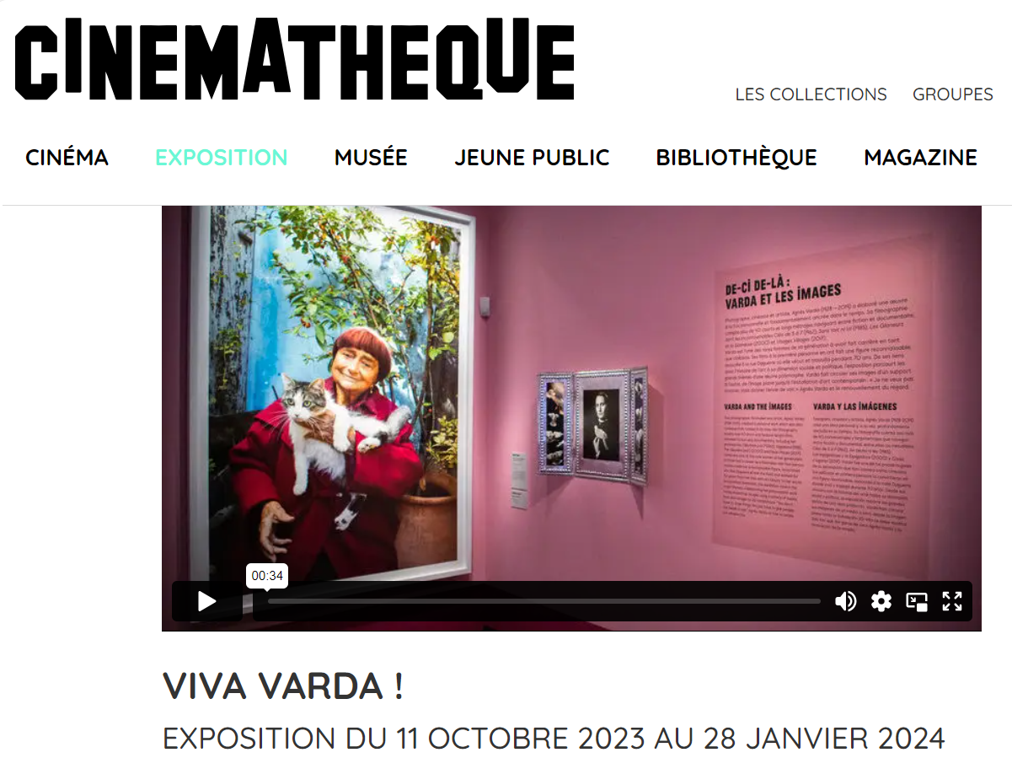


Varda’s Legacy

Slide 28



Varda’s Legacy
Sex is Comedy, Catherine Breillat, 2002
See also films by Claire Denis, Laetitia Masson, Sofia Coppola and Kelly Reichardt
Searching for the self in the other and vice versa: Sciamma and Varda

Slide 29
Additional Bibliography
Stella Bruzzi, ‘Narration: The film and its voice.’ In S. Bruzzi, New Documentary: A Critical Introduction, London: Routledge, 2000, pp. 40-65.
Sandy Flitterman-Lewis, To Desire Differently, Columbia: Columbia University Press, 1996.
Julia Kristeva, ‘Le Temps des femmes.’ In Kristeva, Les Nouvelles maladies de
l’âme, Paris: Fayard, 1993, pp.297-332.
Steven N. Lipkin, ‘Real Emotional Logic: Persuasive Strategies in Docudrama,’ Cinema Journal 38 (4) (1999): 68-85.
Laura Mulvey, ‘Visual Pleasure and Narrative Cinema’, Screen, 16, 3 (1975): 6-18.
Derek Paget, No Other Way to Tell It: Docudrama on Film and Television, Manchester: Manchester University Press, Second Edition, British Library digital collection, 2011.
--------------, ‘Ways of Showing, Ways of Telling: Television and 9/11,’ in Stephen Lacey and Derek Paget (eds), The ‘War on Terror’: Post-9/11 Drama, Docudrama and Documentary, Cardiff: University of Wales Press, 2015.
Alison Smith, Agnès Varda, Manchester: Manchester University Press, 1998.
Sadie Wearing, ‘Subjects of Rejuvenation.’ In Y. Tasker and D. Negra (eds),
Interrogating Postfeminism. Durham and London: Duke University Press, 2007, pp. 277-310.

