Slide 1
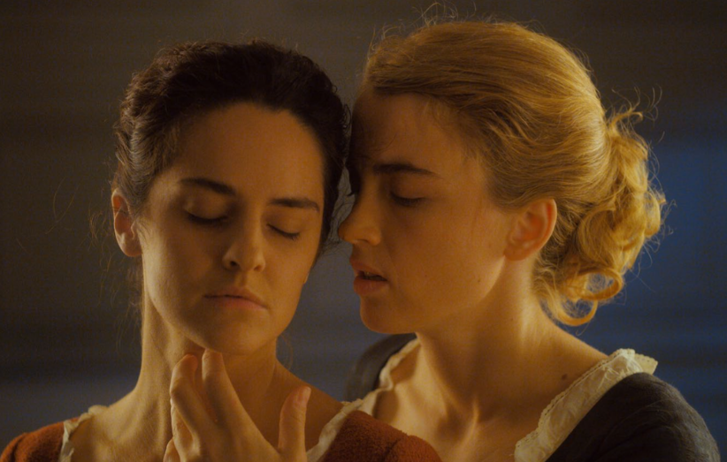
Women Filmmakers
Lecture 6: Revising History and Queering Genre
Portrait de la jeune fille en feu/Portrait of a Lady on Fire (Sciamma 2019)

Slide 2
Structure of the Session
Introduction to queer studies in visual culture
Heritage and history
Sciamma as queer feminist auteur(e)
- Themes and visual style
- The star director and her films
- The question of autofiction

Slide 3
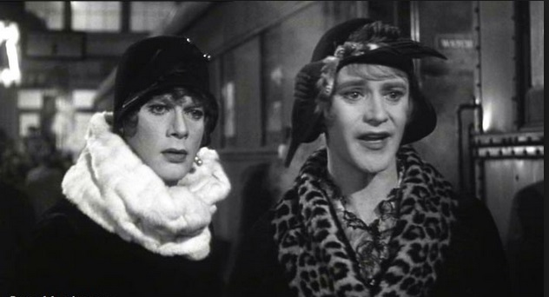
Queerness and its Relation to Camp Aesthetics
For Susan Sontag, in her 1966 essay ‘Notes on “Camp”’:
- camp is a sensibility that is ‘almost ineffable’ but that is linked to ‘things-being-what-they-are-not’ and that thrives on artifice and exaggeration.
Some like it Hot (Billy Wilder, 1959)

Slide 4
Camp Aesthetics (Sontag cont.)
‘To emphasize style is to slight content, or to introduce an attitude which is neutral with respect to content. It goes without saying that the camp sensibility is disengaged, depoliticized – or at least apolitical.’ (p.277)
And yet….
marginality may be a prerequisite – Cocteau not Gide* (p. 278); ‘[c]amp taste turns its back on the good-bad axis of ordinary aesthetic judgement’, rejecting ‘the pantheon of high culture’ (p.286) [cf. postmodernism as a whole].
‘[E]very sensibility is self-serving to the group that promotes it [… and] Camp taste […] definitely has something propagandistic about it’ (p.290).
*Writer Gide much more defensive about his gayness than Cocteau, especially in his youth - as well as more ‘establishment’ in artistic style and positioning (e.g. won Nobel Prize)
Notes:
Does it have an ideological resonance?

Slide 5
‘Camp and the Gay Sensibility’ – Jack Babuscio (1980)
The explicitly stated aim of this piece:
‘I define the gay sensibility as a creative energy reflecting a consciousness that is different from the mainstream; a heightened awareness of certain human complications of feeling that spring from the fact of social oppression; in short, a perception of the world which is coloured, shaped, directed and defined by the fact of one’s gayness’
Reproduced in Babuscio, Camp (Edinburgh: Edinburgh University Press, 1999).
Notes:
Babuscio aims ‘to promote solidarity and a greater sense of identification among gays’.

Slide 6
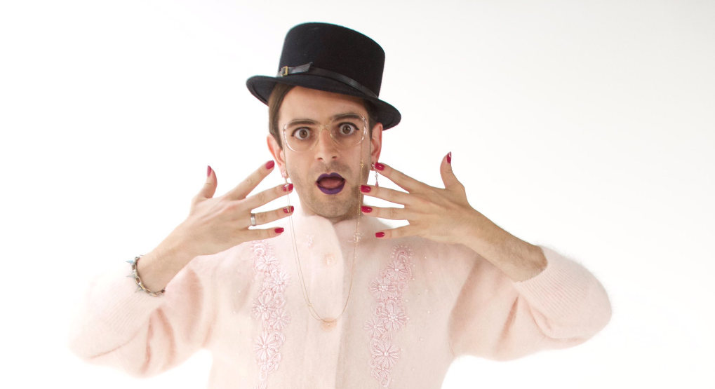
The Emergence of Queer (Studies)
In the 1990s, lesbians and gay men identify their oppositional reading strategies of media and literary texts as ‘queer’.
Away from the notions of oppression and liberation of earlier gay and lesbian criticism, ‘queer readings are fully inflected with irony, transgressive gender parody and deconstructed subjectivities.’
The Oxford Guide to Film Studies (1998), p.142.
Leading to an expansion of queerness to take in but also transcend the category of sexual identity, including in cinema – in tandem with social changes, including in France.

Slide 7
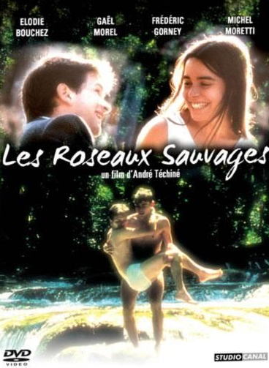
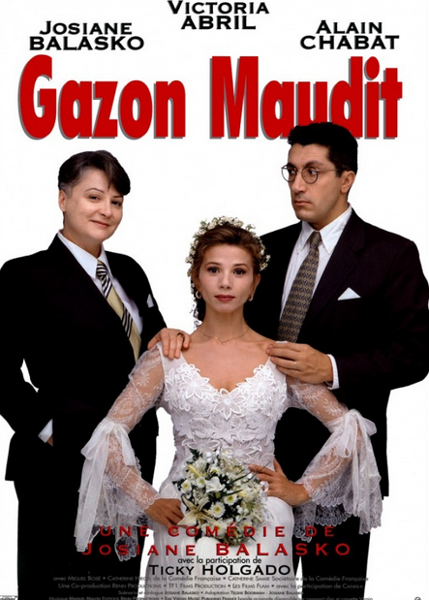
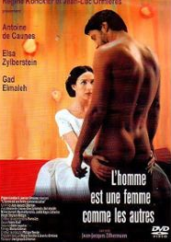
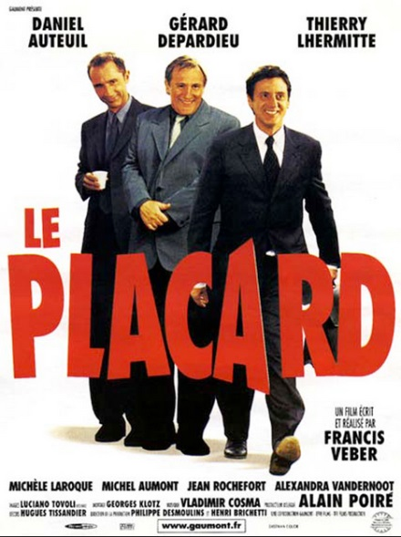
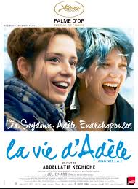
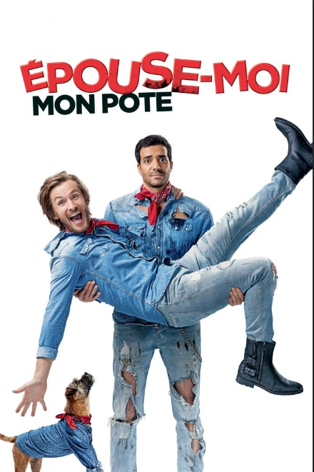

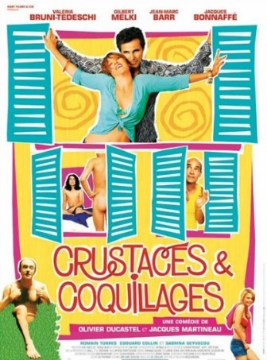
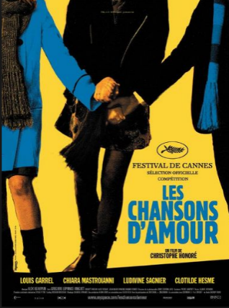
Overtly Queer Themes in French Cinema
Wild Reeds, 1994
French Twist,
1995
Man is a Woman,
1997
The Closet,
2000
Cockles and
Muscles,
2005
Blue is the
Warmest Colour,
2013
Love Songs,
2007
Marry Me,
Buddy
2017
2019

Slide 8
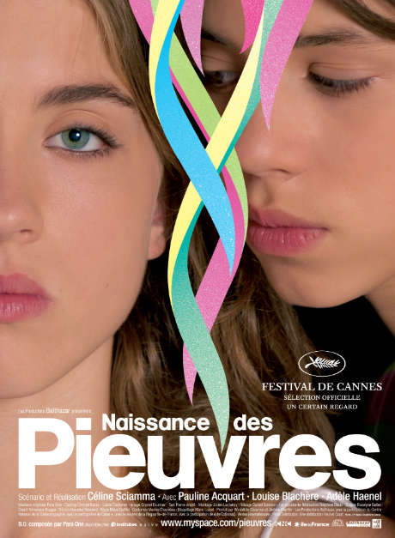
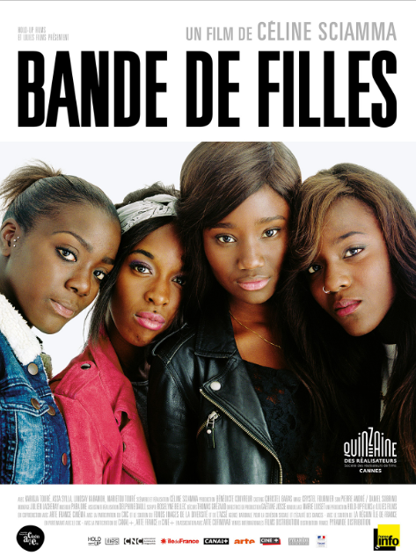
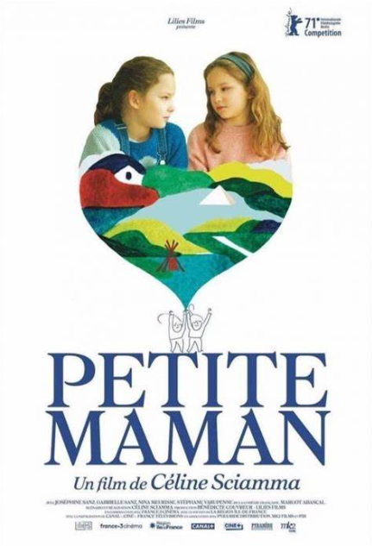
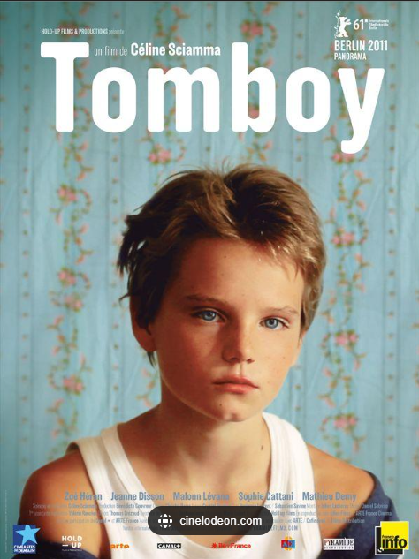

Sciamma’s Directing Oeuvre
Waterlilies
Girlhood

Slide 9

Sight and Sound Poll 2022

Slide 10
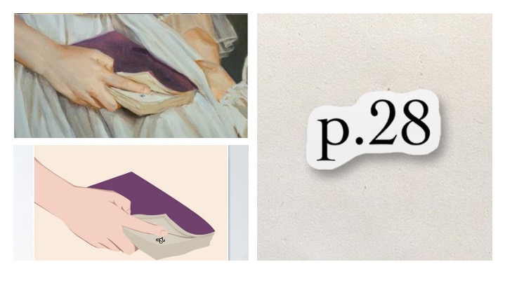
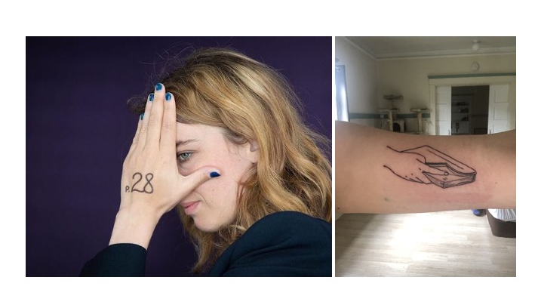
Portrait de la jeune fille en feu (2019)
"Page 28" Poster for Sale by VanillaBubble | Redbubble
https://www.pinterest.fr/pin/492581277999137401/
See Delon, S. 2019. ‘Rencontre avec Céline Sciamma pour Portrait de la jeune fille en feu.’ Jeanne Magazine, 10 December.

Slide 11
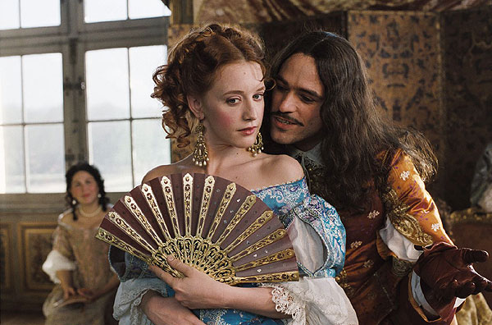
Heritage Cinema: Filming the Past
Selling an image of the national past at a time when national identities are in question (1980s)
Depicts middle- and upper-class experience for a middle-class, older audience
Character, place, atmosphere and milieu favoured over dramatic, goal-directed action
Molière (2007)

Slide 12
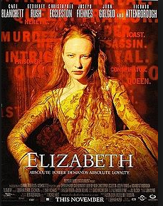
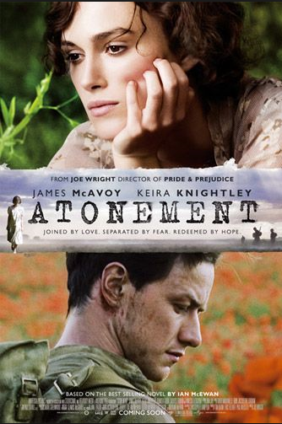
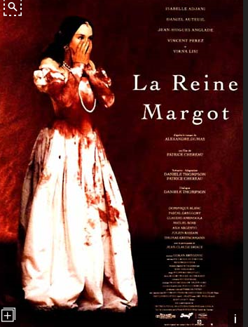
Note difference from ‘post-heritage’ cycle since mid-1990s, characterised by more sex and violence, a faster pace and a ‘showier’, often faster-paced aesthetic.

Slide 13
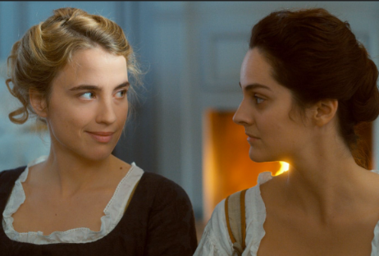
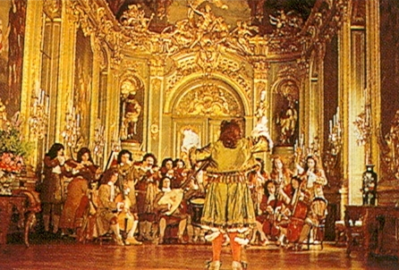
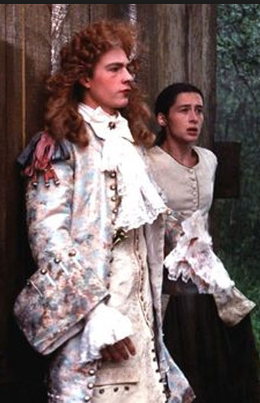
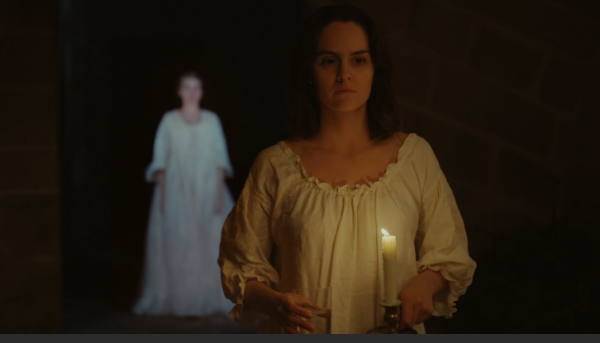

The Spectacle of the Past
Tous les matins de monde/All the Mornings of the World (1991)

Slide 14
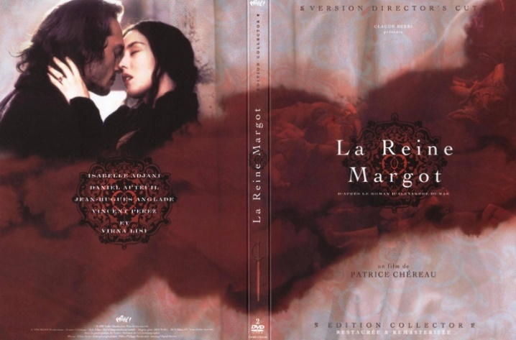
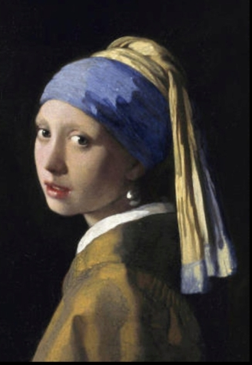
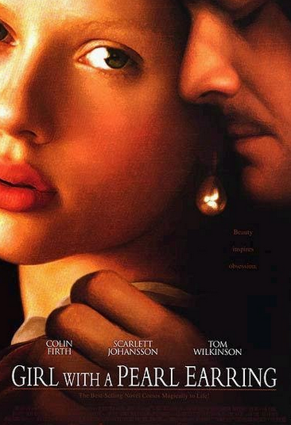
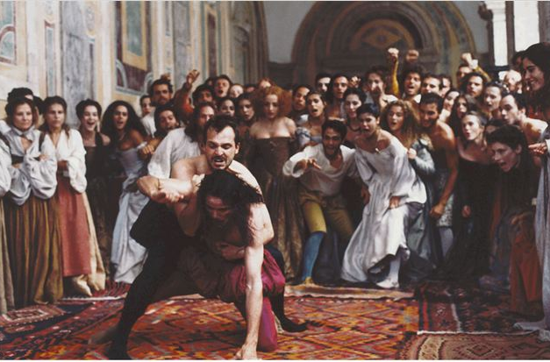
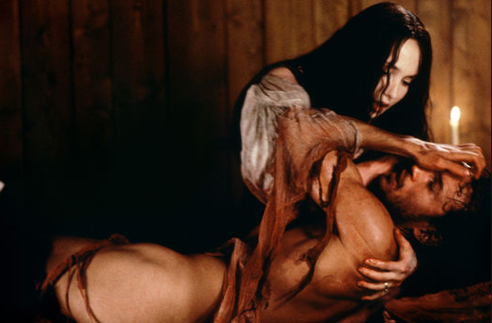
Painterly and Other ‘High’ Cultural References
See also Belén Vidal, Figuring the Past: Period Film and the Mannerist Aesthetic (Amsterdam University Press, 2012).

Slide 15
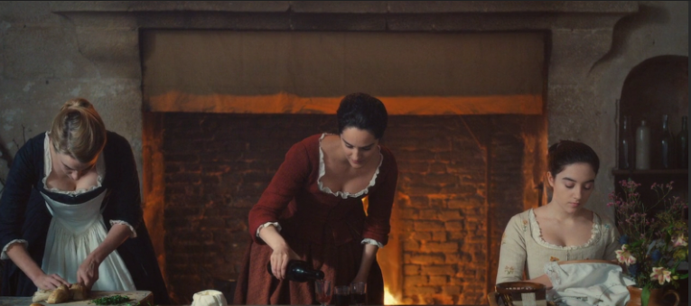
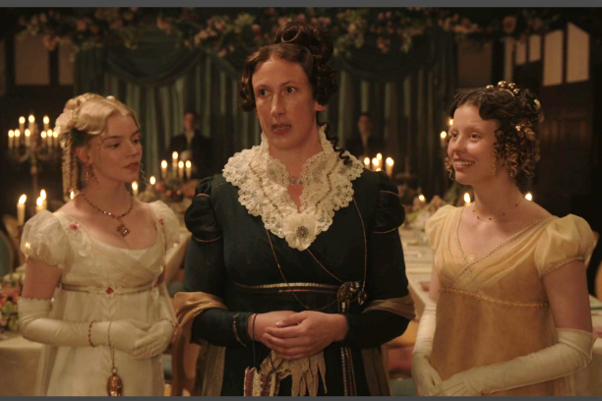
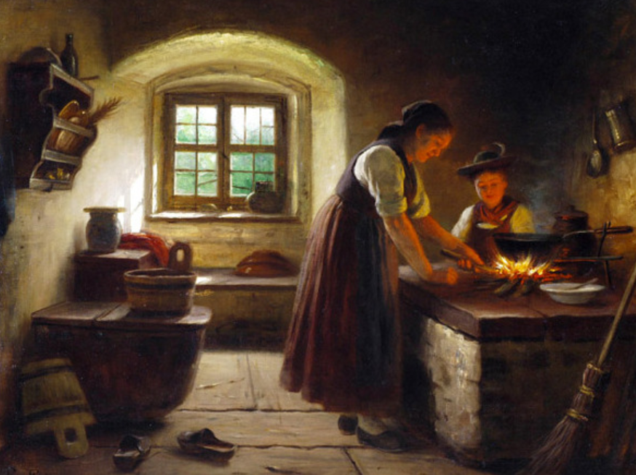
Emma, 2020

Slide 16
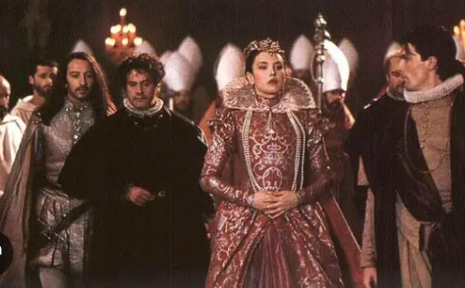
Heritage Critique
‘the past is displayed as visually spectacular pastiche, inviting a nostalgic gaze that resists the ironies and social critiques so often suggested narratively by these films’ (Higson 1993: 109)
‘Even those films that develop an ironic narrative of the past end up celebrating and legitimating the spectacle of one class and one cultural tradition and identity at the expense of others through the discourse of authenticity, and the obsession with the visual splendors of period detail’ (Higson 1993: 119)

Slide 17

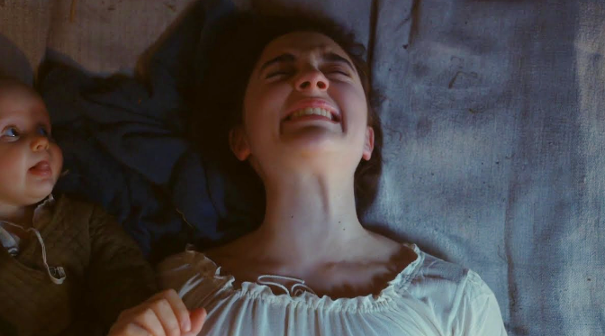
Making Visible the Invisible:
Women’s Bodily Experiences

Slide 18
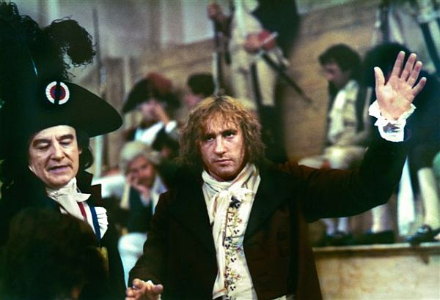
French Heritage Cinema
‘une nouvelle qualité française’?
Promoted and funded by 1980s Socialist government as educational
Danton (Wajda, 1982) contained an ambiguous message about France’s revolutionary heritage

Slide 19
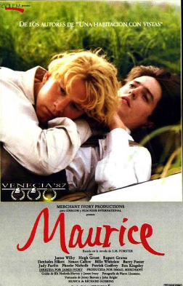
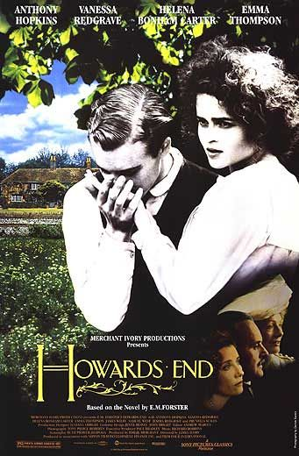
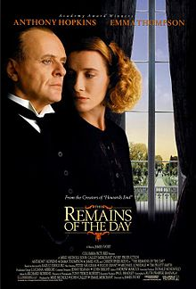
Desire in the Period Film
Dir. James Ivory, 1992 (Prod: Ismail Merchant) aka Merchant Ivory Productions
Dir. James Ivory, 1987 (Prod: Ismail Merchant) aka Merchant Ivory Productions
Dir. James Ivory, 1993 (Prod: Ismail Merchant) aka Merchant Ivory Productions

Slide 20
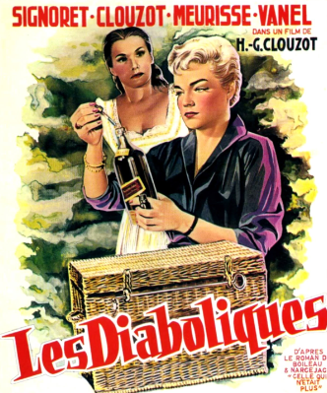
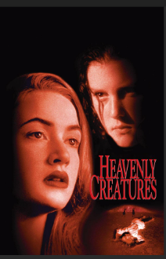
Historicising Lesbian Desire Onscreen
Henri-Georges Clouzot,
1955
Peter Jackson,
1994

Slide 21
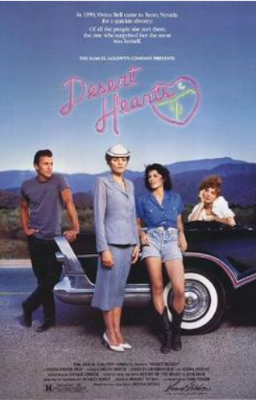
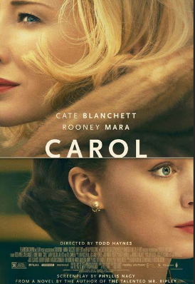
Historicising Lesbian Desire Onscreen
Donna Deitch, 1987
Set in 1959
Todd Haynes, 2015
Set in 1952
See Clare Bradbury-Rance, Lesbian Cinema after Queer Theory (Edinburgh: Edinburgh University Press, 2020)

Slide 22
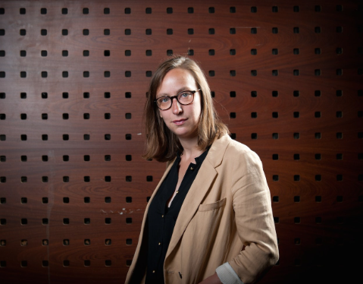
Sciamma
A proudly ‘out’ lesbian director

Slide 23
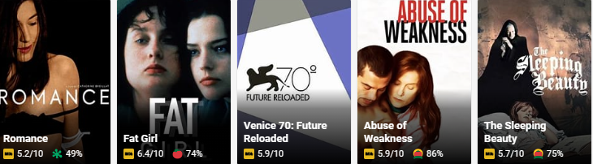
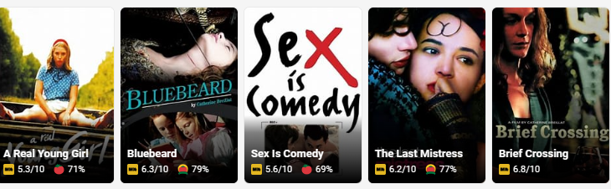
Catherine Breillat
(partial filmography)

Slide 24
France’s ‘Weinstein Moment’
Nov ‘19: Actress Adèle Haenel files sexual harassment claim against director Christophe Ruggia for crimes dating back to 2002, when she was 12 ; formal charges brought in January ’20.
Interview with investigative media organisation Mediapart.
https://www.dropbox.com/scl/fi/1n1tb6czpx3w2a2iqf1nx/MediapartLive-Ad-le-Haenel-brise-un-nouveau-tabou-dans-le-ci.mp4?rlkey=pr9yg04bgw3yoomu8hmq1bqzb&dl=0

Slide 25
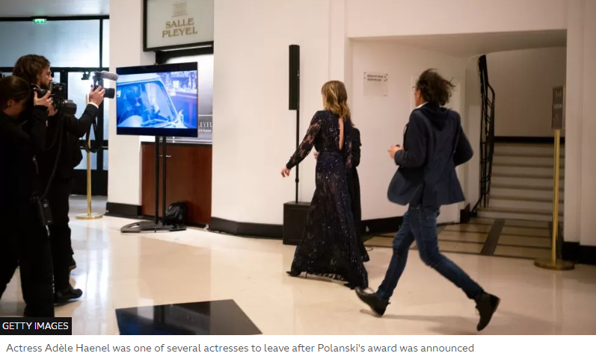
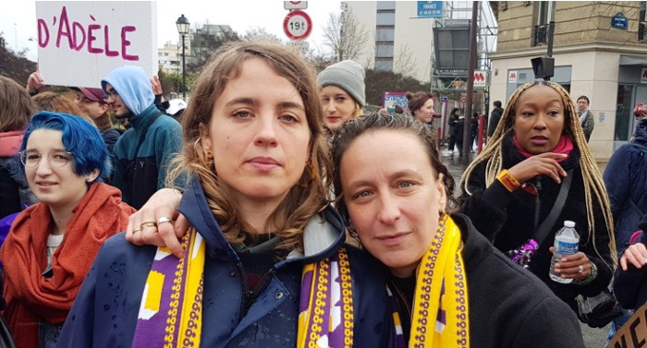
France’s ‘Weinstein Moment’
Feb ’20: Haenel exits César Awards in protest at alleged rapist Roman Polanski’s Best Director win, followed by….
Céline Sciamma, her colleague, onetime romantic partner and fellow activist

Slide 26
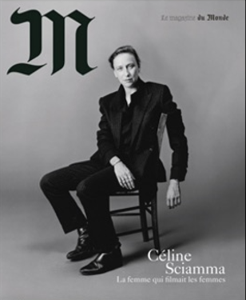
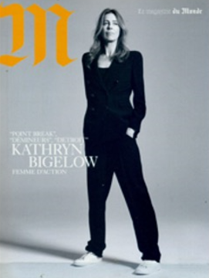
Ginette Vincendeau (2022). ‘“Why has Céline Sciamma become so iconic?”
2019
2017

Slide 27
See Karine Chevalier (2019). ‘Repetition and Difference: The Representation of Youth in the Films of Céline Sciamma.’
In Screening Youth, Contemporary French and Francophone Cinema, edited by Romain Chareyron and Gilles Viennot, 60-80. Edinburgh: Edinburgh University Press.
Waterlilies
Girlhood

Slide 28



Naissance des pieuvres/Waterlilies

Slide 29


Tomboy

Slide 30





‘Haptic’ Style?
Haptic cinema ‘encourages a bodily relationship between the viewer and the image’ (Laura U. Marks 2000, p. 164)
For Karl Schoonover and Rosalind Galt, cinematic hapticity ‘is itself queer’, for
‘it constitutes a disruption of dominant modes of heteronormative vision and provokes a
relationship between spectator and screen that opens up the viewer to unexpected and
transgressive intimacies’ (2016: 237).
See also Vivan Sobchack, ‘What My Fingers Knew’ in Carnal Thoughts: Embodiment and Moving Image Culture (Oakland: University of California Press, 2004), pp.61-64.

Slide 31


Bande de filles
See Frances Smith (2020). Bande de filles: Girlhood Identities in Contemporary France. London and New York: Routledge.

Slide 32

Petite maman
See also Ellie Smith, ‘« Des plafonds dans les yeux »: Representing the New Town in Naissance des pieuvres.’

Slide 33

Petite maman: internal echoes - or reverberations
‘Tu es douée pour ton âge, dis-donc.’

Slide 34


Spaces of Magic and Possibility

Slide 35

Architectural improbability

Slide 36

From autobiography to autofiction
One began to be tired of ‘I’. Not but what [sic] this ‘I’ was a most respectable ‘I’; honest and logical; as hard as a nut, and polished for centuries by good teaching and good feeding. I respect and admire that ‘I’ from the bottom of my heart. But […] in the shadow of the letter ‘I’ all is shapeless as mist.
Virginia Woolf, A Room of One’s Own (1939)

Slide 37




Mary Harrod (2022). ‘Staging the generic self: Céline Sciamma’s autofictional praxis’
French Screen Studies, DOI: 10.1080/26438941.2022.2149171 (open access)

Slide 38

The Place of the Other in the Self
‘La musique du future’
‘Si mon cœur est dans ton cœur// Ton cœur // Ton cœur est dans mon cœur’

Slide 39





Slide 40



Slide 41


(Un)veiling the Other

Slide 42

Interchangeability and Substitution as (Proto-?)Queer
See also Clouds of Sils Maria
Personal Shopper
On Waterlilies: ‘synchronized swimming […] symbolized something I wanted to be or somebody that I wanted to love.’ (Sciamma in Harrod 2023)
1994

Slide 43
Additional Bibliography
Alain Brassart, L’Homosexualité dans le cinéma français, Paris: Nouveau monde, 2007.
Lucille Cairns, Sapphism on Screen: Lesbian Desire in French and Francophone Cinema, Edinburgh: Edinburgh University Press, 2006.
Karl Schnoonover and Rosalind Galt, Queer Cinema in the World, Durham, NC: Duke
University Press, 2016.
Colette Guillaumin, Racism, Sexism, Power, and Ideology, London and New York: Routledge, 1995.
Andrew Higson, ‘Re-presenting the National Past: Nostalgia and Pastiche in the Heritage Film’, in Lester Friedman (ed.), British Cinema and Thatcherism: Fires were Started, London: UCL Press, 1993, pp. 109-29.
Laura U. Marks, The Skin of the Film: Intercultural Cinema, Embodiment, and the Senses, Durham,
NC: Duke University Press, 2000.
Ellie Smith, ‘« Des plafonds dans les yeux »: Representing the New Town in Naissance des pieuvres.’ French Screen Studies 23:2-3, 133-144.
Susan Sontag, ‘Notes on “Camp”’, London: Penguin Modern, 2018 [1966].
Ginette Vincendeau, ‘“Why has Céline Sciamma become so iconic?”: The auteure as celebrity’, French Screen Studies, 23:2-3, 231-247.

