Slide 1
Other modernisms
4 October 2023

Slide 2
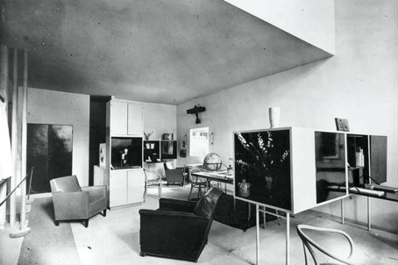
Design / applied arts / craft
Design
  the way something has been made : the way the parts of something (such as a building, machine, book, etc.) are formed and arranged for a particular use, effect, etc. the process of planning how something will look, happen, be made
  a drawing of something that is being planned or created
  a decorative pattern that covers something : a repeating picture, shape, etc., on something (https://www.britannica.com/dictionary/design)
Applied arts
  Arts such as ceramics, furniture construction, decorative objects (such as jewellery) and so on, that are not considered ‘fine arts’. In this sense, applied arts are
  associated with crafts and design. Applied arts is also referred to, more pejoratively, as the ‘minor arts’. https://forarthistory.org.uk/keywords/
Craft
  skill in planning, making, or executing
  an occupation, trade, or activity requiring manual dexterity or artistic skill
  https://www.merriam-webster.com/dictionary/craft

Slide 3
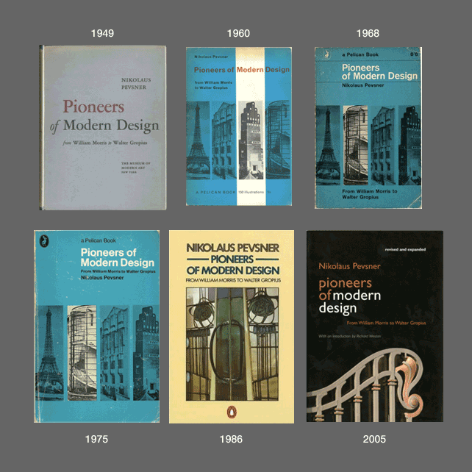
Remember canon?
How are disciplines constructed?
Author (writer, creator) : he or she or they?
Nikolaus Pevsner, The Pioneers of Modern Movement, 1936
Pioneers of Modern Design, 1949-

Slide 4
Gender in modernism
Considering the role of women in art and design as makers, viewers, consumers, students, patrons…
Queering
Decentering
Questioning

Slide 5

Materials and the decorative
What materials and art forms are traditionally associated with male and female practices?
https://www.menti.com/alrprjdr1khz

Slide 6
Some literature
Pat Kirkham, Gendered Object (Manchester University Press, 1996).
Penny Sparke, As long as it’s pink. The sexual politics of taste (Pandora/Harper Collins, 1995).
Rozsika Parker, The Subversive Stitch: Embroidery and the Making of the Feminine (London: Women’s Press, 1983).
Joseph McBrinn, Queering the Subversive Stitch: Men and the Culture of Needlework (London: Bloomsbury, 2021).

