Slide 1
Modernism at the Fair
Other modernisms
8 November 2023

Slide 2
Introduction
London: Great Exhibition, 1851
Vienna: Weltausstellung, 1873
Paris: International Exhibition of Modern Decorative and Industrial Arts, 1925
Paris: Colonial Exhibition, 1931
New materials
New ideas
Discoveries
Progress
Notes:
much of today's modern culture has its roots in world's fairs of the past. World expositions can be seen as manifestations of the struggle by societies to give "meaning to modernity" and to properly represent their social realities.
Studying the world's fairs helps us to understand the extent to which they modernized the world

Slide 3
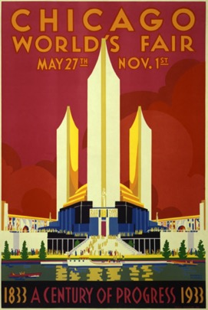
World’s fairs, international exhibitions, expositions universelles
Notes:
Exhibitions of all sizes served as crucial vehicles of communicating modernity; they were linked to industrialisation, progress, the growth of consumer culture and the history of these exhibitions in many ways reflects the history of progress.
In the second half of the nineteenth century, many large cities and metropolises planned to host a national or international exhibition that would display the region’s or country’s achievements and inventions to date. International exhibitions soon became important events that created political visions about exhibiting nations and states and about the exhibited objects.
World's fairs are large, international exhibitions that date back to the mid-19th century. They were initially founded to promote global free trade, but inevitably came to function as vehicles of cultural and political self-definition. These events also mirrored the rapid changes in culture, society, politics and economy that took place at the time = modern world.
Inventions and industrial advancements, the increasing importance of international trade and competition, or the rise and decline of colonial empires were projected into exhibitions. In many ways, they summarized and reimagined the modern experience in the physical and condensed space of the exhibition ground.
Inventions and industrial advancements, the increasing importance of international trade and competition, or the rise and decline of colonial empires were projected into exhibitions. In many ways, they summarized and reimagined the modern experience in the physical and condensed space of the exhibition ground.

Slide 4
Exhibitions theory
Tony Bennett: ”the exhibition complex”
Walter Benjamin: “sites of pilgrimages to the commodity fetish”
Paul Greenhalgh: ”ephemeral events”
Robert Rydell: exhibitions closely linked with global expansion of capitalism and imperialism
Bennett, Tony. “The Exhibitionary Complex,” New Formations 4 (Spring 1998): 73–102.
Benjamin, Walter. “Paris, die Hauptstadt es XIX. Jahrhunderts,” In Allegorien kultureller Erfahrung. Ausgewihlte Schriften 1920-1940. Leipzig: Reclam. 1984.
Greenhalgh, Paul. Ephemeral Vistas: The Expositions Universelles, Great Exhibitions and World's Fairs, 1851-1939. Manchester, U.K.: Manchester University Press, 2000.
Rydell, Robert W. All the World’s a Fair: Visions of Empire at American International Expositions, 1876 – 1916.Chicago: University of Chicago Press, 1984.
Rydell, Robert W. World of Fairs: The Century-of-Progress Expositions. Chicago: University of Chicago Press, 1993.
Notes:
Various theorists examined world’s fairs from many points of views. Here are some examples which have been significant in exhibition studies.
The cultural theorist Tony Bennett described the so-called “exhibition complexes,” where the various displays, pavilion designs, and even the flow of the crowd were aligned with the official ideological system of the ruling class—a system supported by the exhibition itself.
Bennett, Tony. “The Exhibitionary Complex,” New Formations 4 (Spring 1998): 73–102.
Walter Benjamin, talking about the 19th century Parisian expositions, described them as pilgrimage sites where commodities are fetishized through display.
Benjamin, Walter. “Paris, die Hauptstadtd es XIX. Jahrhunderts,” In Allegorien kultureller Erfahrung. Ausgewihlte Schriften 1920-1940. Leipzig: Reclam. 1984.
Paul Greenhalgh described world’s fairs as ephemeral – they didn’t survive, they were temporary, but still made an incredible mark and impact in contemporary culture, society and economy.
Greenhalgh, Paul. Ephemeral Vistas: The Expositions Universelles, Great Exhibitions and World's Fairs, 1851-1939. Manchester, U.K.: Manchester University Press, 2000.
Robert Rydell focuses mostly on American fairs, which he sees as “contested terrains” and “sites of struggle” between various groups, dominant and subordinate.
Rydell, Robert W. All the World’s a Fair: Visions of Empire at American International Expositions, 1876 – 1916.Chicago: University of Chicago Press, 1984. Rydell, Robert W. World of Fairs: The Century-of-Progress Expositions. Chicago: University of Chicago Press, 1993.

Slide 5
World‘s fairs and international exhibitions (selected)
1851 Great Exhibition, London
1855 Exposition Universelle Paris
1869 Exposition des Beaux-Arts Appliqués a l'industrie, Paris
1873 International Exhibition, Vienna
1876 Exposition Internationale, Brussels
1876 Centennial Exhibition, Philadelphia
1881 Colonial Exhibition, Australia
1889 Exposition Universelle, Paris
1891 Jubilee Exhibition, Prague
1896 Millenium Exhibition, Budapest
1900 Exposition Universelle, Paris
1901 Glasgow International Exhibition
1904 Louisiana Purchase Exhibition, St. Louis
1915 Panama Pacific Exhibition, San Francisco
1922 Colonial Exhibition, Marseille
1924 British Empire Exhibition
1925 International exhibition of Modern Decorative and Industrial Arts, Paris
1930 Colonial Exhibition, Paris
1933 Century of Progress, Chicago
1935 International Exposition, Brussels
1939 World of Tomorrow, New York
1939 Golden Gate Exhibition, San Francisco
A list: https://en.wikipedia.org/wiki/List_of_world_expositions
Notes:
The phenomenon of an international exhibition, world’s fair or exposition universelle, as they were known, was very popular in the second half of the 19th and first half of the 20th century. These are just a few examples of such events that took place around the globe.

Slide 6
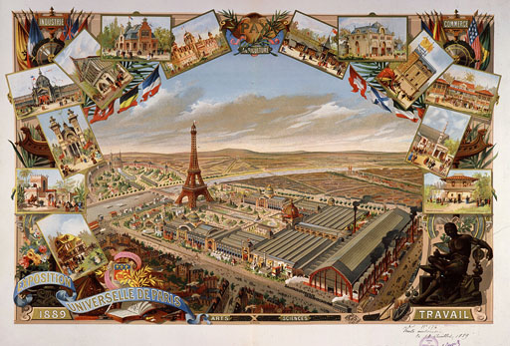
World’s fairs
Industries, inventions
Technology
Foreign possessions
Animals, plants
Art and design
Paris, Exposition universelle, 1889
Notes:
From London, the phenomenon of exhibitions spread to other countries. They often contained a similar range of exhibits and pavilions, that included displays of industrial products, inventions, technology, colonial possessions, cultural achievements, exotic and local animals, plants and foodstuffs, fine art and design.

Slide 7
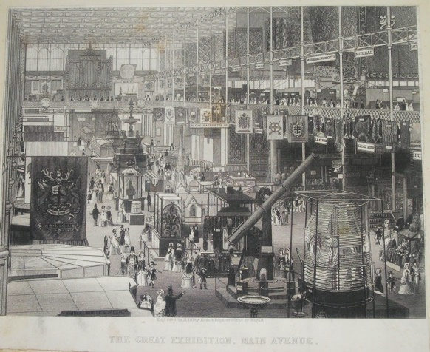
The Great Exhibition of the Works of Industry of All Nations of 1851, London
Notes:
The first large exhibition took place in London in 1851 under the official name The Great Exhibition of the Works of Industry of All Nations. Housed in the Crystal Palace, Although the original aim of the world fair had been as a celebration of art in industry for the benefit of All Nations, in practice it appears to have been turned into more of a showcase for British manufacturing: more than half the 100,000 exhibits on display were from Britain or the British Empire.

Slide 8
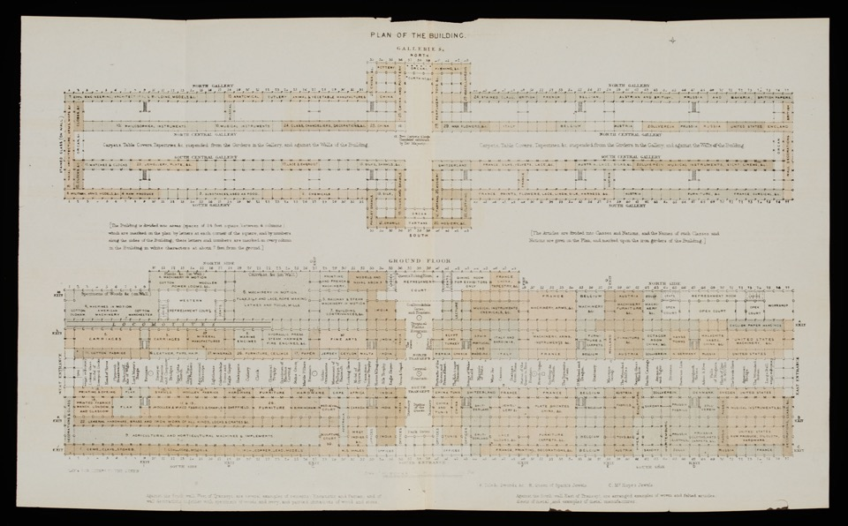
Joseph Paxton, The Crystal Palace

Slide 9
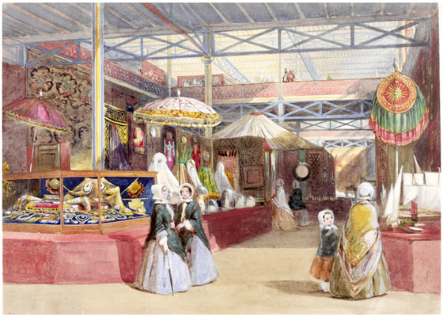
Industries, inventions
Technology
Overseas (colonial) gains
Foreign sections
Animals, plants
Food
Art and design
Henry Clarke Pidgeon (1807-80), 'The Indian Court and Jewels’, 1851
Notes:
the exhibition showed many great things of the Victorian age, including pottery, porcelain, ironwork, furniture, perfumes, pianos, firearms, fabrics, steam hammers, hydraulic presses etc.

Slide 10
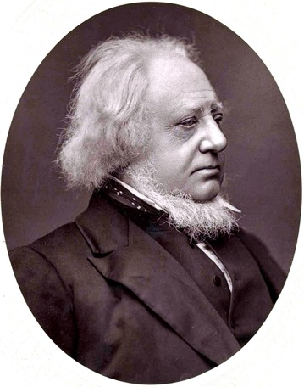
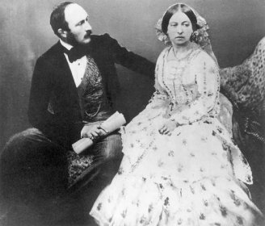
Initiators
Prince Albert (1819-1861)
Henry Cole (1808-1882)
Notes:
Henry Cole, the V&A's first Director, declared that the Museum should be a "schoolroom for everyone". Its mission was to improve the standards of British industry by educating designers, manufacturers and consumers in art and science. Acquiring and displaying the best examples of art and design contributed to this mission, but the 'schoolroom' itself was also intended to demonstrate exemplary design and decoration.
The Museum's founding principles, therefore, were to instruct the public on all matters relating to good design. And what better way, Cole felt, to demonstrate 'correct' design and good taste than to provide a display of all that should be seen as its antithesis? Alongside displays of outstanding furniture, ceramics, textiles, glass and metalwork that would, he hoped, create public demand for "improvements in the character of our national manufactures", visitors were also presented with a Gallery of False Principles.
https://www.vam.ac.uk/articles/building-the-museum#slideshow=31131014&slide=0

Slide 11
Henry Cole
”good design” x “bad design”
naturalistic images
excessive ornamentation
Replicating perspective
Illogical use of material
The False Principles Gallery
Notes:
Bad design: Fabrics and wallpapers with naturalistic images of foliage and flowers were particularly frowned on, as were over-elaborate objects with excessive ornamentation and any objects in which the choice of materials or ornament seemed illogical. The failings of these exhibits were spelled out in the gallery labels, and they were displayed alongside comparative objects which were judged successful and correct.

Slide 12
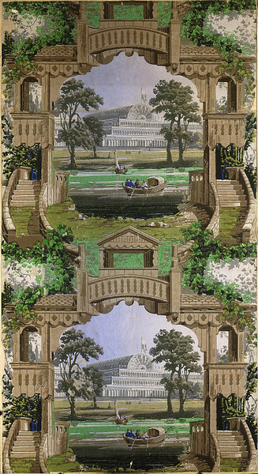
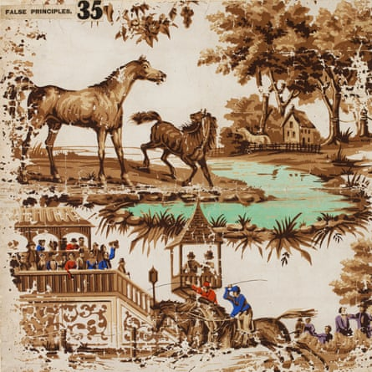
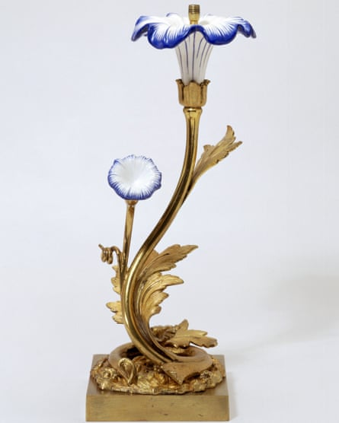

Slide 13
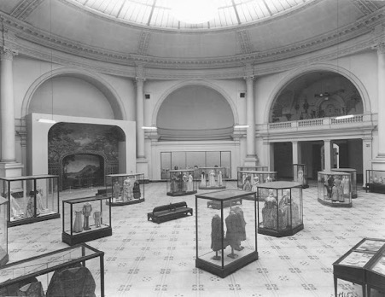
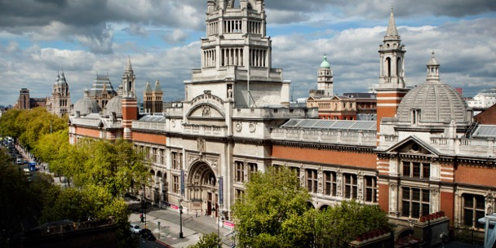
Victoria and Albert Museum
Museum of Manufactures
South Kensington Museum
from 1899 Victoria & Albert Museum
the largest museum of applied art, crafts and design in the world
Museum as a classroom for everyone
A showcase of good design and good taste
Notes:
V&A
to educate designers, manufacturers and the public in art and design = Cole.
it was decreed that the whole collection should be displayed by material (all the wood, together, all the textiles, all the ceramics etc.) in a huge three-dimensional encyclopedia of materials and techniques.
From the Great Exhibition not just Victoria & Albert Museum, also the Natural History Museum, the Science Museum, the Royal Colleges of Art and Music, Imperial College, and the Royal Albert Hall.

Slide 14
Exhibitions introduce
Taste
What is good design
Means of new technology
Canon of modern art and design
Museums

Slide 15
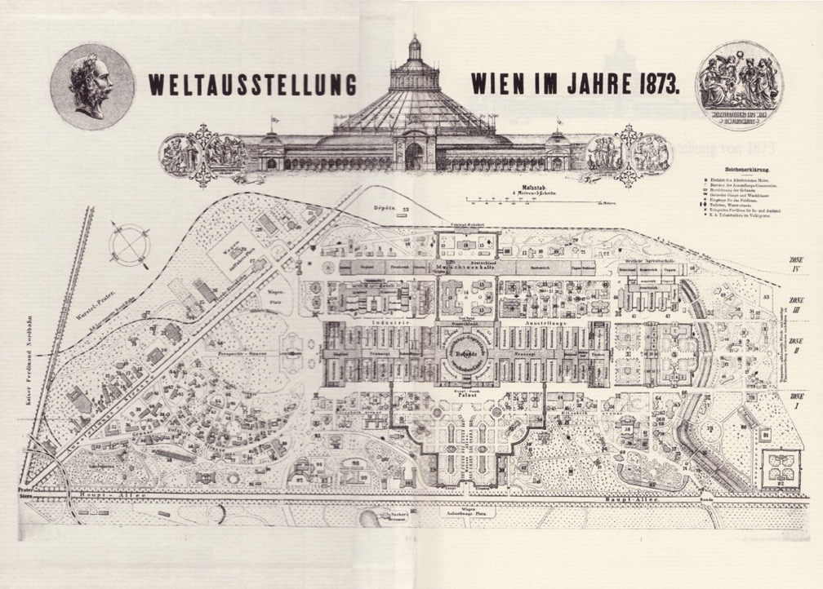
Vienna
Notes:
Exhibitions put on almost in all states in Europe, framed by political situation of the day
This grand project showcased science and industry as well as contemporary culture and civilisation.
The different pavilions were located in the Prater park and hosted about 26,000 exhibitors from thirty-five nations.

Slide 16
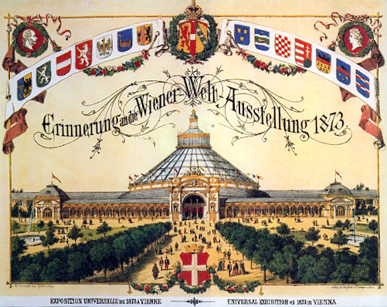
World’s fair, 1873, Vienna
Motto “Culture and Education”
“To direct the gaze of the world towards Austria and ensure the recognition of the participation of our fatherland in the promotion of the wellbeing of mankind through work and instruction.”
Archduke Carl Ludwig, 1873
Notes:
960 meter long and 205 meter wide Industrial Palace
Various motivations
after political struggles with neighbours, wars, need to show the level of civilisation, progress, possession of colonies,
Power, dominance, progress, civilisation
But in Austria Hungary, internal politics and the place of Habsburg monarchy within Europe were also given a significant place: the new political identity of the Empire was shown as a bridge between East and West.
As individual nations and peoples in the Monarchy were claiming more and more autonomy and recognition, the empire found an increasing need to strengthen and centralise itself. The Weltausstellung was meant to do exactly that.

Slide 17
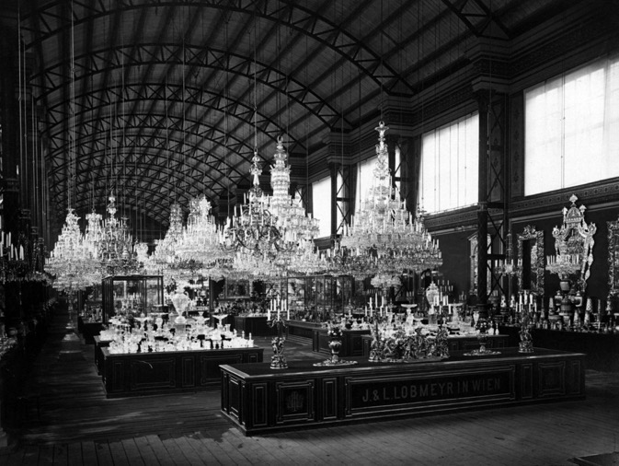
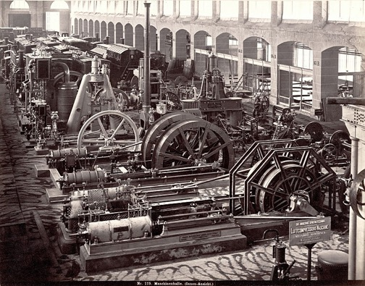
Lobmeyr glass factory
Machine hall
Notes:
Around 200 buildings, foreign countries – Britain, France, America, Russia, Japan...presenting industries, education, housing, arts, religion, sciences...

Slide 18
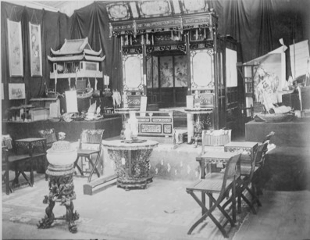
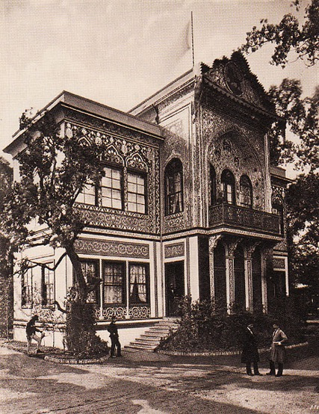
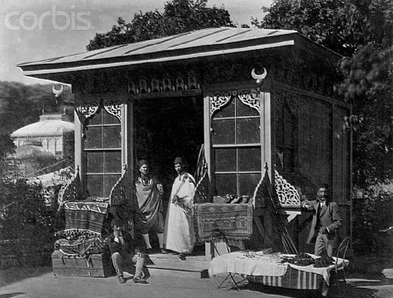
Chinese display
Persian pavilion
Ottoman pavilion
Notes:
They contained displays of industries and technology, agriculture, science, arts and national domestic industries (or arts and crafts), next to foreign exhibits of the British colonies, and the Japanese, Chinese, Persian or Egyptian sections.
The domestic was combined with the exotic.
There was also an “ethnographic village” with European farmhouses and model schoolhouses.

Slide 19
The peasant ʻvillage’ at the 1873 Vienna World’s Fair
Large ethnographic displays: Vienna
Examples of other foreign displays:
American wigwam
Japanese garden
Notes:
In the displays of the individual nations of the Habsburg monarchy, the minorities were usually portrayed as rural and backward
On the one hand countryside of the provinces usually poor, but this emphasised by the state – to justify the dominant ruler, who brings progress and education
= colonial mindset
In Vienna, there was for example a display of farmhouses from Upper Austria, Transylvania, cottage from Galicia, Croatia, mostly in wood, putting emphasis on the traditional (and obsolete) way of building.
This supported an emphasis on hierarchy – Germanic (Austrian, Viennese) culture was at the top, while at the bottom were the cultures of Romania, Slovakia, Galicia ... – these were the economic peripheries which the Emperor needed to protect.
= museums, open-air museums

Slide 20
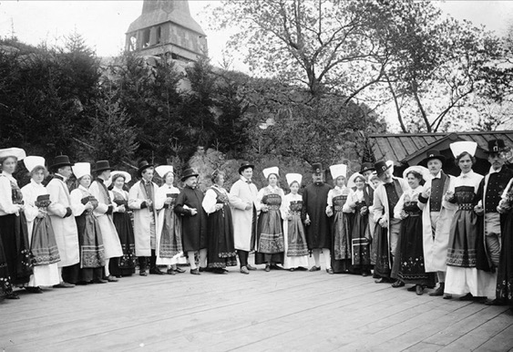
Open air museums
Skansen by Artur Hazelius (1833–1901)
Folk dance at the Skansen in 1904
Notes:
Some of the display items ended in collections in Vienna
Other types of museums
The ethnographic displays had a growing tradition in Europe. The recently opened Skansen open air museum in Stockholm featured Swedish village houses with guides in traditional costumes and demonstrations of dances, songs and craft making. The Skansen, which gave a name to the open air museum, was founded in Sweden by Artur Hazelius (1833–1901) in 1891. These museums were set up as a reaction to industrialisation and an attempt to preserve the traditional life and culture. Hazelius bought around 150 houses from all over Sweden and some from Norway, and had them shipped piece by piece to the museum, where they were rebuilt to provide a unique picture of traditional Sweden. Only three of the buildings in the museum are not original and were painstakingly copied from examples he had found.

Slide 21
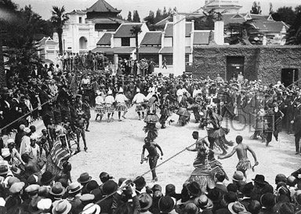
The spectacle of the exhibition
Pageants / tableaux vivants
Life performances
Human zoos
Recreations of streets, villages, e.g. Rue de Caire
​
wildness and civility
nature and culture
black and white
female and male
Notes:
The rural ‘primitivism’ on display here consisted of peasant houses and outbuildings, costumes and objects of everyday and festive life. Placed next to the technical, cultural and scientific achievements of the ‘civilized’ urban middle classes, it provided a stark contrast between the more developed, urban culture and the “backward” rural regions.
This was often symbolised through the contrast between wildness of the countryside (local or foreign) and the civility of the city,
contrast between nature x culture, black x white in the way people were classified racially, and also the contrast between the male x the female – where women were often exoticized in the roles of dancers, performers or hosts.
These exotic references and contrasts were also often displayed through live pictures, or tableaux vivants, performances such as dances and music, or through recreations of various customs, traditions and habits.
Often presented as spectacle but with deeper meaning and ideologz

Slide 22
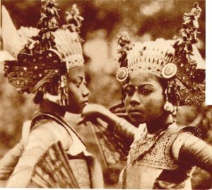
The spectacle and the other
Balinese dancers in 1931
Little Egypt in Chicago, 1893
Sally Rand in Chicago 1933
Notes:
Male, white middle-class self, the savage other (a woman, a primitive, dark skin,)

Slide 23
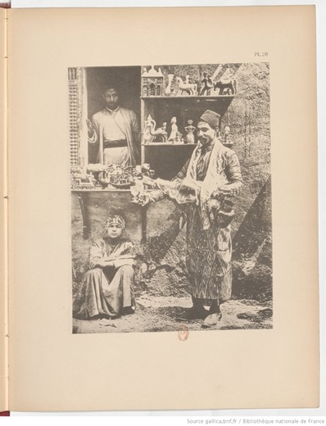
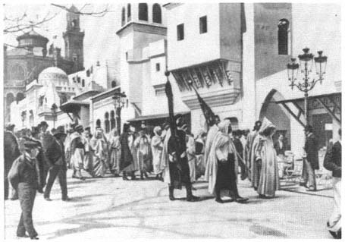
Exhibited colonies
Rue de Cairo, Paris, 1889
Notes:
A few example

Slide 24
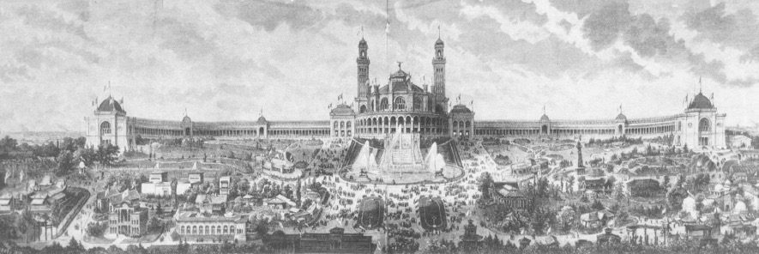
Colonial displays
1878 Algerian village in front of Trocadero Palace, Exposition universelle, Paris
Notes:
1889 a negro village – human zoos, also Carl Hagenbeck
Paris: Here 400 people
Non-Western people, under control of the white men, of the organizers, - global hierarchy of races
A village placed in contrast with grand buildings, displaying latest inventions, fine art works – to show the primitive nature of the natives, with their huts, tools, habits – to portray them as savages, -
France as protector of its people, colonies – the more educated, powerful, advanced
Villages considered as scientifically accurate, based on drawings, writing, research, but in fact imagined to fit the intention of the organizers
Needed to be presented as a spectacle, entertaining, e.g. local daily life, in which weddings or shopping at a bazaar were enacted – brought the experience of the orient to Paris

Slide 25
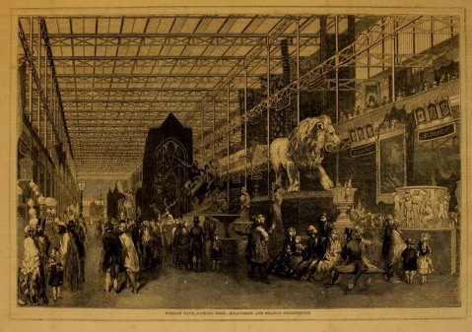
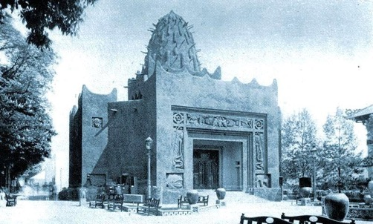
A recurrent notion was: ‘they’ are where ‘we’ were. I.e. they remained stuck at a primitive stage of existence whereas ‘we’ (i.e. the West) have developed, moved on.
Notes:
They don’t have what defines western civilisation
In art, this means that art works are seen as primitive, underdeveloped, sometimes pure, expressions of the people
Art is looked at from the western point of view, through a westernised lense
Art and culture as a curiosity

Slide 26
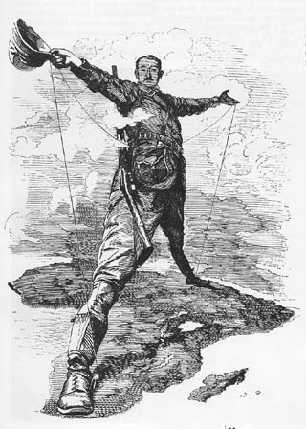
Colonialism
1. European powers came into direct control of ca. ¾ of the world’s population.
2. It brought Europeans into contact with cultures that technologically were far less advanced (Sub-Saharan Africa, North America, South Seas) or who had radically alien customs and beliefs (Central America).
3. It produced a close relation of economic interdependence and exploitation. E.g. black slavery in the US, sugar plantations in the Caribbean, Tea plantations in India and Sri Lanka, rubber plantations in Malaysia etc.

Slide 27
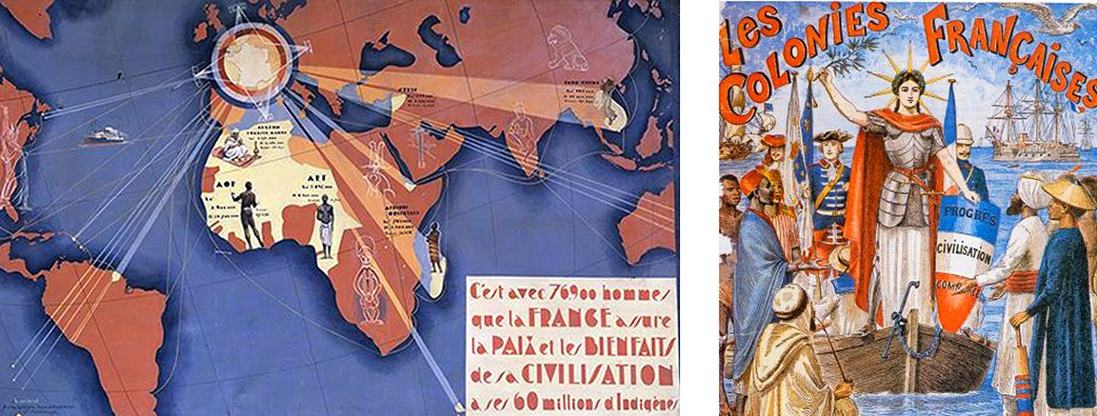
France and its colonies

Slide 28
Paris exhibitions before 1900
1855 Exposition universelle des produits de l'agriculture, de l'industrie et des beaux arts
1867 Exposition Universelle: Agriculture, Industrie et Beaux-Arts
1878 Exposition Universelle: Technologies Nouvelles
1889 Exposition Universelle: Centenaire de la Révolution française
1900 Exposition Universelle et Internationale: Le bilan d'un siècle
Notes:
Colonisation explicitly displayed in France
Displays of technology, inventions
The 1867 exposition in Paris established an important division of foreign participations into national pavilions. There was, for example, a British, American, or Japanese pavilion, the latter played an important role in communicating to the public what Japanese art, especially woodcuts, looked like.

Slide 29
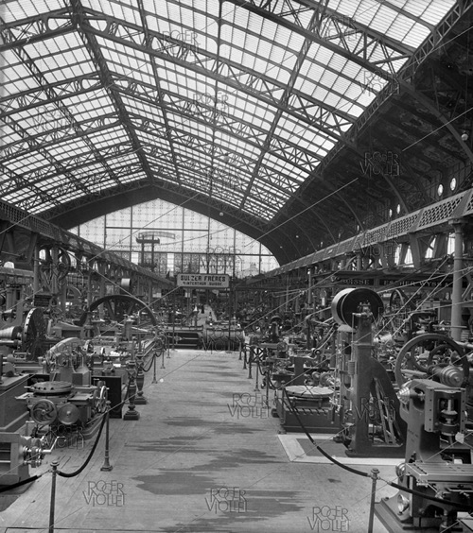
Exposition universelle, Paris 1889
The Machinery Hall
Rue de Cairo
Notes:
The Parisian expositions also constructed various villages of native people from the colonies and recreated entire streets. One of the most famous was the Rue de Cairo in 1889, which consisted of Egyptian architecture as well as the native African people, who were also put on display here. (At this time, French colonies included Algeria, large parts of NW Africa, India, Syria and the Near East.)

Slide 30
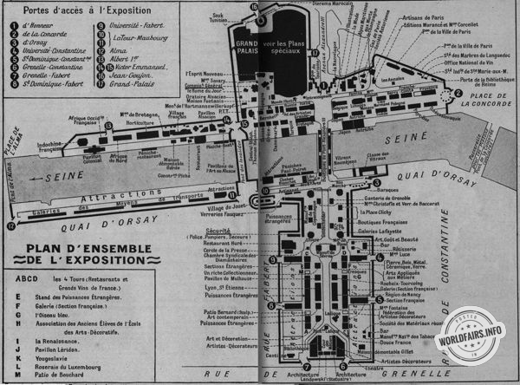
Exposition Internationale des Arts Décoratifs et Industriels Modernes, Paris, 1925
Notes:
The Exposition Internationale des Arts Décoratifs et Industriels Modernes was supposed to bring together the nations of the world and to show, if not quite a unified front, at least some sense of a developing common aesthetic among the practitioners of decorative art and architecture. However, many nations chose not to participate.
This exhibition was – as the name suggests – focused on art and design rather than purely on economy and trade, even though there was an undeniable commercial benefit sought by the organizers and exhibitors. In terms of the exhibition politics, it was motivated by France's ambitions in the postwar years to promote French taste and luxury goods. The French organizers aimed to showcase a new style that became known as Art Deco.

Slide 31
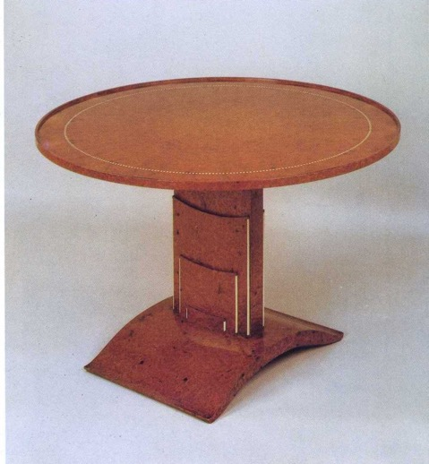
Materials
diverse, often precious (expensive) materials
various combinations of man-made materials (plastic, bakelite, aluminium, reinforced concrete) and natural materials (nephrite, silver, ivory, obsidian, chrome, crystal, zebra skin).
Emile-Jacques Ruhlmann, a table with rotating wooden top and ivory inlay, 1925

Slide 32
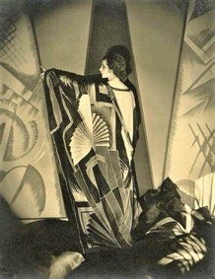
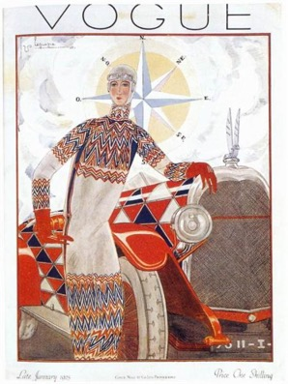
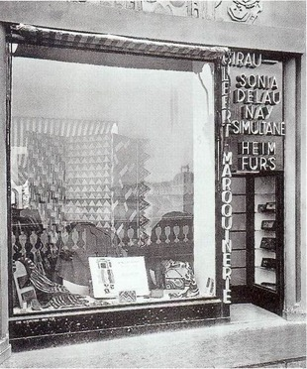
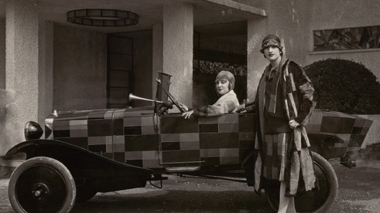
Sonia Delaunay
Boutique for the exhibition, 1925
Vogue cover, 1926

Slide 33
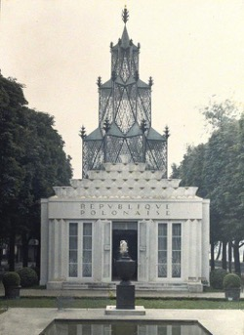
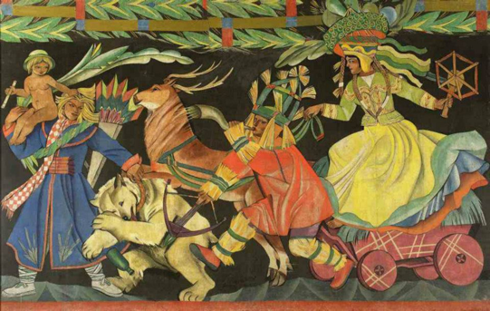
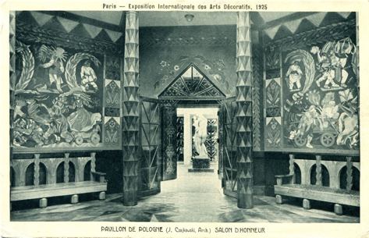
Polish pavilion
Architecture by Józef Czajkowski, Wojciech Jastrzębowski
Sculptor Henryk Kuna, painter Tadeusz Gronowski, Józef Mehoffer and Zofia Stryjeńska
Zofia Stryjeńska

Slide 34
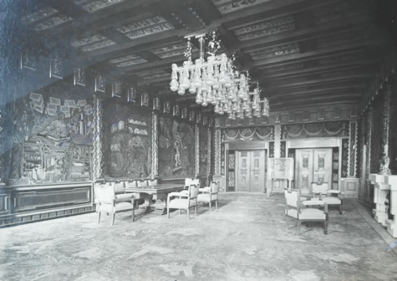
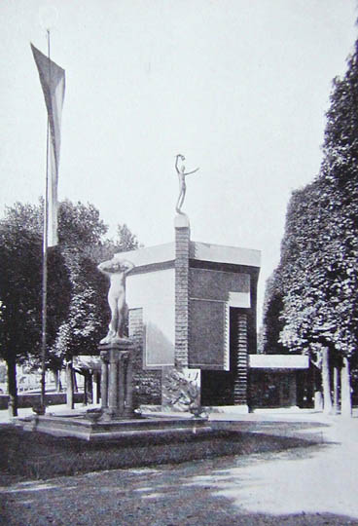
Czechoslovak pavilion
Pavel Janák
Josef Gočár
František Kysela

Slide 35
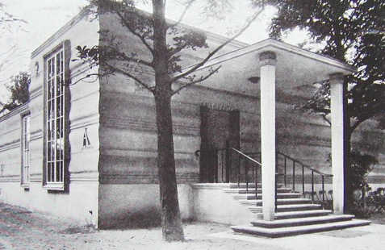
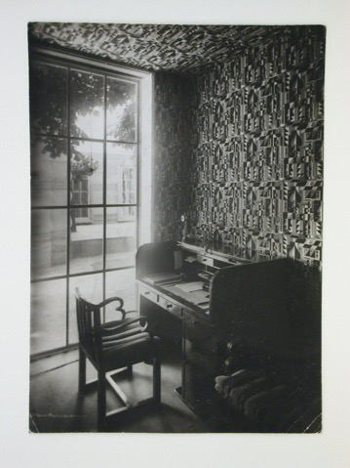
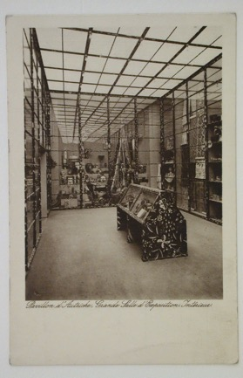
Austrian pavilion
Josef Hoffmann
Study
Main exhibition hall
Notes:
architect, Josef Hoffmann: Built of concrete with bold horizontally moulded walls, the mass of this Pavilion was striking. It was top lit except for the vestibule, and contained an excellent gallery
both the exterior and interior decorated in “exuberant floral- and folk-derived calligraphy” of Dagobert Peche, a recently deceased director of the Wiener Werkstätte, making the pavilion the organisation’s showcase. The heavy decorations were criticized by the architect Adolf Loos, who saw them as a symptom of Vienna’s conservativism bordering on kitsch.
Criticised by Loos

Slide 36
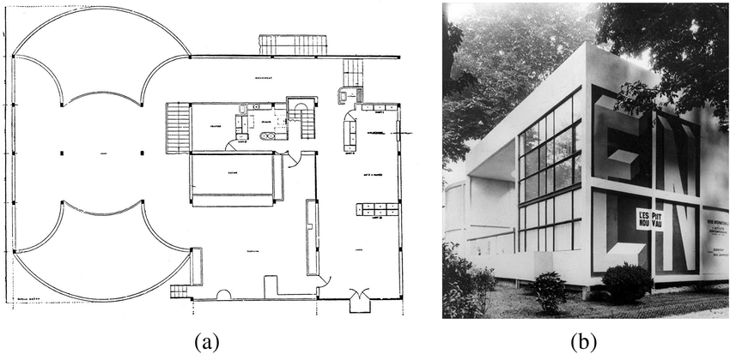
Alternatives
Le Corbusier, Pavilion de l'Esprit Nouveau
Notes:
Alternativy
There’s not ONE modernism
Konstantin Melnikov’s Soviet pavilion or Le Corbusier’s L’Esprit Nouveau, were more innovative in their approach to the architectural space, material, light and colour.
The exhibition grounds therefore became a place of various competing views of the place of decoration and decorative arts in the modern world.
Le Corbusier’s construction, using reinforced concrete, glass and steel, challenged the view of a model house.
the French architect Le Corbusier’s functionalist model house l’Esprit Nouveau, put emphasis on the function of buildings and denounced decoration. The abstract, geometric structure was deemed incompatible with the overall concept of the exposition and a twenty-foot-high fence was temporarily put up around it.
Makaryk, April in Paris; Marilda Azulay Tapiero, ‘Arquitectura española y la exposición
internacional de artes decorativas e industriales modernas (parís, 1925): actitudes, impresiones e implicaciones,’ in Las exposiciones de arquitectura y la arquitectura de las exposiciones. La arquitectura Española y las exposiciones internacionales (1929-1975) (Pamplona: T6, 2014), 157-166; Richard Anderson, ’Ginés Garrido, Mélnikov en París, 1925,’ Cahiers du monde russe 55, no. 3-4 (2014): 406-410; R. J. Difford, ‘Infinite Horizons : Le Corbusier, the Pavillon de l’Esprit Nouveau dioramas and the science of visual distance,’ Journal of Architecture 22, no. 5 (2017): 825-853.

Slide 37
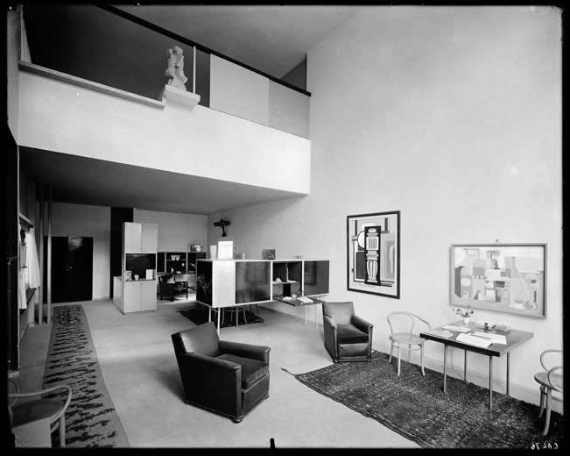
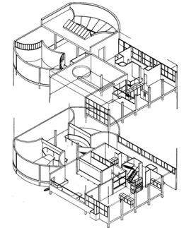
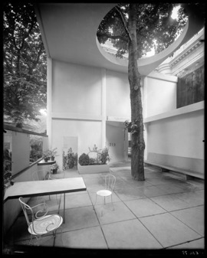

Slide 38
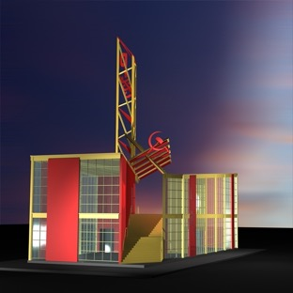
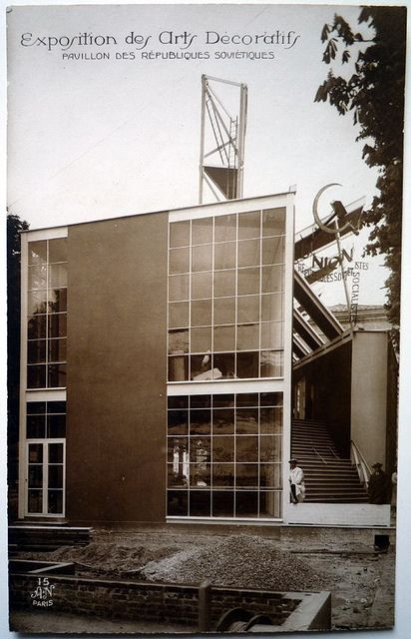
Soviet pavilion
Konstantin Melnikov
Notes:
Melnikov’s dynamic composition of the different geometrical shapes joined by a diagonal staircase disrupted what would be then seen as a traditional national pavilion
The design of the Soviet pavilion at the 1925 Paris expo was by Melnikov and its dynamic composition was in stark contrast to the middle class commercialised tone of the other pavilions, Melnikov used the aesthetic of the factory combined with the thrusting diagonal expression seen in Constructivist compositions.

Slide 39
Alexander Rodchenko, The Worker’s Club
Notes:
Inside, the sparse decor emphasized worker solidarity. Peasant art was on display as a sign of eternal rural vigor in the Russian landscape. But it was Rodchenko's workers' club that showed the vision of the urban future for Russia: hard, geometric chairs without cushions facing a common table designed to hold magazines and pamphlets. On the walls are posters proclaiming the good of the Soviet Republic, and racks of periodicals for workers to read. The Soviet pavilion announced clearly that the Russian view of corporate life in the twentieth century that would eventually, inevitably, capture the higher echelons of political and economic power in the world.

Slide 40
Colonial exhibition, Paris, 1931
France and her colonies
The Netherlands
Belgium
Italy
Japan
Portugal
United Kingdom
United States
Notes:
Other nations participated in the event, including the Netherlands, Belgium, Italy (with a pavilion designed by Armando Brasini), Japan, Portugal, the United Kingdom, and the United States
Politically, France hoped the exposition would paint its colonial empire in a beneficial light, showing the mutual exchange of cultures and the benefit of France's efforts overseas.

Slide 41
Notes:
Most exhibition pavilions showcased native architecture from various Asian and African colonies, as well as efforts by the colonialists to improve the lives of the colonised peoples, in an attempt to justify and glorify the notion of colonialism. As such, displays of agricultural production and a wide variety of statistics, as well as the history of Indochina were exhibited at the Cambodian Pavilion.
French colonial policy makers felt genuinely that France could and should exert her powerful civilizing influence on the under-developed nations of the world.

Slide 42
Notes:
Angkor Wat, testimony to the decayed Khmer high culture of the 12th century – the original of which was a vine-covered ruin when it was “discovered” by Europeans in the mid-19th century –, was copied by the architects Charles and Gabriel Blanche in 1931 in Paris and protected – this was the gesture – from being forgotten, as it was linked with western art and placed under the watchful eye of the metropolitan police.
Plaster casts
On the outside the Angkor Wat pavilion was a stunningly detailed replica made possible by the disciplinary complex of social sciences studying colonized cultures. Simultaneously, the inside demonstrated the use of this knowledge to reconstitute Khmer culture and to make it the basis for a revitalized Cambodian culture.
Video

Slide 43
Criticism
"Here we have rebuilt the marvelous stairway of the temple of Angor Wat, and we watch enthralled the sacred dancers; but, in Indo-China, we are shooting, we are deporting, we are imprisoning these people.”
Léon Blum Le Populaire, May 7, 1931
Notes:
Mentioned in lecture on primitivism
the socialist leader Léon Blum commented acidly: "Here we have rebuilt the marvelous stairway of the temple of Angor Wat, and we watch enthralled the sacred dancers; but, in Indo-China, we are shooting, we are deporting, we are imprisoning these people.” "Moins de fêtes et de discours, plus d'intelligence humaine," in Le Populaire, May 7, 1931
Do not visit the exhibition https://www.arthurchandler.com/aragon-text

Slide 44
Milada Marešová
Pestrý týden 1931

Slide 45
Brussels International Exhibition, 1935
Joseph van Neck, The Exhibition Hall

Slide 46
The Indian village
The Belgian Congo pavilion
Notes:
Congo
The first hall on the right was devoted to works of civilisation and the Catholic missions.
colonial education, teaching in the Congo
Indian village
This set of buildings, of a rigorous and colourful authenticity, had been realized by the "Associated American Indian Group",
A whole tribe
Now business

Slide 47
Human zoos
Brussels 1897
Brussels Expo 1958

Slide 48
When I was at first asked to attend the St. Louis World’s Fair I did not wish to go. Later, when I was told that I would receive good attention and protection, and that the President of the United States said that it would be all right, I consented… Every Sunday the President of the Fair sent for me to go to a Wild West show. I took part in the roping contests before the audience. There were many other Indian tribes there, and strange people of whom I had never heard… I am glad I went to the Fair. I saw many interesting things and learned much of the white people. They are a very kind and peaceful people. During all the time I was at the Fair no one tried to harm me in any way. Had this been among the Mexicans I am sure I should have been compelled to defend myself often.
Geronimo, biography
Geronimo and Apache tribe members at the St. Louis fair 1904
Geronimo in a Locomobile Model C (not a Cadillac) at the Miller brothers’ 101 Ranch, 1905
Notes:
Geronimo also kept a stash of hats to sell and sold pictures of himself. He was a celebrity and marketed himself, even as others marketed him for their own purposes. He regularly appeared at fairs–notably the 1904 World’s Fair in St. Louis–
It is noteworthy that many Indians took jobs in Wild West shows and appeared in fairs, and early Western films.
Geronimo and Native peoples were, like other people in the U.S., becoming modern. By 1905 some were using cars as a practical means of transportation. The experience of Native Americans has been distinct, of course, in that modernity came for them as part of defeat and policies of coercive assimilate.
https://historicalhorizons.org/2015/12/18/what-do-we-see-in-a-picture-of-geronimo/

Slide 49
USA
Chicago 1893
St. Louis 1904
San Diego
San Francisco 1913
Philadelphia 1926
Chicago 1933
New York 1939
San Francisco 1939

Slide 50
New York, The World of Tomorrow, 1939/40
Notes:
X Perisphere, Trylon
The 1939–40 New York World's Fair was a world's fair held at Flush­ing Meadows–Corona Park in Queens, New York, United States. It was the second-most ex­pen­sive Amer­i­can world's fair of all time, ex­ceeded only by St. Louis's Louisiana Pur­chase Ex­po­si­tion of 1904. Many coun­tries around the world par­tic­i­pated in it, and over 44 million peo­ple at­tended its ex­hibits in two sea­sons.^{[2]} It was the first ex­po­si­tion to be based on the fu­ture, with an open­ing slo­gan of »Dawn of a New Day«, and it al­lowed all vis­i­tors to take a look at »the world of to­mor­row«.

Slide 51
The world of tomorrow
Norman Bell Geddes, Futurama
Notes:
Technologie je budoucnost,
More things for more people
Futurama Bel Geddes designed the General Motors Pavilion, known as Futurama, for the 1939 New York World's Fair. For that famous and enormously influential installation, Bel Geddes exploited his earlier work in the same vein: he had designed a "Metropolis City of 1960" in 1936
Vice věcí pro vice lidí

Slide 52
Exhibitions show
Taste
What is good design
New technology
Canon of modern art and design
New materials
Future, progress
Knowledge
Museums
Human zoos
Hierarchy
Notes:
Conclusion
World’s fairs, international exhibitions and expositions universelle carefully constructed an idealized image of reality – these exhibition projecting a miniature, idealized version of the state or locality accessible to a mass audience. Such exhibitions therefore told the story of the ruling ideology in which minorities were often under- or misrepresented.
National, international and universal exhibitions that originated in the so-called west can be very much seen as a western phenomenon.
= ideas of what is modern

