Slide 1
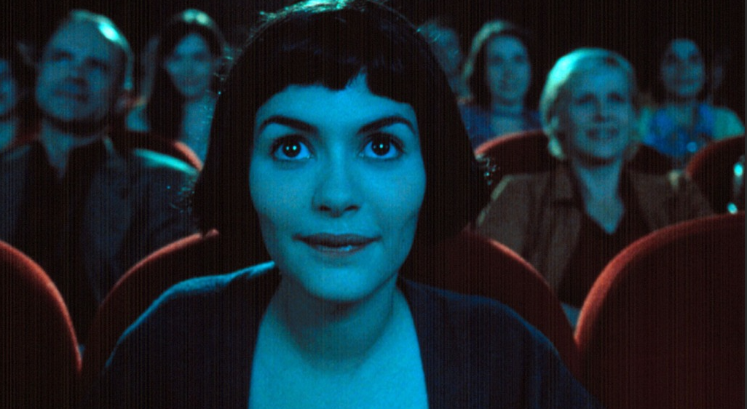
Welcome to the course!
FRENCH CINEMA IN THE 21st CENTURY
Dr. Mary Harrod, University of Warwick
m.g.m.harrod@warwick.ac.uk

Slide 2
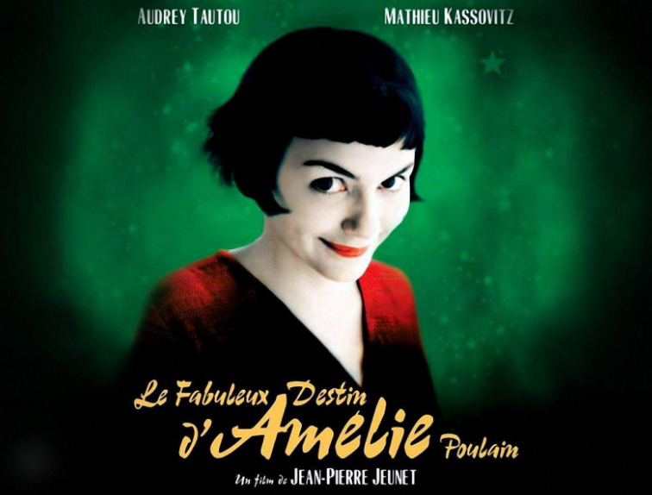
A (Post)National Mainstream Industry
Lecture 1: Comedy and French Identity
Background, contexts, course rationale
What is the relationship between film and society in France?
Overview of the state of the French nation in the 21st century
Overview of the state of the French film industry over the same period
French Comedy: the Case of Amélie
Positioning, context, stylistic predecessors
Reception, ideology, genre

Slide 3

Cinema as a Barometer of the Nation?
The ‘state-of-the-nation film’ – see John Hill, British Cinema in the 1980s (Clarendon Press, 1999).
E.g.
Engaged with contemporary social reality
Dealing with ‘gritty’ social issues
Filmed in a broadly realist style in terms of mise-en-scène in particular: location shooting, naturalistic lighting, a ‘vernacular’ style of acting.

Slide 4
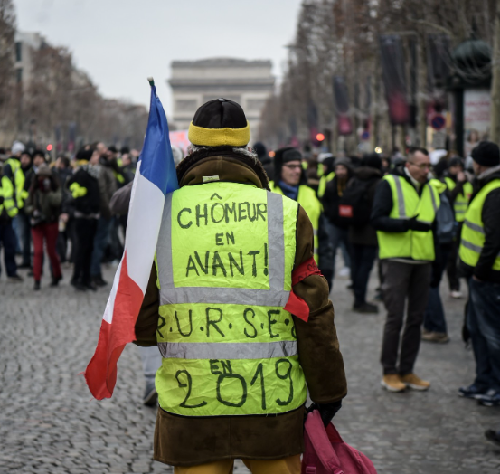
Growing wealth divide
Post-2000 economic slowdown and growing inequality
See Ludivine Bantigny (2013), La France à l’heure du monde: de 1981 à nos jours (Paris: Editions du Seuil)
Only aggravated by the 2007-8 global financial crisis, COVID-19 (from 2019/20) and most recently the cost-of-living crisis.
> Resentment; left-wing ideologies especially question the wealth divide.
21st-Century France: Some Key Shifts
‘Put the unemployed first!’

Slide 5
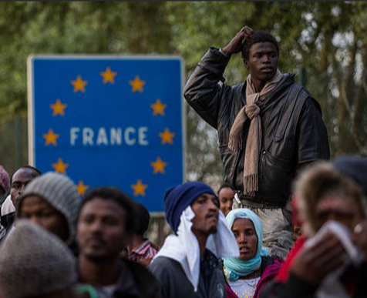
21st-Century France: Some Key Shifts 2
Increased resentment of France’s large immigrant population
Successes by the Right-wing National Front (Rassemblement national) in successive elections; problems exacerbated by extremist terrorists.
Ongoing and growing fears about globalisation and secondarily Europeanisation

Slide 6

Apocalyptic narratives about the decline of France as a nation.
Present since the end of Empire, these have gathered force e.g.
La France qui tombe, Nicolas Bavarez 2004
Quand la France disparaît du monde!, Nicolas Tenzer 2008
L’Identité malheureuse, Alain Finkielkraut 2013
Mélancolie française, Eric Zemmour, 2010
Le Suicide français, Eric Zemmour, 2014 https://www.youtube.com/watch?v=SV4IK7yC56Y
Linked also to Europe’s decline as a world power.
See also Sarah Waters, 'The 2008 Economic Crisis and the French Narrative of National Decline: Une causalité diabolique,' Modern & Contemporary France Vol 21, No 3 .
21st-Century France: Some Key Shifts 3
Extract from Jonathan Fenby’s The History of Modern France (Simon and Schuster 2016), p. xxvi.

Slide 7
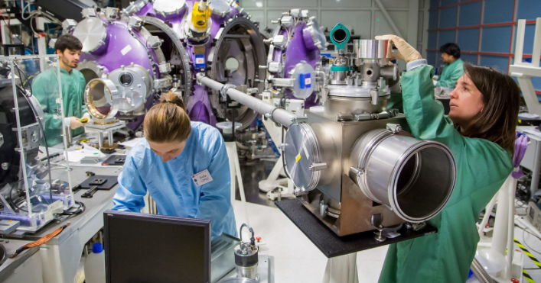
21st-Century France: Some Key Shifts 4
Changes in the private sphere, related to women’s increased access to greater equality.
In traditionally patriarchal, Catholic France, women make up 47% of the workforce in 2020
(Évolution de la population active − Emploi, chômage, revenus du travail | Insee).

Slide 8
The Paradoxes of French Cinema
‘a vigorous industry but also a subsidized artform; a field with intellectual ambitions that also courts widespread popularity; a craft extending from idiosyncratic experiments to commercial operations; a medium identified with a local audience yet one that also allows France to export itself on-screen around the globe, even to America’
Tim Palmer, ‘The Contemporary French Film Ecosystem’ (see further reading suggestions), p. 2.

Slide 9
Palmer cont.: A Booming Industry
Total French films produced 100% French-financed
97 63
145 111
2005 187 126
2009 182 137
(taken from p. 8)
See also CNC France for up-to-date film statistics Soutien à la création cinéma, séries, TV, jeu vidéo | CNC

Slide 10
The Best-selling Films on the French Market since 2000
Extracted from a list of the 100 best-sellers, Internet Movie Database.
Position | Year of release | Title | Director
2 | 2008 | Bienvenue chez les Ch'tis/Welcome to the Sticks | Dany Boon
3 | 2011 | Intouchables/The Intouchables | Olivier Nakache, Éric Toledano
8 | 2009 | Avatar | James Cameron
11 | 2002 | Astérix & Obélix: Mission Cléopatre/Asterix & Obelix: Mission Cleopatra | Alain Chabat
19 | 2014 | Qu'est-ce qu'on a fait au Bon Dieu?/Serial (Bad) Weddings | Philippe de Chauveron
25 | 2006 | Les Bronzés 3: amis pour la vie/French Fried Vacation 3: Friends Forever | Patrice Leconte
26 | 2000 | Taxi 2 | Gérard Krawczyk
33 | 2003 | Finding Nemo | Andrew Stanton, Lee Unkrich
35 | 2001 | Harry Potter and the Philosopher's Stone | Chris Columbus
39 | 2002 | Harry Potter and the Chamber of Secrets | Chris Columbus
47 | 2001 | Le Fabuleux Destin d’Amélie Poulain/Amelie | Jean-Pierre Jeunet
48 | 2004 | Les Choristes/The Chorus | Christophe Barratier
51 | 2011 | Rien à declarer/Nothing to Declare | Dany Boon
57 | 2007 | Ratatouille | Brad Bird, Jan Pinkava
59 | 2001 | La Vérité si je mens! 2/Would I Lie to You 2 | Thomas Gilou
61 | 2009 | Ice Age: Dawn of the Dinosaurs | Carlos Saldanha, Mike Thurmeier
62 | 2000 | The Sixth Sense | M. Night Shyamalan
64 | 2005 | Harry Potter and the Goblet of Fire | Mike Newell
68 | 2014 | La Famille Bélier | Éric Lartigau
70 | 2003 | The Lord of the Rings: The Return of the King | Peter Jackson
75 | 2005 | Star Wars: Episode III – Revenge of the Sith | George Lucas
78 | 2004 | Shrek 2 | Andrew Adamson, Kelly Asbury, Conrad Vernon
79 | 2004 | Harry Potter and the Prisoner of Azkaban | Alfonso Cuarón
83 | 2002 | The Lord of the Rings: The Two Towers | Peter Jackson
87 | 2012 | Skyfall | Sam Mendes
90 | 2001 | The Lord of the Rings: The Fellowship of the Ring | Peter Jackson
96 | 2008 | Astérix aux jeux olympiques/Asterix at the Olympic Games | Frédéric Forestier, Thomas Langmann
See M. Harrod and P. Powrie, ‘New directions in contemporary French comedies: from nation, sex and class to ethnicity, community and the vagaries of the postmodern,’ Special Issue of Studies in French Cinema on contemporary French comedy, vol. 18, issue 1.

Slide 11
Resistance to the Perceived Acceleration in Commercialising French Film Culture
Darren Waldron and Isabelle Vanderschelden have argued suspicious attitudes towards popular cinema have only been exacerbated in recent years by a French critical tendency among cinephilic critics to equate so-called commercial filmmaking with ‘a multifaceted crisis’ linked to inflated production costs and shorter cinema runs.
E.g. Jean-Michel Frodon in articles in the auteurist-cinephilic journal Cahiers du cinéma from 2005 onwards.
Waldron, D. and I. Vanderschelden. 2007. ‘Introduction.’ In D. Waldron and I. Vanderschelden (eds), France at the Flicks: Trends in Contemporary French Popular Cinema. Cambridge: Cambridge Scholars Publishing, pp.1-15, p. 8.

Slide 12
French films in top 20 at French box office in 2009
Le Petit Nicolas/ Little Nicholas (Laurent Tirard, France/ Belgium)
Lol (Laughing Out Loud) (Lisa Azuelos)
Arthur et la vengeance de Maltazard/ Arthur and the Great Adventure (Luc Besson)
Coco/ Coco Before Chanel (Anne Fontaine)
Neuilly sa mère (Gabriel Laferrière)
OSS 117 Rio ne répond plus/ OSS 117 – Lost in Rio (Michel Hazanavicius)
          Data sourced from CNC France

Slide 13
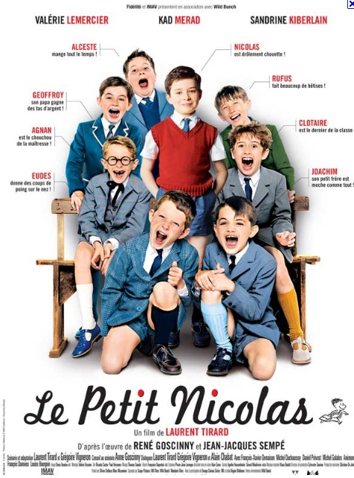
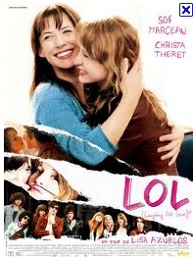

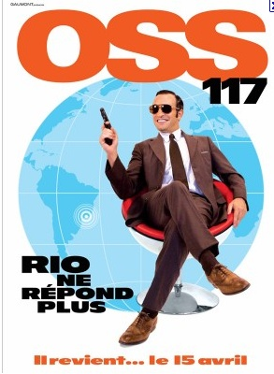
For top domestic hits historically see also: http://www.imdb.com/list/ls057849414/

Slide 14
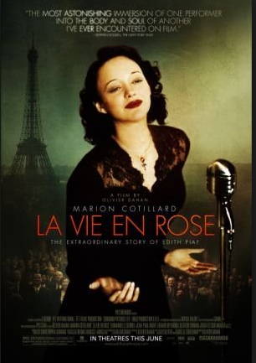
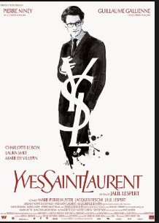
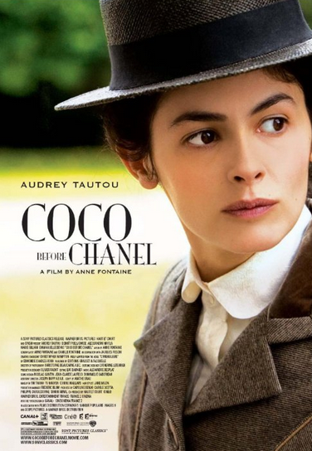
Representative Big-budget International Successes: Heritage Bio-pics
2007
2014
2009

Slide 15
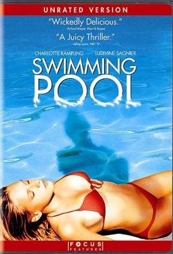
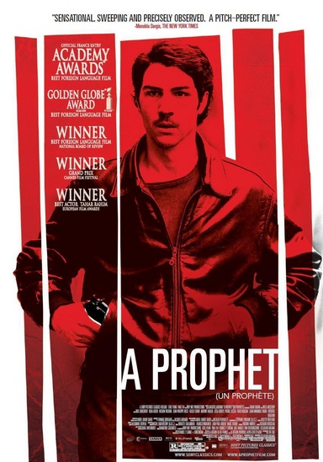
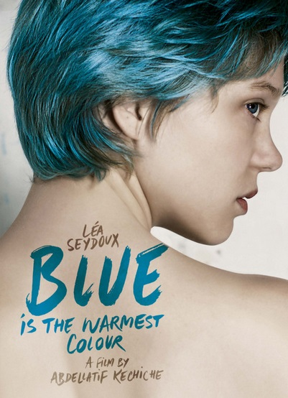
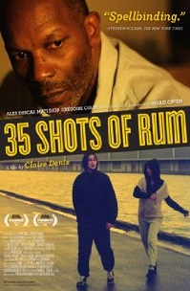
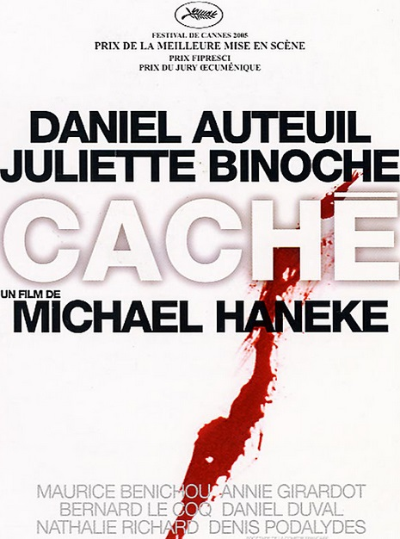

And Some Internationally Successful Auteur Films

Slide 16
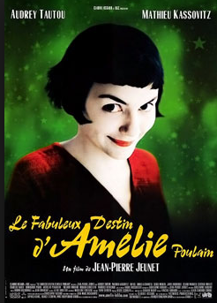
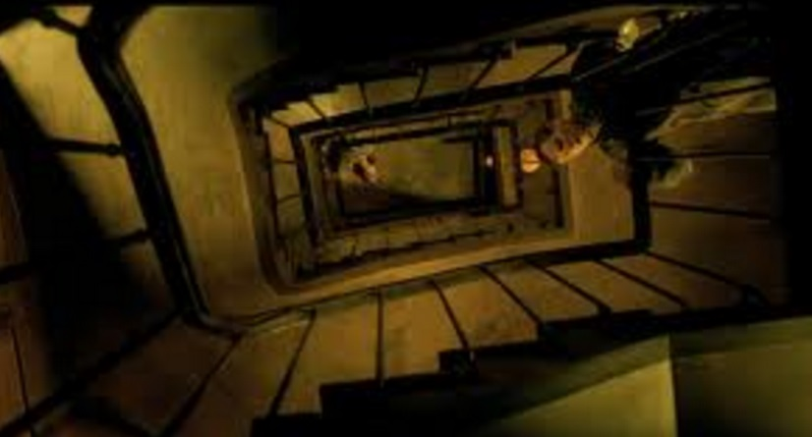
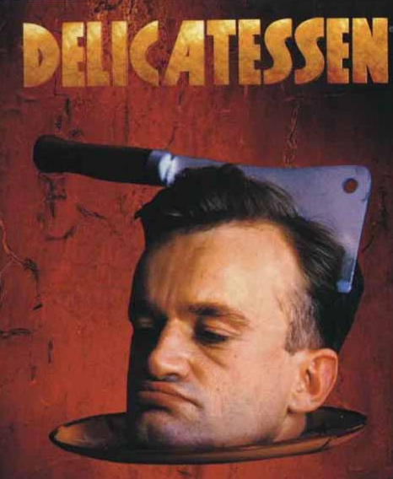
Amélie as extending the notion of the comédie d’auteur?
This term is coined by Raphaëlle Moine, ‘Reconfigurations génériques de la comédie dans le cinéma français contemporain,’ in Le Cinéma français face aux genres, Paris: Association française de recherche sur le cinéma, 2005, pp. 214-223.
Cf. Jeunet’s earlier work e.g. Delicatessen (Jeunet and Caro, 1991)
Clip – opening.

Slide 17
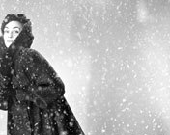
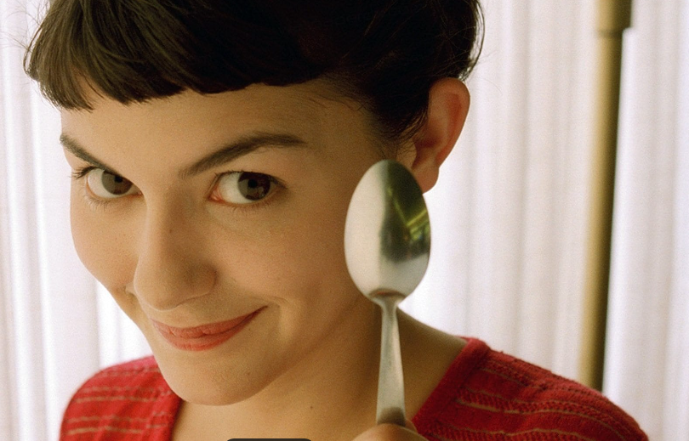
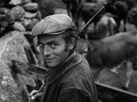
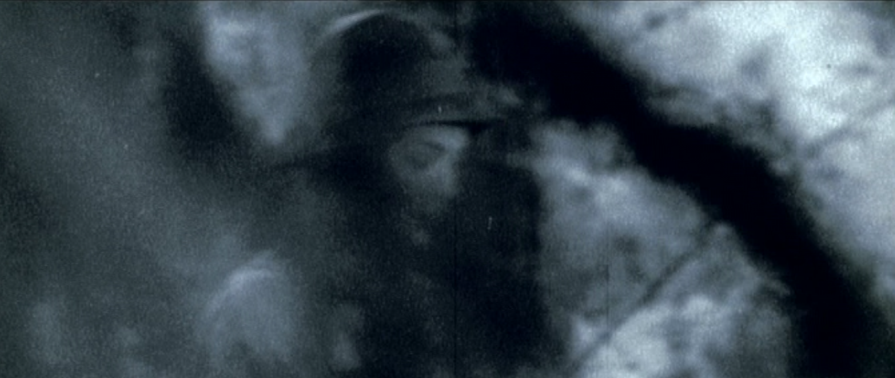
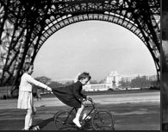
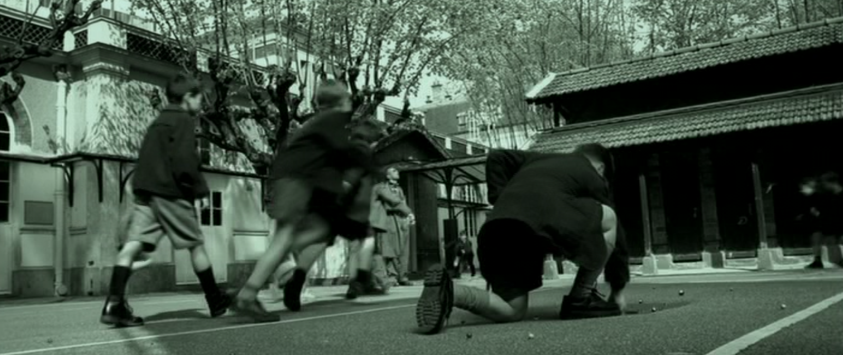
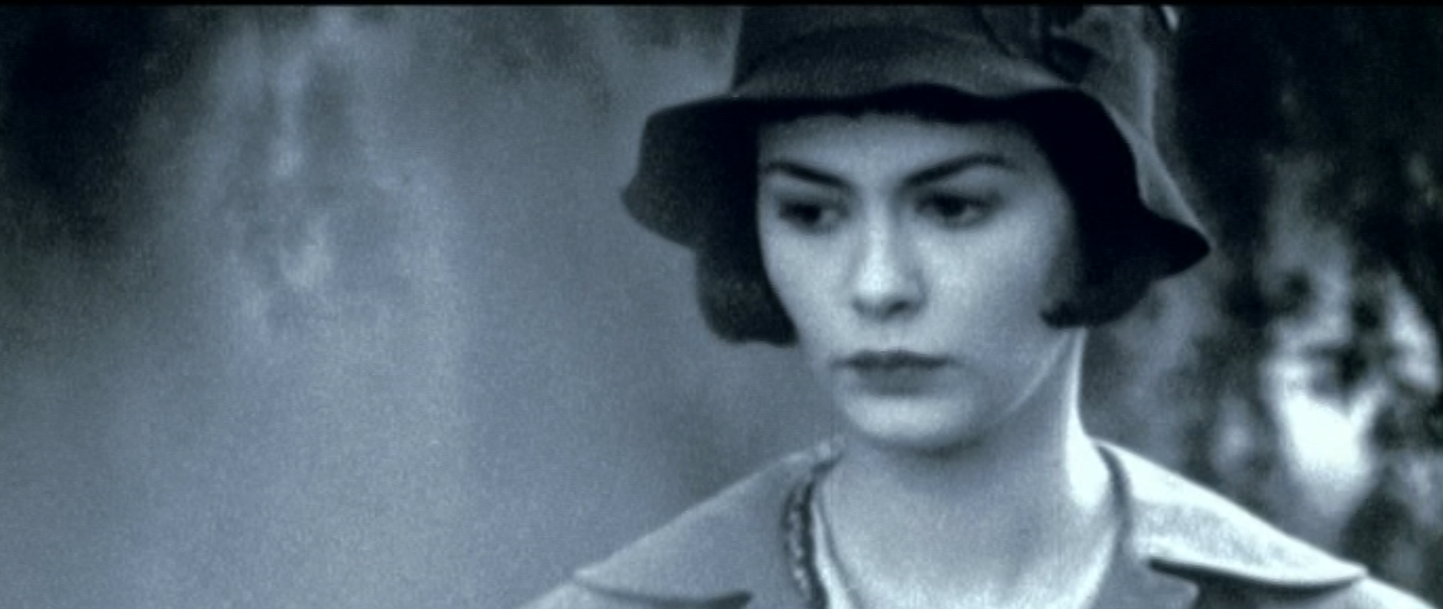
Photographs by
Robert Doisneau (1912-1994)
Retro Aesthetic Influences on Amélie

Slide 18
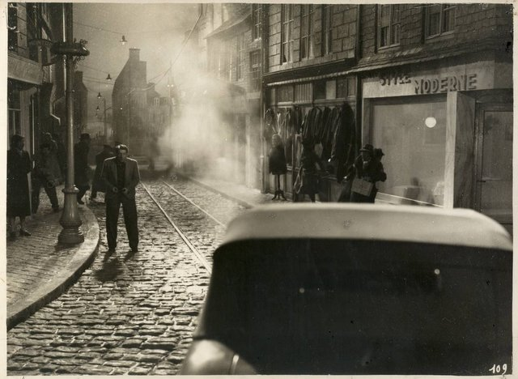
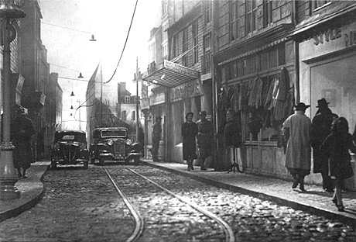
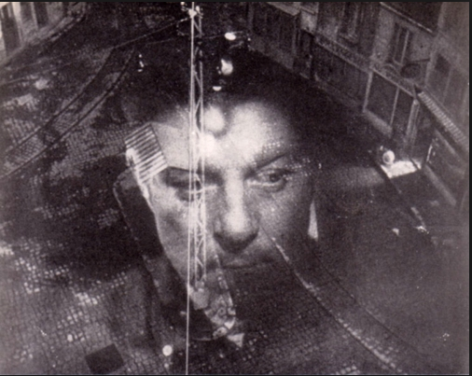
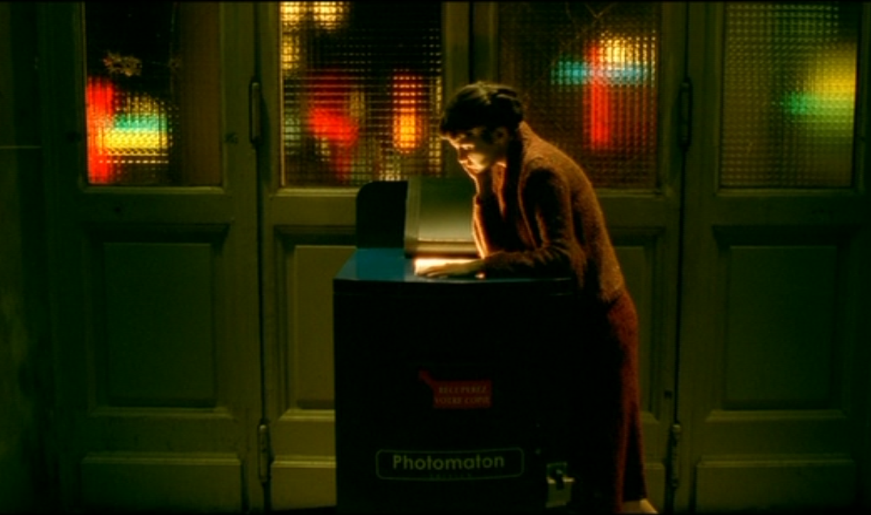
Retro Aesthetic Influences on Amélie
Poetic Realist films of the 1930s and 40s e.g.
Hotel du Nord (Carné, 1938)
Le Quai des brumes/Port of Shadows (Carné, 1938)
CLIP Le jour se lève/Daybreak (Carné, 1939)
‘Not reproducing reality so much as recreating it, stories in these films are anchored to defined social settings, but aim to convey “essential” human truths that transcend social realities. Poetic realism undervalues a film’s direct links with the material world in order to explore the symbolic resonances which that world – when photographed – is capable of releasing’
(Baron Turk 1989: 109)
Often featured vulnerable young women.
Creation of an intimate ambience through set design. (Andrew 1995: 186).
‘The development of panchromatic film allowed a greater control of shadow and light in the studio and aided the presence of typical motifs, such as glistening cobbles, rain-spattered pavements, and dark shadows.’ (McCann 2017: 54-5)
‘France has become an imaginary realm available only through loss, exile, and nostalgia’ (Andrew 1995: 230)

Slide 19
Reception of Amélie: a Divided Picture
Global box office blockbuster (8.5 million French spectators, over $33m taken in US)
BUT frequently critically derided e.g. Serge Kaganski, ‘ «Amélie», pas jolie ,’ Libération, 31 May 2001
‘Jeunet est sous l'emprise d'une telle volonté de maîtrise et de contrôle absolu de ses images que ses films ne respirent plus, que son monde paraît être filmé sous cloche. Amélie Poulain fait ainsi penser à ces boules de neige enfermant les monuments de Paris que l'on vend dans les boutiques de souvenirs kitsch.
Jeunet is so anxious to have total control over every single frame that his films become suffocating: his worlds are imprisoned under glass. AP makes you think of one of those snow-globes with Parisian monuments inside you find in shops selling kitsch souvenirs.
[…]

Slide 20
Kaganski Continued
[…]
Que vois-je dans le Montmartre de Jeunet? Des Français aux patronymes qui fleurent bon le terroir. Je vois aussi un beur désarabisé qui s'appelle Lucien. Mais où sont les Antillais, les Maghrébins, les Turcs, les Chinois, les Pakis, etc? Où sont ceux qui vivent une sexualité différente? Où sont les Parisiens qui peuplent la capitale en 1997 (année où est censé se passer le film)?’
What do I see in Jeunet’s Montmartre? French people with ‘good old-fashioned French’ names. I also see a de-Arabized ‘beur’ called Lucien. But where are the Antilleans, North Africans, Turks, Chinese, Pakistanis and so on? Where are the LGBTQ+ individuals? Where are the Parisians of 1997 (the year when the film’s meant to take place)?

Slide 21
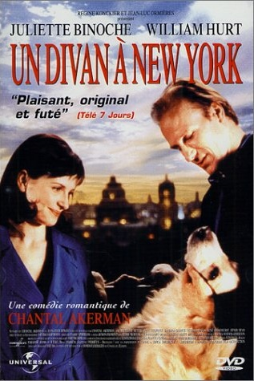
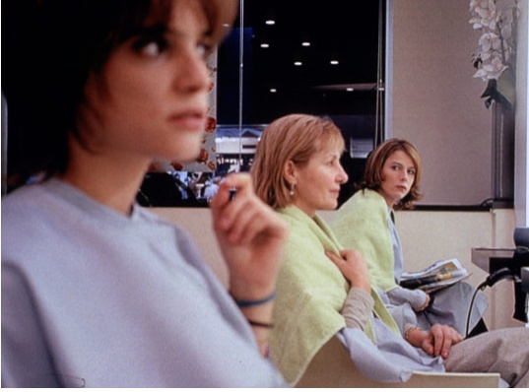
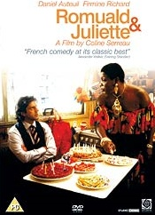
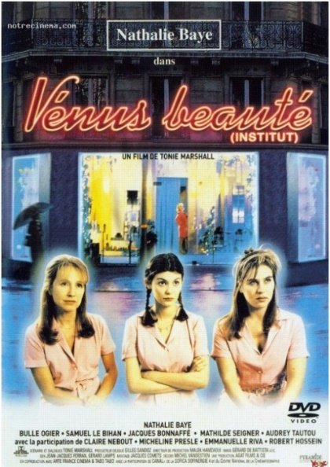
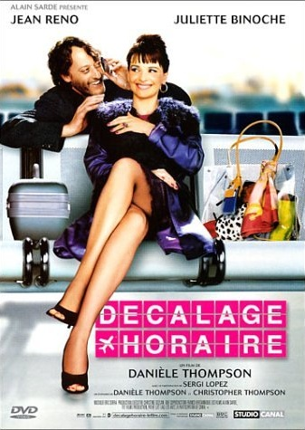
Early French Romcoms
Reines d’un jour (‘Queens for a Day’)
Marion Vernoux, 2001
A Couch in New York
Chantal Akerman, 1996
Venus Beauty Salon
Tonie Marshall, 1999
CLIP
Coline Serreau, 1989
See also: Rollet, B. 2008. ‘Transatlantic Exchanges and Influences: Décalage horaire (Jet Lag), Gender and the Romantic Comedy à la française.’
In S. Abbott and D. Jermyn (eds), Falling in Love Again: Romantic Comedy in Contemporary Cinema. London: I.B. Tauris, pp. 92-104.
Jet-Lag
Danièle Thompson, 2002

Slide 22
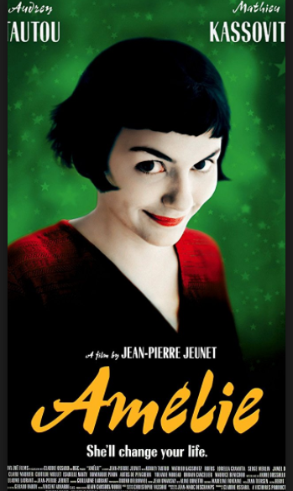
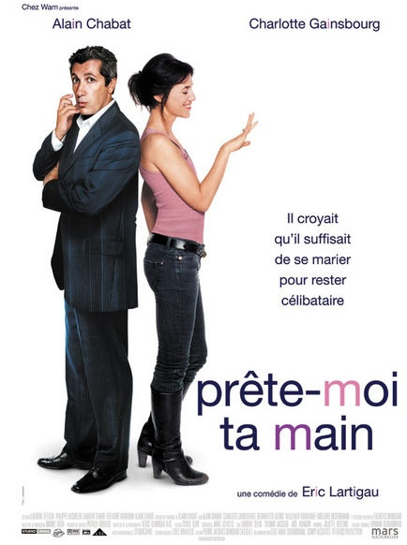
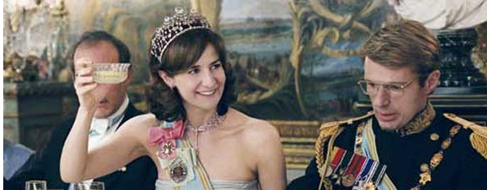
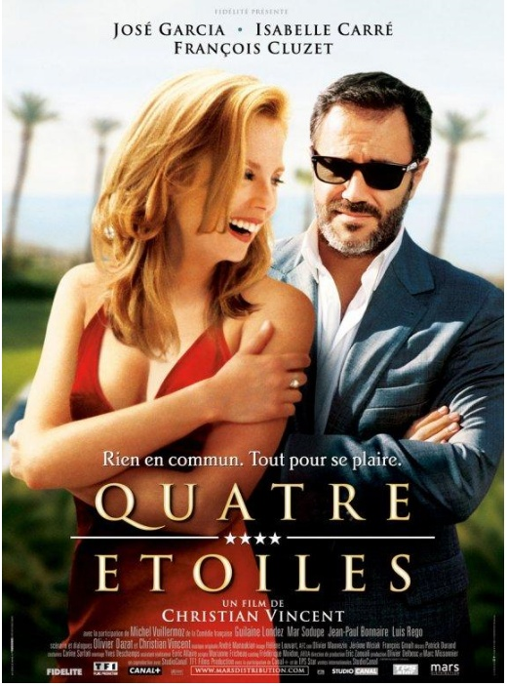
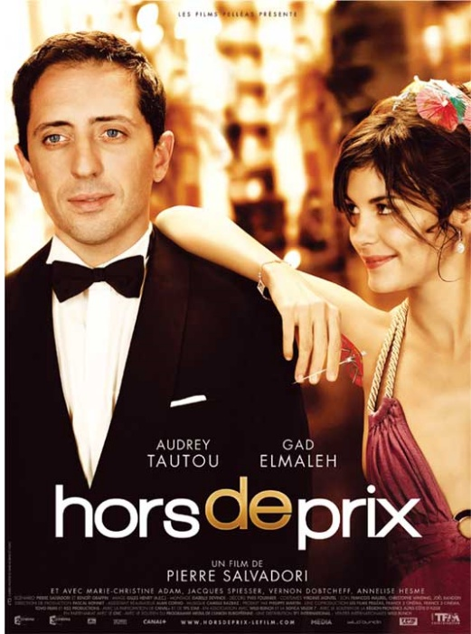
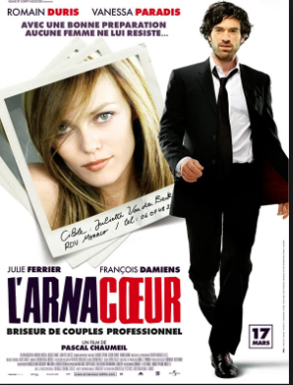

Consolidation of the Genre Post-2000
Palais Royal, Valérie Lemercier, 2005
I Do, 2006
2001
Four Stars, 2006
Heartbreaker, 2010
Priceless, 2006
2012
Post-2015: see Netflix e.g. The Hookup Plan, I Am Not an Easy Man….

Slide 23
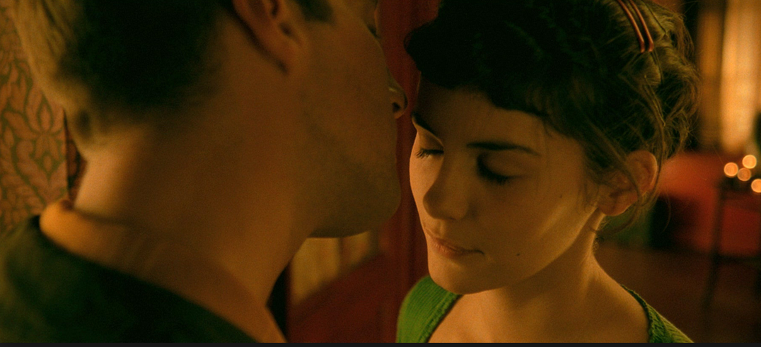
Ambivalent Endings
‘The end of the film […] brings the hitherto star-crossed lovers together, the sheer predictability of their union, the “fabulous”, storybook fulfilment of Amelie’s “destin”, recalls the ending of countless Hollywood films’ (Ezra, p.301).
Or do you agree with Moore that Amelie is a ‘borderline sociopath’ and the film’s ending constitutes ‘a series of seemingly incoherent (or irrational) images’ (pp. 16-17)

Slide 24
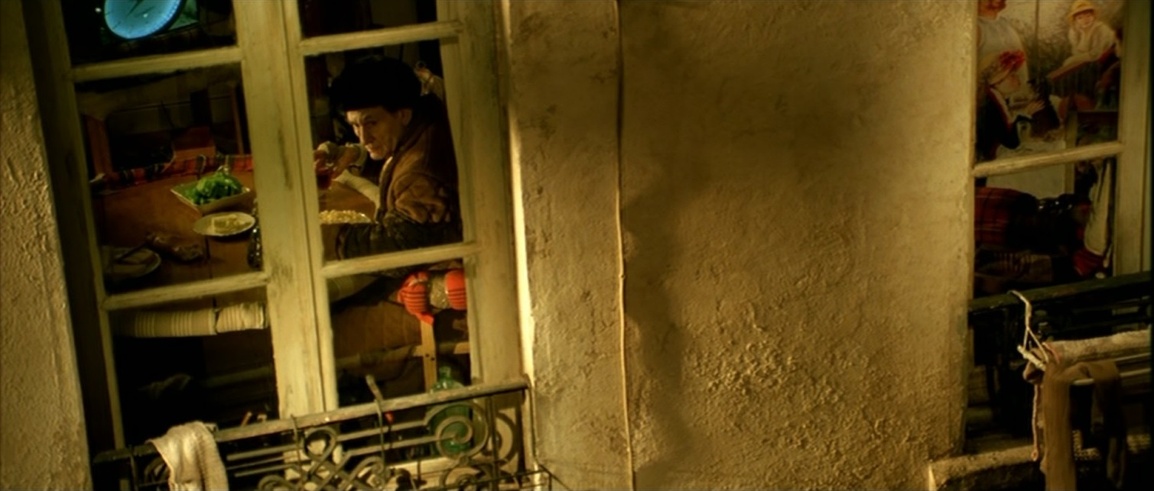
Amélie: Romance or Realism?
For Michelle Scatton-Tessier, Le Fabuleux destin d’Amélie Poulain is ‘well anchored in its socio-historical and cinematic period, exploiting the same issues of loneliness and isolation found in recent French new social cinema’.
In ‘Le Petisme, Flirting with the Sordid in Le Fabuleux destin d’Amélie Poulain.’ Studies in French Cinema 4, no.3 (2004): 197-207, p. 197.

Slide 25
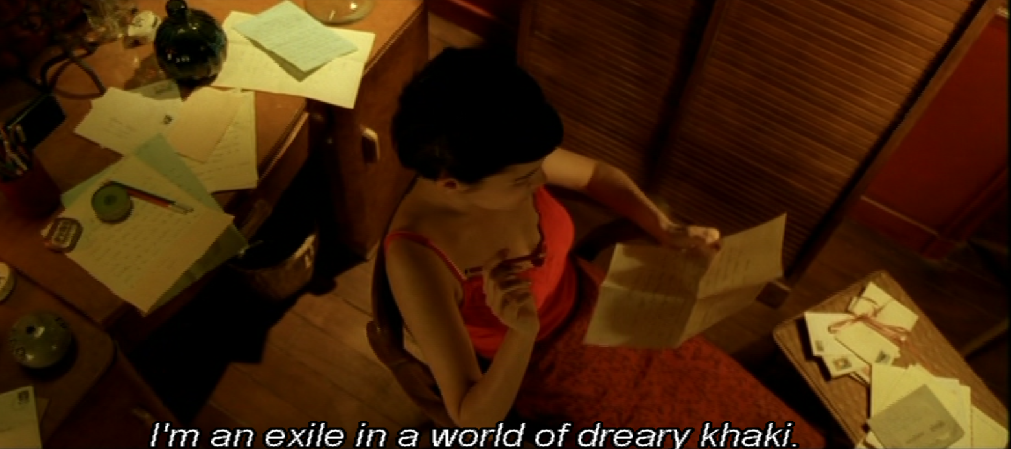
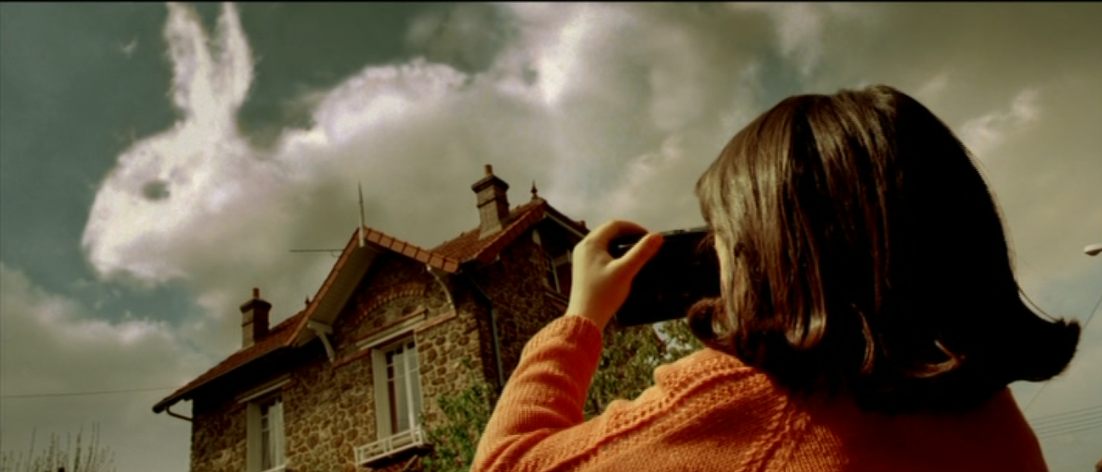
Isolating Camerawork

Slide 26
The Idea of a Nation
Benedict Anderson on the nation as an ‘imagined political community’, formulated through technology and modernity:
‘[It] is imagined because even the members of the smallest nation will never know most of their fellow-members, meet them or even hear of them, yet in the mind of each there lives the image of the communion.’
Anderson, Imagined Communities: Reflections on the Origins and Spread of Nationalism (first published in 1983))

Slide 27
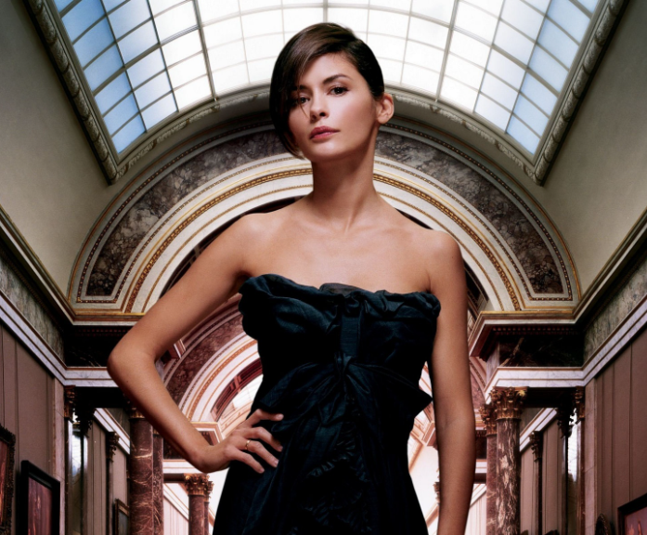
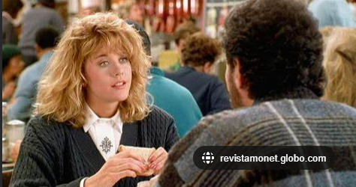
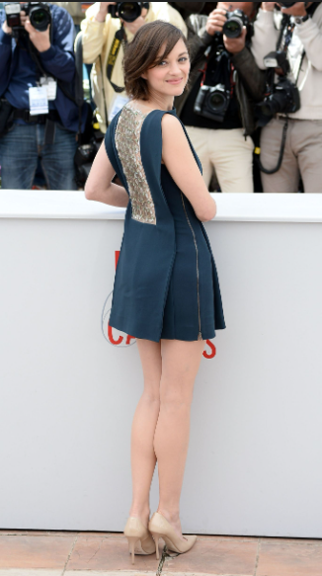
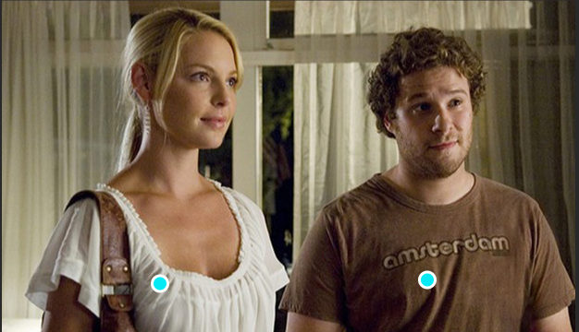
Amélie and the National Body

Slide 28
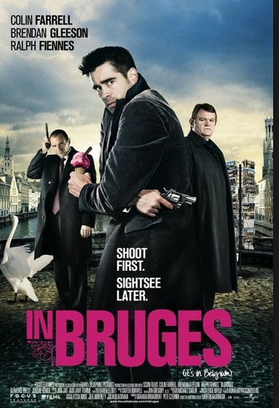


Amélie and ImpersoNation
(Elsaesser 2005)
National identity a key area of signification for filmic discourse, just as film and now television are key signifiers for constructions of national identity both inside and outside the nation – though not always through co-extensive versions.
ImpersoNation refers to films designed to play to ‘the look of the other’ (2005, 49).
UK poster French poster US poster

Slide 29
Additional Bibliography
Dudley Andrew, Mists of Regret: Culture and Sensibility in Classic French Film, Princeton: Princeton University Press, 1995.
Edward Baron Turk, Child of Paradise: Marcel Carné and the Golden Age of French Cinema, Cambridge, MA: Harvard University Press, 1989.
Thomas Elsaesser, European Cinema: Face to Face with Hollywood, Amsterdam: Amsterdam University Press, 2005.
Elizabeth Ezra, ‘The Death of an Icon: Le Fabuleux destin d’Amelie Poulain.’ French
Cultural Studies 15, no. 3: 301-10.
Ben McCann, Julien Duvivier, Manchester: Manchester University Press, 2017.

