Slide 1

Modern Chinese for non-major students I
Week 1

Slide 2
施博凯(SHĪ, BÓ-KǍI )
Kevin
Line：vivi2338923
Email：1126.6haha.kevin@gmail.com
Notes:
自我介紹

Slide 3
Class Rule
  1.) 迟到15分钟算是缺课一堂。
  1.) Being 15 minutes late for class counts as an absence.
  2.) 若无法到课，除了依据学校规定请假，应提早一天告知老师，病假例外。
  2.) If you are unable to attend class, in addition to asking for leave according to school regulations, you should inform the teacher one day in advance, except for sick leave.
  3.) 课程中会根据情况分配作业，提交作业后才可进行期末考试。
  3.) In the course, homework will be distributed according to the situation, and the final exam will not be allowed until the homework is submitted.
Notes:
規則

Slide 4
Class Rule
  4.) 每完成一堂课都有一个测验。只有在完成所有考试后才能参加期末考试。如果由于某种原因无法参加考试，请向老师要求补考。
  4.) There is a quiz for every completed lesson. The final exam can only be taken after all exams have been completed. If for some reason you are unable to take a test, please ask teacher for a make-up test.
  5.) 因为需要向学校提交班级证明，所以有时需要给班级拍照（不是针对个人，只拍整个教室的班级情况）。
  5.) Because I need to submit a class certificate to the school, sometimes I need to take pictures of the class (not for individuals, just take pictures of the class status of the entire classroom).
  6.) 课堂主题仅用作语言练习的工具。如果某个话题让您感到不舒服，您有权拒绝参与。
  6.) Topics in class are used only as a tool for language practice. If a topic makes you uncomfortable, you have the right to refuse to participate.

Slide 5
Class Rule
  7.) 上课不可以吃东西和喝饮料，因为老师还没吃饭，看你们吃我会饿，饿了就没有力气上课。除了装在水壶我不能直接看到的以外。
  7.) You are not allowed to eat or drink in class, because the teacher has not eaten yet, I will be hungry when I see you eat, and I will not have the strength to go to class when I am hungry. Except in the kettle, I can't see it directly.

Slide 6
What is the “Chinese character” ?
山
月
下
燹
日
凯
博
上
施
明
Notes:
很多人覺得漢字像圖畫

Slide 7

Notes:
漢字是方正的

Slide 8
山
pinyin
shān
Notes:
聲音和漢字連結不起來

Slide 9


dǒng
bù
dǒng
Understand
Not Understand
Notes:
懂不懂

Slide 10
i
u
ǚ
a
o
e
e
Notes:
有37個注音符號

Slide 11
a
a
a
a
a
ǚ
o
e
a
ǚ
a
i
o
a
a
a
a
a
e
e
a
e
i
o
a
e
a
a
a
a
a
a
a
e
o
a
i
a
e
e
a
a
a
a
a
a
e
ǚ
a
i
a
ǚ
e
a
a
a

Slide 12
ai
ei
ao
ou
an
en
ang
eng
er

Slide 13
a
ai
a
eng
a
a
ai
ao
a
ei
a
ou
ao
a
a
a
a
a
a
a
a
en
ou
an
ang
ai
ang
an
a
a
a
a
a
a
ei
an
ao
ai
ei
eng
ou
a
a
a
a
a
er
ei
en
ou
a
a
er
ao
an
a

Slide 14
i
u
ǚ
a
o
e
e
yi
wu
yǚ
Notes:
有37個注音符號

Slide 15
yi
wu
yǚ
a
o
e
e
ai
ei
ao
ou
an
en
ang
eng
er

Slide 16
yi
e
a
o
e
e
wu
ai
ei
ao
ou
an
en
ang
eng
yǚ

Slide 17
a
o
e
e
yi
ai
ei
ao
ou
y
an
en
ang
eng
yin
ying
Notes:
yā yō yē yāo yōu yān yīn yāng yìng

Slide 18
a
o
e
e
wu
ai
ei
ao
ou
w
an
en
ang
eng
Notes:
wā wō wāi wēi wān wēn wāng wēng

Slide 19
a
o
e
e
yǚ
ai
ei
ao
ou
yu
an
en
ang
eng
yun
yong
Notes:
yuē yuān yūn yōng

Slide 20
yi
ya
yo
ye
yao
you
yan
yin
yang
ying
wu
wa
wo
wai
wei
wan
wen
wang
weng
yu
yue
yuan
yun
yong
Notes:
九宮格

Slide 21
Before “yi” “wu” “yu”
b
p
m
f
d
t
n
l
g
k
h
j
q
x
zh
ch
sh
r
z
c
s

Slide 22
Before “yi” “wu” “yu”
b
p
m
f
yi
i
d
t
n
l
g
k
h
wu
u
j
q
x
yǚ
u
zh
ch
sh
r
z
c
s

Slide 23
practice (b,p,m,f)
wu
yǚ
ba
bi
bu
bo
ma
mi
mu
mo
pa
pi
pu
po
fa
fu
fo

Slide 24
practice (b,p,m,f)
wu
yǚ
ba
pa
bu
pu
ma
fa
mu
fu
po
bo
pi
pu
bo
po
mo
fo
fu
mu
pu
bu

Slide 25
practice (d,t,n,l)
wu
yǚ
da
di
du
de
ta
ti
tu
te
na
ni
nu
ne
nǚ
la
li
lu
le
lǚ

Slide 26
Practice(d,t,n,l)
wu
yǚ
da
ta
di
ti
du
tu
de
te
lu
lǚ
nu
nǚ
lu
nu
lǚ
nǚ
le
ne
te
de
du
tu
lu
nu

Slide 27
Practice(g,k,h)
wu
yǚ
gu
ge
ga
ku
ke
ka
hu
he
ha
gu
hu
ge
he
gu
ku
ge
ke
ke
he
ku
hu
gu
ku
hu
he
ke
ge

Slide 28
Practice(j,q,x)
wu
yǚ
ji
ju
qi
qu
xi
xu
ji
qi
ju
qu
qi
xi
qu
xu
ji
xi
ju
xu
ji
qi
xi
ju
qu
xu

Slide 29
Practice(zh,ch,sh,r)
yi
wu
yǚ
zha
zhu
zhe
zhi
cha
chu
che
chi
sha
shu
she
shi
ru
re
ri
sha
zha
shu
zhu
zha
cha
zhu
chu

Slide 30
Practice(zh,ch,sh,r)
yi
wu
yǚ
chu
shu
sha
cha
shi
zhi
chi
shi
she
zhe
che
she
shu
ru
shi
ri
lu
ru
li
ri
she
re
le
re

Slide 31
Practice(zh,ch,sh,r)
yi
wu
yǚ
zhe
re
che
re
sha
cha
zha
shu
zhu
chu
ru
zhi
chi
shi
ri
che
zhe
she
re

Slide 32
Practice(z,c,s)
yi
wu
yǚ
za
zu
ze
zi
ca
cu
ce
ci
sa
su
se
si
sa
za
su
zu
se
ze
si
zi

Slide 33
Practice(z,c,s)
yi
wu
yǚ
za
ca
zi
ci
ze
ce
zu
cu
sa
ca
si
ci
su
cu
se
ce

Slide 34
Practice(z,c,s)
yi
wu
yǚ
sa
za
ca
su
zu
cu
se
ze
ce
si
zi
ci
za
cu
se
su
zi
ce
ci
sa
zu

Slide 35
combination
1
2
yi
yi
a
y
o
wu
wu
w
e
yǚ
yǚ
.
.
.
.
.
yu

Slide 36
combination
3
b
yi
i
p
wu
u
m
.
.
.
.
yǚ
u/ǚ

Slide 37
combination
4
b
yi
a
i
p
o
wu
u
m
e
.
.
.
.
yǚ
.
.
.
.
.
u

Slide 38
practice
x
yi
a
xia
d
wu
o
duo
x
yǚ
e
xue

Slide 39
exception
b
x
yi
ou
xiu
p
s
wu
ei
sui
m
d
wu
en
dun
.
.
.
.
.
.
d
wu
eng
dong
x
yǚ
eng
xiong

Slide 40
xiu
fei
a
a
a
a
ba
sui
qi
a
xia
a
a
a
a
a
xiong
sui
xiu
fei
dun
a
a
mi
dong
a
xiong
a
a
dong
qi
a
a
a
mi
a
a
dun
ba
xia
Notes:
寫學生念
挑戰學生念學生寫

Slide 41
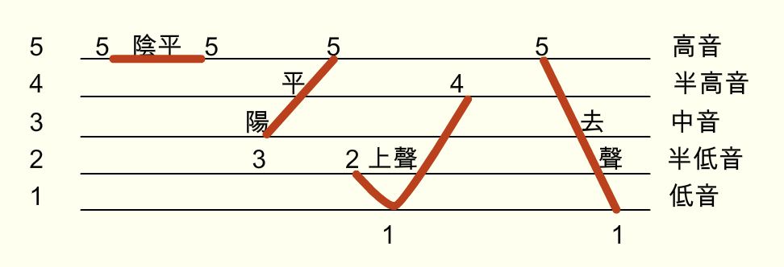
Tone
ā á ǎ à
a>o>e>i=u

Slide 42
yi
ya
yo
ye
yao
you
yan
yin
yang
ying
wu
wa
wo
wai
wei
wan
wen
wang
weng
yu
yue
yuan
yun
yong
Notes:
九宮格

