Slide 1
Modern Chinese for non-major students I
Week 10
记得点名

Slide 2
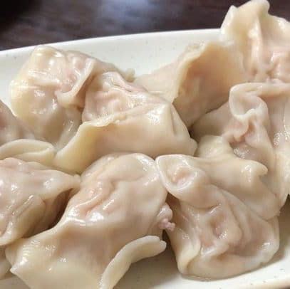
包饺子活动 Dumpling-making activity
时间：12月5日（周二）下午2点
Money：200 Kč
Notes:
If you want to sign up, you can give me money now

Slide 4
第四课–爱好
Dì sì kè – ài hào
Lesson 4 -- Hobbies

Slide 5
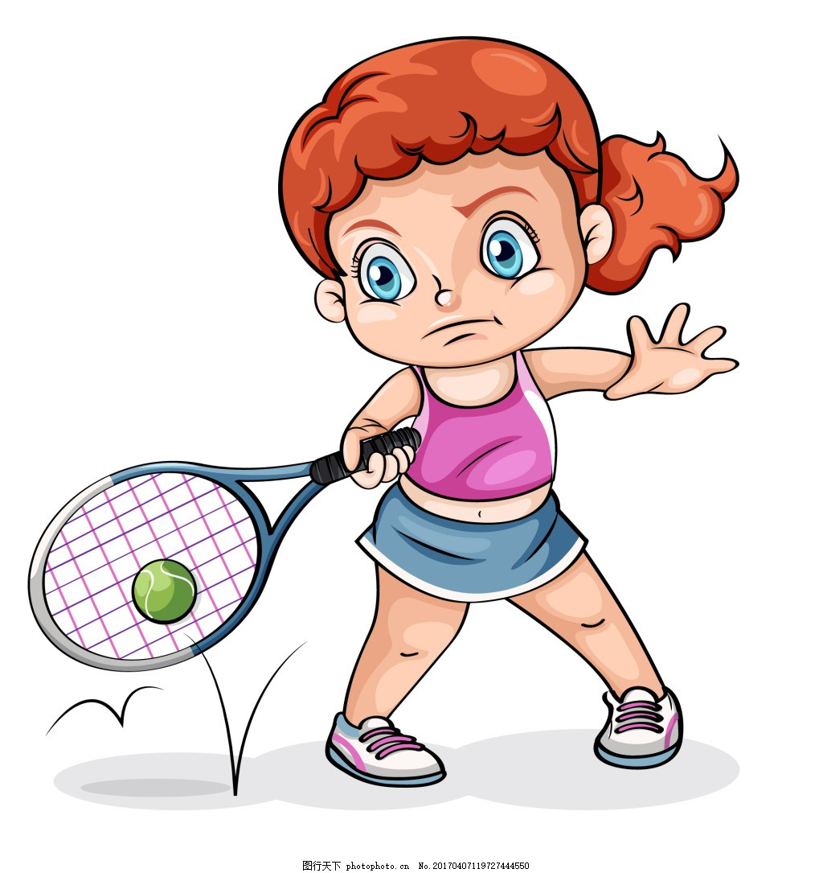

Slide 6
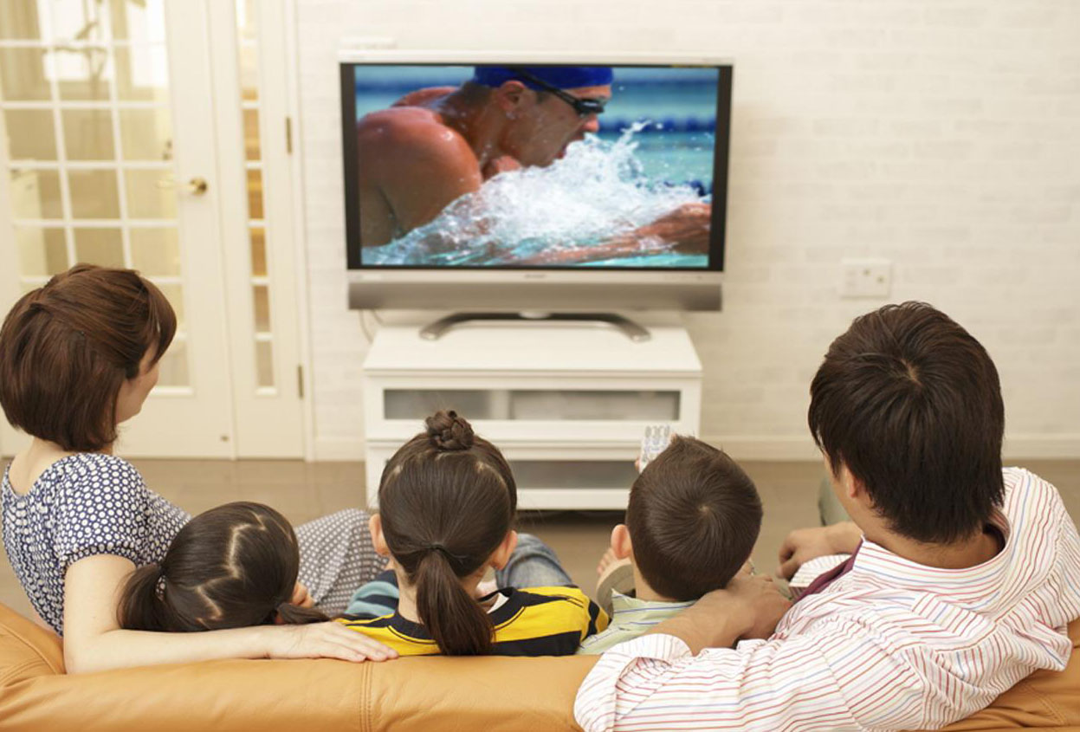

Slide 14
小 xiǎo adj. small; little
大 dà
adj. big

Slide 15
再见 zàijiàn Goodbye; see you again
再 zài again
见 jiàn to see
See you tomorrow.
See you next week.
明天见。 Míngtiān jiàn.
下礼拜见。 Xiàlǐbài jiàn.

Slide 16
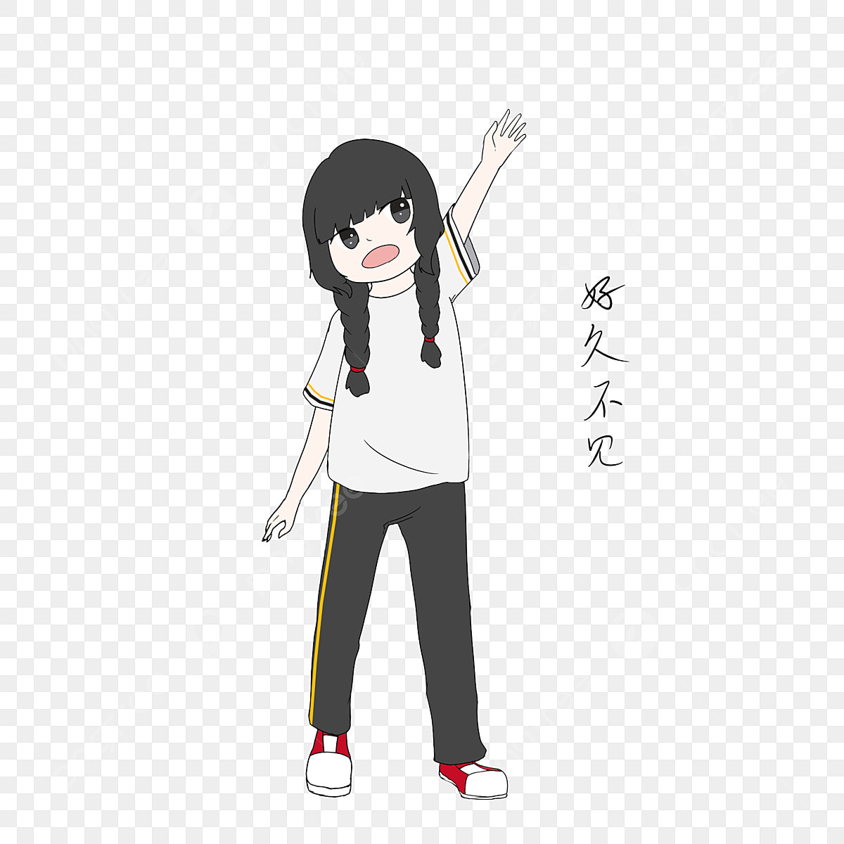
好久 hǎojiǔ a long time
好久不见 hǎojiǔbújiàn
Long time no see

Slide 17
好久 hǎojiǔ a long time
好 hǎo adv. very
久 jiǔ adj. long(time)

Slide 18
睡觉 shuìjiào vo. to sleep

Slide 19
错 cuò adj. wrong
不错 búcuò
adj. Pretty good

Slide 20
觉得 juéde v. to feel; to think

Slide 21
__________，你觉得呢？ Nǐ juéde ne? what do you think?
帅 shuài adj. handsome
漂亮 piàoliang
adj. Pretty
Notes:
topic

Slide 22
意思 yìsi n. meaning
handsome
帅

Slide 23
有意思 yǒu yìsi
Adj.

Slide 24
我觉得_______没/很有意思，你觉得呢？ Wǒ juéde _______ méi /hěn yǒu yìsi, nǐ juédéne?
看书
看电视
看电影
看球
吃___菜
睡觉
打球
唱歌
跳舞
听音乐

Slide 25
只 zhǐ adv. only
只有一个人。
Zhǐ yǒu yígè rén.

Slide 26
算了 suànle forget it; never mind

Slide 27
找 zhǎo v. to look for

Slide 28
别人 biérén n. other people; another person
我女朋友
我
别人
别人

Slide 29
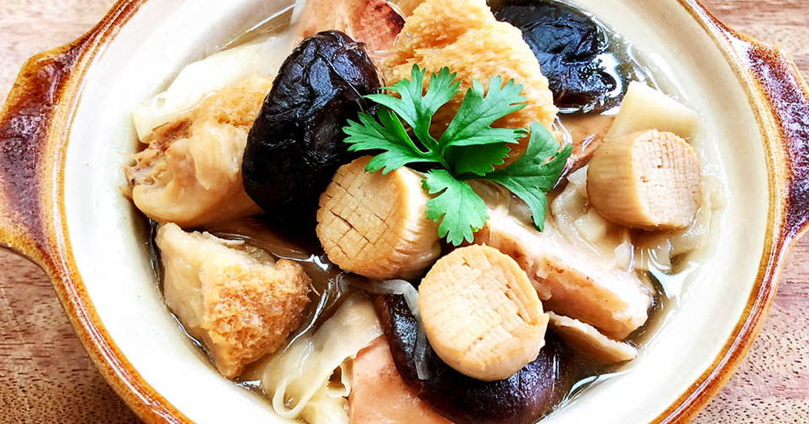
别的 bié de
adj. other
捷克菜
jiékè cài
中国菜
zhōngguócài
Notes:
你喜欢吃捷克菜还是中国菜

Slide 30
想 xiǎng mv. to want to; would like to; to think

Slide 31
想 xiǎng want to; would like to
想 has several meanings. In this lesson it is a modal verb indicating a desire to do something. It must be followed by a verb or a clause.
你晚上想做什么？
Nǐ wǎnshang xiǎng zuòshénme?
去
看书
看电视
看电影
看球
吃___菜
睡觉
打球
唱歌
跳舞
听音乐

Slide 32
 | Monday | Tuesday | Wednesday | Thursday | Friday | Saturday | Sunday
Little Wang

Slide 33
Go another place
night
 | Monday | Tuesday | Wednesday | Thursday | Friday | Saturday | Sunday
Little li wants

Slide 34
Verb + Object as a Detachable Compound
Even though 睡觉, 唱歌, and 跳舞 are treated each as a word, grammatically speaking, they are all verb-object compounds. When there is an attributive element to modify the object, such as an adjective or a number-measure word combination, it must be inserted between the verb and the noun. Such a compound is called a "detachable compound." It is important to remember that a detachable compound does not take an object. Here are examples:
睡觉 → 睡一个好觉
唱歌 → 唱英文歌
跳舞 → 跳中国舞
In later lessons, you will see examples of other elements, like aspect markers, being inserted between the verb and the object in a detachable compound.

Slide 35
画画儿 huà huàer Draw

Slide 36
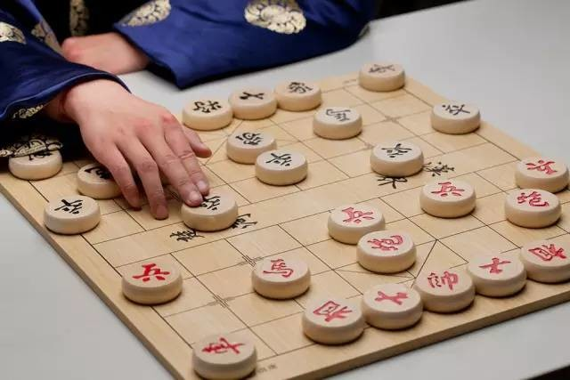
下棋 xiàqí play chess

Slide 37
上网 shàngwǎng Internet

Slide 38
聊天儿 liáotiānér Chat

Slide 39
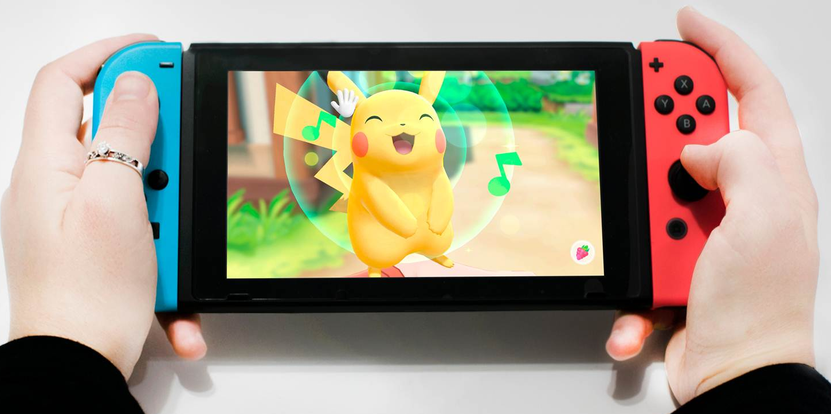
玩游戏机 wán yóuxìjī Play game consoles

Slide 40
逛街 guàngjiē Shopping

Slide 41
聊天儿
A:这个周末你想做什么？
Zhège zhōumò nǐxiǎng zuòshénme?
B:这个周末我想_______。
Zhège zhōumò wǒxiǎng _______.
A:你想_______吗？
Nǐxiǎng _______ ma?
B:我想/不想_________。
Wǒxiǎng / bùxiǎng _________.
A:你觉得________有意思吗？
Nǐ juéde ________ yǒu yìsima?
B:我觉得________很有意思/没有意思。
Wǒ juéde ________ hěn yǒuyìsi /méiyǒu yìsi.
逛街
画画儿
下棋
上网
唱歌
跳舞
听音乐
看电视
看书
睡觉
看电影
看球
吃___菜
玩游戏机
打球

Slide 42
A:小高，好久不见，你好吗？
B:我很好。你怎么样？
A:我也不错。这个周末你想做什么？想不想去打球？
B:打球？我不喜欢打球。
A:那我们去看球。怎么样？
Xiǎogāo, hǎojiǔbùjiàn, nǐhǎoma?
Wǒ hěnhǎo. Nǐ zěnmeyàng?
Wǒ yěbùcuò. Zhège zhōumò nǐxiǎng zuòshénme? xiǎng bùxiǎng qù dǎqiú?
Dǎqiú? Wǒ bùxǐhuan dǎqiú.
Nà women qù kànqiú. Zěnmeyàng?

Slide 43
B:看球？我觉得看球也没有意思。
A:那你这个周末想做什么？
B:我只想吃饭、睡觉。
A:算了。我去找别人。
Kànqiú? Wǒ juéde kànqiú yě méiyǒuyìsi.
Nà nǐ zhège zhōumò xiǎng zuòshénme?
Wǒ zhǐxiǎng chīfàn, shuìjiào.
Suànle. Wǒ qù zhǎo biérén.

