Slide 1

Modern Chinese for non-major students I
Week 3
记得点名

Slide 2
review
1126.6haha.kevin@gmail.com

Slide 3
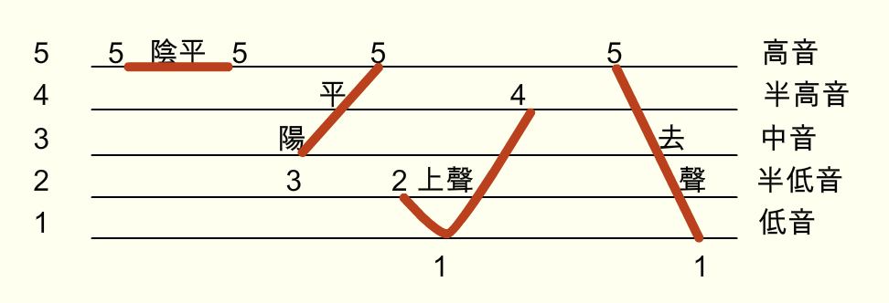
Tone
ā á ǎ à
a>o>e>i=u

Slide 4
fāngài
For read
For word
fāngài
fāng’ài
Notes:
詞彙斷句，相連兩個元音aoe和前面的結尾是n’ng時要加上‘符號，避免混淆Avoid confusion

Slide 5
‘
‘
‘
dàài
dèngài
ēnài
ēnyuàn
liègǒu
‘
duìōu
‘
‘
fānàn
fānàn
jiùài
Notes:
詞彙斷句，相連兩個元音aoe和前面的結尾是n’ng、原音時要加上‘符號，避免混淆Avoid confusion

Slide 6
1
2
3
ne
lǐ
nǐ
4
5
6
wènhǎo
guìxìng
wǒ
7
8
9
dìyīkè
nǐhǎo
xìng
10
11
12
wáng
xiǎojiě
jiào
13
lǐyǒu
14
lǐshēng
wángpéng
15

Slide 7
1
ma
2
shénme
míngzi
3
4
bù
5
shì
6
lǎoshī
7
yě
8
jiékè
9
měiguó
10
běijīng
11
niǔyuē
12
zhōngguó
bùěrnuò
13
14
táiwān
15
xuéshēng

Slide 8
ne | lǐ | nǐ | wènhǎo | guìxìng
wǒ | dìyīkè | nǐhǎo | xìng | wángpéng
wáng | xiǎojiě | jiào | lǐyǒu | lǐshēng
ma | shénme | míngzi | bù | shì
lǎoshī | yě | jiékè | měiguó | běijīng
niǔyuē | zhōngguó | bùěrnuò | táiwān | xuéshēng

Slide 9

好 hǎo
Fine
Good
Nice
OK
It’s settled
Yes

Slide 10


你 nǐ
你好 nǐhǎo
Hello
you

Slide 11

请 qǐng
请问 qǐngwèn
Excuse me, may I ask……
问 wèn
Please (polite form of request)
To treat or to invite (somebody)
To ask (a question)

Slide 12
贵 guì
贵姓 guìxìng
姓 xìng
Honorable
expensive
(one’s) surname is…..
To be surnamed
Surname 【Grammer 1】

Slide 13
姓 xìng
姓 is both a noun and a transitive verb.
When it is used as a verb, it must be followed by an object.
nǐ xìng shénme?
什么 shénme
你姓什么？
What is your surname?
what

Slide 14
姓 xìng
姓 is both a noun and a transitive verb.
When it is used as a verb, it must be followed by an object.
wǒ xìng lǐ.
我 wǒ
李 lǐ
我姓李。
My surname is Li.
I
me
(a surname)
plum
Notes:
The surname what we put before the name.

Slide 15
姓 xìng
姓 is both a noun and a transitive verb.
When it is used as a verb, it must be followed by an object.
wǒ xìng wáng.
我姓王。
王 wáng
My surname is Wang.
(a surname)
king
Notes:
The surname what we put before the name.

Slide 16
姓 xìng
姓 is both a noun and a transitive verb.
When it is used as a verb, it must be followed by an object.
nǐ xìng shénme?
wǒ xìng lǐ.
wǒ xìng wáng.
你姓什么？
我姓李。
我姓王。
What is your surname?
My surname is Li.
My surname is Wang.
Notes:
問我，同學問答

Slide 17
姓 xìng
姓 is both a noun and a transitive verb.
When it is used as a verb, it must be followed by an object.
nǐ xìng lǐ ma?
你姓李吗？
吗 ma
Is your surname Li?
For question (to make sure)

Slide 18
姓 xìng
姓 is both a noun and a transitive verb.
When it is used as a verb, it must be followed by an object.
wǒ bú xìng lǐ.
我不姓李。
wǒ xìng lǐ.
我姓李。
My surname is not Li.
My surname is Li.
wǒ bú xìng lǐ.
wǒ xìng wáng.
我不姓李。我姓王。
My surname is not Li.
My surname is Wang.

Slide 19
姓 xìng
姓 is both a noun and a transitive verb.
When it is used as a verb, it must be followed by an object.
wǒ xìng lǐ.
wǒ bú xìng lǐ.
我姓李。
我不姓李。
nǐ xìng lǐ ma?
你姓李吗？
My surname is Li.
My surname is not Li.
Is your surname Li?
wǒ bú xìng lǐ.
wǒ xìng wáng.
我不姓李。我姓王。
My surname is not Li.
My surname is Wang.
Notes:
問我，同學問答

Slide 20
姓 xìng
姓 is both a noun and a transitive verb.
When it is used as a verb, it must be followed by an object.
wǒ xìng lǐ.
我姓李。
nǐ guì xìng?
你贵姓？
My surname is Li.
What is your surname?(reply)
wǒ xìng wáng.
我姓王。
My surname is Wang.
Notes:
問我，同學問答

Slide 21
呢 ne
Question particle【Grammar 2】
呢 often follow a noun or pronoun to form a question when the content of the question is already clear from the context.
A
B
Qǐngwèn, nǐ guì xìng?
请问，你贵姓？
wǒ xìng lǐ, nǐ ne?
我姓李，你呢？
What is your surname, please?
My surname is Li. How about you?
wǒ xìng wáng.
我姓王。
My surname is Wang.

Slide 22
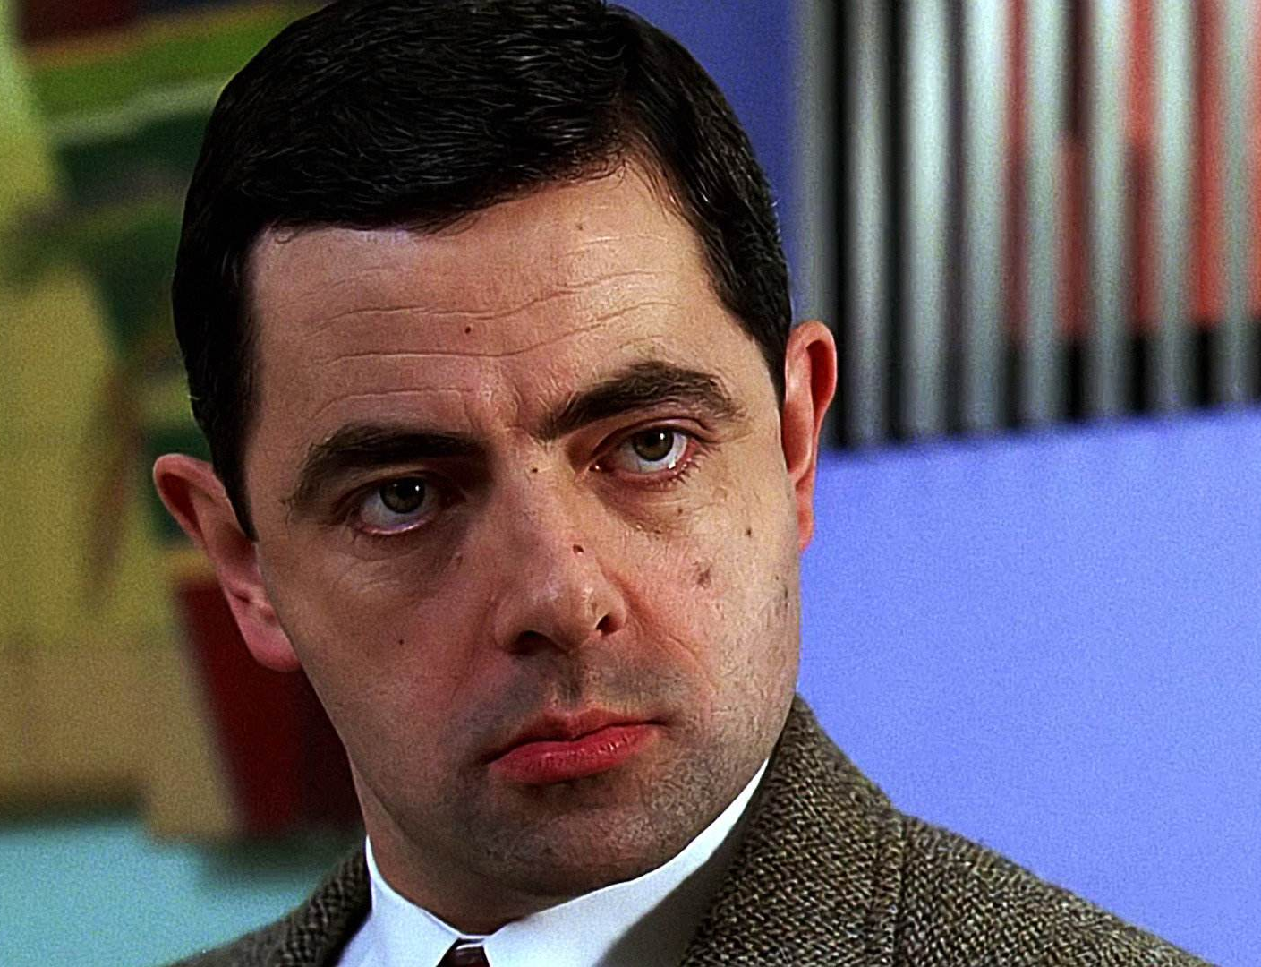

先生 xiānsheng
小姐 xiǎojiě
Mr.
Husband
Teacher
Miss
Young lady
Notes:
Xiānsheng/xiǎojiě

Slide 23
呢 ne
Question particle【Grammar 2】
呢 often follow a noun or pronoun to form a question when the content of the question is already clear from the context.
A
Qǐngwèn, xiānsheng/xiǎojiě guì xìng?
请问，先生/小姐贵姓？
B
wǒ xìng lǐ, nǐ ne?
我姓李，你呢？
What is Mr./Miss surname, please?
wǒ xìng wáng.
My surname is Li. How about you?
我姓王。
My surname is Wang.
Notes:
問我，同學問答

Slide 24
叫 jiào
To be called
To call 【Grammar 3】
The verb 叫 has several meanings. It means “to be call” in this lesson. Like 姓, it must be followed by an object, which can be either a full name or a given name, but seldom a given name that consists only one syllable.
名字 míngzi
Nǐ jiào shénme míngzi?
Wǒ jiào wáng péng.
Name
你叫什么名字？
我叫王朋。
What is your name?
My name is Wang Peng.

Slide 25
叫 jiào
To be called
To call 【Grammar 3】
The verb 叫 has several meanings. It means “to be call” in this lesson. Like 姓, it must be followed by an object, which can be either a full name or a given name, but seldom a given name that consists only one syllable.
A
B
Nǐ jiào shénme míngzi?
Wǒ jiào wáng péng.
nǐ ne?
你叫什么名字？
我叫王朋。
你呢？
What is your name?
My name is Wang Peng.
How about you?
wǒ jiào lǐshēng.
我叫李生。
My surname is Li Sheng.

Slide 26
叫 jiào
To be called
To call 【Grammar 3】
The verb 叫 has several meanings. It means “to be call” in this lesson. Like 姓, it must be followed by an object, which can be either a full name or a given name, but seldom a given name that consists only one syllable.
Wǒ jiào lǐyǒu.
Wǒ bú jiào lǐyǒu.
我叫李友。
我不叫李友。
Nǐ jiào lǐyǒu ma?
你叫李友吗？
My name is Li You.
My name is not Li You.
Is your name Li You?
Wǒ bú jiào lǐyǒu.
Wǒ jiào lǐshēng.
我不叫李友。
我叫李生。
My name is not Li You.
My name is Li Sheng.
Notes:
in English we put the question word before the sentence. but
in Chinese we put the question word after the sentence.

Slide 27

A：你好！
B：你好！
A：请问，你贵姓？
B：我姓李，你呢？
A：我姓王。李小姐，你叫什么名字？
B：我叫李友。王先生，你叫什么名字？
A：我叫王朋。
A：nǐ hǎo!
B：nǐ hǎo!
A：qǐngwèn, nǐ guì xìng?
B：wǒ xìng lǐ, nǐ ne?
A：wǒ xìng wáng. lǐ xiǎojiě, nǐ jiào shénme míngzi?
B：wǒ jiào lǐ yǒu. wáng xiānsheng, nǐ jiào shénme míngzi?
A：wǒ jiào wáng péng .
Notes:
Who is the boy?
Who is the girl?
B姓什麼？叫什麼名字？
A姓什麼？叫什麼名字？

Slide 28
问好 wènhǎo
A：你好，我姓X。请问，你贵姓？
B：你好，我姓X，我叫XOO，你呢？
A：我叫XOO。
A:Nǐ hǎo, wǒ xìng X. Qǐng wèn, nǐ guì xìng?
B:nǐ hǎo, wǒ xìng X, wǒ jiào XOO, nǐ ne?
A:wǒ jiào XOO.

Slide 29
Homework
Give me an E-mail.
  Introduce yourself for me.
  And tell me your country in English. (if you can write Chinese, it’s better.)
Deadline Friday
Test
Pinyin
  I say the pinyin and you write down pinyin and tone.
Next week

