Slide 1
Modern Chinese for non-major students I
Week 9
记得点名

Slide 2
Notes:
Taiwanese Literature
22号（周三）下午4点有台湾文学相关的活动

Slide 3
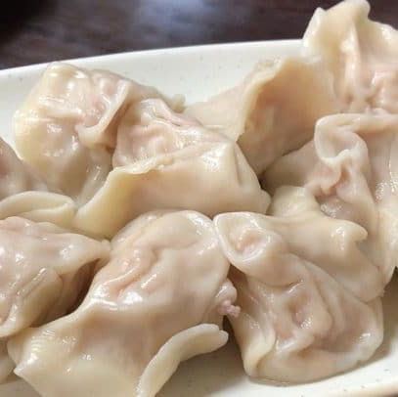
包饺子活动 Dumpling-making activity
时间：12月5日（周二）下午2点
Money：200 Kč

Slide 4
第四课–爱好
Dì sì kè – ài hào
Lesson 4 -- Hobbies

Slide 5
zhōumò | Dǎ qiú | Kàn diànyǐng | Chàng gē | Tiào wǔ
Kàn shū | duì | Tīng yīnyuè | yǒude | shíhou
chángcháng | nà | Kàn diànshì | qù | wàiguó
hǎojiǔ | xiǎo | zuótiān | qǐngkè | suǒyǐ
yǒuyìsi | xiǎng | búcuò | juéde | zhǐ
biérén | suànle | shuìjiào | zhǎo | biéde

Slide 6
周末 n. weekend
zhōumò
Notes:
喜欢

Slide 7
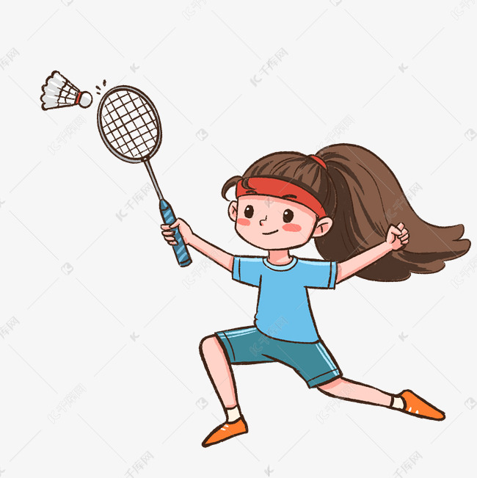
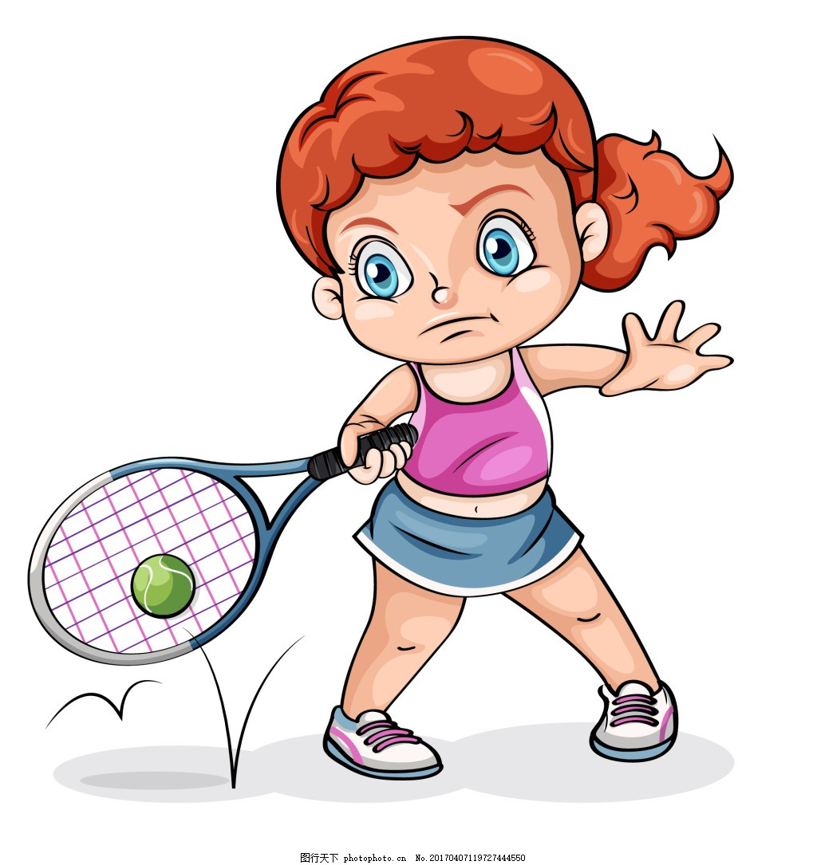
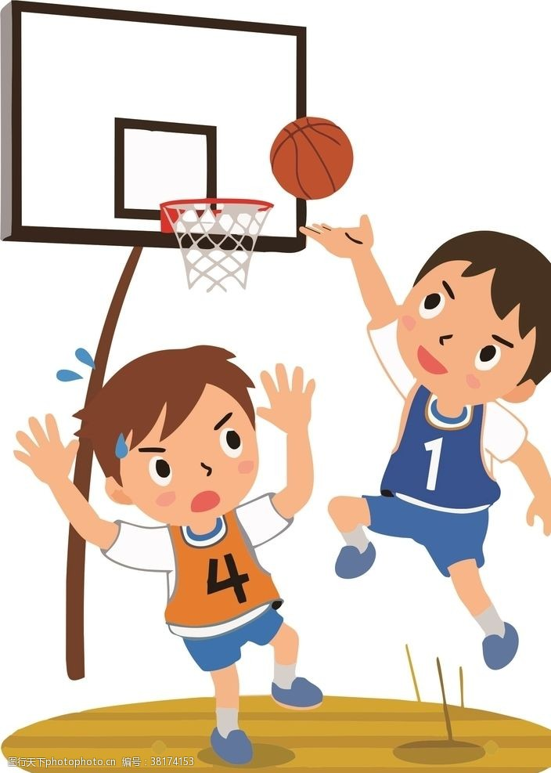
打球 vo. To play ball
dǎqiú
打 v. To hit
dǎ
球 n. ball
qiú

Slide 8
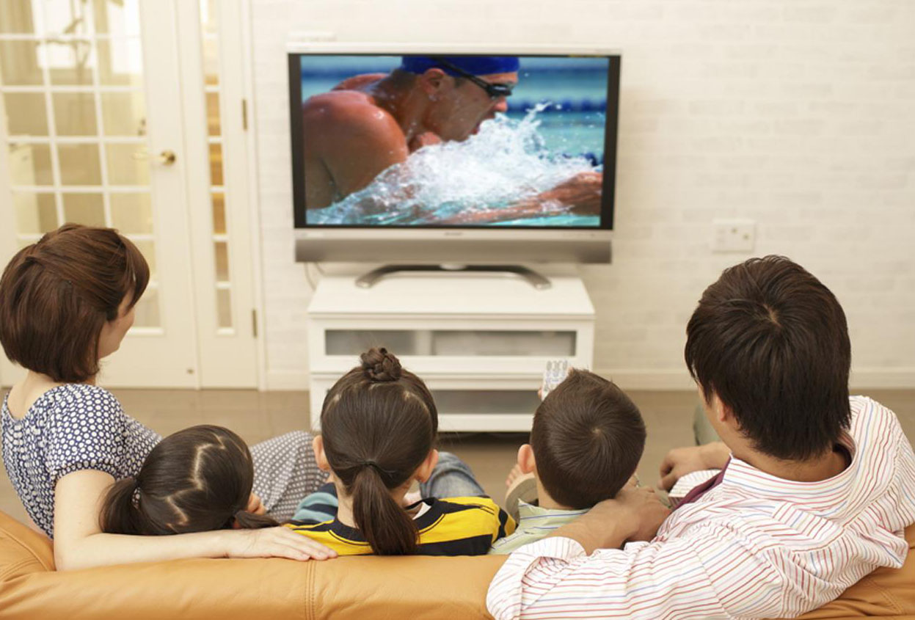
看电视 vo. Watch TV
Kàn diànshì
看 v. to watch/look/read
Kàn
电视 n. TV
diànshì

Slide 9
唱歌 vo. To sing
chànggē
唱 v. to sing
chàng
歌 n. song
gē

Slide 10
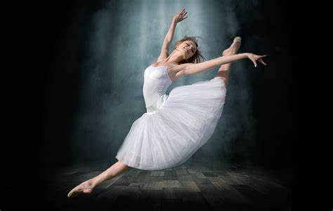
跳舞 vo. dance
tiàowǔ
跳 v. to jump
tiào
舞 n. dance
wǔ

Slide 11
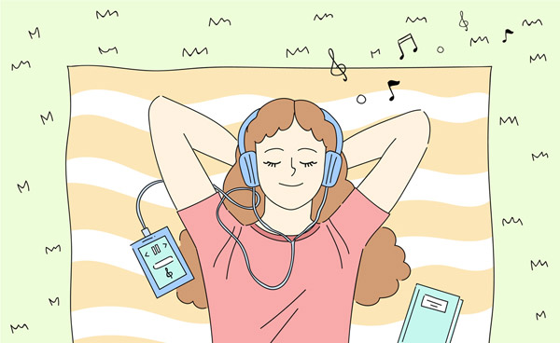
听音乐 vo. Listen to music
tīng yīnyuè
听 v. to listen
tīng
音乐 n. music
yīnyuè

Slide 12
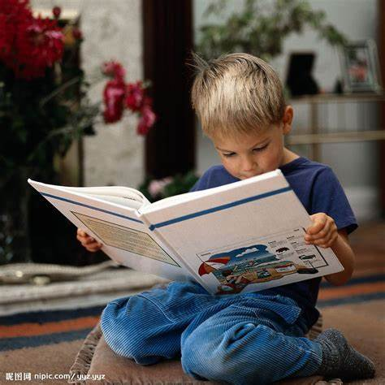
看书 vo. Reading
kànshū
书 n. book
shū

Slide 13
对 adj. correct/right
duì

Slide 14
忙 máng busy
很 hěn very
He is busy.
→__________。
他很忙

Slide 15
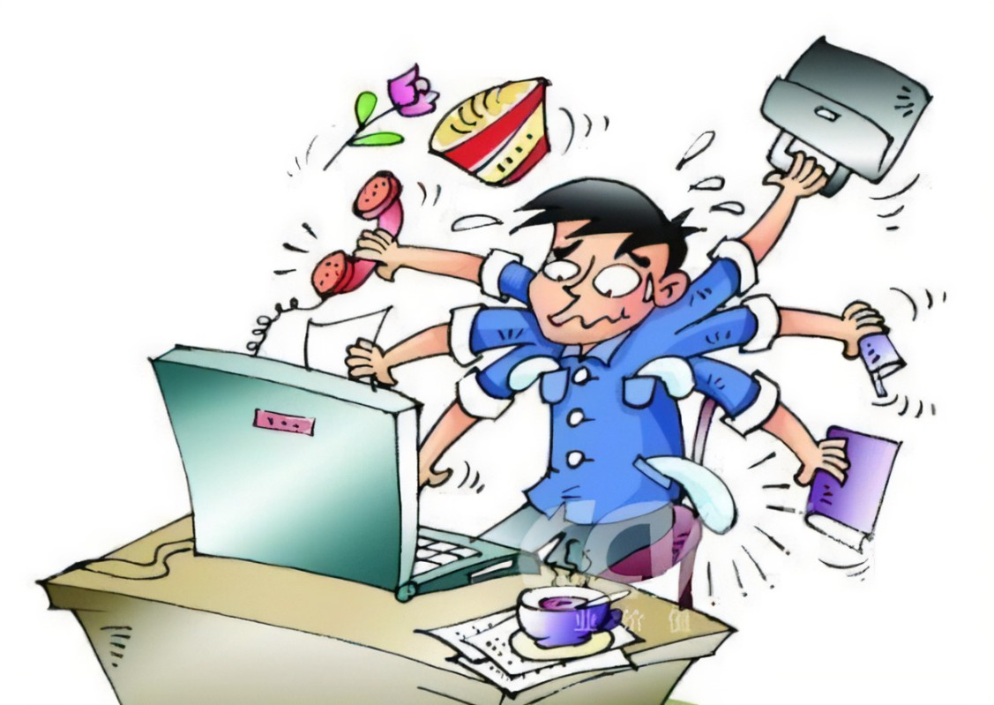
有的时候 sometime
Yǒude shíhòu
有的 pr. some
Yǒude
时候 n. (a point in)time/(a duration of)time/moment
shíhòu

Slide 16
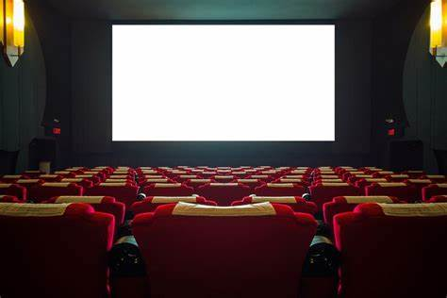
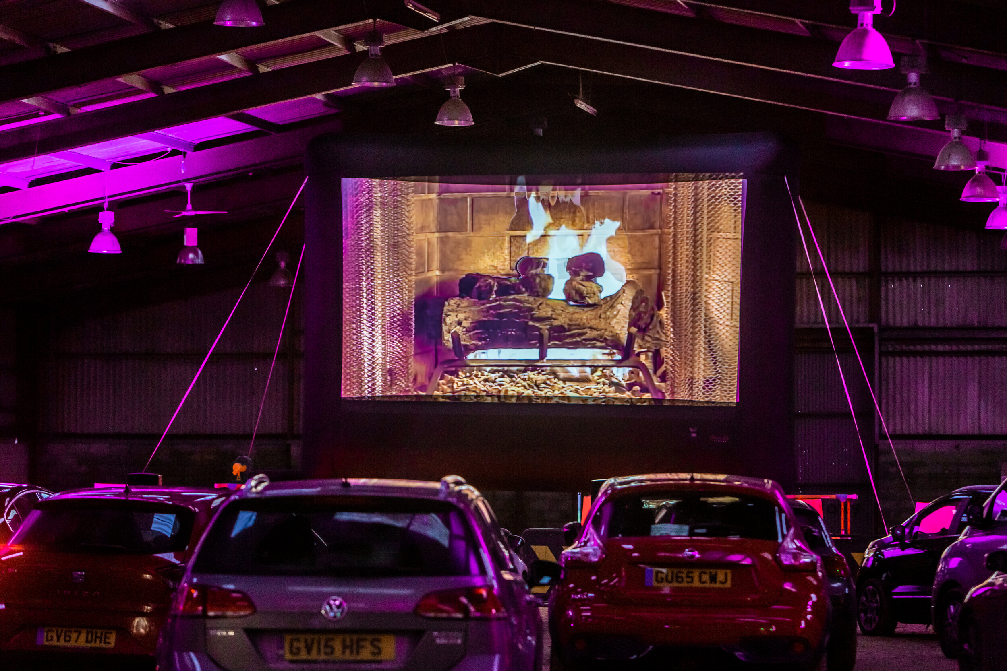
看电影 vo. Watch a movie
Kàn diànyǐng
电影 n. movie
diànyǐng

Slide 17
常常 adv. Often
chángcháng
dance
dance
dance
dance
dance
dance
dance
dance
dance
dance
dance
dance
dance
dance
dance
dance
dance
dance
dance
dance
dance
dance
dance
dance
dance
dance
dance

Slide 18
那nà conj. In that case/ then
In a dialogue, immediately following a statement by speaker A, speaker B can often start with 那(么) (nà (me)), which links up the sentences by the two speakers.
爱好Àihào hobbies
A:你有什么爱好？ What are your hobbies?
B:我喜欢跳舞。 I like dance.
A:那你喜欢唱歌吗？ Do you like to sing?
B:我(不)喜欢唱歌。 I (don’t)like singing.
Notes:
练习；底线的地方换其他的词

Slide 19
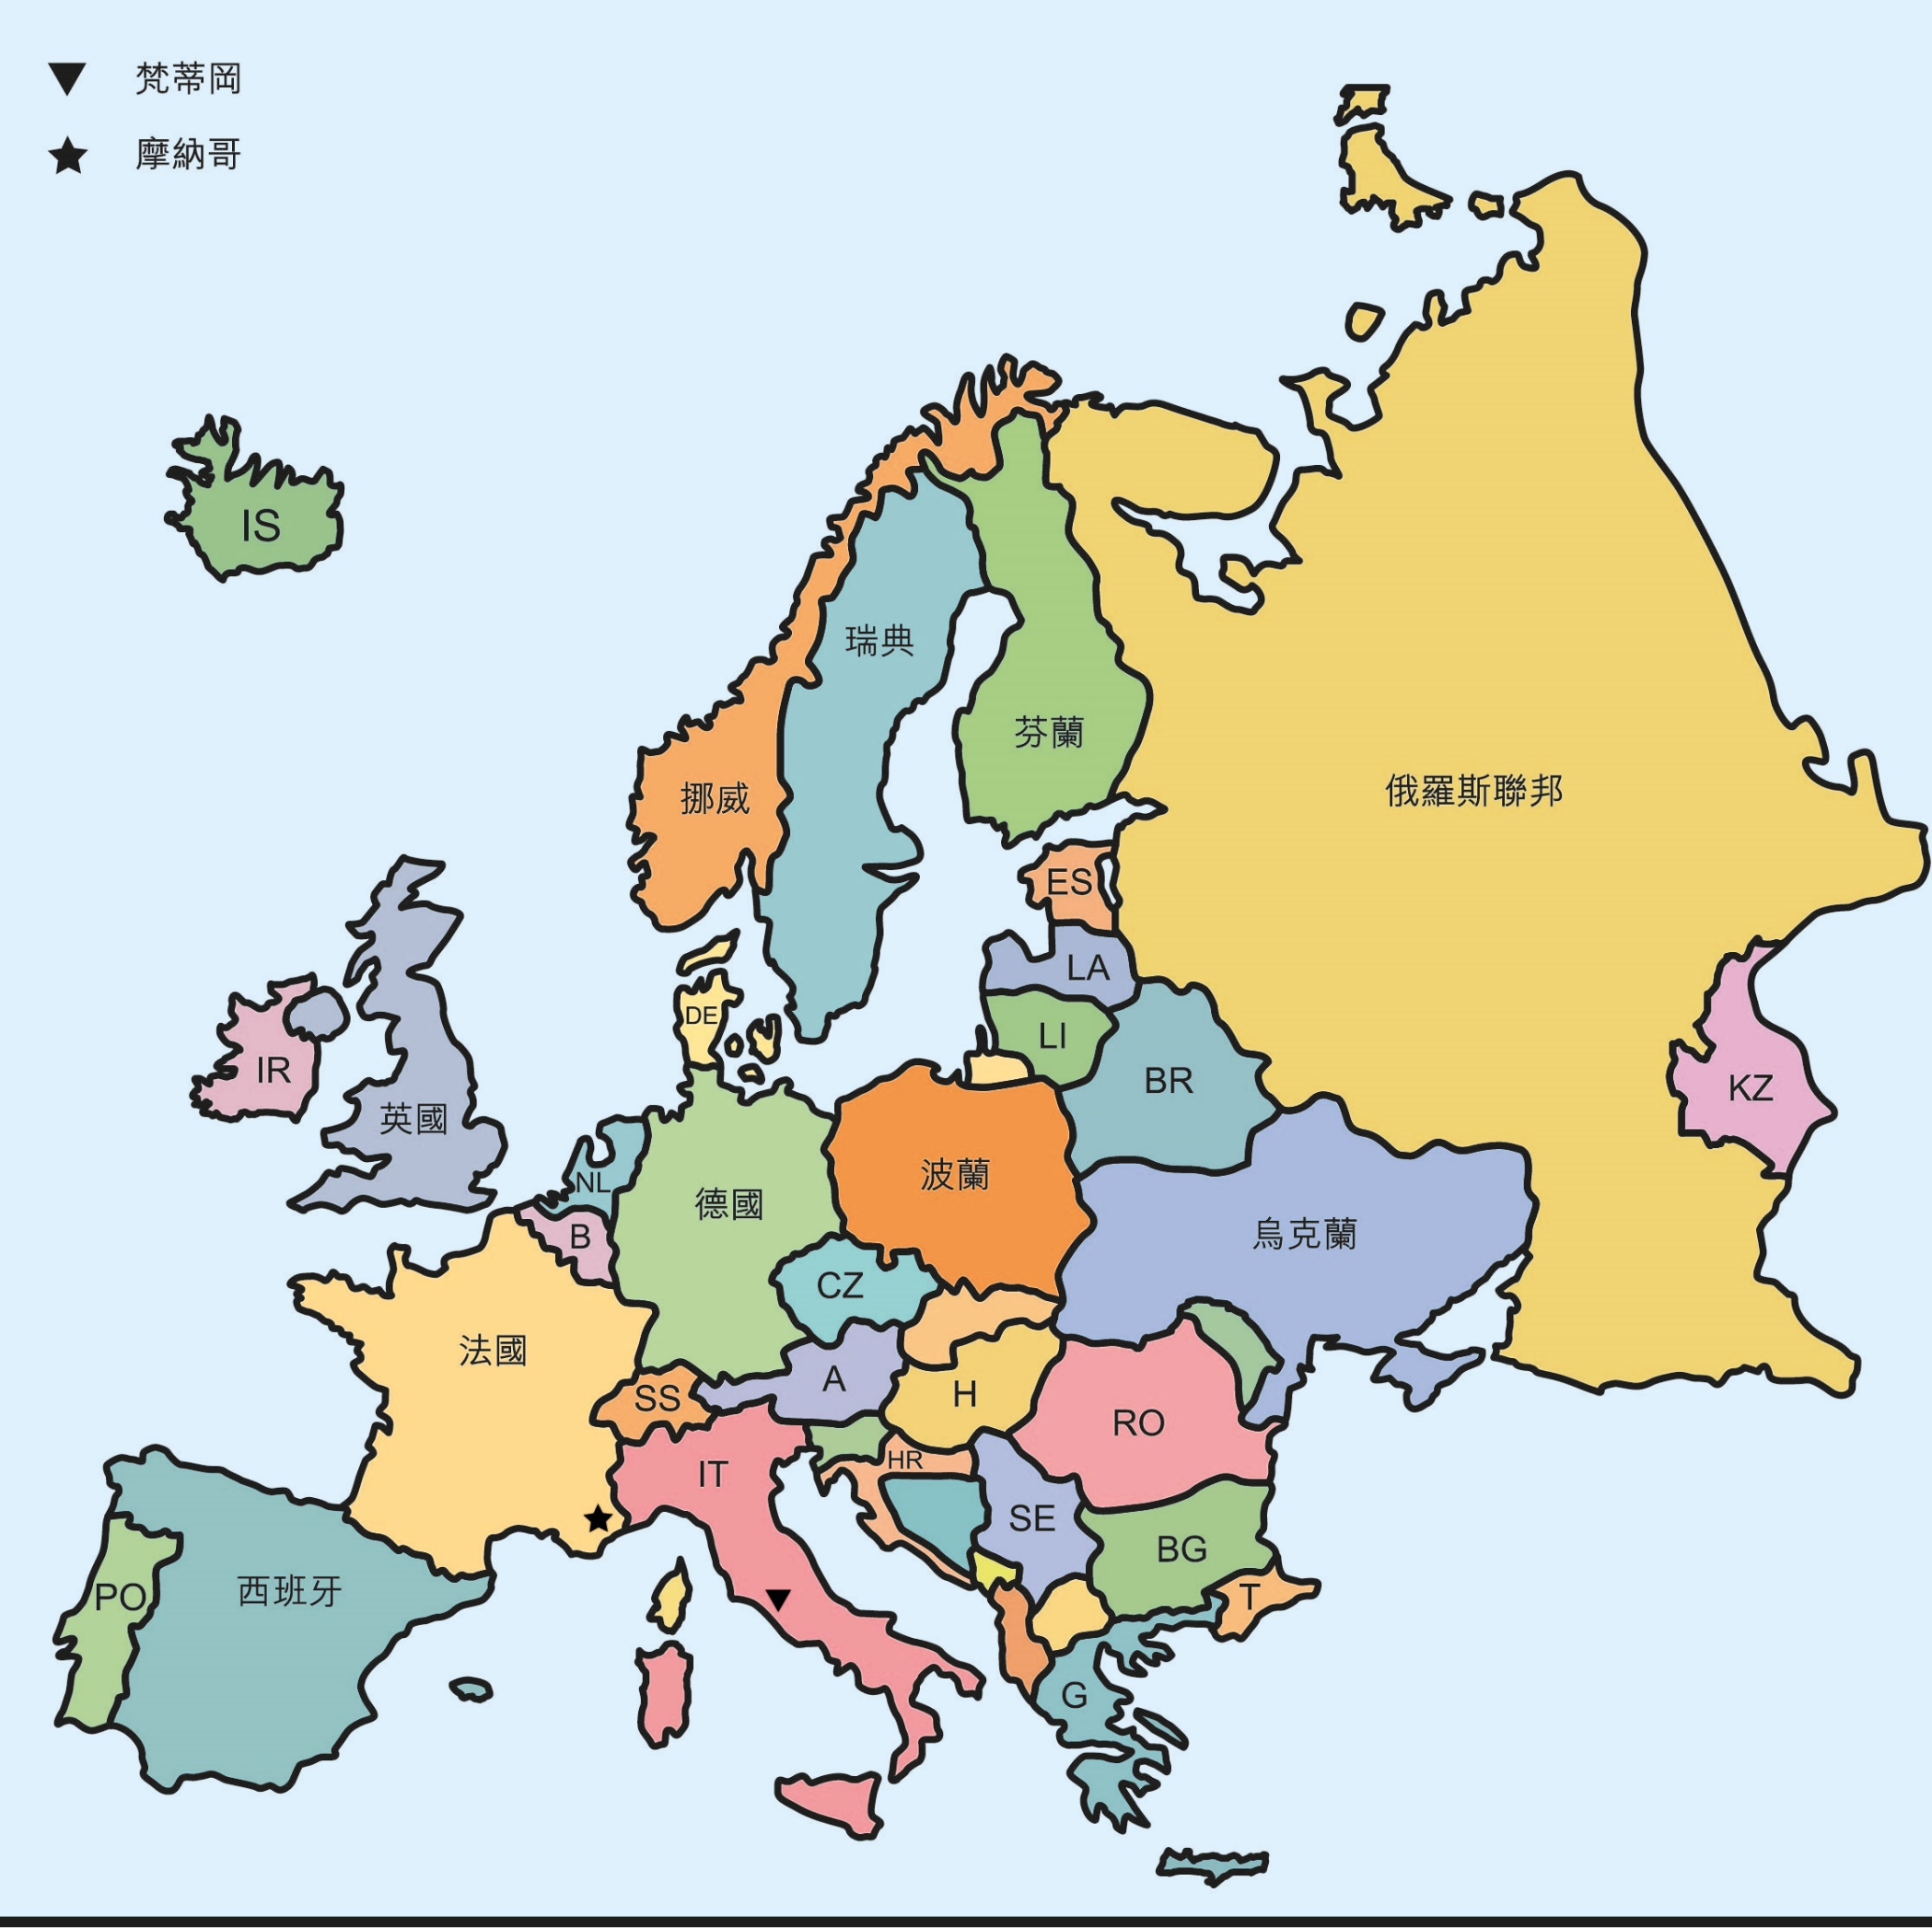
外国 n. foreign country
wàiguó
外国人 n. foreigner
wàiguórén

Slide 20
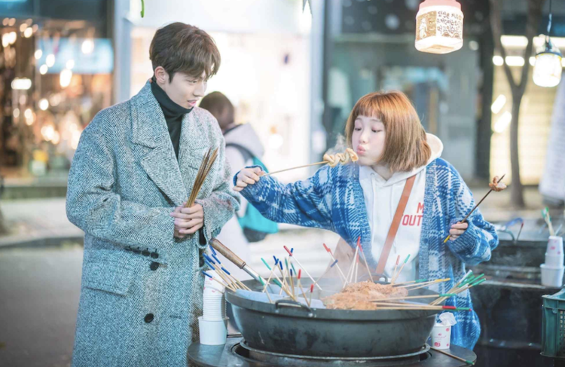
请客 vo. to invite someone (to dinner, coffee) /to play the host
qǐngkè

Slide 21
昨天 t. yesterday
zuótiān

Slide 22
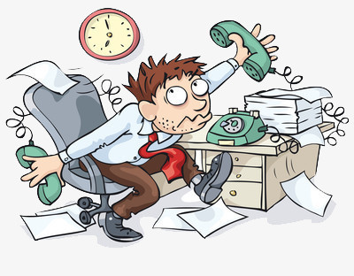
事(儿) shì(r) matter; affair; event
你现在有事(儿)吗？
Nǐ xiànzài yǒushì(r) ma?
Do you have something to do now?
我现在没有事/有事。
Wǒ xiànzài méiyǒushì /yǒushì.
I'm don't have anything/have something right now.

Slide 23
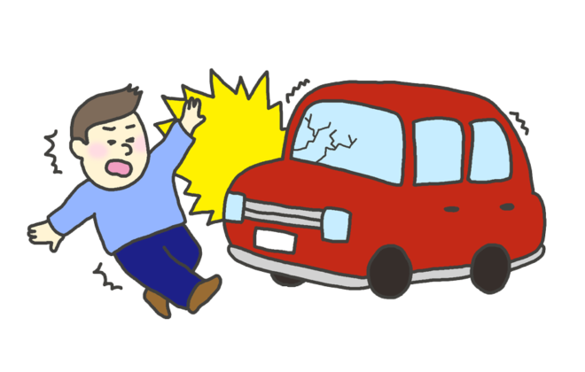
事(儿) shì(r) matter; affair; event
你有事(儿)吗？
Nǐ yǒushì(r) ma?
Is there anything wrong with you?
我没事。
Wǒ méishì.
I'm okay.

Slide 24
因为 yīnwéi Because
为什么 wèishénme Why
所以 suǒyǐ
conj. So
Did you eat dinner?
你为什么没有吃晚餐？
Nǐ wèishénme méiyǒu chī wǎncān?
因为___________，所以 _________。
Yīnwéi __________________, suǒyǐ __________________.

Slide 25
吃 chī
V. eat
饭 fàn
N. meal; rice
菜 cài
N. cuisine; dishes
中国菜
Zhōngguócài
Chinese food
捷克菜
Jiékècài
Czech food
英国菜
Yīngguócài
British food

Slide 26
Questions with 好吗 (hǎoma)
To solicit someone's opinion, we can ask 好吗 after stating an idea or suggestion.
那我们晚上吃中国菜好吗？

Slide 28
王朋 Wángpéng 李友 Lǐyǒu 高文中 Gāowénzhōng 白英爱 Báiyīng’ài (你的同学的名字) | 周末 常常 有的时候 明天 昨天下午五点半 (Time for you want) | 听 吃 看 打 跳 唱 | 球 音乐 饭 电视 电影 歌 舞 书

Slide 29
去qù v. to go + Action
If the performance of an action involves a change of location, then this is the construction we use.
(你的同学的名字) | 周末 常常 有的时候 明天 昨天下午五点半 (Time for you want) | 听 吃 看 打 跳 唱 | 球 音乐 饭 电视 电影 歌 舞 书

Slide 30
Affirmative + Negative (A-not-A) Questions (I) Besides adding the question particle 吗 (ma) to a declarative sentence, another common way of forming a question in Chinese is to repeat the verb or adjective in its affirmative and negative form.
你忙吗？
Nǐ máng ma?
你忙不忙？
Nǐ máng bùmáng?
我很忙。
Wǒ hěnmáng.
我不忙。
Wǒ bùmáng.

Slide 31
Affirmative + Negative (A-not-A) Questions (I) Besides adding the question particle 吗 (ma) to a declarative sentence, another common way of forming a question in Chinese is to repeat the verb or adjective in its affirmative and negative form.
你喜欢吃中国菜吗？
Nǐ xǐhuān chī zhōngguócài ma?
你喜欢不喜欢吃中国菜？
Nǐ xǐhuān bùxǐhuān chī zhōngguócài?

Slide 32
Affirmative + Negative (A-not-A) Questions (I) Besides adding the question particle 吗 (ma) to a declarative sentence, another common way of forming a question in Chinese is to repeat the verb or adjective in its affirmative and negative form.
请问王律师今天有没有事？
Qǐngwèn wánglǜshī jīntiān yǒu meiyǒu shì?
请问王律师今天有事吗？
Qǐngwèn wánglǜshī jīntiān yǒushì ma?

Slide 33
Affirmative + Negative (A-not-A) Questions
In this type of question there can be no adverbials before the verb other than time words as in (1) and (2).
你明天去不去？
你明天去吗
→__________________________？
她今天晚上看不看电视？
她今天晚上看电视吗
→__________________________？

Slide 34
Affirmative + Negative (A-not-A) Questions
If there is an adverbial--such as 很(hěn, very), 都 (dōu, all), or 常常 (chángcháng, often)--before the verb, the 吗 type question must be used instead, as in (3), (4), and (5).
他们都是学生吗？
*他们都是不是学生？
你常常看电影吗？
*你常常看不看电影？
王医生很忙吗？
*王医生很忙不忙？

Slide 35
Affirmative + Negative (A-not-A) Questions
If there is more than one verb, the question form applies to the first verb, as seen in (6) and (7).
你想不想跳舞？
*你想跳不跳舞？
你的同学去不去打球？
*你的同学去打不打球？

Slide 36
还 hái also; too; as well As an adverb, 还 (hái) indicates that the action or situation denoted by the verb involves someone or something else in addition to what has already been mentioned.
我喜欢吃中国菜，还喜欢吃美国菜。
Wǒ xǐhuān chī zhōngguócài, hái xǐhuān chī měiguócài.
你认识谁？(3)
Nǐ rènshi shuí?

Slide 37
A:白英爱，你周末喜欢做什么？
B:我喜欢打球、看电视。你呢？
A:我喜欢唱歌、跳舞，还喜欢听音乐。你也喜欢看书，对不对？
B:对，有的时候也喜欢看书。
A:你喜欢不喜欢看电影？
B:喜欢。我周末常常看电影。
Báiyīngài, nǐ zhōumò xǐhuan zuòshénme?
Wǒ xǐhuān dǎqiú, kàndiànshì. Nǐ ne?
Wǒ xǐhuān chànggē, tiàowǔ, hái xǐhuan tīngyīnyuè. Nǐ yě xǐhuān kànshū. Duìbuduì?
Duì, yǒude shíhòu yě xǐhuān kànshū.
Nǐ xǐhuan bùxǐhuan kàndiànyǐng?
Xǐhuān. Wǒ zhōumò chángcháng kàndiànyǐng.

Slide 38
A:那我们今天晚上去看一个外国电影，怎么样？我请客。
B:为什么你请客？
A:因为昨天你请我吃饭，所以今天我请你看电影。
B:那你也请王朋、李友，好吗？
A: …好。
Nà wǒmen jīntiān wǎnshang qù kàn yíge wàiguó diànyǐng, zěnmeyàng? Wǒ qǐngkè.
Wèishénme nǐ qǐngkè?
Yīnwéi zuótiān nǐ qǐngwǒ chīfàn, suǒyǐ jīntiān wǒ qǐngnǐ kàndiànyǐng.
Nà nǐ yě qǐng wángpéng, lǐyǒu, haoma?
...hǎo.

