Slide 1
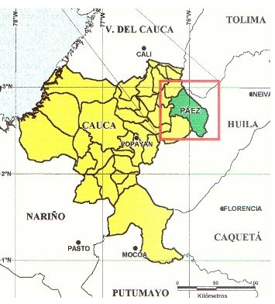
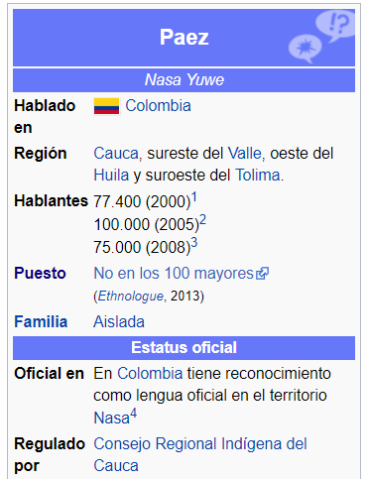
A short note on Páez (nasa yuwe)
A language spoken in Cauca, south-east of Valle de Cauca, east of Huila and south-east of Tolima.

Slide 2
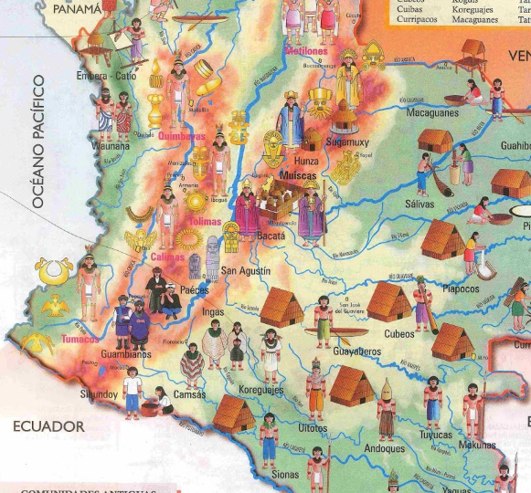

Slide 3
The language is originally called Nasa Yuwe “Language of the Nasa”
It is an isolated language and its classification is unclear. Most probably it belongs into a Macro-Chibcha family (with a possible relationship to Barbacoan languages like Awa, Namtrik, Cayapa and others).
Nasa Yuwe is an agglutinative language (synthetic language). The order of sentence is Subject- Object- Verb
Verbs can be inflected by adding suffixes of tenses and modes. In the second person, there is a feminine and masculine form.
Pronouns: The first and second person sg. are different for feminine and masculine genders. The third person is neutral.

Slide 4
Verb pa`ya “to call”- present tense
1st sg. | pa`yatj
2nd sg. | pa`yang (masc.) pa`yai`cue (fem.)
3rd sg. | pa`yac
1st pl. | pa`ya`tja`w
2nd pl. | pa`yai`cue
3rd pl. | pa`ya`ty
Personal pronouns:
1st sg. masc. fem. | andy u`cue
2nd sg. masc. fem. | indy i`cue
3rd sg. | tyäa
1st pl. | cue`sh
2nd pl. | i`cue`sh
3rd pl. | tyäawe`sh

Slide 5
The nouns have declinations- there is nominative, accusative, dative, ablative, locative and instrumental. These are formed with suffixes.
There is no lexical difference between singular and plural. Plural is marked by adding a suffix we`sh. (used only for people and animals and expresses a group of subjects):
U`y “woman”
Naa u`ya` wala zhichcue`
“This woman is very beautiful” (sg.)
U`ya` tawtyi umu` “The women weave chumbes” (pl.)
U`ywesha` tjengnaty űsu` “the women (a group) are looking. (col. pl.)

Slide 6
Nominative
Jimba` tangute`c wete. “The horse fell down white returning.”
Accusative
In singular: `s, after a consonant: a`s
In plural: ty, after a consonant: tyi
Mama` luucha`s pa` ya` c. “Mother called the child.” luuch- “child”.
Caapiyaj sa` luuchtyi pa`cuena űsa. “The teacher is looking for the children.”
Adjectives
Adjectives always follow the noun:
Yat wala “a big house”

Slide 7
To say “thank you” to somebody, a word wech is used in the sentence:
Wech pu`ching “Thank you for helping me.”
Some additional materials:
http://talkingdictionary.swarthmore.edu/paez/?lang=es
https://www.youtube.com/watch?v=F0njgdJkhmE&t=269s
https://www.youtube.com/watch?v=XEGfbFAqF0E
https://www.youtube.com/watch?v=dYrqAHLvL6Y

