Slide 1
Listening to the Art on a Seabed

Slide 2
Conditions
Water and Dreams
Vilém Flusser's media philosophy as a daydreaming
“…For him technical media had been a pile, a treasure of possibilities (or perhaps better potentialities), which permanently had to be explored, every day and every day again.”
Z. Zielinski

Slide 3
Fluxes and stagnant waters
“I live them synthetically in their original complexity, often according them my unreasoning adherence.”
G. Bachelard

Slide 4
Images that sound
“This is not the music of the future but rather a critique of the present.”
V. Flusser
https://www.youtube.com/watch?v=lyfOcAAcoH8

Slide 5
Images that sound
“It will become pointless to try to distinguish between music and
so-called visual arts because everyone will be a composer, will make images. The universe of technical images can be seen as a universe of musical vision.” V. Flusser
„Technical sounding images“
Vilém Flusser

Slide 6
Images that sound
EVERY ICON
John F. Simon jr., 1996
Given: A 32 X 32 Grid
Allowed: Any element of the grid
to be black or white
Shown: Every Icon
http://numeral.com/appletsoftware/eicon.html

Slide 7
Images that sound
EVERY ICON
John F. Simon jr., 1996
Image sings its composition…

Slide 8
Into the universe of singing images
The eye assigns them names,
but only the hand truly knows them.
G. Bachelard
“… not Euclidian space but dataspace that is fugitive, flecking, more akin to water or wind in its ephemeral, flowing materiality, than to the granite permanency of traditional works of art.”
R. Ascott

Slide 9
Surface play of Chamber orchestra
“The scenario, the fable, I propose here is this: people will sit in separate cells, playing with their fingertips on keyboards, staring at tiny screens, receiving, changing, and sending images. … People will be in contact with one another through their fingertips and so form a dialogical net, a global superbrain, whose function will be to calculate and compute improbable situations into pictures, to bring information, catastrophes about. […] In terms of function, then, it will be meaningless to try to distinguish between natural and artificial intelligences (between primate brains and secondary brains). The whole thing will function as a cybernetically controlled system that cannot be divided into constituent elements: a black box.”
V. Flusser

Slide 10
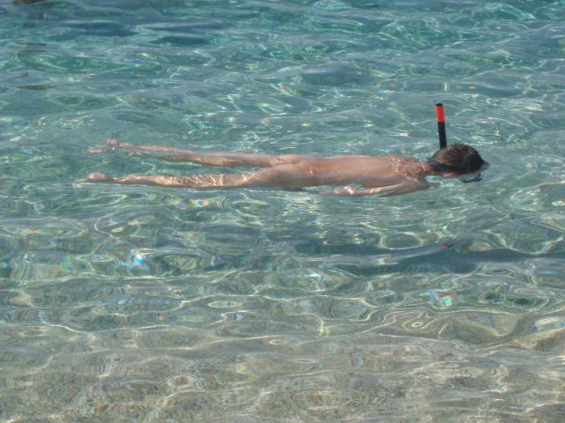
Immersion & snorkeling
“… in the present context it refers to the experience of being inside the world of a synthetic image. … By extension the term is used to describe the experience of the user of certain new media technologies (particularly Virtual Reality, but also videogames …”
M. Lister & col.

Slide 11
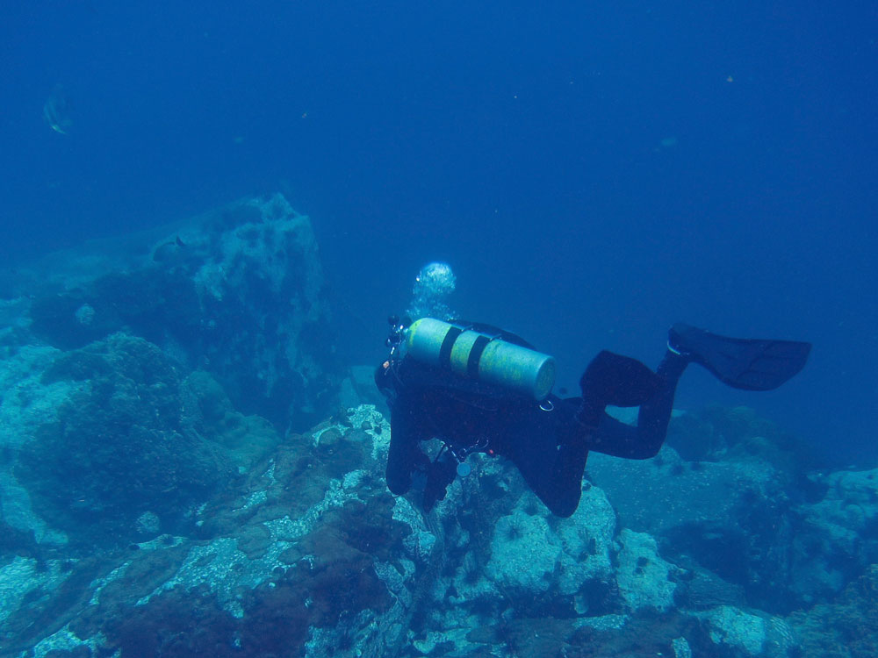
Materiality of media analyses & Deep diving
Into the universe of singing images …
…to know the materiality of the dataspace

Slide 12
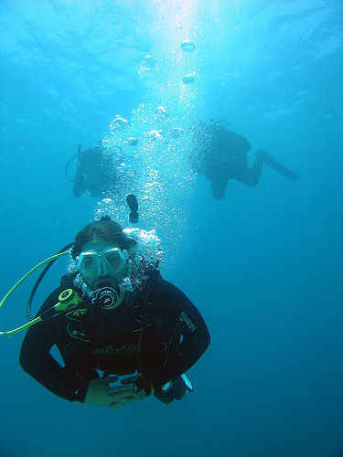
Thank you for your attention

