Slide 1
Golem today.
Programming excesses
Jana Horáková, Masaryk University Faculty of Arts

Slide 2
Computer /network/ is a golem of today
I have run through a number of essays… from God to the machine … That machine … is a modern counterpart of the Golem of the Rabbi of Prague.
Norbert Wiener: God & Golem, Inc.: A Comment on Certain Points Where Cybernetics Impingnes on Religion. 1964.

Slide 3
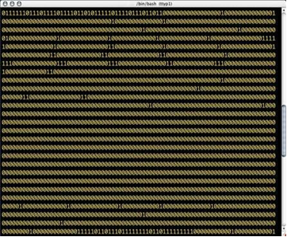
Golem of Prague & figure/s/ of excess
Programming of excess 01 / Artistic virus
Alex McLean
Forkbomb.pl (2002)

Slide 4

Golem of Prague & figure/s/ of excess
Programming of excess 01 / Artistic virus
Jaromil
ASCII Shell forkbomb (2002)

Slide 5
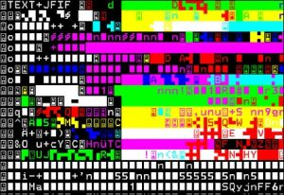
Golem of Prague & figure/s/ of excess
Programming of excess 02 / Aesthetics of glitch
Jodi
http://text.jodi.org
http://wwwwww.jodi.org

Slide 6
Golem of Prague & figure/s/ of excess
Programming of excess 02 / Aesthetics of glitch
“Functional machines, robots, mechanized people (from Judaism`s Golem, Frankenstein`s monster) to the rebellious computers of the twentieth century) are interpreted as alien to human nature, sooner or later becoming ‘evil’ as they stop functioning correctly.”
Olga Goriunova, Alexei Shulgin: Glitch. In Software Studies / A Lexicon (ed. M. Fuller), 2008, p. 104.

Slide 7
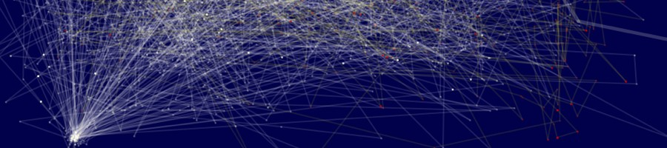
Golem of Prague & figure/s/ of excess
Programming of excess 03 / Interrogability (reflexivity of the system)
Loops and feedbacks
Andrew Spitz: Me doing this (2012)
http://www.youtube.com/watch?v=1qt_pAhExHM&feature=related

Slide 8
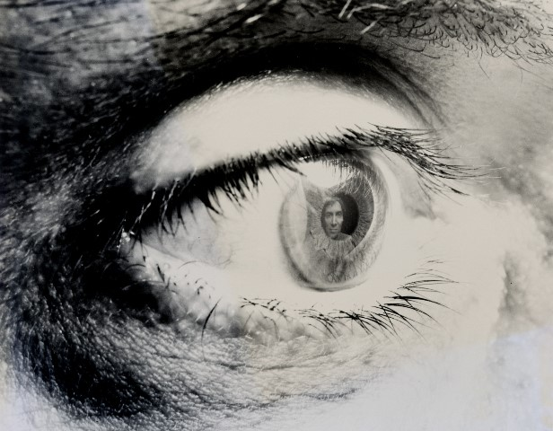
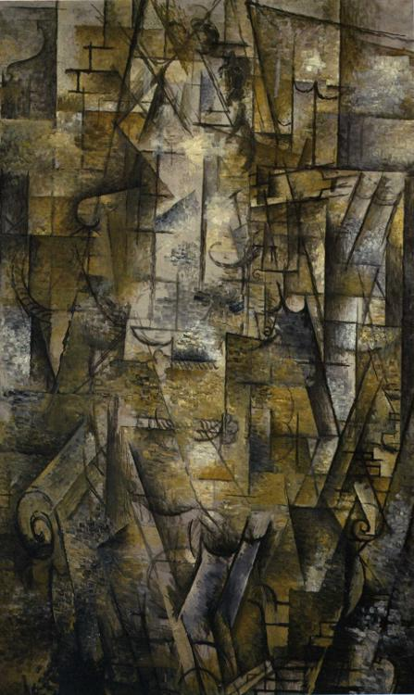
Golem of Prague & figure/s/ of excess
Programming of excess 03 / Interrogability (reflexivity of the system) The excess of self-portrait
William Anastasi: Maintenance III (Self Portrait), 1967. / Georges Braque: Woman Reading, 1911. / Andrew Spitz: Me doing this, 2012.

Slide 9


Golem today.
Programming of excess
GOLEM
https://www.pond5.com/sound-effects/1/walk-earth.html#1/2080/walk,earth

Slide 10
Thank you for your attention.
horakova@phil.muni.cz

