Slide 1
The TILLER GIRLS DANCING ORNAMENT OF POSTINDUSTRIAL SOCIETY

Slide 2
Dancing ornament of postindustrial society

Slide 3
Intro „This is not the music of the future but rather a critique of the present.“ Vilém flusser
Q: How work-of-art will look like in post-industrial society?
A: To find an answer follow tendencies of the electronic media…
…“[…] the tendency of technical images to become more and more immediate and to repress texts or the tendency of images to become electronic or the tendency of apparatuses to become smaller and cheaper and to penetrate into the smallest spaces.“ (Vilém Flusser, Into the Universe of Technical Images, p. 160)

Slide 4
INTRO „This is not the music of the future but rather a critique of the present.“ Vilém flusser
Q: How work-of-art will look like in post-industrial society?
A: Follow tendencies of the electronic media…
and you will find two core characteristics:
1. Compute and compose are synonyms
“[T]he universe of music is as calculated and computed as that of technical images.” (Flusser).
2. The universe of technical images has an audio-visual character
“It will become pointless to try to distinguish between music and so-called visual arts because everyone will be a composer, will make images. The universe of technical images can be seen as a universe of musical vision.” (Flusser)

Slide 5
Technical sounding image Art of the future
Genealogy of „technical sounding image“
Abstract painting
New music compositions
Technical sounding image is an „ideogram that work“
{graphic score & performativity of software}

Slide 6
Technical sounding image Art of the future
Robotic performance as a technical sounding 3D image
1. Genealogy of Robotic performance
Abstract, pure film (as a fusion of abstract painting and new music composition)
_____________________________________________
2. Robotic performance as an „Ideograms that works.“
Robotic performance as an anti-narrative, non-matrixed “choreography” of abstract 3D objects.

Slide 7
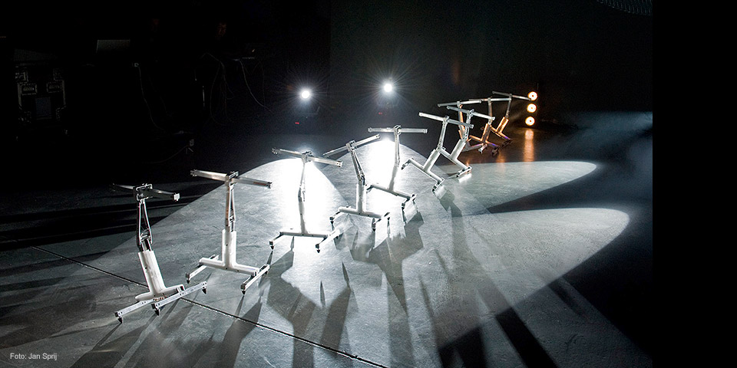
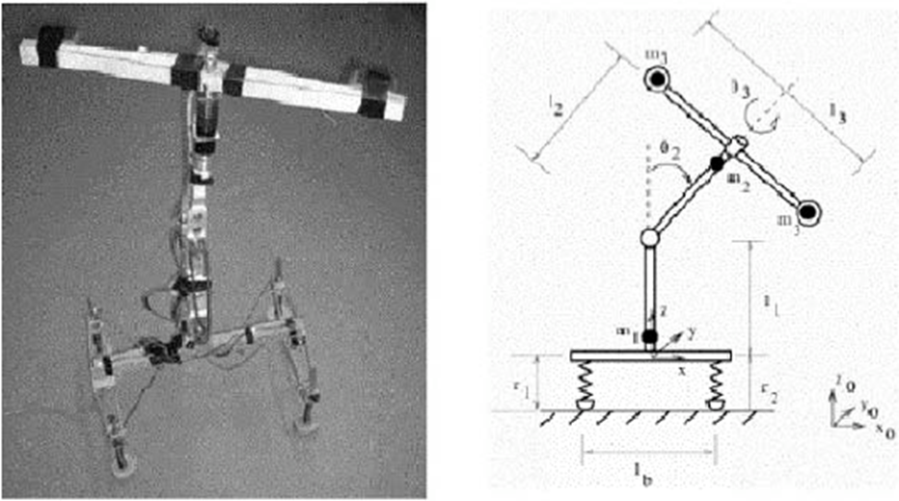
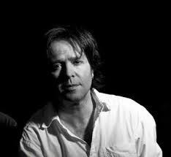
The tiller girls. All meet the stage
“What we do is, that we start from the minimum amount of phrases, movements. […] Just like people are improvising with music, we are improvising with the robots, the sound and the lights.” (L.-P. Demers)
http://disnovation.tumblr.com/post/81681234826/louis-philippe-demers-the-tiller-girls-ai-meets

Slide 8
The tiller girls. All meet the stage
“Something equivalent to Taylor’s scientific selection, based on measurement, was involved in [Tiller’s] choice of personnel. The four children who were to feature in the first showpiece were to be as near identical as possible in height and build. … he … choreographed geometrical pattern of synchronized movements, in which they were drilled morning until late at night.” (P. Auslander)
https://www.youtube.com/watch?v=0XQ17OZ4mwU

Slide 9
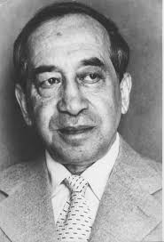
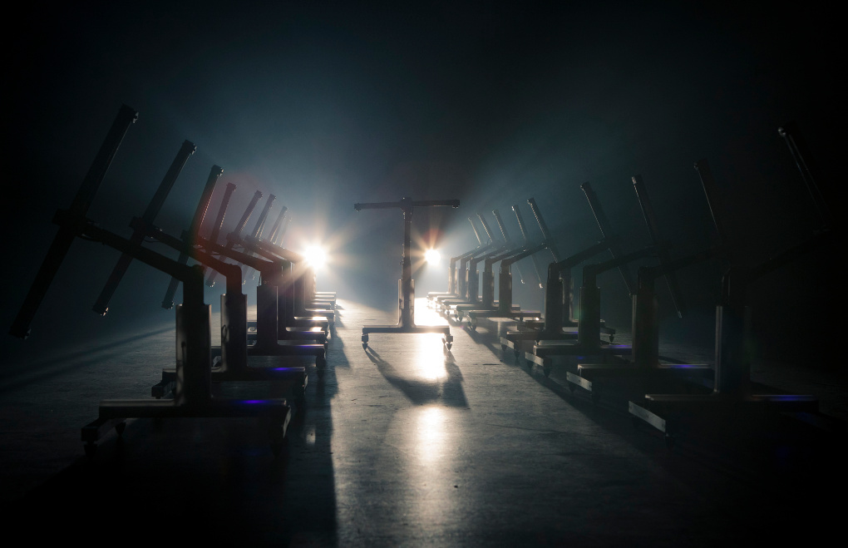
Remake the tiller girls. All meet the stage
“…Tiller Girls. These products of American distraction factories are no longer individual girls, but indissoluble girl clusters whose movements are demonstrations of mathematics. As they condense into figures in the revues, performances of the same geometric precision are taking place in what is always the same packed stadium, be it in Australia or India, not to mention America.” (Kracauer, p. 75-76)

Slide 10
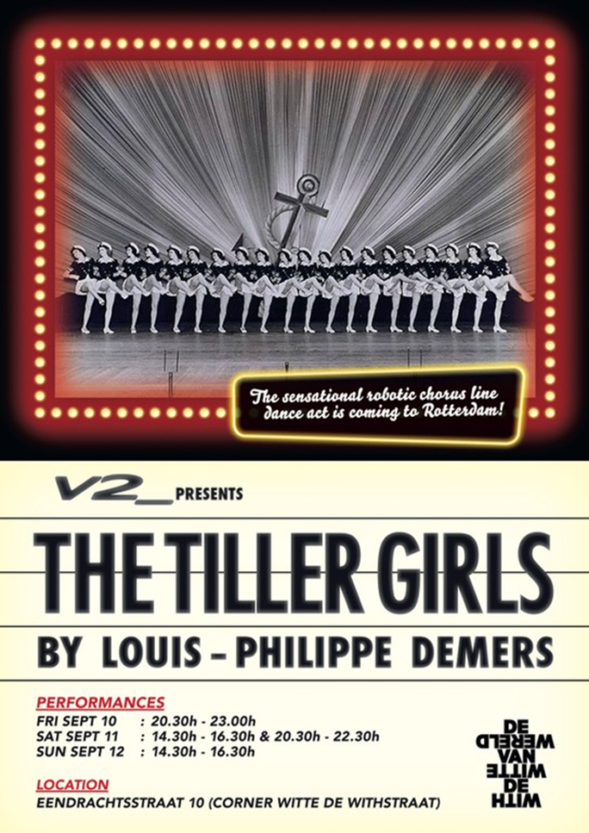
Remake The Tiller girls. All meet the stage
“…Tiller Girls. These products of American distraction factories are no longer individual girls, but indissoluble girl clusters whose movements are demonstrations of mathematics. As they condense into figures in the revues, performances of the same geometric precision are taking place in what is always the same packed stadium, be it in Australia or India, not to mention America.” (Kracauer, p. 75-76)

Slide 11
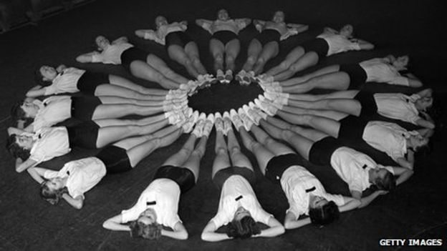
Remake the tiller girls. All meet the stage

Slide 12
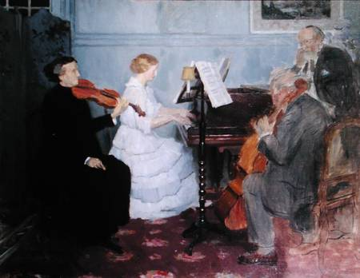
Chamber music

Slide 13
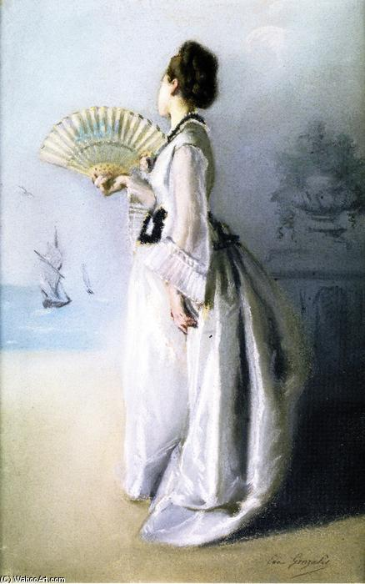
General theory of gestures. Remedy for daydreaming…
„[…] the gesture may be defined as a movement that expresses a freedom. […].“
(V. Flusser, Gestures, p. 163)
“This sums up the engagement of the theory presented here: to contribute to an enhanced freedom, and to be able to actually make gestures in the full sense of the concept defined previously.” (V. Flusser, p. 175/176)

Slide 14
Thank you for your attantion

