Slide 1

Korean Pop Class
https://www.youtube.com/watch?v=MBdVXkSdhwU

Slide 2
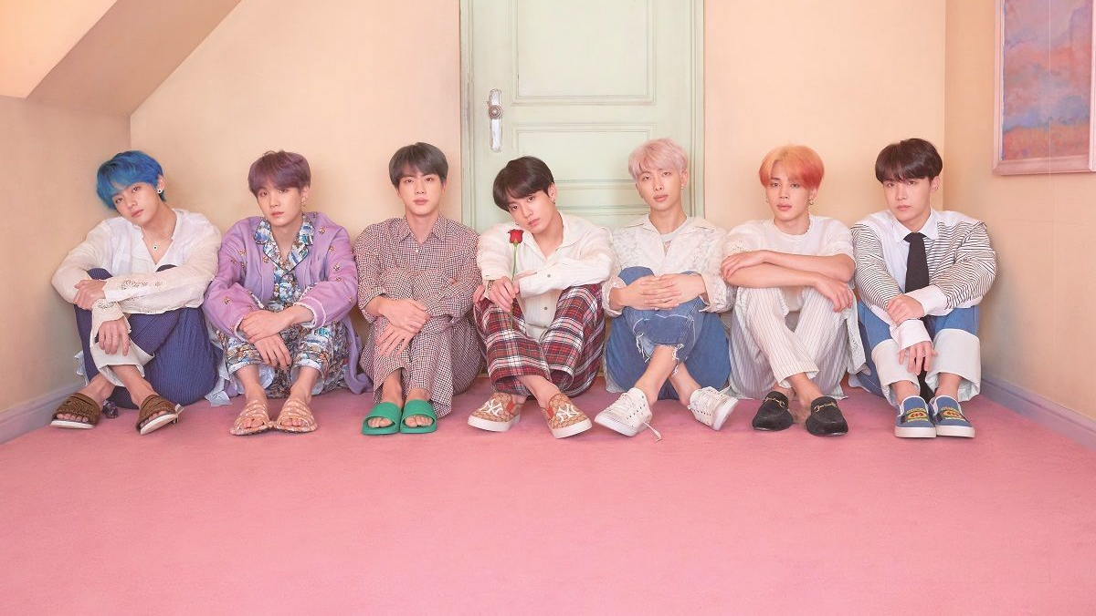
Which groups do you like?

Slide 3

Korean K-POP Fan’s Terms
Idol
Fandom
Cheering Light Stick
Hom-Ma
Direct Cam (Gik Cam)

Slide 4
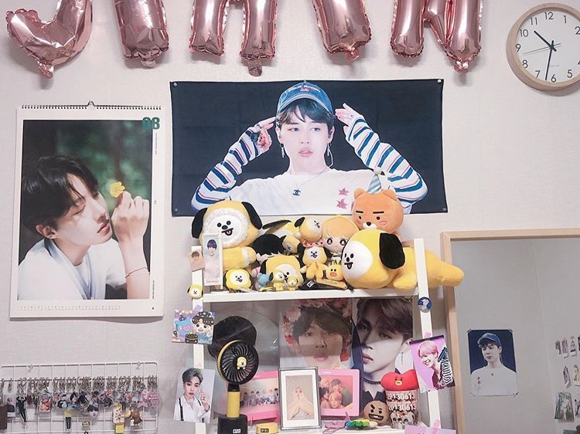
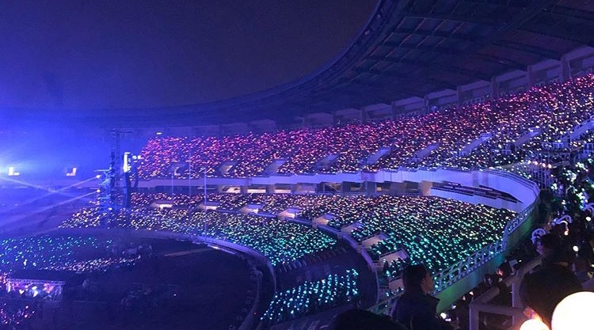

Slide 5



Slide 6
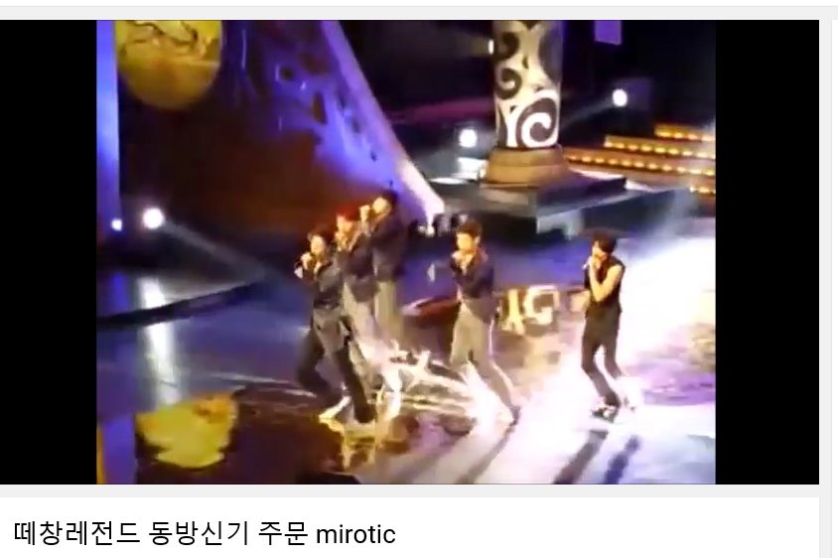
https://www.youtube.com/watch?v=EqnKqmX8UhM

Slide 7




Slide 8
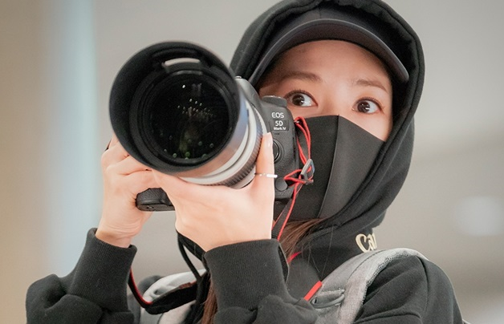
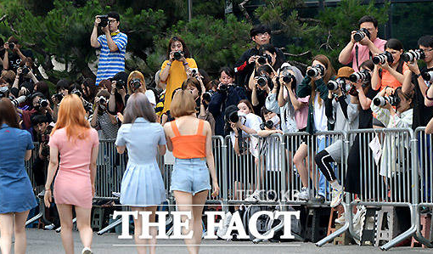

Slide 9
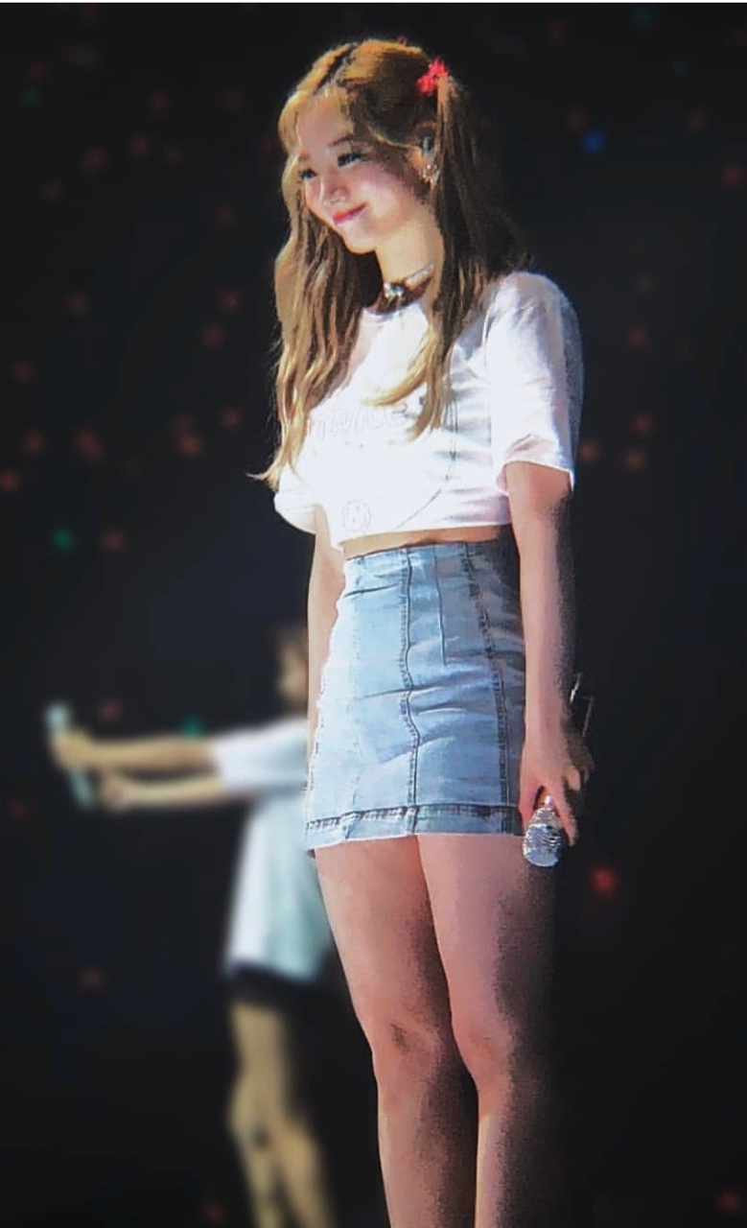



Slide 10
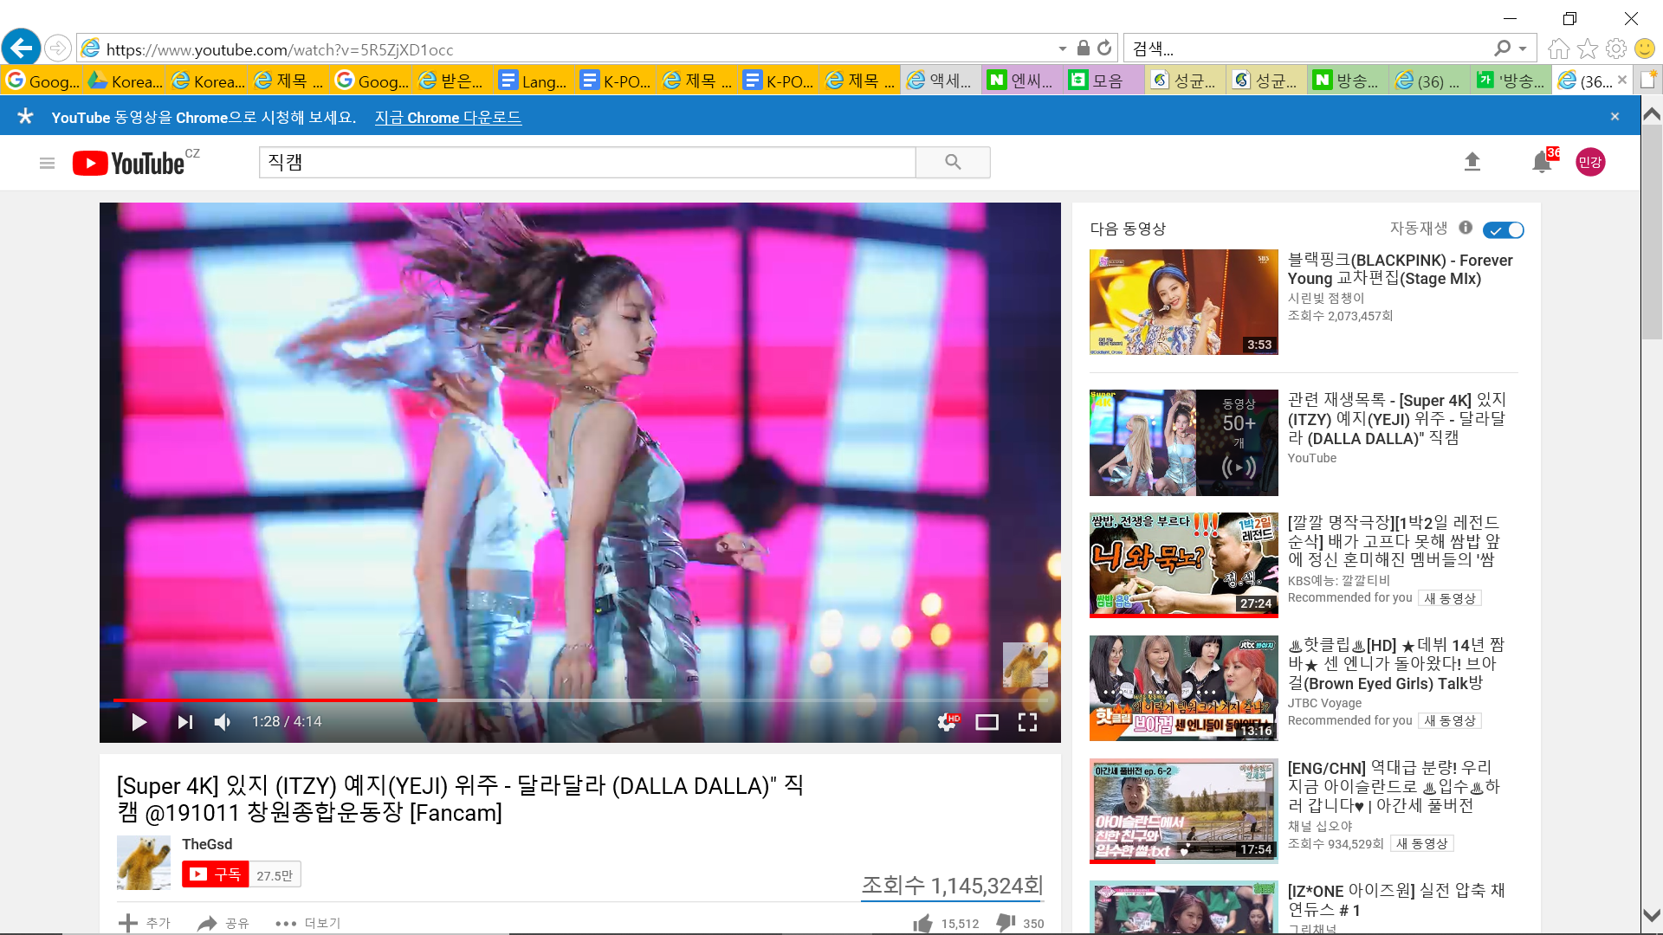
https://www.youtube.com/watch?v=5R5ZjXD1occ

Slide 11
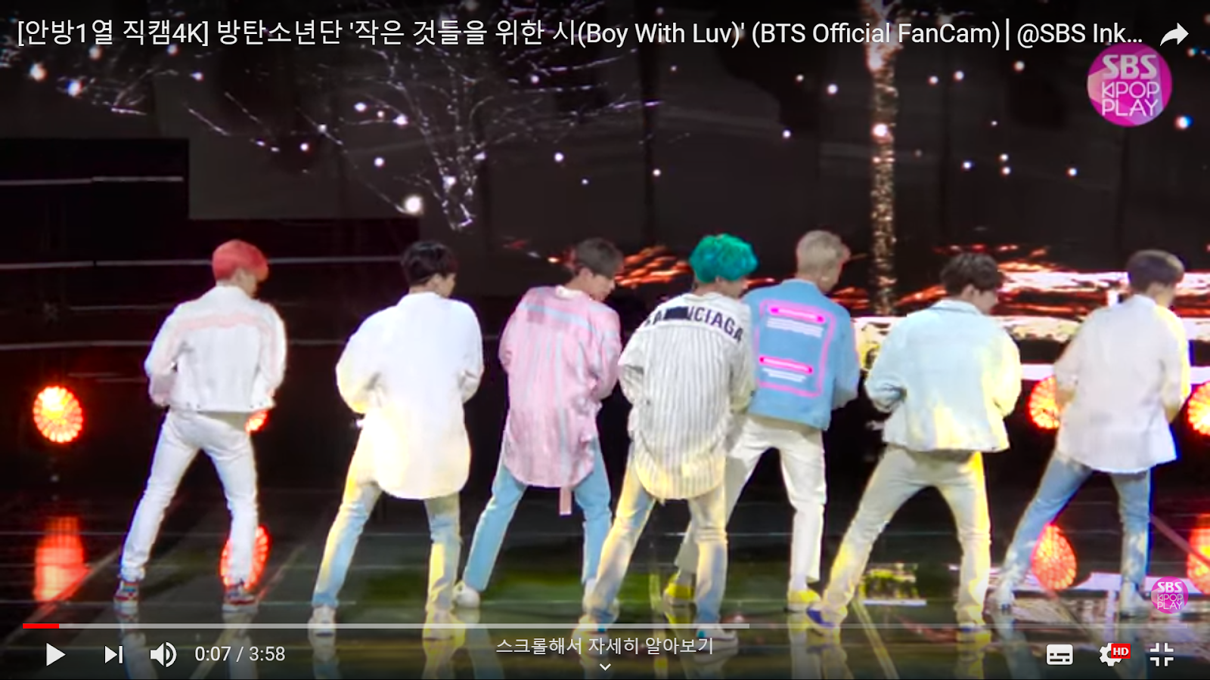
https://www.youtube.com/watch?v=0gdEeP2CWEk

Slide 12
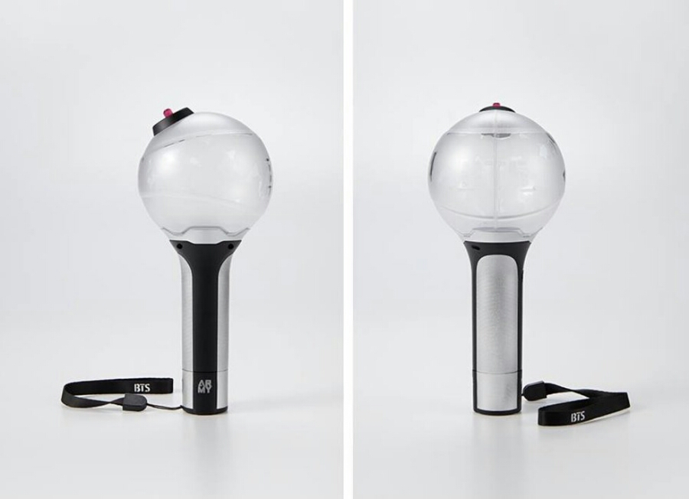
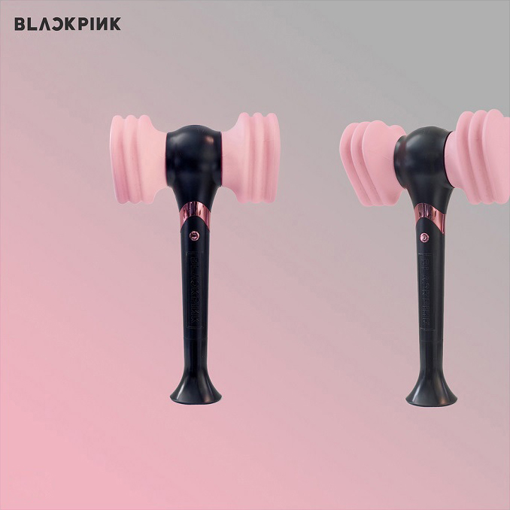
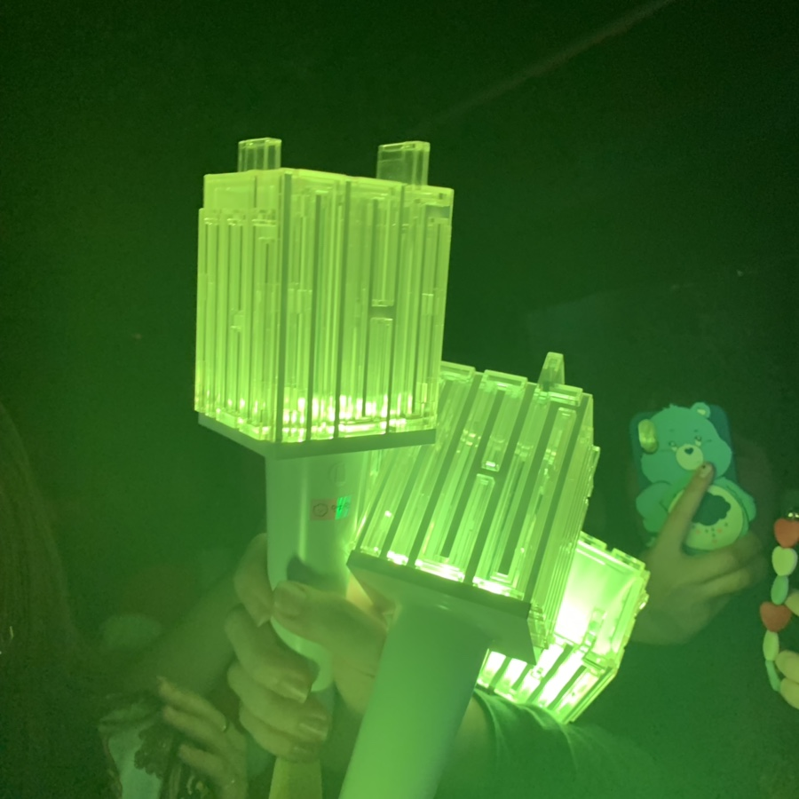


Slide 13

Korea’s Idol Audition programs

Slide 14
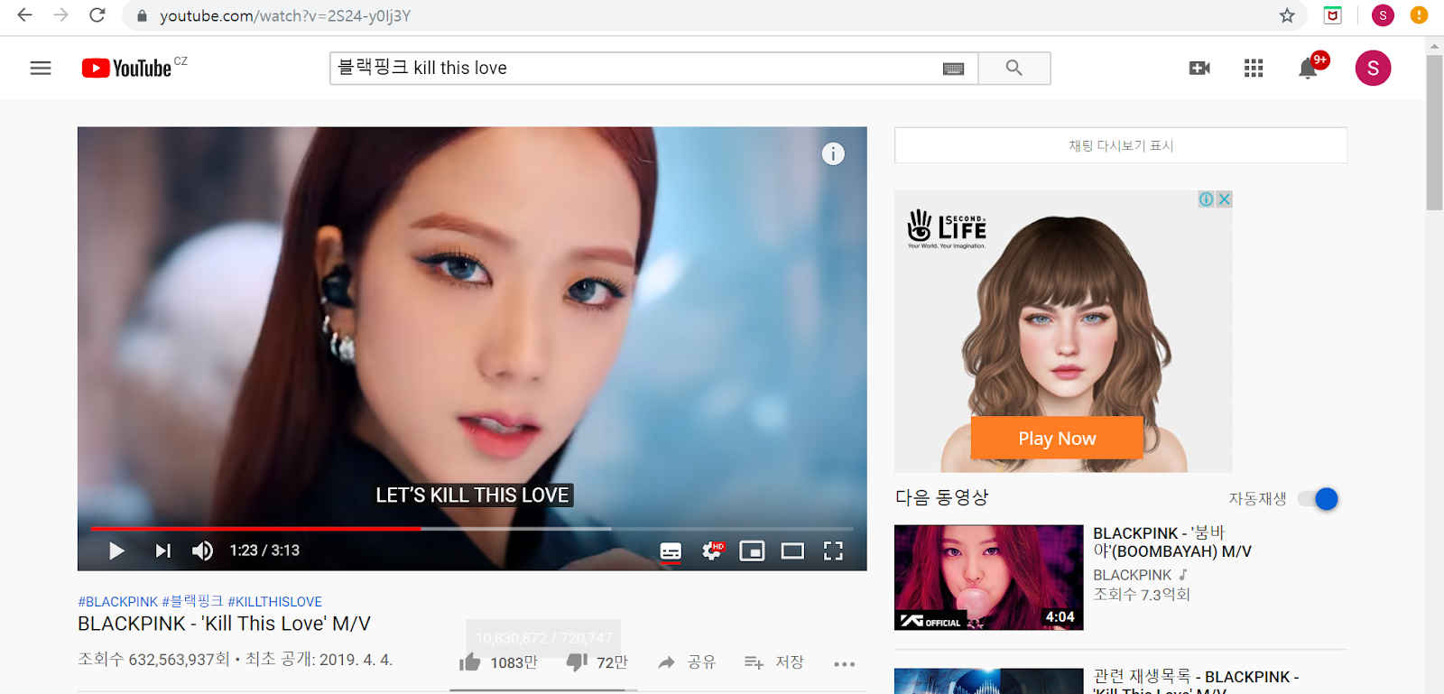
https://www.youtube.com/watch?v=2S24-y0Ij3Y

Slide 15
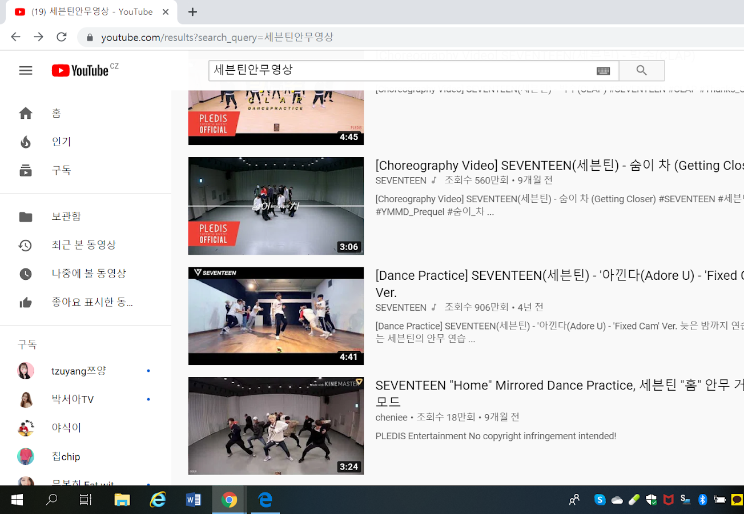

https://www.youtube.com/watch?v=zV-Ift89Lgo

