Slide 1
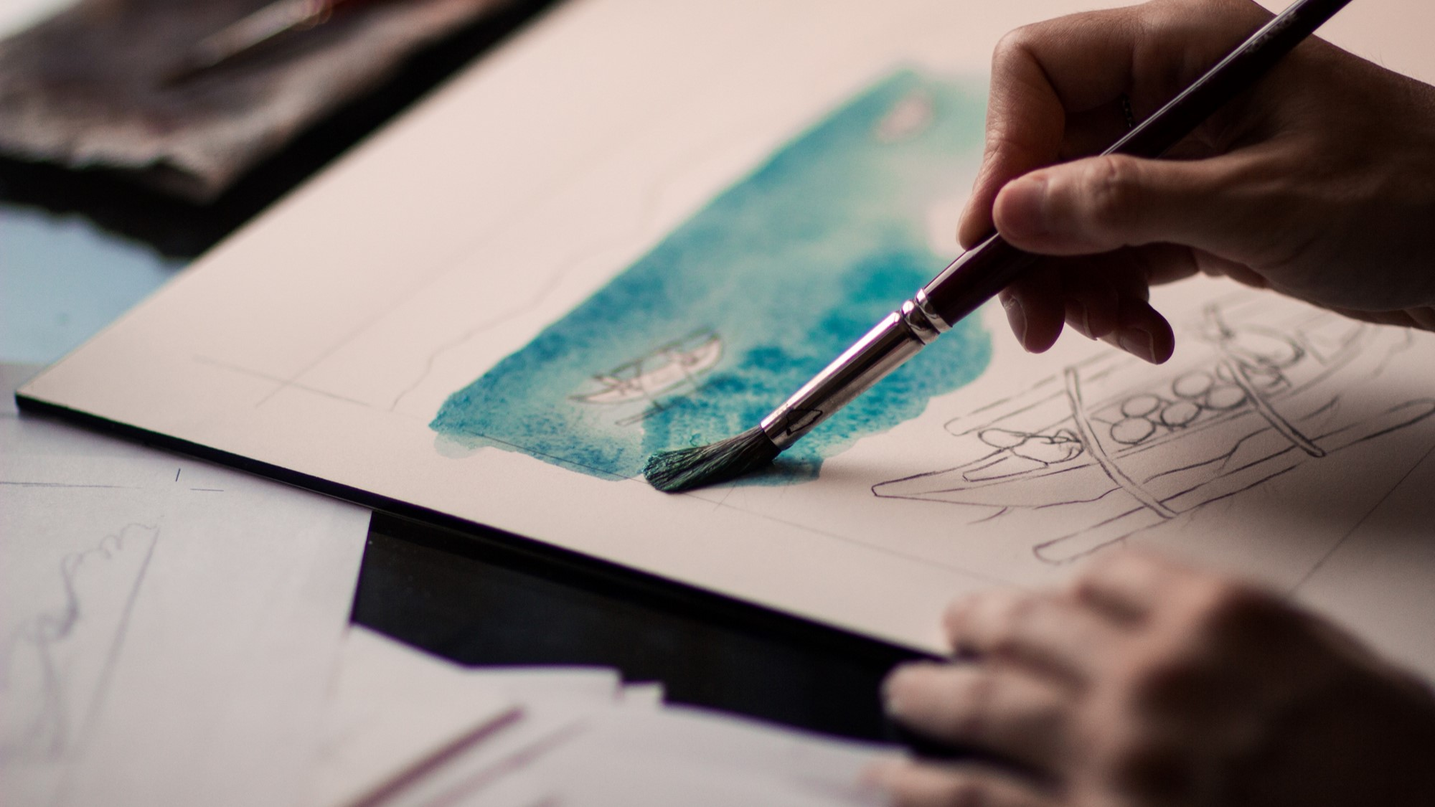
KPOP CLASS
2019.11.12 + 2020.12.24 + 2021.11.03 + 2022.10.26 + 2023.10.25
Copyrightⓒ. Saebyeol Yu. All Rights Reserved.

Slide 2

KPOP HISTORY

Slide 3

H.O.T
01
Best songs
We hate all kind of violence
The Warrior’s Descendants
Candy
Resurrection
Light
Light
https://www.youtube.com/watch?v=6U4IEgYmXRk
Comedy program
https://www.youtube.com/watch?v=fgbG-zPpt7w

Slide 4
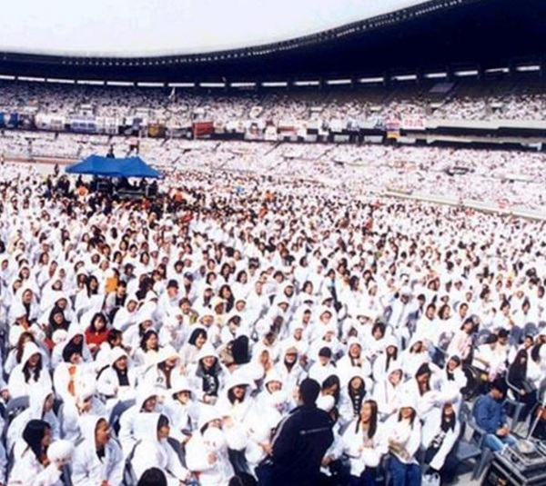
H.O.T
02
Popularity
Awards
Fandom

Slide 5
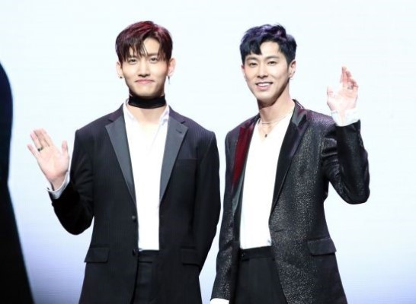
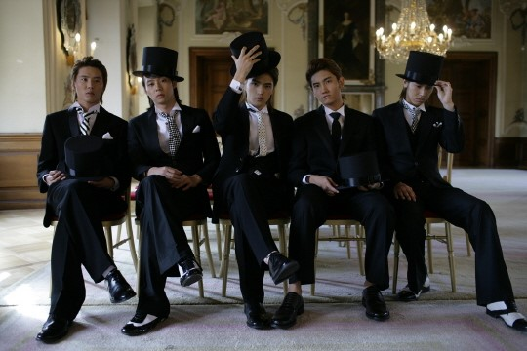
Saebyeol’s PowerPoint
PART 1
Second GENERATION OF KOREAN IDOLS
Why
https://www.youtube.com/watch?v=Jd9yMbsiY_w
110610 드림콘서트 2011 MAXIMUM+WHY - TVXQ!
https://www.youtube.com/watch?v=pAVF3QEhRgE
TVXQ
Members
You know Yunho
Cheogang Changmin
Debut: 2003.12.26
Entertainment: SM
Fandom: Cassiopeia[Korea], Bigeast[japan]
Official color: Pearl Red
Members
You-know Yunho
Cheogang Changmin
Yeongung Jaejung
Xia Junsu
Micky Yucheon
hug 2004
https://www.youtube.com/watch?v=ItwTg3Cm7oU

Slide 6
https://www.youtube.com/watch?v=KpTEBV5iMNg
유노윤호
https://www.youtube.com/watch?v=fSiaoZ-GzBU
Copyrightⓒ. Saebyeol Yu. All Rights Reserved.

Slide 7

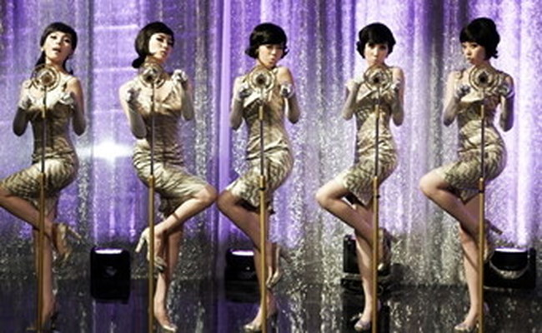
Saebyeol’s PowerPoint
PART 1
Second GENERATION OF KOREAN IDOLS
Girl’s Generation
Wonder Girls
Entertainment: SM
Debut: 2007.08.05
Official color: Pastel Rose
Members: Taeyeon Sunny Tiffany Hyoyeon Yuri Sooyeong Yuna Seohyeon
Entertainment: JYP
Debut: 2007
Members: Yubin Yeeun Sunmi Hyerim
Gee 2009
https://www.youtube.com/watch?v=U7mPqycQ0tQ
Nobody 2008
https://www.youtube.com/watch?v=QZBn1e9pr2Q

Slide 8
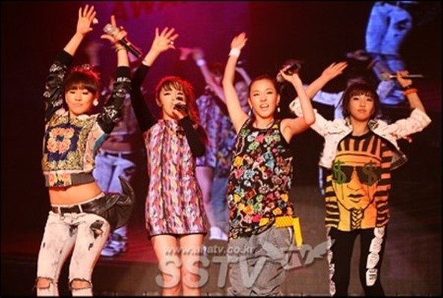
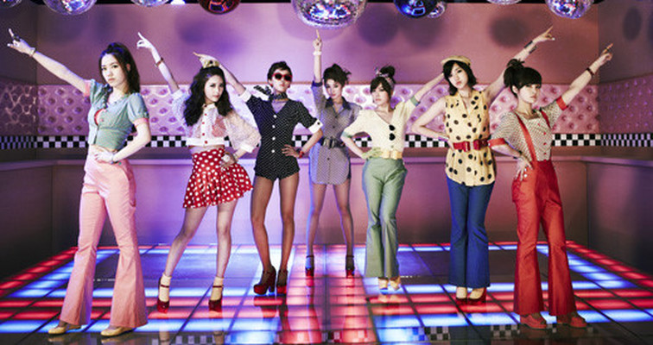
I don’t care 2009
https://www.youtube.com/watch?v=9wJs6dByMJI
2NE1
Entertainment: YG
Debut: 2009
Members: Park Sandara CL Park Bom Gong Minji
T-ARA
Entertainment: MBK
Debut: 2009
Members Jiyeon Hyomin Eunjung quri Boram Soyeon
Roly Poly 2009
https://www.youtube.com/watch?v=afwK0Mv0IsY

Slide 9

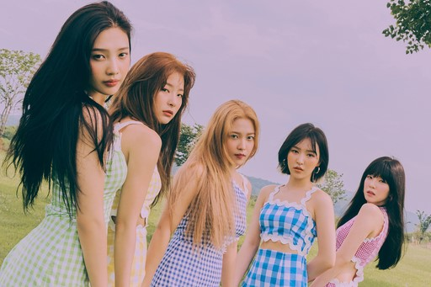
growl 2013
https://www.youtube.com/watch?v=kHwFJRFCq-8
EXO
Entertainment: SM
Debut: 2012.04.08
Members: Suho Chanyeol Kai DO BeakHyun Sehun Xiumin Chen Lay
Red Velvet Bridge Compilation
Red Velvet Bridge Compilation [2014-2019] - YouTube
Red Velvet
Entertainment: SM
Debut: 2014
Members: Wendy Irene Seulgi Joy Yeari

Slide 10
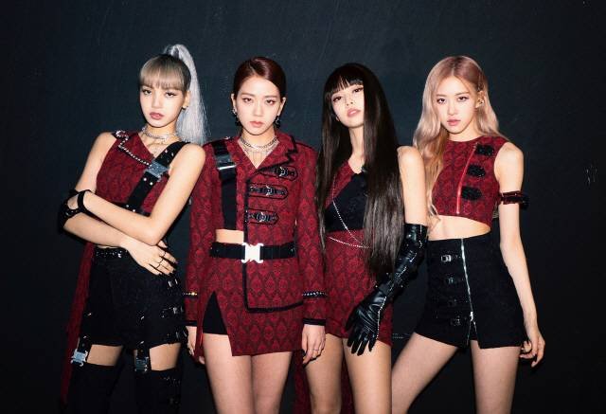

BLACKPINK
Debut: 2016
Entertainment: YG
Members: Jisu Jenny Rose Lisa
https://www.youtube.com/watch?v=IHNzOHi8sJs
TWICE
Debut: 2015.10.20
Entertainment :JYP
Memebers: Nayeon Jungyeon Momo Sana
Jihyo Mina Dahyeon Chaeyeong Zzeuwi
https://www.youtube.com/watch?v=ePpPVE-GGJw

Slide 11


DAY6

