Slide 1

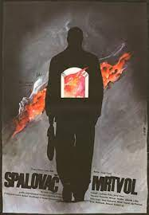
THE CREMATOR
Juraj Herz
What kind of people are used by Dictatorial Regimes

Slide 2
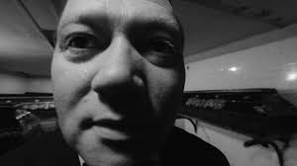
Cinematic Style and Format
Distorted perception of the world conveyed by erratic filming techniques
First person point of view provides unsettling personal connection
Quick and jarring cuts and sudden zoom ins
In many ways a horror film
Incredibly inventive techniques and style

Slide 3
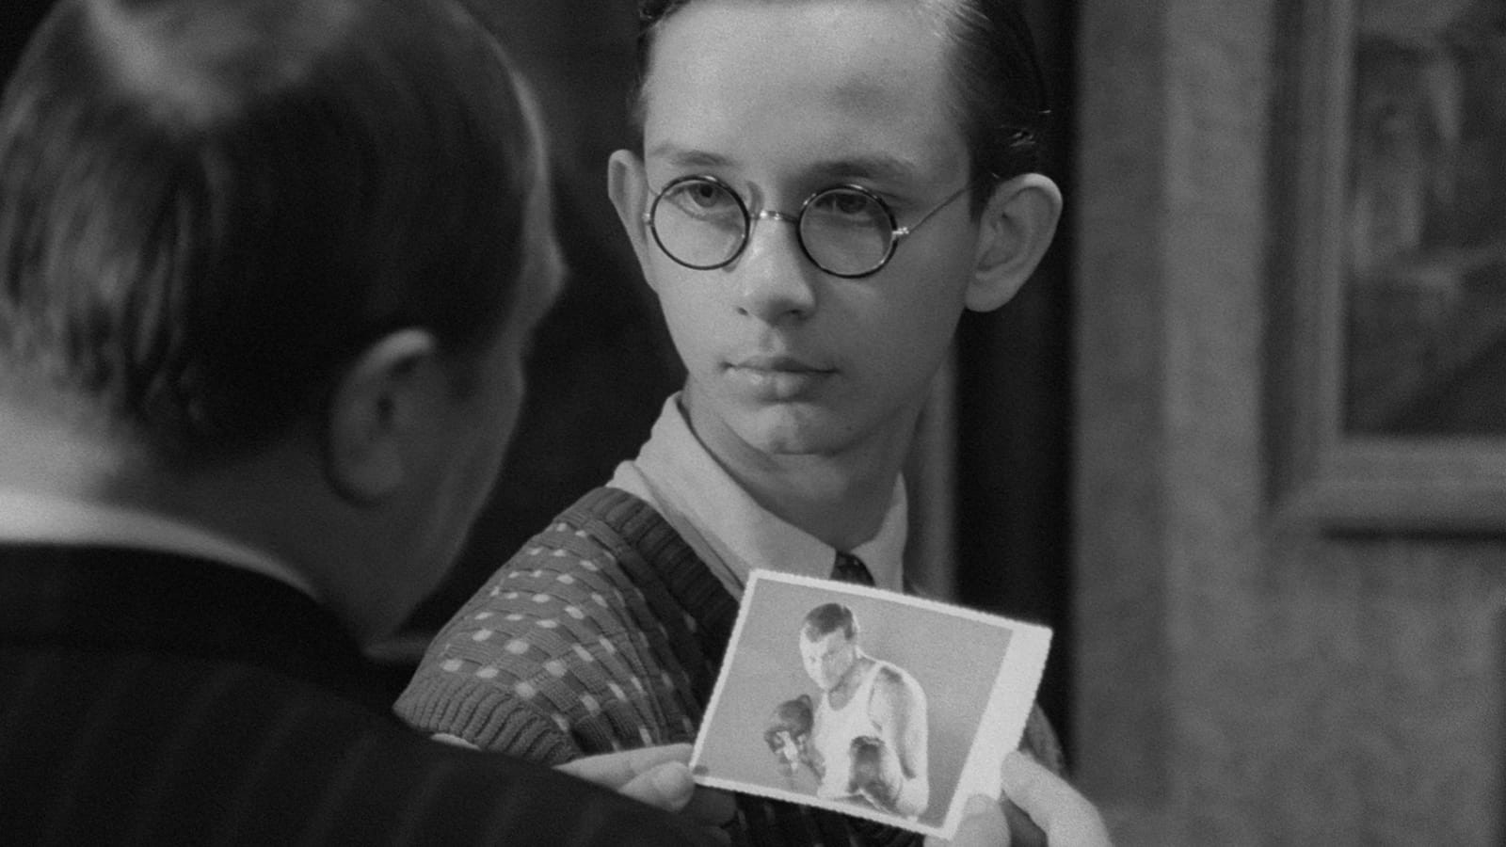
The ‘type’ of person susceptible to Nazism
Patriarchal, masculine values prioritized – emphasis on strength
Attracts men who feel they are owed something
Men who feel a desire to be special or noticed
In this case clearly already slightly unhinged
‘Effeminate’ characteristics must be removed

Slide 4
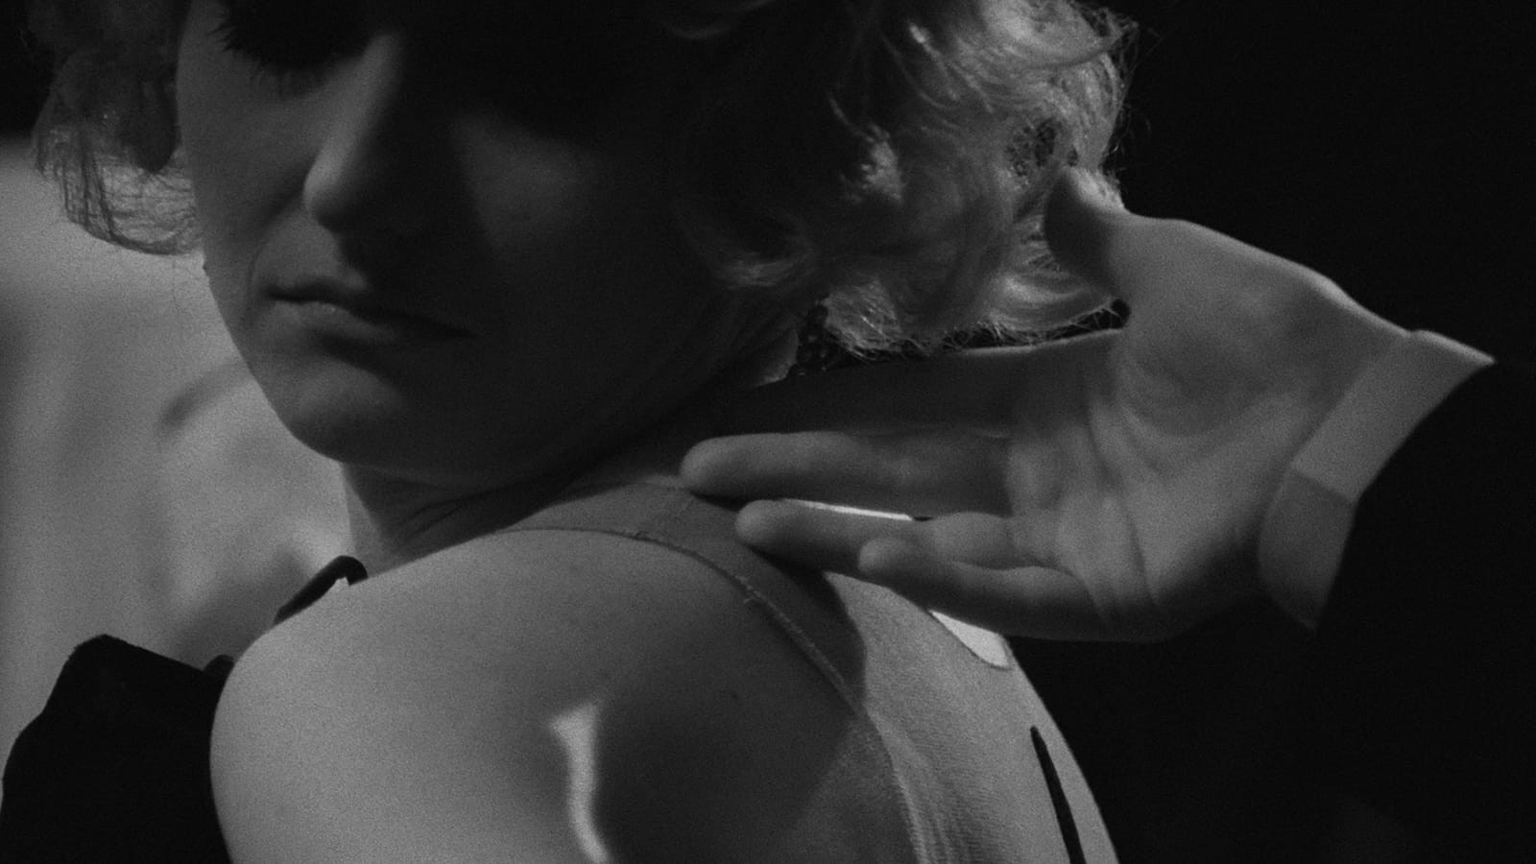
Ironic Inherent weakness of Nazi Characters
Insecurities both physically and mentally
Sexism – all the Nazi characters are shown to treat women as both inferior and as sexual objects
Kopfrkingl harasses his young staff, his wife and frequents the brothel
Women’s role in the film is limited to that of a victim – no real voice
Fear acts as a catalyst to push people into certain behaviours
German army on the doorstep motivates many into self preservation

Slide 5
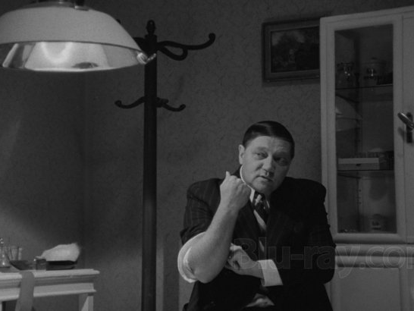
Concepts of Purity
Kopfrkingl becomes obsessed with concept of purity
Insistent on maintaining his good German blood
Removes the ‘taint’ from his name and bloodline by eliminating all members of his Jewish family one by one
Once again insecurities present
Insistence on tee totalism – reflection of his obsession with purity

Slide 6
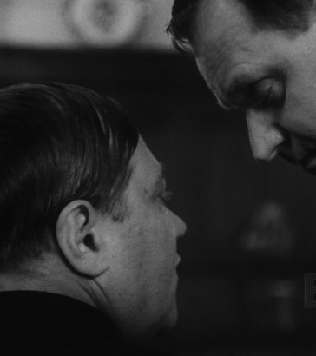
Betrayal and Denunciations
Kopfrkingl betrays every Jew he knows in order to win the Nazis favor
Key element of Dictatorial regimes is fear and mistrust
Reliance on informants
Omnipresence ensures suppression of opposition and facilitates cleansing of undesirables

Slide 7
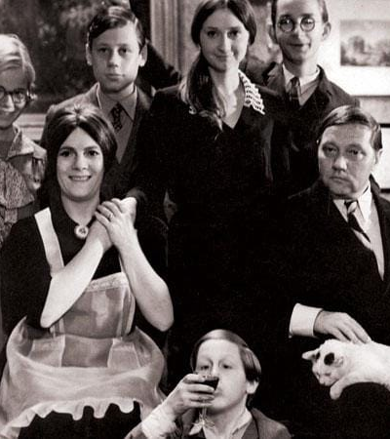
Illusion of the perfect Middle Class
Kopfrkingl constantly maintains that he has a perfect, content family
Strict adherence to societal norms and roles
So caught up in presenting his family as perfect that he lacks real connection, he is completely alienated
Nazi emphasis on family morals
A dangerous concept as it encourages submission and suppresses individualism
Ideal conditions for dictatorial regimes

