Slide 1
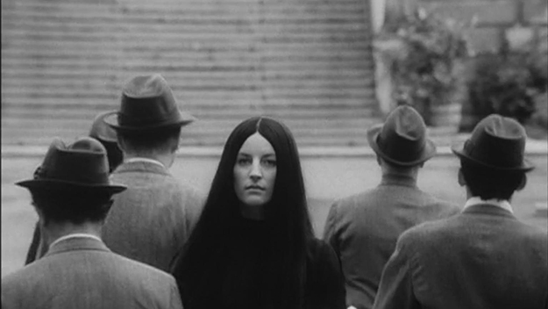
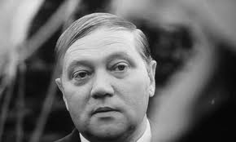
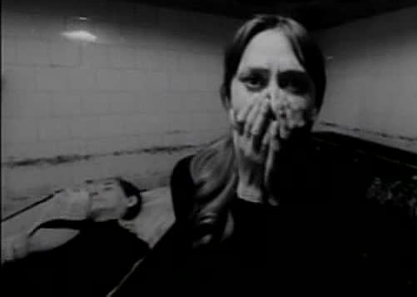
The Cremator
‘What kind of people are used by dictatorial regimes, according to The Cremator?’ - Dominic Bogle

Slide 2
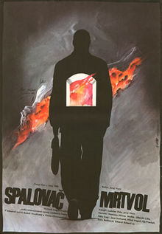
Defining The Dictatorial
System that relies on and seeks to maintain a unified ideology
Ideology can quickly be used as tool to judge an individual’s use or lack thereof
‘Them’ and ‘Us’ Dichotomy
Exercised throughout the film
Simplification of ideals fuels the rise of Dictatorship
Promise of Paradise
Notes:
Through the eyes of a dictatorial regime, it’s important to understand the groups of people and their respective uses to each authoritarian establishment.
A dictatorship is a government system that relies on and aims to maintain an ideologically weighted rule. Within this framework, whole groups and sections of a nation’s population can be categorised and judged by their usefulness and passivity to the government. This ultimately leads to the simplification and creation of a certain ‘them’ and ‘us’ dichotomy of which is a powerful rhetorical tool used in dictatorial propaganda and highlighted throughout the movie.
Most notably when Walter visits and speaks of German pride and blood to that of Czech, When Nazi party members take to villifying the Jewish population to that of the Germans and Bohemians, and when Karel Kopfringl convinces himself of the incompatibility of his family within his political and spiritual ambitions.
This process of simplification of ideals and aims is characteristic of Dictatorial regimes, often aiding their swift rise to uncontested power and allowing the everyday citizen to see justification in acts that, under a more balanced and less divisive regime, would seem all too harsh.
And further justification and reason for the endurance of such regimes is that of the promise of the idea of paradise - or a Utopia. The near-religious belief that world changing difference and benefit can reach a nation through the work and support of a dictator is paramount to a regime’s stability. For far beyond the simplifcation of ideals, it is this promise of paradise that can truly transform individuals into a collective embrace of a political ideal, no matter the means of procurement.

Slide 3
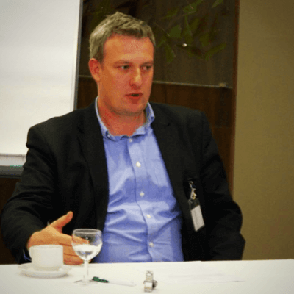
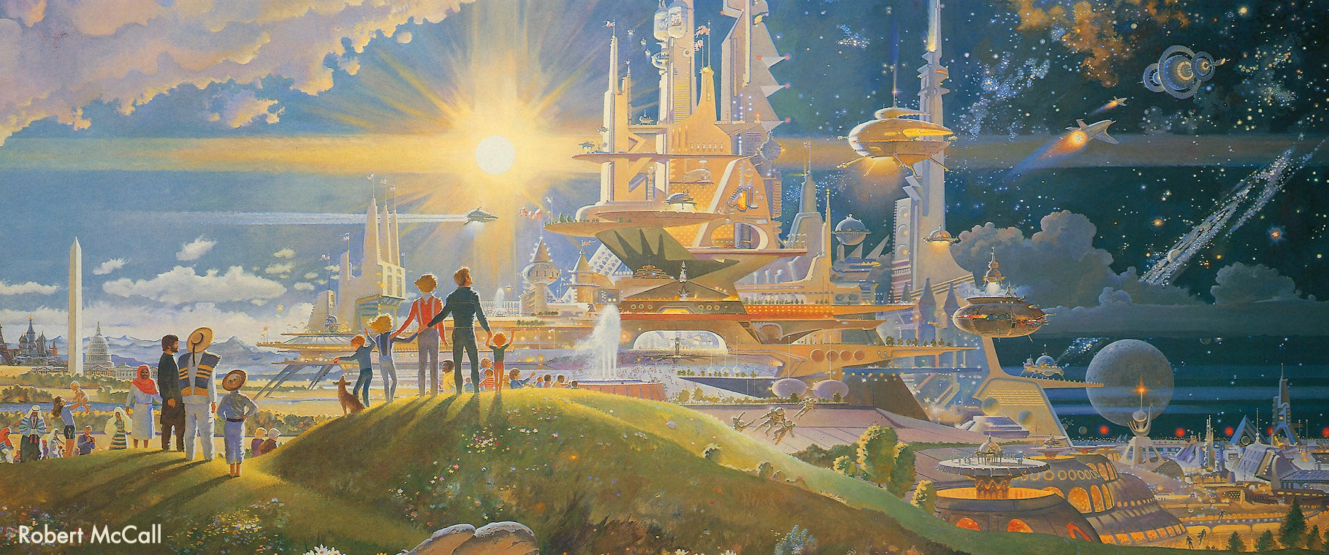
The Promise of Utopia
Richard Stahel:
‘every social organisation relies on something that is not realized or feasible, but has the ideal that is somewhere beyond the horizon, a lighthouse to which it may seek to approach if it considers that ideal socially valid and generally accepted’ (2017)
Notes:
To quote Slovak philosopher and lecturer Richard Stahel:
‘every social organisation relies on something that is not realized or feasible, but has the ideal that is somewhere beyond the horizon, a lighthouse to which it may seek to approach if it considers that ideal socially valid and generally accepted’
This same reliance toward the lighthouse of future prospects is exactly the bait with which dictatorial regimes seek to reel in people they seek to use. And I believe the Cremator posits two main groups of people used in Dictatorial regimes for differing purposes, and to different lengths.
There is the group of people that have use only to bolster and help ensure the central ideology is ‘socially valid’ and ‘generall accepted’ - in a sense the mass public that passively supports the government or at least can be swayed to do so. The other group is far more desirable for the regime to look into controlling as they have tools that not only can help support the central ideology but help bring down more barriers toward its realisation.

Slide 4
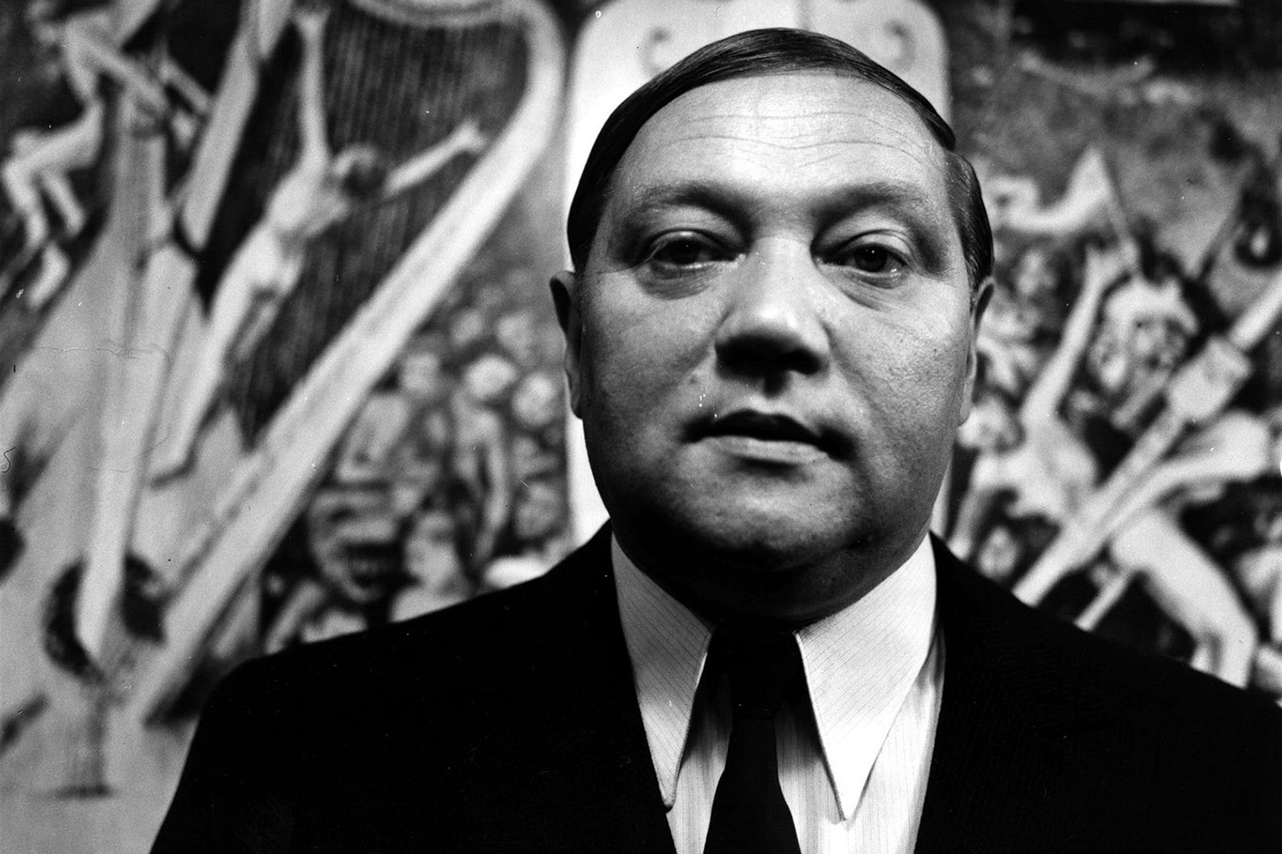
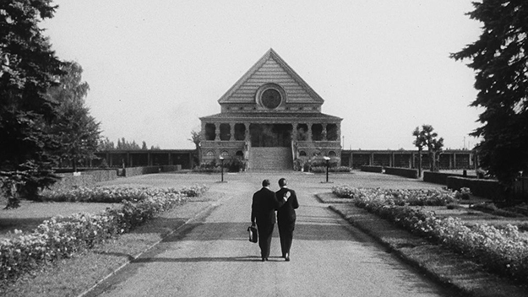
Types of people used - Desirables - Karel K.
Case in Point - Karel Kopfrkingl
Desired personality + power
Those who are ambitious
Works to liberate the dead
Ideologically maneuverable
Jason Pirodsky (Prague Reporter): ‘Many of the cremator’s friends and colleagues are Jewish, and others are anti-German, making Karel the perfect spy.’
Illuminating a beneficial higher purpose
Notes:
The Prime example in the film of this type of person is in that of Karel Kopfringl.
Karel is a desirable person for a regime to use as he has personality traits as well as powers that can be beneficial to materialising an establishment’s aims.
Firstly Karel is ambitious. Immediately from the outset of the movie, he declares: ‘I’m worried I don’t do enough for you’ (his family). And that he thinks he can increase his income. A dictatorial regime will rely on this ambition to do better and to strive to entice Karel to work for them.
What’s more is that Kopfrkingl serves a usage to draw out from that ambition. Being in his line of work, eventually directing the ins and outs of a crematorium, it seems he is eccentric as well as demented by the idea of spiritual liberation and vanquishing human suffering. This stance and view on his work is easily translated toward the end of the film where he is convinced the same methods of liberating suffering can apply when on a larger scale and even if the souls are not truly dead before cremation begins - a chilling thought.
This is the key to the use of such Desirables like kopfrkingl in dictatorial regimes as they are very ideologically maneuverable becasuse they are so unhinged. Throughout the course of the movie he can be seen to be swaying form being proud of his ‘czech blood’ to declaring the strength of ‘Germany’ as a nation and sentencing his friends and family (previously ‘decent’ and ‘honest’ men) to death and isolation all with the help of dictatorial influence.
And of course as Jason Pirodsky notes in his review of the move in the Prague reporter, ‘Many of the cremator’s friends and colleagues are Jewish, and others are anti-German, making Karel the perfect spy.’ Therefore dictatorial regimes educate, covert and use those closest to the ‘Them’ category of the ideological dichotomy to further support and accelerate the ‘anti’ feeling the mass population should feel against them. Thus by indoctrinating men like Karel to feel like one of them (inviting him to their casino, promising wealth and opportunity to the ambitious) they are able to tap into previously invisible networks with the ability to infiltrate and de-stabilise those they do not see having any future within their regime - a powerful and desirable tool. And the constant illumination of a higher purpose and something more to achieve within the framework of the dictatorship, blinds judgement for men like Karel, keeping them on a steady track of following ambition, whilst clearing the path for barriers to the regime.

Slide 5
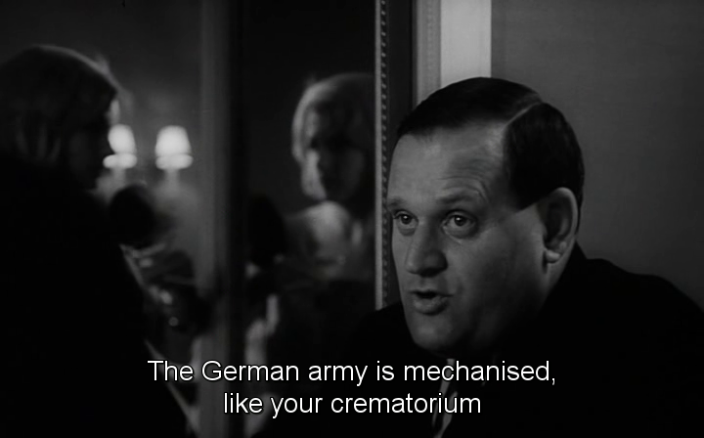
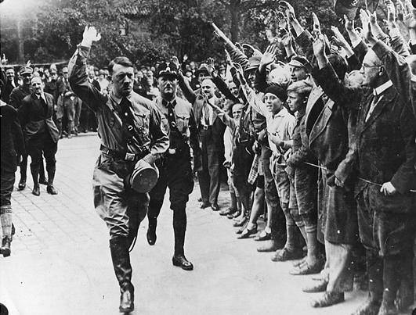
Types of people used - Desirables - Walter Reinke
Those who can persuade
Those who are persistent
Those who are unflinching
Those who can manipulate
Those who can see weakness
Notes:
The second most obviously used character in the film is that of German official, Walter Reinke.
Being an old friend of Karel’s Walter is fantastic and a formidable device for completely persuading Karel to join the Nazi party, distrust his friends and murder his own family. A dictatorial regime looks for those who can use their persuasion skills to gather up more desirable people for the regime.
Another trait is that Walter is persistent. He is aware of the process it takes to ideologically shift someone’s stance. On nearly every meeting together Walter brings up the party as well as the notion of the greatness of the German state of which he wishes his old friend could be a part of.
A third trait that dictatorial regimes are after is someone who remains unflinching even in the face of counter logic and debate. The ideology of the regime is thread into the fabric of their thoughts and such is the case with Walter. Against protests of Czech pride, Walter remains defiant that Germany and the Nazi state is truly great and that other countries, and even people, are subordinate. It is this unflinching attitude coupled with Walter’s skills of manipulation (for example teasing Karel on the doubts over his family and encouraging him to make changes) that makes him very useful in the eyes of a regime.
At a time in history where Nazism was on the rise and spreading through Europe, whilst Czechoslovakia faced decline, people like Walter can be used to bolster and convert potentially powerful people, once having established their weaknesses and inner insecurities, which is in itself a very powerful tool to be utilised by dictatorial regimes.

Slide 6
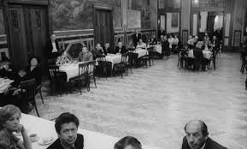
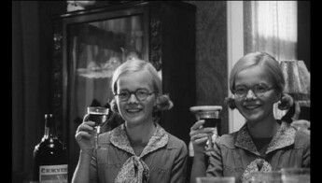
Types of people to be used - The Everyday
Everyday have their use within system
Can illuminate insecurities
Can act as passive to allow stronger wills to seize control/influence.
In movie: 1 - Karel’s cafe/rest. Speech 2. Speech at Lakme’s funeral
Silent majority left supporting the regime
The Everyday can be swayed to support through acceptance/repression, thus serve use
Notes:
As much as Karel may seem the focus of dictatorial use, the supposed ‘Everyday’ person has their value within the dictatorial regime, according to The Cremator.
For example, Walter Reinke’s children are pictured as idealistic, twin aryans smiling against that of Karel’s who with Mili in particular, he holds much doubt over. And it’s this doubting and insecurity with which Karel is able to retreat into fantasy and aim always for self-betterment, at the expense of anything but the regime who can get him to a higher place.
In the movie alos, the everyday can act as a blank canvas of passivity for those of stronger will to paint over. At Karel’s speech at the start of the film for example, he justifies the cremation process to a large group of restaurant goers and commands the room with his rhetoric. Quite similarly, the rhetoric Karel employs towards the end of the film during Lakme’s funeral, although causing family members to leave, is met with no resistance and only jubilation at the side of Nazi supporters.
Thus the banal, everyday character is vital in its silence and lack of power in the movie. Those that may show resistance are given up or effectively destroyed and the silent majority are left to support the regime whether willfully or not. Therefore the Cremator I believe likes to highlight that even common, people lacking political passion or societal ambition can be swayed to support an ideological cause either through passive support or fear/death - both of which are displayed in this movie between the scenes.

Slide 7
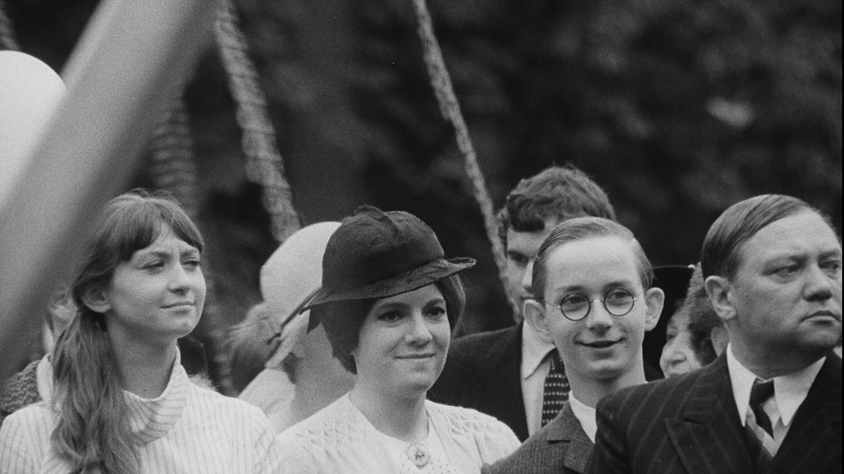
Fluidity between categories of use
There can be change between Desirable, undesirable and everyday
Depending on actions of those in positions of movement
Depending on the ideological needs of a dictatorial regime
  E.g. Nazi Pursuit of anti-semitic and exclusionary society
Ideology reigns supreme in judgement of use
Draws parallels to Naxi experience in Czechoslovakia to highlight the kinds of people in which can and cannot be used by dictatorships
Film of human behaviour, instinct and misled ambition
Notes:
It is worth noting as I close out that I believe the movie The Cremator also seeks to highlight the fluidity of position of use between the everyday, the desirable and even the undesirable as the film aims to highlight.
This opportunity for motion depends on the actions of the person in question as well as the ideological agenda of the regime. For example, had Karel not eventually been persuaded by and taken Reinke’s advice to join the party and act as an informant, he most likely would not have served as important a use to the regime yet would not have been cast out the same way Jews were seen. Not being ‘anti-German’ but more falling into the category of the passive everyday.
In a different vain, if the Nazis had not been so aggressively pursuing an anti-semitic and exclusionary society, Lakme and her children would most likely still be living - serving no resistance to the regime, or even Karel’s pro-Nazi efforts, other than their ethnicity and blood.
Thus as in most cases of dictatorial rule, it is the ideology instilled in the right people that in turn help generate who and who cannot serve a function within such a society. The Cremator seeks to show his level of categorization, isolation and humiliation, carefully drawing parallels to the Nazi regime in Czechoslovakia, to highlight the kinds of people Dictatorships can and cannot use. Which I believe really highlights its power as being a film of human behaviour, instinct and misled ambition.

