Slide 1
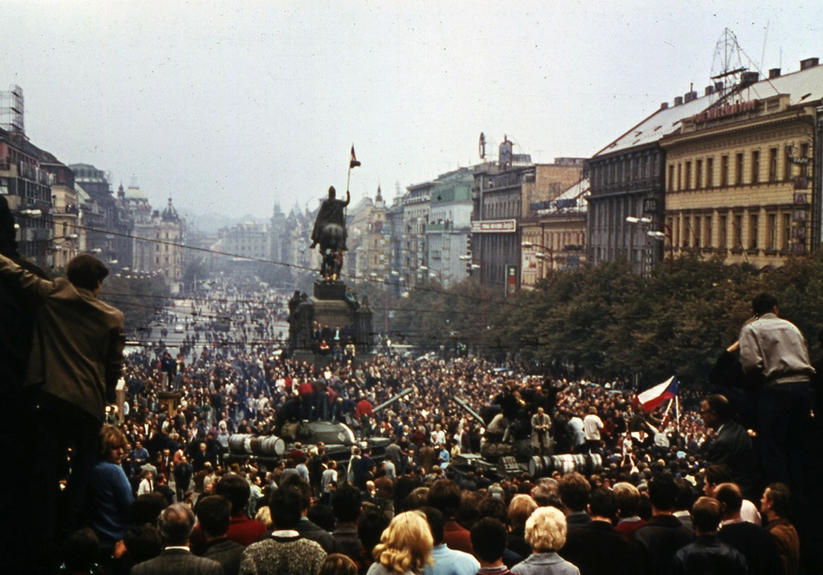
Prague Spring and Russian Winter
The Liberal 60s and the Warsaw Pact Invasion of Czechoslovakia

Slide 2
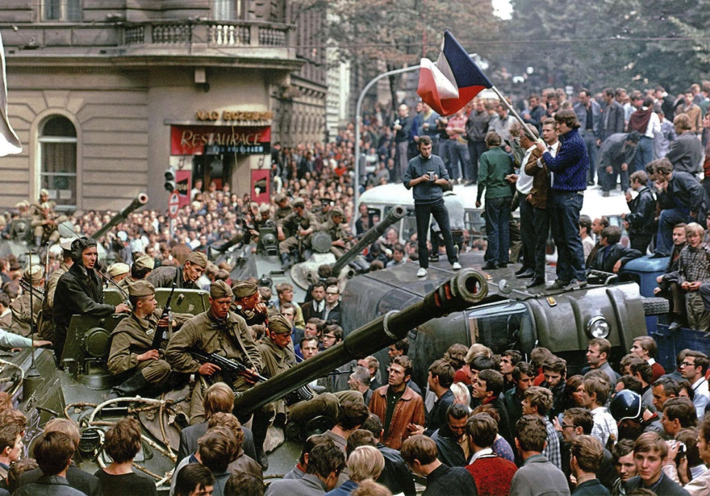
1. The Bratislava and Prague Springs 2. Warsaw Pact invasion of Czechoslovakia 3. Aftermath

Slide 3
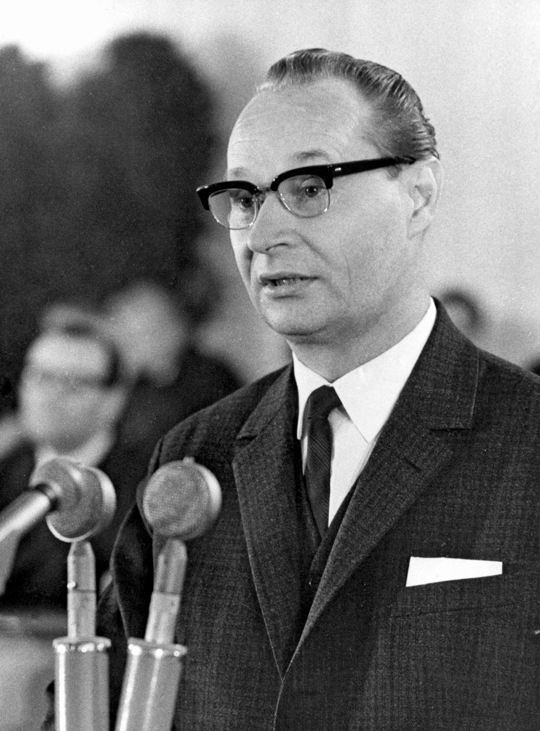
1. The Bratislava and Prague Springs
Alexander Dubček and Socialism with a human face

Slide 4
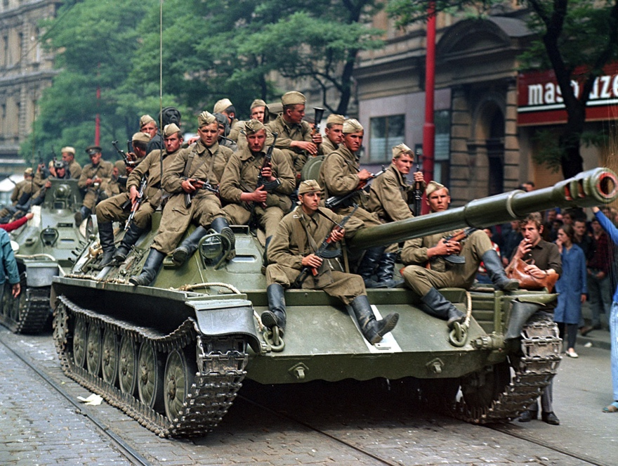
2. the Warsaw Pact Invasion of Czechoslovakia

Slide 5
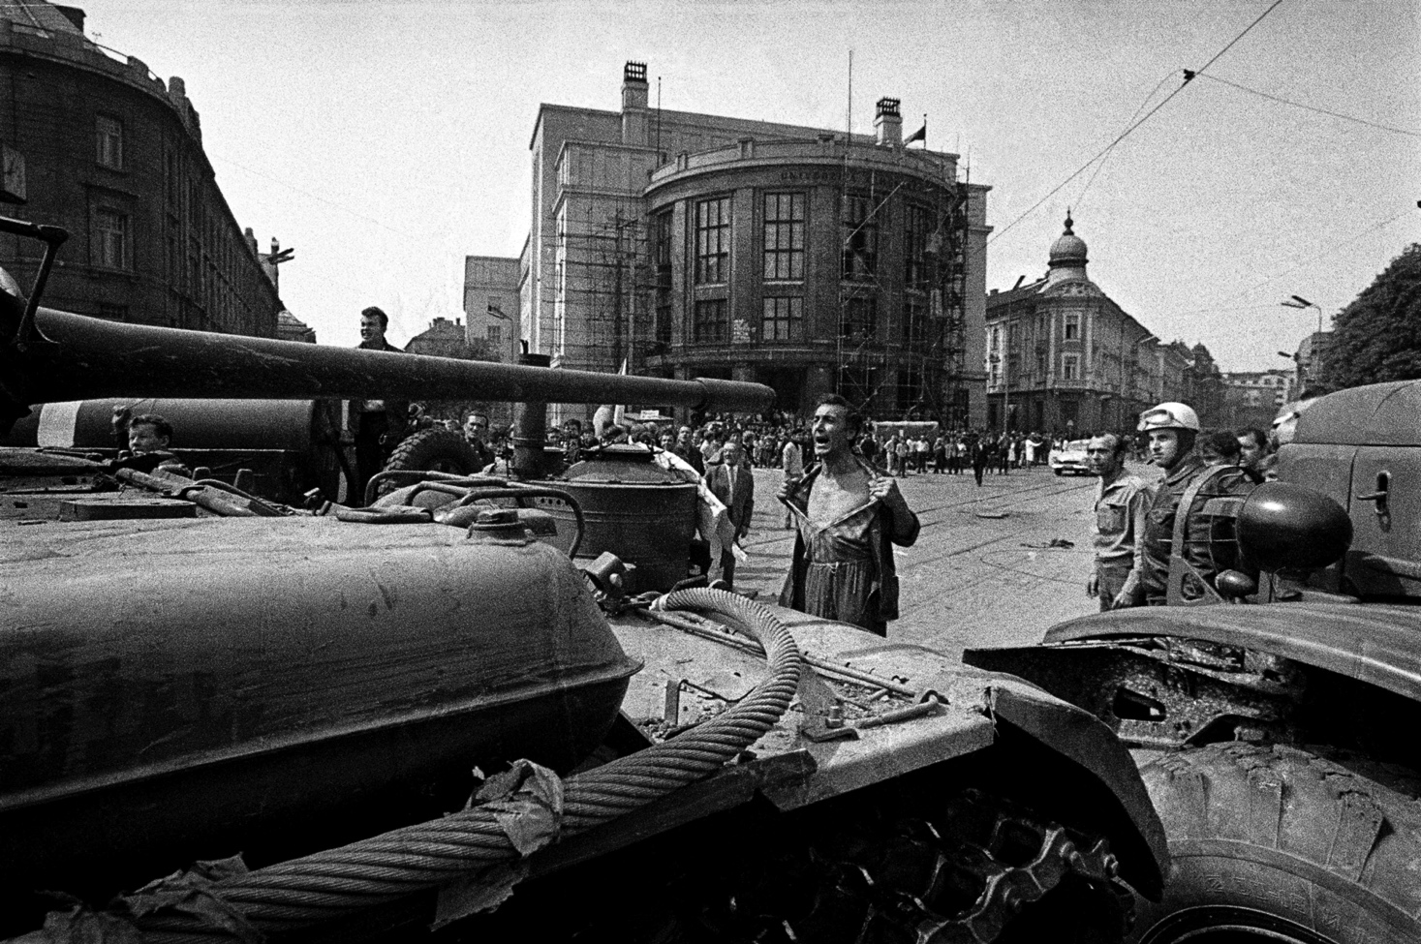

Slide 6
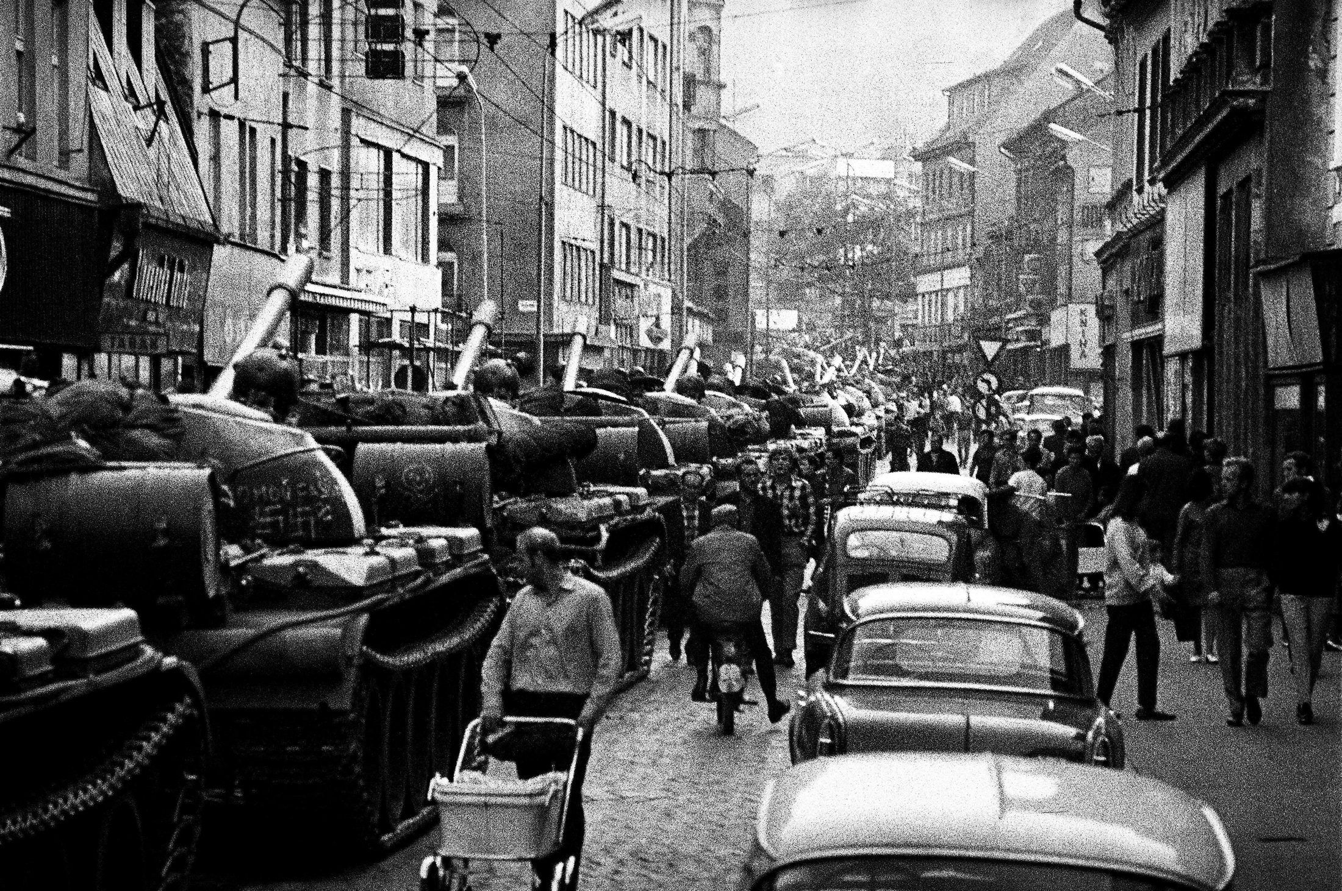

Slide 7
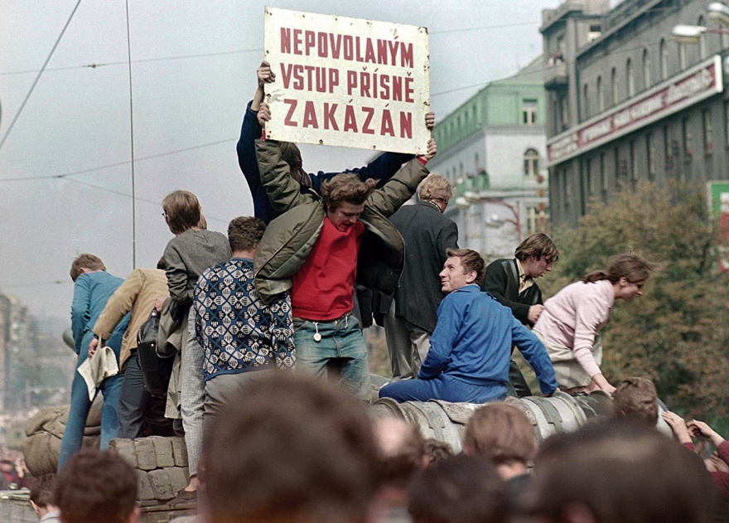

Slide 8
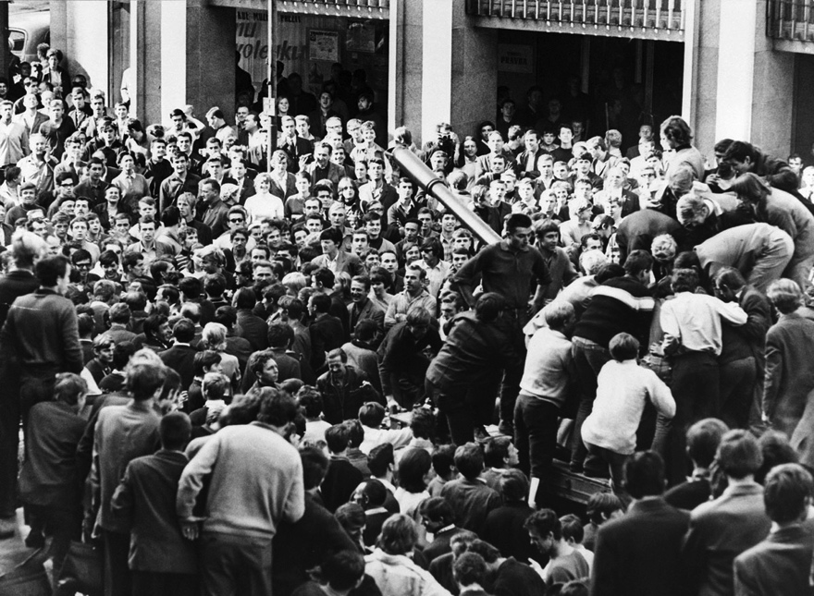

Slide 9
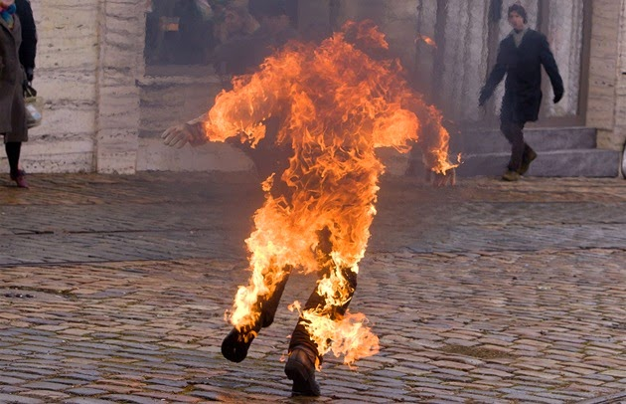
3. Aftermath

Slide 10
Questions
Should Dubček be considered a hero?
Was the Prague Spring doomed from the start?
Was the invasion of Czechoslovakia the correct move for Brezhnev, or was it counter-productive?

