Slide 1
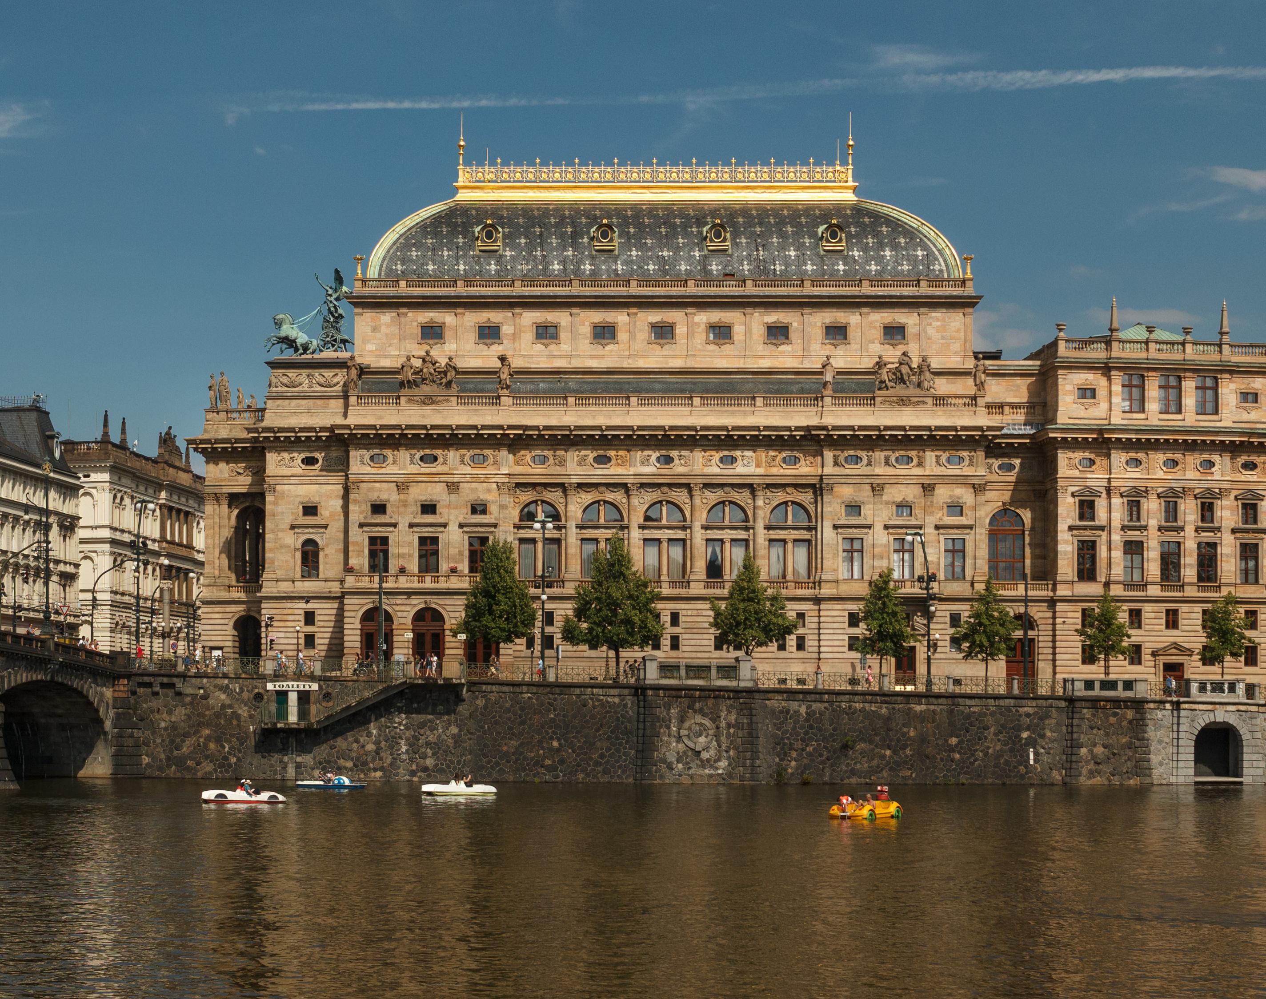
National Theatres in 19th Century
Mgr. et. Mgr. Klára Škrobánková, Ph. D.
Department of Theatre Studies
skrobankova@phil.muni.cz

Slide 2
„The purpose of theatre is the embroidering and improvement of the mind of a whole nation… A good theatre serves a whole nation.“
                J. E. Schlegel

Slide 3
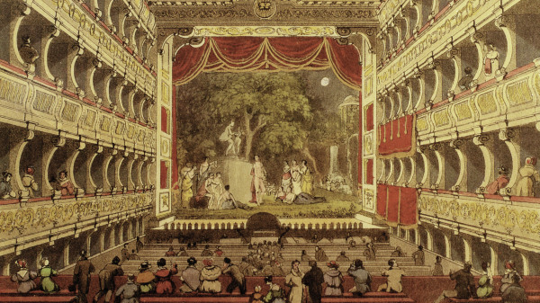
How to define National Theatre?
Each national theatre reflected a specific originating moment, location, set of goals, language, history, and mythology, as well as the idiosyncratic beliefs of its individuals founding members (Wilmer)
Types of NT:
  Established by a stable autocratic government (Comédie-Française in Paris in 1680, Burgtheater in Vienna in 1741, etc.)
  Established after an effort of a nationalist movement in emerging states under a foreign rule (Prague National Theatre in 1883, Abbey Theatre in Dublin in 1904)

Slide 4
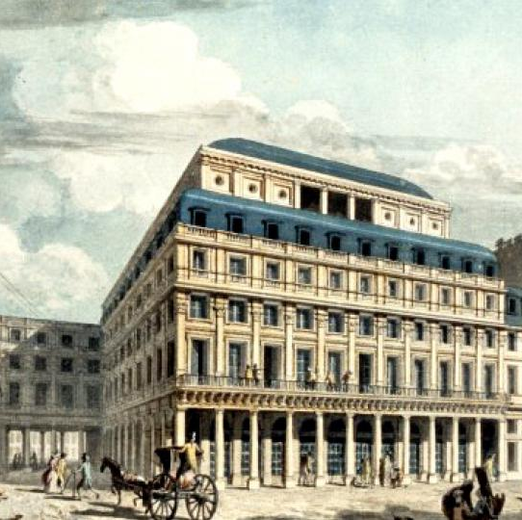
Comédie Française (1680)
Established by Louis XIV.
For plays by Moliére, Corneille, Racine

Slide 5
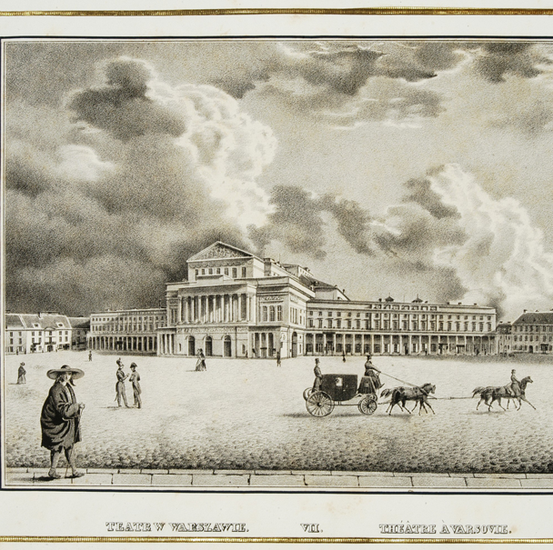
Polish National Theatre in Warsaw (1765)
Founded in 1765 by the king Stanisław Poniatowski
Poland is dissolved (Russia, Prussian, Austria) 1772, 1793, 1795
Polish NT could not exist under the title “national”
Idea of NT as Poles try to regain sovereignty (1924)

Slide 6
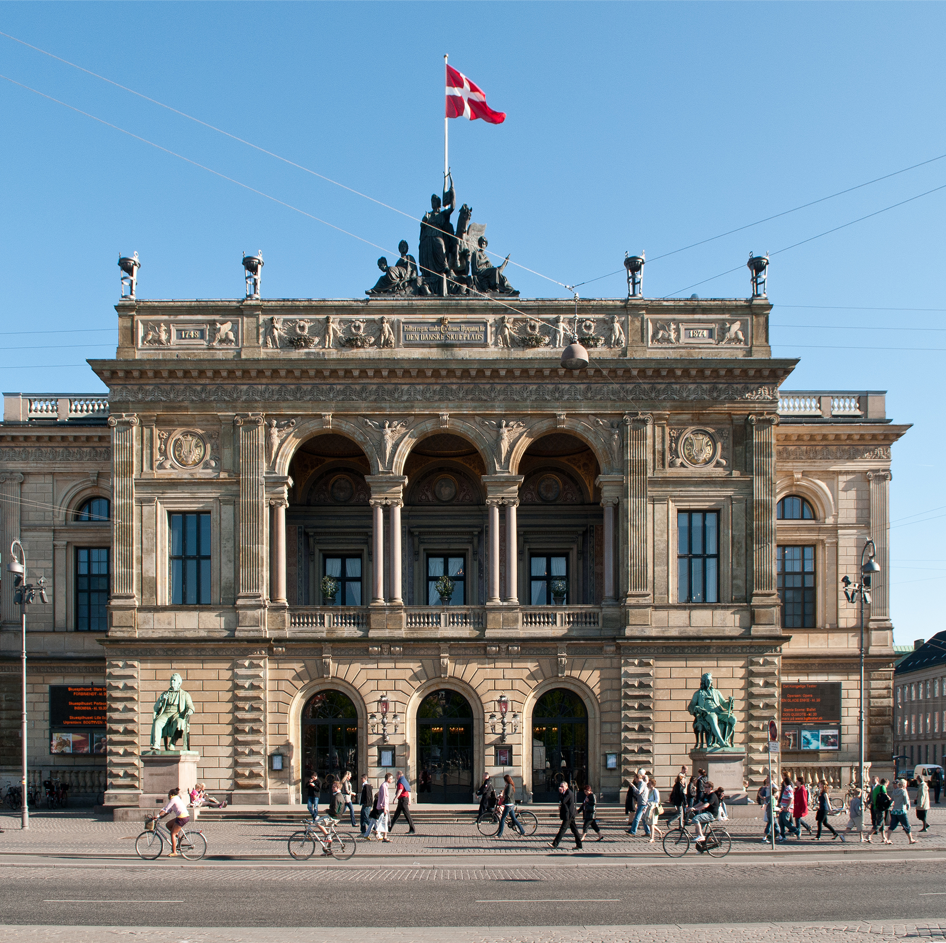
Danish Royal Theatre in Copenhagen (1748)
Built on land provided by the king
Quickly stepped away from the tradition of hiring Italian and French actors
Engaging Danish actors and staging Danish drama
Ludwig HOLBERG – in 1750s 25 of his plays in the repertoire
Handed to municipality in 1750

Slide 7
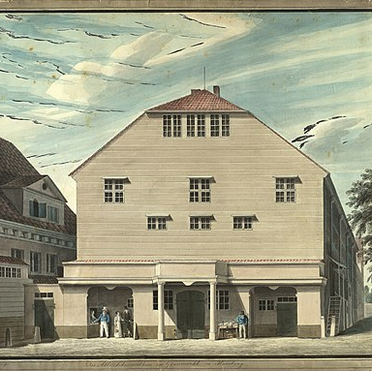
Hamburg National Theatre (1767)
Established by the citizens and theatre professionals – first attempt on German NT
A failed experiment that had nevertheless shown the potential and the method
An idea of dramaturgy – Gotthold Ephraim LESSING
A need to write national plays, in national language, with nationalist themes
Also translations into German

Slide 8
„The good-natured idea of getting the Germans a national theatre, while we Germans are not yet a nationality! I don’t speak about the political condition, but only about the moral character. One should almost say that this consists in not having one of our own, yet. We are still the devoted admirers of the never enough admired French. Everything that comes to us from across the Rhine is beautiful, charming, lovely, divine”.
Gotthold Ephraim Lessing

Slide 9
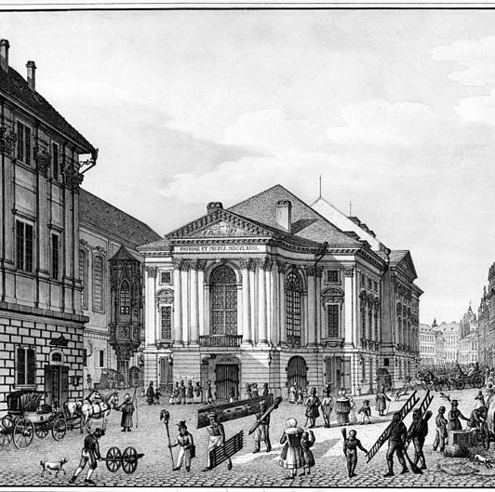
Nostitzsches Nationaltheater
(1783)
Built by count Franz Anton von Nostitz-Rieneck.
Motto: Patriae et Musis ("To the Native Land and the Muses"), which is inscribed above the portal.
Opened by performance of play Emila Galotti (written by G. E. Lessing)
Today part of National theatre in Prague (named Estates Theatre)

Slide 10
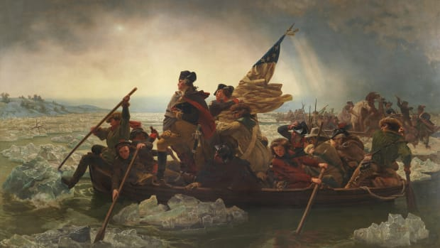
Washington crosses Delaware river, Commons

Slide 11
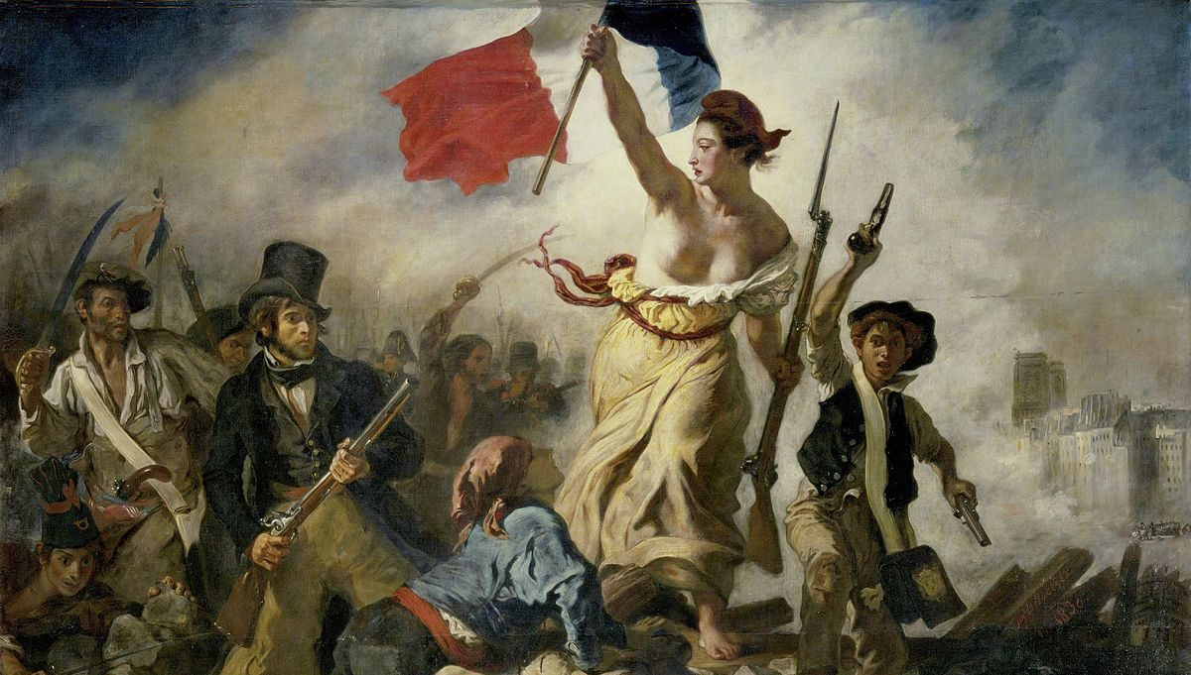
E. Delacroix, Commons

Slide 12
„If in all our plays there was one main stream, if our poets reached an agreement and created a firm union for this final purpose – if a strict selection led their work and their brushes dedicated themselves only to national matters – in one word, if we had a national stage, we would also become a nation.“
Friedrich Schiller

Slide 13
19th century national theatres were often established with nationalist agenda
  Constructing national identity
  Legitimating the aspirations of nationalist movement
  Instilling a sense of national commitment and future citizenship
  Essentialist and exclusionary notions of identity (us and them)
  → Johann Gottfried von Herder: importance of cultural traditions of common people

Slide 14
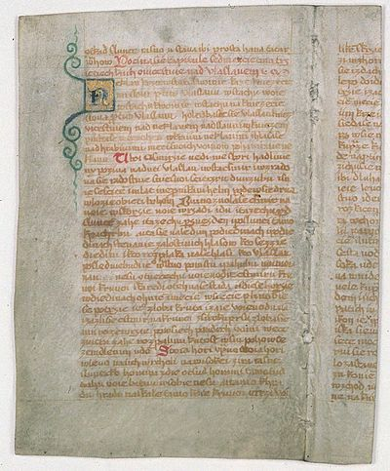
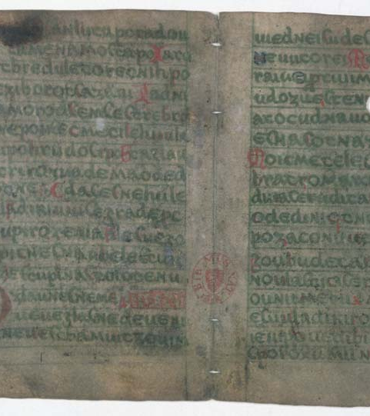
Manuscripts of Zelená Hora and Dvůr Králové
Proved to be faked by Hanka and Linda in 19th century

Slide 15
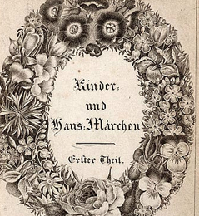
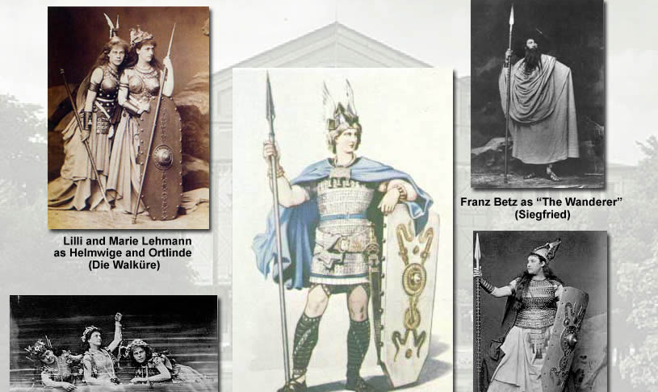
Collecting and reworking folktales and legends
Fairytales by the Grimm brothers
Nibelungenlied – Germanic saga adapted into an opera cycle by Richard Wagner

Slide 16
Nationalist Movement and the Romantics
Friedrich Schiller: Wilhelm Tell (1804)
ROSSELMANN. By this fair light, which greeteth us, before
Those other nations, that, beneath us far,
In noisome cities pent, draw painful breath,
Swear we the oath of our confederacy!
We swear to be a nation of true brothers,
Never to part in danger or in death!
[They repeat his words with three fingers raised.
We swear we will be free, as were our sires,
And sooner die than live in slavery!

Slide 17
Juliusz Slowacki: Kordian (1833)
KORDIAN. So from the fire of all the stars I will make a crown on my forehead,
In the blue sky of the spheres I will melt the body so
That like marble, like ice, it will light up with sun beams...
Then beautiful as the ghost of a fairy tale,
I'll go to a cold world and I can swear
That those thousand stars on the forehead and in the eyes a thousand more,
That the statuesque grace of nations will expand the feelings
And inspire the people;
And in hearts as a thought will strike,
Like God's miracle...

Slide 18
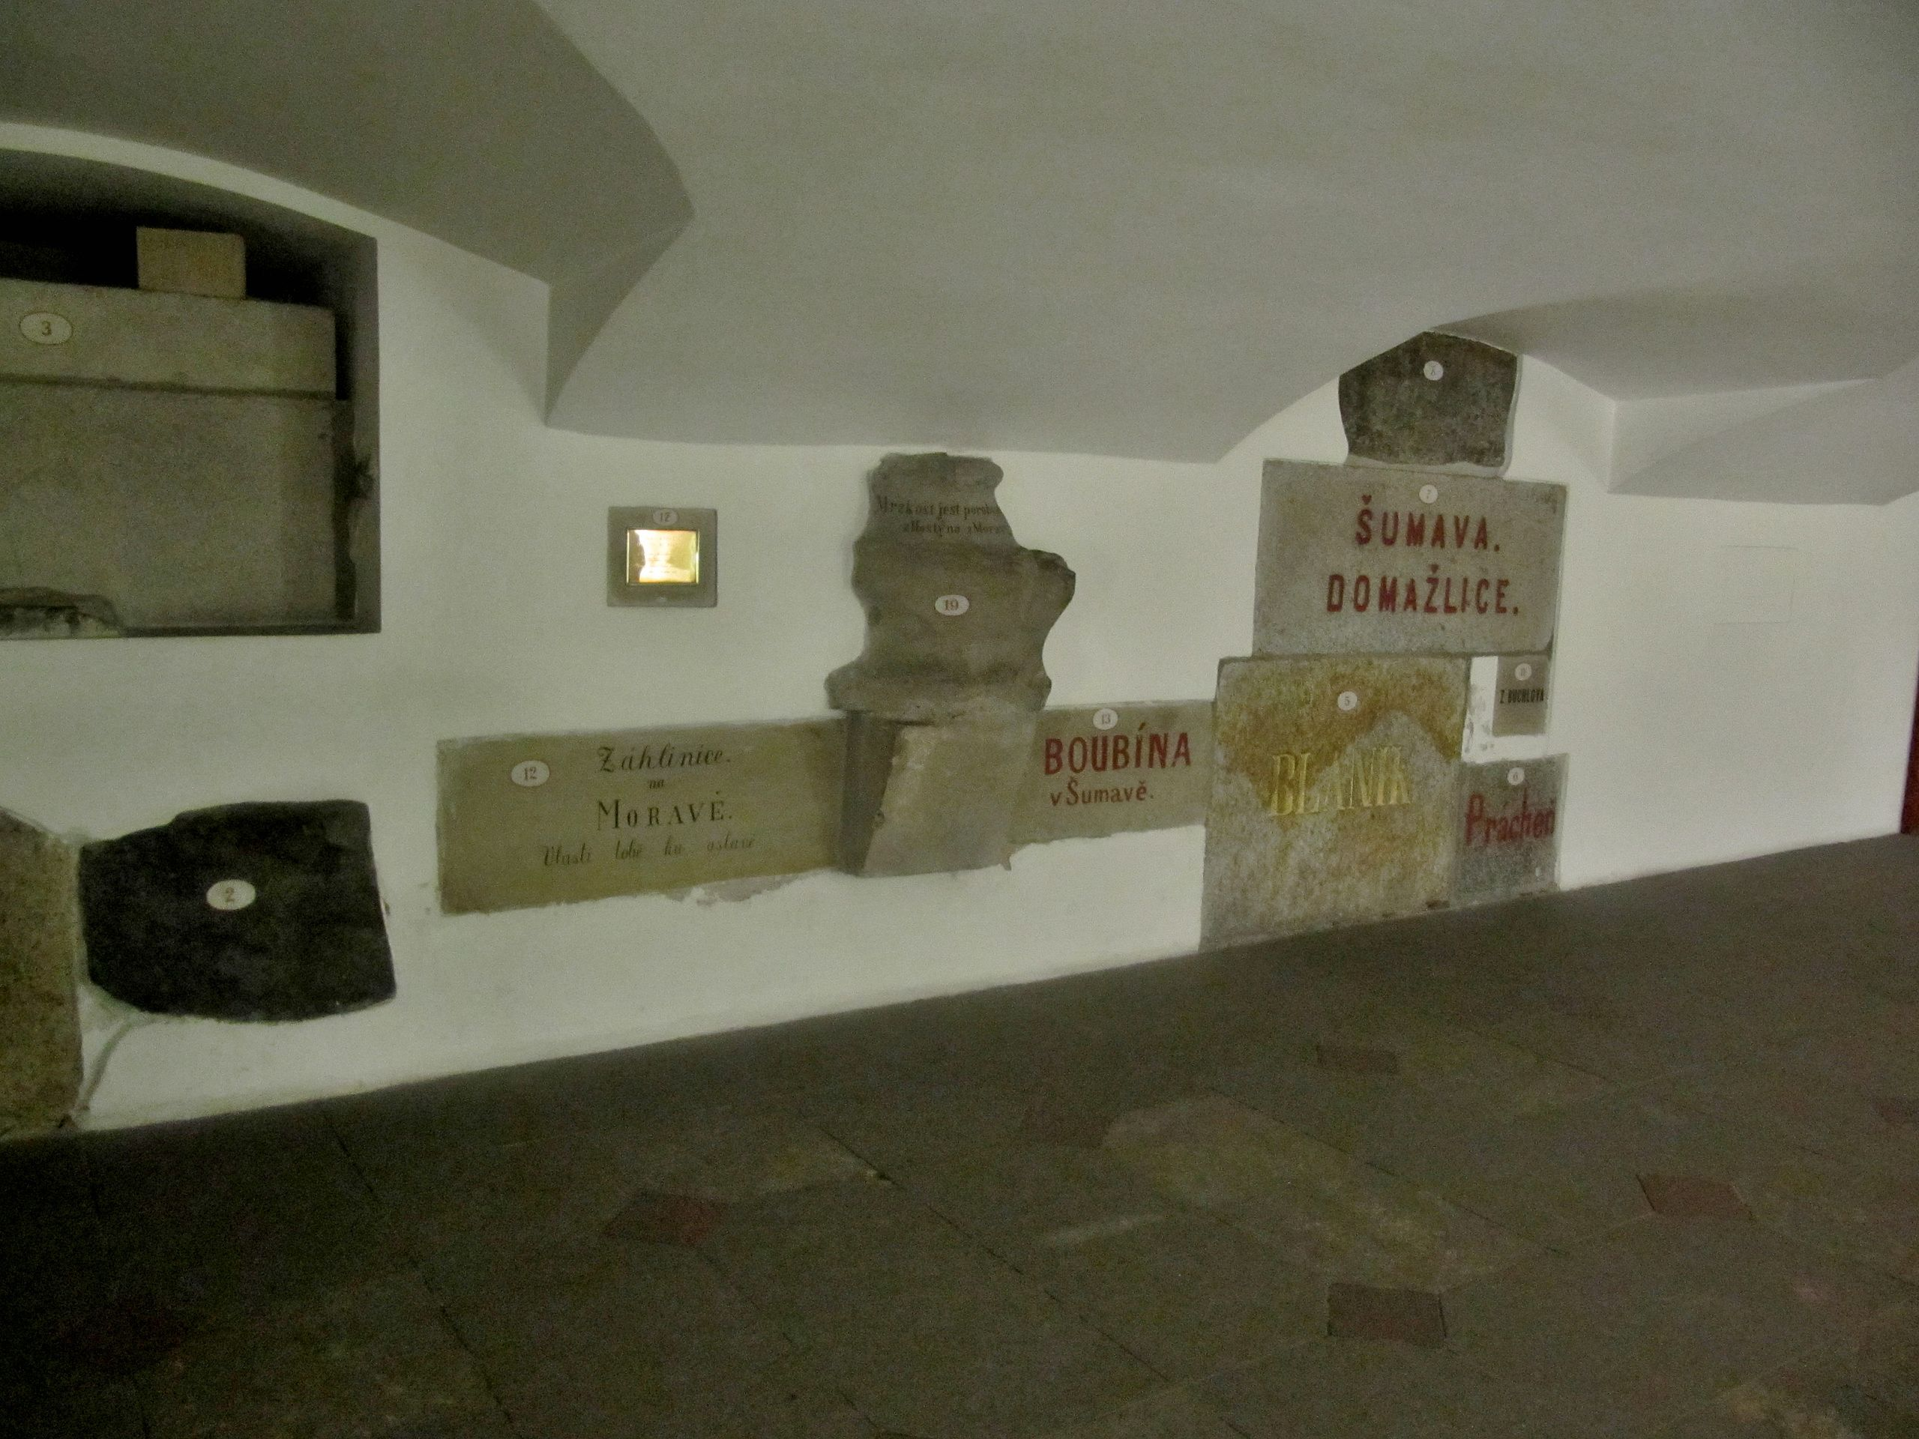
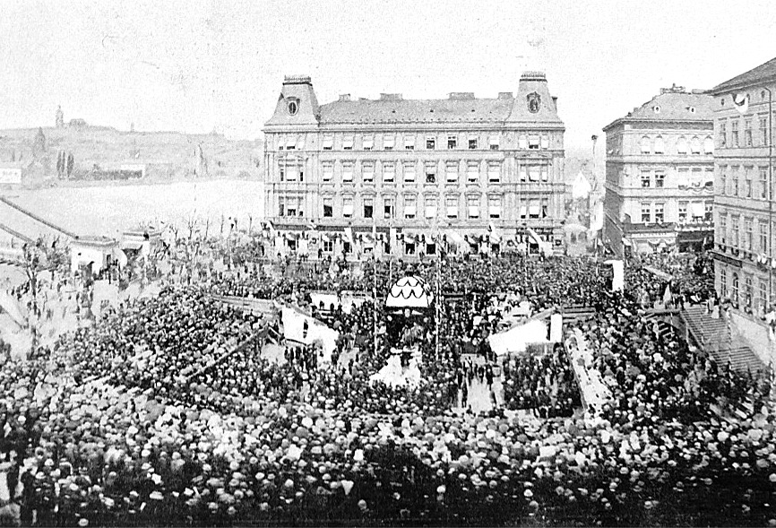
Czech National Theatre (1883)
František Palacký after 1848: “Our national theatre will soon arise as a monument to our constitutional rights and equality”
Who will pay for it? → Fundraising, public collections
Laying the foundations – stones from various places

Slide 19
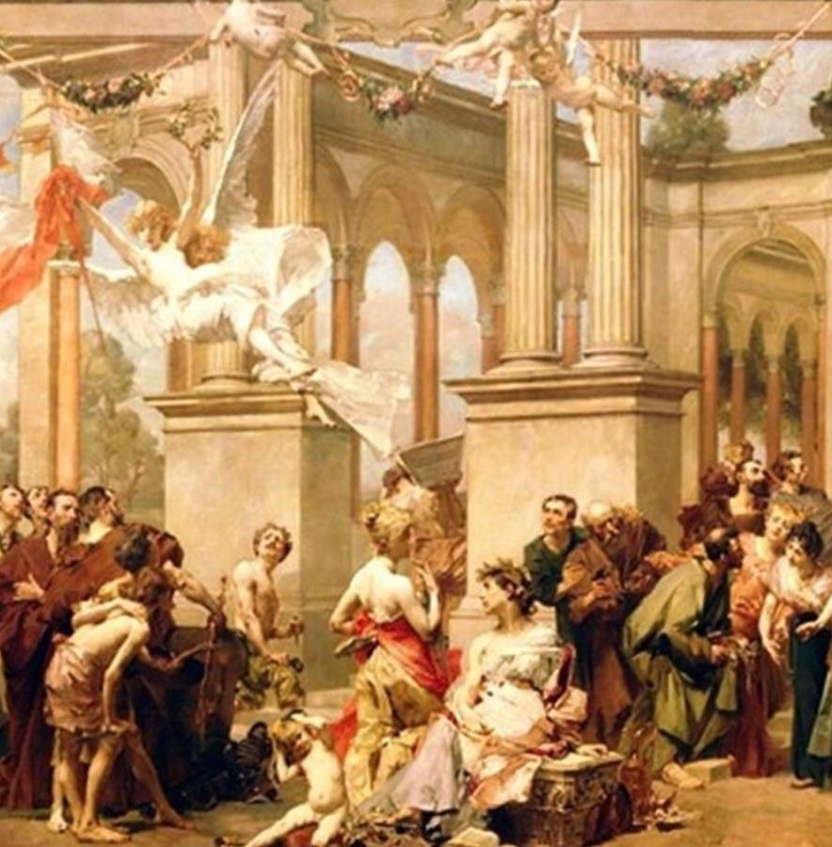
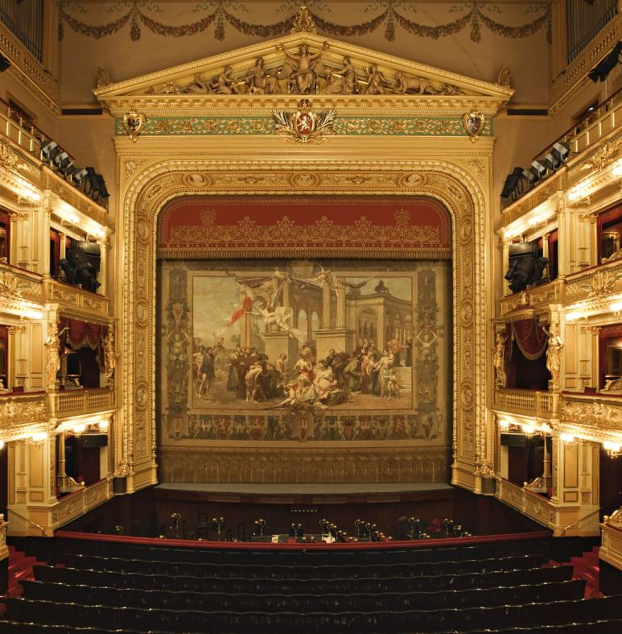
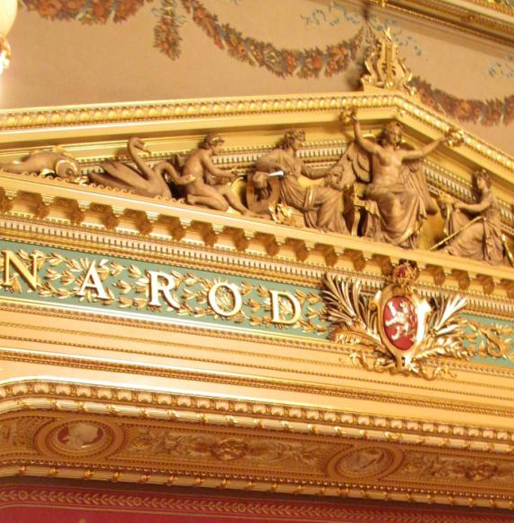
Vojtěch Hynais: curtain of the National Theatre
Národ sobě – The Nation to Themselves
Allegory of Slavia

Slide 20
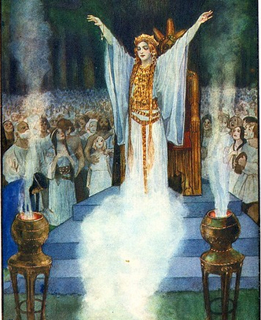
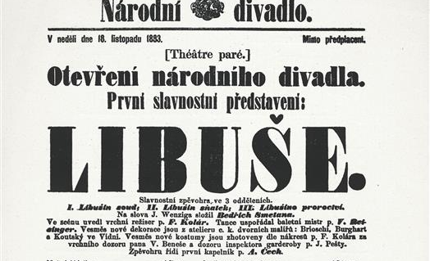
Opened with Bedřich Smetana‘s opera Libuše
  Far-reaching importance of legendary figures
    Wilhelm Tell (Germany and Switzerland)
    Joan of Arc (France)
    Boris Godunov (Russia)
    Cathleen Ni Houlihan (Ireland)

Slide 21
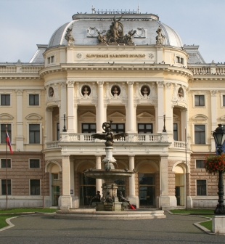
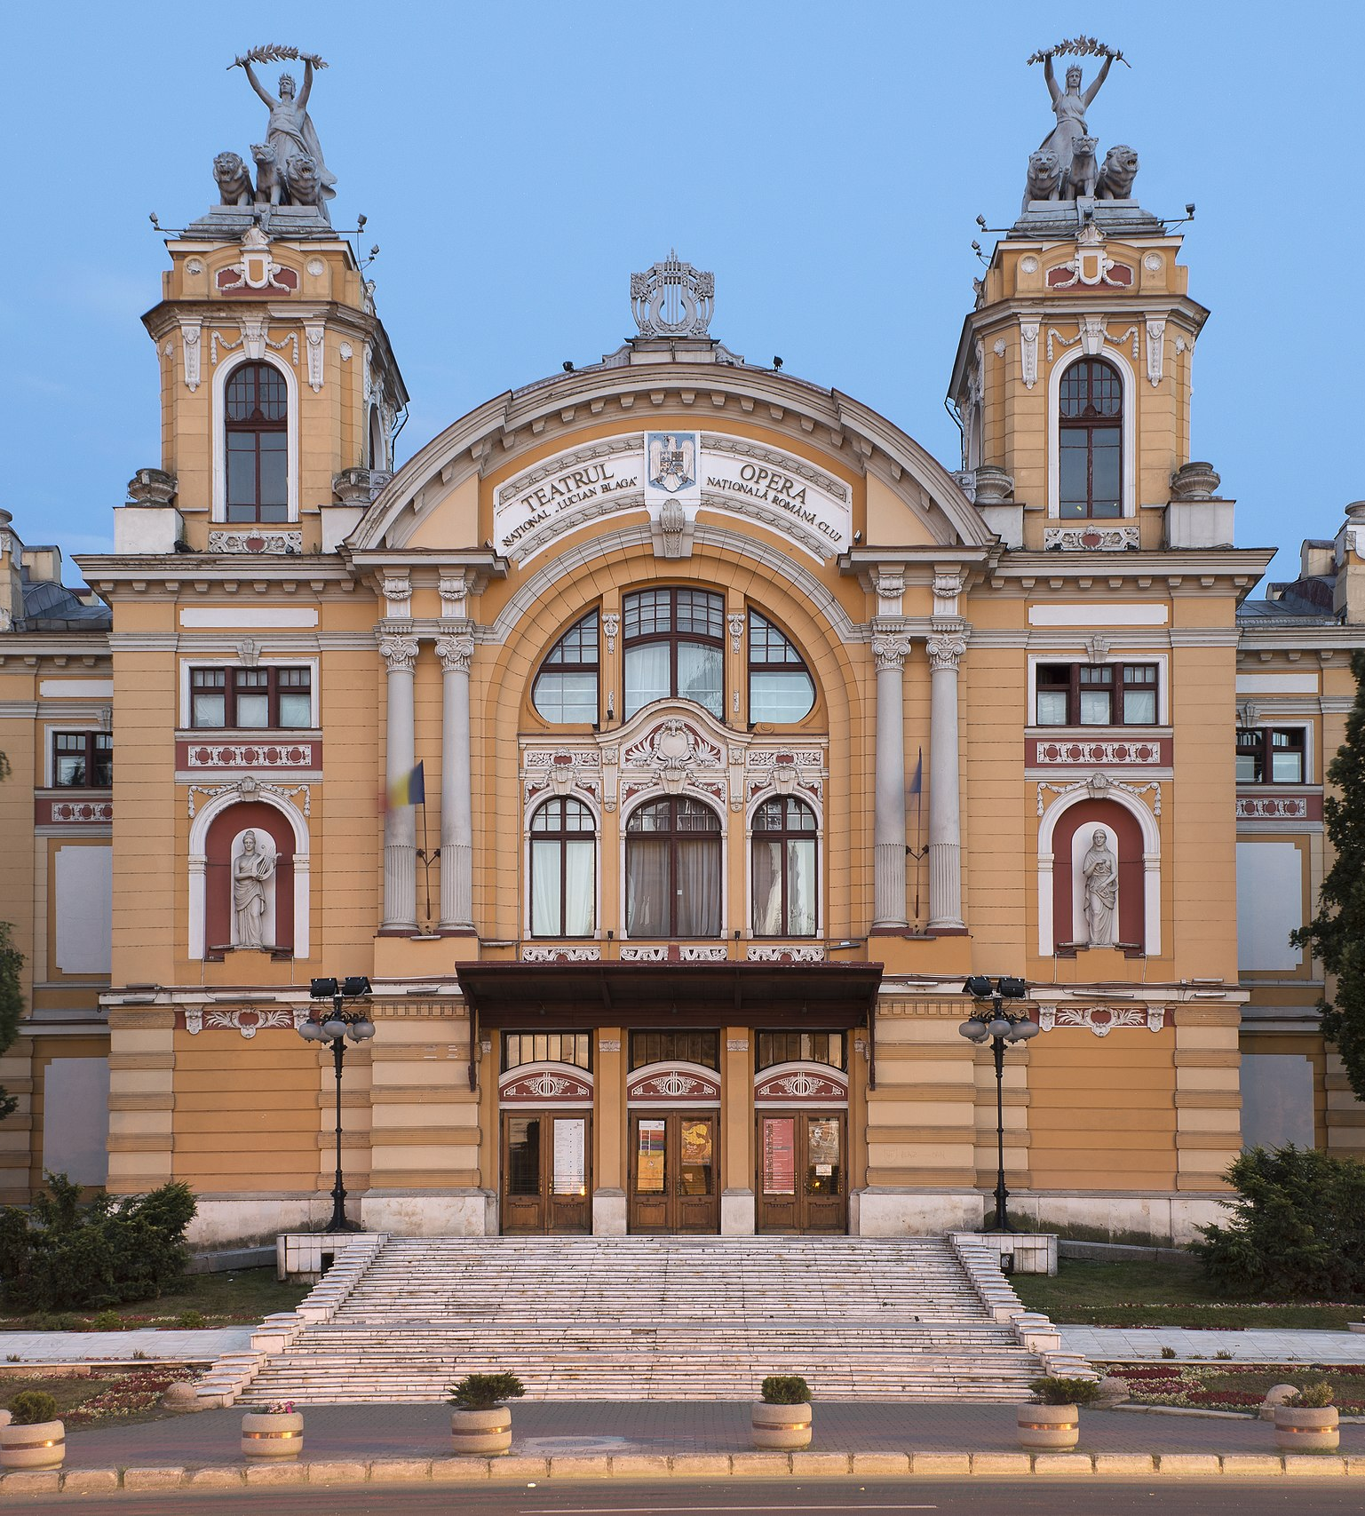
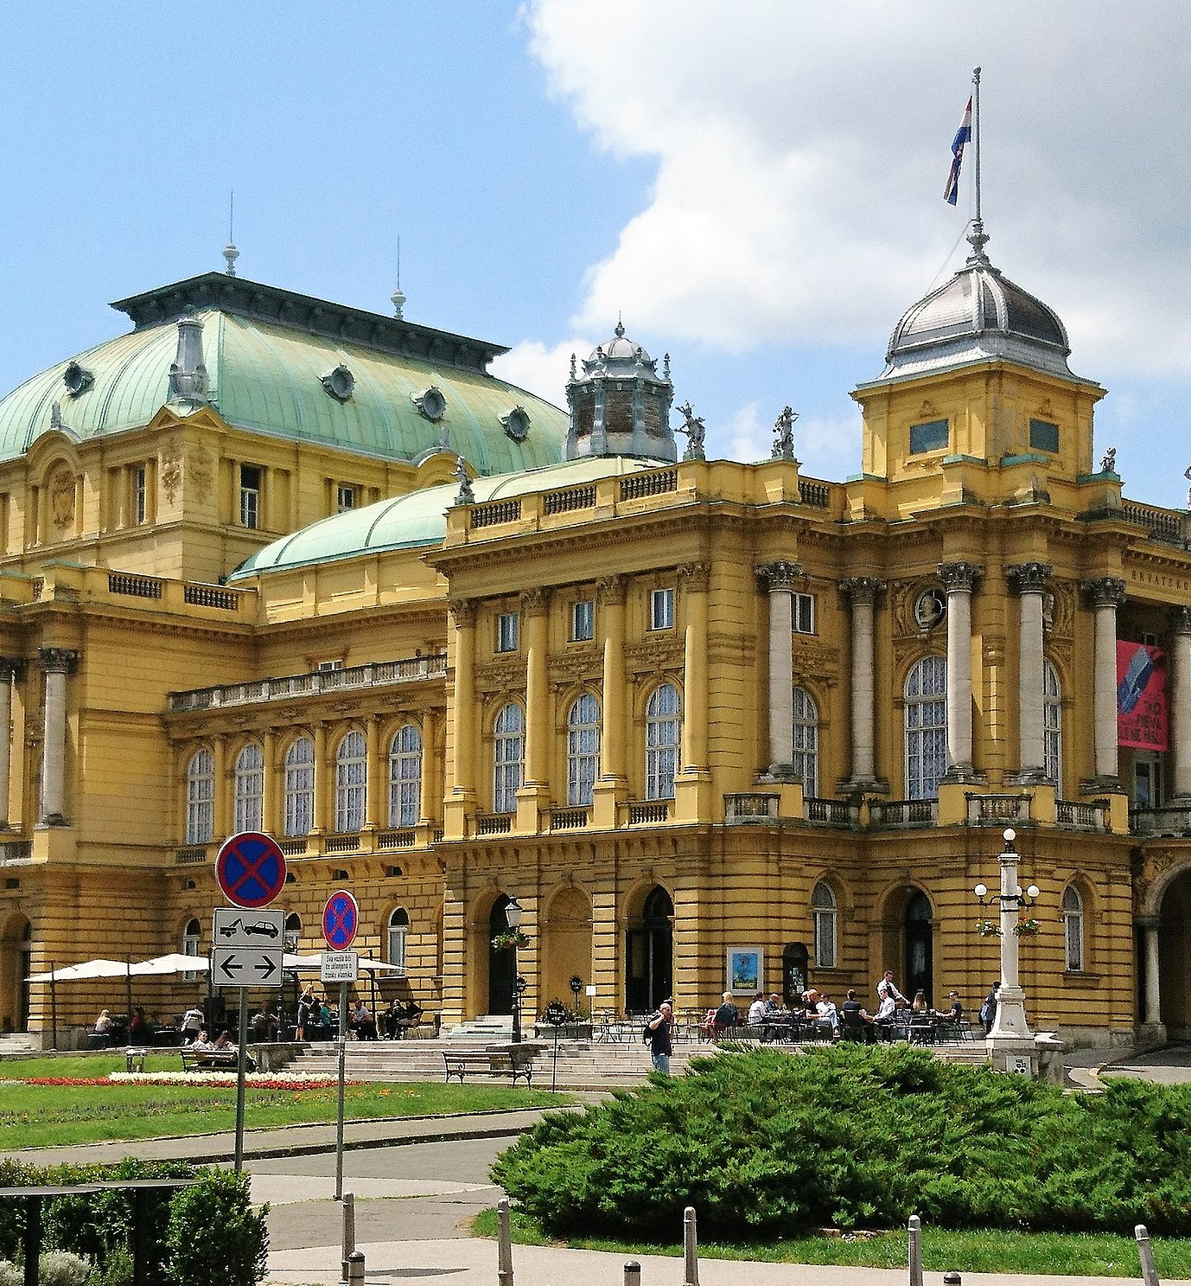
Fellner and Helmer, architects of European National Theatres

Slide 22
Recommended Readings
HOLDSWORTH, Nadine and Nicholas HYTNER. Theatre and Nation. London: Macmillan Education UK, 2010.
THER, Philipp. Center Stage: Operatic Culture and Nation Building in 19th Century Central Europe. West Lafayette: Purdue University Press, 2014.
WILMER, S. E. (ed.). National Theatres in a Changing Europe. New York: Palgrave Macmillan, 2008.

