Slide 1
Opera as National and Transcultural Phenomenon

Slide 2
Nationalism
"No matter how many times a country has been conquered, subjugated and even destroyed by enemies, there is always a certain national core preserved in its character, and, before you are aware of it, a long-familiar popular phenomenon has emerged." (J. W. von Goethe, 1998: 139)
"Nationalism is not the awakening of the nation to self-consciousness; it invents nations where they do not exist. (Ernest Gellner, 1964: 169)"
Primordialism: nations or ethnic identities are fixed, natural and ancient, national identity is intimately connected to ethnicity
Instrumentalism or modernism: ethnic identities develop and nationalism ensues in the pursuit of particular political goals together with modernity (i.e. with the Enlightenment, after the French Revolution, with industrialisation)

Slide 3
Culture and transculturalism
The idea of "national culture"
What does the concept of "invention of" a national culture means?
"Invented tradition" (Eric Hobsbawm, Terence Ranger, 1983: 1): "Invented tradition' is taken to mean a set of practices, normally governed by overtly or tacitly accepted rules and of a ritual or symbolic nature, which seek to inculcate certain values and norms of behaviour by repetition, which automatically implies continuity with the past."
Legitimizing power of tradition, defining key elements of "national culture"
Transculturalism: problematic concept, "one", implying "clearly defined" "national culture" in premordialist terms
Alternatives: hybridity, "bricolage", ...

Slide 4
Opera
performing genre connecting music and theatre
created in Italy at the end of 16th century
key part of Western classical music tradition and Western theatre tradition

Slide 5
Opera of the 19th century in Europe
Romanticism
Bel canto
Grand Opera
Verdi and Wagner
...

Slide 6
Opera of the 19th century in Europe
1803-1815 - Napoleonic Wars → "turmoil" inspirations for music (sounds, form/rhythm - e.g. march, sound of fighting...)
1805 and 1814 - premieres of Beethowen's Fidelio
first half of the century - renewed interest in the opera buffa

Slide 7
Opera of the 19th century in Europe
1824
1848
1876
opening of Festspielhaus in Bayreuth
1883
R. Wagner dies (Italy)
1901
G. Verdi dies
1813
birth of Bedřich Smetana
Revolution
birth of Wagner (Germany) and Verdi (Italy)
1884
B. Smetana dies
2nd opening of NT Prague
1881
1st opening of NT Prague
1869
G. Rossini dies (France)
1792
birth of Gioacchino Rossini (Italy)
1791
Mozart dies (Austria)

Slide 8
Opera as a manifestation of nation and its pride

Slide 9
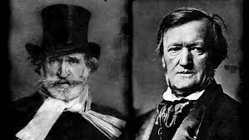
Concept of Music drama
Richard Wagner (May 1813 – 1883)
Giuseppe Verdi (October 1813 – 1901)

Slide 10
"Va pensiero sull'ali d'orati" [Fly thought on golden wings]
Nabucco (Verdi), 1842
choir – passionate, fiery melody and rhythm
liberation of the Jews from Babylonian captivity
the choir became "liberation song", sung throughout Italy
correndence with the overall mood of Italian citizens - desire for liberation from Austro-Habsburg rule and for the unification of Italy
https://www.youtube.com/watch?v=GS6L_9xUT5E
Vivat VERDI! - 1860s: Viva Vittorio Emanuele Re D’Italia (Long Live Victor Emmanuel King of Italy)

Slide 11
Viva VERDI
Long Live Victor Emmanuel, King of Italy (Vittorio Emanuele, re d'Italia)

Slide 12
Richard Wagner's revolutions – in political life and music
1842-1849 - Dresden
1848 - participation in revolutionary activities
Exile:
1849-1958 - Switzerland
1858-1862 - Paris, Venice
1862 - return to the homeland (Biebrich, Munich...)
1864 - eighteen-year-old Ludwig II of Bavaria ascends the throne
Wagner's benafactor

Slide 13
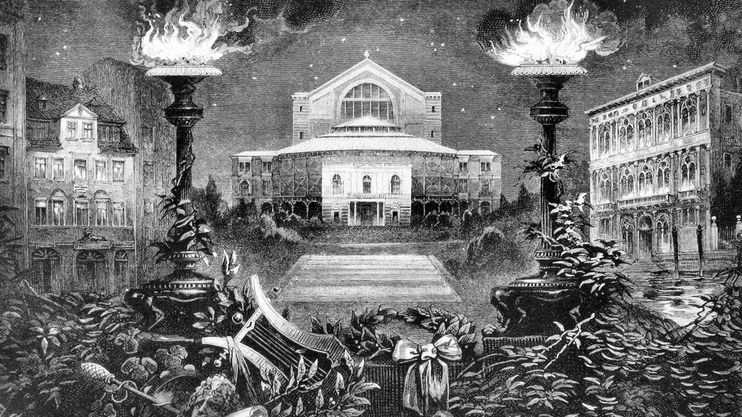
Music drama – art and revolution
Die Kunst und die Revolution (1849), Das Kunstwerk der Zukunft (1849-1852), Oper und Drama (1851)

Slide 14
"Pilgrimage" to Bayreuth

Slide 15
Music drama
Wagner's ideal: opera as symphonic poem (J. Kerman)
concept of Gesamtkunstwerk
https://www.youtube.com/watch?v=PSuRJueqsQg

Slide 16
Musicalization and staging the nation: the case of Wagner
the plots "supported by" music of Wagner's music dramas to evoke German pride
Der Ring des Nibelungen [The Ring of the Nibelung]
mythology - medieval Germanic and Scandinavian myths
Die Meistersinger von Nürnberg
Bayreuth Festival
misused by the Nazis during the WWII

Slide 17
Transgressing borders with national rivers

Slide 18
Bedřich Smetana (1824-1884)
composer, pioneered the development of Czech music
Prague Provisional Theatre – first Kapellmeister (1866-1874)
The Bartered Bride (1866)
Má vlast [My homeland] (1872-1879)
cycle of 6 symphonic poems
Vyšehrad, Vltava (Moldau, 1874), Šárka, From Bohemian Woods and Fields, Tábor, Blaník
Libuše (1881)
NT Prague opening(s) – 1881, 1883

Slide 19
Smetana's cycle My homeland
1874-1879
6 symphonic poems
"Moldau" - 2nd poem (1874) - imitating (tone painting) the flow of the Moldau river: https://www.youtube.com/watch?v=3G4NKzmfC-Q
see also Wagner's the flow of the Rhine waters (1852): https://www.youtube.com/watch?v=wfAKZj2pYrs

Slide 20
Smetana's Bartered Bride
premiered on May 30, 1866 (Provisional Theatre in Prague)
spontaneously taken as the first truly national opera
comic opera with plot taken from the village life – also the reason of the doubts about its "appropriatenes" to the task of national opera
later, opera Libuše met the demands

Slide 21
Dream about Libuše
“The dying Magdalena Dobromila Rettigová reportedly let herself be carried from her bed to the floor. She did so (...) like Libuše, of whom legend has it that, seeing death approaching, she laid down on the floor and died.” (Vl. Macura)
to seal importance of one's own life in "tableau vivant"

Slide 22
Libuše
Czech mythical duchess / duchess of tribe of Czechs
oracle
mythical foundress of Prague
progenitor of Premyslid dynasty
known from chronicles (Kosmas – early 12th century, Hájek z Libočan - 16th century...)
J. Mathauser: Princess Libuše foretells the glory of Prague

Slide 23
Shared mythology as transcultural phenomenon
Libuše - also a favorite story of German literature
Franz Grillparzer: Libussa (1872)
Trauerspiel in fünf Aufzügen
Austrian play(wright)
German poets
a "proper" matter belonging to the German cultural sphere, a "German fairy tale"
also regarded as a "monumental drama from the Slavic antiquity of Bohemia" (Herder 1828), the attribute "bömisch"
an exotic matter (at the same time)

Slide 24
"Our" and "Their" Libuše:
"German" Libussa as exotic matter
story pointing towards the past
mythical bedrock pointing towards "other", "exciting"
reference to "Germany's excitingly unknown ethnic prehistory" (V. Macura)
dream visions of heroic past and deeds
dream of past "Golden Age"...

Slide 25
Becoming a symbol of Czech nation
image of ancient times - less emphasis on realm of myths
more: recounting about:
beginnings of Czech national independence
Czech origin
foundations of the Czech state
Přemysl the Plouhgman

Slide 26
Libuše as symbol of Czech nation
Libuše's oracles
a call to presence
to call for/"attract" / focus attention to the bright future
personification and embodiment of relations to the homeland
symbol of Czech nation
in Manuscript of Zelená Hora (faked, discovered 1817):
the establishment of a new, invented tradition of understanding Libuše
transformation of Libuše into a Czech national symbol
L. presented in her key role: ruler of a distinct nation "with a different language, different laws from those of the Germans, a nation that is essentially and directly genetically democratic and cultural" (V. Macura)
Libuše as sacred value (recall M. D. Retiggová's pre-death gesture)

Slide 27
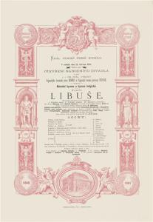
Bedřich Smetana's Libuše
composed 1872
premiere: National Theatre, Prague - June 11, 1881
opening performance of National Theatre (1881, 1883)
(Marie Sittová as Libuše)

Slide 28
Smetana's Libuše
idea of national opera - programmatically nationalistic opera
closest to the concept of Wagner's music drama
influences: Tristan und Isolde, Rheingold, Valküre ...
original German libretto Josef Wenzig – transl. by Ervín Špindler
Mikoláš Aleš - draft of tableau vivant (1897)

Slide 29
legacy of coronation opera
only not to celebrate coronation of a ruler – but the nation
Czech waiting for a ruler (coronation that never took place)
character of Libuše - off the main line of the story
demonstrations of historical events
musical-choreographic characters
ceremoniality
intentionally performed only on festive, nationally important occasions
contribution to the process of symbolization of Libuše
up to today staged rather ocassionally – (e.g. 2018 - centenary of the founding of the Czech state)
Mikoláš Aleš - draft of tableau vivant (1897)

Slide 31
Libuše as a dramatic character
First scene, Libuše's hall at Vyšehrad with a view of the Vltava valley.
Libuše (lifting Radmila to herself, calmly): Rise up and put your mind at peace! / Libuše's guiders are the gods. / With their help we shall succeed in solving / the strife which now divides your kin.
Eternal gods, ye that dwell above the clouds, / look down with grace upon this our land! / To concord do ye lead it, / to love consecrate it, / outside its borders keep the serpent of strife! / May the land’s powers bring about good / and produce plenty for all its men!
May concord and love lead the people [nation]forward / and proclaim the glory of its future days! / O, my gods, hear this my prayer, / take my people [nation] under your wing! / O, protect my land [homeland]! / Take my people [nation] under your wing!
--------
Last scene, the Royal castle in Prague
Libuše/All: Czech people [nation] shell never perish / they [it] all hell's horrors will ever resist!
(186) Bedřich Smetana: Libuše 1983 (Košler - Beňačková - Zítek ) - YouTube
(1983, cond. Zdeněk Košler, dir. Karel Jernek, scenography Josef Svoboda, costumes Olga Filipi, choreography Jiří němeček, Libuše - Gabriela Beňačková)

Slide 32
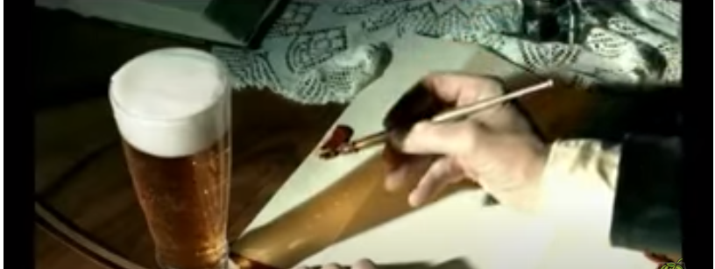
Representing national values https://www.youtube.com/watch?v=787loxr6t_U

Slide 33
Mythology today – in Brno
Libuše, National Theatre, Brno, 2018 (trailer)
https://www.youtube.com/watch?v=LCHYKq8Z2H8
https://www.google.com/search?q=ndb+libu%C5%A1e&oq=ndb+libu%C5%A1e&aqs=chrome..69i57j0i13i30i625.2440j0j7&sourceid=chrome&ie=UTF-8#fpstate=ive&vld=cid:15a29d78,vid:Ng0b_mn0Kec
"Libuše is the story of an amazing woman" (Patricie Částková, NT Brno dramaturge)

Slide 34
Inauguration of Petr Pavel
https://www.youtube.com/watch?v=E2I9qTDElqc

Slide 35
Selected bibliography
Futtera, Ladislav. Cesta k národnímu mýtu [The path to a national myth]. In Německá píseň o české Libuši – Obraz českého dávnověku v české a německé literatuře 19. století [The German Song of the Czech Libuše - The Image of Czech Antiquity in Czech and German Literature of the 19th Century]. Pistorius & Olšanská, Příbram, 2015.
Macura, Vladimír. Český sen [Czech dream]. Praha: Nakladatelství lidové noviny, 1998:
Macura, Vladimír. The Mystifications of a Nation: "The Potato Bug" and Other Essays on Czech Culture [transl. by Hana Píchová]. University of Wisconsin Press, 2010.
Ottlová, Marta - Pospíšil, Milan. Bedřich Smetana a jeho doba [Bedřich Smetana and his time]. Praha: Lidové noviny, 1997.
Ther, Phillip. Center Stage: Operatic Culture and Nation Building in 19th Century Central Europe. West Lafayette: Purdue University Press, 2014.

