Slide 1
History of Central European Culture I
Intro meeting
Tuesday 16.00

Slide 2
17. 9. | Lesson canceled
24. 9. | Intro lecture / Central Europe as a Concept / Nationalism as the Concept | David Drozd
1. 10. | Political history I (revolutions in 1848) | Jana Musilová
8. 10. | National Theatres in 19th century | David Drozd
15. 10. | Opera as Transnational Phenomenon | Šárka Havlíčková Kysová
22. 10. | Printed Media and Their Role in 19th Century | Markéta Malá
29. 10. | Problem of National Cinema and Film Culture till 1918 | Michal Večeřa
5. 11. | Political history II (WWI) | Jana Musilová
12.11 | Theatre Avantgarde between Popular and Elitistic | David Drozd
19.11 | Reading week
26.11 | Film Studios and Production Culture in Central Europe | Michal Večeřa
3. 12. | Interwar Political Situation | Jana Musilová
10.12. | Media at begining of 20th century | Markéta Malá
17.12 | Media in Interwar Period | Markéta Malá

Slide 3
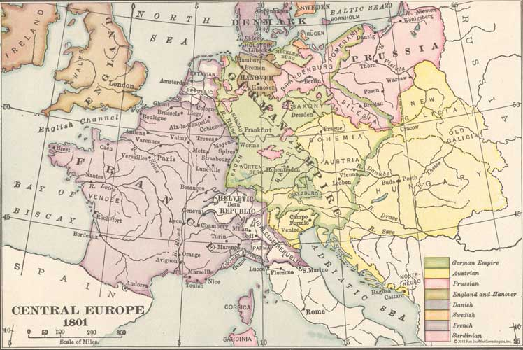

Slide 4
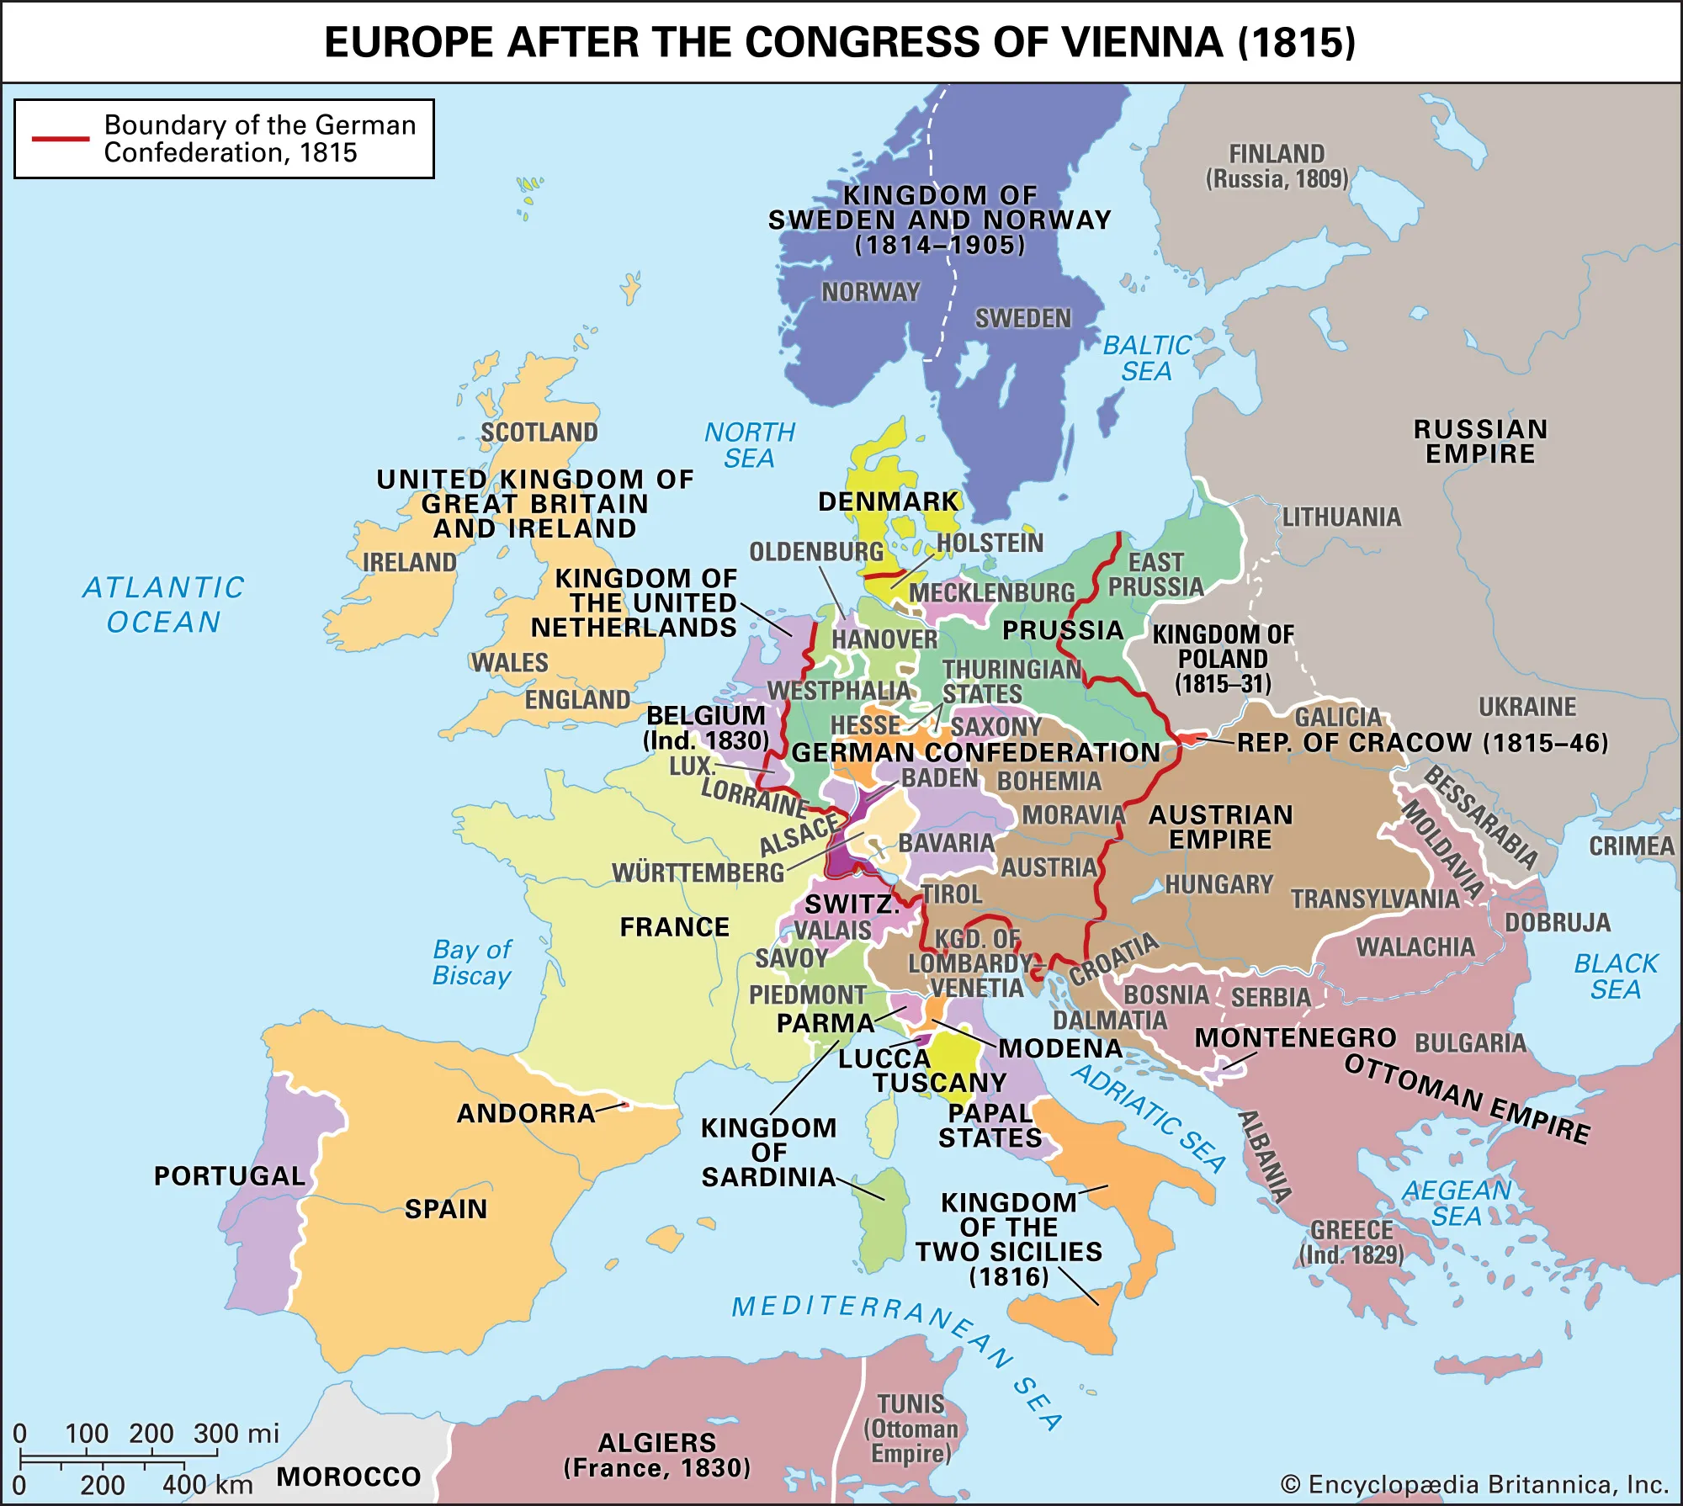

Slide 5
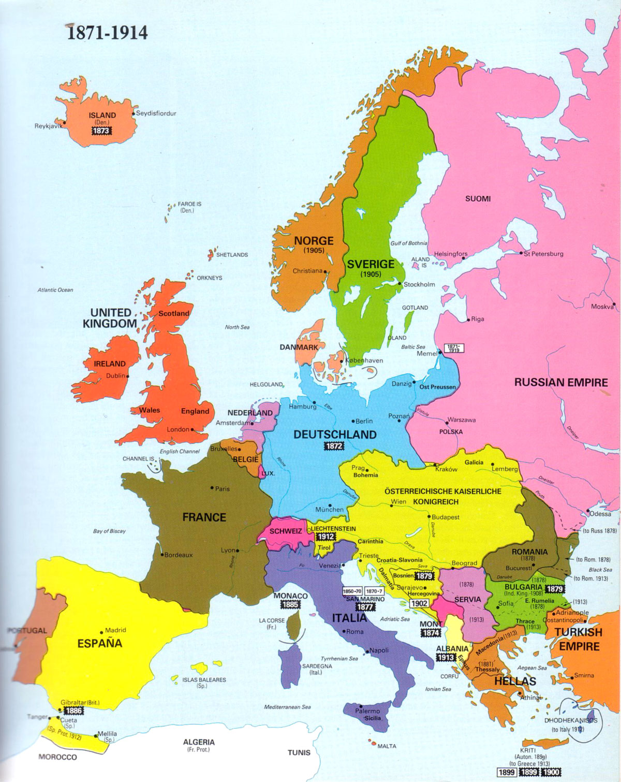
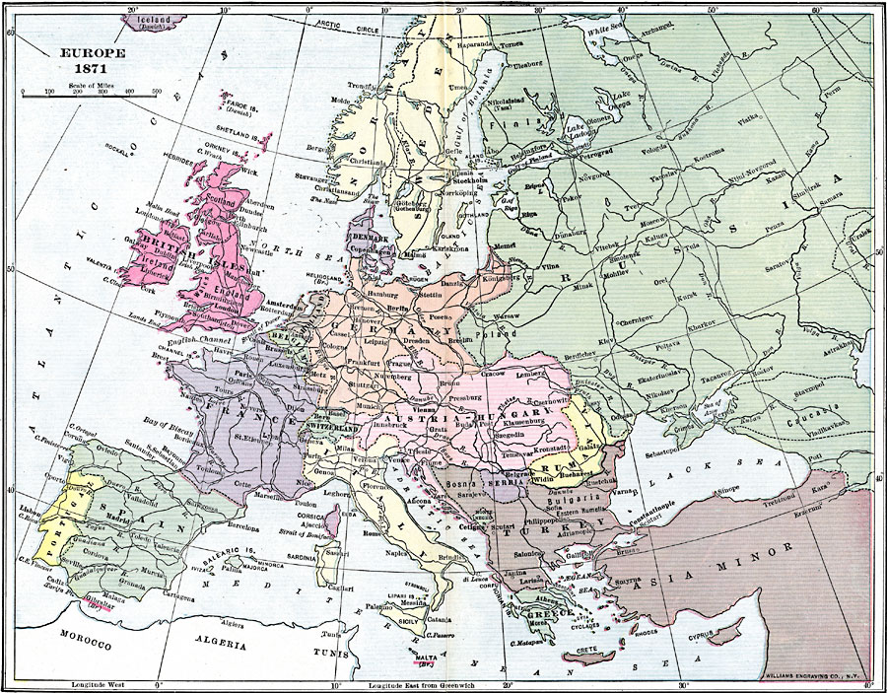

Slide 6
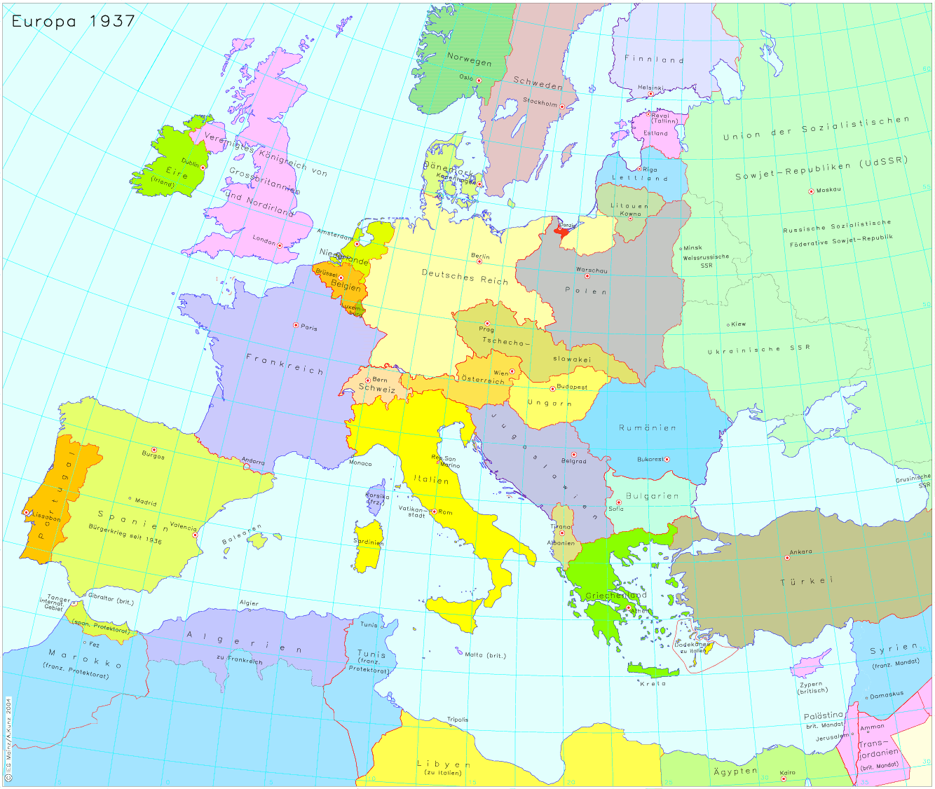

Slide 7
History of Europe in 12 minutes ;)
https://youtu.be/UY9P0QSxlnI?si=i70KtaomK1QQeWvz

Slide 8
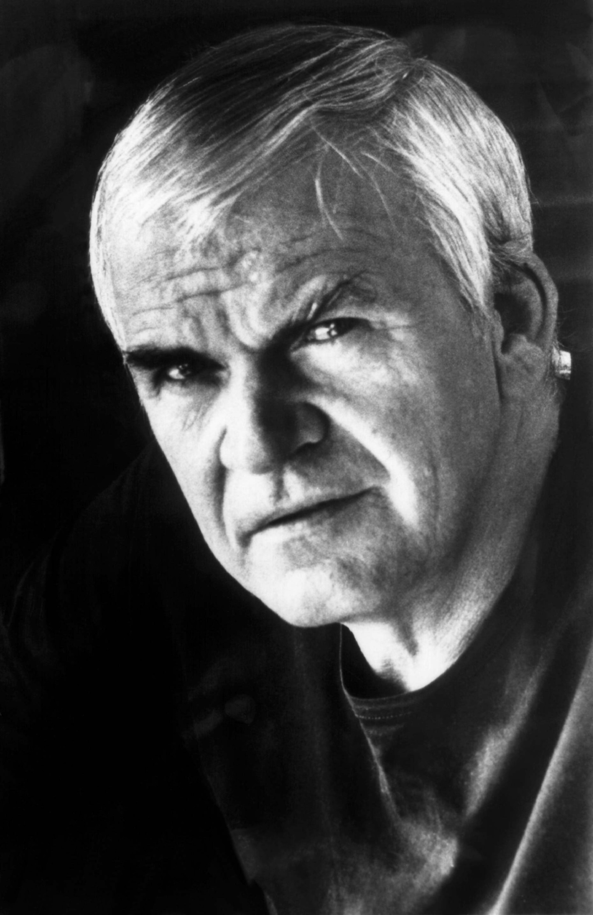
Milan Kundera: The Tragedy of Central Europe (1984)
Czech (Brno born!) French (?) novelist and essayist
Crucial questions:
  Where is Central Europe and its borders?
  How diverse it is culturally?
  Central Europe is not a state: it is a culture of a fate. Its borders are imaginary and must be drawn and redrawn with each new historical situation.

Slide 9
Concepts of (modern) nation
The formation of the nation as a social process which formed part of the changes during the transition from the feudal society of Estates to the capitalist society of the citizens. The formation of the modern nation thus took the following course: a new class, the' third estate', set itself·up against the old feudal ruling class and sooner or later proclaimed itself the representative of the whole nation. In fact the' third estate' regarded itself as identical with the nation, in that it comprised all the formally equal individuals, i.e. all the citizens. In the new society of citizens, organized as the nation, national consciousness, patriotism, became an ingredient in social consciousness.
(Miroslav Hroch)

Slide 10
Nation and modernisation…
New ways of trade, travel and communication (railways, print, telecomunication)
Mass production / Industrialisation (Industrial Revolution)
Centralisation of the state
Globalisation x localisation (and national specificity)
Difference between
big and small nations
Concept of national renessance
Nation as "an imagined political community.“
Benedict Anderson

Slide 11
The objective modernity of nations to the historians' eyes vs. their subjective antiquity in the eyes of nationalists.
(2) The formal universality of nationality as a socio-cultural concept [...] vs. the irremediable particularity of its concrete manifestations [and]
(3) the 'political power of such nationalisms vs. their philosophical poverty and even incoherence.
Anderson, Benedict R. (1991). Imagined communities: reflections on the origin and spread of nationalism

Slide 12
Further Reading:
Holsworth – Nation, national identity and nationalism in Theatre and Nationalism
Miroslav Hroch – SOCIAL PRECONDITIONS OF NATIONAL REVIVAL IN EUROPE (introduction)
Vladimír Macura – PART I The Nineteenth Century: Genesis of a Nation - Where Is My Home? - Mystification and the Nation - Dream of Europe

