Slide 1


How to present research findings
Martina Novotná
9. 12. 2024 | CMAa11 Qualitative Research

Slide 2
CONTENT OF THE LECTURE
Research data reporting in qualitative study
01
01
How to write the analytical part of the study – student thesis, report
02
03
Presentation

Slide 3
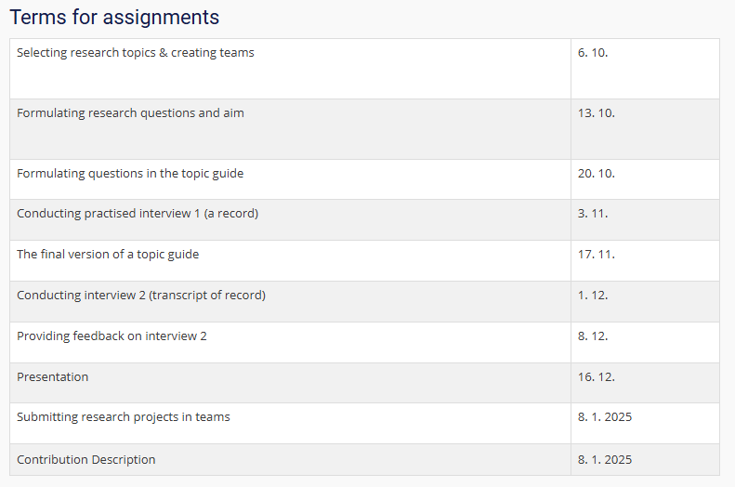
⭐
⭐
⭐

Slide 4

ESSENTIALS FOR ANALYTICAL PART
Provide guidance at the outset: say at the outset what the purpose of the text is.
What is the central message of our research study?
Not to write the analytical part as a "detective story". It's a good idea to start writing this part after we have thought through the story we want to tell.
What is the contribution of our study?

Slide 5
INTERPRETATION
Sorting and structure by topics, questions or categories/types of identifications in analysis
Participant, respondent, interviewee, informant
Differs in narrative, referring to theory, working with illustrations from data, and referring to participants and their characteristics
Here is an example described by participant 13:
You know, when a shooter gets killed by the opposite team, in many cases he would blame support for not helping him. […] Specifically, he might say “hey support, do you know how to play?” […] And when this happens again, he might say something worse like “support don’t you have eyes? Are you blind?” Then he would swear words to insult your mother. You know, it is like a chain - once you start flaming, the rest of this chain follows naturally.

Slide 6
WRITING THE ANALYTICAL PART
We are not concerned with reporting the number of participants who did this and that.
All except David, Lucie and Romana were watching TV series. Hana, Marie, Květa and Elisabeth preferred to receive messages on their way to work.
On the other hand, we are particularly interested in the contexts, going more in-depth.
It is good to support the data with excerpts from interviews / not to dominate the text.
It is important to relate to our research question/objective/patterns that emerge in the data.

Slide 7
AN EXAMPLE OF HOW TO USE THE STATEMENTS OF THE PARTICIPANT(S)
“The frustration with the dynamic of the discussions on these topics reflects that participants are not willing to listen to each the other side. Some participants say they are exhausted from discussing these topics and unwilling to engage in discussions they describe as “pointless”. Moreover, participants perceive these debates as extremely divided. Especially in discussions about the pandemic, participants perceived no room for a middle-ground, with balanced opinions being pushed aside. Because extreme opinions were predominant, participants felt like balanced opinions were not endorsed (Jonáš, male, 30).”
As noted by prior research, frequent discussants tend to be less affected by anti-normative discourse (Hmielowski et al., 2014).

Slide 8
THE ROLE OF INCIVILITY
"Discussions of people from the other side, when I say it politely, so I just provoke, and then I don't look at those discussions anymore. Because it is just bunch of vulgar words and shits, so I do not follow discussions anymore."– Jan (60 years old)
"(…) so for instance they comment post and I am writing with him a bit, but in most of the cases it ended up with aggression and I do not want to be part of this (…)"– Martin (55 years old)
„When he/she downloads pictures from a profile of kids of the other discussants and writes down threats, it is something that I really do not like. I always report it.“ – Bára (25 years old)

Slide 9
INCIVILITY: KEY THEMES
Different coping strategies – a different level of sensitivity
= running away (immediately/later/avoidance), punching back,
unfriending/blocking, emotional responses
reading, active engagement, a mix of those strategies
Various types of incivility: blurred terminology: incivility/intolerance attacks
= personal attacks X attacks toward political arguments
= extreme attacks (racism, xenophobia,..)
Personal characteristics Perceived incivility: conflict avoidance
communication strategies
Initiating incivility: assertiveness,
a lower level of education
Role of the environment

Slide 10
PRESENTATION OF RESULT: SUGGESTIONS
You should be concise and lead with that argument.
A brief summary of what the implications are – perhaps even about the topic‘s relevance – which contributions are surprising and what is, on the contrary, consistent with what we already know.
Vizualisation (mind maps)
Carefully consider what excerpts from participants' statements you will include in the analysis (what might help readers navigate the text).

Slide 11

Challenges in qualitative data reporting
(Ritchie et al., 2014)
Tell a story
Come up with the main story line
The reader needs to be taken into account
Evidence for our interpretations
More difficult than in the case of quantitative methods (tables, graphs)
10 % of direct quotations
Reporting of deflected statements
We are interested in recurring patterns, but also in exceptional cases
Limits of qualitative research
Impossibility to generalise data but possible implications for society

Slide 12

RESEARCH PROJECT WRITING

Slide 13
Purpose of the final report and information on the "origin" of the research
The introduction should contain relevant information about the topic and explain why the research is significant.
The proposal assists in ensuring that the researcher has a well-defined plan before commencing the study.
The proposal is a communication between the researcher and other stakeholders (teachers).

Slide 14
Formulation of research objectives and research questions:
Present the research design: why it is interesting, relevance
Research questions (you must clearly define what you are interested in within the research topic)
How you have tried to answer those RQs

Slide 15
Explication of the research method
Description of the selection of participants + then a description of their characteristics (basic soc. demo and variability)
Type of interviews (structured/unstructured/semi-structured interviews)
Conduct of interviews (online/offline)
Definition of data collection time
Duration of interviews
Financial reward for the interviews

Slide 16
Barriers to Participation in Polarized Online Discussions about COVID-19 and the Russo-Ukrainian War
Martina Novotná, Alena Macková, Karolína Bieliková and Patrícia Rossini
11. 12. 2023 | CMAa11 Qualitative Research

Slide 17
THEORETICAL FRAMEWORK
POLITICAL PARTICIPATION
CROSS-CUTTING DISCUSSIONS
An important element of active democratic citizenship.
Might result in uncertainties about political opinion and further demobilization.
Online political discussions are perceived as a valuable form of political participation (Ohme, 2019)
Scholars have raised concerns about access and new barriers to the online public sphere (Habermas, 2022; Kennedy et al., 2021; Vochocová et al., 2016)
INCIVILITY
Incivility may deepen the divide between people who hold different opinions.
BUT reactions to incivility vary.

Slide 18
RESEARCH QUESTIONS
What discussion dynamics can demobilize participation in online debates during global crises?
RQ1: How are online cross‐cutting discussions related to the perception of polarization among the public?
RQ2: How does incivility affect active participation in discussions on Facebook?
RQ3: How do different types of incivility affect people’s perceptions and evaluations of their discussion partners?

Slide 19
METHODOLOGY
Context of the study
Participants
Czech Republic (CEE region)
COVID-19 pandemic and Russo‐Ukrainian War
Political participation (online discussions) on Facebook
Data collection
Data analysis
(N = 50), 21 to 74 (Mean = 35, Median = 29), gender (32% female)
Active commenters in online discussions
Semi-structured interviews (Spring 2021, 2022)
Thematic analysis
(Braun & Clarke, 2006)

Slide 20
CONCLUSION AND LIMITS
Limits of methodology (specific sampling)
„Our inferences refer to perceived experiences reported by a limited sample of participants, and self‐reports of prior experiences may also differ from actual behavior.“
Further recommendations
„Future research could address this gap and focus on participants who are part of racial minorities and who have personal experiences with more harmful comments, such as racism, which might bring a different perspective to the barriers to active engagement in online discussions.“

Slide 21
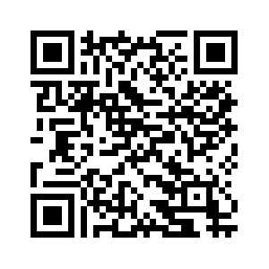
Thank you for your attention!
Do you have any questions?
mnovotna@fss.muni.cz
@novotnamarti
Please keep this slide for attribution

Slide 22
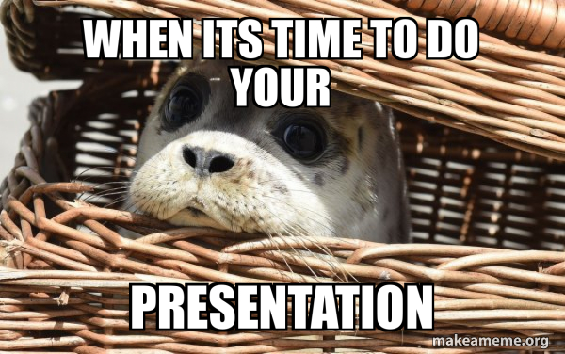
PRESENTATION
10 minutes (approx. 8 slides) – be on time
Theory
Main research aim/questions
Methodology: Information about interviews
Briefly describe suggested steps involved in the data analysis
Conclusion and limits.

Slide 23

COURSE ASSIGNMENT (RESEARCH PROJECT)
The main aim is to demonstrate an understanding of all phases of qualitative interview-based research.
the word limit is a minimum of 2,500 and a maximum of 3,000 words (without references).
Using a recognized academic style, such as APA or Chicago, is essential for proper citation and referencing. Consistency in style usage is necessary.

Slide 24

Any questions?

Slide 25
SOURCES
Brett, B. M. & Wheeler (2022). How to Do Qualitative Interviewing. SAGE. ​
Habermas, J. (2022). Reflections and hypotheses on a further structural transformation of the political public sphere. Theory, Culture & Society, 39(4).
Kennedy, R. D., Sokhey, A. E., Abernathy, C., Esterling, K. M., Lazer, D., Lee, A. S., Minozzi, W., & Neblo, M. A. (2021). Demographics and (equal?) voice: Assessing participation in online deliberative sessions. Political Studies, 69(1), 66–88.
Ritchie, J., Lewis, J., Nicholls, C.M. & Ormston, R. (2014). Qualitative Research Practice: A Guide for Social Science Students and Researchers. SAGE.
Mihelj, S., Kondor, K., & Štětka, V. (2021). Audience Engagement with COVID-19 News: The Impact of Lockdown and Live Coverage, and the Role of Polarization. Journalism Studies, 23(5–6), 569–587.
Novotná, M., Macková, A., Bieliková, K., & Rossini, P. (2023). Barriers to participation in polarized online discussions about COVID-19 and the Russo-Ukrainian war. Media and Communication, 11(3). https://doi.org/10.17645/mac.v11i3.6657
Ritchie, J., Lewis, J., Nicholls, C. M., & Ormston, R. (2013). Qualitative Research Practice: A Guide for Social Science Students and Researchers. SAGE Publications Limited.
Ohme, J. (2019). Updating citizenship? The effects of digital media use on citizenship understanding and political participation. Information, Communication & Society, 22(13), 1903–1928. https://doi.org/10.1080/1369118X.2018.1469657
Silverman, D. (2022). Doing Qualitative Research (6th edition). SAGE Publications. Chapters (you find them also in older editions, they might have different names): What you Can (and Can’t) do with qualitative research (introduction, what is qualitative research,…) Silverman, D. (2015). Interpreting Qualitative Data (Fifth). SAGE Publications Ltd.
Vochocová, L., Štětka, V., & Mazák, J. (2016). Good girls don’t comment on politics? Gendered character of online political participation in the Czech Republic. Information, Communication & Society, 19(10), 1321–1339.
Pictures and presentations motives
https://www.pexels.com/
https://storyset.com/
https://www.flaticon.com/

