Slide 1
DSBcB49 Starověká ekumena - antické zprávy o Asii a Africe
Mesopotamie

Slide 2
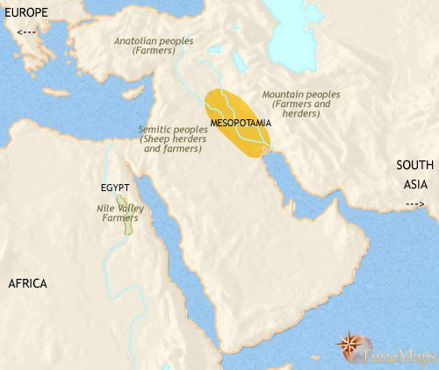
Etymologie
Mesopotamie (Μεσοποταμία) – Území mezi řekami, μέσος, ποταμός
Eufrat a Tigris, území kolem řek
Hladina moře ve starověku odlišná
Assýrie – sever, od města Aššur (město Řekům neznámé)
Babylónie – jih, od města Babylón (Bábilim)
Běžné pojmenování pro oblast a říše – Assýrie (x Sýrie), Babylóňané též Chaldejci

Slide 3
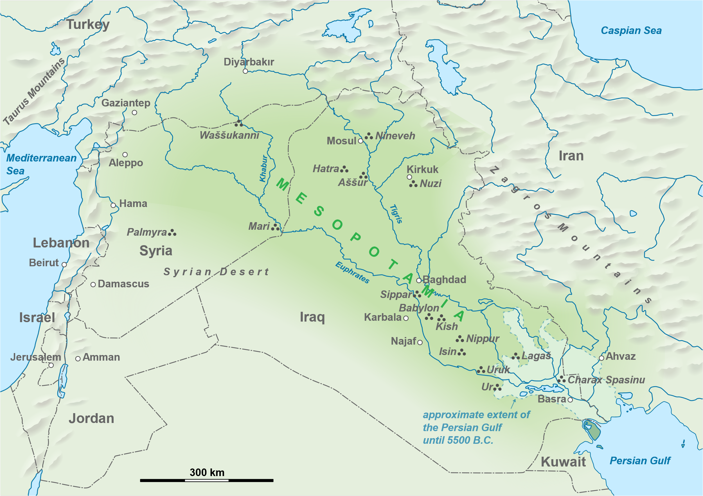
Mesopotamie
Městské státy
Ur
Uruk
Nippur
Aššur
Babylón
Kiš
Lagaš

Slide 4
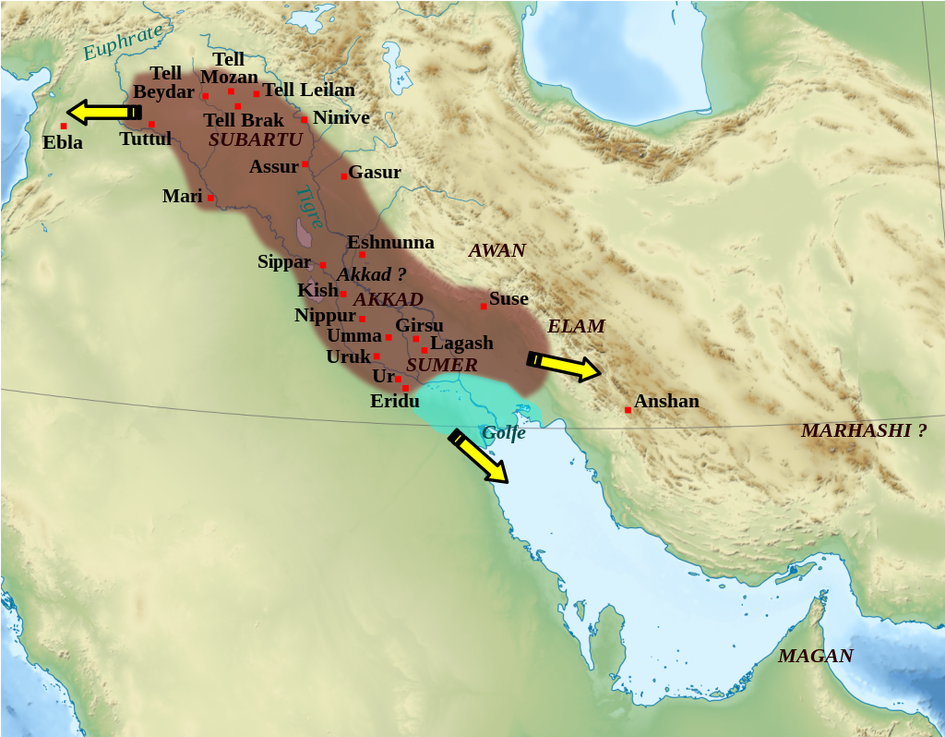
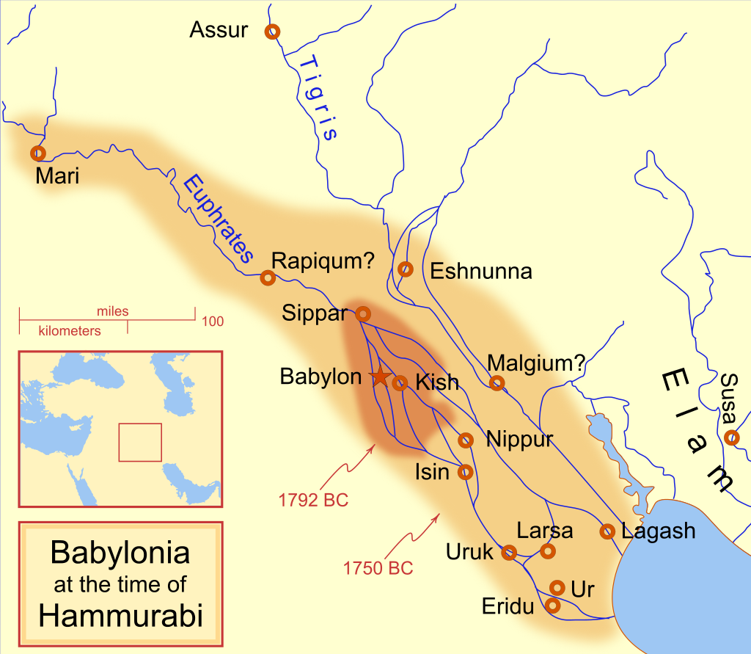
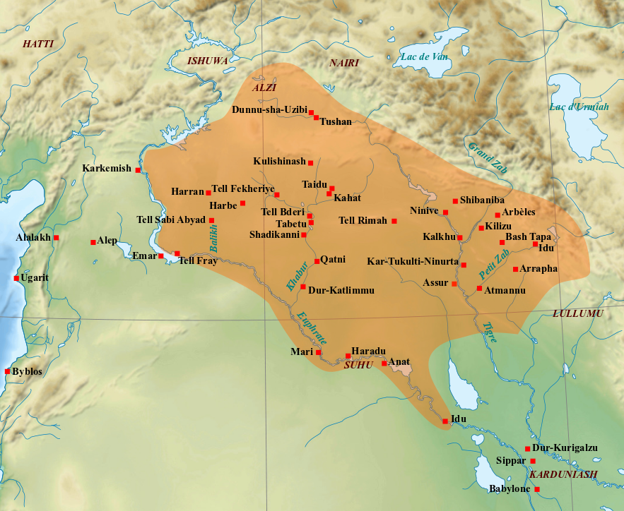
Dějiny mesopotamie do 1 000 pnl
Sumer
Akkad (Sargon I., Narám-Sín), akkadština – lingua franca
Babylónská říše (Chammurabi)
Assyrská říše (Šamší-adad I., Tukultí-Ninurta I., Tiglatpilesar I.)

Slide 5
Dějiny mesopotamie od 1 000 pnl
Novoassyrská říše (911–609 pnl) – Řekové nezakládají kolonie v Sýrii (obchodní stanice, Al-Míná), střety v Kilikii, hl. město – Aššur → Ninive
Sargonská dynastie - Sargon II., Sínacherib, Asarhaddon, Aššurbanipal
Novobabylónská říše (626–539 pnl) – Nabopolasar, Nabukadnesar II., Nabonidus
Achaimenovská říše (550–330 pnl)
Parthská říše (141 pnl–226 nl)

Slide 6
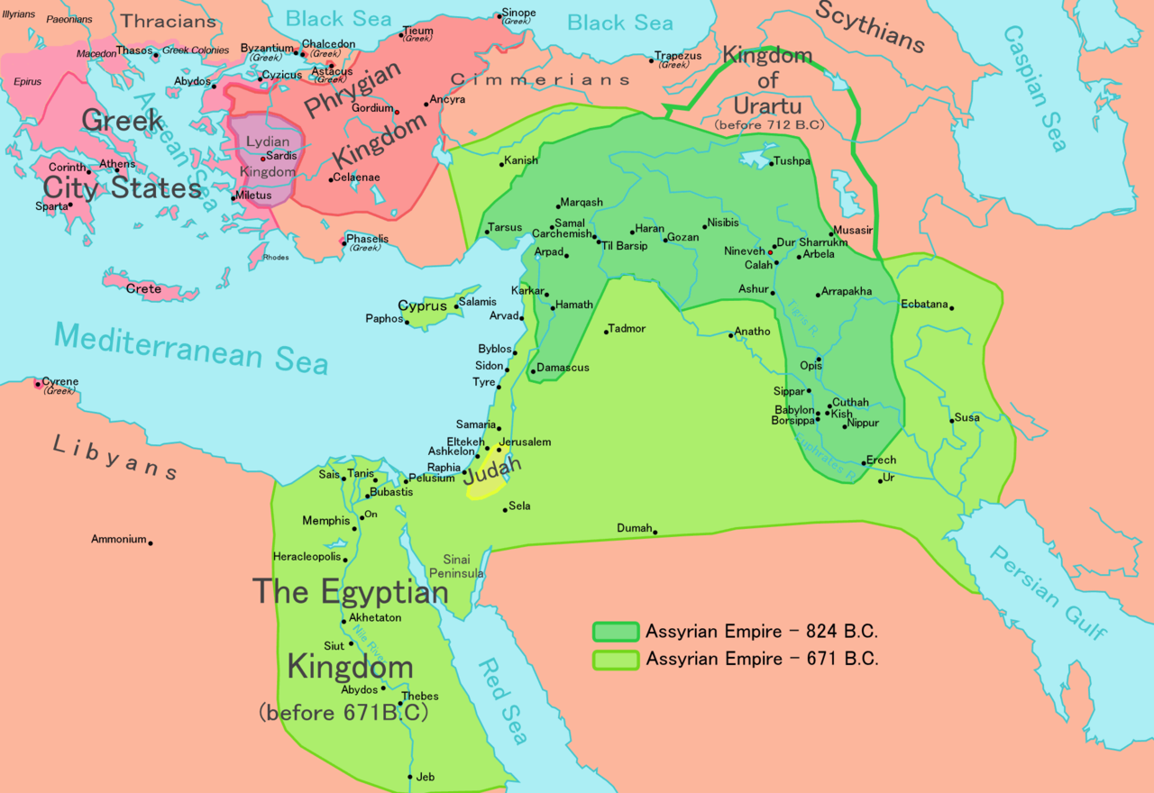
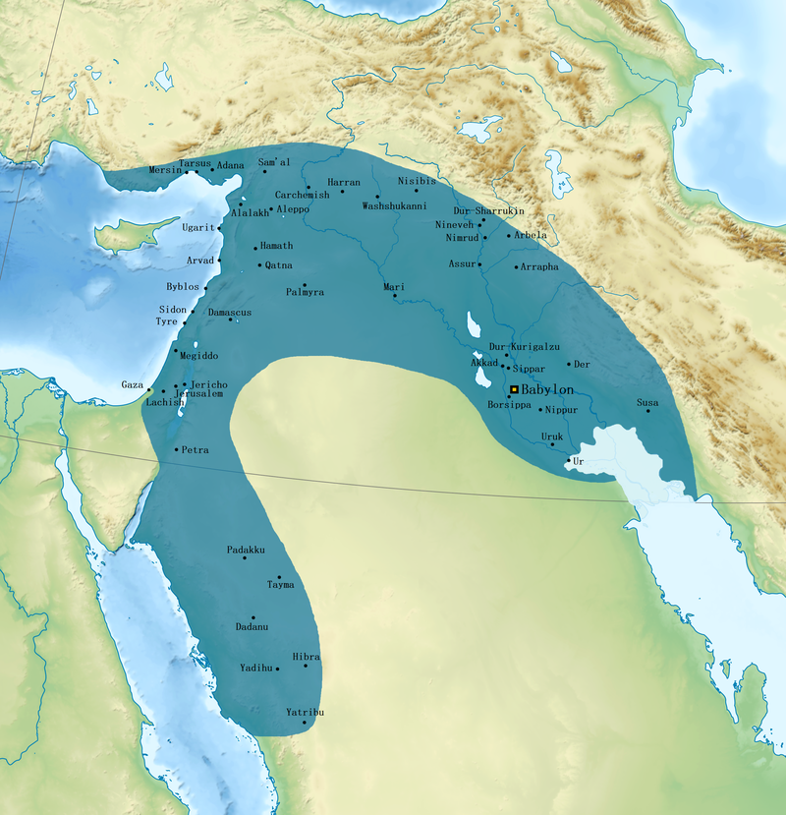

Slide 7
Kontakty
Řekové na tabulkách z Ninive již od 8. stol. pnl (Jamani, Iaunaia)
Řekové v Kilikii – boje s assyrskými králi, nájezdy Řeků, piráti, obchodníci
Al-Míná (Sýrie) – převzetí písma, foinícké
Kypr pod nadvládou Assyřanů
Řekové jako žoldnéři – Egypt, Babylón (Antimenidás, bratr Alkaia)
Kulturní vliv na Řecko z východu

Slide 8
kontakty
Vznik filosofie – myšlenky z Mesopotamie
Vznik vědy – poznatky z Mesopotamie (mapy, astronomie)
Náboženství – Epos o Kumarbim, Enúma Elíš (Hésiodos?), Epos o Gilgamešovi, mesopotamské eposy, příběhy → skrze prostředníky
Zprávy o dějinách, zvycích – často přes prostředníky, neznalost klínopisu, akkadštiny
Ninive zánik 612 pnl, Babylón dobyt Peršany 539 pnl, více Řeků až později
Assýrie „zničena“, Babylón – hl. město Perské říše

Slide 9
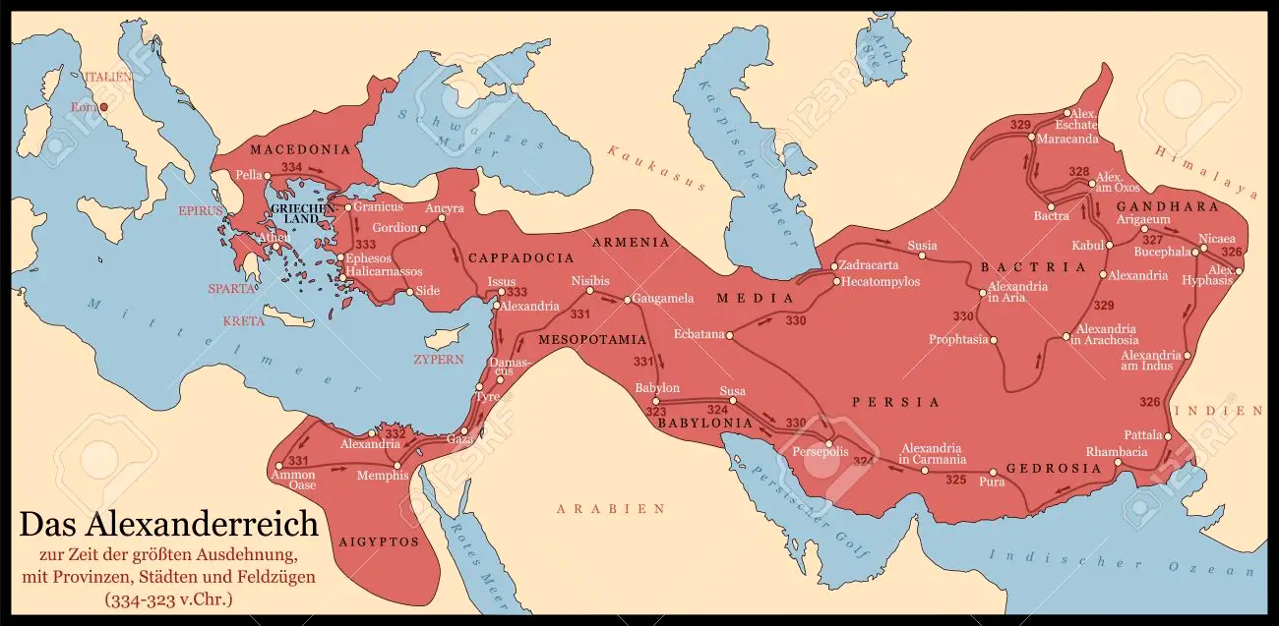
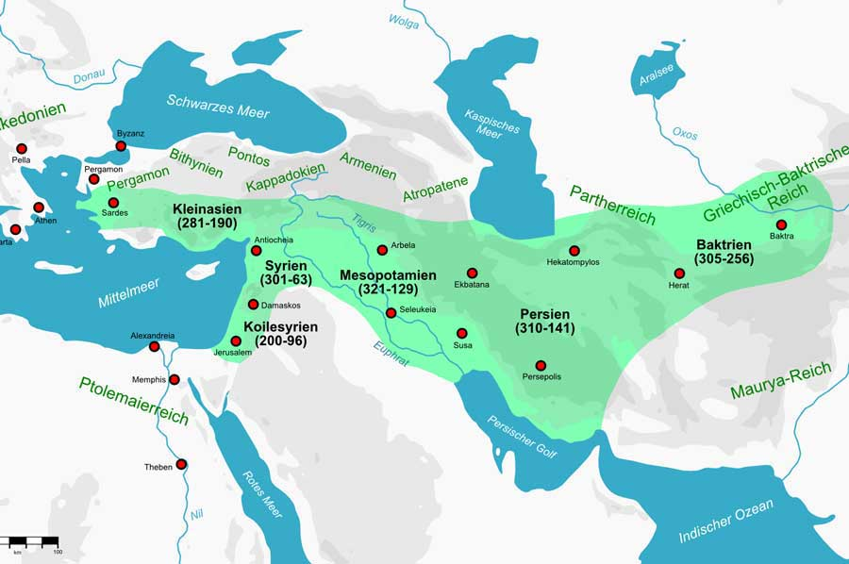
kontakty
Vzpoury proti Peršanům (Dáreios I., Xerxés)
331 pnl – Alexandr Veliký dobývá Mesopotamii
Babylón hl. město Alexandrovy říše, místo smrti 323 pnl
Boje o území
Seleukovská říše, nové město Seleukeia
Seleukovci – králové Babylónu
141 pnl – Mithridatés I. dobývá Mesopotamii

Slide 10
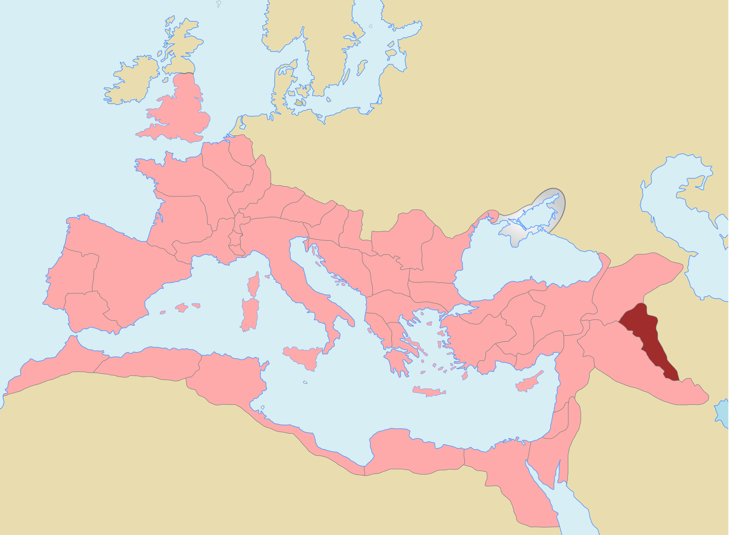
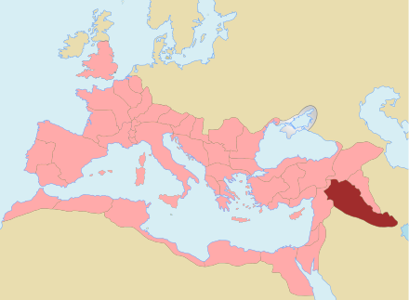
kontakty
Římané
Tažení proti Parthům, Sasánovcům
M. Crassus, M. Antonius, Traian, L. Verus, S. Severus, Julian
Provincie Assyria, Mesopotamia (krátce 116–118 nl, i za S. Severa)

Slide 11
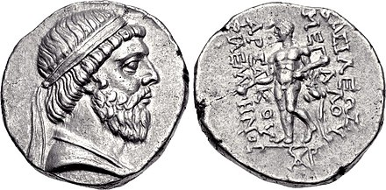
kontakty
Hellénismus
Prolínání řecké a místní kultury
Zakládání měst – Seleukeia, Antiocheia na Orontu (v Sýrii, dnes v Turecku, Antiochie)
Řecké/makedonské obyvatelstvo v nových městech, část místních
Řečtina (koiné) – dorozumívací jazyk (+aramejština)
Parthové dále používají řečtinu na nápisech, mincích (filhelléni)

Slide 12

Prameny
Hérodotos – popis Babylónu
Ktésiás – Persika (část díla Assyriaka)
Deinón - =
Béróssos – Babylóniaka (rodilý Babylóňan, kněz boha Marduka)
Juba II., Abydénos, Kefalión, Kastór – Assyriaka
Flavius Josephus – Židovské starožitnosti
Eusébios - Kronika

Slide 13
Dějiny assýrie podle řeků
Bélos – od něj pochází rod assyrských králů, vnuk Héraklea
Hdt. 1.7 Ἄγρων μὲν γὰρ ὁ Νίνου τοῦ Βήλου τοῦ Ἀλκαίου πρῶτος Ἡρακλειδέων βασιλεὺς ἐγένετο Σαρδίων
Za jeho panování vládl v Řecku Zeus
Eus. Chron. 15
he was descended from Alcaeus, son of Heracles; Agron, son of Ninus, son of Belus, son of Alcaeus, was the first Heraclid king of Sardis,
[Castor] says: "Belus was the king of the Assyrians. During his reign, the Cyclopes, using thunder and lightning, fought on Zeus' side in the battle Zeus (Aramazd) fought against the Titans.

Slide 14
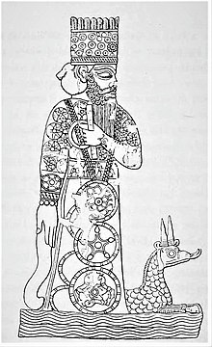
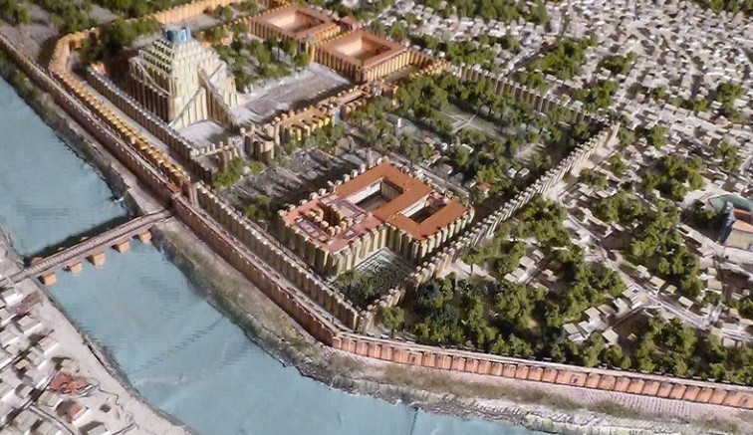
bélos
Βῆλος, Belus
Eus. Chron. 15
Belus, about whom we spoke earlier, died and was regarded as a god.
Bél Marduk – hlavní bůh Babylónu
Bélos také zakladatel Babylónu
= Zeus, (Bélos Zeus), Jupiter
Eus. Chron. 17
Belus, which is translated as Zeus in Greek, cut the darkness in half.
Chrám Dia Béla v Babylónu Hdt. 1.181

Slide 15
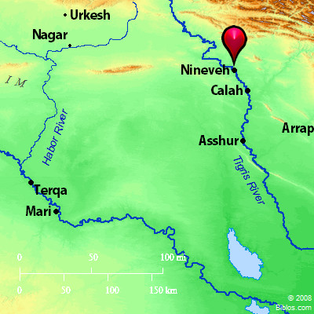
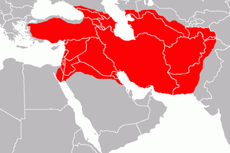
Dějiny assýrie
Diod. 2.1–28 (Ktésiás)
Ninos
= Ninive v řečtině (hl. město Assýrie v 7. stol. pnl, Ninua)
Syn Béla
První vládce Asie/první král Assýrie
Zakladatel města Ninive
Dobyvatel Asie (Mesopotamie, Arménie, Egypt, Baktrie, Malá Asie)
Eus. Chron. 17 - In ancient times, the Assyrians ruled over Asia, and Ninus the son of Belus was their king.

Slide 16
Dějiny assýrie
Údajně o 3. tis. pnl. Ninos → poslední vládce Assýrie 9./7. stol. pnl
520 – cca 1 350 let trvání
Řecké seznamy králů – smyšlené, nevycházejí z assyrských, babylónských záznamů
Zakomponování do řecké chronologie
Řecké mýty x mesopotamské mýty (trójská válka, Memnón, Zeus a Bélos, Héraklés)
Ninos (Bélos) až pád Ninive
Řecké představy o vzestupu a pádu říší
Ktésiás → kopírují jej další autoři

Slide 17
Ninos
Diod. 2.2
κατεστρέψατο μὲν γὰρ τῆς παραθαλαττίου καὶ τῆς συνεχοῦς χώρας τήν τε Αἴγυπτον καὶ Φοινίκην, ἔτι δὲ Κοίλην Συρίαν καὶ Κιλικίαν καὶ Παμφυλίαν καὶ Λυκίαν, πρὸς δὲ ταύταις τήν τε Καρίαν καὶ Φρυγίαν καὶ Μυσίαν καὶ Λυδίαν, προσηγάγετο δὲ τήν τε Τρῳάδα καὶ τὴν ἐφ᾽ Ἑλλησπόντῳ Φρυγίαν καὶ Προποντίδα καὶ Βιθυνίαν καὶ Καππαδοκίαν καὶ τὰ κατὰ τὸν Πόντον ἔθνη βάρβαρα κατοικοῦντα μέχρι Τανάιδος
Of the lands which lie on the sea and of the others which border on these, Ninus subdued Egypt and Phoenicia, then Coele-Syria, Cilicia, Pamphylia, and Lycia, and also Caria, Phrygia, and Lydia; moreover, he brought under his sway the Troad, Phrygia on the Hellespont, Propontis, Bithynia, Cappadocia, and all the barbarian nations who inhabit the shores of the Pontus as far as the Tanaïs;

Slide 18
Ninos
Diod. 2.3 (Ninive)
ἐπιφανεστάτας γὰρ πράξεις τῶν πρὸ αὐτοῦ κατειργασμένος ἔσπευδε τηλικαύτην κτίσαι τὸ μέγεθος πόλιν ὥστε μὴ μόνον αὐτὴν εἶναι μεγίστην τῶν τότε οὐσῶν κατὰ πᾶσαν τὴν οἰκουμένην, ἀλλὰ μηδὲ τῶν μεταγενεστέρων ἕτερον ἐπιβαλόμενον ῥᾳδίως ἂν ὑπερθέσθαι.
καὶ τὴν μὲν πόλιν ὠνόμασεν ἀφ᾽ ἑαυτοῦ Νίνον, τοῖς δὲ κατοικισθεῖσι πολλὴν τῆς ὁμόρου χώρας προσώρισεν.
For having accomplished deeds more notable than those of any king before him, he was eager to found a city of such magnitude, that not only would it be the largest of any which then existed in the whole inhabited world, but also that no other ruler of a later time should, if he undertook such a task, find it easy to surpass him. …And to the city he gave his own name, Ninus, and he included within the territory of its colonists a large part of the neighbouring country.

Slide 19
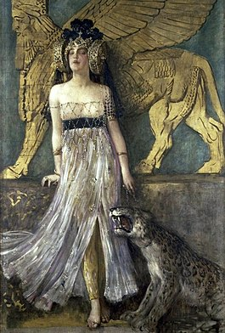
Semírámis
Polobůh (matka bohyně Derketó, smrtelný otec)
Manželka Nina
Šammu-ramát, Nakia
Stavitelka, válečnice
Tažení do Indie
Zakladatelka Babylónu (nebo alespoň hradeb, cihly, asfalt)
Založení mnoha měst, památek napříč Asií
Visuté zahrady ?
Krutá

Slide 20
Semírámis
Diod. 2.7–10 – popis Babylónu (Ktésiás)
Vysoké hradby kolem celého města
Most přes řeku Eufrat
Paláce
Chrám Marduka (zikkurat)
Tunel pod řekou
Park (paradeisos)
Chrám – tři sochy, Zeus, Héra, Rheia
Odtud pozorují hvězdy

Slide 21
Semírámis
Str. 16.1.2
καὶ τῆς Σεμιράμιδος χωρὶς τῶν ἐν Βαβυλῶνι ἔργων πολλὰ καὶ ἄλλα κατὰ πᾶσαν γῆν σχεδὸν δείκνυται ὅση τῆς ἠπείρου ταύτης ἐστί, τά τε χώματα ἃ δὴ καλοῦσι Σεμιράμιδος, καὶ τείχη καὶ ἐρυμάτων κατασκευαὶ καὶ συρίγγων τῶν ἐν αὐτοῖς καὶ ὑδρείων καὶ κλιμάκων καὶ διωρύγων ἐν ποταμοῖς καὶ λίμναις καὶ ὁδῶν καὶ γεφυρῶν.
and as for Semiramis, apart from her works at Babylon, many others are also to be seen throughout almost the whole of that continent, I mean the mounds called the Mounds of Semiramis, and walls, and the construction of fortifications with aqueducts therein, and of reservoirs for drinking-water, and of ladder-like ascents of mountains, and of channels in rivers and lakes, and of roads and bridges.

Slide 22
Semírámis - hradby
Diod. 2.7
ὀπτὰς δὲ πλίνθους εἰς ἄσφαλτον ἐνδησαμένη τεῖχος κατεσκεύασε τὸ μὲν ὕψος, ὡς μὲν Κτησίας φησί, πεντήκοντα ὀργυιῶν, ὡς δ᾽ ἔνιοι τῶν νεωτέρων ἔγραψαν, πηχῶν πεντήκοντα, τὸ δὲ πλάτος πλέον ἢ δυσὶν ἅρμασιν ἱππάσιμον: πύργους δὲ τὸν μὲν ἀριθμὸν διακοσίους καὶ πεντήκοντα, τὸ δ᾽ ὕψος καὶ πλάτος ἐξ ἀναλόγου τῷ βάρει τῶν κατὰ τὸ τεῖχος ἔργων.
Making baked bricks fast in bitumen she built a wall with a height, as Ctesias says, of fifty fathoms, but, as some later writers have recorded, of fifty cubits,​ and wide enough for more than two chariots abreast to drive upon; and the towers numbered two hundred and fifty, their height and width corresponding to the massive scale of the wall.

Slide 23
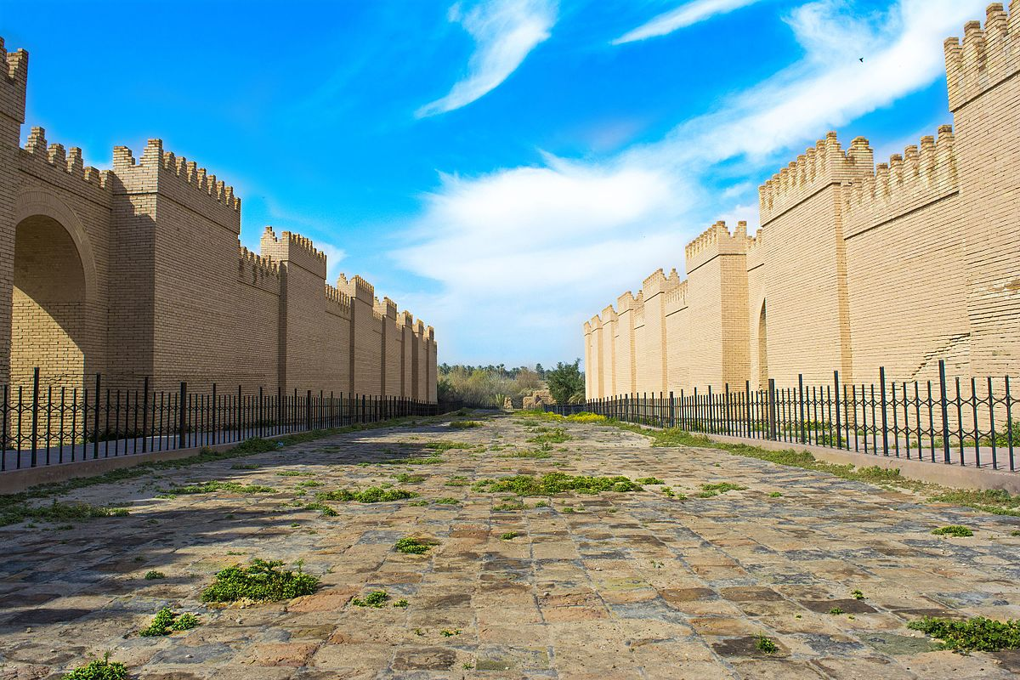
Semírámis - hradby
Ov. Met. 4.57–58
ubi dicitur altam
coctilibus muris cinxisse Semiramis urbem.
Hyginus, Fabulae, 223
The wall in Babylon, which Semiramis, daughter of Dercetis, made, of baked brick and bitumen
near the walls that Queen Semiramis had built of brick around her famous city, they grew fond, and loved each other
Amm. 23.6.23
Babylon, whose walls Semiramis built with bitumen (for the ancient king Belus built the citadel),

Slide 24
Semírámis – visuté zahrady
Hdt. 1.184
τῇ οὔνομα ἦν Σεμίραμις, αὕτη μὲν ἀπεδέξατο χώματα ἀνὰ τὸ πεδίον ἐόντα ἀξιοθέητα· πρότερον δὲ ἐώθεε ὁ ποταμὸς ἀνὰ τὸ πεδίον πᾶν πελαγίζειν.
Diod. 2.10
ὑπῆρχε δὲ καὶ ὁ κρεμαστὸς καλούμενος κῆπος παρὰ τὴν ἀκρόπολιν, οὐ Σεμιράμιδος, ἀλλά τινος ὕστερον Σύρου βασιλέως κατασκευάσαντος χάριν γυναικὸς παλλακῆς: ταύτην γάρ φασιν οὖσαν τὸ γένος Περσίδα καὶ τοὺς ἐν τοῖς ὄρεσι λειμῶνας ἐπιζητοῦσαν ἀξιῶσαι τὸν βασιλέα μιμήσασθαι διὰ τῆς τοῦ φυτουργείου φιλοτεχνίας τὴν τῆς Περσίδος χώρας ἰδιότητα.
and her name was Semiramis: it was she who built dykes on the plain, a notable work; before that the whole plain was wont to be flooded by the river.
There was also, because the acropolis, the Hanging Garden, as it is called, which was built, not by Semiramis, but by a later Syrian king to please one of his concubines; for she, they say, being a Persian by race and longing for the meadows of her mountains, asked the king to imitate, through the artifice of a planted garden, the distinctive landscape of Persia.

Slide 25
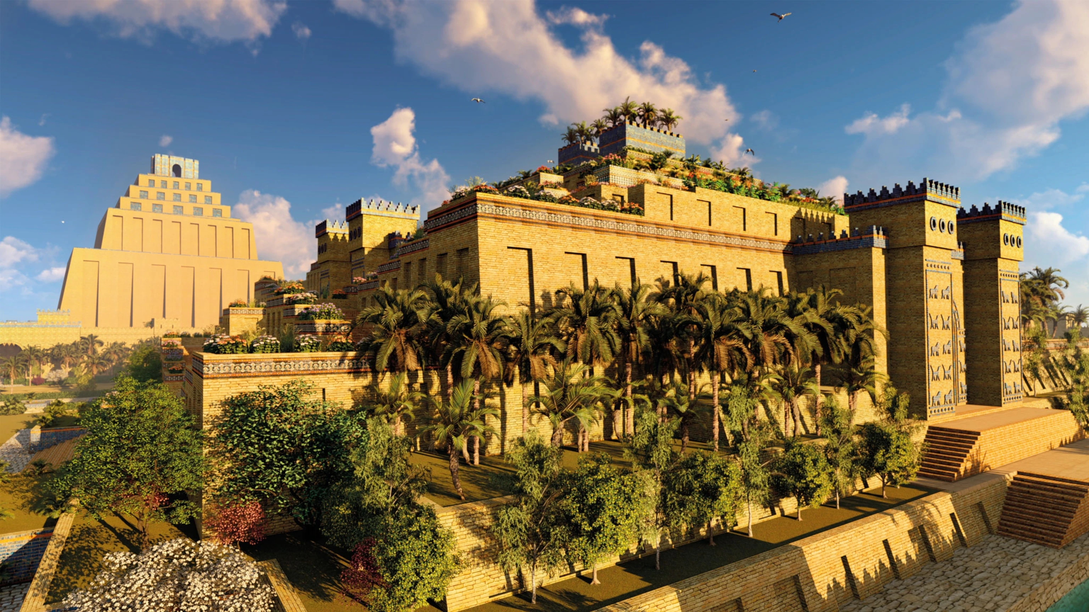

Slide 26
Semírámis – konec vlády
Diod. 2.20
Some time later her son Ninyas conspired against her through the agency of a certain eunuch; and remembering the prophecy given her by Ammon,​ she did not punish the conspirator, but, on the contrary, after turning the kingdom over to him and commanding the governors to obey him, she at once disappeared, as if she were going to be translated to the gods as the oracle had predicted;
Eus. Chron. 17
and how she killed her own sons, but was herself put to death by Ninyas, another of her sons, when she had reigned for 42 years.

Slide 27
Semírámis - krutost
Diod. 2.20
And Semiramis, upon receiving the sceptre and the regal garb, on the first day held high festival and gave a magnificent banquet, at which she persuaded the commanders of the military forces and all the greatest dignitaries to co‑operate with her; and on the second day, while the people and the most notable citizens were paying her their respects as queen, she arrested her husband and put him in prison
Diod. 2.13
she was unwilling, however, to contract a lawful marriage, being afraid that she might be deprived of her supreme position, but choosing out the most handsome of the soldiers she consorted with them and then made away with all who had lain with her.

Slide 28
Semírámis – alternativní verze
Oros. Advers. 2.2
occiso Nino Samiramis uxor eius, totius Asiae regina, Babylonam urbem instaurauit caputque regni Assyriis ut esset instituit.
1.4
huic mortuo Samiramis uxor successit, uirum animo, habitu filium gerens, auidosque iam usu sanguinis populos per duos et quadraginta annos caedibus gentium exercuit.
After his death, his wife Semiramis, the queen of all Asia, restored the city of Babylon and made it the capital of the Assyrian kingdom.
His wife Semiramis succeeded him on the throne. She had the will of a man and went about dressed like her son. For forty-two years she kept her own people, lusting for blood from their previous taste of it, engaged in the slaughter of foreign tribes.

Slide 29
Semírámis – alternativní verze
Oros. Adver. 1.4
haec, libidine ardens, sanguinem sitiens, inter incessabilia et stupra et homicidia, cum omnes quos regie arcessitos, meretricie habitos concubitu oblectasset occideret, tandem filio flagitiose concepto, impie exposito, inceste cognito priuatam ignominiam publico scelere obtexit. praecepit enim, ut inter parentes ac filios nulla delata reuerentia naturae de coniugiis adpetendis ut cuique libitum esset liberum fieret.
Burning with lust and thirsty for blood, Semiramis in the course of continuous adulteries and homicides caused the death of all those whom she had delighted to hold in her adulterous embrace and whom she had summoned to her by royal command for that purpose. She finally most shamelessly conceived a son, godlessly abandoned the child, later had incestuous relations with him, and then covered her private disgrace by a public crime. For she prescribed that between parents and children no reverence for nature in the conjugal act was to be observed, but that each should be free to do as he pleased.

Slide 30
Semírámis – další tradice
Pl. NH. 8.155
equum adamatum a Samiramide usque in coitum Iuba auctor est.
Manželka Nabuchadnezzara
Manželka Nimroda
Arménská tradice - negativní
Juba attests that Semiramis fell so deeply in love with a horse that she married it.

Slide 31
Dějiny assýrie
Ninyás – syn Nina a Semírámidy
Žije zavřený v paláci, rotace armády kolem města
Mnoho vládců, nikdo nevykonal nic významného
Dekadence, zženštilost, luxus
Dějiny světa budou začínat Assýrie + křesťanský/židovský výklad, provázání

Slide 32
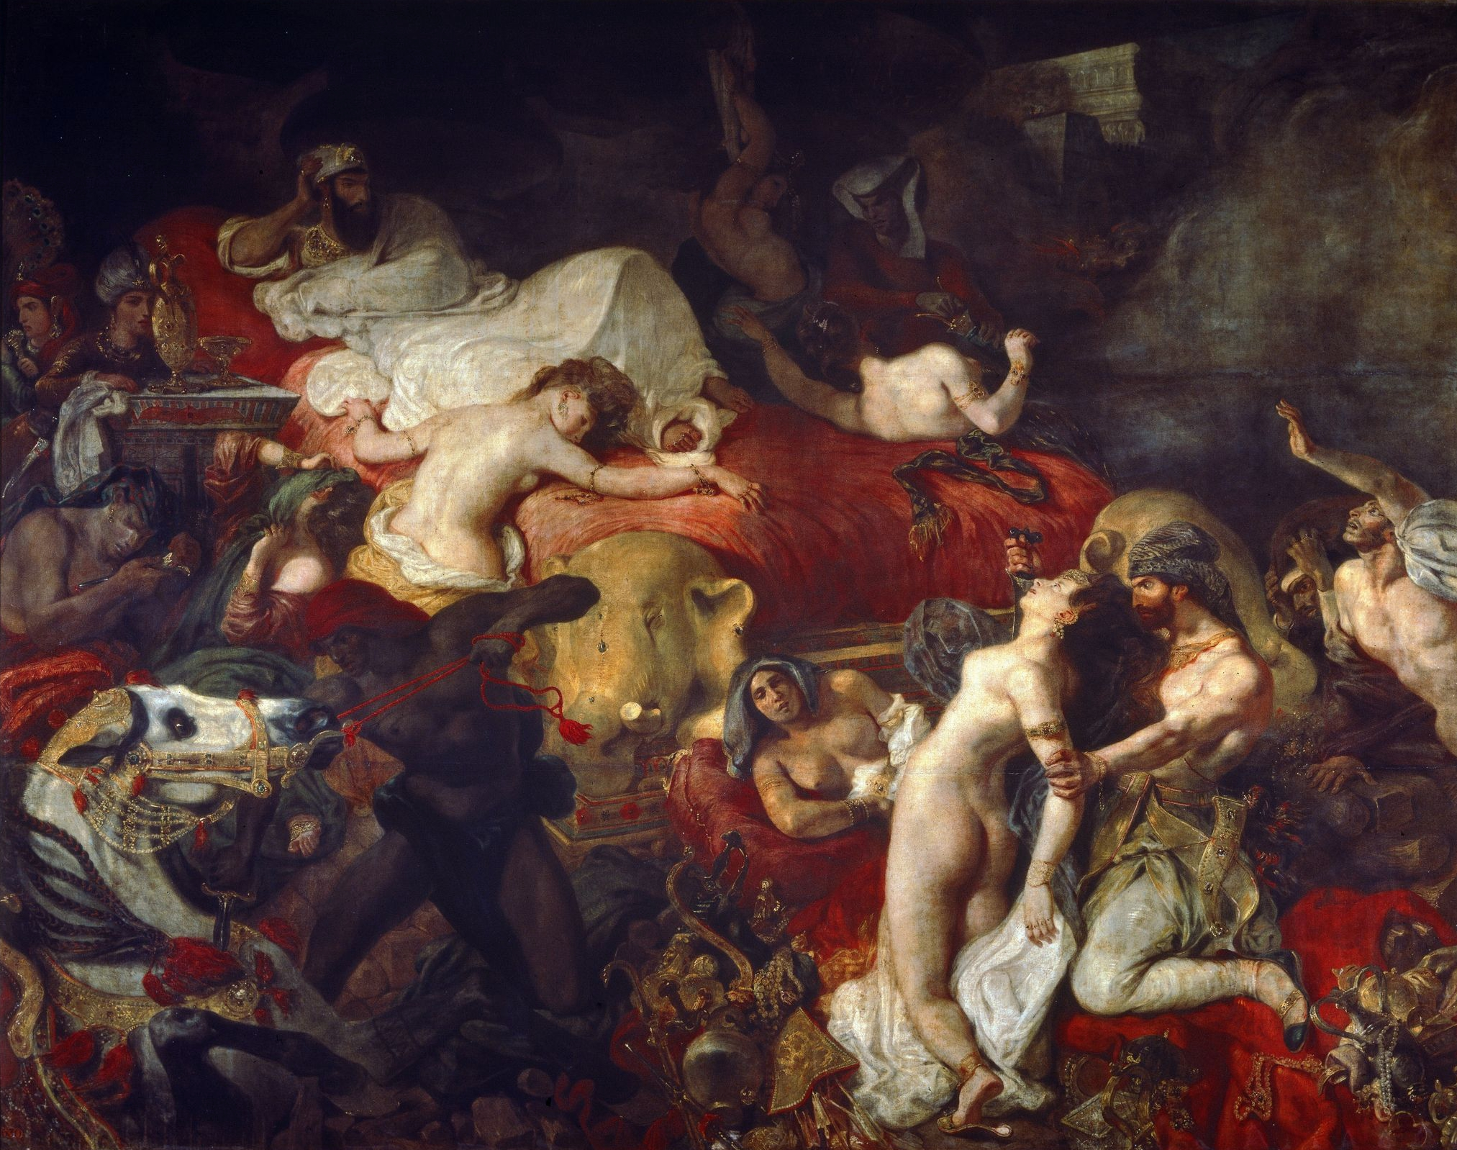
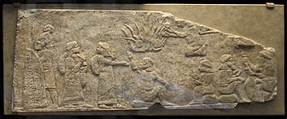
Sardanapallos
Poslední vládce Assýrie
Zkomolenina Aššurbanipal
Velmi bohatý
Hdt. 2.150
Zcela zženštilý
Šaty, způsob života, líčení
Vzpoura Médů (Arbakés)
Umírá v plamenech při dobytí Ninive
Aššurbanipal x Šamaš-šum-ukín

Slide 33
sardanapallos
Diod. 2.23
Σαρδανάπαλλος δέ, …. ἔσχατος δὲ γενόμενος Ἀσσυρίων βασιλεύς, ὑπερῆρεν ἅπαντας τοὺς πρὸ αὐτοῦ τρυφῇ καὶ ῥᾳθυμίᾳ. χωρὶς γὰρ τοῦ μηδ᾽ ὑφ᾽ ἑνὸς τῶν ἔξωθεν ὁρᾶσθαι βίον ἔζησε γυναικός, καὶ διαιτώμενος μὲν μετὰ τῶν παλλακίδων, πορφύραν δὲ καὶ τὰ μαλακώτατα τῶν ἐρίων ταλασιουργῶν, στολὴν μὲν γυναικείαν ἐνεδεδύκει, τὸ δὲ πρόσωπον καὶ πᾶν τὸ σῶμα ψιμυθίοις καὶ τοῖς ἄλλοις τοῖς τῶν ἑταιρῶν ἐπιτηδεύμασιν ἁπαλώτερον πάσης γυναικὸς τρυφερᾶς κατεσκεύαστο. [2] ἐπετήδευσε δὲ καὶ τὴν φωνὴν ἔχειν γυναικώδη καὶ κατὰ τοὺς πότους οὐ μόνον ποτῶν καὶ βρωτῶν τῶν δυναμένων μάλιστα τὰς ἡδονὰς παρέχεσθαι συνεχῶς ἀπολαύειν, ἀλλὰ καὶ τὰς ἀφροδισιακὰς τέρψεις μεταδιώκειν ἀνδρὸς ἅμα καὶ γυναικός: ἐχρῆτο γὰρ ταῖς ἐπ᾽ ἀμφότερα συνουσίαις ἀνέδην, …
Sardanapallus … and the last king of the Assyrians, outdid all his predecessors in luxury and sluggishness.​ For not to mention the fact that he was not seen by any man residing outside the palace, he lived the life of a woman, and spending his days in the company of his concubines and spinning purple garments and working the softest of wool, he had assumed the feminine garb and so covered his face and indeed his entire body with whitening cosmetics and the other unguents used by courtesans, that he rendered it more delicate than that of any luxury-loving woman. 2 He also took care to make even his voice to be like a woman's, and at his carousals not only to indulge regularly in those drinks and viands which could offer the greatest pleasure, but also to pursue the delights of love with men as well as women; for he practised sexual indulgence of both kinds without restraint, …

Slide 34
Sardanapallos
Diod. 2.27
ἵνα δὲ μὴ τοῖς πολεμίοις ὑποχείριος γένηται, πυρὰν ἐν τοῖς βασιλείοις κατεσκεύασεν ὑπερμεγέθη, καὶ τόν τε χρυσὸν καὶ τὸν ἄργυρον ἅπαντα, πρὸς δὲ τούτοις τὴν βασιλικὴν ἐσθῆτα πᾶσαν ἐπὶ ταύτην ἐσώρευσε, τὰς δὲ παλλακίδας καὶ τοὺς εὐνούχους συγκλείσας εἰς τὸν ἐν μέσῃ τῇ πυρᾷ κατεσκευασμένον οἶκον ἅμα τούτοις ἅπασιν ἑαυτόν τε καὶ τὰ βασίλεια κατέκαυσεν.
And in order that he might not fall into the hands of the enemy, he built an enormous pyre​ in his palace, heaped upon it all his gold and silver as well as every article of the royal wardrobe, and then, shutting his concubines and eunuchs in the room which had been built in the middle of the pyre, he consigned both them and himself and his palace to the flames.

Slide 35
Sardanapallos - epitaf
Str. 14.5.9
Here, he says, is the tomb of Sardanapallus, and a stone figure which represents the fingers of the right hand as snapping together, and the following inscription in Assyrian letters: "Sardanapallus, the son of Anacyndaraxes, built Anchiale and Tarsus in one day. Eat, drink, be merry, because all things else are not worth this,"
Ath. 12.38–39
Sardanapalus The king, and son of Anacyndarases, In one day built Anchiale and Tarsus. Eat, drink, and love; the rest's not worth e'en this, — by "this" meaning the flip he was giving with his fingers.
Σαρδανάπαλλος Ἀνακυνδαράξεω παῖς Ἀγχιάλην καὶ Ταρσὸν ἔδειμεν ἡμέρῃ μιῇ. ἔσθιε, πῖνε, παῖζε: ὡς τἄλλα τούτου οὐκ ἄξια τοῦ ἀποκροτήματος ἔοικε λέγειν.’

Slide 36
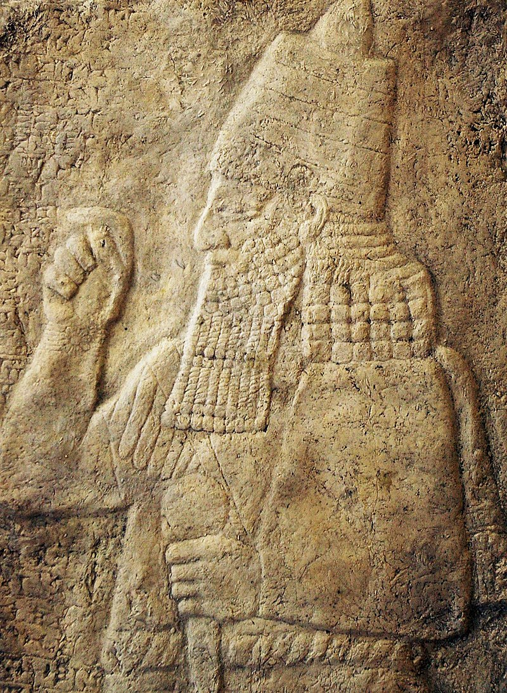
sanacharibos
Hdt. 2.141
μετὰ δὲ ἐπ’ Αἴγυπτον ἐλαύνειν στρατὸν μέγαν Σαναχάριβον βασιλέα Ἀραβίων τε καὶ Ἀσσυρίων· … ἐνθαῦτα ἀπικομένοισι​ τοῖσι ἐναντίοισι αὐτοῖσι ἐπιχυθέντας νυκτὸς μῦς ἀρουραίους κατὰ μὲν φαγεῖν τοὺς φαρετρεῶνας αὐτῶν κατὰ δὲ τὰ τόξα, πρὸς δὲ τῶν ἀσπίδων τὰ ὄχανα, ὥστε τῇ ὑστεραίῃ φευγόντων σφέων γυμνῶν πεσεῖν πολλούς.
So presently came king Sanacharib​ against Egypt, with a great host of Arabians and Assyrians; …Their enemies too came thither, and one night a multitude of fieldmice​ swarmed over the Assyrian camp and devoured their quivers and their bows and the handles of their shields likewise, insomuch that they fled the next day unarmed and many fell.

Slide 37
sanacharibos
V kronikách
Eus. Chron. 8
The Hebrew scriptures say that Sennacherib was king at the time of king Hezekiah and the prophet Isaiah.
Sennacherib the king of the Assyrians led an army against the Babylonians and defeated them in battle.
After bringing the Babylonians under his control, he appointed his son Asordanus to be their king.
2. královská 18.13
Čtrnáctého roku krále Ezechiáše vytáhl asyrský král Senacherib proti všem judským opevněným městům a dobyl je.
Eus. Chron. 11
At this time, Sennacherib became the 25th of the [Assyrian] kings. He conquered Babylon and brought it under his control. He defeated a fleet of Greek ships in a naval battle off the coast of Cilicia. He established a temple of the Athenians, and erected bronze columns on which he inscribed in writing his mighty achievements. He built Tarsus with a design which was similar to Babylon, so that the river Cydnus flows through the middle of Tarsus, just as the Euphrates flows through the middle of Babylon.

Slide 38
babylón
Zakladatelka Semírámis
X Bélos
První král – Alóros (Alulim)
Jeden z divů světa (hradby, visuté zahrady)
Mýty o stvoření světa, potopě, věži
Část říše Assyřanů (Hérodotos, Ktésiás) x nezávislý (Béróssos)

Slide 39
Babylónské mýty
Eus. Chron.
In the first year, a horrible beast appeared out of the Red Sea in the region near Babylonia. Its name was Oannes, according to Apollodorus. It had the complete body of a fish, but underneath its head there grew another head, beneath the fish's head; and in the same way the feet of a man grew of the tail of the fish.
Apkallu
Eus. Chron.
As well as these [beasts], there were fish and reptiles and snakes and many other strange creatures, each of which had a different appearance. Representations of them were set up in the temple of Belus. A woman called Omorca ruled over all these [creatures]; she is called Thalatth in the Chaldaean language, which is translated into Greek as thalassa ("the sea"). When everything was joined together in this way, Belus came along and split the woman in half. Half of her he made the heavens, and the other half he made the earth; and he destroyed all the creatures on her.
Tiamat a Marduk

Slide 40
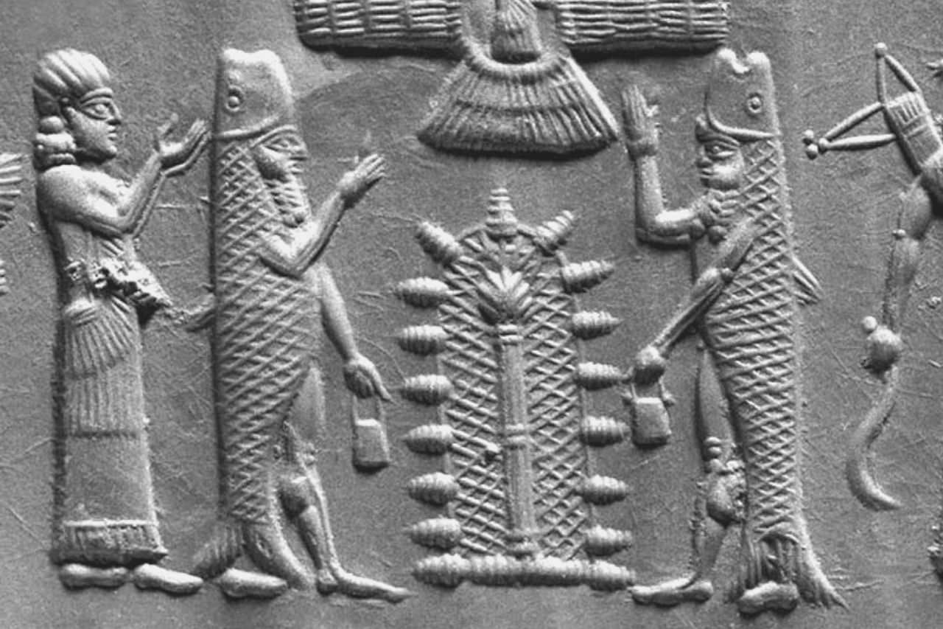
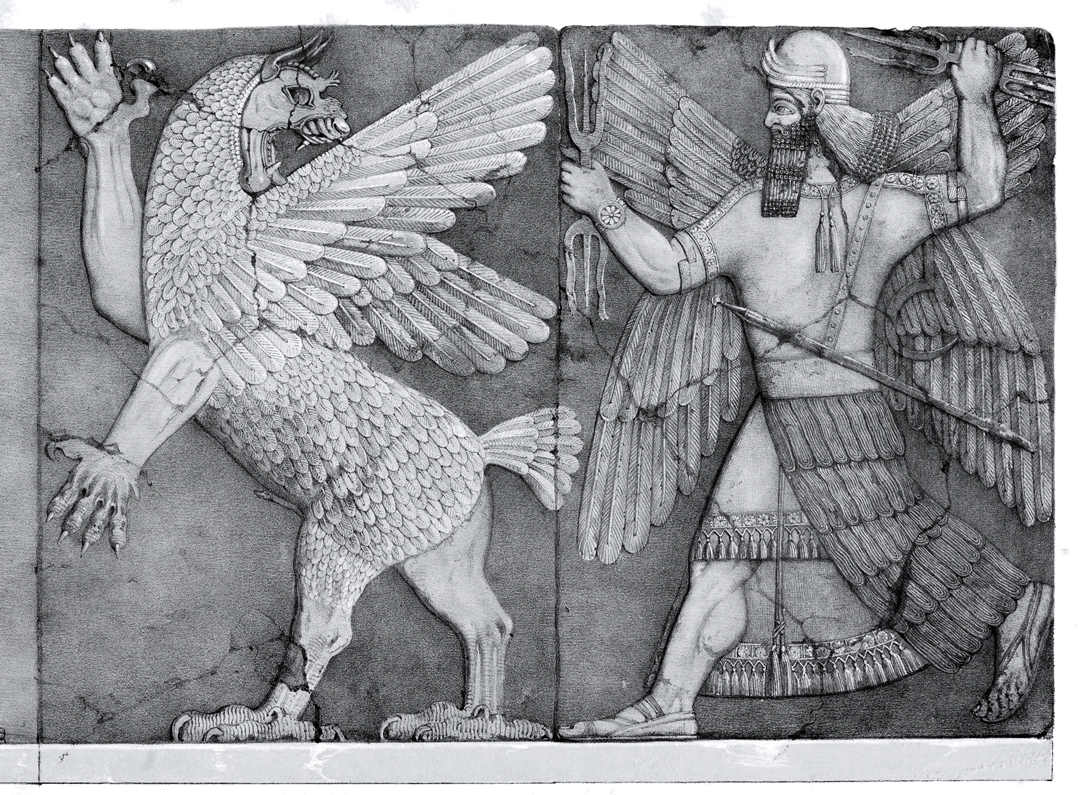

Slide 41
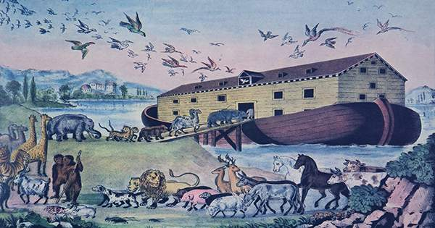
potopa
Cronus ordered him (Xisúthros = Ziusudra) to bury the beginnings, the middles and the ends of all writings in Heliopolis, the city of the Sippareni; to build a boat and embark on it with his close friends; to load the boat with food and drink, and to put on board every kind of bird and four-footed creature; and then, when all the preparations were complete, to sail away.

Slide 42
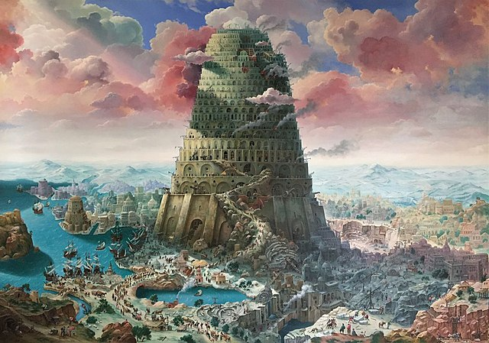
Babylónská věž
They say that the first men at that time were puffed up with pride because of their strength and height, and in their arrogance they thought that they were better than the gods. They built a huge tower where Babylon now is, and it was already close up to heaven. But the winds came to the aid of the gods, and threw down the structure around them. The remains of the tower were called Babylon. Up to that time they had shared a common language but then they received a great variety of different speech from the gods.

Slide 43
nabuchadnesar
Syn Nabopolassara
Novobabylónská říše
Eus. Chron.
Sardanapallus sent an army to the assistance of Astyages, the satrap of the Medes, and accepted Amyïtis, the daughter of Astyages, as the bride of his son Nebuchadnezzar.
Then Saracus became king of the Assyrians, and when he was informed that an army like a swarm of locusts had invaded by sea, he immediately sent his general Nabopolassar [Busalossorus] to Babylon. But this general started to plot rebellion, and betrothed his son Nebuchadnezzar [Nabuchodonosor] to Amytis the daughter of Astyages, the king of the Medes.

Slide 44
nabuchadnesar
Jos. Ap. 1.132 (Béróssos)
βασιλέα καὶ τὰς τούτου πράξεις ἀφηγούμενος λέγει, τίνα τρόπον πέμψας ἐπὶ τὴν Αἴγυπτον καὶ ἐπὶ τὴν ἡμετέραν γῆν τὸν υἱὸν τὸν ἑαυτοῦ Ναβοκοδρόσορον μετὰ πολλῆς δυνάμεως, ἐπειδήπερ ἀφεστῶτας αὐτοὺς ἐπύθετο, πάντων ἐκράτησεν καὶ τὸν ναὸν ἐνέπρησε τὸν ἐν Ἱεροσολύμοις ὅλως τε πάντα τὸν παρ᾽ ἡμῶν λαὸν ἀναστήσας εἰς Βαβυλῶνα μετῴκισεν, συνέβη δὲ καὶ τὴν πόλιν ἐρημωθῆναι χρόνον ἐτῶν ἑβδομήκοντα μέχρι Κύρου τοῦ Περσῶν βασιλέως.
And in his narrative of the acts of this king, he describes how he sent his son Nebuchadnezzar against Egypt, and against our land, with a great army, when he was informed that they had revolted from him. After he had subdued them all, and destroyed our temple at Jerusalem by fire, he removed our people entirely out of their own country, and transported them to Babylon. Then our city was deserted for a period of seventy years, until the days of Cyrus king of Persia.

Slide 45
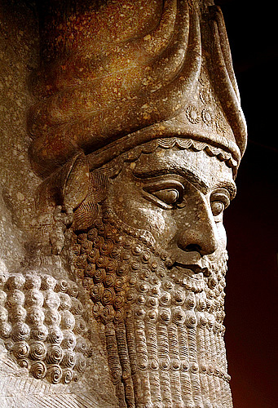
Nabuchadnesar
Eus. Chron.
When Nebuchadnezzar came to power, he fortified Babylon with a three-fold circuit of walls in about fifteen days. … He adorned the palace with new kinds of plants, and called it "The Hanging Gardens". Then he gives a detailed description of this Hanging Garden. He says that the Greeks regard it as one of the so-called seven wonders of the world.
And Abydenus declares that he was "mightier than Heracles … But the Chaldaeans say that afterwards, when he went up to the palace, he was possessed by some god, and uttered these words: 'O Babylonians, I Nebuchadnezzar predict that a great disaster will befall you.' "

Slide 46
nabuchadnesar
Jos. Ap. 141 (Béróssos)
ἐν δὲ τοῖς βασιλείοις τούτοις ἀναλήμματα λίθινα ὑψηλὰ ἀνοικοδομήσας καὶ τὴν ὄψιν ἀποδοὺς ὁμοιοτάτην τοῖς ὄρεσι, καταφυτεύσας δένδρεσι παντοδαποῖς ἐξειργάσατο καὶ κατεσκεύασε τὸν καλούμενον κρεμαστὸν παράδεισον διὰ τὸ τὴν γυναῖκα αὐτοῦ ἐπιθυμεῖν τῆς ὀρείας διαθέσεως τεθραμμένην ἐν τοῖς κατὰ τὴν Μηδίαν τόποις.
In this palace he erected very high walks, supported by stone pillars, and by planting what was called a Hanging Garden, and adorning it with all sorts of trees, he gave it the appearance of a mountainous country. This he did to please his queen, because she had been brought up in Media, and was fond of mountainous scenery."

Slide 47
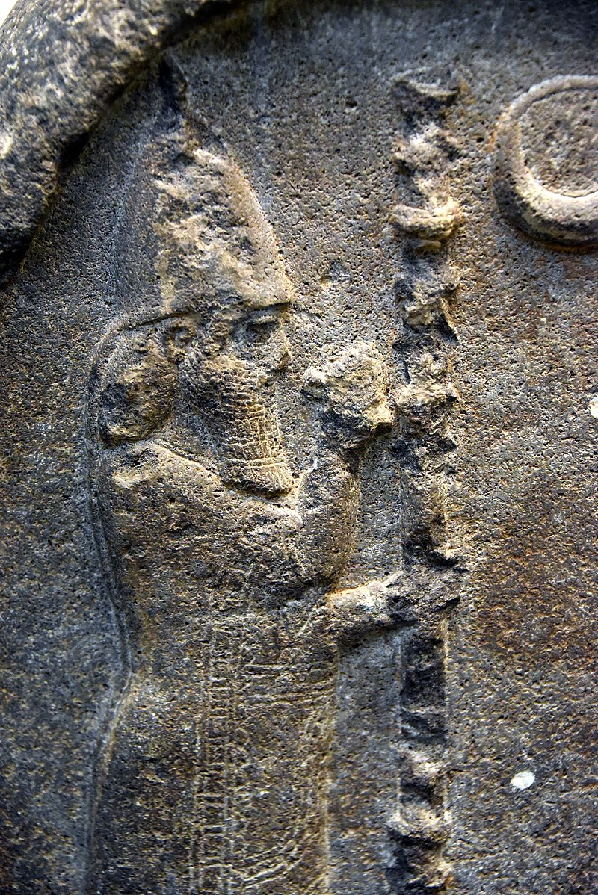
nabonidos
Poslední král Babylónské říše
Hdt. 1.77 = Labynétos
1.188
ὁ δὲ δὴ Κῦρος ἐπὶ ταύτης τῆς γυναικὸς τὸν παῖδα ἐστρατεύετο, ἔχοντά τε τοῦ πατρὸς τοῦ ἑωυτοῦ τοὔνομα Λαβυνήτου καὶ τὴν Ἀσσυρίων ἀρχήν.
Cyrus, then, marched against Nitocris' son, who inherited the name of his father Labynetus and the sovereignty of Assyria.

Slide 48
Nabonidus
Eus. Chron.
and then Nabonidus for 17 years. In his reign, Cyrus the son of Cambyses led an army against the land of the Babylonians. Nabonidus met him [in battle], but was defeated and put to flight.

Slide 49
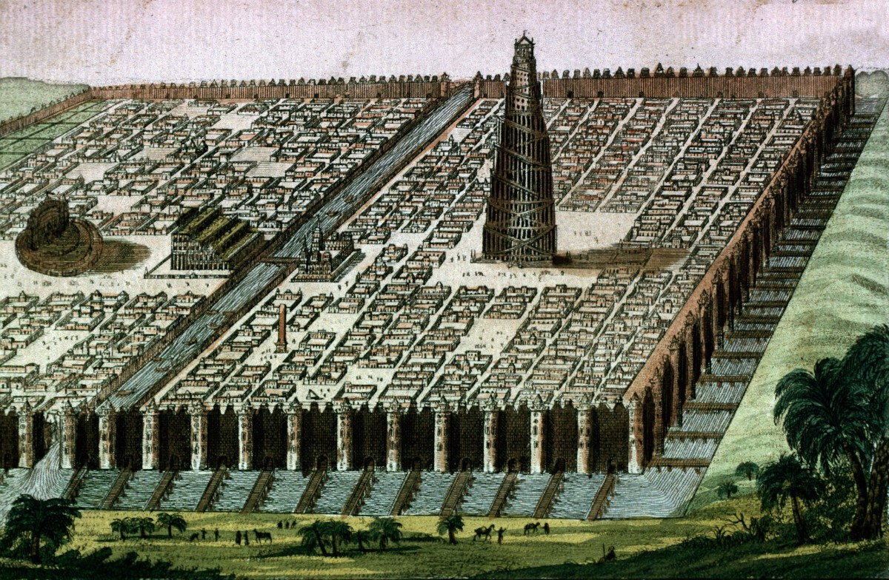
Babylón - památky
Hdt. 1.178
κέεται ἐν πεδίῳ μεγάλῳ, μέγαθος ἑοὺς μέτωπον ἕκαστον εἴκοσι καὶ ἑκατὸν σταδίων, ἐούσης τετραγώνου· οὗτοι στάδιοι τῆς περιόδου τῆς πόλις γίνονται συνάπαντες ὀγδώκοντα καὶ τετρακόσιοι.
Popis příkopu, zdí, dělení města na dvě poloviny, patrové domy,
It lies in a great plain, and is in shape a square, each side an hundred and twenty furlongs in length; thus four hundred and eighty furlongs make the complete circuit of the city.
(22 km, 88 km)

Slide 50
Babylón - památky
Hdt. 1.181
ἐν δὲ τῷ ἑτέρῳ Διὸς Βήλου ἱρὸν χαλκόπυλον, καὶ ἐς ἐμὲ ἔτι τοῦτο ἐόν, δύο σταδίων πάντῃ, ἐὸν τετράγωνον. ἐν μέσῳ δὲ τοῦ ἱροῦ πύργος στερεὸς οἰκοδόμηται, σταδίῳ καὶ τὸ μῆκος καὶ τὸ εὖρος, καὶ ἐπὶ τούτῳ τῷ πύργῳ ἄλλος πύργος ἐπιβέβηκε, καὶ ἕτερος μάλα ἐπὶ τούτῳ, μέχρι οὗ ὀκτὼ πύργων.
Esagila, Etemenanki (zikkurat)
and in the midmost of the other is still to this day the sacred enclosure of Zeus Belus,​ a square of two furlongs each way, with gates of bronze. In the centre of this enclosure a solid tower has been built, of one furlong's length and breadth; a second tower rises from this, and from it yet another, till at last there are eight.

Slide 51
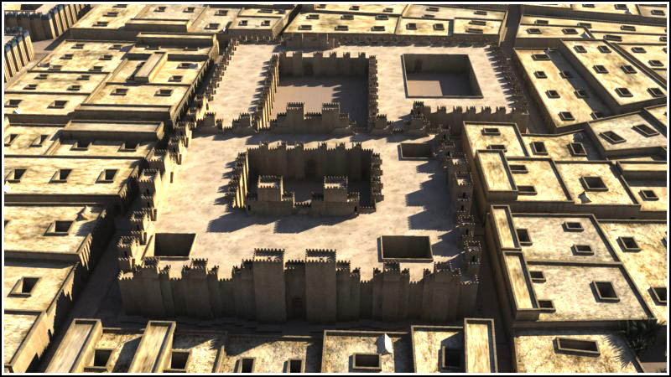
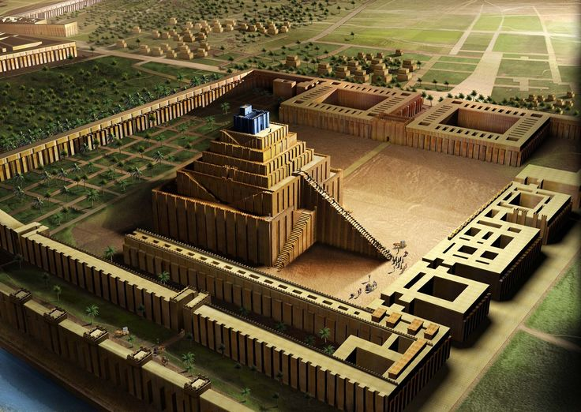

Slide 52
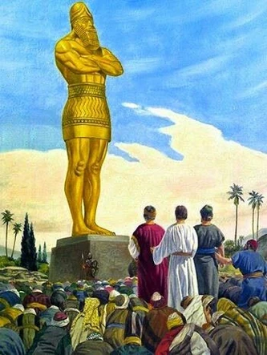
Babylón - památky
Socha Marduka (Zeus Bélos)
Paláce (Diod. 2.8)
Lov, Semírámis, Ninos (Diod. 2.8)
Chrám (Diod. 2.9)

Slide 53
Babylón - zvyky
Hdt. 1.196
κατὰ κώμας ἑκάστας ἅπαξ τοῦ ἔτεος ἑκάστου ἐποιέετο τάδε· ὡς ἂν αἱ παρθένοι γενοίατο γάμων ὡραῖαι, ταύτας ὅκως συναγάγοιεν πάσας, ἐς ἓν χωρίον ἐσάγεσκον ἀλέας, πέριξ δὲ αὐτὰς ἵστατο ὅμιλος ἀνδρῶν, ἀνιστὰς δὲ κατὰ μίαν ἑκάστην κῆρυξ πωλέεσκε, πρῶτα μὲν τὴν εὐειδεστάτην ἐκ πασέων· μετὰ δέ, ὅκως αὕτη εὑροῦσα πολλὸν χρυσίον πρηθείη, ἄλλην ἂν ἐκήρυσσε ἢ μετ’ ἐκείνην ἔσκε εὐειδεστάτη· ἐπωλέοντο δὲ ἐπὶ συνοικήσι.
It is this: once a year in every village all the maidens as they came to marriageable age were collected and brought together into one place, with a crowd of men standing round. Then a crier would display and offer them for sale one by one, first the fairest of all; and then when she had fetched a great price he put up for sale the next comeliest, selling all the maidens as lawful wives.

Slide 54
Babylón - zvyky
Hdt. 1.197
Δεύτερος δὲ σοφίῃ ὅδε ἄλλος σφι νόμος κατέστηκε· τοὺς κάμνοντας ἐς τὴν ἀγορὴν ἐκφορέουσι· οὐ γὰρ δὴ χρέωνται ἰητροῖσι. προσιόντες ὦν πρὸς τὸν κάμνοντα συμβουλεύουσι περὶ τῆς νούσου, εἴ τις καὶ αὐτὸς τοιοῦτο ἔπαθε ὁκοῖον ἂν ἔχῃ ὁ κάμνων ἢ ἄλλον εἶδε παθόντα, ταῦτα προσιόντες συμβουλεύουσι καὶ παραινέουσι ἅσσα αὐτὸς ποιήσας ἐξέφυγε ὁμοίην νοῦσον ἢ ἄλλον εἶδε ἐκφυγόντα. σιγῇ δὲ παρεξελθεῖν τὸν κάμνοντα οὔ σφι ἔξεστι, πρὶν ἂν ἐπείρηται ἥντινα νοῦσον ἔχει.
I come now to the next wisest of their customs: having no use for physicians, they carry the sick into the market-place; then those who have been afflicted themselves by the same ill as the sick man's, or seen others in like case, come near and advise about his disease and comfort him, telling him by what means they have themselves recovered of it or seen others so recover. None may pass by the sick man without speaking and asking what is his sickness.

Slide 55
Babylón - zvyky
Hdt. 1.199
Ὁ δὲ δὴ αἴσχιστος τῶν νόμων ἐστὶ τοῖσι Βαβυλωνίοισι ὅδε· δεῖ πᾶσαν γυναῖκα ἐπιχωρίην ἱζομένην ἐς ἱρὸν Ἀφροδίτης ἅπαξ ἐν τῇ ζόῃ μιχθῆναι ἀνδρὶ ξείνῳ. … ἔνθα ἐπεὰν ἵζηται γυνή, οὐ πρότερον ἀπαλλάσσεται ἐς τὰ οἰκία ἤ τίς οἱ ξείνων ἀργύριον ἐμβαλὼν ἐς τὰ γούνατα μιχθῇ ἔξω τοῦ ἱροῦ· ἐμβαλόντα δὲ δεῖ εἰπεῖν τοσόνδε· " Ἐπικαλέω τοι τὴν θεὸν Μύλιττα." Μύλιττα δὲ καλέουσι τὴν Ἀφροδίτην Ἀσσύριοι.
The foulest Babylonian custom is that which compels every woman of the land once in her life to sit in the temple of Aphrodite and have intercourse with some stranger. … When a woman has once taken her place there she goes not away to her home before some stranger has cast money into her lap and had intercourse with her outside the temple; but while he casts the money, he must say, "I demand thee in the name of Mylitta" (that is the Assyrian name for Aphrodite).

Slide 56
Babylón - astronomie
Diod. 2.29
Χαλδαῖοι τοίνυν τῶν ἀρχαιοτάτων ὄντες Βαβυλωνίων τῇ μὲν διαιρέσει τῆς πολιτείας παραπλησίαν ἔχουσι τάξιν τοῖς κατ᾽ Αἴγυπτον ἱερεῦσι: πρὸς γὰρ τῇ θεραπείᾳ τῶν θεῶν τεταγμένοι πάντα τὸν τοῦ ζῆν χρόνον φιλοσοφοῦσι, μεγίστην δόξαν ἔχοντες ἐν ἀστρολογίᾳ. ἀντέχονται δ᾽ ἐπὶ πολὺ καὶ μαντικῆς, ποιούμενοι προρρήσεις περὶ τῶν μελλόντων …
Now the Chaldaeans, belonging as they do to the most ancient inhabitants of Babylonia, have about the same position among the divisions of the state as that occupied by the priests of Egypt; for being assigned to the service of the gods they spend their entire life in study, their greatest renown being in the field of astrology. But they occupy themselves largely with soothsaying as well, making predictions about future events,

Slide 57
Babylón - astronomie
Diod. 2.30
τῶν δ᾽ ἄστρων πολυχρονίους παρατηρήσεις πεποιημένοι, καὶ τὰς ἑκάστου κινήσεις τε καὶ δυνάμεις ἀκριβέστατα πάντων ἀνθρώπων ἐπεγνωκότες, πολλὰ τῶν μελλόντων συμβαίνειν προλέγουσι τοῖς ἀνθρώποις.
And since they have observed the stars over a long period of time and have noted both the movements and the influences of each of them with greater precision than any other men, they foretell to mankind many things that will take place in the future.

Slide 58
Babylón - astronomie
Cic. Div. 1.2 And in that same nation the Chaldeans—a name which they derived not from their art but their race —have, it is thought, by means of long-continued observation of the constellations, perfected a science which enables them to foretell what any man's lot will be and for what fate he was born.
Chaldejec – věštec
Lucr. 5.727 ut Babylonica Chaldaeum doctrina refutans
Juv. 10.93–94
principis angusta Caprearum in rupe sedentis
cum grege Chaldaeo?
and be counted guardian of a Prince seated on the narrow ledge of Capri with his herd of Chaldaean astrologers?

Slide 59
Literatura
Drews, R. (1965). Assyria in Classical Universal History. Historia, 14(2), 129–142.
Rollinger, R. (2017). Assyria in Classical Sources. In E. Frahm (Ed.). A Companion to Assyria. Malden: Wiley-Blackwell. 570–582.
Tuplin, C. (2013). Berossus and Greek Historiography. In J. Haubold (Ed.). The World of Berossus. Harrassowitz: Wiesbaden.
Verbrugghe, G. & J. Wickersham. (1996). Berossos and Manetho, introduced and translated. Ann Arbor: University of Michigan.
Heller, A. (2013). Why the Greeks Know so Little about Assyrian and Babylonian History. In R. Rollinger & E. van Dongen (Eds.). Mesopotamia in the Ancient World. Ugarit: Münster. 331–348.

