Slide 1
Art, visual culture, activism

Slide 2
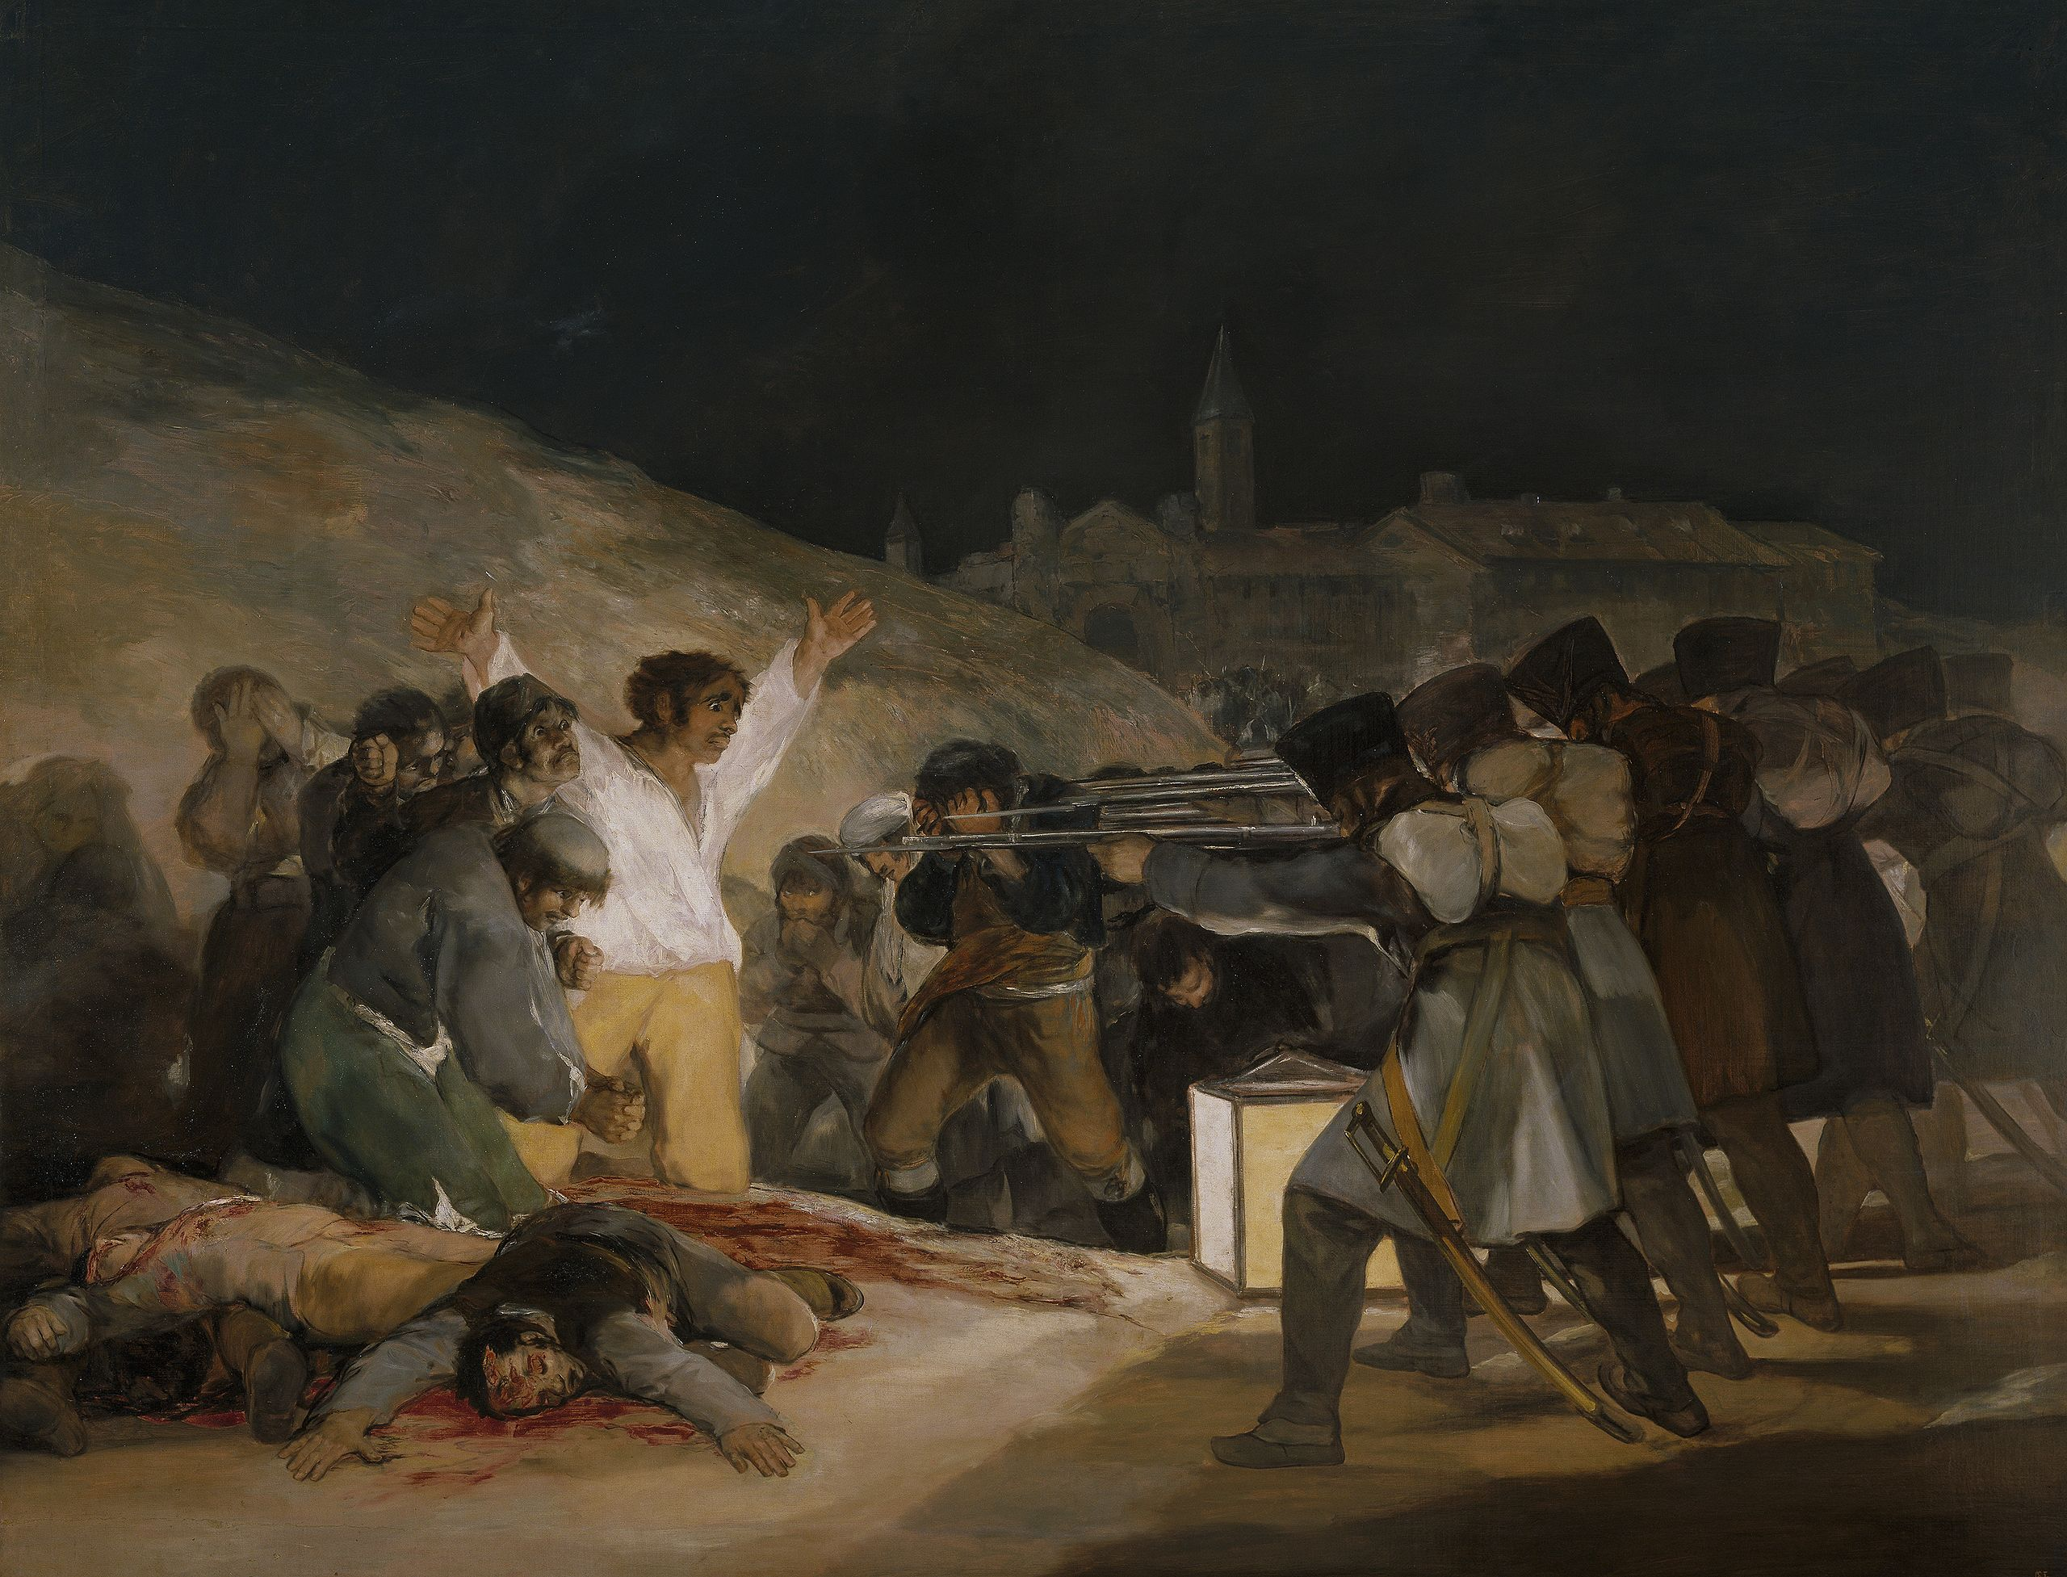
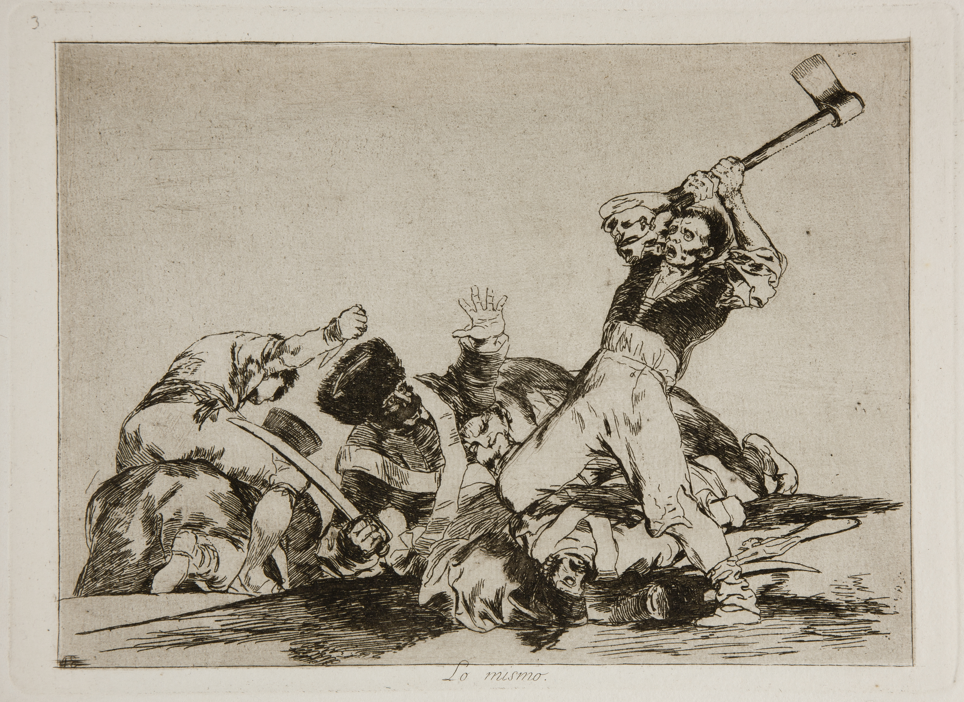
Goya, Disastres of War 1810-20

Slide 3
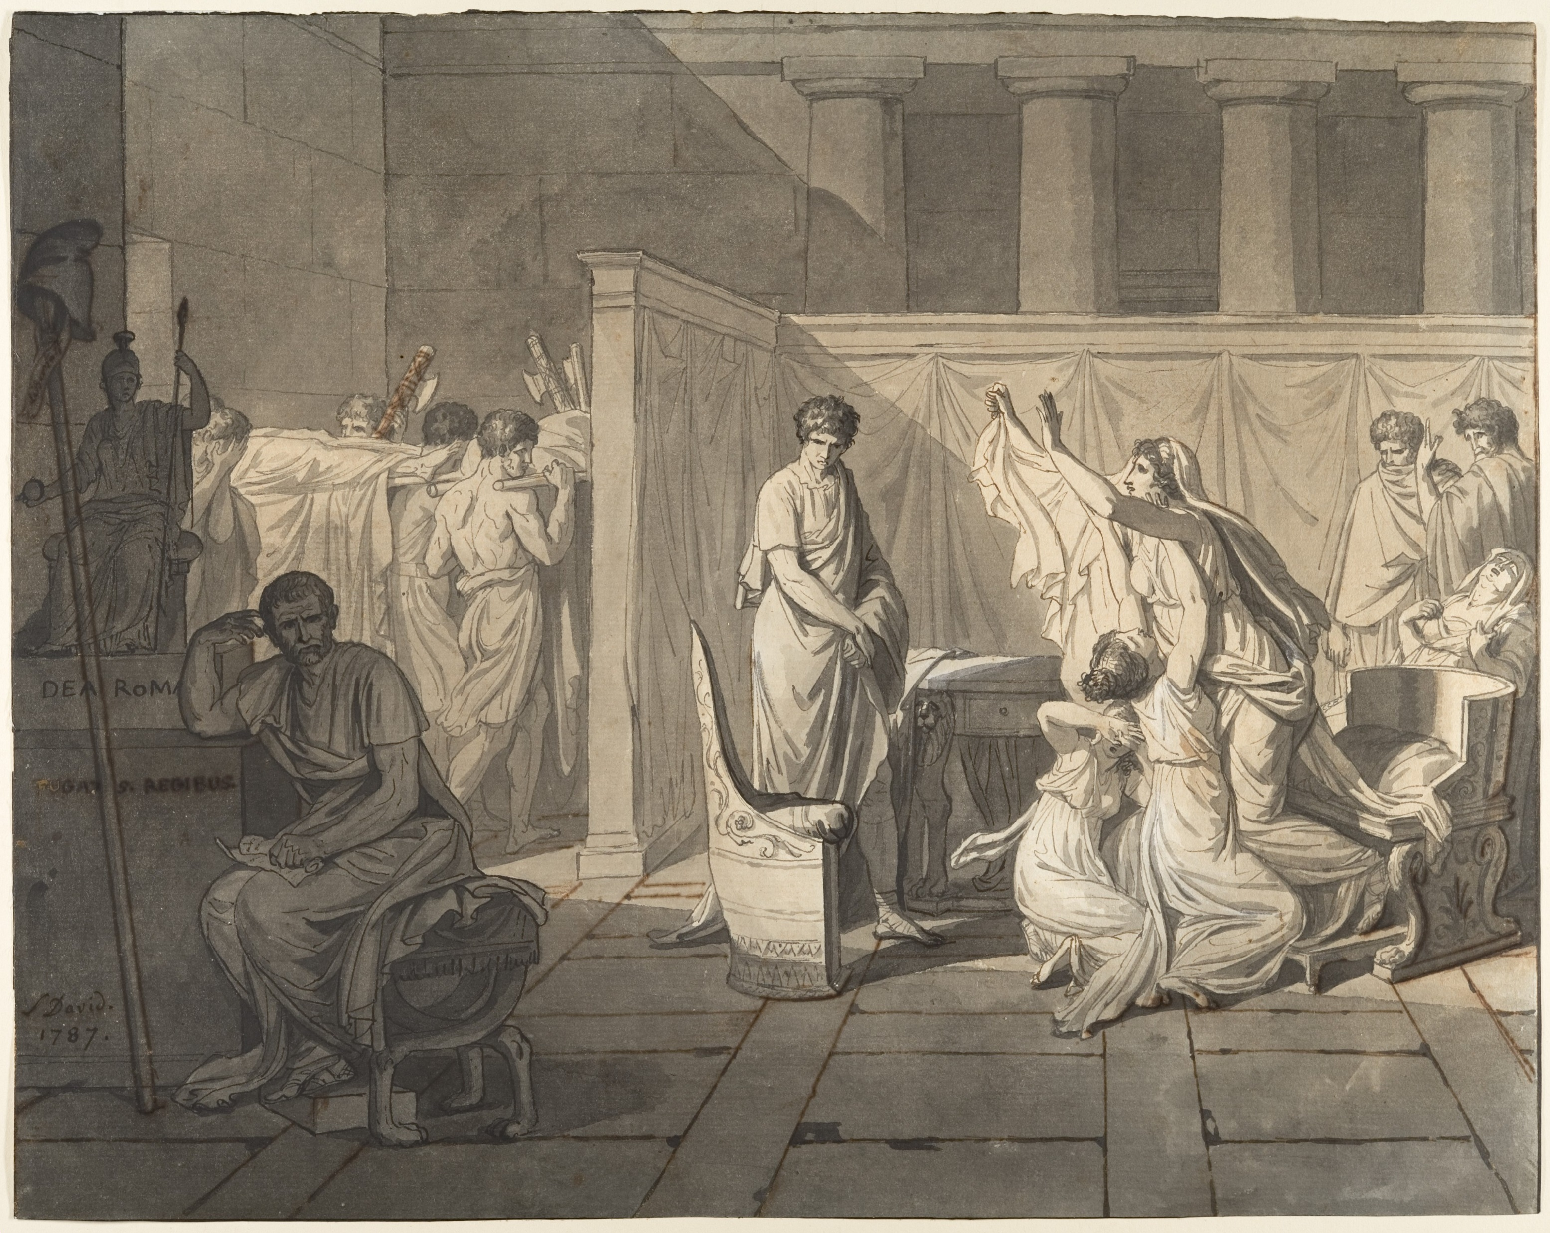
Brutus, reacts to the death of his sons. Since they wanted to overthrow the government and restore the monarchy, Brutus ordered their death.
This painting is a representation of civic virtue and Brutus’ immense sacrifices for the Republic. The government prohibited the exhibition of the artwork at the Salon because it could be interpreted as propaganda supporting the French Revolution. A ban on the painting was announced in the newspaper and it caused an outrage that forced the royal court to give their permission for the exhibition of the painting.
Study for The Lictors Bring to Brutus the Bodies of His Sons by Jacques-Louis David, 1787

Slide 4
Aims of critical and activist art
Create visibility
Create awareness
Create change
Persuade
Change attitude
Move to action

Slide 5
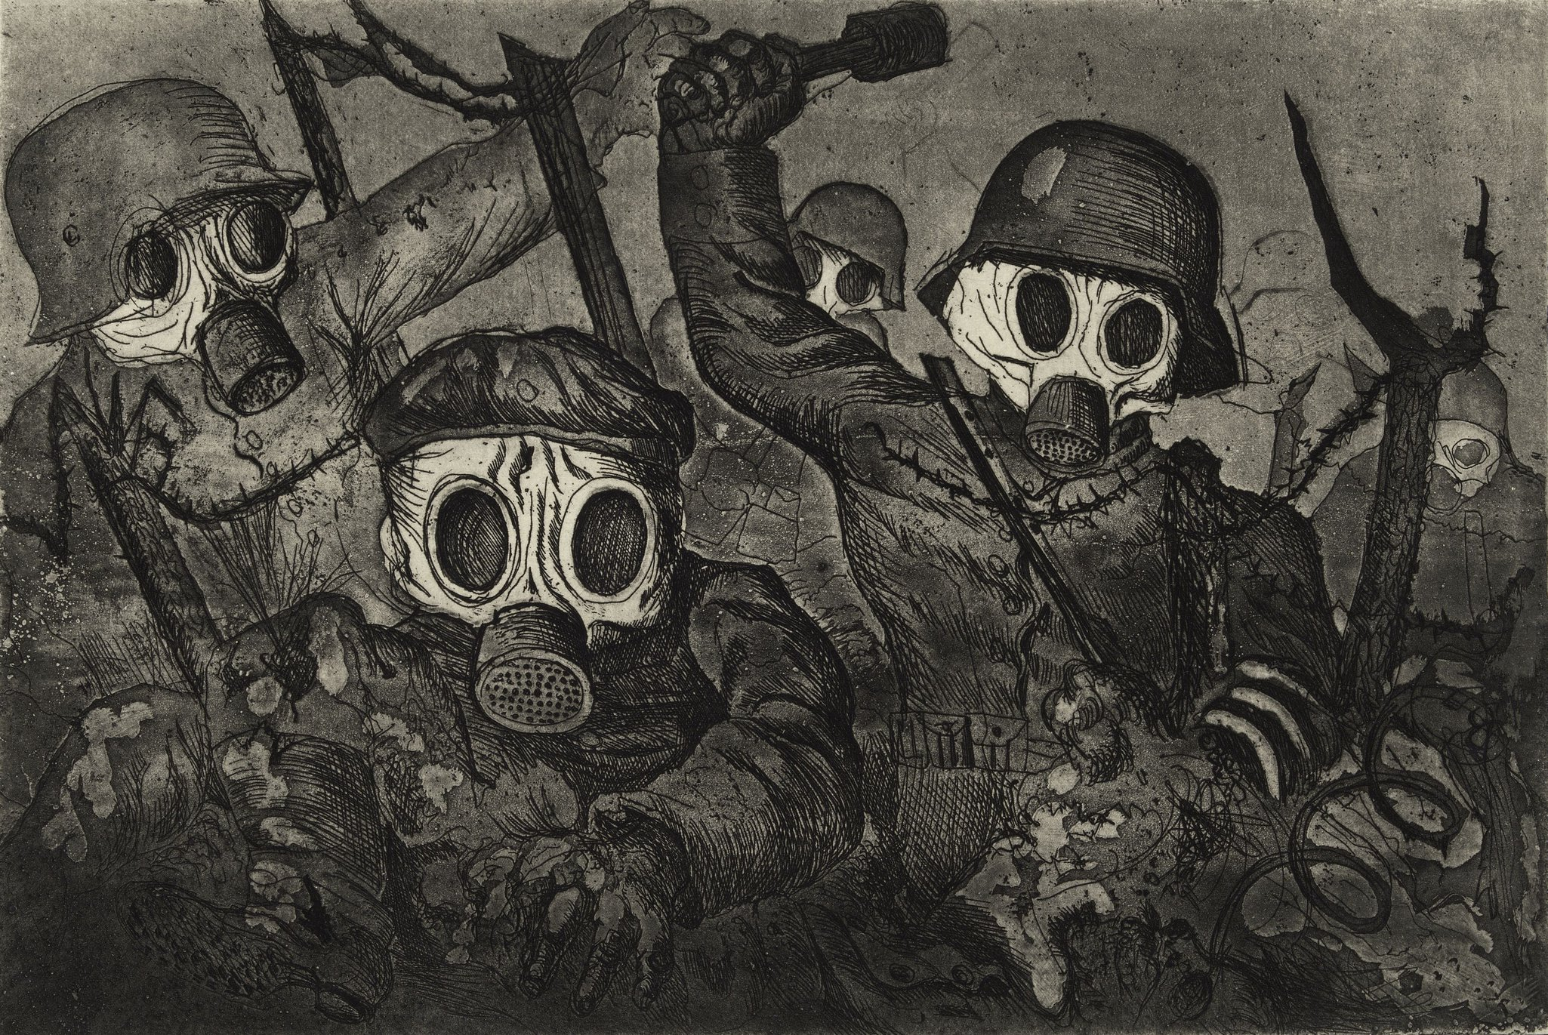

Slide 6
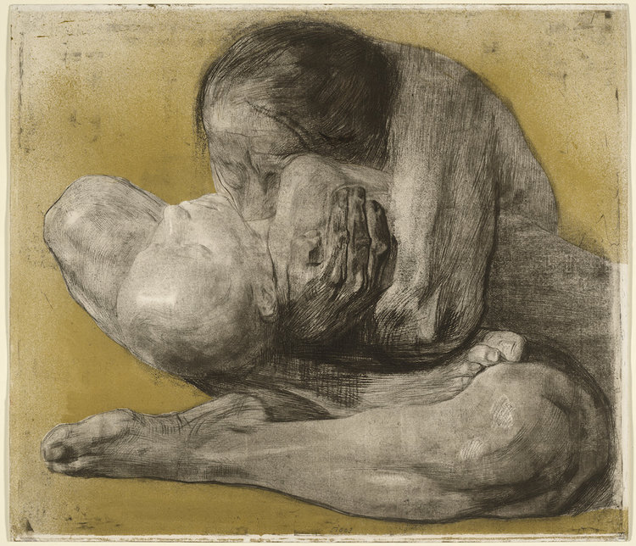
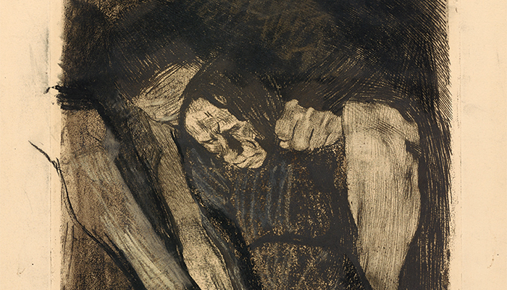
Käthe Kollwitz

Slide 7
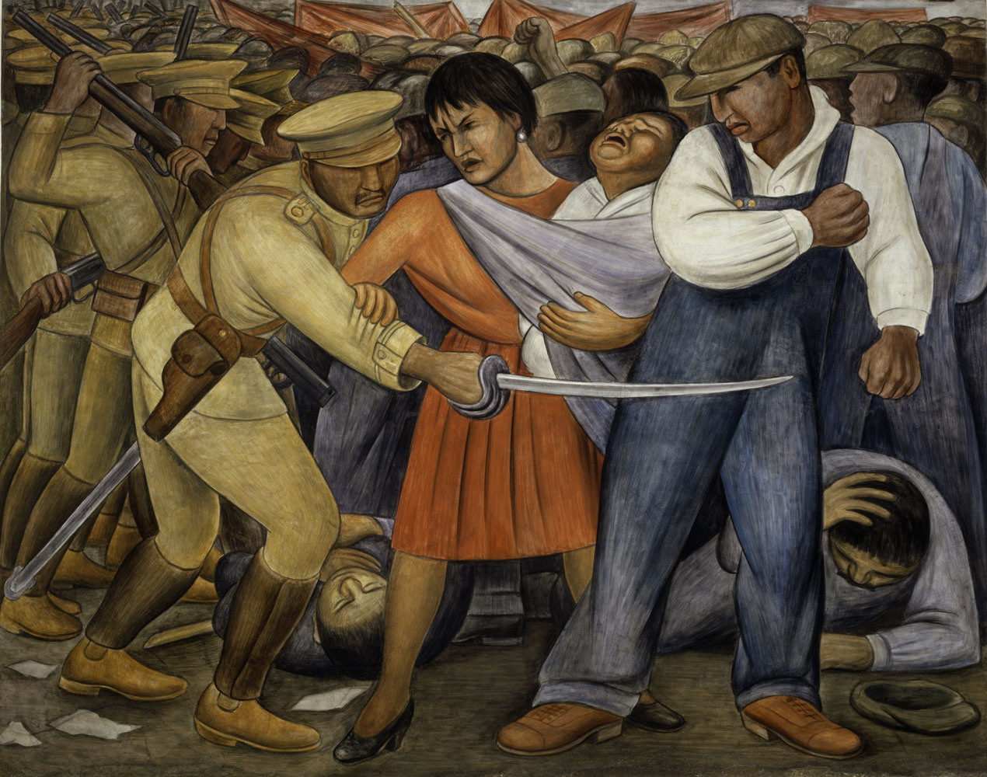
Diego Rivera, Uprising 1931

Slide 8
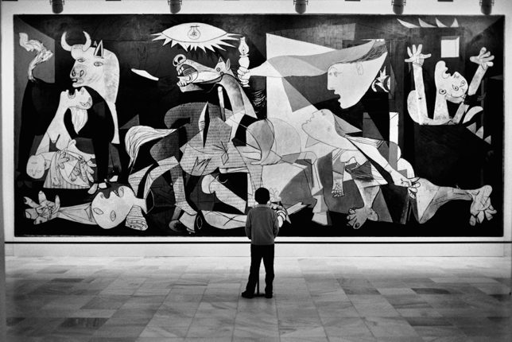
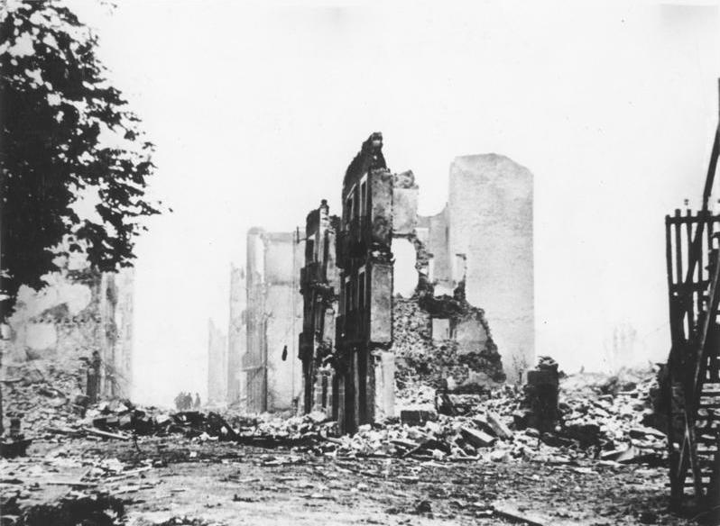
Modern art as a means of protest….

Slide 9
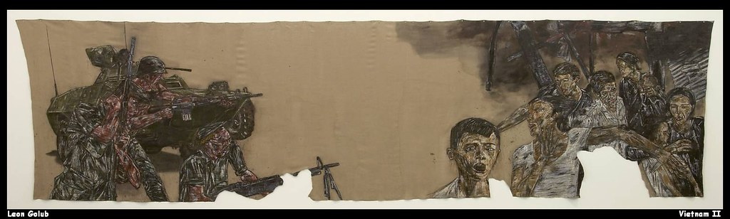
and raising public awareness
Leon Golub, Vietnam 1973

Slide 10
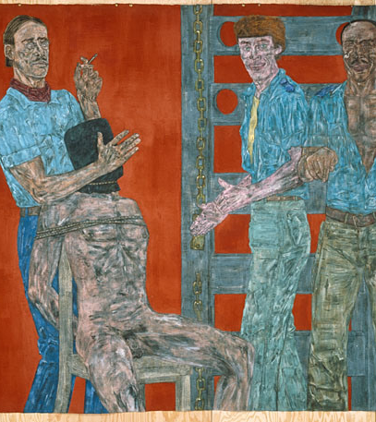
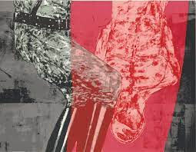
Interrogation II 1981

Slide 11
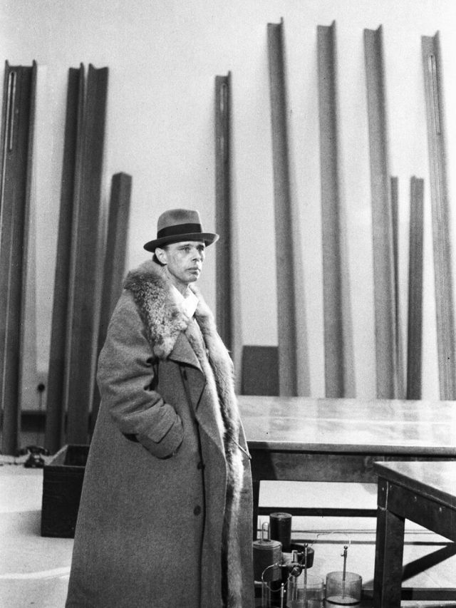
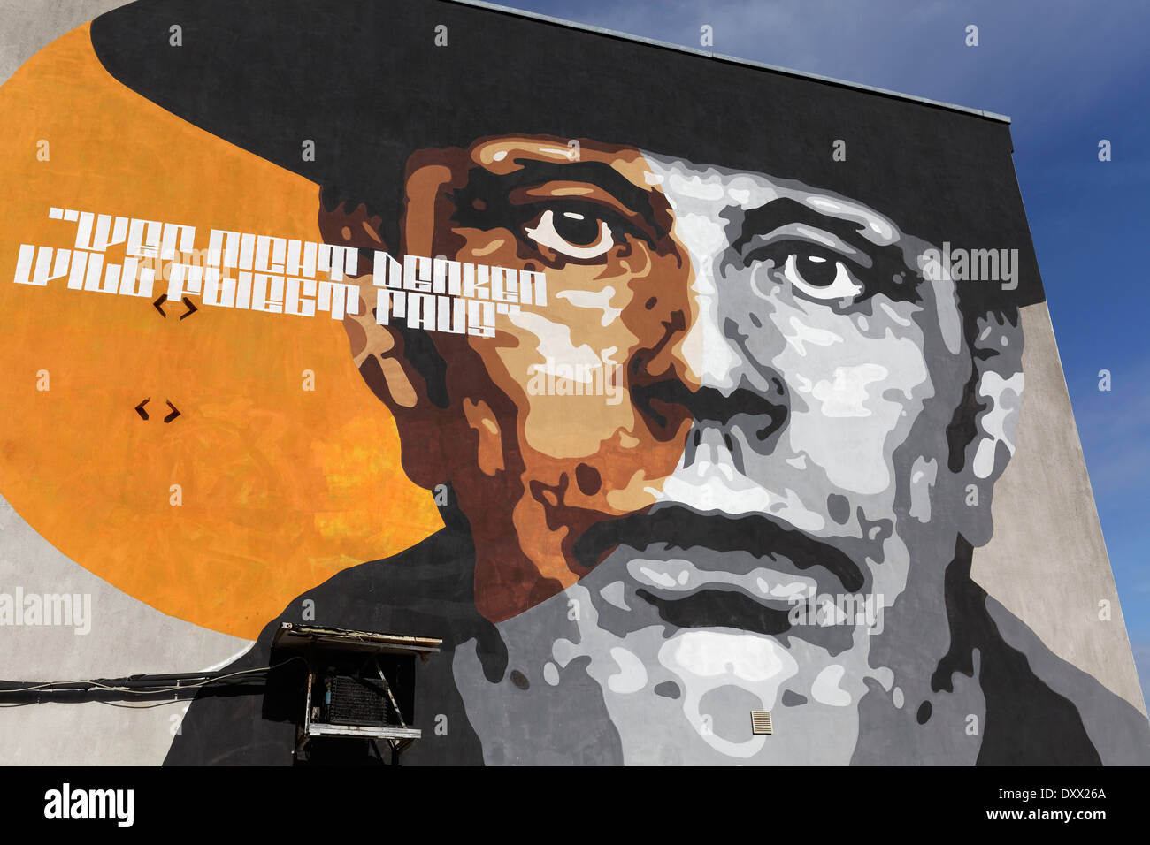
Activist art vs critical art
Art activists do not want to merely criticize the art system or the general political and social conditions under which this system functions. Rather, they want to change these conditions by means of art—not so much inside the art system but outside it, in reality itself.

Slide 12
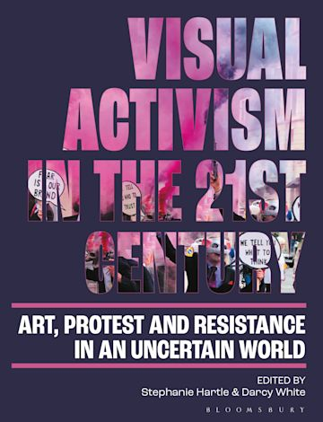
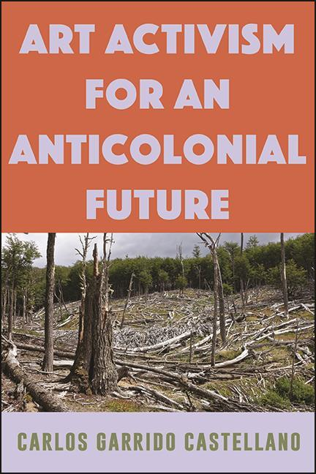
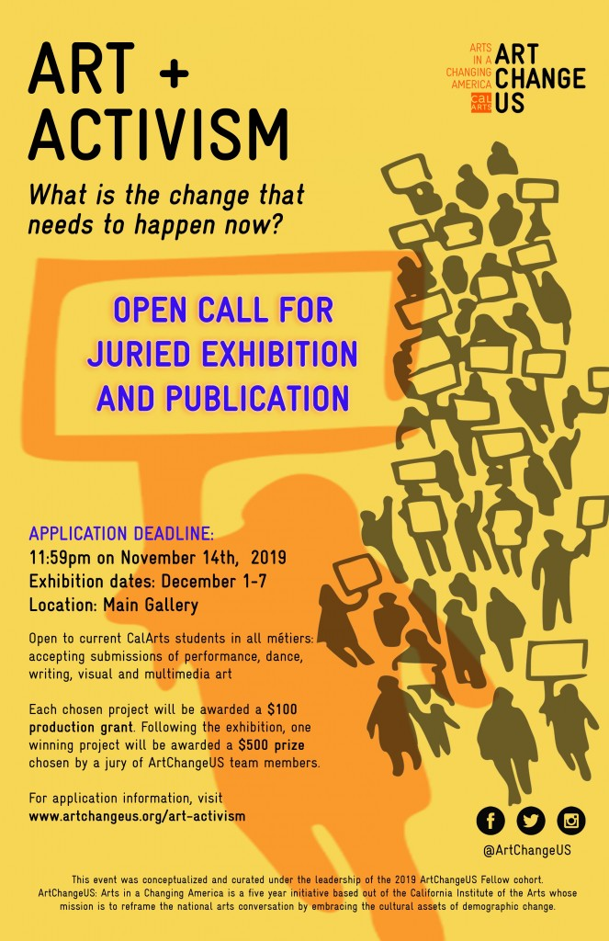
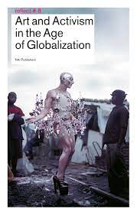
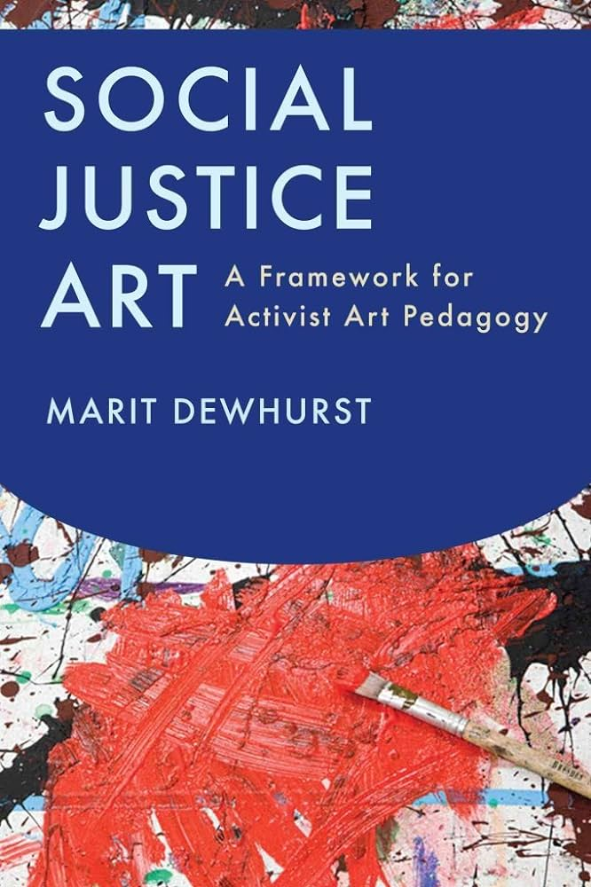

Slide 13
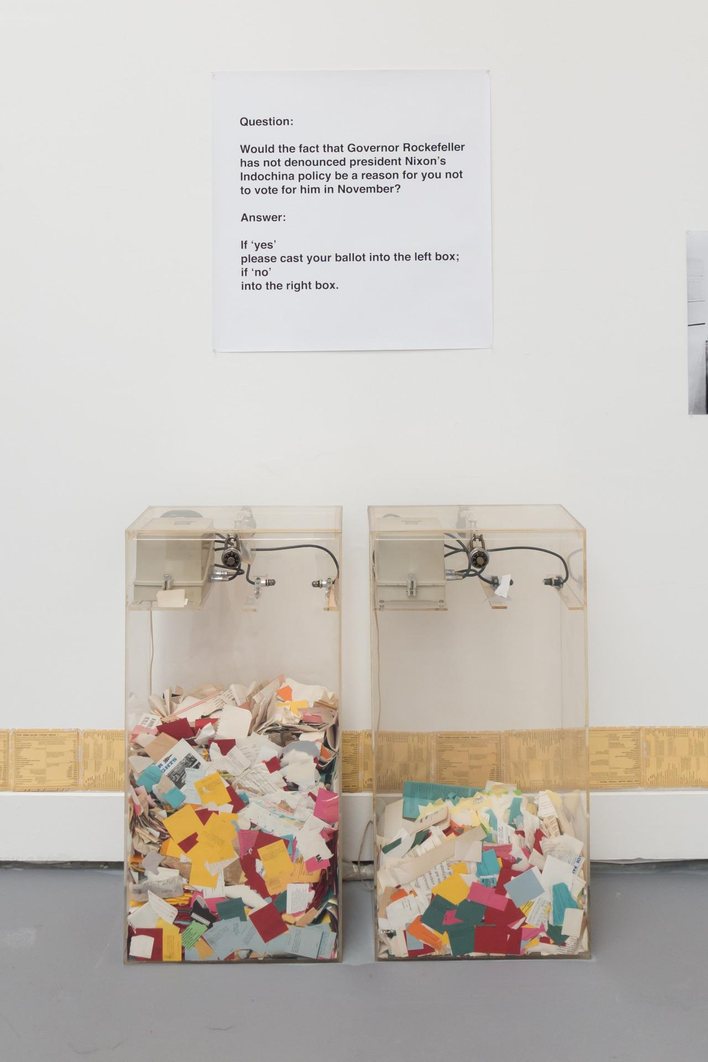
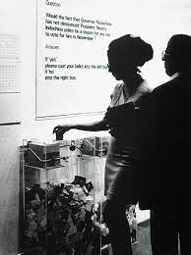
A few examples….
Hans Haacke “MoMA Poll” 1970
visitors of New York’s Museum of Modern Art were asked whether or not they would support Governor Nelson Rockefeller, whose family remains one of MoMA’s major donors.

Slide 14
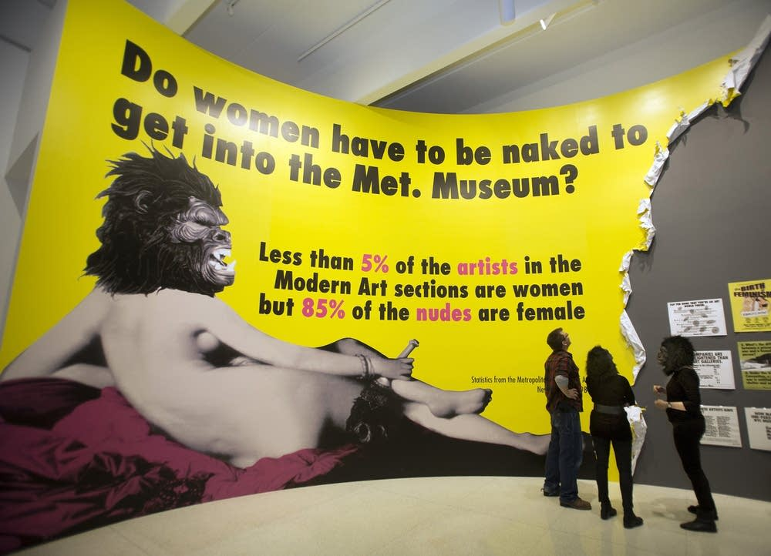
Guerilla Girls (since 1985)
Do women have to be naked to get into the Met. Museum?.
According to their survey, only five percent of the artists in the Modern Art sections of the museum are female, but 85 percent of the nudes depict women.

Slide 15
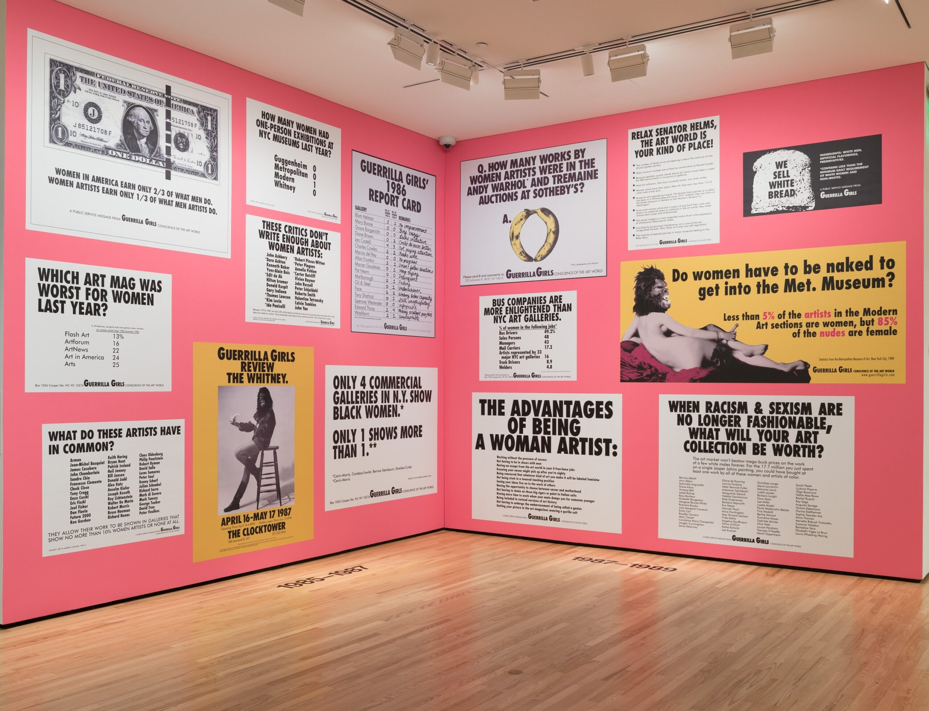
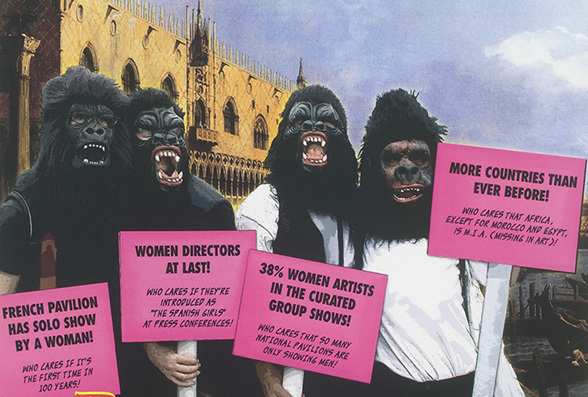

Slide 16
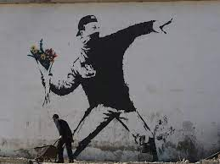
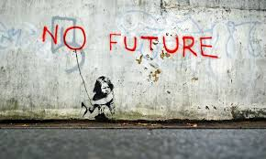
Banksy

Slide 17
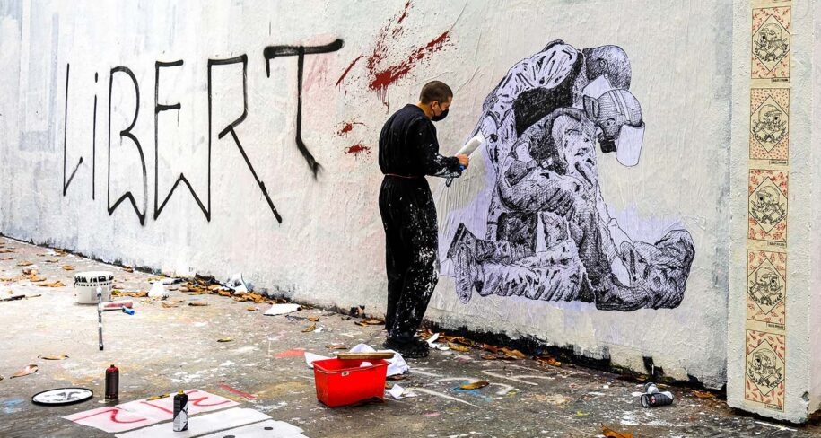
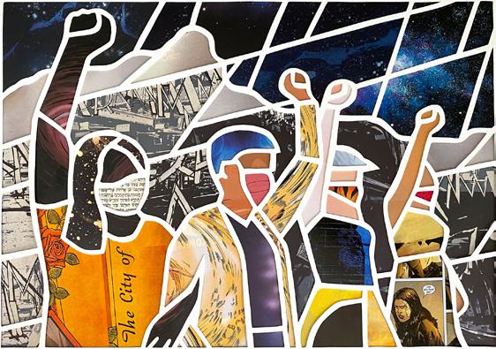
Visual culture and actvisim
Street activism

Slide 18
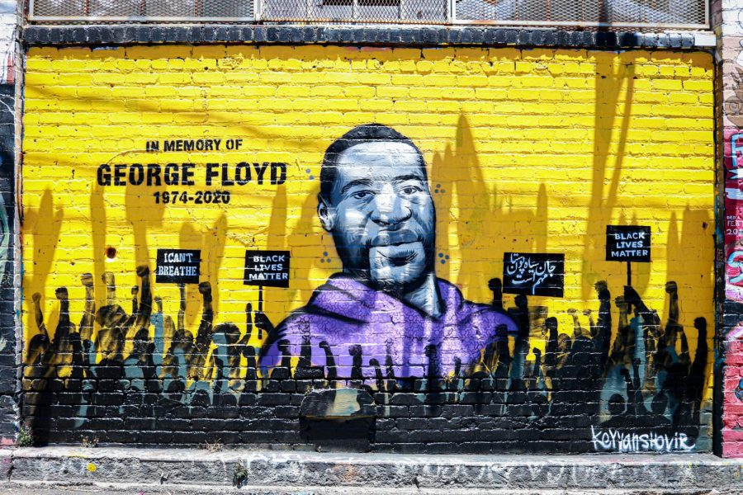
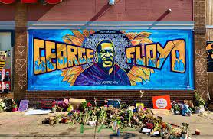

Slide 19
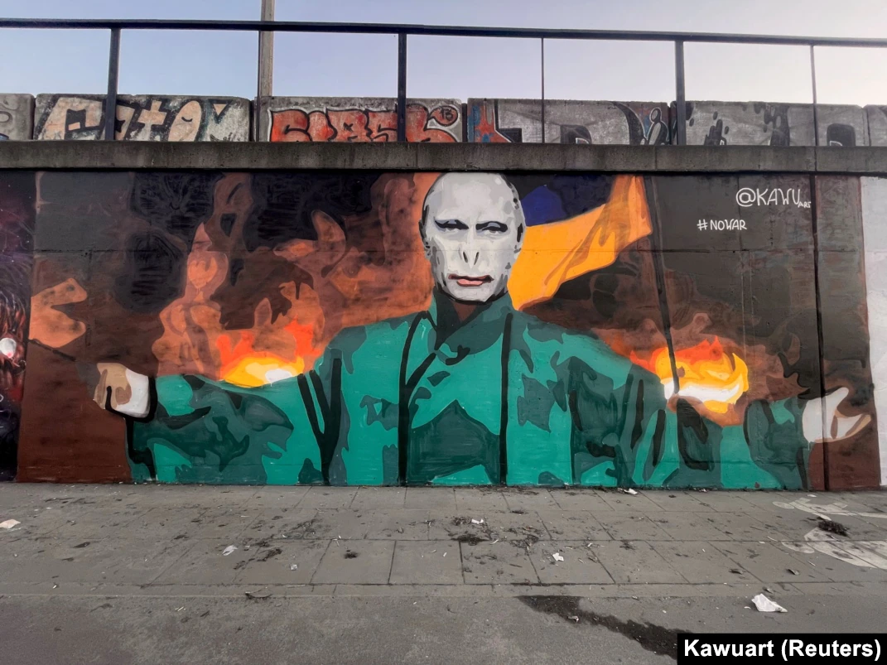

Slide 20
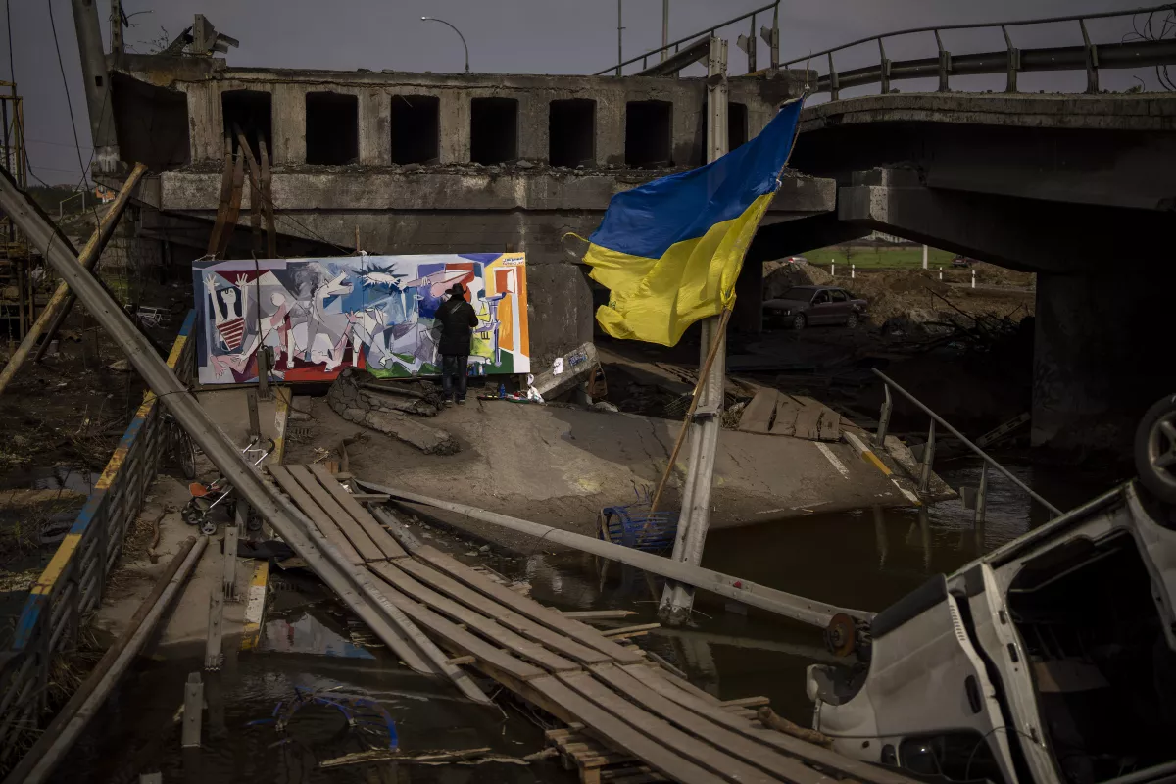
Mexican artist Roberto Marquez paints a work inspired by Picasso’s “Guernica” on a Ukrainian bridge destroyed in Irpin, near Kyiv, on April 26, 2022

Slide 21
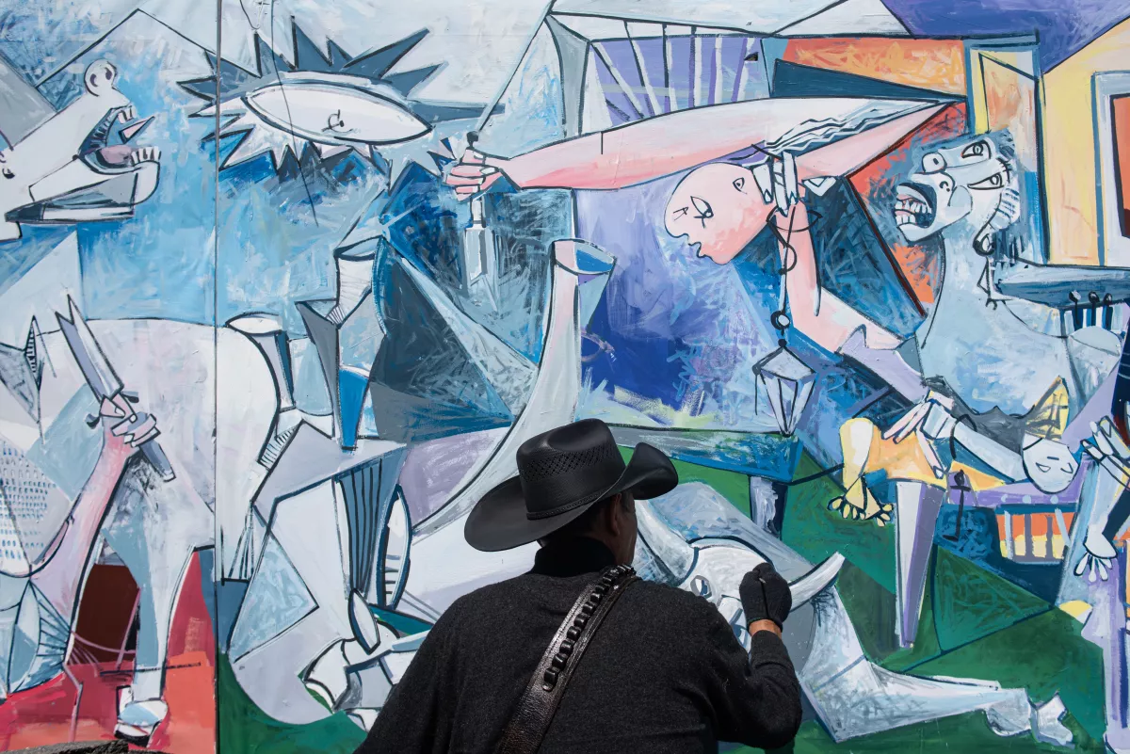

Slide 22
What about art?

Slide 23
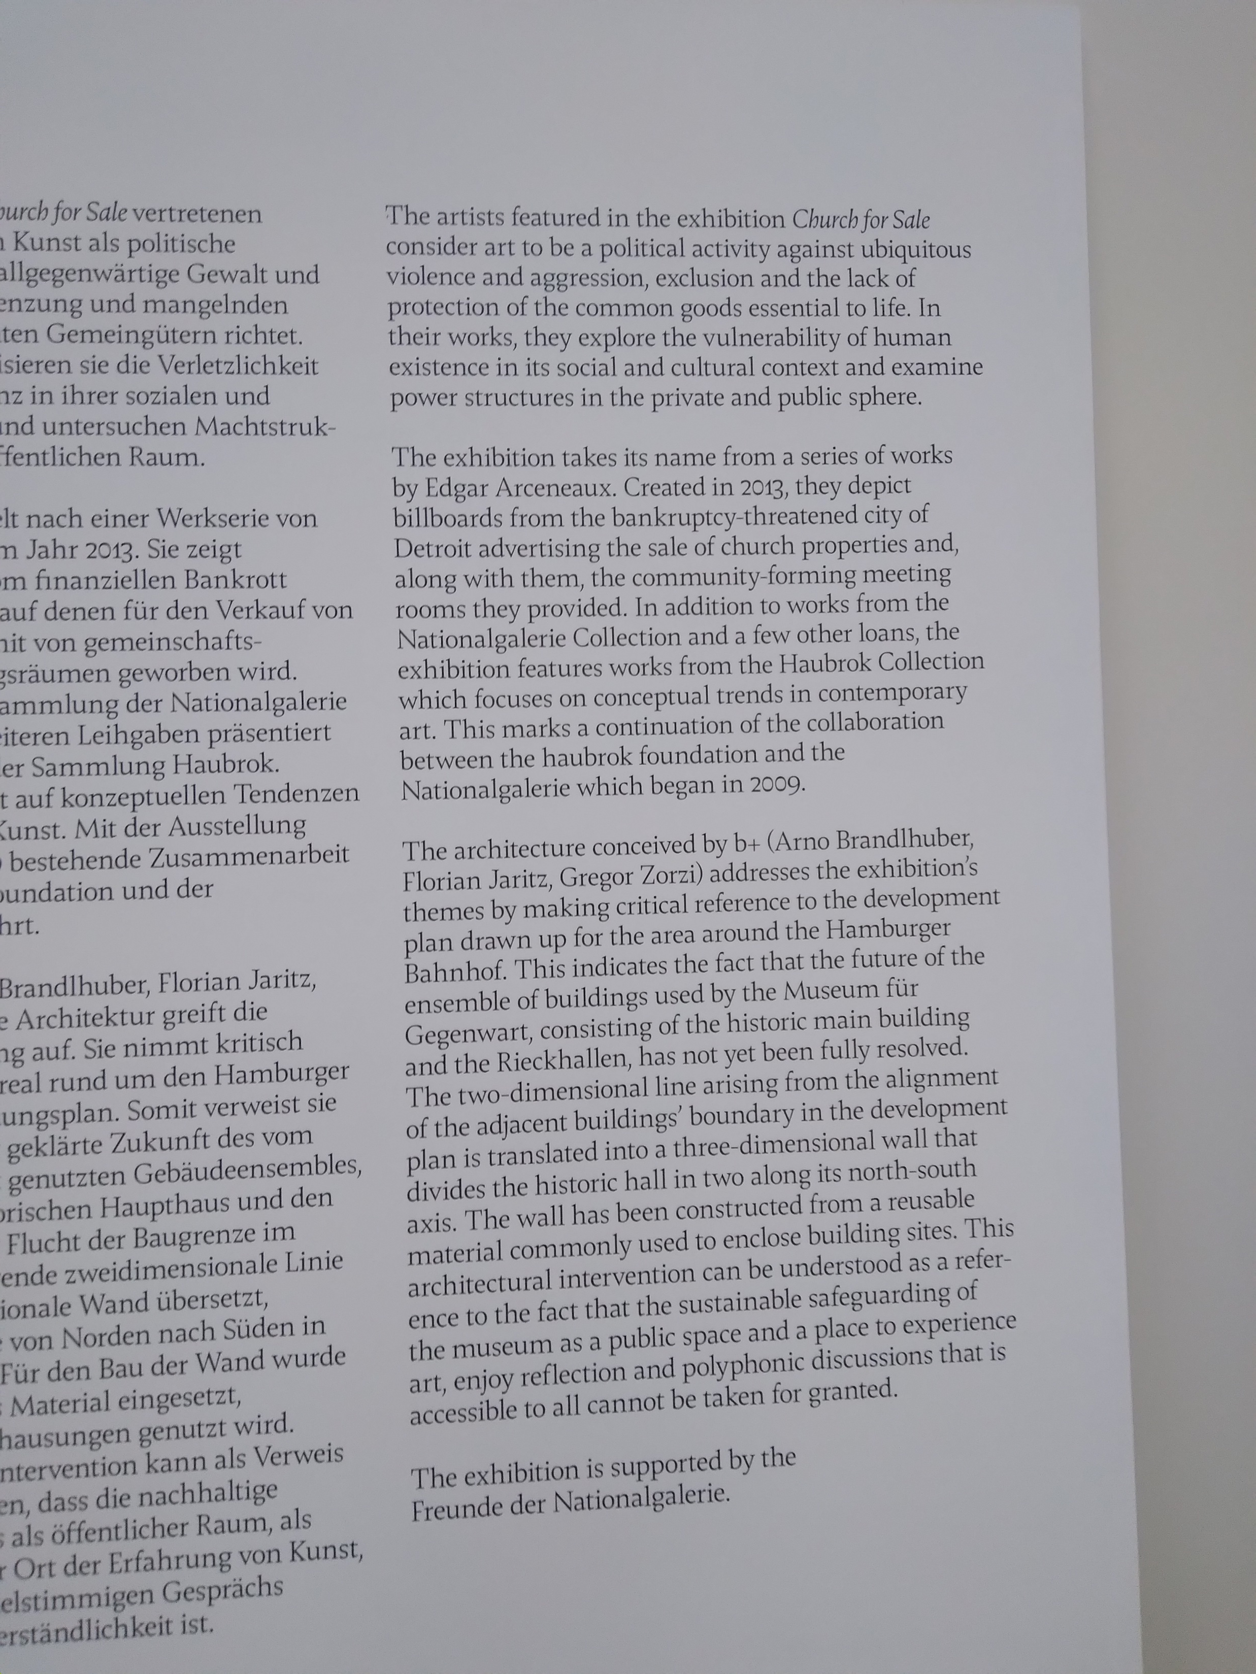
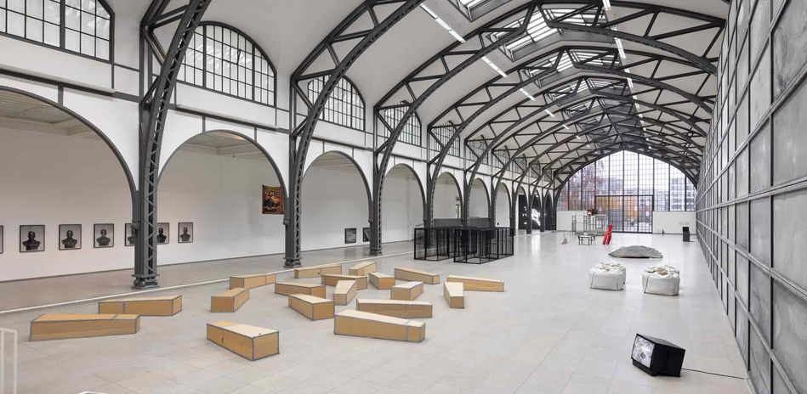

Slide 24
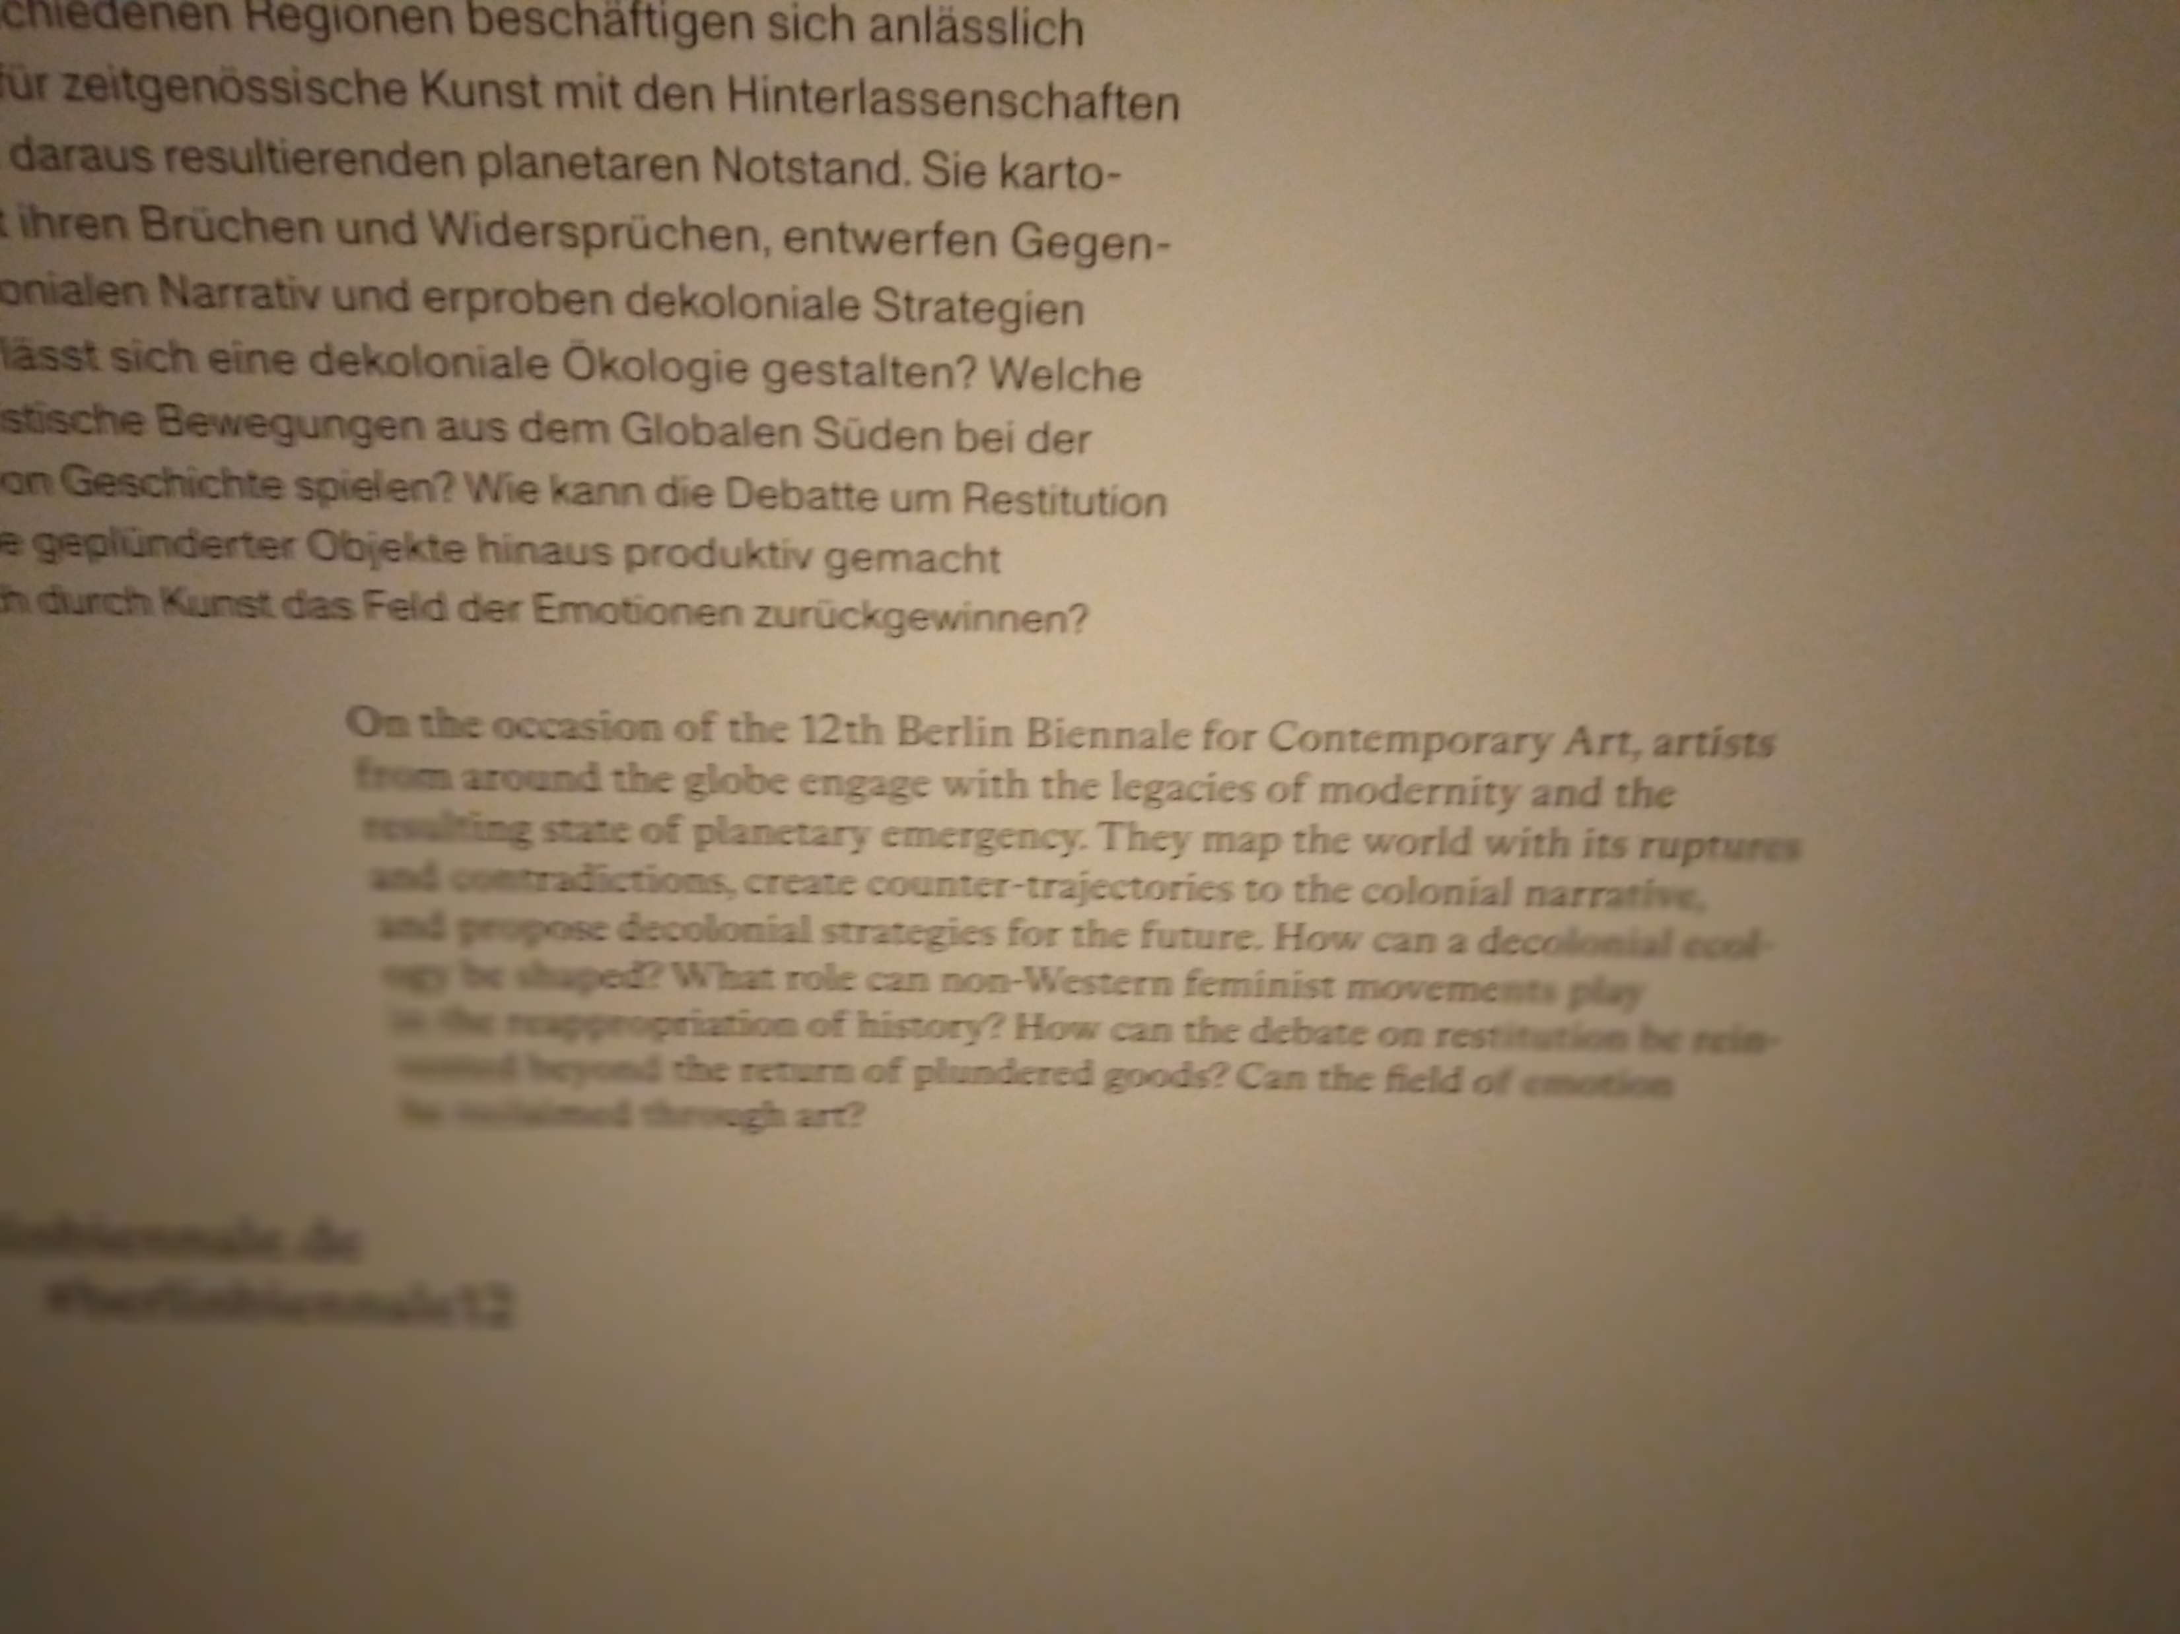
12th Berlin Biennale of Contemporary Art 2022
They create counter-trajectories to the colonial narrative, and propose decolonial strategies for the future. How can a decolonial ekology be shaped? What role can non-Western feminist movements play in the reappropriation of history? ….

Slide 25
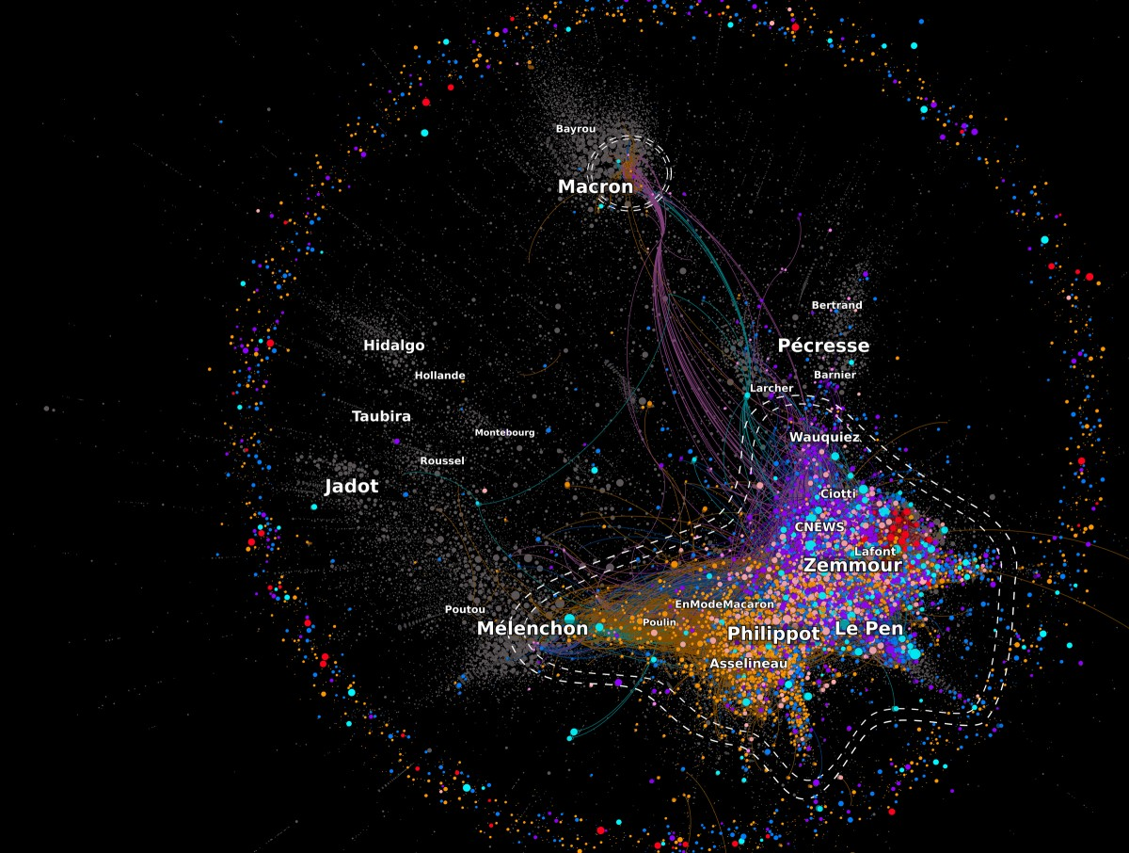
David Chavalarias
History is a constant state of flux channeled by social groups and their leaders. As a researcher at the French National Centre for Scientific Research CNRS in Paris, I try to understand the groups we form, how they evolve, how we shape them, and how in turn they shape us. This approach is rooted in my astonishment over the extreme nature of certain social events, such as the 1994 Rwandan genocide, during which a significant portion of the population engaged in brutal violence against fellow citizens.
From Brexit in 2016 to the January 6, 2021 insurrection at the United States Capitol in Washington D.C., the accession to power of Jair Bolsonaro in Brazil (2018), and Viktor Orbàn in Hungary (2010), we have witnessed in recent years a gradual weakening of democratic institutions accompanied by the rise of populism and fascist thinking. Through an interdisciplinary approach that is both scientific and intuitive, Shifting Collectives (2022) allows us to perceive the invisible social and cognitive structures that shape our identities and collective action by providing us with the necessary reflexivity to understand this ongoing social decohesion.

Slide 26
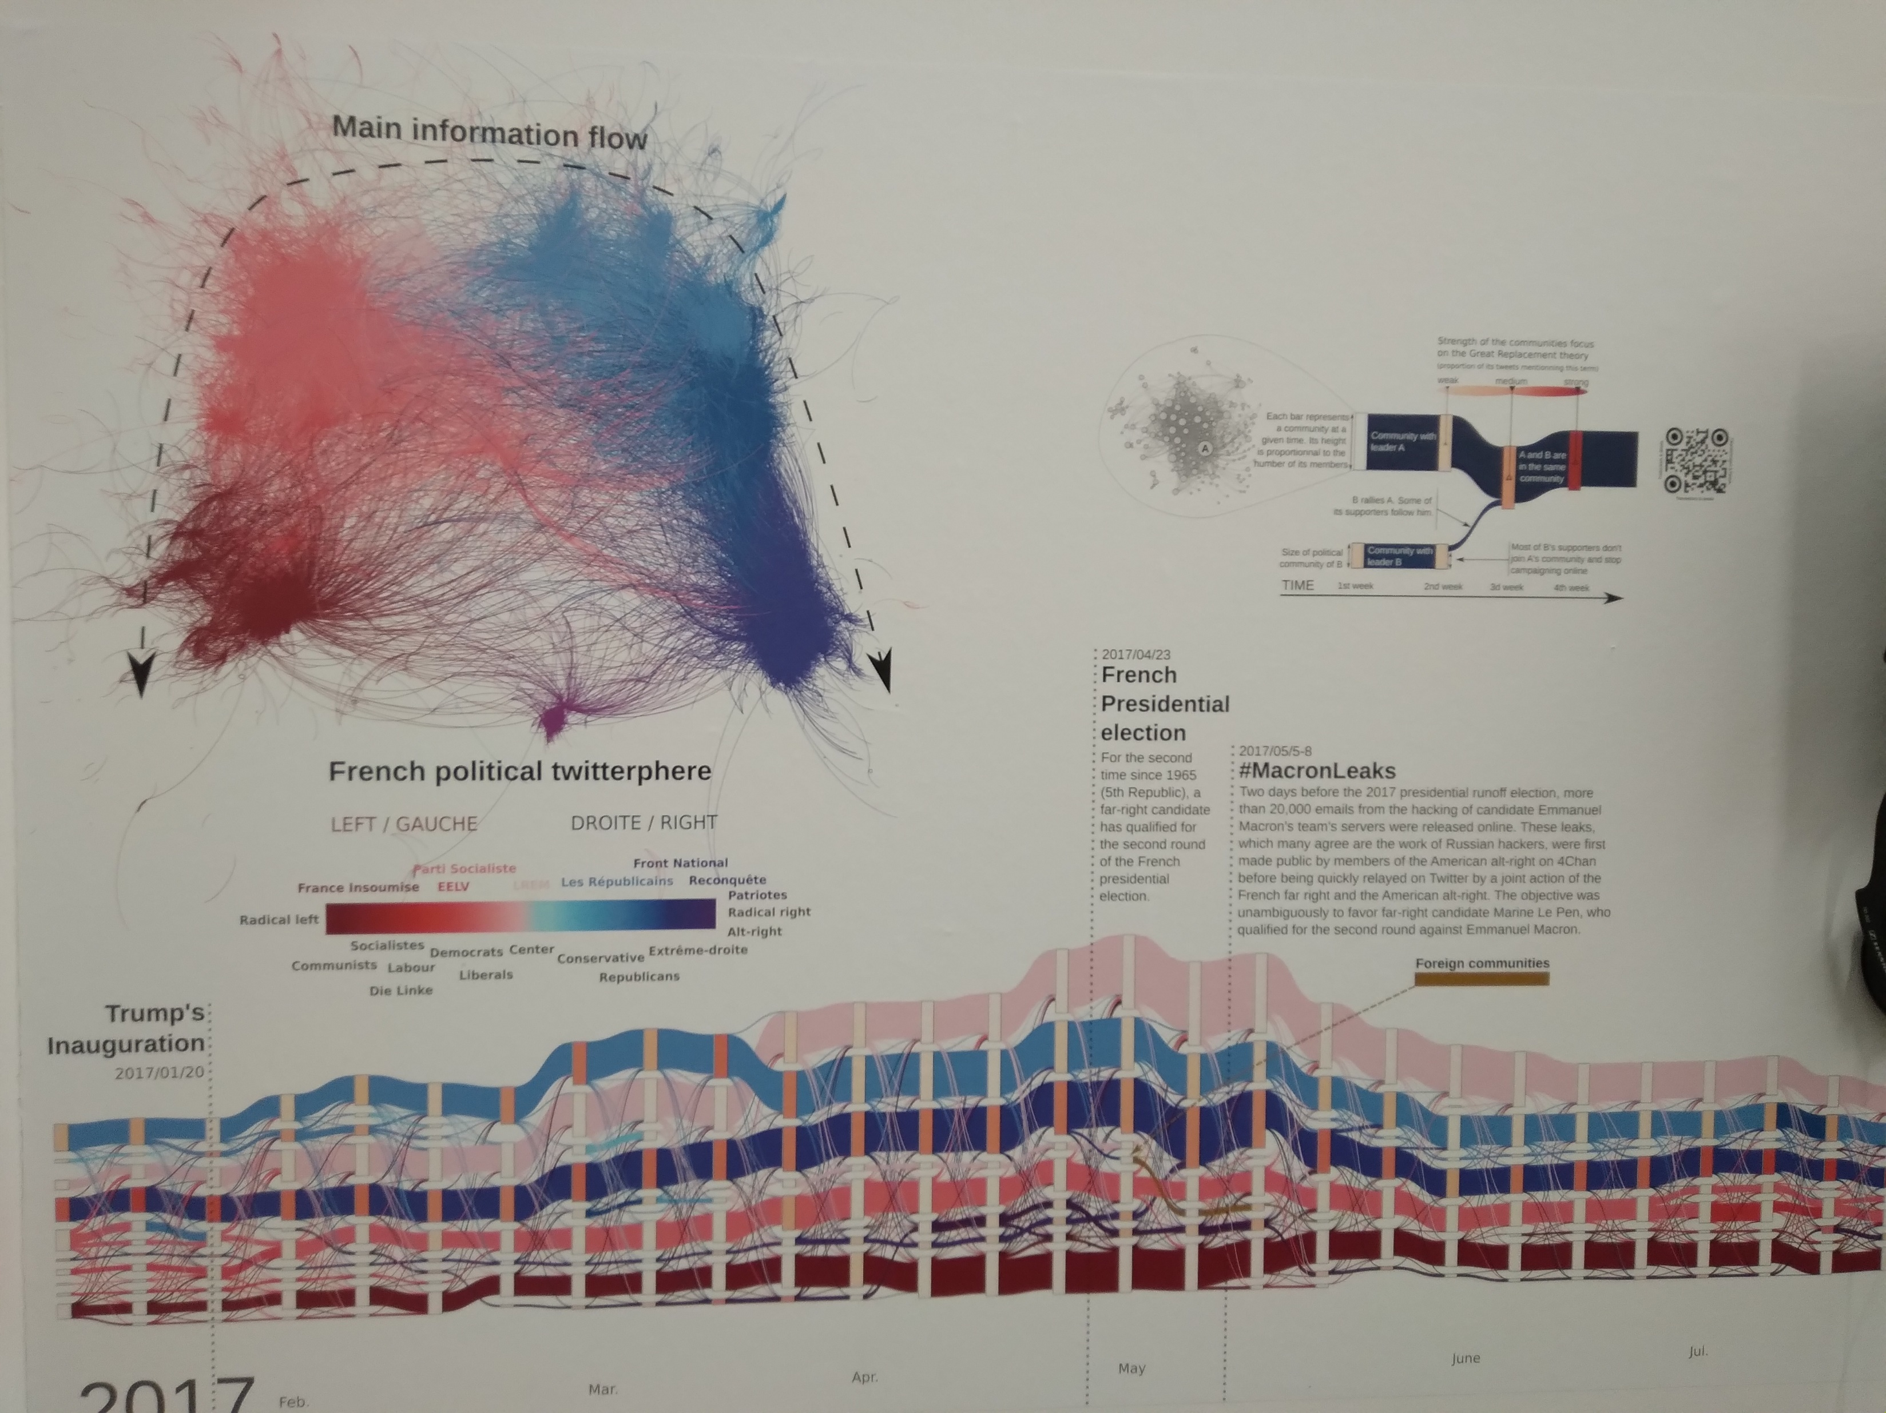
David Chavalarias, Shifting Collectives 2022

Slide 27
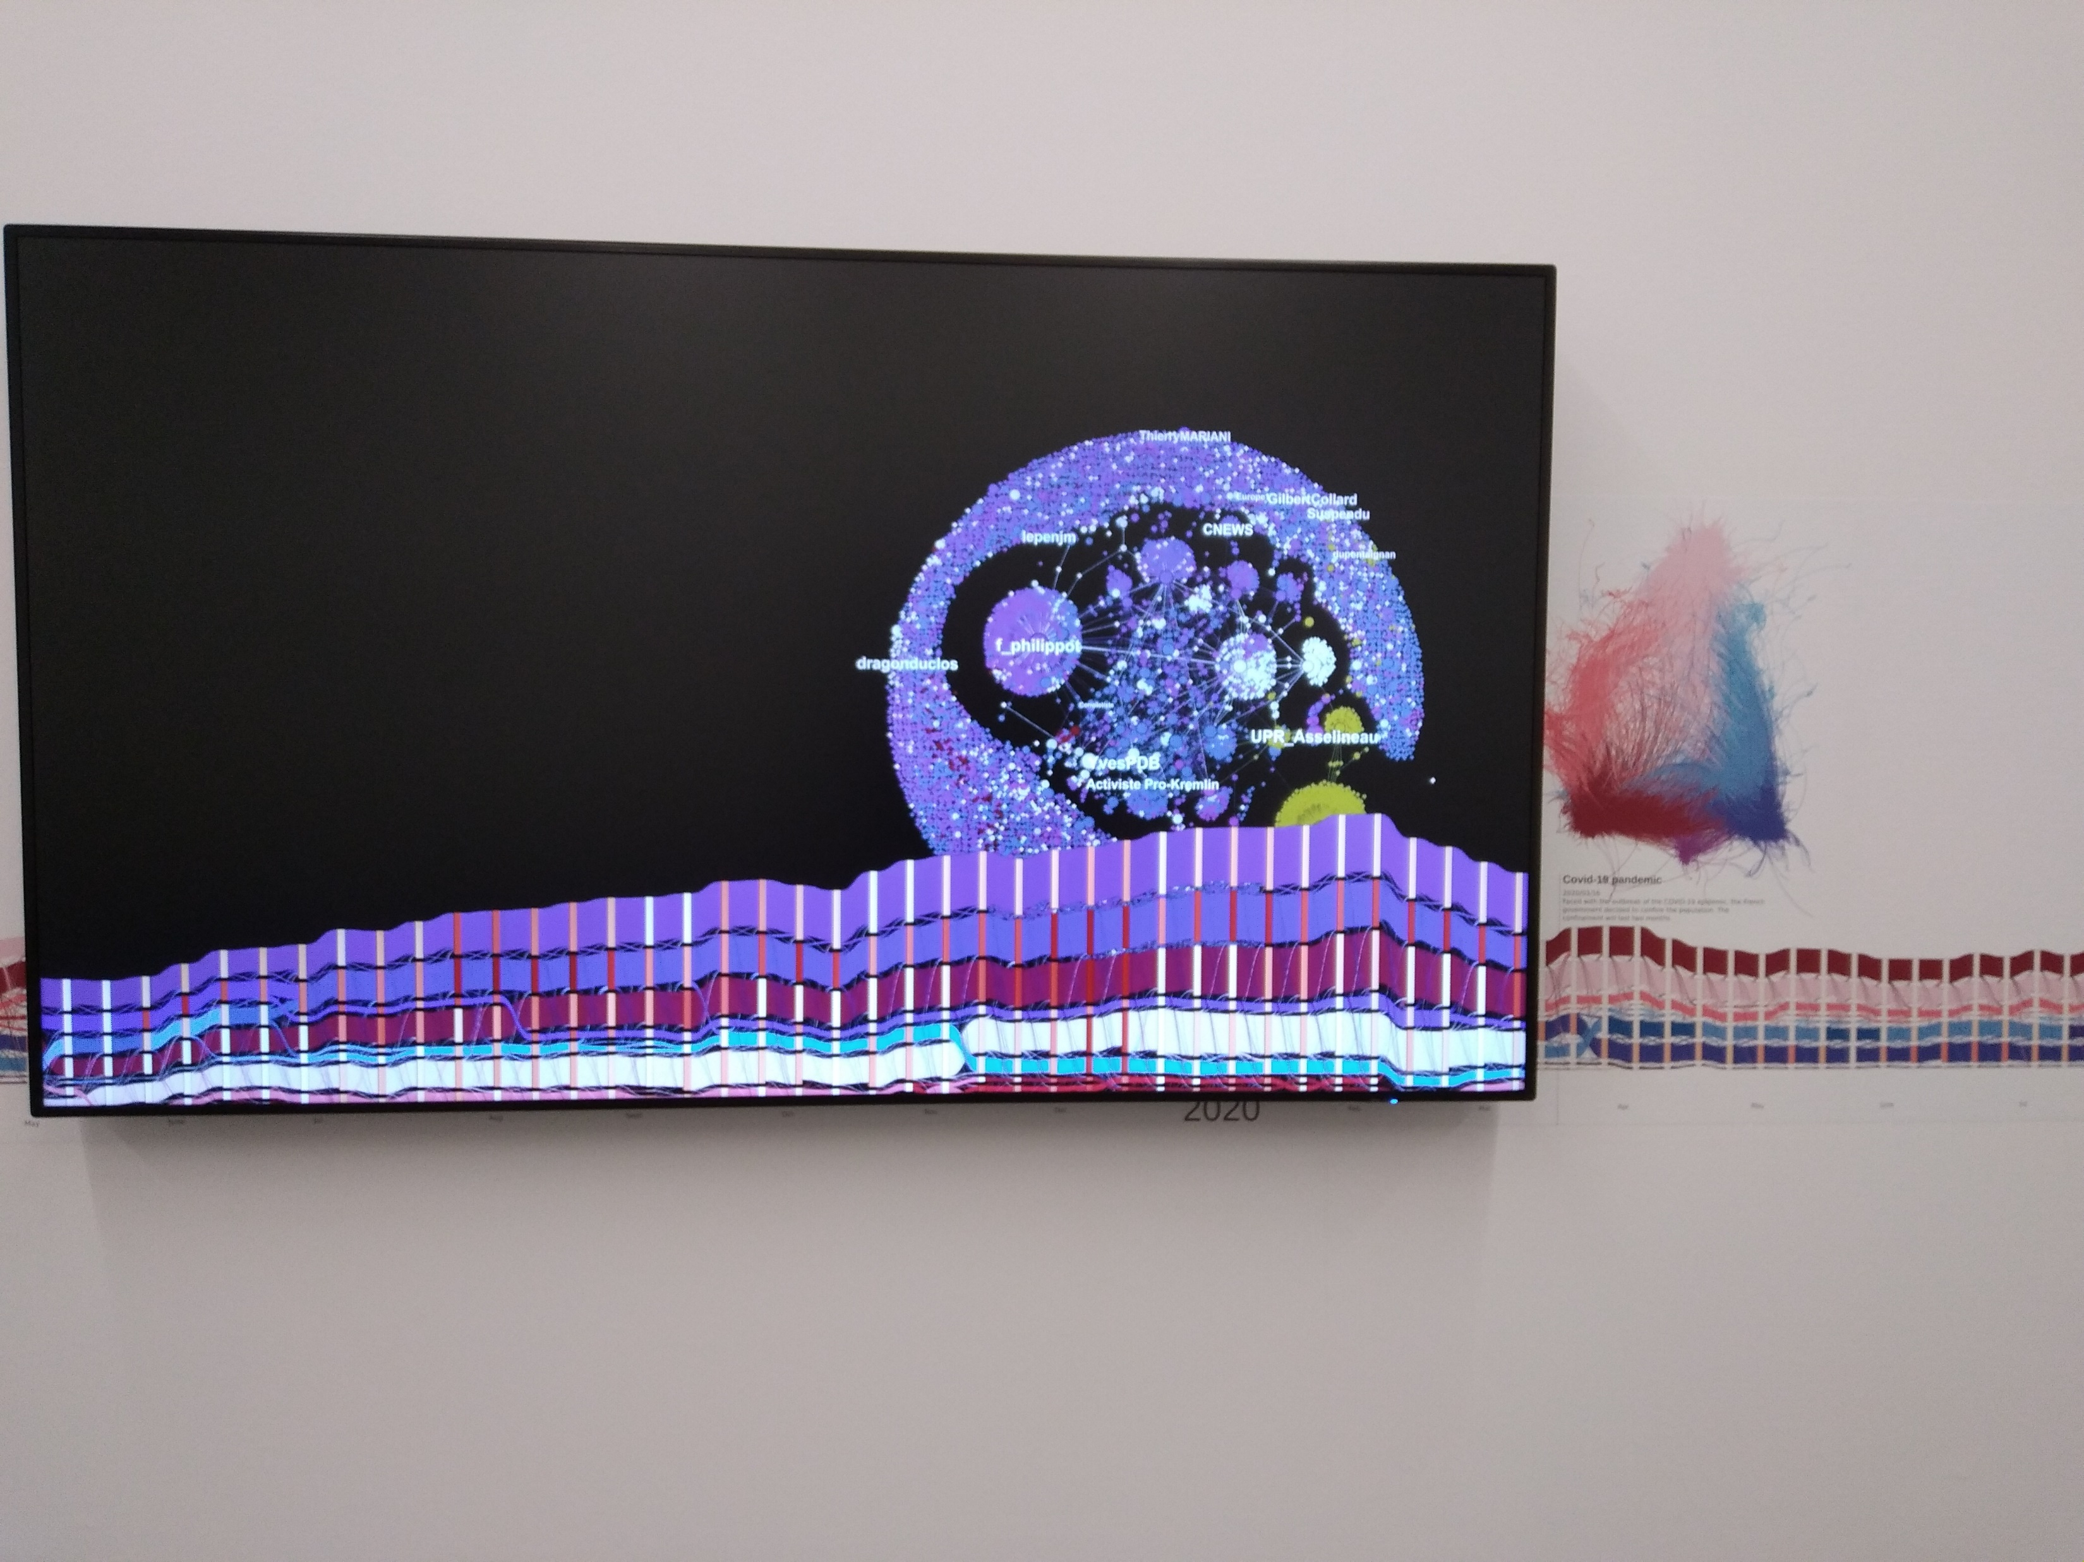

Slide 28
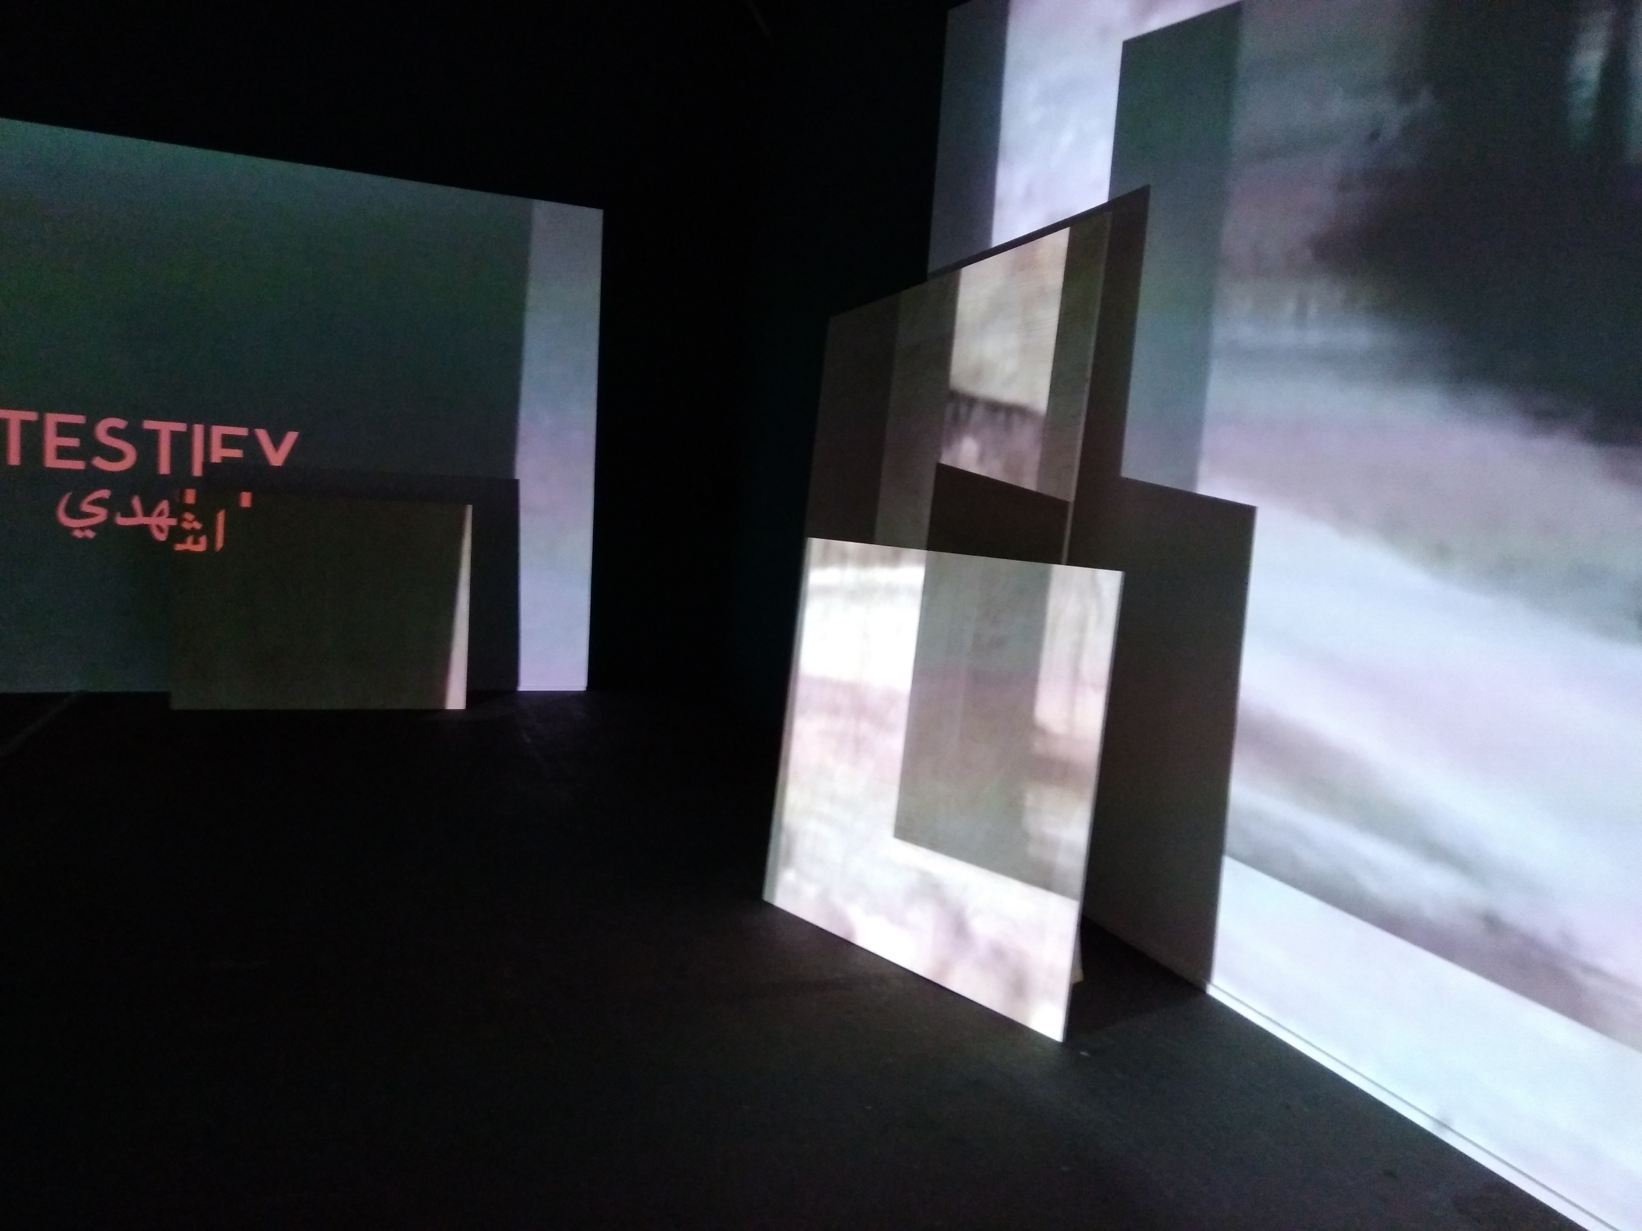
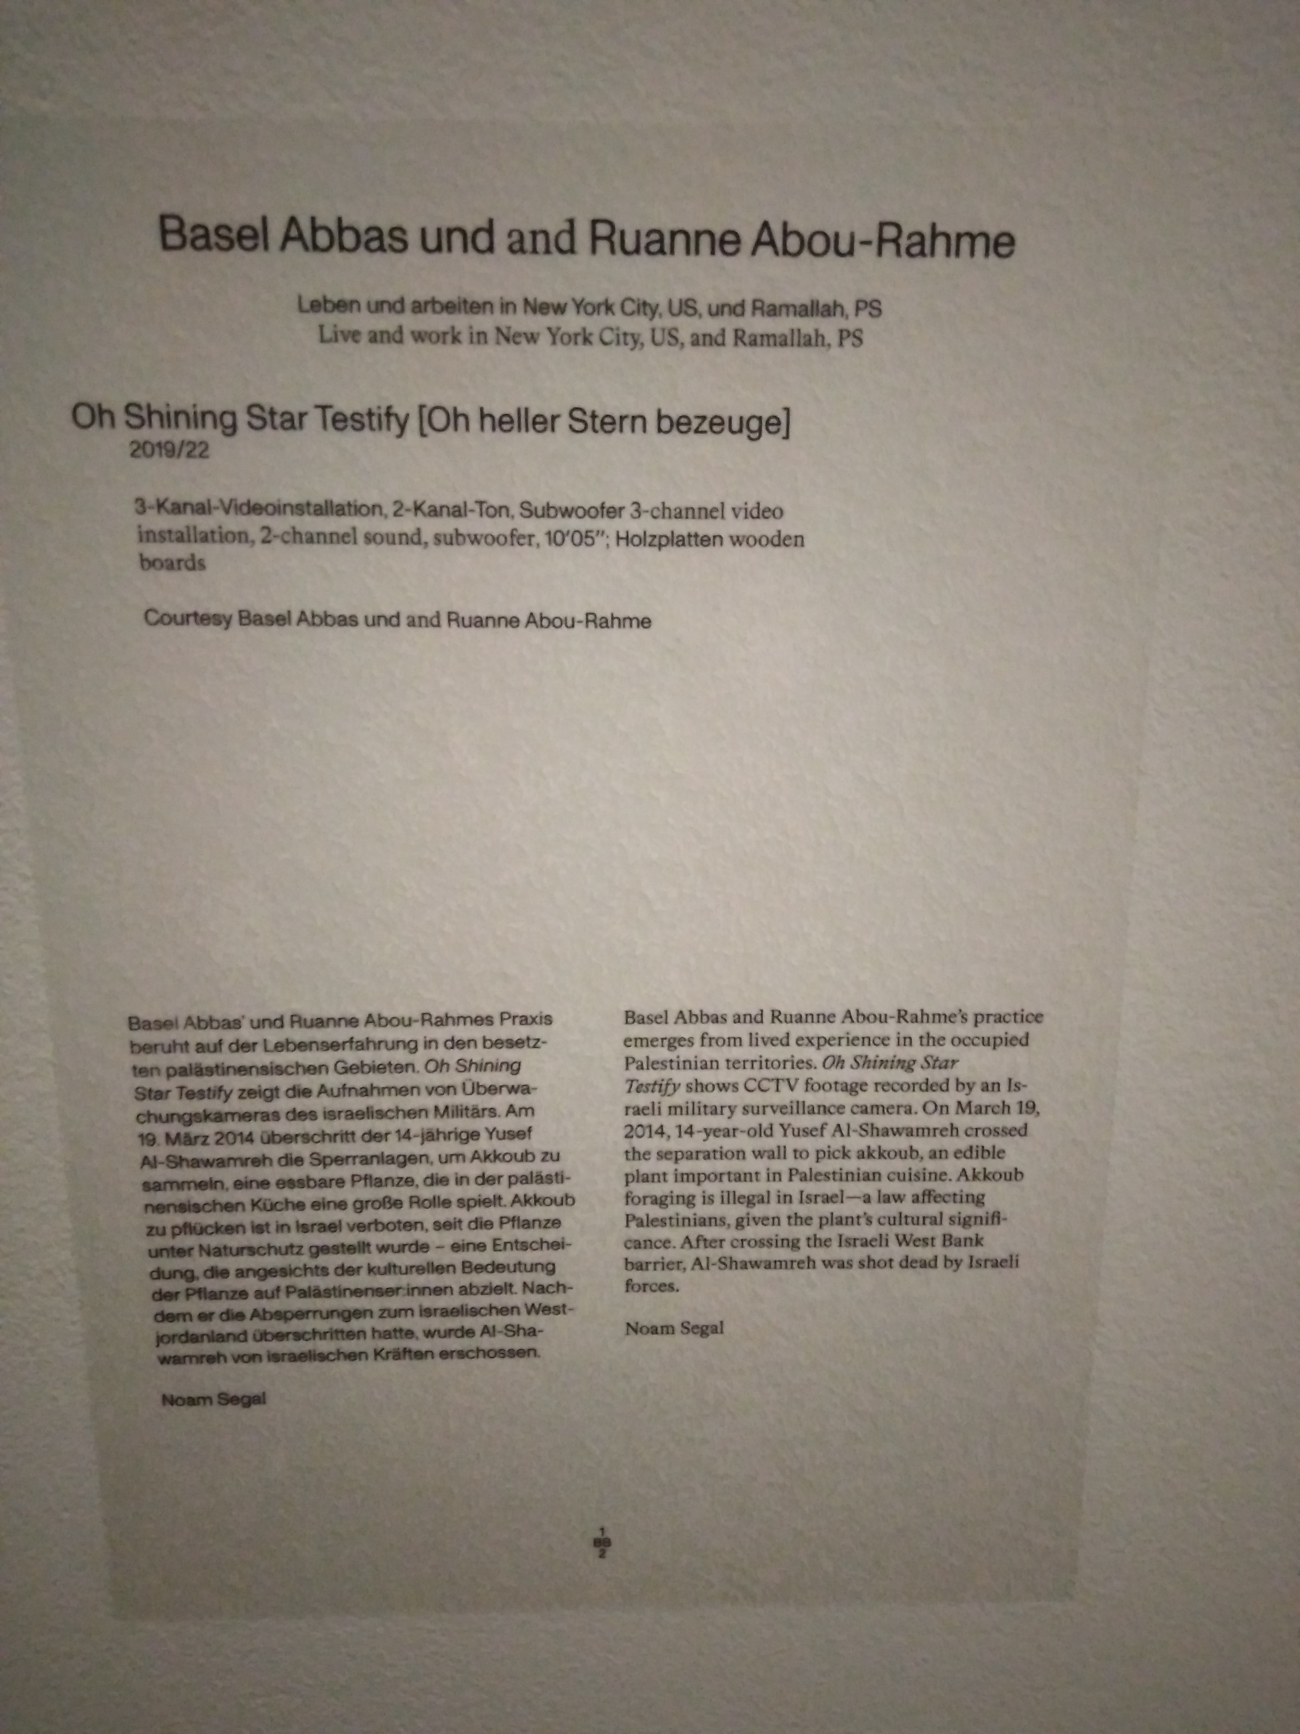

Slide 29
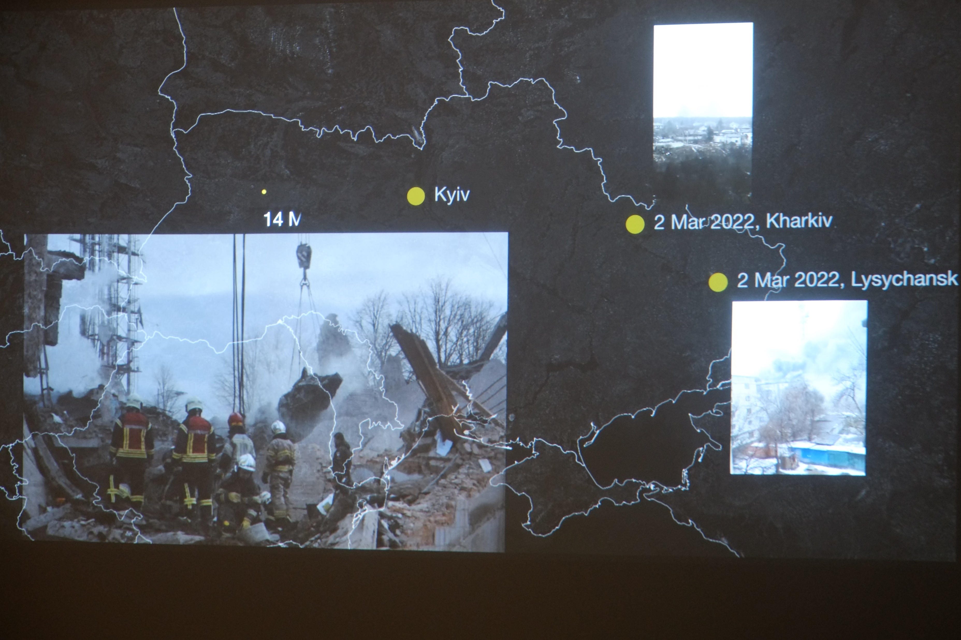
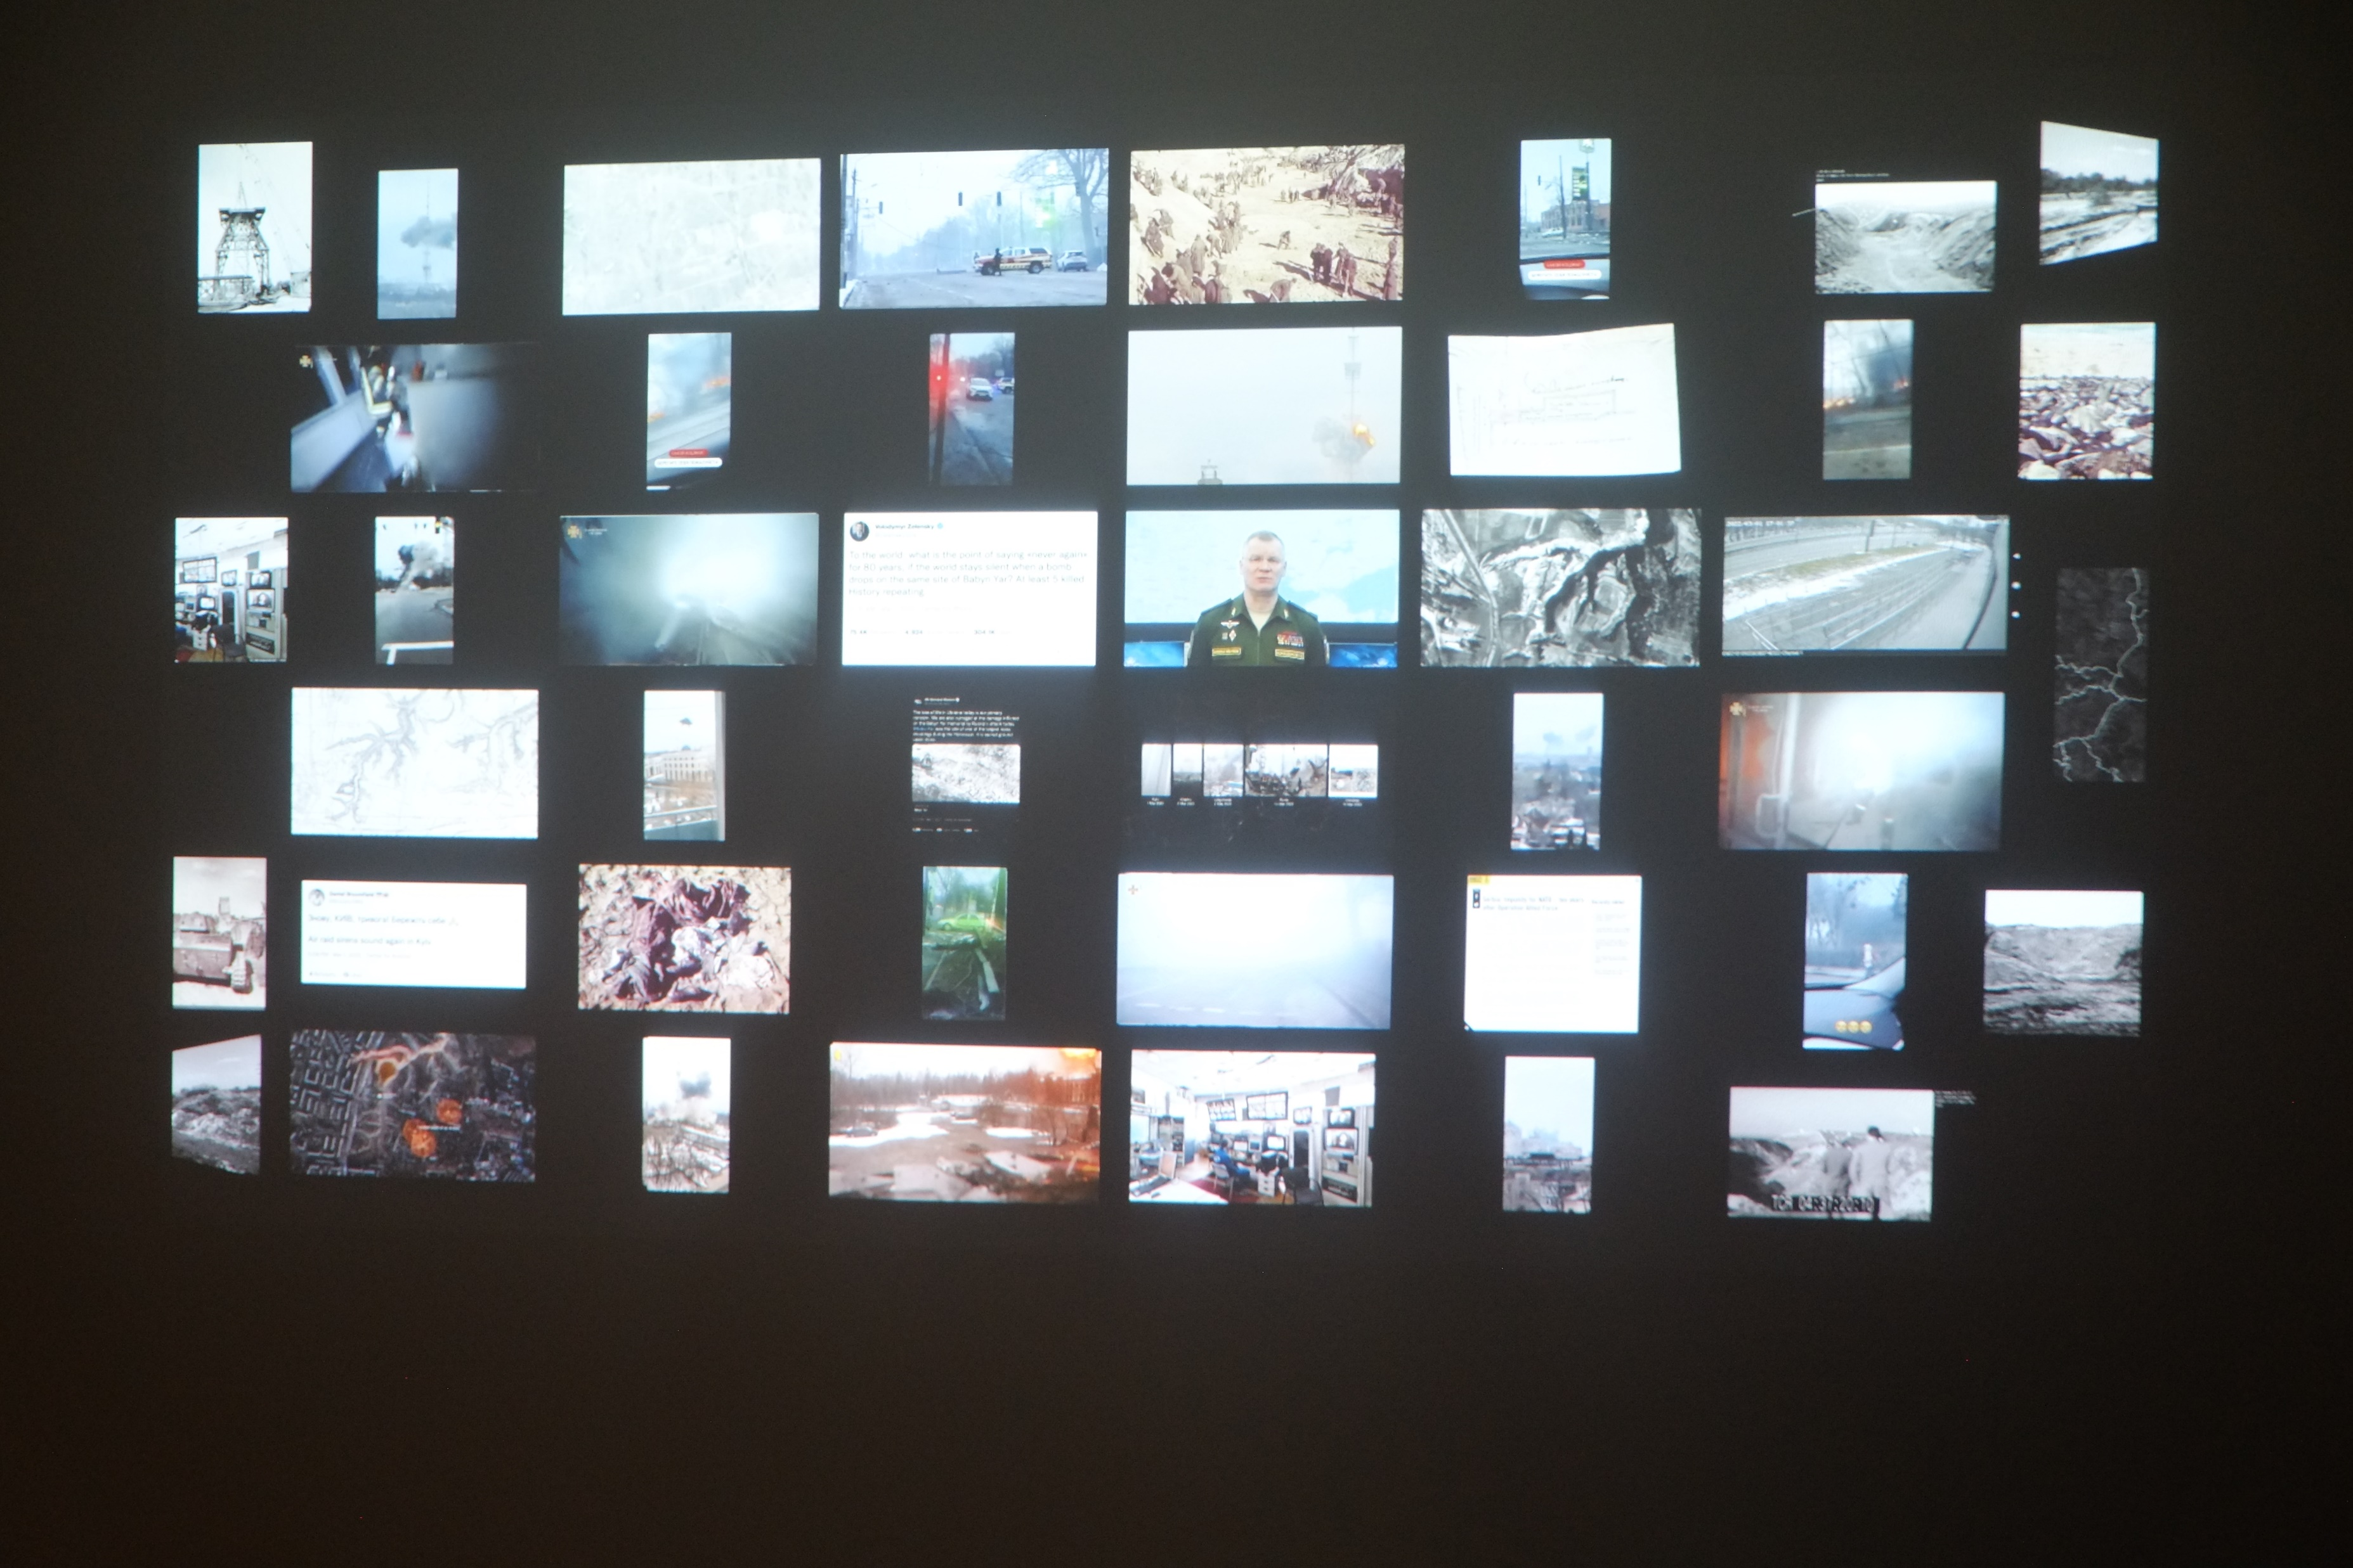
Forensic architecture, Reconstruction of Russian attack on Kiev TV tower, 2022

Slide 30
Forensic Architecture (FA) is a research agency, based at Goldsmiths, University of London, investigating human rights violations including violence committed by states, police forces, militaries, and corporations. FA works in partnership with institutions across civil society, from grassroots activists, to legal teams, to international NGOs and media organisations, to carry out investigations with and on behalf of communities and individuals affected by conflict, police brutality, border regimes and environmental violence.
Our investigations employ cutting-edge techniques in spatial and architectural analysis, open source investigation, digital modelling, and immersive technologies, as well as documentary research, situated interviews, and academic collaboration. Findings from our investigations have been presented in national and international courtrooms, parliamentary inquiries, and exhibitions at some of the world’s leading cultural institutions and in international media, as well as in citizen’s tribunals and community assemblies.

Slide 31
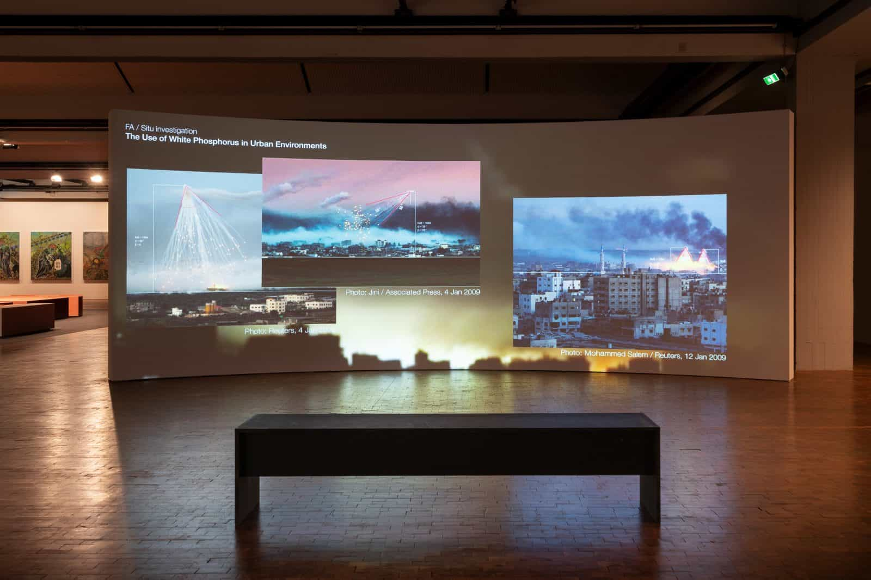
Video Tate

Slide 32
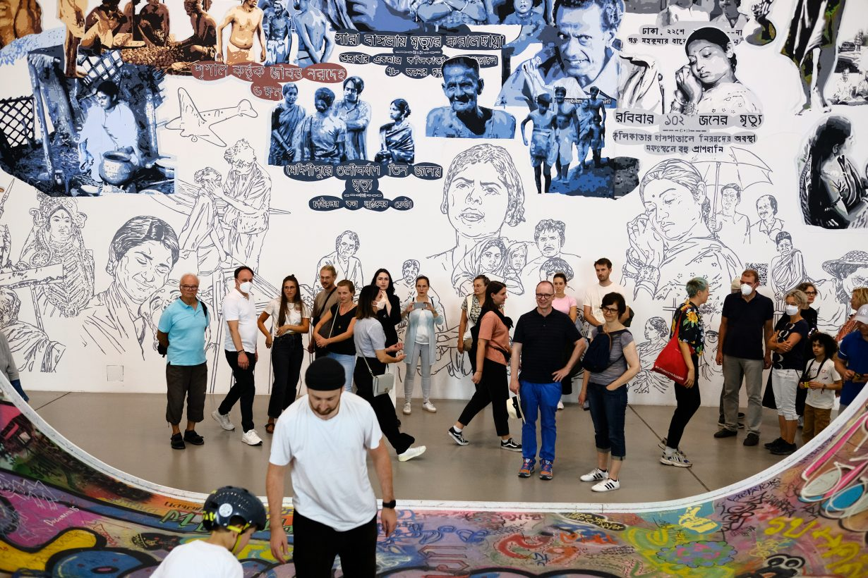
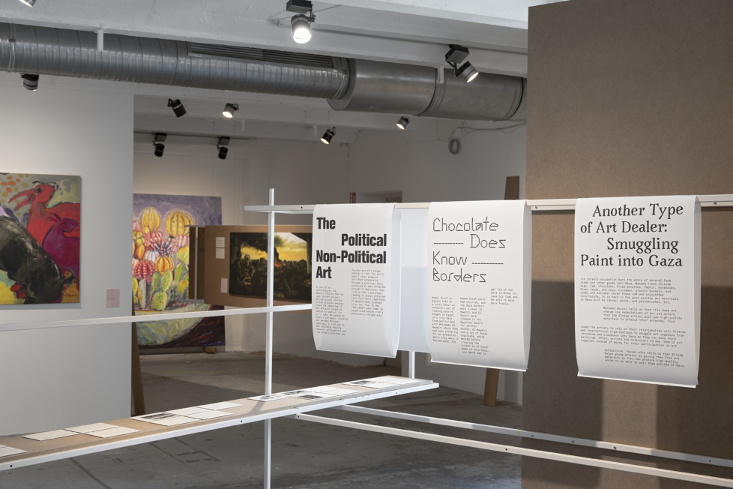
Documenta 15
Baan Noorg Collaborative Arts and Culture, The Rituals of Things, 2022

Slide 33
My thesis:
Work of art, which was not made with political or activist agenda can have a greater potential to engage the viewer in reflecting on contemporary events and problems.

Slide 34
Serving good cause or exploiting suffering of others?
Case study: The plight of refugees

Slide 35
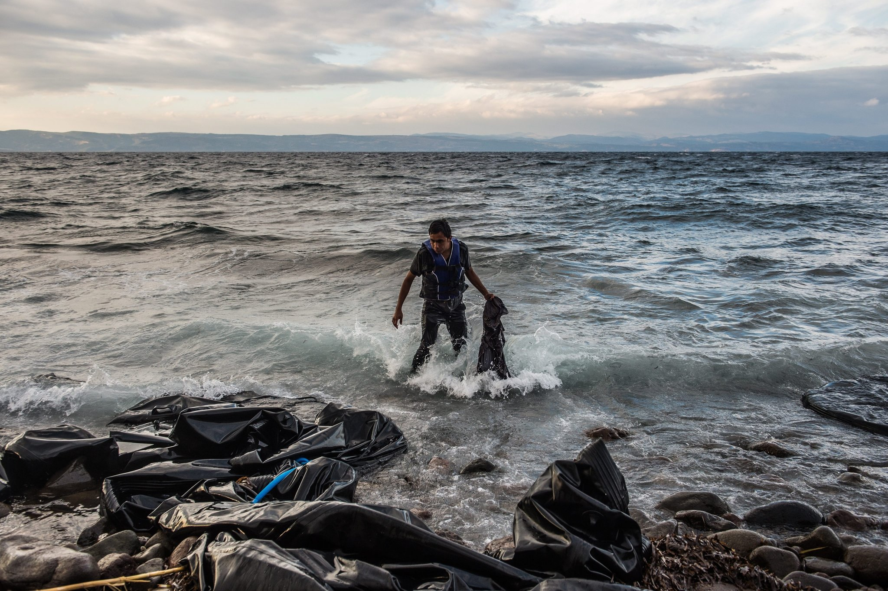
Filip Singer, Lesbos 2015

Slide 36
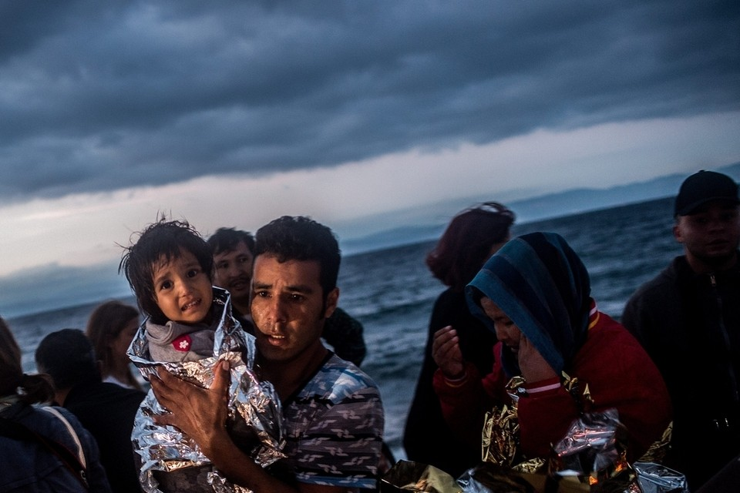

Slide 37
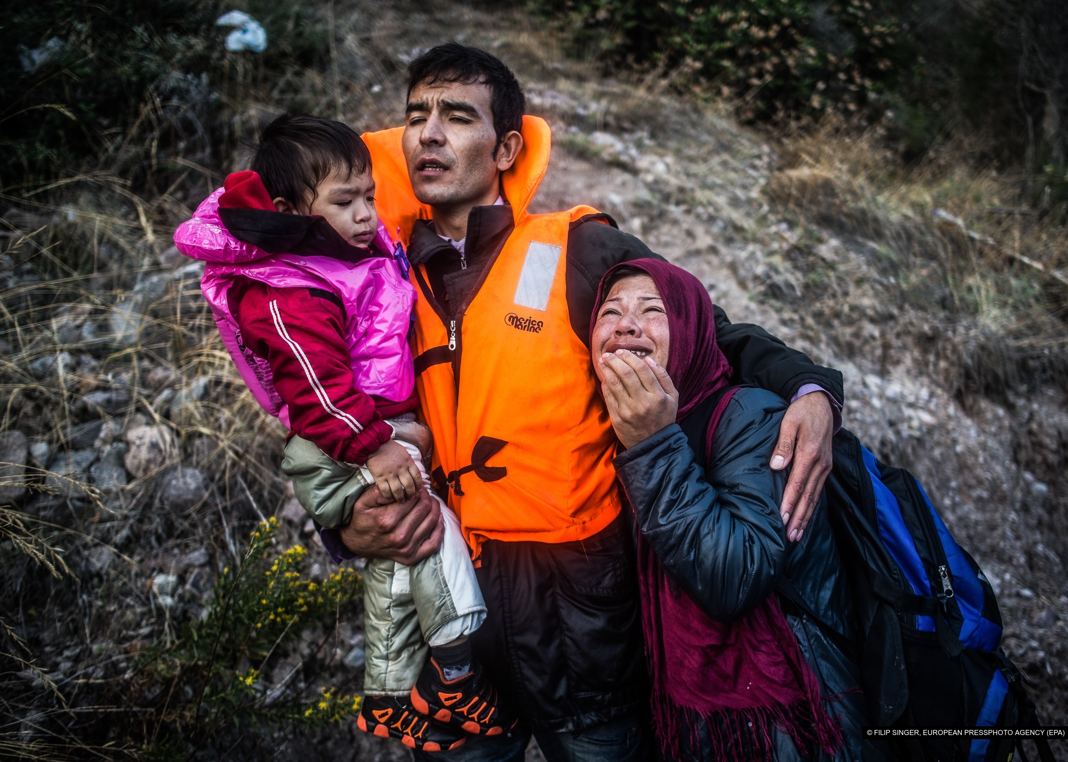

Slide 38
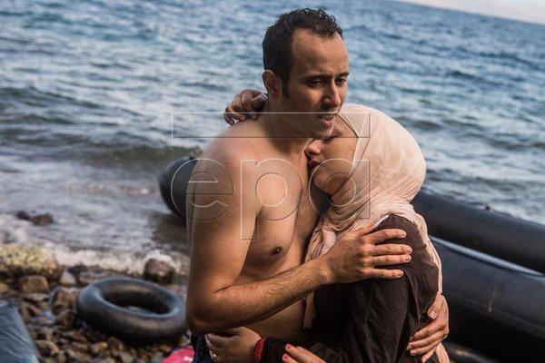

Slide 39



Reflection in popular visual culture

Slide 40


Ai Weiwei, Soleil Levant, 2017

Slide 41


Activism or exploitation?
Ai Weiwei

Slide 42



Slide 43


Venice bienale 2019
Christopher Büchel, Barca nostra

Slide 44
a monument to contemporary migration" and a symbol of human tragedy that brings our collective responsibility into focus.
It is a very important project, that boat is the symbol both of the human tragedy and of the political crisis that the migrant flow is causing to all of Europe", Giovanni Angileri, chief of staff of the Sicilian cultural heritage department, told CNN.^{[4}
Carlotta Sami, a spokeswoman for the United Nations’ refugee agency visited the boat and said: “I feel this cannot be considered a relic of the past. Today, a new shipwreck is telling us that that boat is our present.

Slide 45

BARCA NOSTRA surely is more than just a shipwreck; rather, it is a signifier of our reality, a relic of a human tragedy, as well as a monument to migration narrating the contemporary status of freedom of movement on a global scale. It is an indicator of collective responsibility and the horridness of nationalist discourses and current policies of the majority of European societies today.
Is it?

Slide 46
Sunday Times art critic Waldemar Januszczak, noted that: “There's been a lot of fake news spread about on Twitter about the [migrant] boat at the Venice Biennale. It is not true to say that it has no context and ignores death. The context is spelled out clearly in the catalogue. I found it dark, upsetting, accusatory and powerful….to suggest that the piece somehow glorified or ignored death is, at best, plain wrong.”

Slide 47

Nauseous. This image keeps haunting me. It shows the cynical and ruthless logic of sensational exhibitions where politically correctness and marketing strategy govern upon ethics, research and sensitivity. How one could have thought for a second it was a good Idea to bring this boat (800 persons died in it in 2015) to the Venice biennale? Turning it into a western fetish and a selfie spot…….

Slide 48
The Guardian view on the Venice Biennale’s migrant boat: pushing the limits of art
Editorial
It is precisely this kind of contextualisation that Barca Nostra lacks. Mr Büchel has objected even to the placing of information boards near the vessel. There is no programme of discussions or debates (for example), no immediate connection with those directly affected by the migrant crisis. Mr Büchel seems to intend Barca Nostra to stand as a nakedly distressing, disturbing intervention.
Barca Nostra is certainly provocative. What is less clear is whether it is stimulating much that is productive for those who have lost their lives on the Mediterranean – and for those who will attempt to follow them over the treacherous seas.

Slide 49
Here, as with all of of his previous projects, public response—including press articles, critical essays, and social media posts—is integral to the overall concept. Büchel’s work comprises process and unmediated interactions. Therefore, it has always been his position with BARCA NOSTRA that physical signage and explanatory text at the Arsenale would disrupt the process by which questions are raised, assumptions are made, intentions are projected onto the project, and a meaningful debate ensues.
Again, the fishing vessel is not the artwork; instead, the ongoing project and its journey are the artwork.

Slide 50




Courtyard Tales 2017-18
„blankets are closest thing to your body….you feel the body even not seeing the body“

Slide 51


Berlinde De Bruyckere
Anderlecht 2018

Slide 52


Contemporary (art?) activism once more

Slide 53



Slide 54
Why overtly political and activist art often (mostly?) fails
Hypocrisy of art world:
(the art world’s deep interdependence with the sectors of society benefiting most from the crises caused by capital—from the debt-induced deterioration of labor, the elimination of the middle class, and the global commerce of war to the fracking of our natural environment—has become obvious, a scandalous fact. )
2) Many works with political or social-activist agenda in reality trivialize complex problems, and in some cases parasite on suffering of other people
3)Such works often miss their targets
4) Visual art is not the ideal platform for communication and discussion of difficult and pressing global problems.

Slide 55

What’s wrong with today’s “protest art”—which occupies so much of our public space? Mainly this: it’s long on protest and virtually devoid of art.
aestheticization and spectacularization of politics, including political protest, are bad things because they divert attention away from the practical goals of political protest and towards its aesthetic form. And this means that art cannot be used as a medium of a genuine political protest—because the use of art for political action necessarily aestheticizes….

Slide 56

Works of art can raise public awareness, motivate and mobilize
individuals and groups for to do morally good things.
But they can do so only through their potential to offer an exceptional visual, cognitive and affective experiences.
If they are not capable of providing such experiences, they remain only a piece of propaganda or superficial comment, less effective than other forms of public discourse.

Slide 57
My questions:
Can art really help in addressing major problems of this world, such as climate crisis, wars, inequality etc?
Is art activism making any difference, or is it largely tactics to make oneself visible within the contemporary art world?
Have you encountered any contemporary artist/work of art, which you found
effective as a tool of social change or activism? etc.

