Slide 1

Cantonese I
Week 8
Notes:
start with revision of money. and bargaining conversation. week 7, slide 3, 13,15,20,25,27

Slide 2
Exam
Only oral test online. No scores is counted. Self introduction. Some quick questions regarding week 1-7.
Self-introduction (speak more if you want):
My name is XXX. 我叫 ngo5 giu3 XXX
I am Czech/Slovak/Vietnamese. 我係捷克人/斯洛伐克人/越南人
ngo5 hai6 zit3 haak1 jan4/si1 lok6 fat6 haak1 jan4/jyut6 naam4 jan4
I am xxx years old. 我今年 xxx 歲。
ngo5 gam1 nin4 xxx seoi3。
I have xxx brothers and yyy sisters. 我有 xxx 兄弟同 yyy 姊妹。
ngo5 jau5 xxx hing1 dai6 tung4 yyy zi2mui2。
My hobbies are zzz. 我嘅嗜好係 zzz 。
ngo5 ge3 si3hou3 hai6 zzz 。

Slide 3
Exam
Simple questions regarding week 1-7
for example:
*** the best five words***
Try the 6 tones
How to say “eat rice/have a meal” in Cantonese?
Possessive pronouns such as “ngo5 ge3 pang4 jau5” my friend.
say numbers, day/month/year, price in Cantonese
adjectives: cute, tall, short, ugly
verb: wake up, go home, eat rice, its negation
yes/no question

Slide 4
Exam
Finally… please share your feedback about the whole course.
How do you feel about Cantonese, the teaching and the learning?

Slide 5
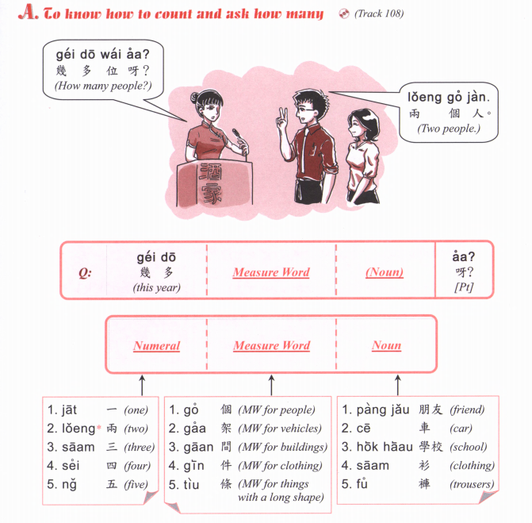

how many

Slide 6
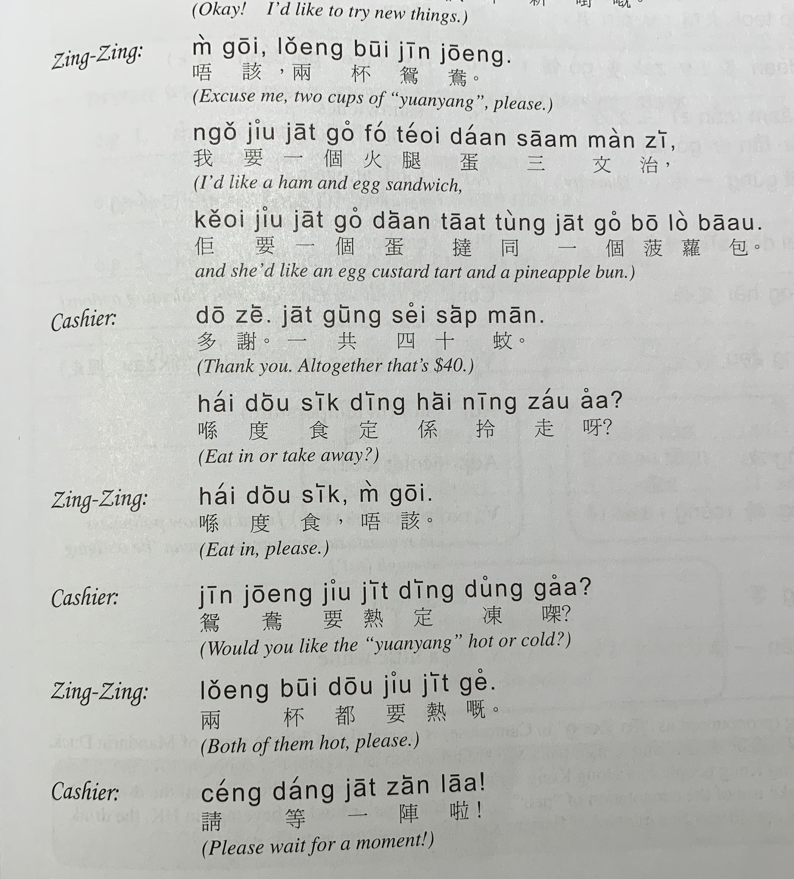
Zing-zing:
M4 goi1, ngo5 jiu3 A, B tung4 C
唔該，我要 A，B 同 C
(Excuse me, I want A, B and C)
Cashier:
Nei5 ge3
你嘅
(Here you go)
Zing-zing:
m4 goi1, zoi3 gin3
唔該，再見
(Thank you, goodbye)

Slide 7
m4 goi1, maai4 daan1
唔該，埋單
Excuse me, the bill please.

Slide 8
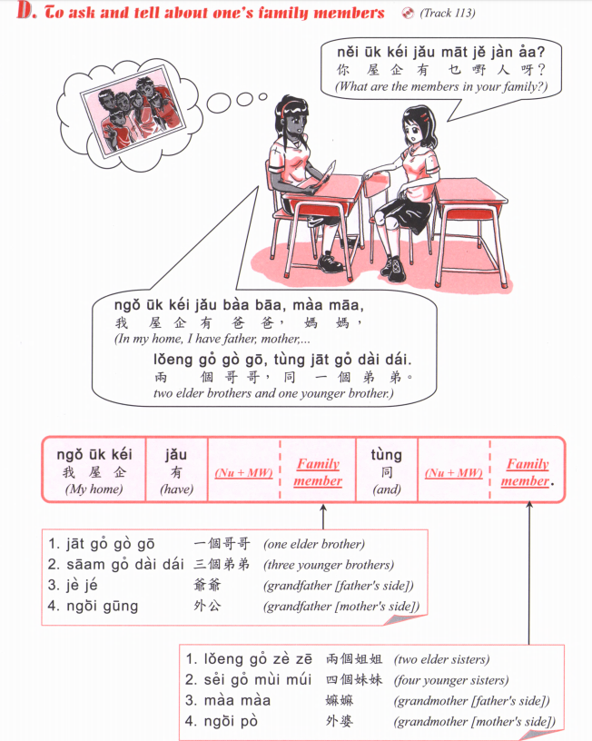
乜嘢 / 咩
Mat1 je5 / me1

Slide 9
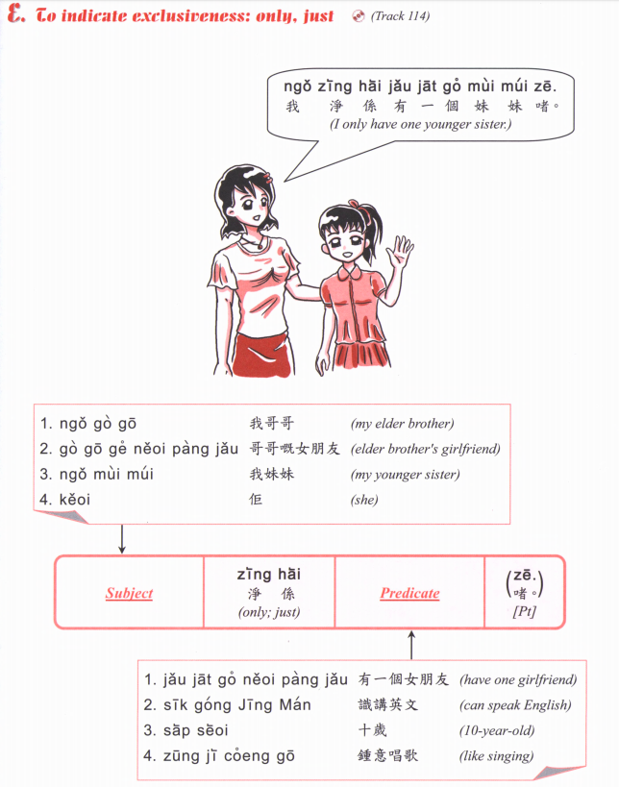

Slide 10
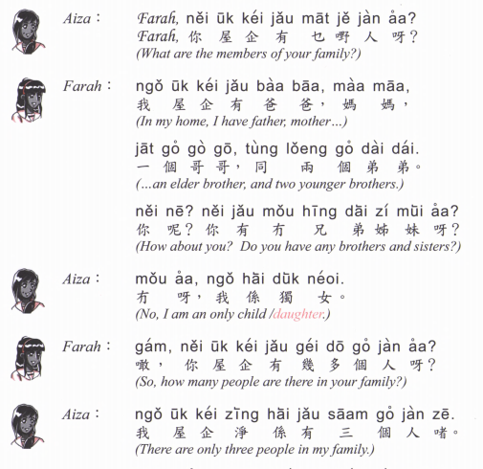
Notes:
finished here in week 7

Slide 11
Ask questions
Introduce your friend
Name
Age (歲 seoi3)
Nationality
How many people in their family (eg: how many brothers/sisters)
zit6 hak1 Jan4
捷克人
Czech
si1 lok6 fat6 hak1 Jan4
斯洛伐克人
Slovak
Jyut6 Naam4 Jan4
越南人
Vietnamese
Ho4 Laan1 Jan4
荷蘭人
Dutch
Notes:
important practice

Slide 12
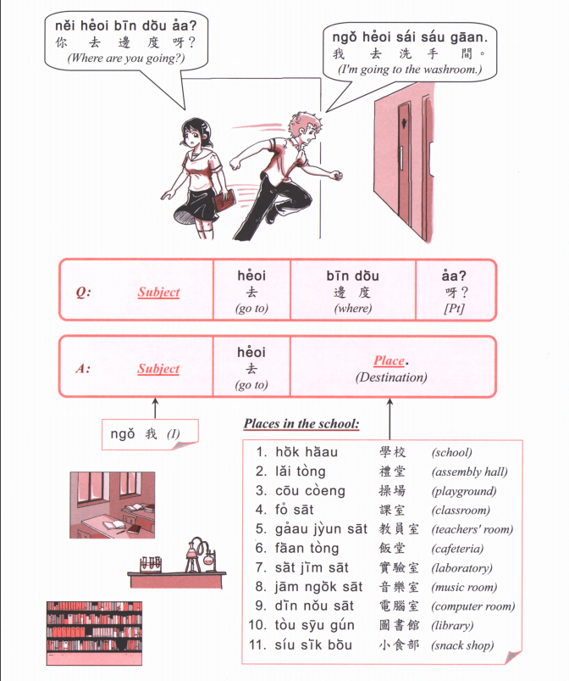

Slide 13
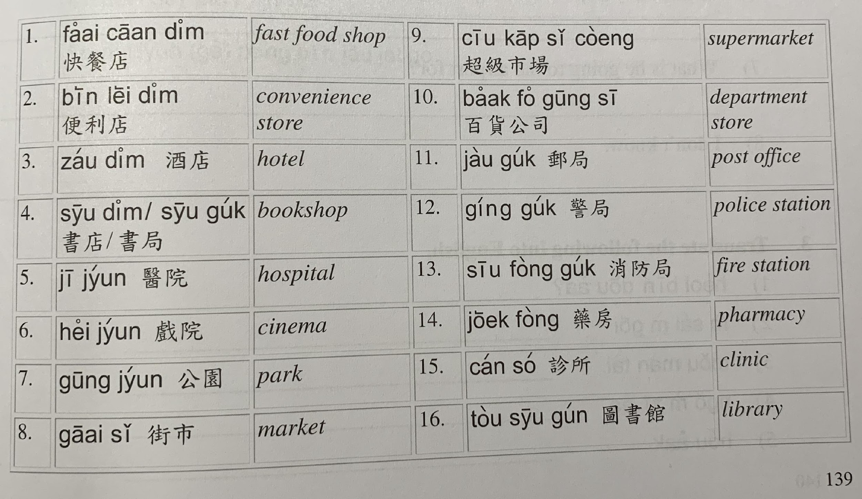

Slide 14
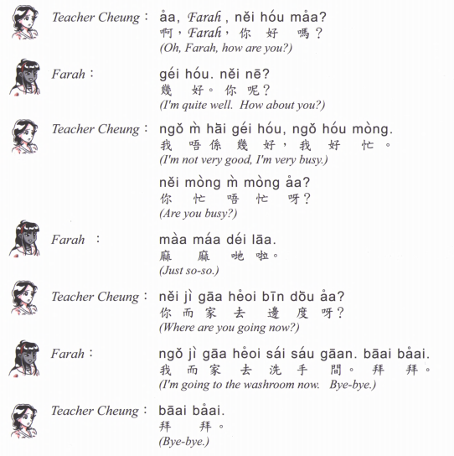
now

Slide 15
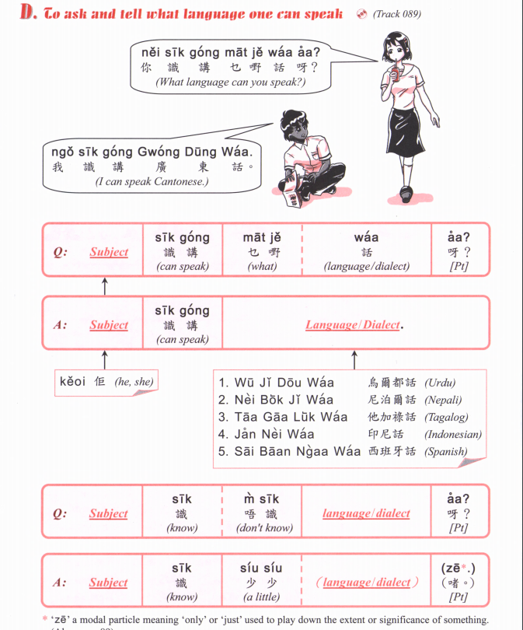
pou2 tung1 waa2
普通話
Mandarin
zit6 hak1 waa2
捷克話
Czech
si1 lok6 fat6 hak1 waa2
斯洛伐克話
Slovak
Jing1 man2
英文
English
Dak1 man2
徳文
German
Faat3 man2
法文
French
Notes:
week 8 ended here.

Slide 16
Notes:
continue week 9

Slide 17
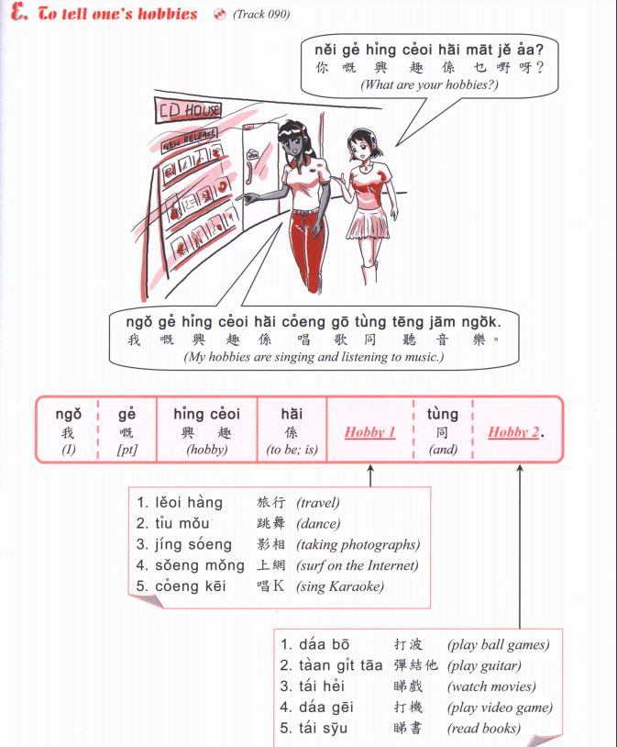
Jau4 seoi2
游水
swimming
Zou6 gym
做gym
Go to the gym
Gin6 san1
健身
Go to the gym
Zyu2 je5 sik6
煮嘢食
Cooking
Haang4 saan1
行山
Hiking
Caai2 daan1 ce1
踩單車
Cycling
Teng1 jam1 ngok6
聽音樂
Listen to music

Slide 18
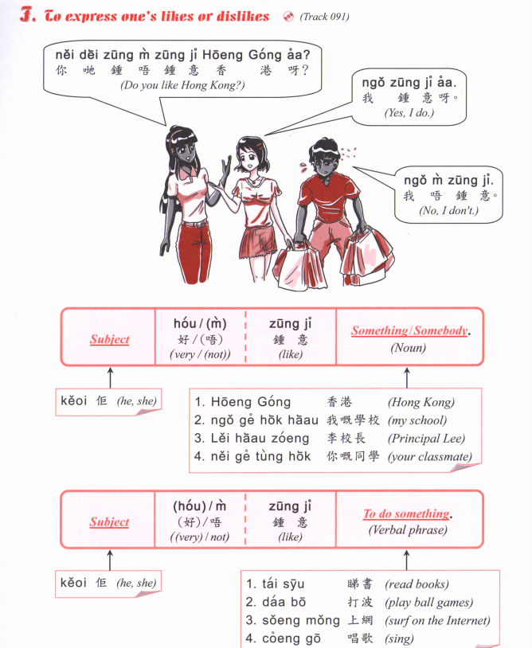

Slide 19
Jau4 seoi2
游水
swimming
Zou6 gym
做gym
Go to the gym
Gin6 san1
健身
Go to the gym
Zyu2 je5 sik6
煮嘢食
Cooking
Haang4 saan1
行山
Hiking
Caai2 daan1 ce1
踩單車
Cycling
Teng1 jam1 ngok6
聽音樂
Listen to music
A: Nei5 zung1 m4 zung1 ji3 XXXX aa3?
B: Ngo5 (hou2) zung1 ji3 XXXXX
OR
Ngo5 (hou2) m4 zung1 ji3 XXXX

Slide 20
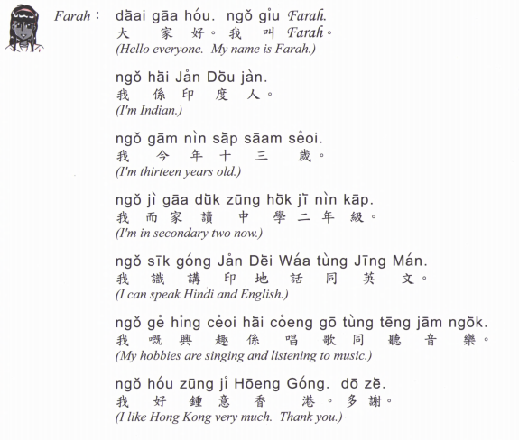

Slide 21
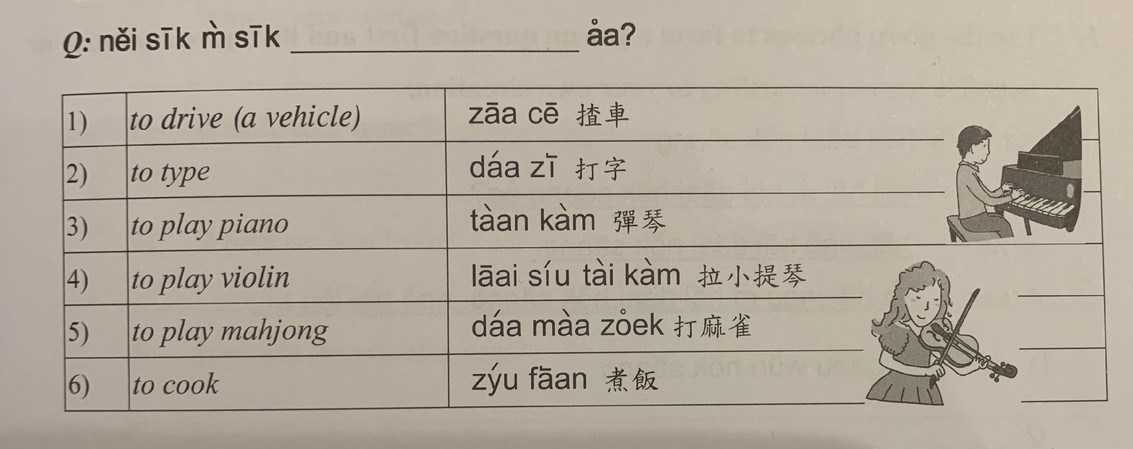
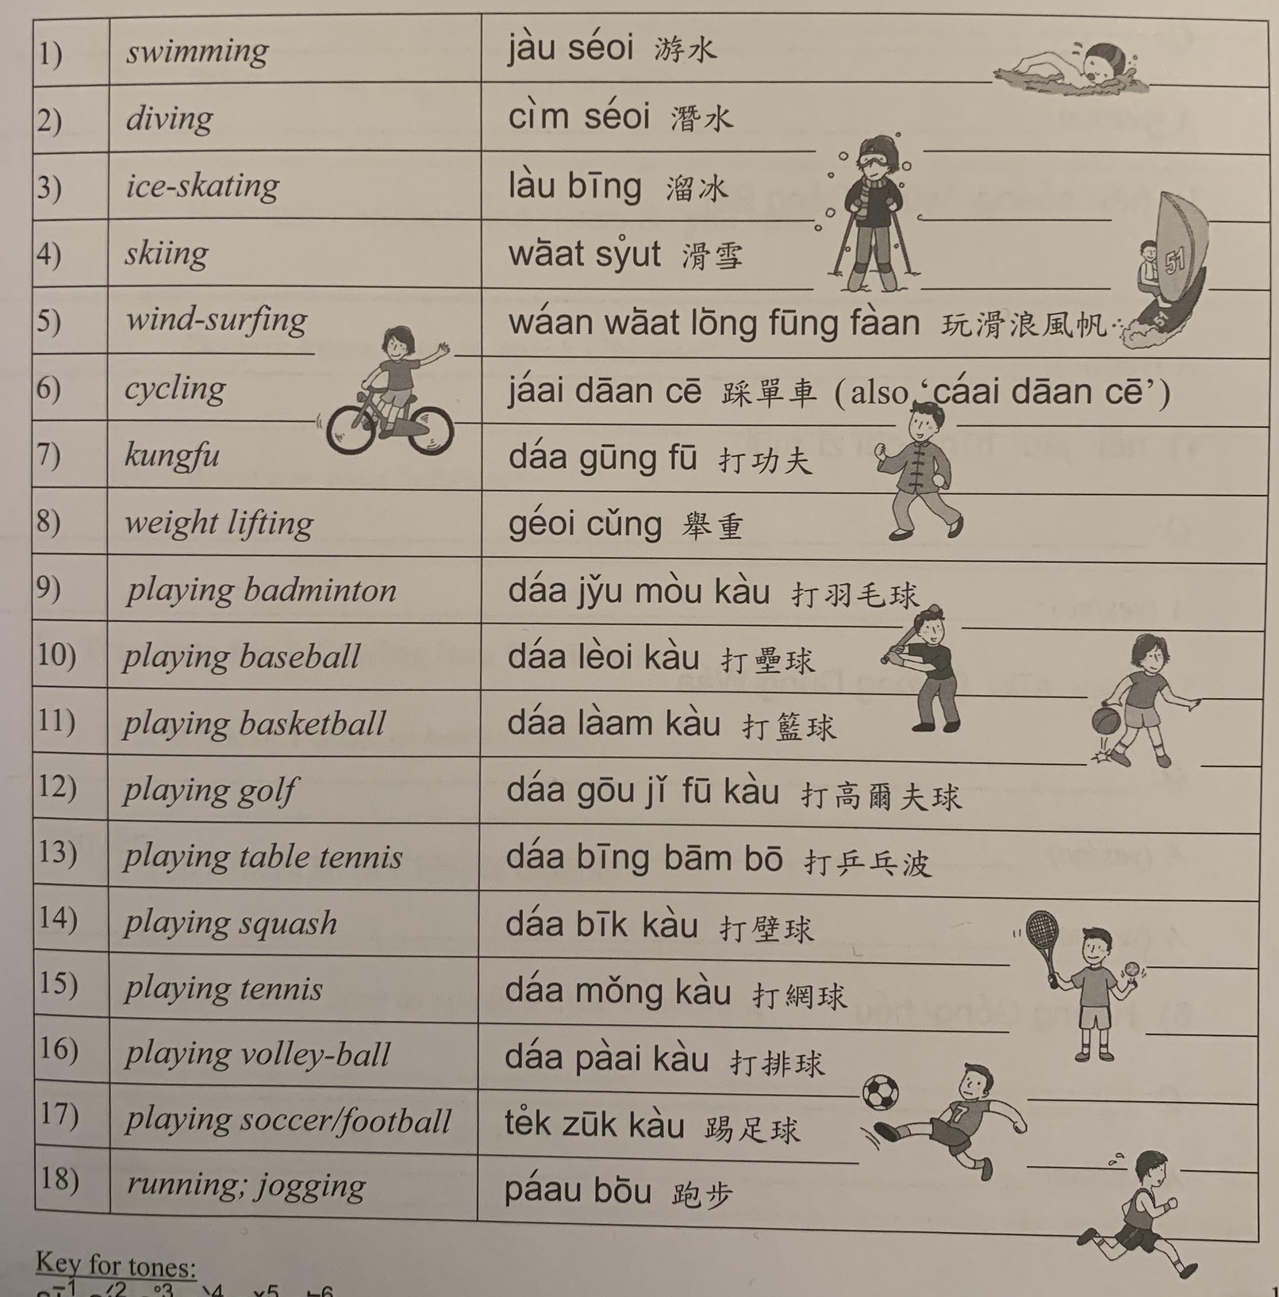

Slide 22
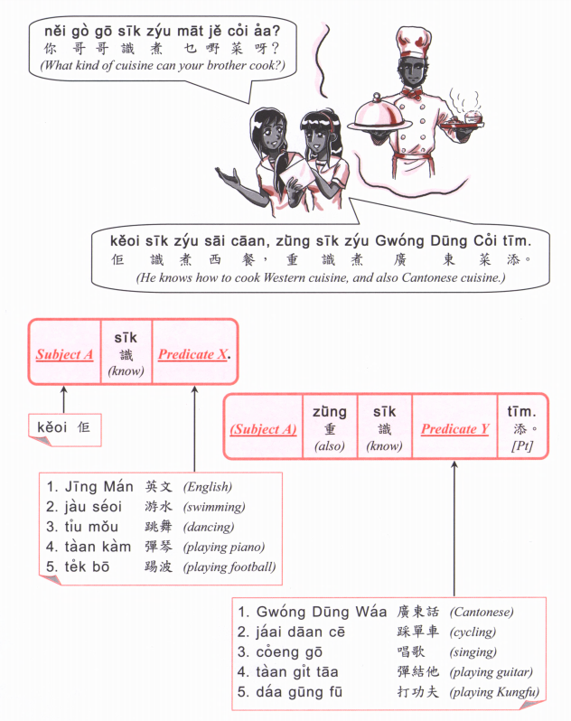

Slide 23
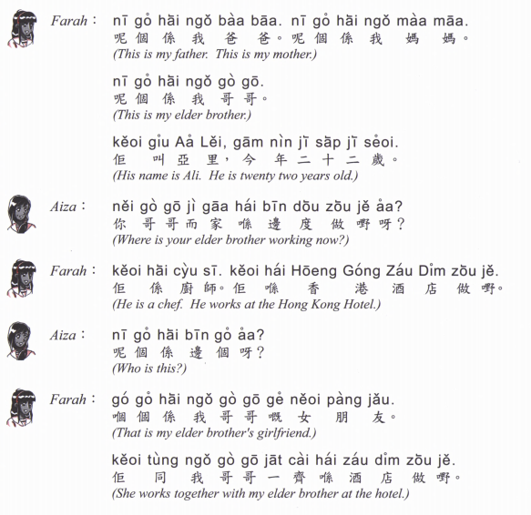
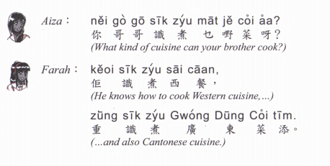

Slide 24
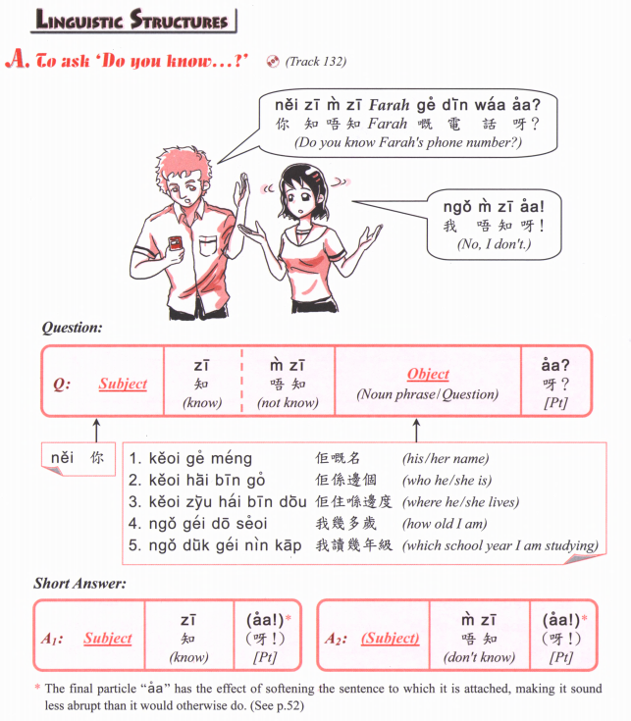

Slide 25
鍾意 | To like | zung1 ji3 | m4 zung1 ji3
識 | To know (a skill, a person | sik1 | m4 sik1
知 | To know (information, news) | zi1 | m4 zi1
去 | To go | heoi3 | m4 heoi3
有 | To have | jau5 | Mou5 (冇)
要 | To want | jiu3 | M4 jiu3
講 | To speak | gong2 | M4 gong2
做 | To do | zou6 | M4 zou6

Slide 26
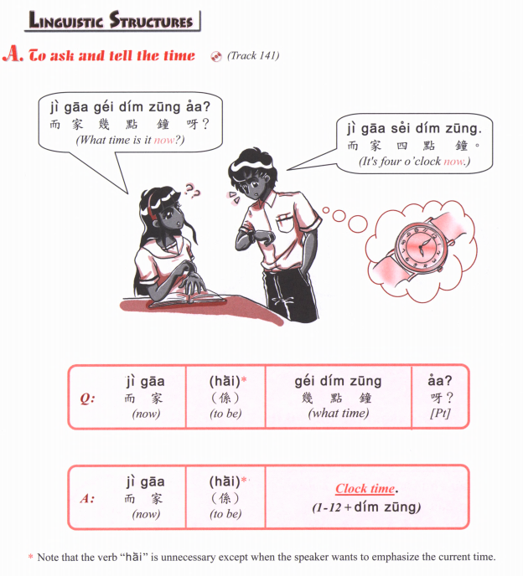

Slide 27
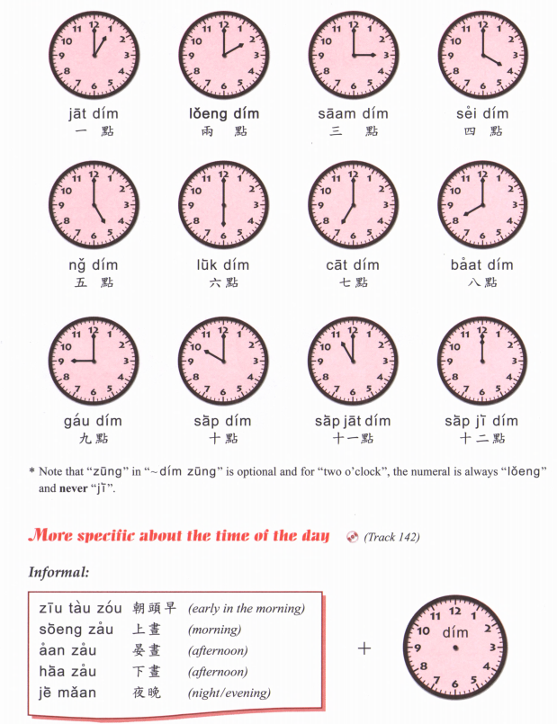

Slide 28
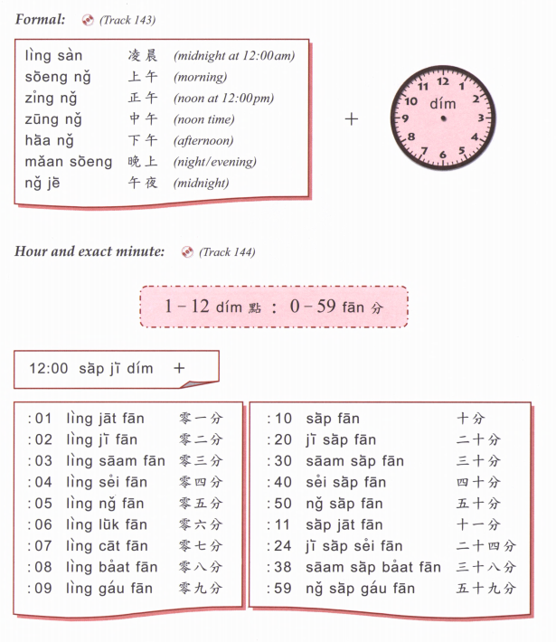

Slide 29
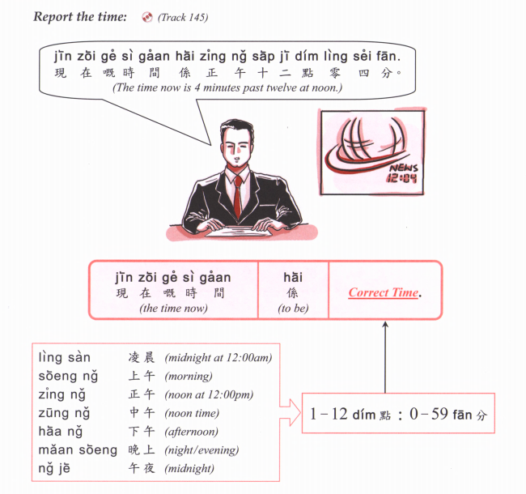

Slide 30
Zou2 caan1 | 早餐 | Breakfast
Zung1 ng5 faan6 | 中午飯 | Lunch
Haa6 ng5 caa4 | 下午茶 | Afternoon tea
Maan5 faan6 | 晚飯 | Dinner
sik6
食
To eat

Slide 31
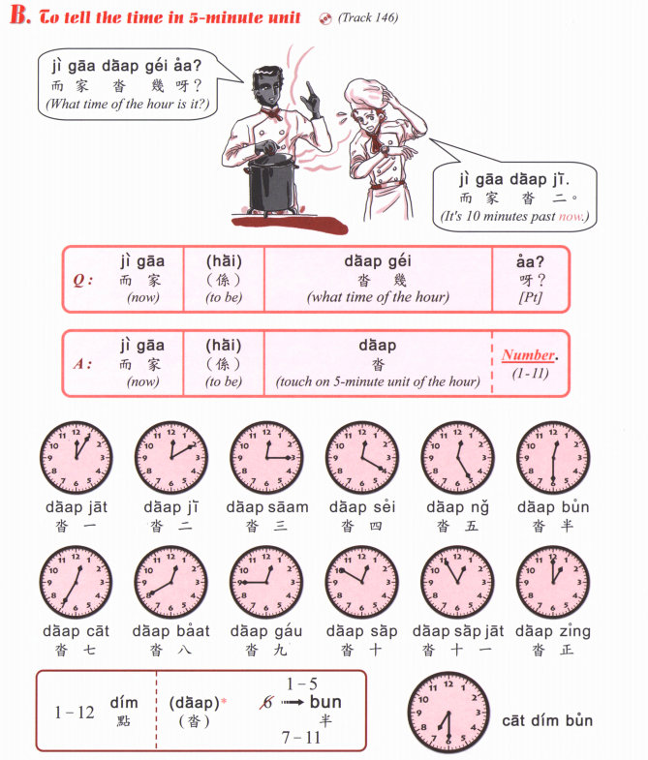

Slide 32
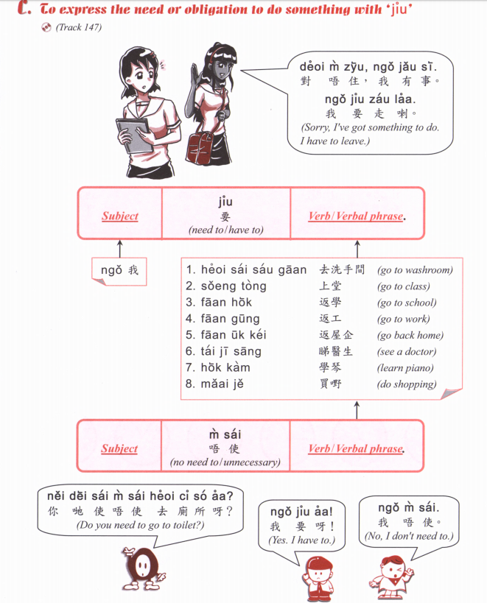
Notes:
teach till here week 8.

Slide 33
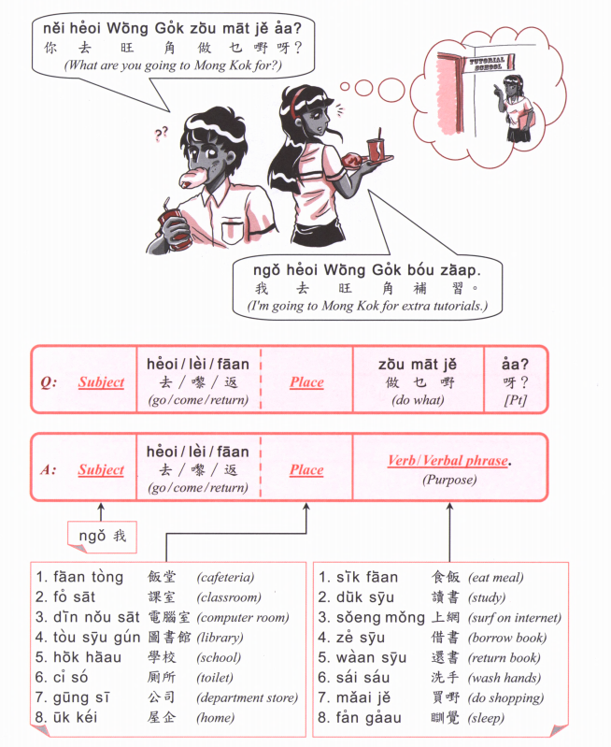

Slide 34
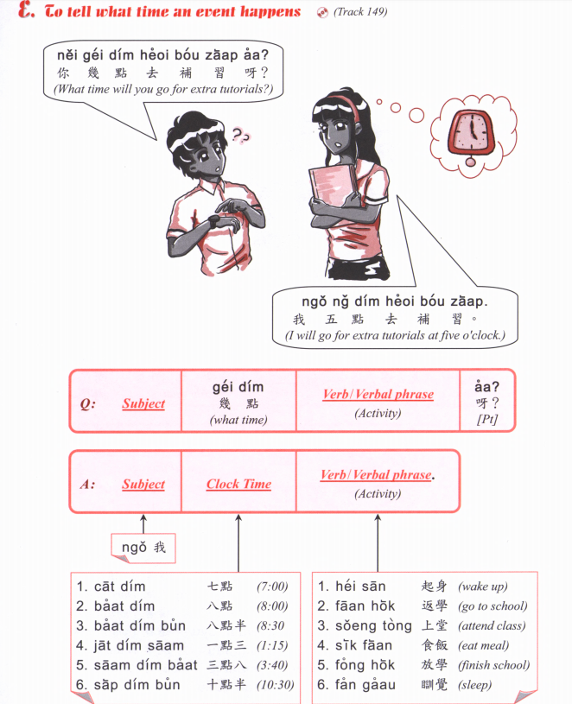

Slide 35
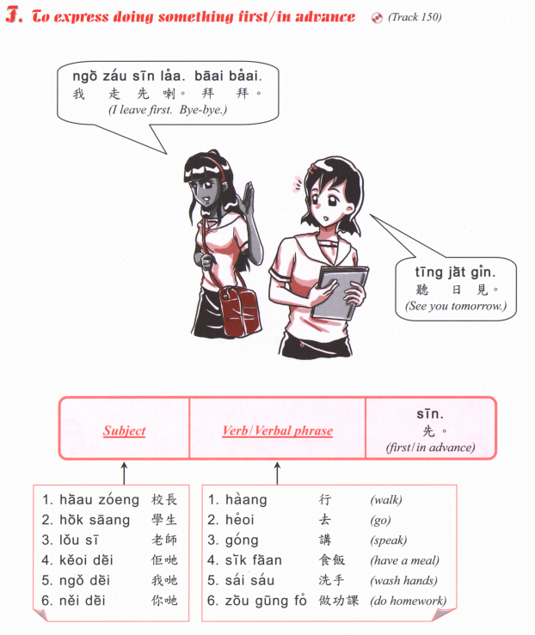

Slide 36
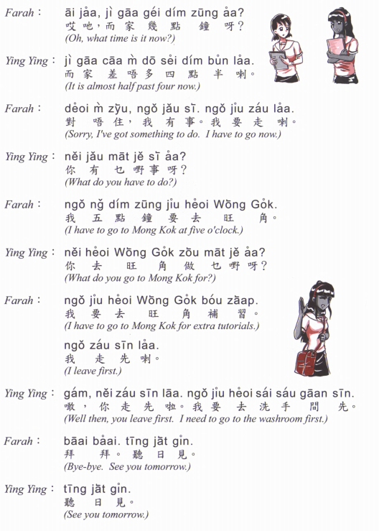

Slide 37
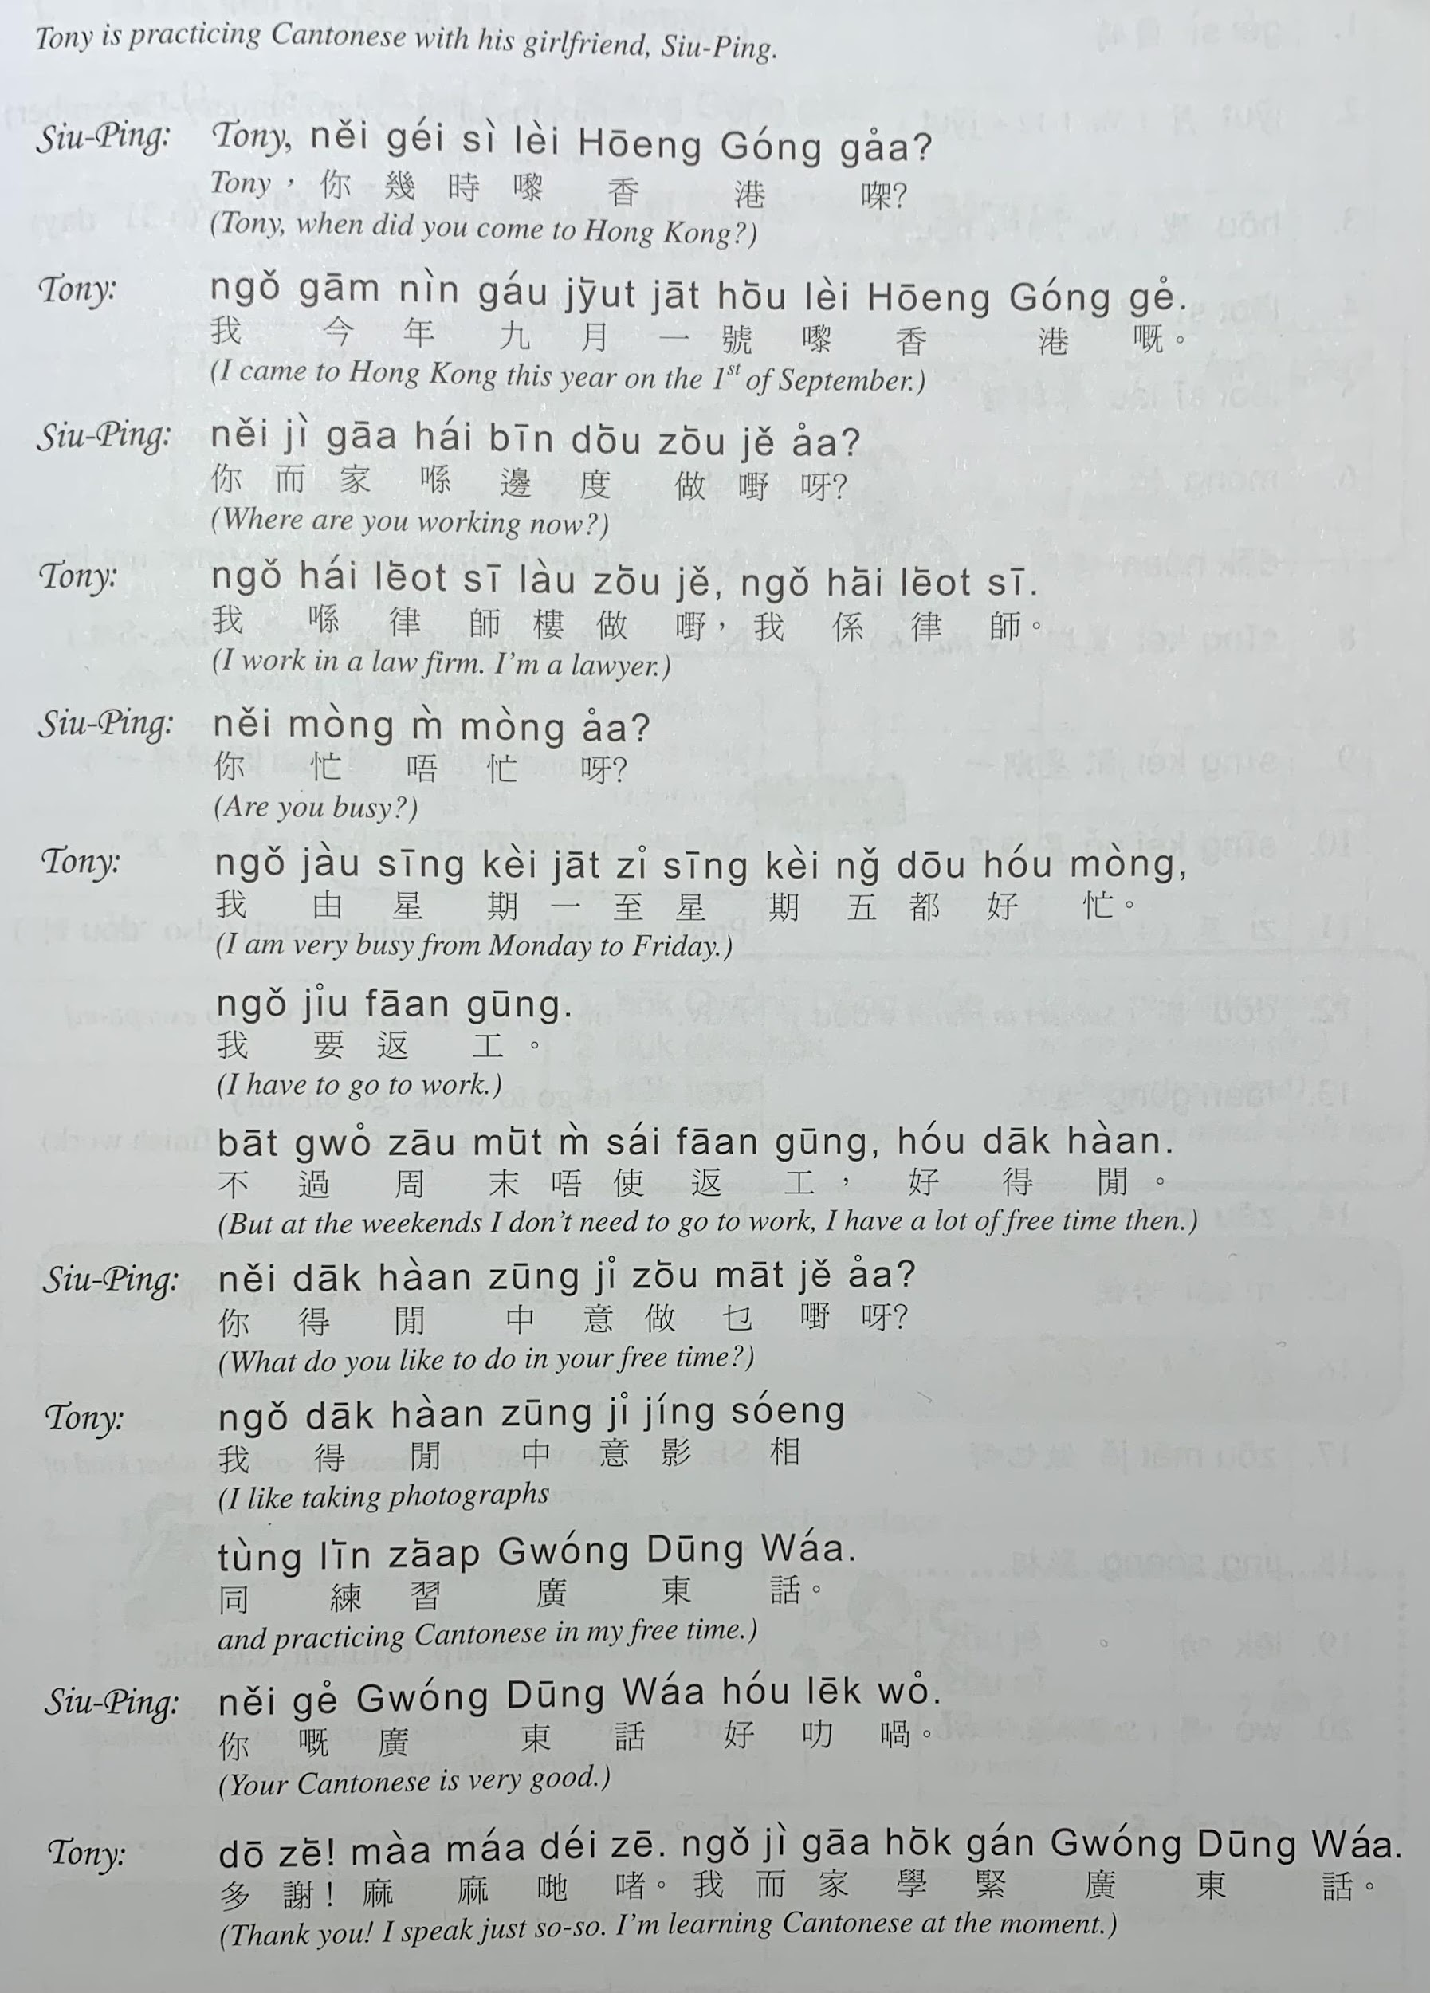

Slide 38
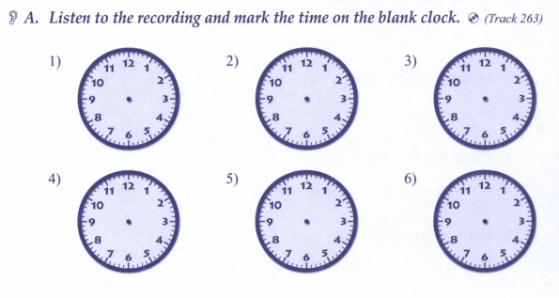

Slide 39
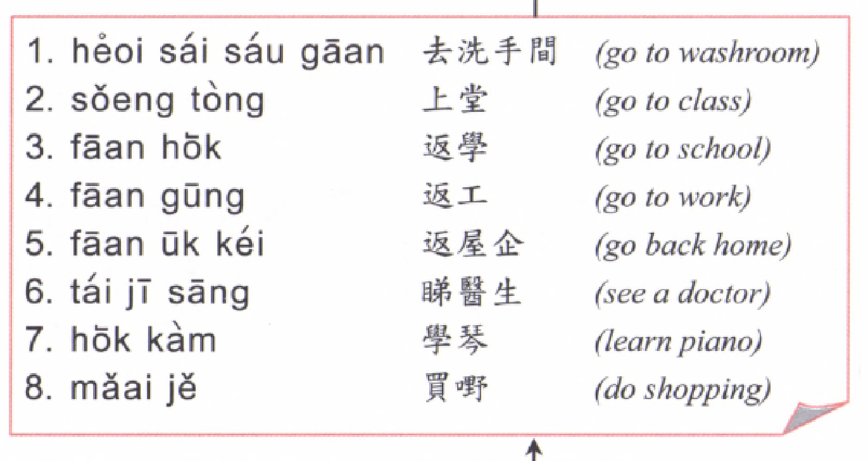
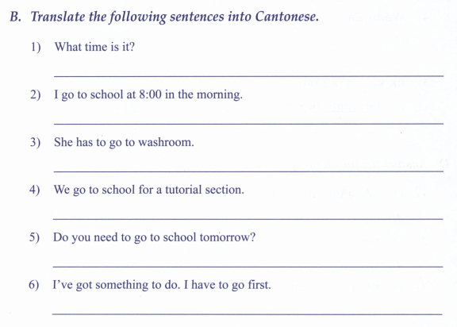

Slide 40
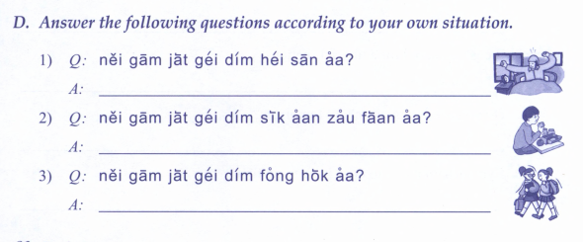
4) What time do you sleep?
5) What time do you go to school?
6) What time do you have dinner?
7) What time do you have breakfast?

Slide 41
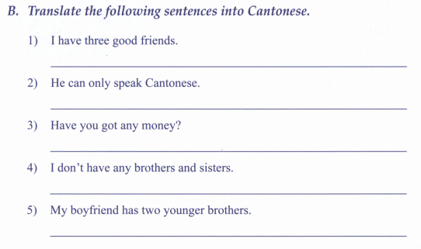
I like to ride bicycle.
My hobby is listening to music.
I go home at 8pm

Slide 42
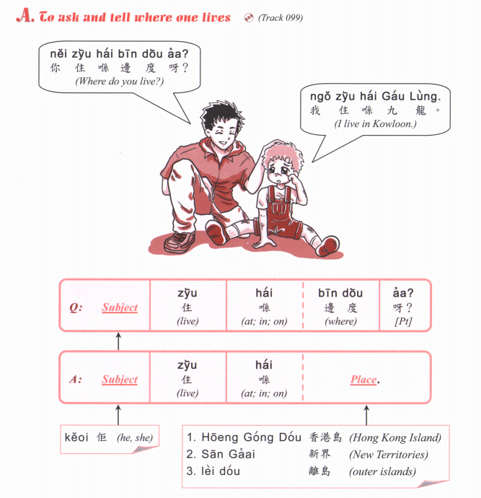
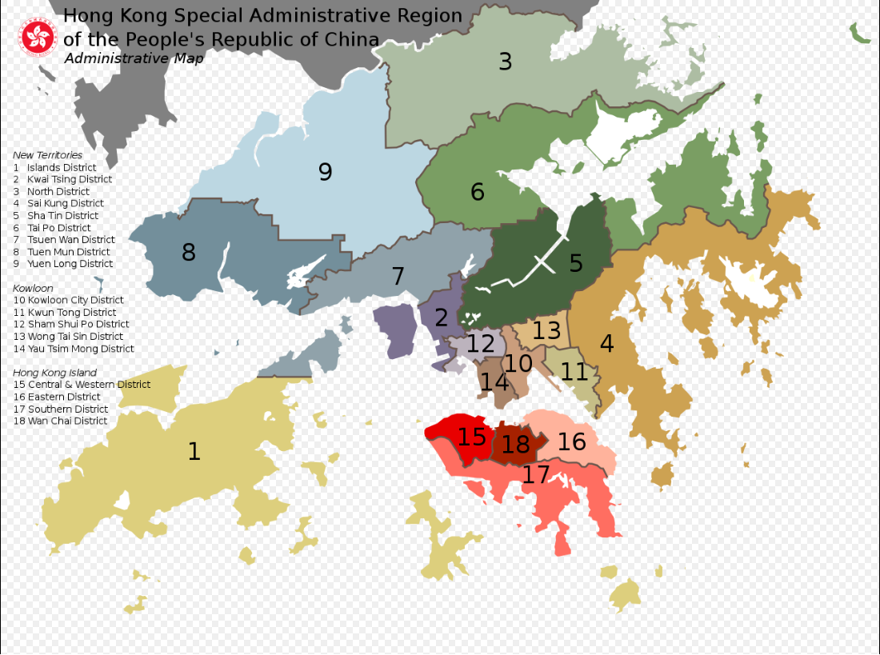

Slide 43
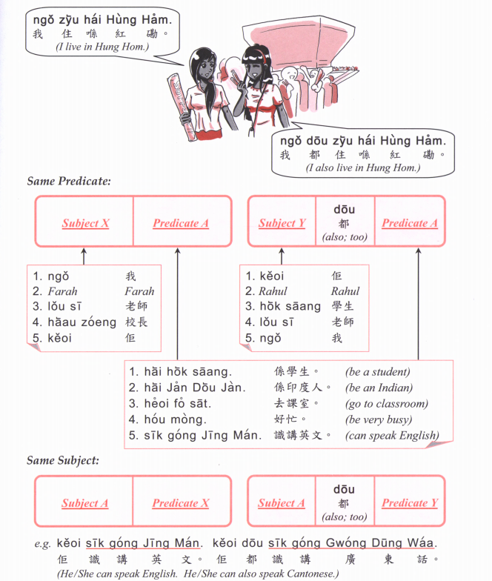

Slide 44
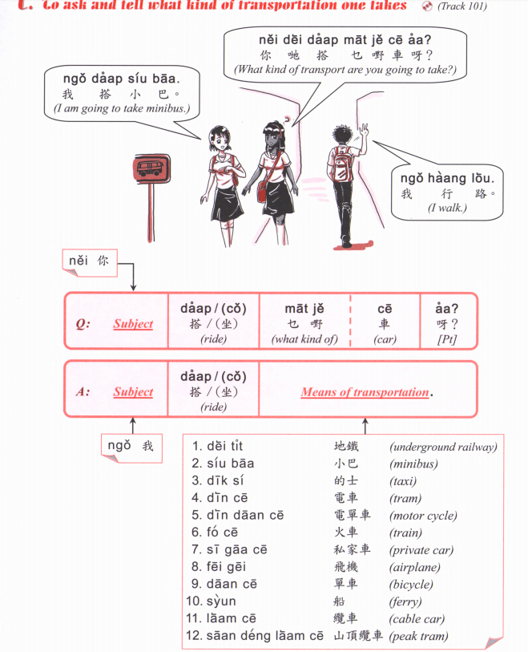

Slide 45
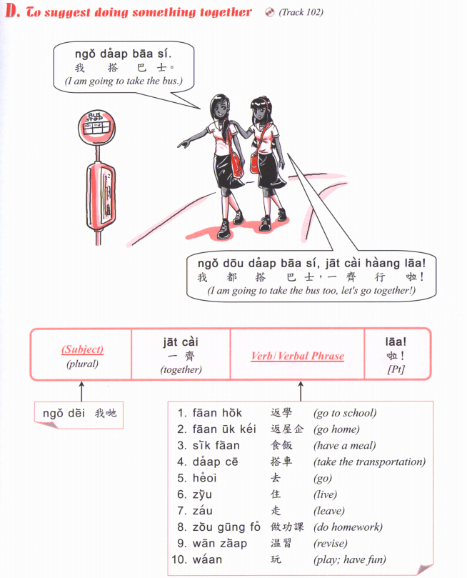

Slide 46
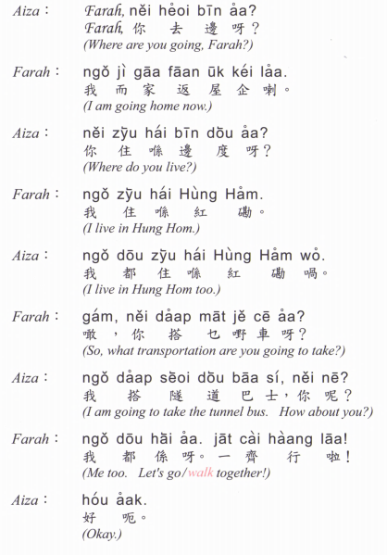

Slide 47
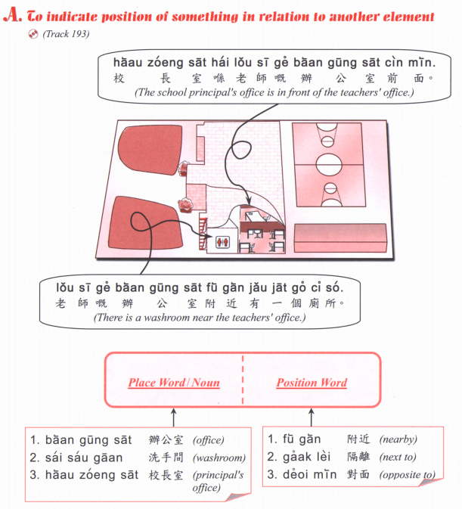

Slide 48
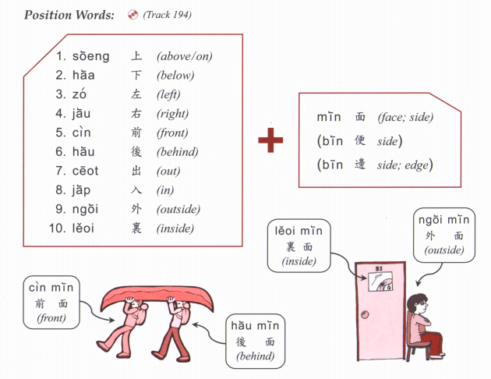

Slide 49
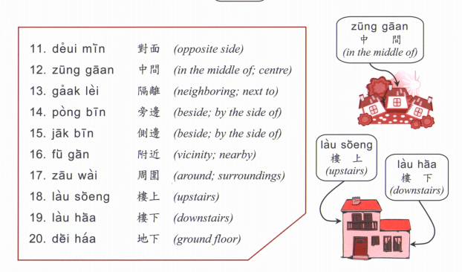

Slide 50
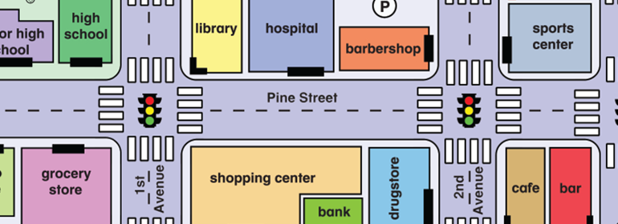
Where is (place)? (Place) + hai2 bin1 dou6 aa3? 喺邊度呀？
Hok6 haau6
Tou4 syu1 gun2
Ting4 ce1 coeng4
wan6 dung6 coeng4
Yi1 jyun2
Fei1 faat3 pou3
Soeng1 coeng4
Zau2 baa1
Ciu1 kap1 si5 coeng4
ngan4 hong4
Joek6 fong4
Caan1 teng1
Answer： (Place) hai2 (Place B) (position word)

Slide 51
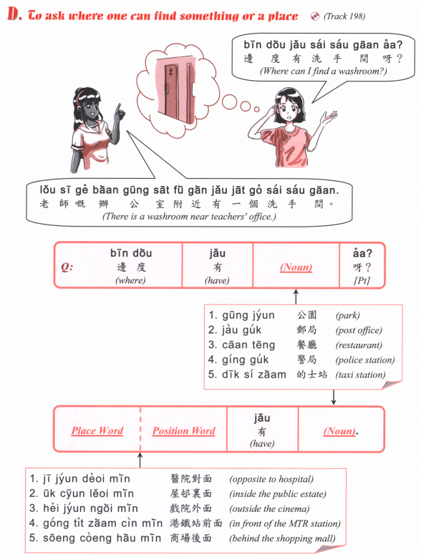

Slide 52
Hok6 haau6
Tou4 syu1 gun2
Ting4 ce1 coeng4
wan6 dung6 coeng4
Yi1 jyun2
Fei1 faat3 pou3
Soeng1 coeng4
Zau2 baa1
Ciu1 kap1 si5 coeng4
ngan4 hong4
Joek6 fong4
Caan1 teng1

Slide 53
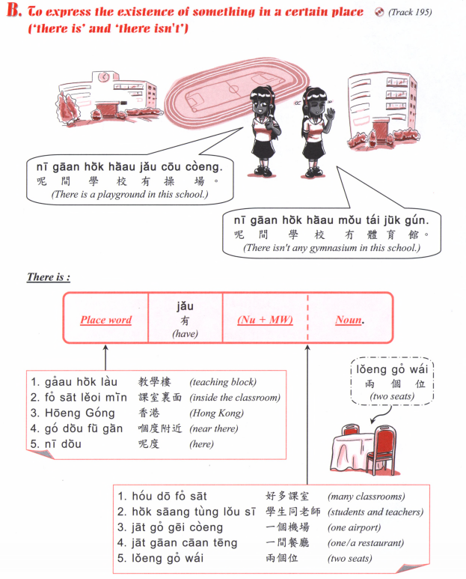

Slide 54
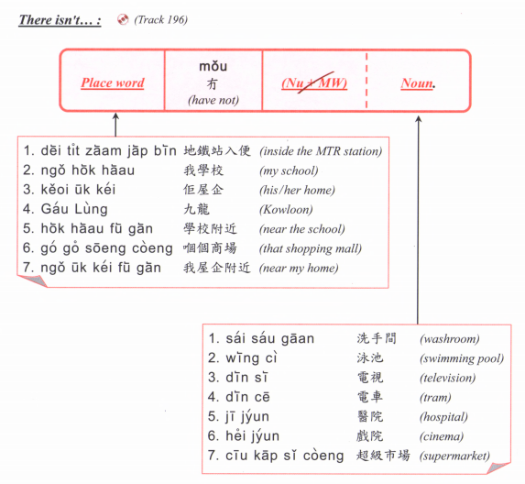

Slide 55
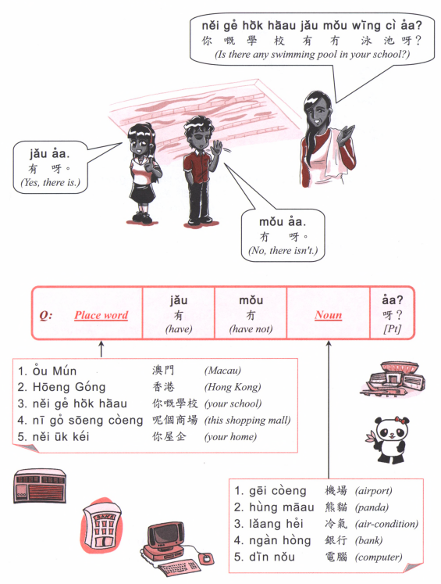

Slide 56
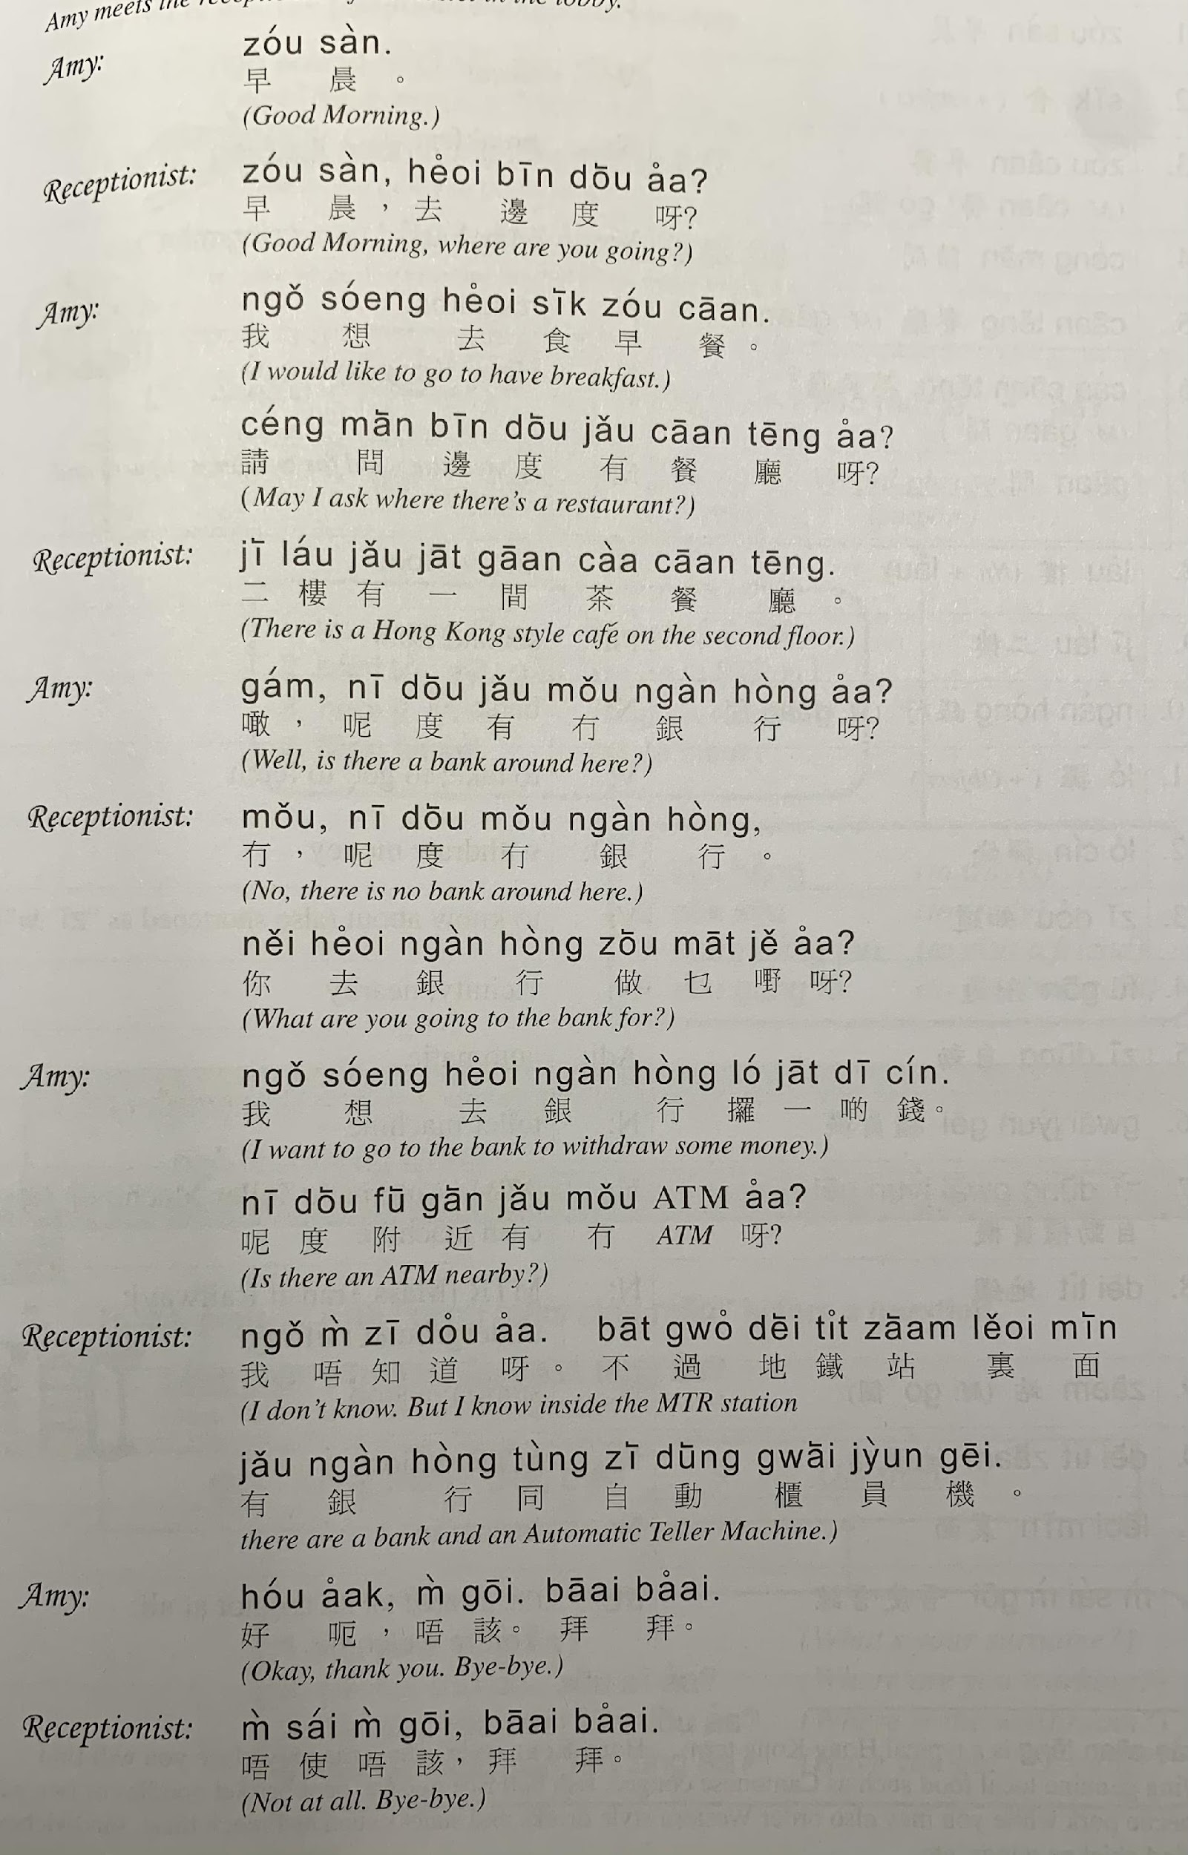

Slide 57
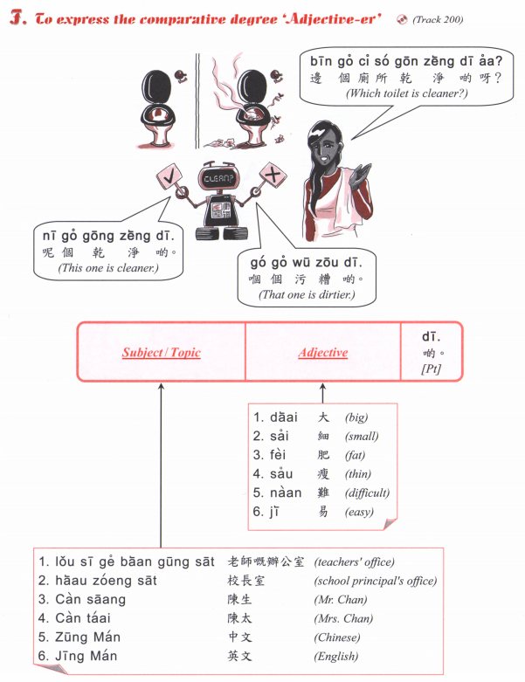

Slide 58


Slide 59
邊個 | Who | Bin1 go6
咩 / 乜嘢 | what | Me1 / Mat1 je5
邊度 | Where | Bin1 dou6
幾多 | How many/ much | Gei2 do1

Slide 60
鍾意 | To like | zung1 ji3 | m4 zung1 ji3
識 | To know (a skill, a person | sik1 | m4 sik1
知 | To know (information, news) | zi1 | m4 zi1
去 | To go | heoi3 | m4 heoi3
有 | To have | jau5 | Mou5 (冇)
要 | To want (something)/have to | jiu3 | M4 jiu3
講 | To speak | gong2 | M4 gong2
做 | To do | zou6 | M4 zou6
想 | To want (to do something) / wish/desire | soeng2 | M4 soeng2

Slide 61


Slide 62

Chinese Studies
中文研究
zung1 man4 jin4 gau3

Slide 63


Slide 64


Slide 65


Slide 66


Slide 67


Slide 68



Slide 69


Slide 70



Slide 71


Slide 72
邊個 | Who | Bin1 go6
咩 / 乜嘢 | what | Me1 / Mat1 je5
邊度 | Where | Bin1 dou6
幾多 | How many/ much | Gei2 do1
幾時 | When | Gei2 si4
點解 | Why | dim2 gaai2
因為 | Because | jan1 wai6
鍾意 | To like | zung1 ji3 | m4 zung1 ji3
識 | To know (a skill, a person | sik1 | m4 sik1
知 | To know (information, news) | zi1 | m4 zi1
明白 /明 | To understand | ming5 baak6 / ming5 | M4 ming5 baak6 / M4 ming5
去 | To go | heoi3 | m4 heoi3
有 | To have | jau5 | Mou5 (冇)
要 | To want (object) / have to (do something) | jiu3 | M4 jiu3 (for object)/ M4 sai2 (for action)
想 | To want (to do something) | soeng2 | M4 soeng2
講 | To speak | gong2 | M4 gong2
做 | To do | zou6 | M4 zou6
覺得 | To think (feeling/opinion) | Gok3 dak1 | M4 gok3 dak1
溫習 | To revise | Wan1 zaap6 | M4 wan1 zaap6

Slide 73


Slide 74


Slide 75


Slide 76


Slide 77


Slide 78


Slide 79


Slide 80


Slide 81


Slide 82



Slide 83
Tell us how you spend a typical week
For example:
From Monday to Friday wake up at ….. Go to school from … to …
Finish school at …
After school I go to [some activity] at …
Saturday…
Sunday…

Slide 84


Slide 85


舊年
Gau6 nin2

Slide 86


