Slide 1
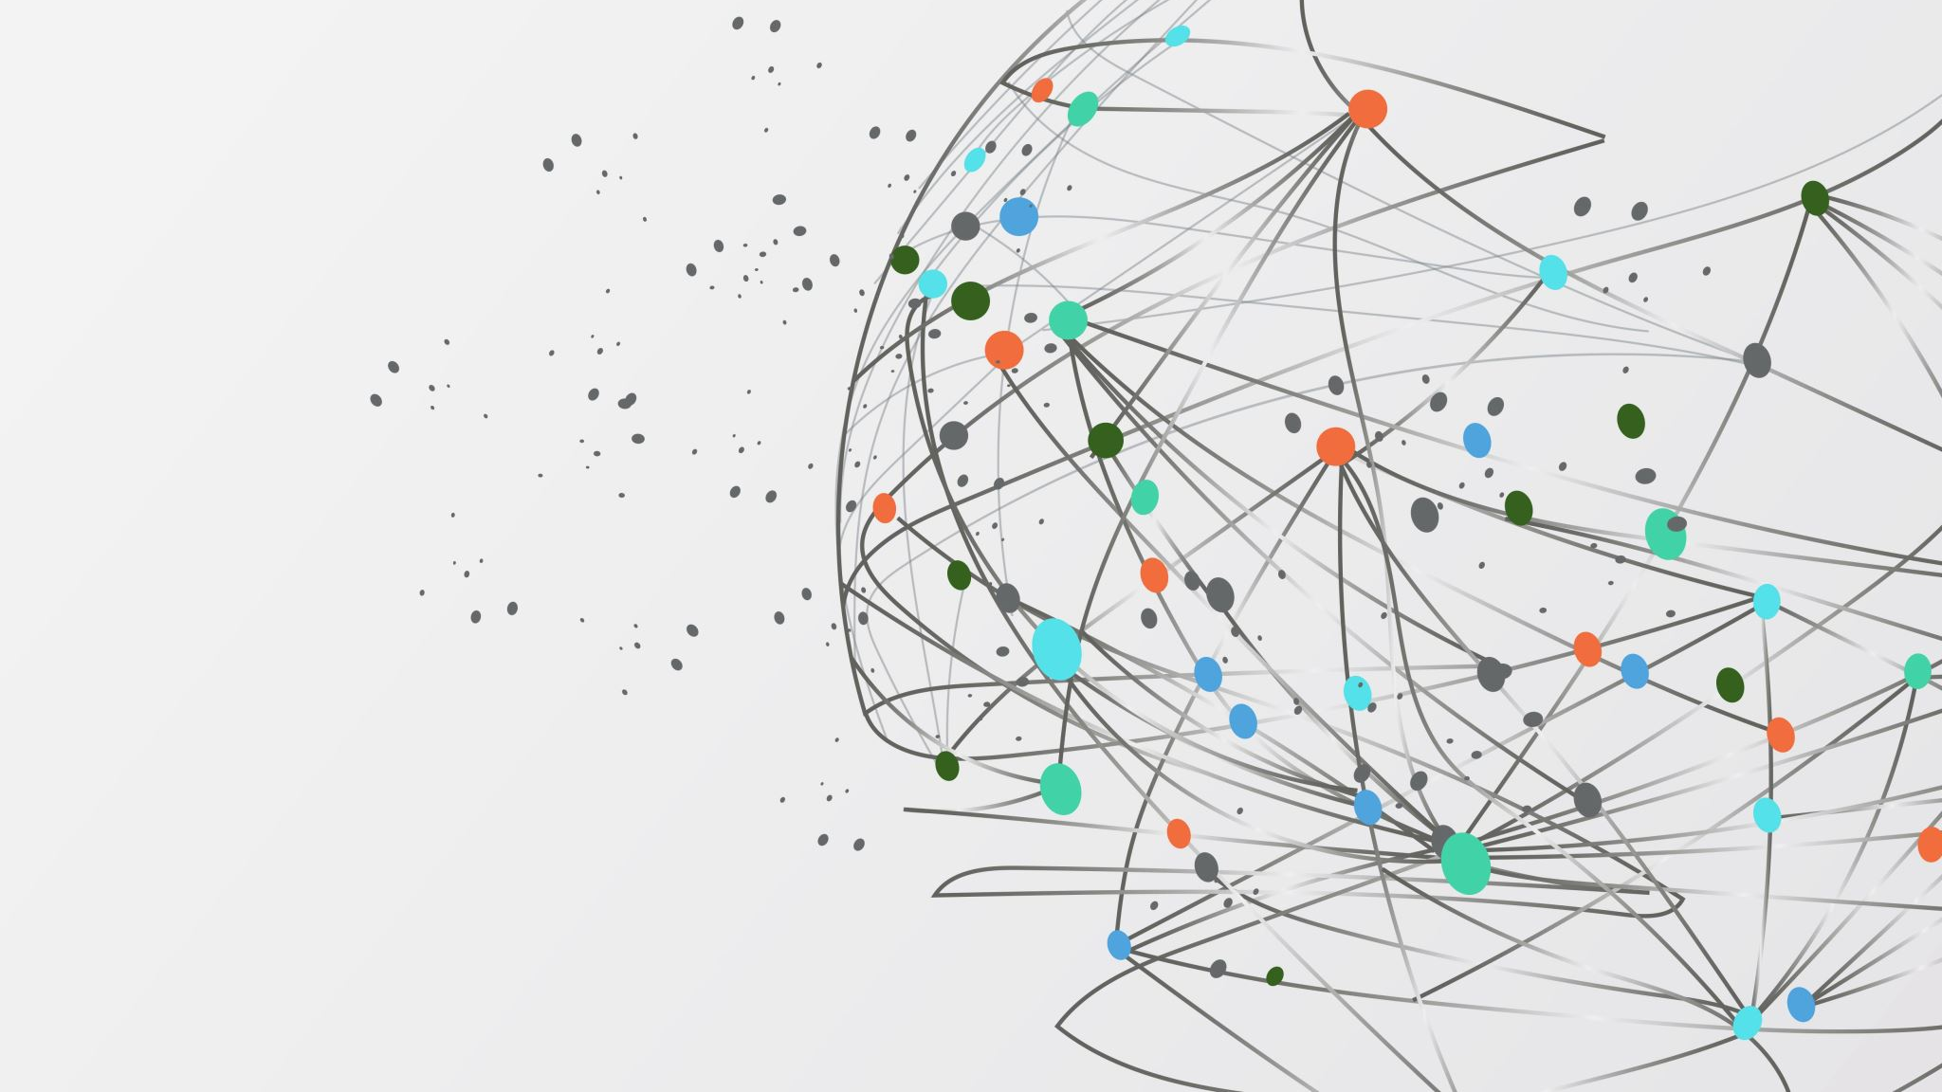
Intercomprehension Between Romance Languages
Based on PanRomanic and EuRom5 Manuals

Slide 2
Index of the presentation
Course Presentation (MED49)
Introduction to the Romance Context

Slide 3
Course Presentation (MED49)

Slide 4
Course Overview
Course Duration:
12 weeks, 1.5 hours per session
Materials:
EuRom5 & PanromanIC manuals
Objective:
To develop the ability to understand multiple Romance languages through comparative study and intercomprehension techniques.

Slide 5
What is Intercomprehension?
Definition:
The ability to understand a language by comparing it with other related languages, often without prior study of the language in question.
Focus:
In this course, the focus is on Romance languages (e.g., Spanish, Portuguese, French, Italian, Romanian).

Slide 6
Why Learn Intercomprehension?
Practical Benefits:
Easier travel and communication in Romance-speaking countries.
Academic and Career Advantages:
Useful for careers in translation, linguistics, and international relations.
Broadened linguistic and cultural understanding.
Opens up access to literature and media in multiple languages.

Slide 7
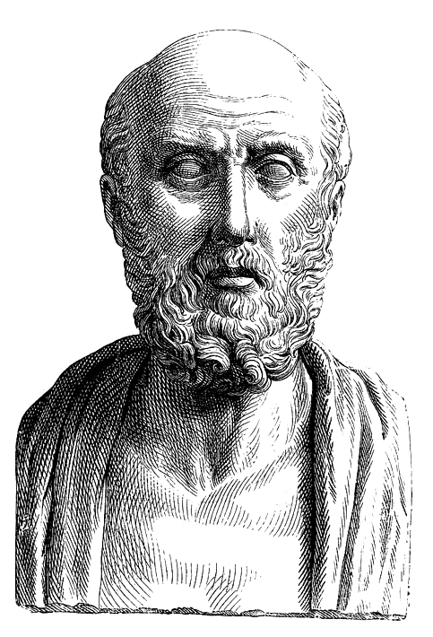
Similia similibus curantur
Coisas semelhantes curam-se com coisas semelhantes (PT)
Lo similar cura lo similar (ES)
Els similars cure els similars (CA)
Les semblables soignent les semblables (FR)
I simili curano i simili (IT)
Asemănările vindecă asemănările (RO)
Podobné se léčí podobným (CZ)
Ἱπποκράτης

Slide 8
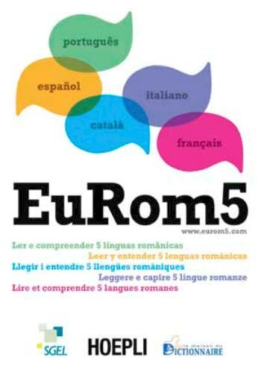
Introduction to EuRom5
Description: EuRom5 is a manual that provides tools for understanding texts in five Romance languages.
Languages Covered: Spanish, Portuguese, French, Italian, Catalan
Key Concepts: seven sections (phonetic, orthographic, lexical, syntactic, morphological, semantic, and pragmatic) as strategies for reading comprehension across languages
Goal: To develop passive reading skills across multiple Romance languages.

Slide 9
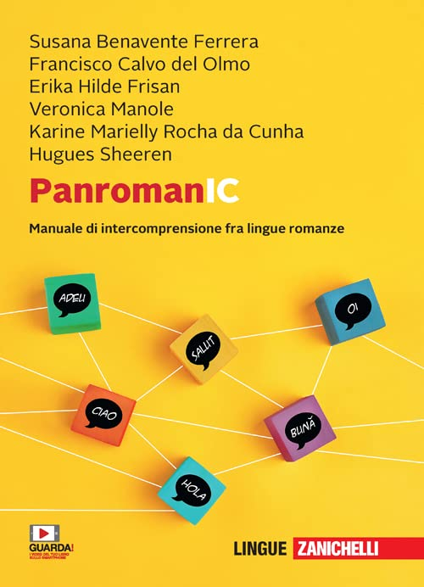
Introduction to PanromanIC
Description: PanromanIC is a manual designed to teach intercomprehension among Romance languages by leveraging their common linguistic roots.
Languages Covered: Spanish, Portuguese, French, Italian, Catalan, and Romanian
Content Focus: Vocabulary similarities, Common grammatical structures ending comprehension techniques.
Methodology: Focus on recognizing and decoding similarities between languages.

Slide 10
Course Outcomes
Skills Developed:
Improved ability to understand and compare Romance languages.
Assessments:
Parodical review of contains and exercises in classroom and at home.
Enhanced reading comprehension across languages.
Familiarity with linguistic similarities and differences.

Slide 11
Introduction to the Romance Context

Slide 12
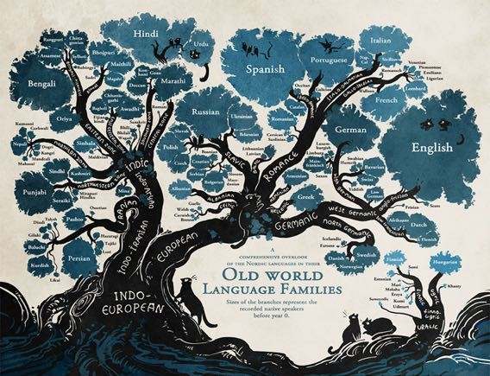

Slide 13
Romània antica
The Romanization zone of Western Europe, i.e. the territories in which Roman civilization was dominant, even for a short period (see Dacia).

Slide 14
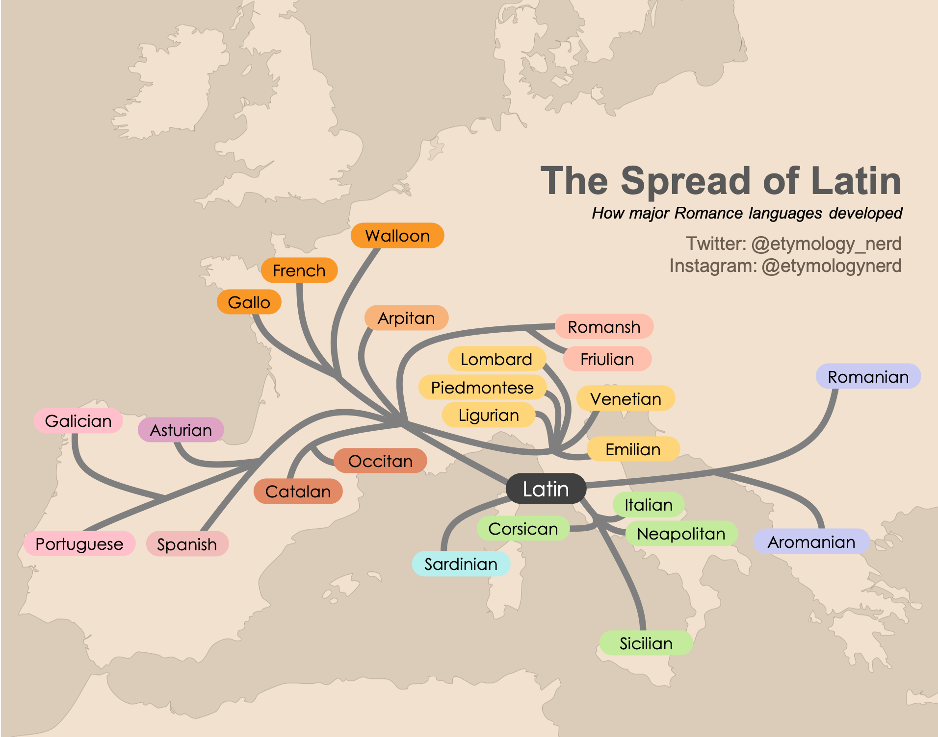

Slide 15
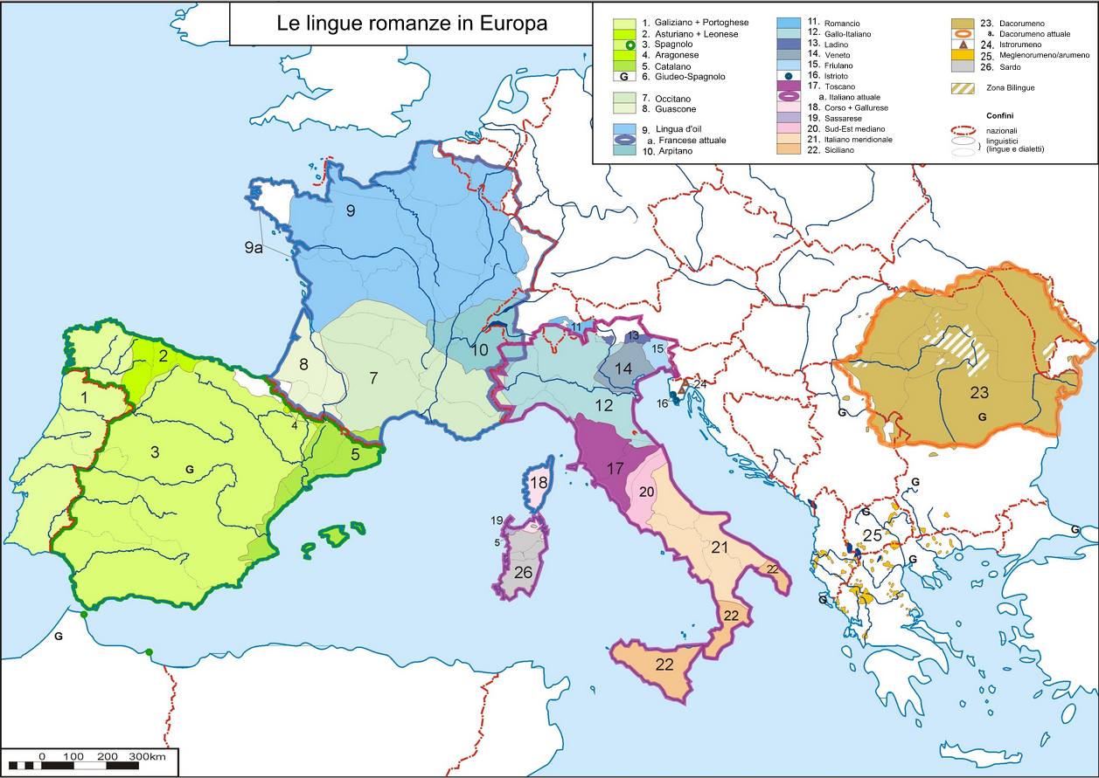

Slide 16
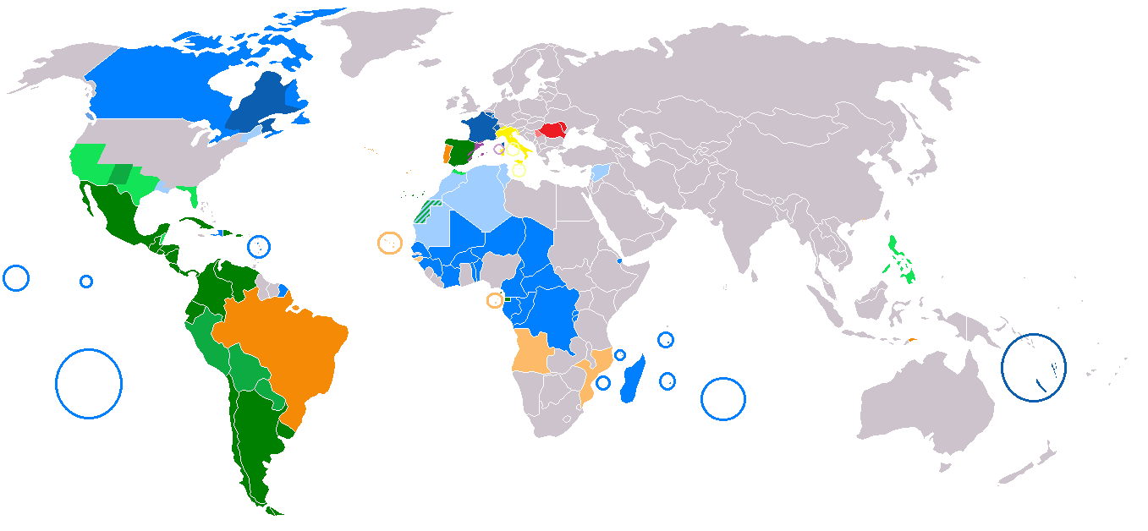
Legenda: Español - Purtuguês - Français - Italiano - Romanesc (dark color indicates that the language is official; light color indicates that the language is in common or administrative use).

Slide 17
Phylogeny of the Romance languages
Indo-European*
Italian languages
Latino-Faliscan languages
Latin
Romance languages
Español, Purtuguês, Français, Italiano, Catalá, Romanesc, etc.
* = reconstructed language

Slide 18
Main Romance Areas
Ibero-romance:
Español, Purtuguês, Catalá, Galego
Gallo-romance:
Français, Occitanic
Italo-romance:
Italiano, Romancio
Eastern romance:
Romanesc

Slide 19
Some comparisons
Italiano | Français | Occitanic | Español | Purtuguês | Catalá | Latin
padre | père | paire | padre | pai | pare | < pătrĕm
madre | mère | maire | madre | mãe | mare | < mātrěm
famiglia | famille | familha | familia | família | família | < fămĭlĭam
pane | pain | pan | pan | pão | pa | < pānĕm
acqua | eau | aiga | agua | água | aigua | < ăquăm
re | roi | rei | rey | rei | rei | < rĕgĕm
terra | terre | tèrra | tierra | terra | terra | < tĕrrăm

Slide 20
Appendix Probi (about 5th century D.C.)
speculum non speclum
vetulus non veclus
columna non colomna
frigida non fricda
turma non torma
solea non solia
auris non oricla
oculus non oclus
vinea non vinia
viridis non virdis

Slide 21
Appendix Probi (about 5th century D.C.)
speculum non speclum
vetulus non veclus
columna non colomna
frigida non fricda
turma non torma
solea non solia
auris non oricla
oculus non oclus
vinea non vinia
viridis non virdis

Slide 22
Latin > romance laguages
SPECULUM > speclum > speclu > speclo > it. specchio; sp. espejo; por. espelho
VETULUS > vectus > veclu > it. vecchio; sp. viejo; por. velho
COLUMNA > colomna > it. colonna; sp. columna; por. coluna
AURICOLA > auricla > oricla > it. ant. orecchia; sp. oreja; por. orelha
OCULUS > oclus > oclo > it. occhio; sp. ojo; por. olho
VIRIDIS > virdis > virdi > it. verde; sp. verde; por. verde

Slide 23
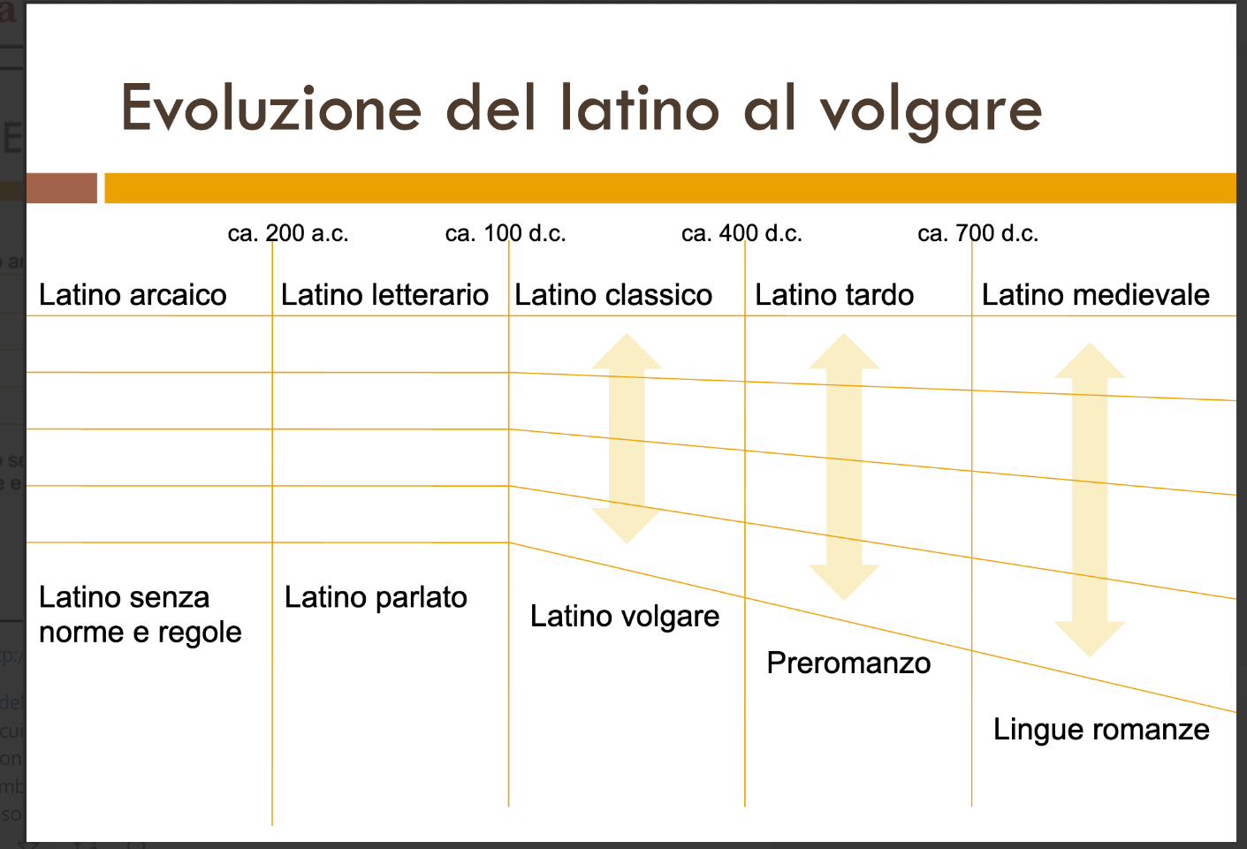

Slide 24
From Latin to the Romance Languages
Archaic Latin
Vulgar Latin
Classic Latin
Romance Languages: Español, Purtuguês, Français, Italiano, Catalá, Romanesc, etc.

Slide 25
A long journey
The Romance languages ​​derive from Vulgar Latin, which is the Latin spoken by most of the European population dominated by the Roman Empire.
Over the centuries, the pre-Roman languages ​​spoken in those areas transformed popular Latin, triggering various phenomena.
Literary Latin, however, will continue to be the language of culture and the common vehicle with which intellectuals of every territory could communicate for centuries.
Undergoing increasingly profound modifications (of a phonetic, morphosyntactic and semantic nature), at a certain moment (around the 7th century) the Romance languages ​​became totally distinct from Latin.

Slide 26
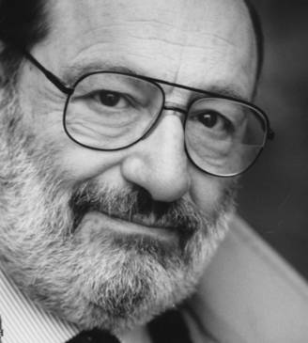
«Una Europa di poliglotti non è un’Europa di persone che parlano correntemente molte lingue, ma nel migliore dei casi di persone che possono incontrarsi parlando ciascuno la propria lingua e intendendo quella dell’altro».
Umberto Eco, La ricerca della lingua perfetta nella cultura europea (1993).

Slide 27
Grazie, Merci, Gracias, Obrigado, Gràcies, Multumesc

Slide 28
Essential bibliography / the Manuals
Elisabetta Bonvino, Sandrine Caddeo, Eulalia Vilagines Serra, Salvador pippa, EuRom5. Leggere e capire 5 lingue romanze (português, español, italiano, català, français), Milano, Hoepli, 2011. http://www.eurom5.com/
Susana Benavente Ferrera, Francisco Calvo del Olmo, Erika Hilde Frisan Veronica Manole, Karine Marielly Rocha da Cunha, Hugues Sheeren, PanromanIC – Manuale di intercomprensione tra lingue romanze, Bologna, Zanichelli, 2022. https://online.universita.zanichelli.it/panromanic/

Slide 29
Essential Bibliography / the Studies
Corina Gabriela Bădeliță, L’intercomprensione – una possibile svolta comunicativa in ambito romanzo, in «Quaestiones Romanicae IV», 2015, pp. 274-282. Online: https://ciccre.uvt.ro/pt-pt/node/824
Marcello Belotti, Plurilinguismo e intercomprensione: un’analisi dei materiali di EuRom5 (attraverso il framework di Littlejohn), in «Italiano LinguaDue», n. 2 (2014), 131-172. Online: https://doi.org/10.13130/2037-3597/4695
Elisabetta Bonvino & Marie-Christine Jamet (Eds.), Intercomprensione: lingue, processi e percorsi, Venezia, Edizioni Ca’ Foscari – Digital Publishing, 2016. Online: https://edizionicafoscari.unive.it/it/edizioni/libri/978-88-6969-135-5/
Maddalena De Carlo, L’intercomprensione nell’insegnamento linguistico e nella formazione degli insegnanti, in Novas tendências no ensino/aprendizagem de línguas românicas e na formação de professores, Olga Alejandra Mordente & Roberta Ferroni (Eds.), São Paulo, Humanitas, 2014, pp. 189-229.
Maddalena De Carlo (Ed.), Intercomprensione e educazione al plurilinguismo, Porto Sant’Elpidio (FM), Wizarts editore, 2011.
Monica Palmerini & Serena Faone, Sul cammino verso l’intercomprensione. Una riflessione epistemologica, in «REDINTER-Intercompreensão», 1, Chamusca, Edições Cosmos / REDINTER, 2010, pp. 187-222.
Maria Helena Araújo e Sá e Ana Sofia Pinho (Eds), Intercompreensão em contexto educativo: resultados da investigação, Aveiro, UA Editora - Universidade de Aveiro, 2015. Online: https://www.miriadi.net/sites/default/files/livro-book_miriadi_-_v.01-08_-_final.pdf

