Slide 1
TRICLOSAN :
environmental exposure,
toxicity and mechanisms of action
Journal of Applied Toxicology 31: 285-311, 2011
Dann and Hontela
Innovation Lectures (INNOLEC)
Masaryk University, May 2012

Slide 2
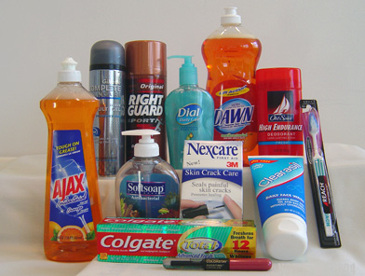
Triclosan – identity, use
Broad spectrum antimicrobial
personal care products – Irgasan, Aquasept,
Sapoderm, …
EU Cosmetic Directive
(0.1-0.3%)
sport clothing –
Ultra-Fresh,
Microban,
Sanitized, …
food packaging Economy – Life style

Slide 3
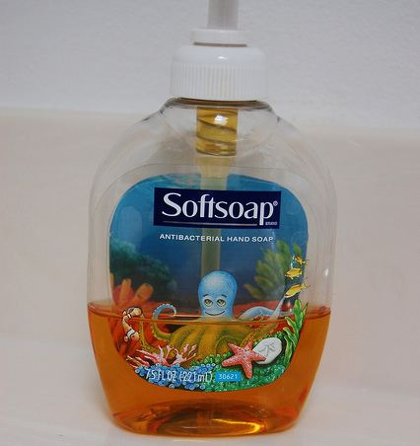
Triclosan – key issues
Detected in surface water,
human plasma, breastmilk
Bioaccumulation
By-product formation
Endocrine disruption
  Thyroid hormones
  Sex hormones
Antibiotic resistance, efficacy

Slide 4
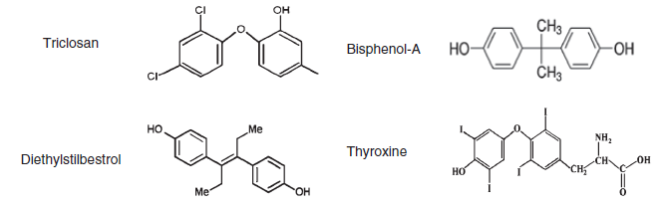
1. Identity and mode of action
Antimicrobial action of TCS
multiple sites in bacteria,
blocks synthesis of FFA
Structural similarity of TCS to Bisphenol A,
to DES
to thyroxine

Slide 5
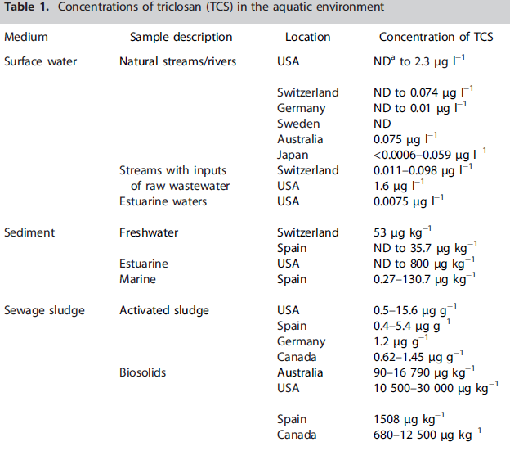
2. Exposure
link to experimental studies

Slide 6
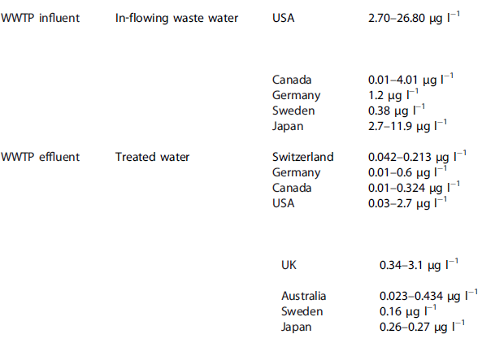
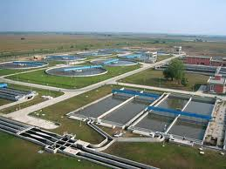
WWTP – Waste Water Treatment Plant

Slide 7
3. Degradation products of TCS
Methyltriclosan
biological methylation, K_{ow} = 5.2
(TCS K_{ow} = 4.7)
used as marker of exposure to WWTP effluent
more persistent than TCS
Dioxins
generated during photodegradation of TCS
at pH > 8
Chloroform and chlorophenols
generated in presence of chlorine or chloramine
Environmental chemistry, Environmental fate

Slide 8
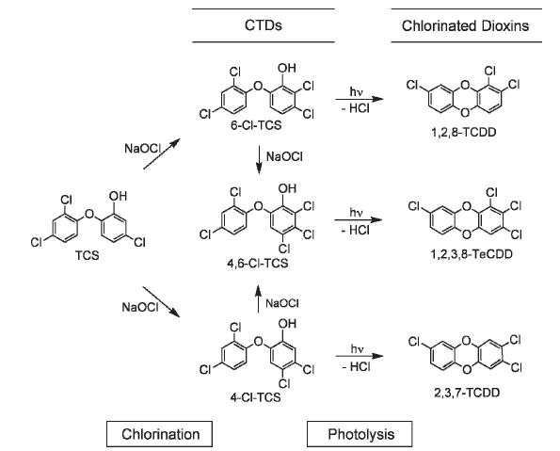
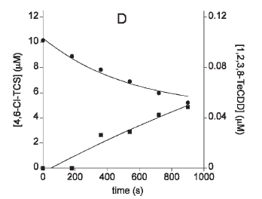
Buth et al. 2009 Environ Toxicology Chem 28: 2555-2563, 2009

Slide 9
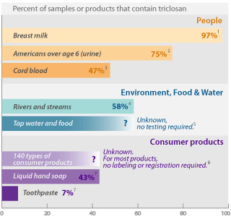
4. Concentrations of Triclosan in organisms
(Adolfsson-Erici et al. 2002; Queckenberg et al. 2010; Dann & Hontela, 2011)

Slide 10
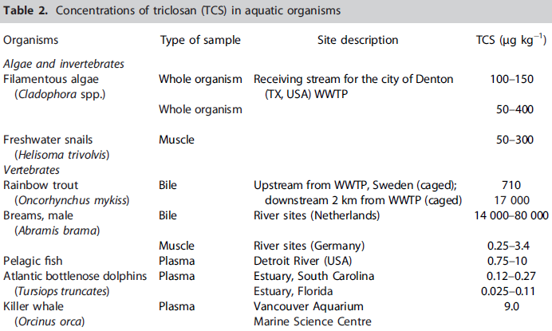
Bioaccumulation (?)

Slide 11
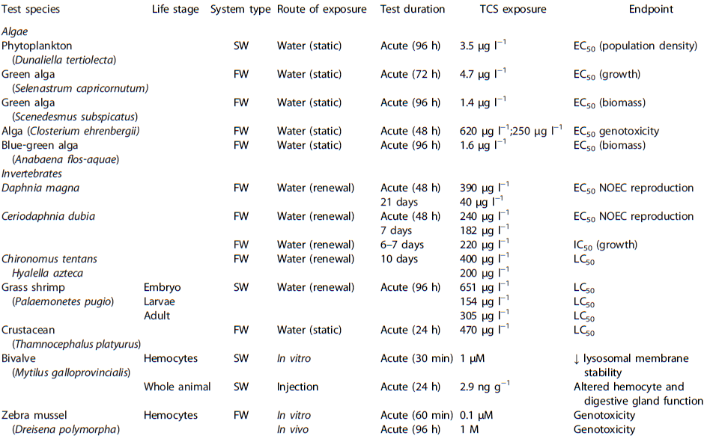

Slide 12
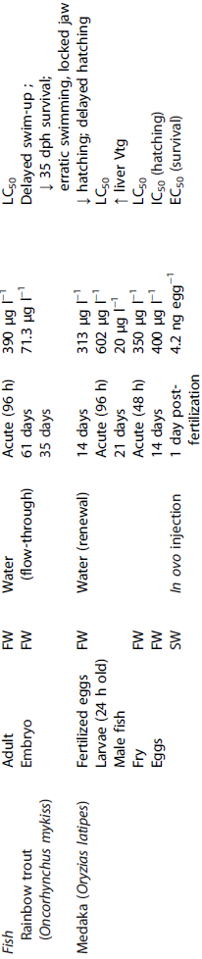
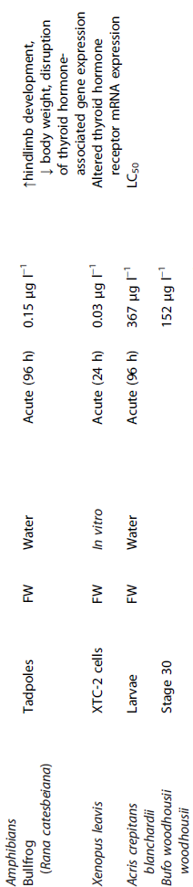

Slide 13
Toxicity of Triclosan
Algae are highly sensitive to TCS
LC50 96 hr = 1-4 µg/L
Invertebrates and fish
average sensitivity
Amphibians - highly sensitive
effects in tadpoles at 0.15 µg/L
effects on thyroid status

Slide 14
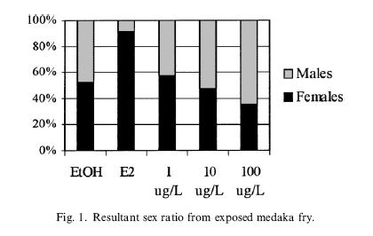
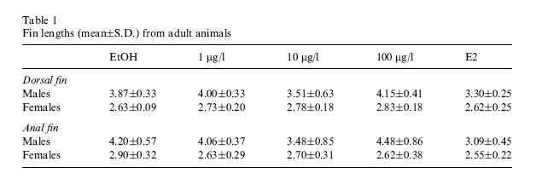
Foran et al. 2000
Mar Environ Res
Triclosan
weak androgenic action
in medaka, Oryzias latipes

Slide 15
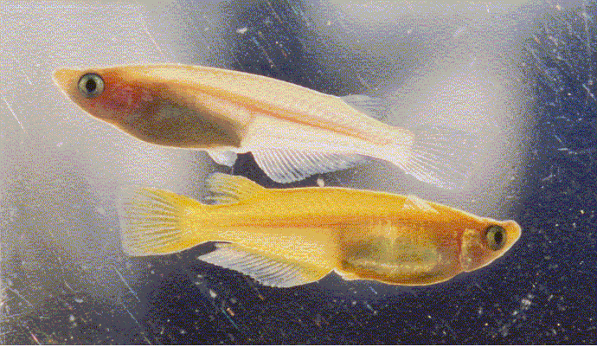
Medaka, Oryzias latipes
Japanese killifish

Slide 16
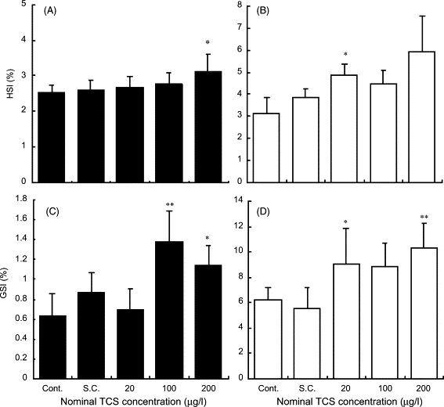
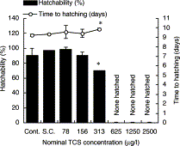
Isihibashi et al. 2004 Chemosphere
Increase in GSI in male Medaka
Lower hatchability of eggs in female
Raut and Angus 2010 Env Toxicol Chem
Decrease in sperm count in Mosquitofish Gambusia affinis

Slide 17
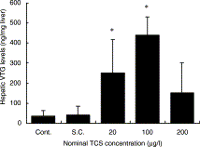
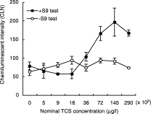
Estrogenic effects in male medaka
induction of Vtg
Estrogenic activity of TCS enhanced by S9 activation

Slide 18
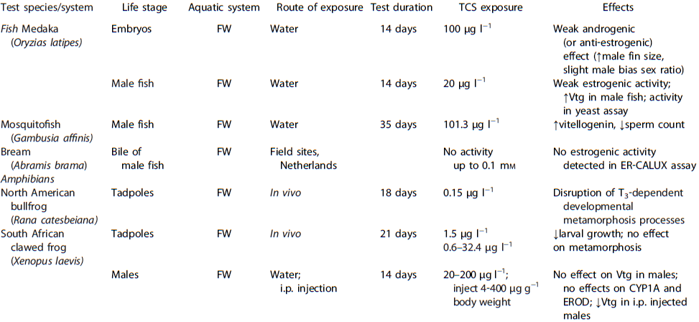

Slide 19
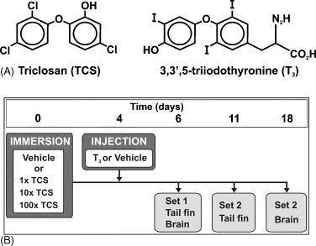
Veldhoen et al. 2006, Aquat Toxicol
Effects of Triclosan on amphibian metamorphosis
Effects of Triclosan on thyroid axis
In vivo
Exposure of tadpoles
(Rana catesbeiana)
In vitro
Exposure of XTC-2 cells
(Xenopus laevis cells)

Slide 20
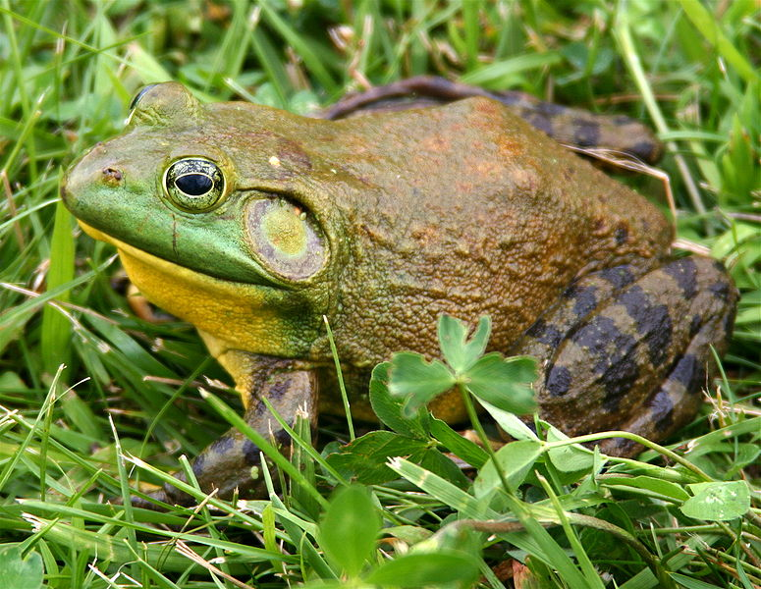
North American bullfrog
Rana catesbeiana

Slide 21
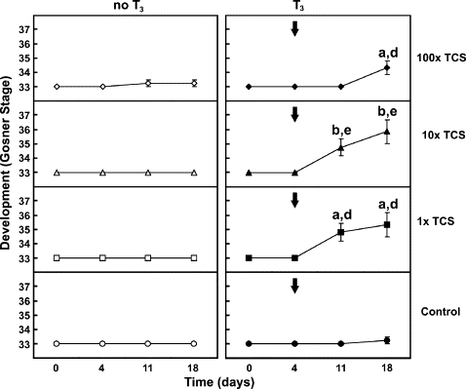
Acceleration of development in tadpoles exposed to
T3 and TCS
T3 alone has no effect

Slide 22
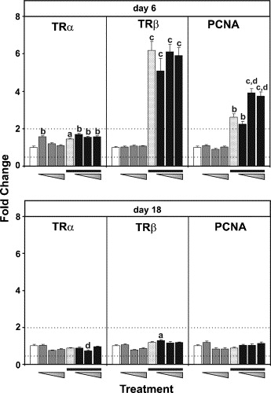
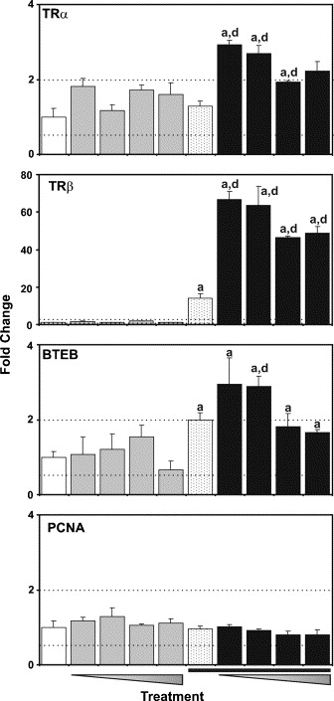
In vivo
In vitro
Relative mRNA expression of TH-regulated genes
Transcripts levels affected by Triclosan at a sensitive
life stage of anuran development
No evidence for estrogenic effects ( no VTG induction)

Slide 23
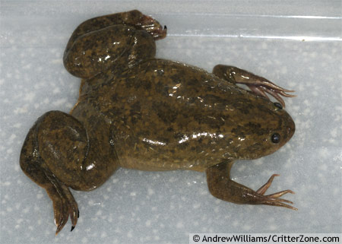
South African clawed frog
Xenopus laevis

Slide 24
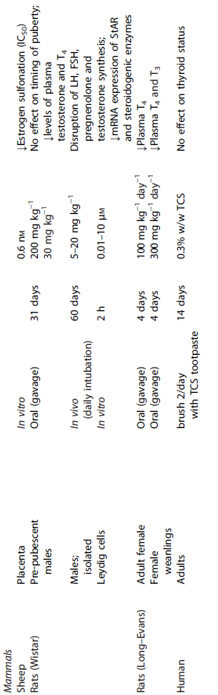

Slide 25
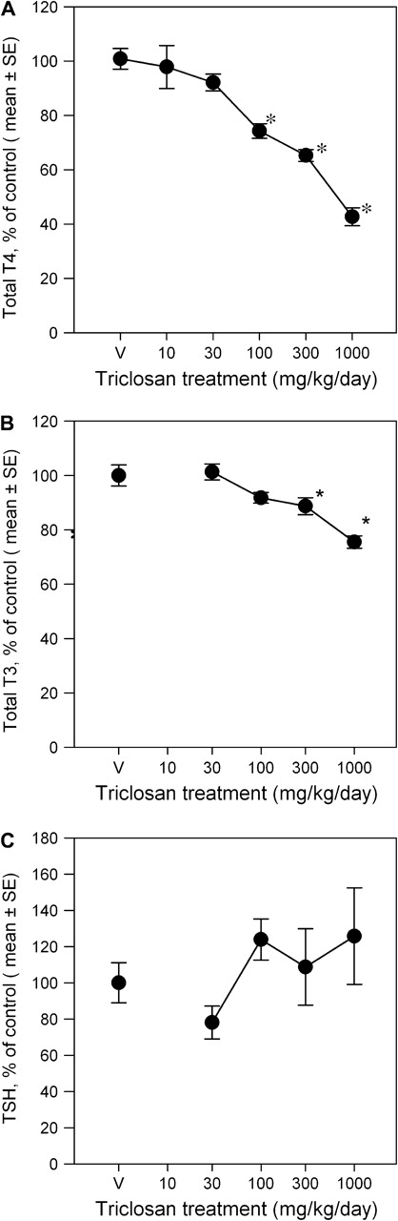
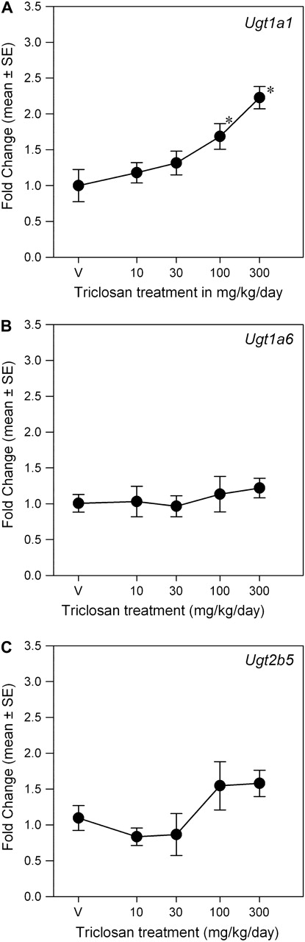
Crofton et al. 2007
Environ Toxicol Pharmacol
Paul et al 2010
Toxicological Sciences
Inhibition of thyroid axis
in rats
exposed to Triclosan
Effect on Phase II
enzymes
(metabolism of thyroid
hormones)

Slide 26
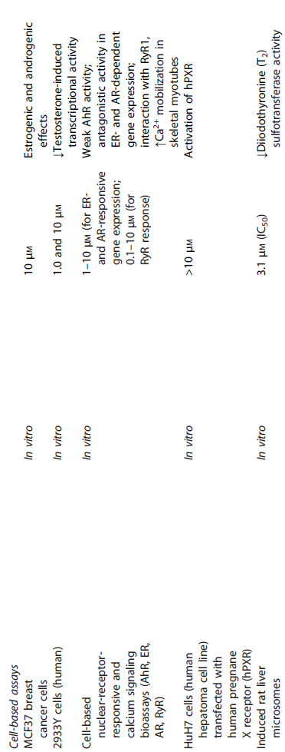

Slide 27
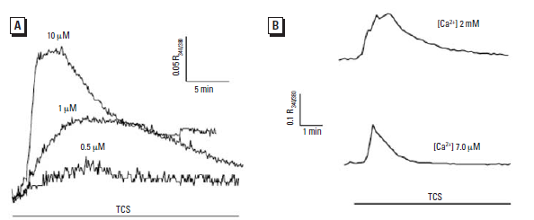
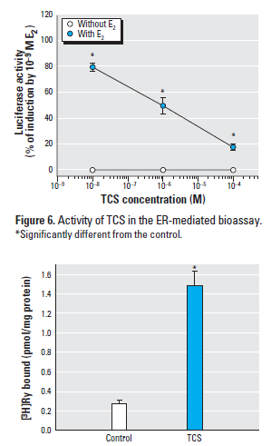


Effects of Triclosan
on intracellular Ca²⁺ homeostasis
Interaction with estrogen
Ahn et al. Environ Health Perspectives 2008

Slide 28
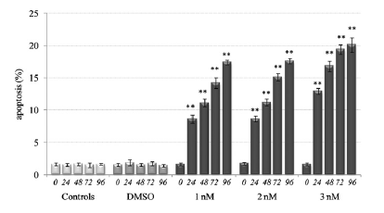
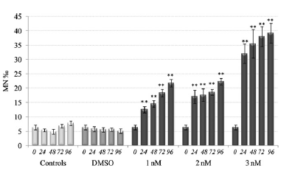


Zebra mussel hemocytes
genotoxic effects of Triclosan in vitro and in vivo
Micronuclei formation
Appoptosis
Binelli et al. 2009 Aquatic Toxicology, 2009

Slide 29
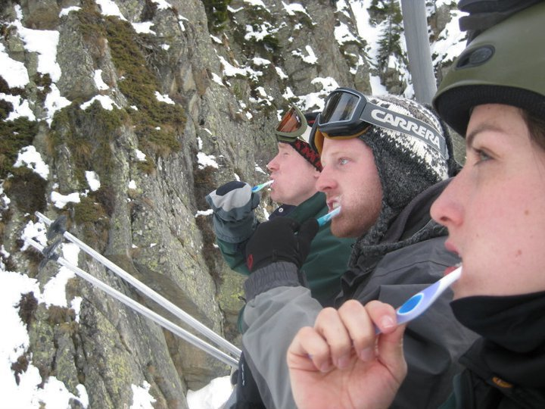
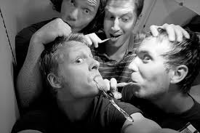
Effects of Triclosan
in human ?
Cell –based assays
estrogenic and
androgenic effects in MCF37
breast cancer cells
weak AhR activity
In vivo effects ???

Slide 30
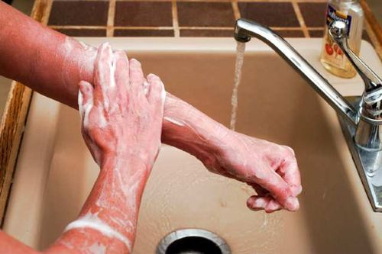
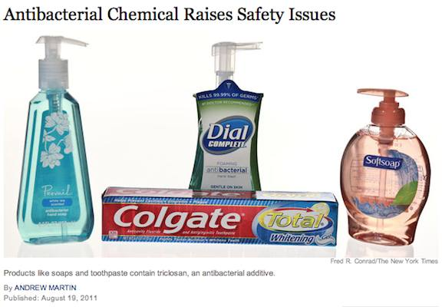
Efficacy of Triclosan
Use in oral hygiene +++
Use in clinical setting as soap +++
Use in personal care ?
Use in food wrapping ?
Use in sport clothing ?

Slide 31
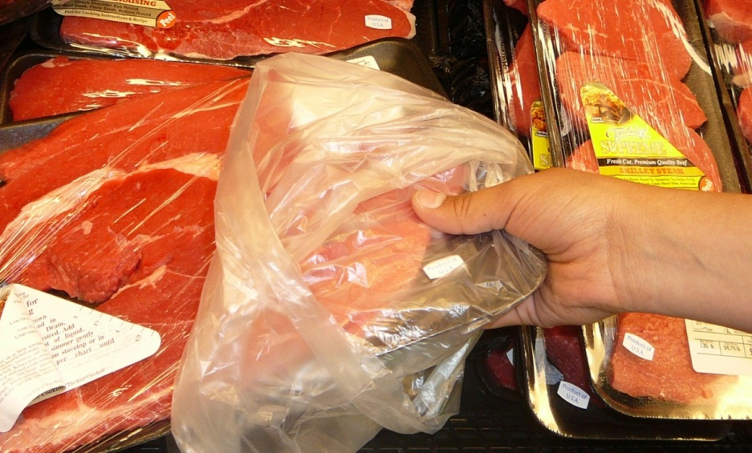
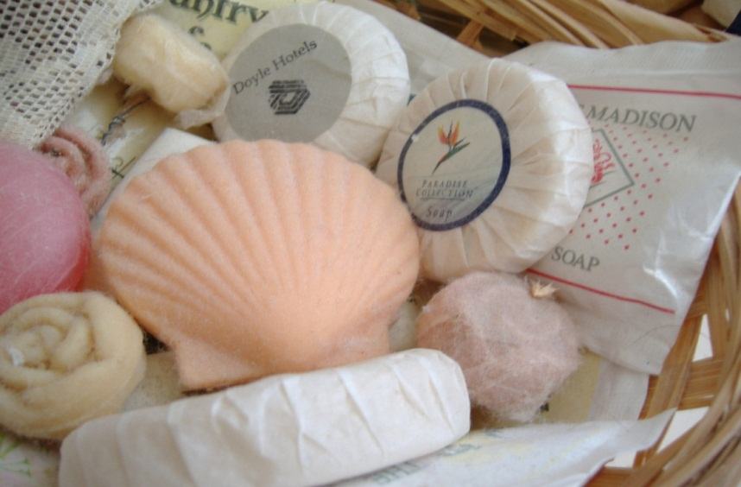

Risk assessment for Triclosan
Antibacterial control
hospitals
oral care
Ecosystem integrity
(algal populations)
Endocrine disruption
amphibians, fish
Antibacterial
resistance

Slide 32


