Slide 1
ROUNDUP - GLYPHOSATE
environmental exposure,
toxicity and mechanisms of action
Innovation Lectures (INNOLEC)
Masaryk University, May 2012

Slide 2
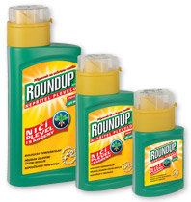
Roundup – identity, use
Herbicide (pesticide targetting plants)
Glyphosate-based chemical
used in home garden care,
sidewalks, highways, …
Used in large scale
agriculture
Used in siviculture
Most widely used agricultural chemical globally
Dobson, Giesy and Solomon, 2003
Economy – Life style

Slide 3

Roundup - key issues
RR (Roundup Ready) crops
Exponential increase in use of Roundup in large scale agriculture
Impact on environment
Potential impact on health of biota and human
Control of food production by one company
Genetically modified – GM crops

Slide 4
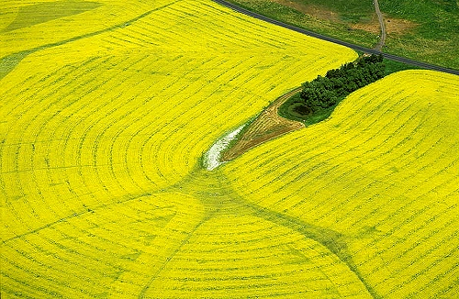

Slide 5
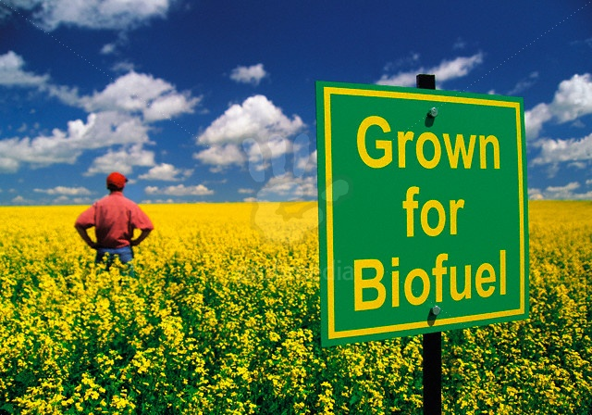

Slide 6
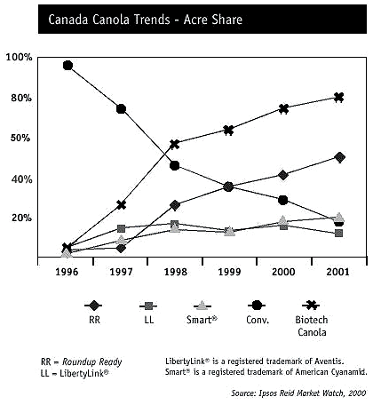
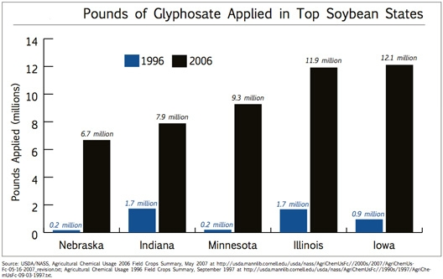
Greater use of Glyphosate herbicides linked to GM (RR) crops

Slide 7
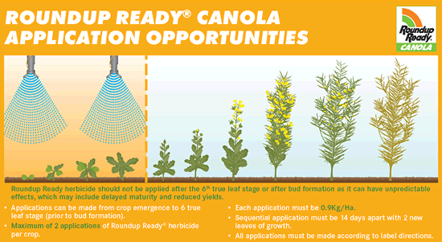
Roundup applied at specific time intervals
RR genetically modified plants grow but weeds are killed
Greater productivity of RR crops

Slide 8
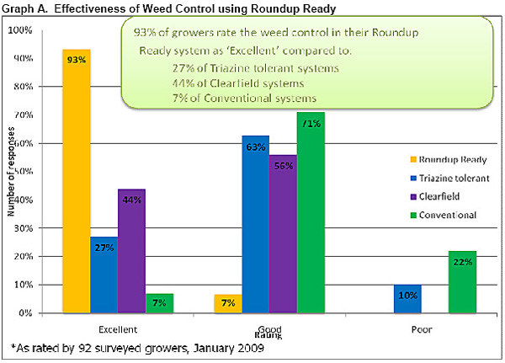
Roundup Ready (RR) crops have good yields

Slide 9
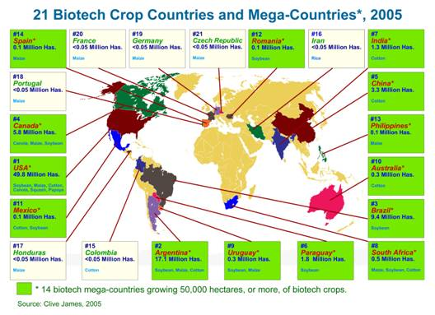

Slide 10
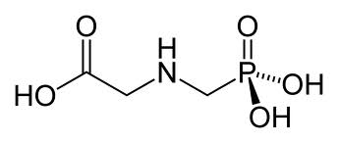
1. Identity and mode of action of RU
glyphosate
Glyphosate - active ingredient of Roundup
weak organic acid, N-(phosphonomethyl)glycine
non-selective herbicide
herbicidal action
inhibition of synthesis of aromatic amino acids
Roundup=glyphosate, surfactants, water, …

Slide 11
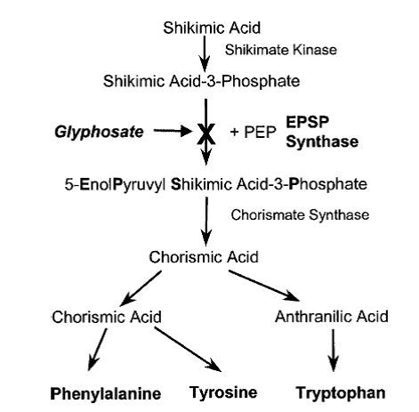
Herbicidal action of glyphosate
inhibition of EPSPS
(5-EnolPyruvyl Shikimic acid-3-Phosphate Synthase)

Slide 12
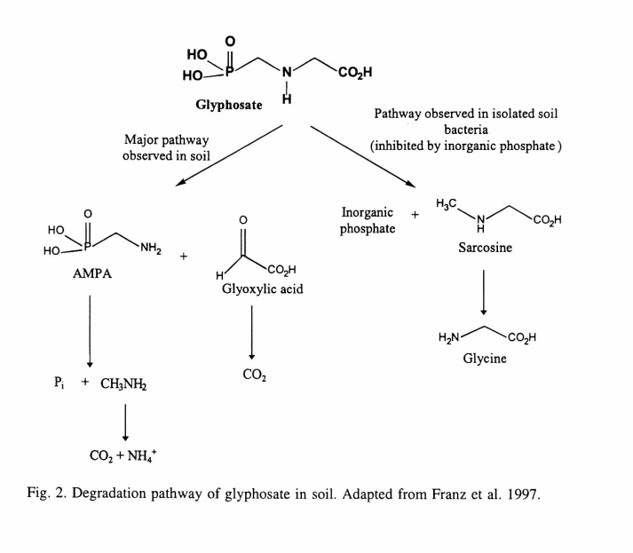
2. Degradation products of Glyphosate
AMPA
Aminomethyl-
phosphonic
acid
N.B.
Surfactant(s)
POEA
Polyethoxylated
tallowamine
used in
commercial
glyphosate
preparations

Slide 13
2. Roundup - Glyphosate Exposure
Sorption, degradation, leachability of GL
strong sorption of GL to soil particles
contamination of ground water limited
leaching of GL to surface waters
during rain events
spraying over water, spray drift

Slide 14
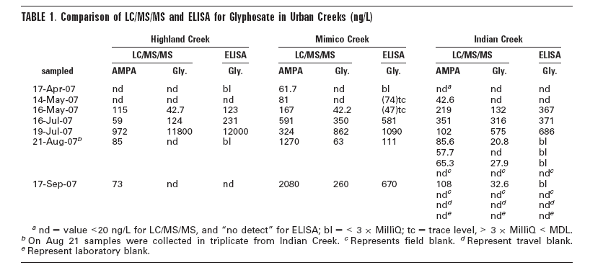
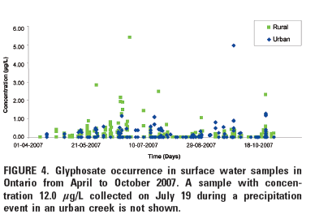
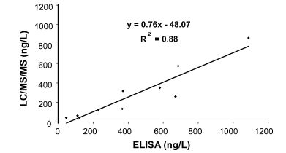
Byer et al. 2008 Environ Sci Technol

Slide 15


Slide 16
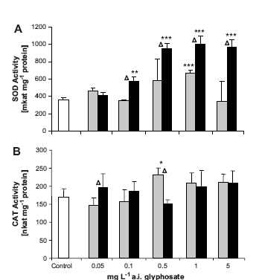
Toxicity of Roundup - Glyphosate
invertebrates
Contardo-Jara et al. 2009
Environ Pollution
Exposure to GL in Lumbricus - link to oxidative stress

Slide 17
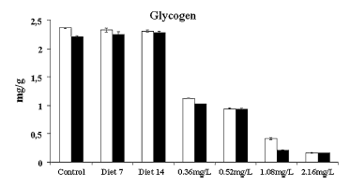
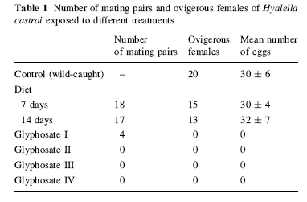
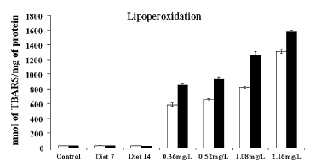
Toxicity of Roundup - Glyphosate
invertebrates
Effect of RU on energetic status, lipid peroxidation,
reproductive fitness of Hyalella Dutra et al. 2011Ecotoxicology

Slide 18
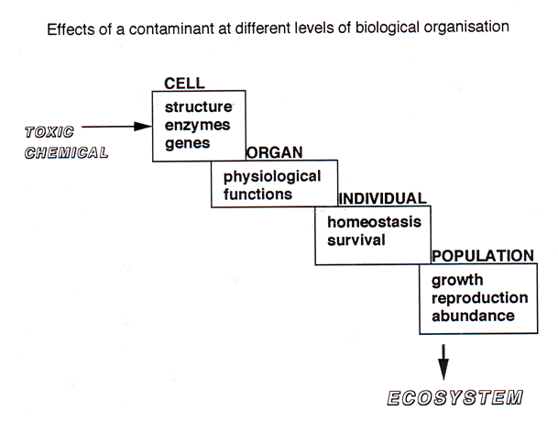
Effects at different levels of biological organisation
Toxicant
Toxicant
Mechanistic links between exposure and effects

Slide 19
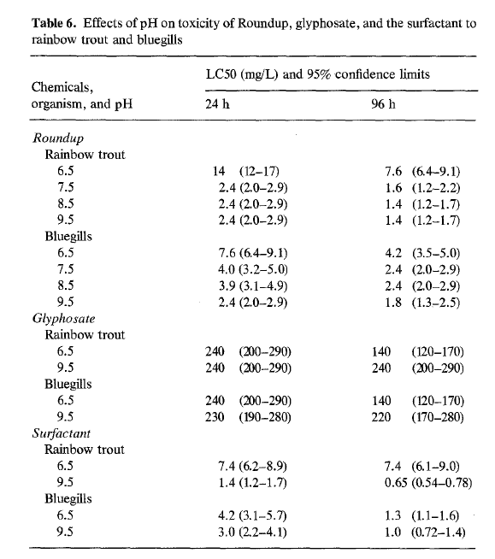
Toxicity
Fish
Toxicity:
RU >GL
Surfactant > GL
Folmar et al. 1979

Slide 20
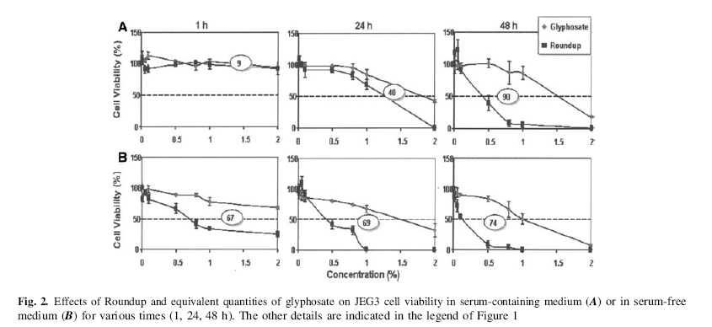
Toxicity of Roundup - Glyphosate
Human placental cells JEG3
Compare
toxicity in serum-containing and serum-free medium
toxicity of RU and GL
Benachour et al. 2007 Arch Env Contam Toxicol

Slide 21
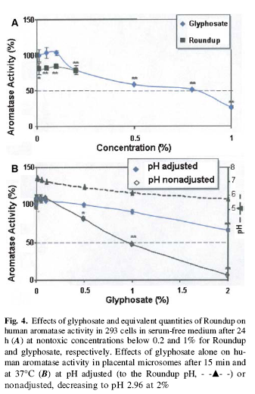
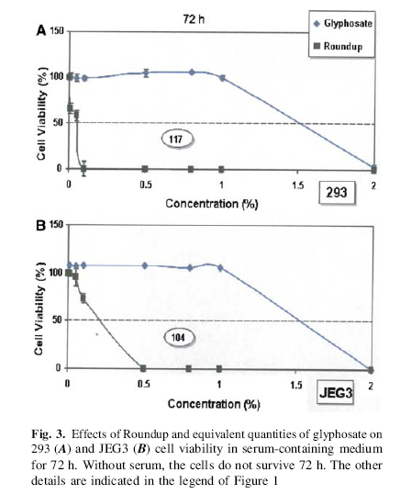
Toxicity of RU >> Toxicity of GL
similar results with HepG2 cells

Slide 22
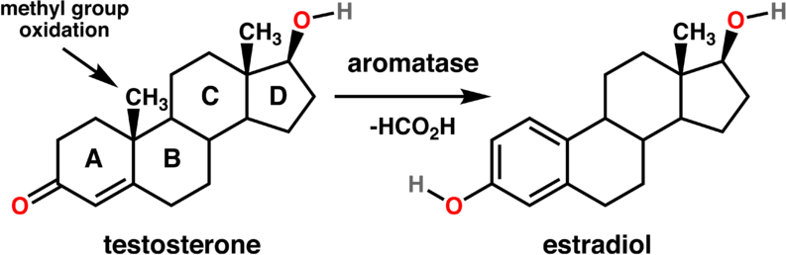
Role of aromatase in steroidogenesis

Slide 23
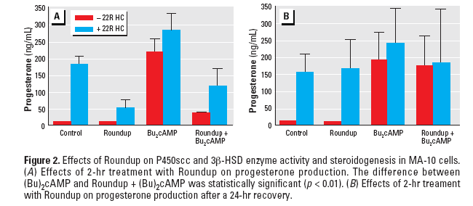
Toxicity of Roundup - Glyphosate
Roundup inhibits steroidogenesis in rats
by disruption of StAR protein expression
Walsh et al. 2000

Slide 24
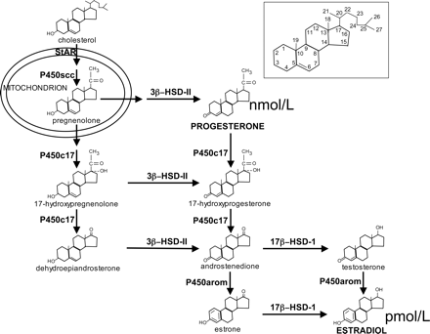
Role of StAR (Steroid Acute Regulatory Protein)
in steroidogenesis
Stocco, 2000

Slide 25
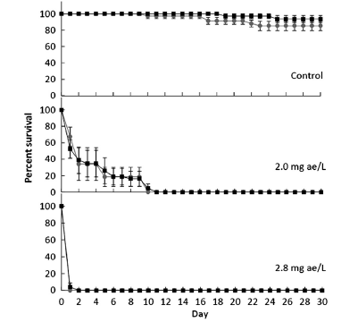
Toxicity of Roundup - Glyphosate
Amphibians
very sensitive to RU-GL
Dinehart et al. 2010 Env Poll
studies by Relyea
controversy
[chronic toxicity] ~ [environmental]
HQ (Hazard Quotient) analysis

Slide 26
HQ analysis = Exposure level : toxicity reference value
HQ < 1.0 no risk, acceptable risk
HQ > 1.0 need for further evaluation
HQ > 100 definite risk
Giesy, Dobson and Solomon, 2000
Ecological Risk Assessment for Roundup Herbicide
Rev Environ Contam Toxicol 167: 35-120

Slide 27
Toxicity of Roundup – Glyphosate
Health concerns
Amphibians - highly sensitive
toxicity to larvae at environmental concentrations (1-2 mg/L)
Endocrine disruption
effects on aromatase
effects on StAR protein
Toxicity to non target plant species

Slide 28
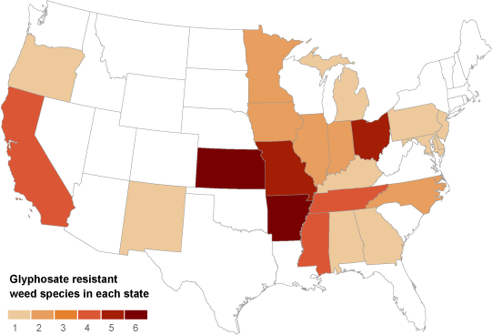
ROUNDUP/GLYPHOSATE - CONCERNS
Evolution of Glyphosate-resistant weeds

Slide 29
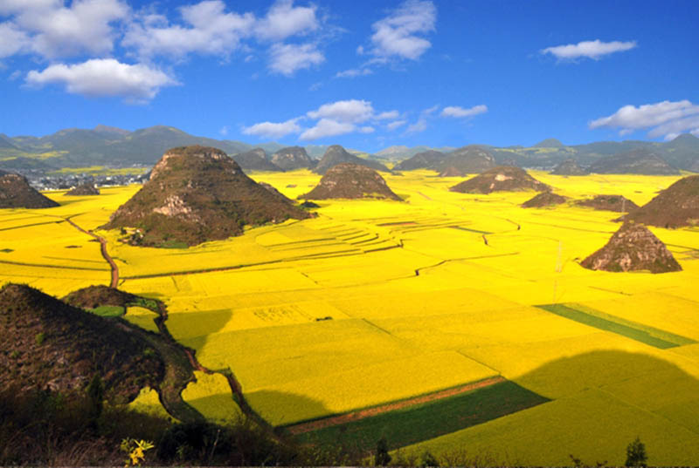

Slide 30
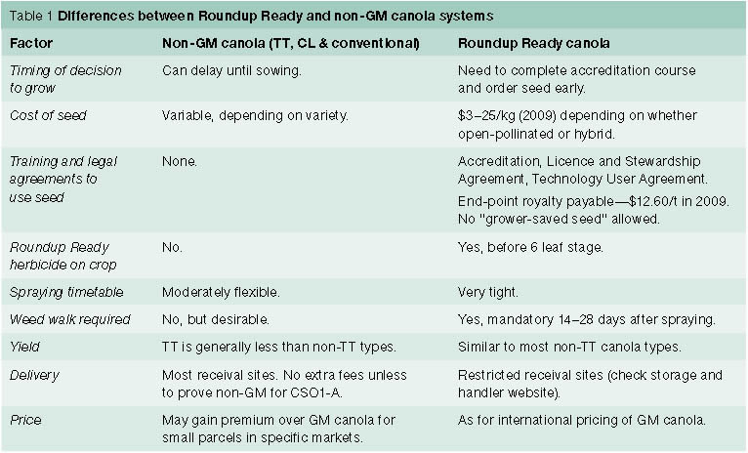
Dependance of food production on GM seeds

Slide 31
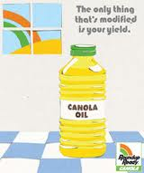
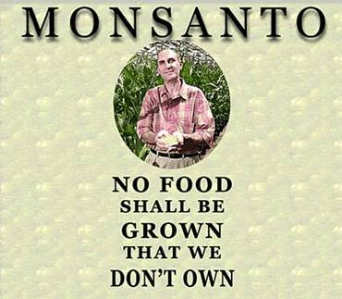
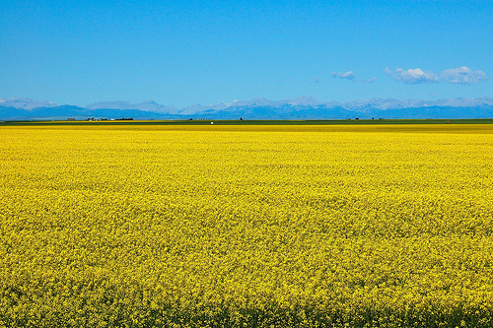
Risk assessment for Roundup
Greater use of RU
Economics of food
production
Contamination of
surface water
Health risks
Biofuel production
Food production

Slide 32

Waterton National Park – Alberta, Canada

