Slide 1
INSTITUT LADY DAVIS DE RECHERCHES MÉDICALES / LADY DAVIS INSTITUTE FOR MEDICAL RESEARCH
Centre Bloomfield de
recherche sur le vieillissement
Cancer and Aging: Two faces of the same coin
(4) Telomerase and Telomere Regulation
The Bloomfield Centre
for Research in Aging

Slide 2
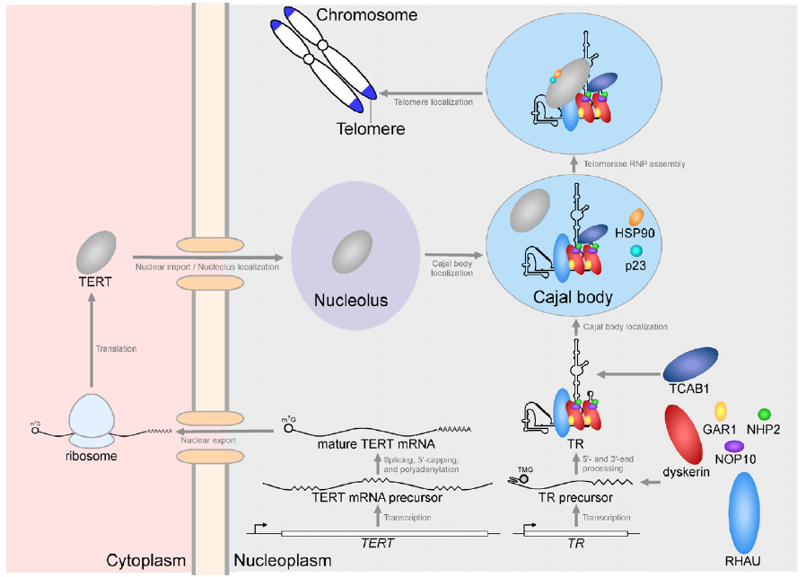
Telomerase and Telomere Regulation
TPP, Pot1
TERRA
Processivity
Posttranslational
modification
Pontin
Reptin
RNA maturation
accumulation
Podlevsky, J. and Chen, J.-J.L. 2012. It all comes together at the ends: Telomerase structure, function, and biogenesis. Mutation Research 730, 3-11.

Slide 3
Transcriptional Regulation of hTERT
Positive regulators: c-myc, Sp1, estrogen receptor, NF-KB
(mTERT)
Negative regulators: WT1 (Wilms tumor 1 suppressor), MZF-2
(myeloid-specific zinc finger protein implicated in cell cycle progression), p53
Chromatin and epigenetic regulation of the hTERT gene
Cifuentes-Rojas, C. and Shippen, D.E. 2012. Telomerase regulation. Mutation Research 730, 20-27.

Slide 4
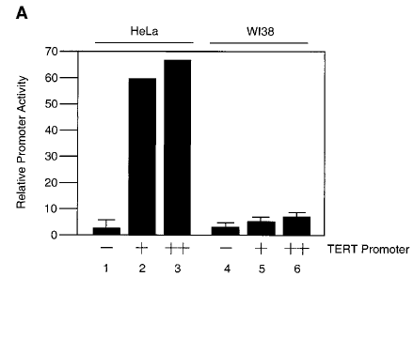
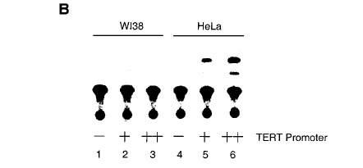
hTERT promoter inactive in telomerase-negative cells
telomerase + telomerase -
acetylated
chloramphenicol
chloramphenicol
Oh, S. et al. 1999. BBRC 263, 361-365.

Slide 5
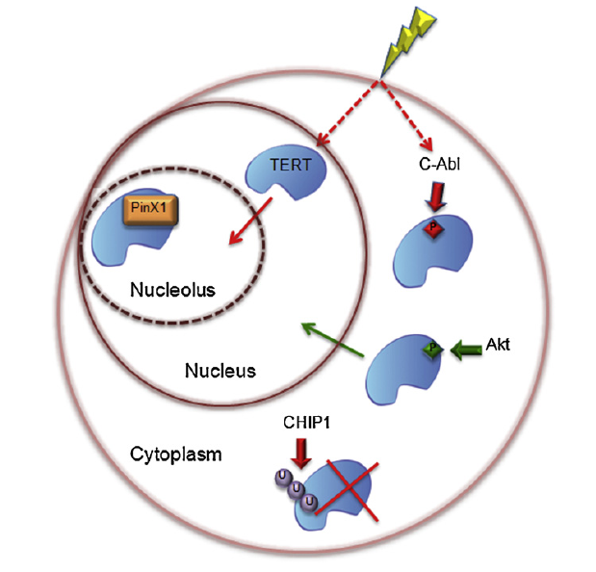
Post-Translational Regulation of TERT
CHIP (C terminus of Hsc70-interacting protein),
a co-chaperone with E3 ubiquitin ligase
Cifuentes-Rojas, C. and Shippen, D.E. 2012. Telomerase regulation. Mutation Research 730, 20-27.

Slide 6
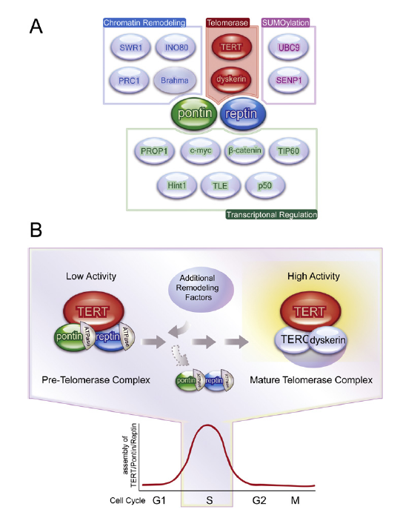
Roles for pontin and reptin in telomerase RNP accumulation and assembly
ATPases with multiple binding
partners and functions
Pontin and reptin, like NAF1, aid in RNP assembly but
do not remain associated with the mature telomerase enzyme
Baek, S.H. 2008. When ATPases pontin and reptin met telomerase. Cell 14, 459-450.

Slide 7
TCAB1: driving telomerase to Cajal bodies and telomeres
Venteicher, A.S. et al. 2009. A human telomerase holoenzyme protein required for cajal body localization and telomere synthesis. Science 323, 644-648.

Slide 8
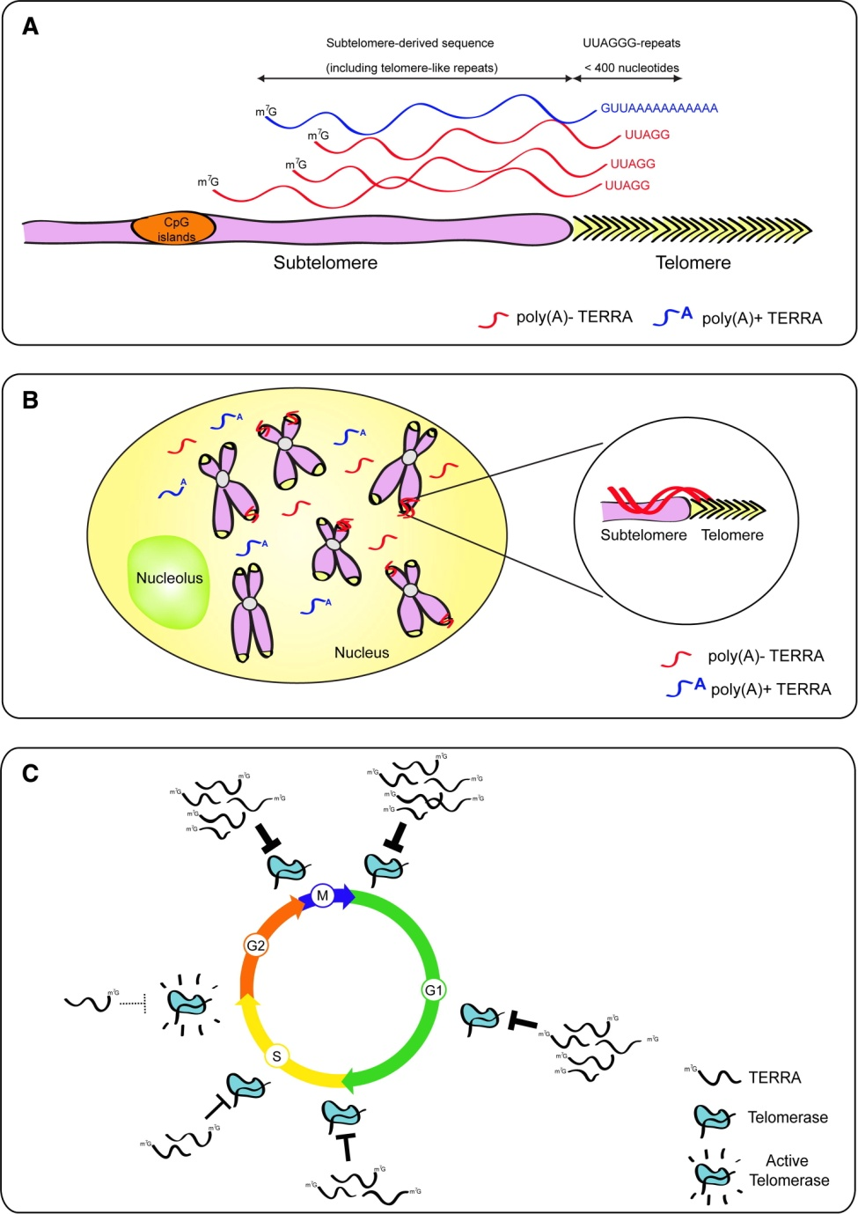
TERRA, telomeric RNA
Feuerhahn, S. et al. 2010. FEBS Lett. TERRA biogenesis, turnover and implications for function. 584, 3812-3818.

Slide 9
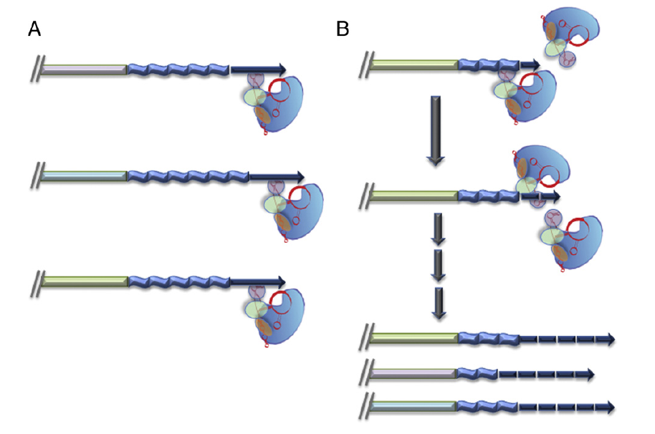
Telomerase processivity and telomere length regulation
Cifuentes-Rojas, C. and Shippen, D.E. 2012. Telomerase regulation. Mutation Research 730, 20-27.

Slide 10
Unique characteristics of telomerase and telomeres as potential anti-cancer targets
Shusen Zhu and Sanjida Khondacker
Human and mouse telomerase spliced
variants
Yasmin D’Souza
Contribution of telomerase
processivity to telomere function
Josephine Chu
Role of unique ‘insertion
in fingers motif’ in telomere
function
May Shawi, Johanna Mancini, Shusen Zhu, Ricky Kwan
Human and mouse telomerase-associated
proteins

Slide 11
The Role of Alternatively-Spliced INS3 and INS4 hTERT mRNAs in
Telomerase Function

Slide 12
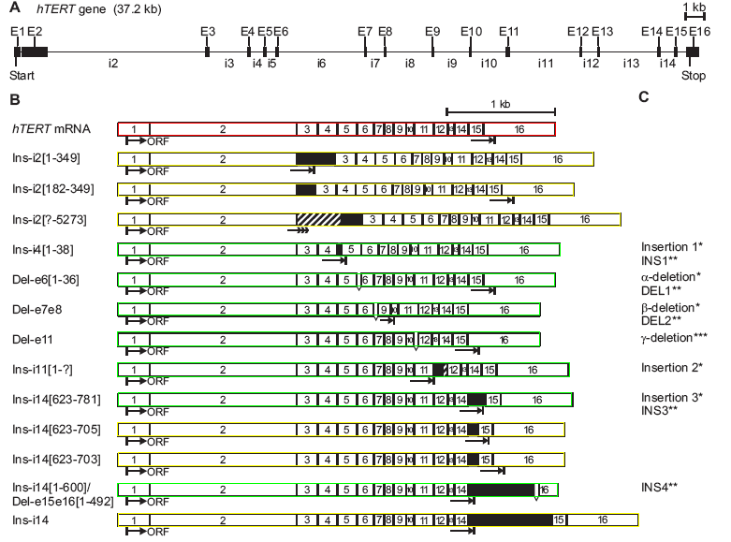
Genomic organization and alternatively spliced sites of the hTERT gene
From: Saeboe-Larssen, S., E. Fossberg, and G. Gaudernack. 2006. BMC Mol. Biol. 7 :26-35.

Slide 13
Role of alternatively spliced TERT mRNA variants?
The potential for complex splicing patterns may reflect a specific aspect of telomerase regulation in proliferation, differentiation and apoptosis
Notably, some splice variants are expressed in primary and cancer cells that lack detectable telomerase activity
In human development, the specific expression of hTERT splice variants that are predicted to encode catalytically-defective telomerases, correlates with telomere shortening and suggests that these transcripts may have important physiological roles
Ectopic expression of the α-deletion variant that lacks conserved catalytic residues results in dominant-negative inhibition of telomerase, telomere shortening, and cell death
Spliced TERT variants have also been reported in rice, chicken, mouse and rat
Arabidopsis POT1A reported to interact with an N-terminal variant of telomerase
The G-quadruplex ligand A549 induces telomerase downregulation by modulating hTERT alternative splicing
Reviewed in Sykorova, E. and Fajkus, J. 2009. Biol. Cell 101, 375-392)

Slide 14
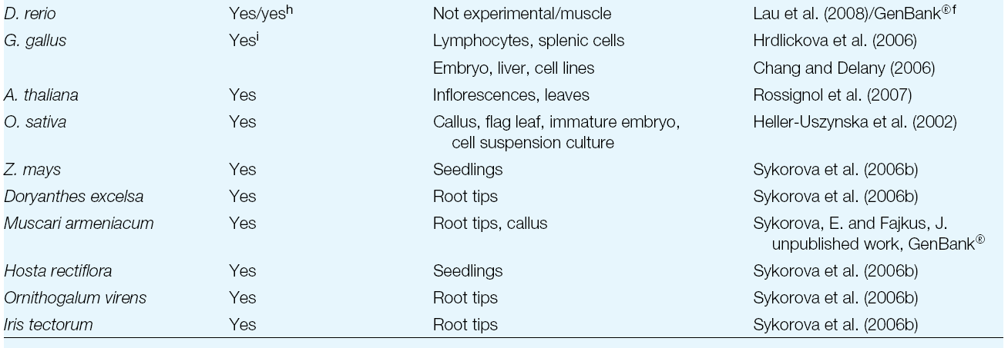
Alternative splicing of TERT in other organisms
Sykorova, E. and Fajkus, J. 2009. Biol. Cell 101, 375-392

Slide 15
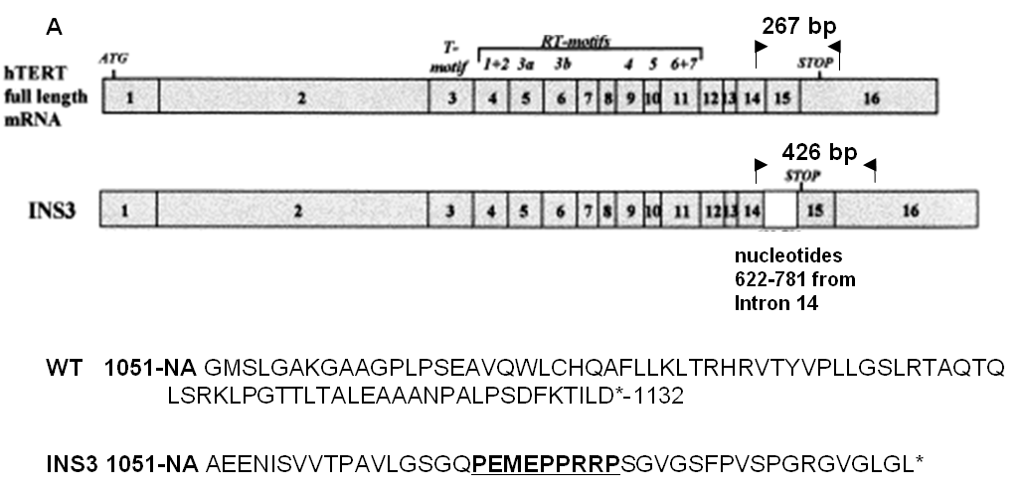
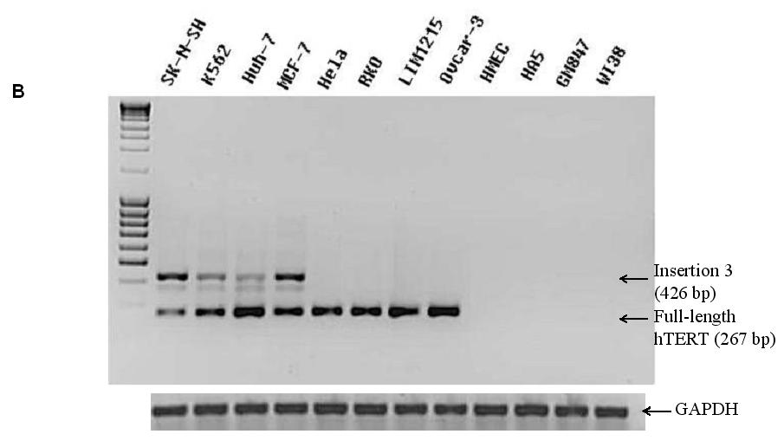
Expression of INS3 spliced hTERT mRNA in some telomerase positive cancer cell lines analyzed
SK-N-SH: neuroblastoma, K562: leukemia,
Huh-7: hepatoma, MCF-7:mammary
adenocarcinoma, HeLa: cervical
adenocarcinoma, RKO: colon carcinoma,
LIM1215: colon carcinoma, Ovcar-3: ovarian
adenocarcinoma, HMEC: SV40 transformed
dermal microvascular endothelial cells,
HA5: SV40 transformed embryonic
kidney cells, GM847: SV40 transformed skin
fibroblasts (ALT cells), WI38:primary lung
fibroblasts.

Slide 16
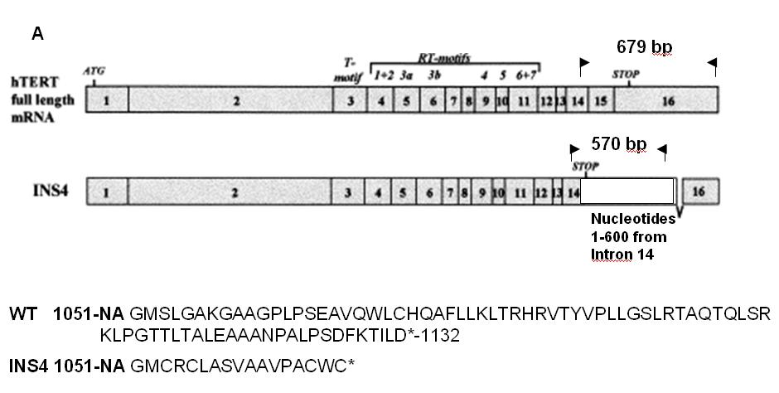
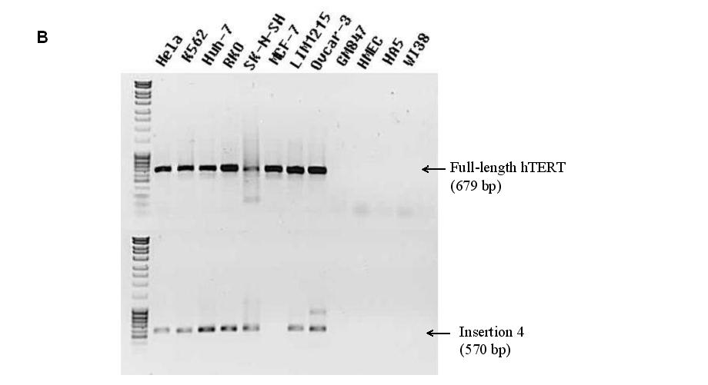
Expression of INS4 spliced hTERT mRNA in most telomerase-positive cancer cell lines analyzed

Slide 17
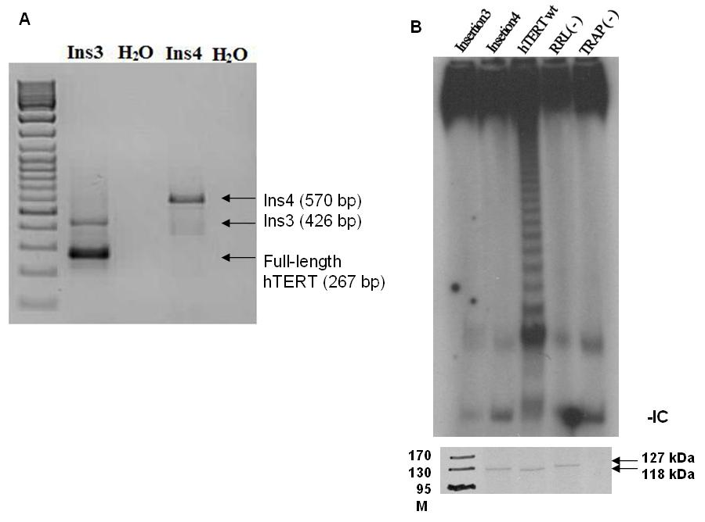
The in vitro INS3- and INS4-reconstituted enzymes do not express telomerase activity, likely due to the importance of the hTERT C-terminus for activity
Confirmation of spliced mRNAs
using polyA purified RNA from
K562 leukemia cell line

Slide 18
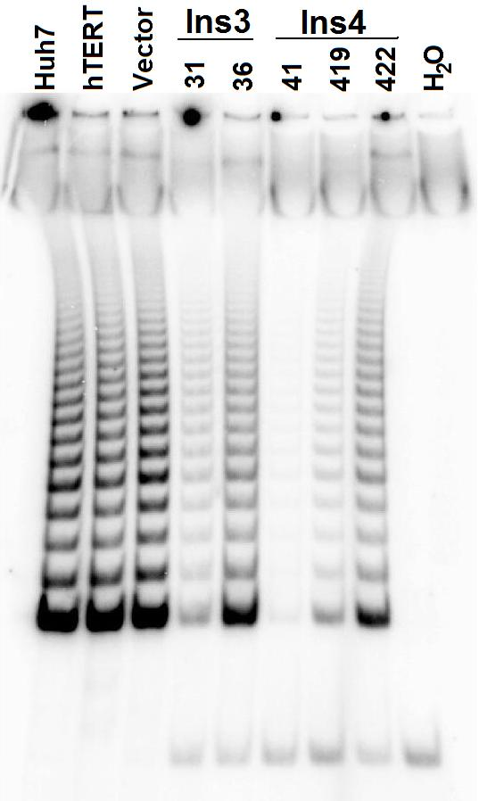
Stable expression of INS3 and INS4 variants in Huh7 hepatocarcinoma cell lines inhibits telomerase activity and slows cell growth
At PD 30

Slide 19
Ins 3 and Ins 4 stably expressing cell lines exhibit shorter telomeres compared to Huh7 parental cells and hTERT control, but telomeres do not progressively
shorten with increasing population doubling

Slide 20
No significant difference in cell cycle profile or percentage apoptosis in cells stably expressing INS3 or INS4 variant compared to parental cells or cells expressing hTERT
PD 60-80

Slide 21
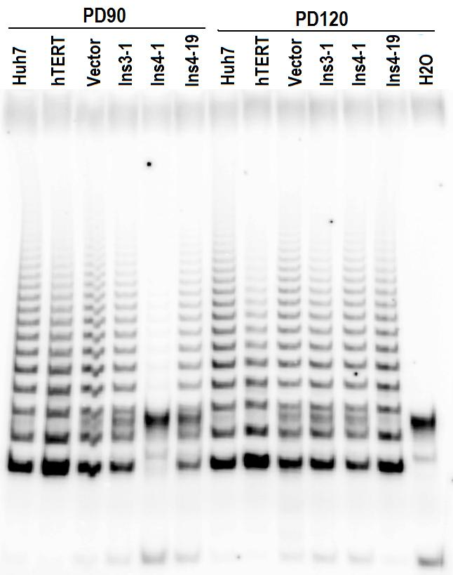
Loss of Ins3 transgene expression results in loss of telomerase inhibition
at late population doublings

Slide 22
Conclusion
Ins3- and Ins4-reconstituted telomerases are inactive in vitro
Stable expression of Ins3 and Ins4 variants in telomerase positive Huh7 leads to telomerase inhibition, slowed growth and shorter telomere lengths, but no significant changes in cell cycle profile
Telomerase inhibition is not maintained at late population doublings, likely due to loss of expression of the Ins3 transgene expression

Slide 23
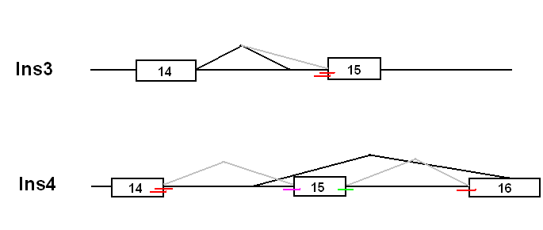
Antisense oligonucleotide-mediated modulation of
Ins3 and Ins4 splicing
-Investigated in the context of genetic diseases to prevent aberrant splicing of genes
-With cancer-related genes has been exploited to redirect the splicing of an anti-apoptotic to
a pro-apoptotic Bcl-x variant
-One report of telomerase and cell growth inhibition upon oligomer-mediated modulation
of hTERT alternative splicing in prostate cancer cells (Brambilla, C. et al. 2004. CMLS 61, 1764-1774)
Ins3-1
Ins3-2
Ins4-1
Ins4-2
Used 2’-O-methyl-RNA phosphorothioate oligonucleotides

Slide 24
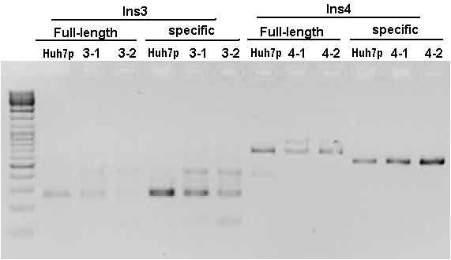
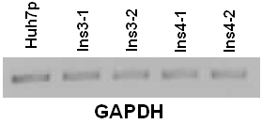
Increased expression of Ins3 and Ins4 spliced variants and decreased expression of full length hTERT mRNA
upon antisense oligonucleotide treatment

Slide 25
Quantitation of endogenous Ins3 levels by Real-time PCR

Slide 26
Quantitation of endogenous Ins4 levels by Real-time PCR

Slide 27
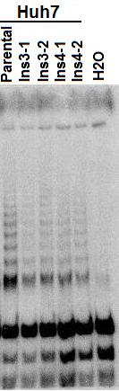
Increased expression of Ins3 and Ins4 spliced variants and decreased expression of full length hTERT mRNA reduces
telomerase activity

Slide 28
Growth inhibition upon antisense oligonucleotide treatment

Slide 29
Antisense oligonucleotide treatment decreased cell proliferation as measured by colony formation ability

Slide 30
Conclusion
Antisense oligomer-mediated expression of Ins3 and Ins4 spliced hTERT mRNAs:
Inhibited endogenous hTERT expression in Huh7 cells
Inhibited endogenous telomerase activity in Huh7 cells
Inhibited the growth, viability and proliferation of Huh7 cells
Perspective
Short term effects are most likely telomere-shortening independent and may be due to the loss of telomere protection
Investigate if apoptosis is induced
Verify off target effects using hTERT-negative cell line

Slide 31
Identification and characterization of alternatively-spliced mTERT mRNAs

Slide 32
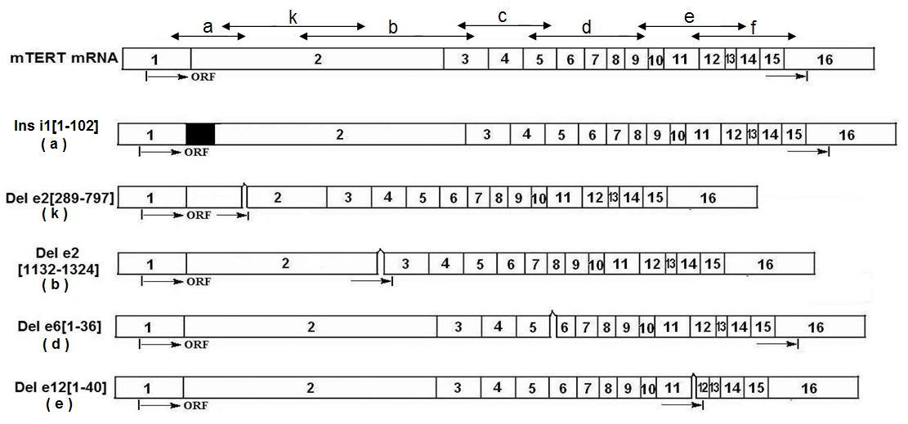
mTERT Alternatively-Spliced Variants
*
Strausberg et al.,
Unpublished Work
*
Similar variant in
hTERT
Five of the suspected variants were confirmed by sequencing.
Exons = white boxes with numbering inside.
Arrowheads above full-length mTERT mRNA = the regions of each PCR product covered.
mTERT ASPSs have been assigned descriptive names.
CB17: mouse fibroblast cell line
NIH3T3: Mouse embryonic fibroblast
FM3A: mouse mammary carcinoma

Slide 33
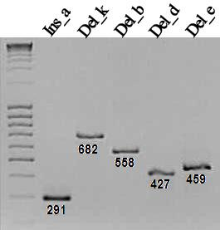
mTERT Alternatively-Spliced Variants
Variant | Primers used for PCR 1 | Primers used for PCR 2 | Expected Size of Product (base pairs)
Ins a | InsaF 1069R | InsaF 500R | 291
Del k | DelkF 2092R | DelkF 1689R | 682
Del b | 806F DelR2 | DelbF 2092R | 558
Del d | DeldF 3056R | DeldF DelR2 | 427
Del e | DeleF Ins4-R3 | DeleF Ins3-R2 | 459
Generated PCR products of alternatively spliced mRNA using splicing variant-specific primers and polyA purified RNA from NIH3T3 cells

Slide 34
Insertion Variant, Insi1
Found in intron 1
Ins i1 is in a region which corresponds to the hTERT RID1 motif.
The telomerase reverse transcriptase (TERT) is divided into three regions, the TERT essential N-terminal (NTE) domain, the reverse-transcriptase (RT) motifs and the TERT C-terminal extension (CTE). Adapted from (Autexier and Lue, 2006.)

Slide 35
Deletion Variant, Dele12
Deletion falls in a region which corresponds to the hTERT CTE
Deleting a sequence in such an essential part of the mTERT may modify it slightly or it might render it completely inactive.

Slide 36
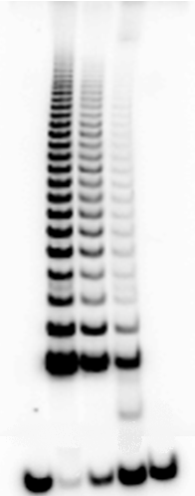
mTERT insertion but not the deletion variant reconstitutes telomerase activity
mTERT + Ins
mTERT - Del
WT mTERT
WT hTERT
TERT (-)

Slide 37
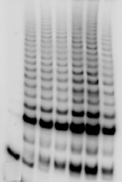
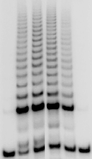
Telomerase activity of mixed wildtype mTERT/insertion variant suggests the insertion variant has no inhibitory effects on wildtype mTERT
0
1
1
1
1
1
0
WT mTERT
0
0
0.5
1
1.5
2
1
Insertion Variant
0
0
(b)
1
1
1
1
1
WT mTERT (µl)
1
Deletion Variant (µl)
0
1.5
2
0

Slide 38
Telomerase activity of mixed wildtype mTERT/deletion variant the deletion variant seems to be inhibiting telomerase activity and may have dominant negative effects on telomerase activity
0
1
1
1
1
0
WT mTERT
0
0.5
1
1.5
2
1
Deletion Variant

Slide 39
Insertion and deletion variants do not appear to have DNA-binding defects in vitro
1
2
1
2
1
2
3
4
3
4
3
4
WT mTERT
Insertion
Deletion
WT mTERT
Insertion
Deletion
5’-biotinylated primer
5’-biotinylated antisense primer
Non-biotinylated primer
No primer

Slide 40
Both variants exhibit RNA-binding defects in vitro
Bound hTR
Precipitated TERT Protein
hTERT, hTR (-)
hTERT, hTR
mTERT, hTR
Deletion Variant, hTR
Insertion Variant, hTR

Slide 41
RID1 Motif and RNA Binding
A major accessory domain containing the RNA-interaction domain 1 (RID1)
RID1 interacts with the hTR pseudoknot-template domain and hTERT's RT motifs and putative thumb and was shown to be essential for processivity, but not DNA synthesis.
Autexier and Lue, 2006
These preliminary results suggest that both the insertion and deletion variants have decreased binding affinities.
For the former, the decrease in binding may be due to the fact that the 102-nucleotide insert falls in a region which corresponds to the human RID1 motif.

Slide 42
Stable expression of the deletion variant in the CB17 mouse fibroblast cell line slows cell growth

Slide 43
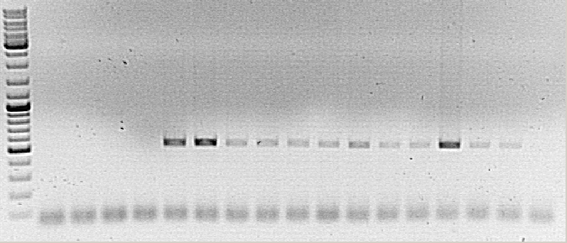
Alternatively spliced variants are stably expressed with increasing population doublings
Non-transfected CB17 cDNA
PCR negative control
SS (II) RT(-)
Ins 2
Ins 8
Del 1
Del 9
cDNA (-)
E
M
L
E
M
L
E
M
L
E
M
L
Confirm levels by qPCR
Confirm protein expression by Western analysis

Slide 44
Stable expression of the deletion variant (clone 9) leads to inhibition of
telomerase with increasing population doublings
Dilutions
100 ng
40 ng
20 ng
10ng
4 ng
2 ng
Internal Control
(-)
Early
Middle
Late

Slide 45
Stable expression of the deletion variant (clone 9) leads to inhibition of
telomerase with increasing population doublings

Slide 46
Conclusions
Five mTERT alternatively-spliced variants were identified by RT-PCR and sequencing.
The splicing patterns are different from rat and human (except for Dele6, which has also been identified in the human).
The variants were confirmed by RT-PCR using purified polyA+ mRNA from NIH 3T3.
In the in-vitro TRAP assay, the insertion variant reconstitutes telomerase activity while the deletion variant does not.
In vitro, while the insertion variant seems to have no inhibitory effects on wildtype mTERT, the deletion variant seems to be inhibiting telomerase activity and may have dominant negative effects on telomerase activity.
The insertion and deletion variants are present in different mouse cell lines and specific mouse tissues, shown through RT-PCR using variant-specific primers.
Deletion variant stable cells (clone 9) exhibit a noticeable growth defect and inhibition of telomerase activity with increasing population doublings

Slide 47
Perspectives
The potential negative-regulatory or dominant-negative function of the alternative-spliced deletion variants will continue to be assayed when expressed in telomerase-positive cell line, CB17 by assessing telomere length or function at various passages
Modulation of splicing in NIH 3T3 cells using anti-sense oligonucleotides and its consequences in gene expression, and telomerase activity and cell proliferation
Can alternatively-spliced mTERT variants function to reduce end-to-end fusions typically observed in late passage mTERT-/- ES cells by assessing signal-free ends

Slide 48
Identification of a Box C/D SnoRNP component as a human
telomerase-associated protein

Slide 49
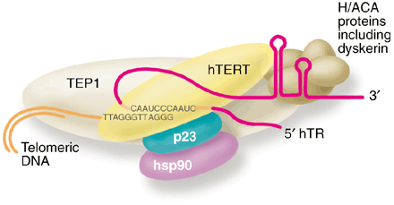
Telomerase-associated Proteins
Reptin/Pontin
??
Cohen et al, 2007 : dimer of hTERT, dyskerin and hTR (total of 1300kDa); Complex in the range of 500-1000 kDa (Schapp et al., 1998)
Shay et al, 1999

Slide 50
TAP-tagged hTERT reconstitutes an active enzyme in vitro
Flag- hTERT
AC-TAP-hTERT
RRL
-
TERT
+ cellular extract
148 kDa
Created stably expressingTAP-tagged hTERT expressing Flp-In 293 cell line

Slide 51
Mass Spectrometry identifies NOP17 as a potential interacting protein

Slide 52
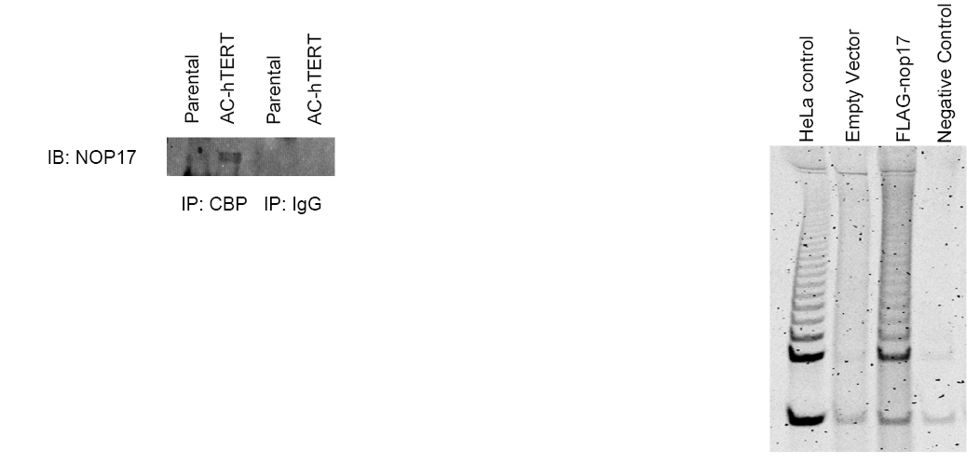
NOP17 :a telomerase interacting protein
IP: FLAG

Slide 53
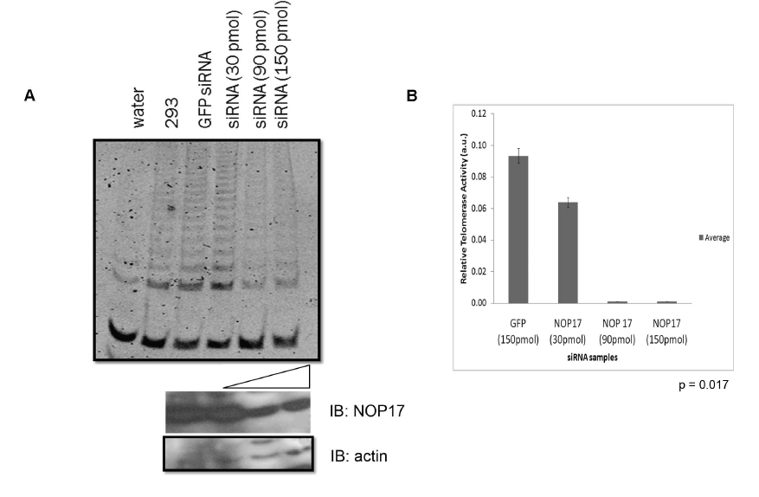
Depletion of NOP17 reduces telomerase activity

Slide 54
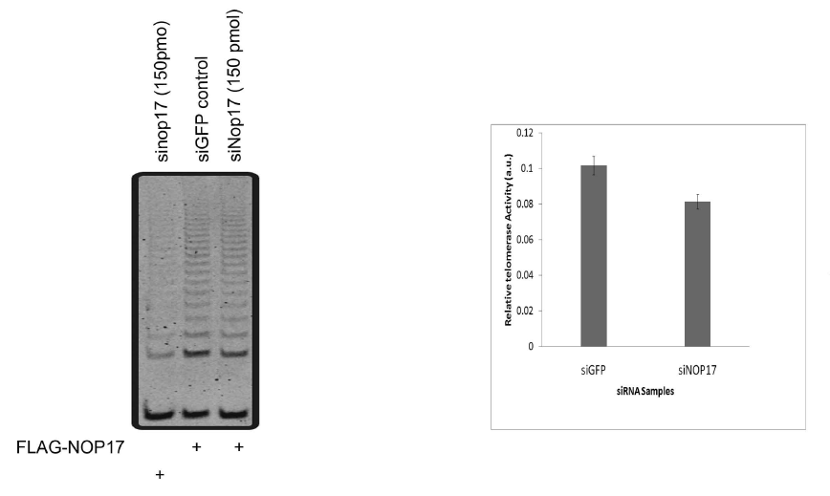
NOP17 overexpression prevents the knockdown of telomerase activity

Slide 55
NOP17 forms a complex with pontin

Slide 56
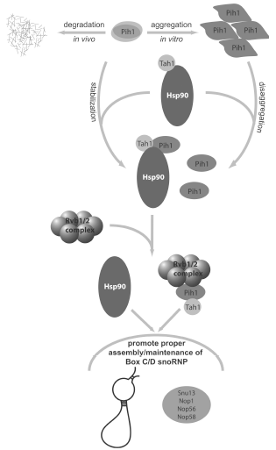
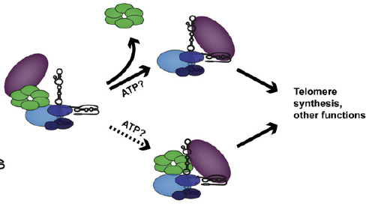
Role for Nop17 in telomerase assembly?
Pih1=Nop17
pontin/reptin
hTERT
Rvb1/2=pontin/reptin
=
Dyskerin/NOP10/NHP2/GAR1

Slide 57
Conclusions and Perspective
NOP17 is a potential interacting protein of telomerase
Immunoprecipitation against calmodulin binding peptide tagged hTERT confirms coimmunoprecipitates NOP17
Immunoprecipitation of FLAG-NOP17 co-immunoprecipitates telomerase activity
siRNA against NOP17 reduces telomerase activity
Overexpression of NOP17 prevents knockdown of telomerase activity
Assess if stable knockdown of NOP17 causes telomere shortening and reduced accumulation of hTR
Assess if hTR, and various snoRNAs (H/ACA and C/D) co-immunoprecipitate with NOP17

Slide 58
Characterization of unique properties of telomerase that regulate
telomere maintenance

Slide 59
Unique features of telomerase such as its repeat addition mechanism
of DNA polymerization could be excellent specific targets
What are the determinants of processivity?
In vitro studies implicate TR, TERT, telomere and telomerase-interacting
proteins (TPP1, Pot1), proofreading activities?
Does processivity in vitro correlate with telomere maintenance?
Emerging pharmacological and genetic evidence, primarily in yeast,
suggests that telomerase processivity is a significant determinant of
telomere length
However, human telomerase is much more processive than yeast
telomerase, and a fundamental unknown aspect of human
telomerase biology is the contribution of enzyme processivity to
telomere length maintenance and human cellular immortalization

Slide 60
Residues predicted to be important for processivity
V791Y
L866Y
W930F
hTERT Mutant | Previous Mutation (TERT species) | Phenotype of TERT mutant | Effect on telomere length | Reference
V791Y | LYID589AAAA (Est2p) | Decreased processivity | Telomere shortening | Lue et al, 2003
W930F | FCA720WCG (Est2p) | Increased processivity | Telomere length increase | Peng et al, 2001
L866Y | L813Y (tTERT) | Increased processivity | N/A | Bryan et al, 2000

Slide 61
In vitro-reconstituted hTERT RT domain mutants -W930F and -V791Y are less active than wild-type
W930F
V791Y
Wild-type
Notes:
1/50; 1/65; 1/100; 1/200; 1/250; 1/400

Slide 62
Processivity of in vitro-reconstituted hTERT-W930F and -V791Y enzymes are severely compromised
hTERT mutant | T2AG3 repeats
-W930F | 3
-V791Y | 4
-W930F
-V791Y
Wild-type
Wild-type

Slide 63
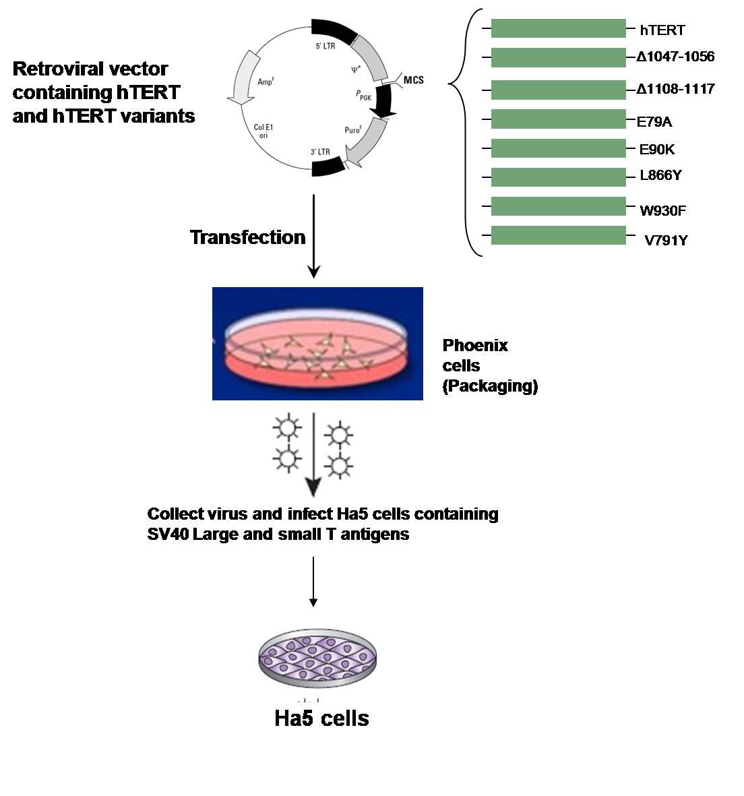
Mutant telomerases reconstituted in cells with limited lifespan
hTERT
V791Y
W930F
Growth
Activity
Protein expression
Telomere length
hTERT-/- hTR +/+
Fibroblasts expressing SV40 early region
Late passage, near crisis

Slide 64
Despite similar activities of in vitro-reconstituted enzymes, HA5 cells expressing hTERT-V791Y are unable to survive in culture, unlike HA5 cells expressing hTERT–W930F
Growth curve of mortal Ha5-hTERT mutant clones in culture
B
Population doublings
Population doublings
Days
Days
Population doublings

Slide 65
HA5 cells expressing hTERT-V791Y undergo apoptosis
W930FF2 PD174
WTM2 PD108
W930FF2 PD6
W930FF2 PD81
W930FF1 PD207
WTF1 PD6
WTF1 PD111
WTF1 PD207
V791YD PD5.6
W930FF1 PD81
WTM2 PD6
V791YD PD5.6
V791YE PD8.4
W930FF1 PD10.5
V791YD PD8.4
vectorB PD5.6
V791YE PD5.6
vectorC PD5.6
vectorH PD5.6
WTM2 PD207
hTERT
127Kd
Actin

Slide 66
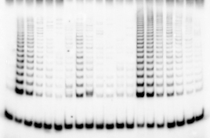
hTERT-V791Y and hTERT-W930F expressed in cells can reconstitute active enzymes
V791YD
V791YE
Wild-type F1
(-)
PD5.6
PD8.4
PD5.6
PD8.4
PD18
W930F F2
PD 12
W930F F2
PD 87
W930F F2
PD 207
Wild-type F1
PD 111

Slide 67
The processivity of mutant telomerase enzymes expressed in cells parallels the processivity of in vitro-reconstituted enzymes
Overexpress both hTERT and hTR components in 293T cells, collect extract and perform direct primer extension assay
W930F
293T
hTERT
V791Y

Slide 68
Critical telomere length
It is disputed whether it is one critically short telomere or a subset of critically short telomeres that directs the cell towards senescence/cell death
Critically short telomere: “SIGNAL FREE END” (SFE)
Telomerase
Telomerase
Kamranvar and Masucci, 2011

Slide 69
HA5 cells expressing hTERT-V791Y contain higher number of telomeric signal free ends than cells expressing hTERT–W930F
3000 telomere ends
% SFE
% SFE
1000 telomere ends

Slide 70
Possible identification of hTERT residues that regulate substrate utilization and/or recruitment to telomeres
Telomerase enzymes with similar activities and processivities function differently in telomere maintenance
Activities and processivities of in vitro-reconstituted enzymes and enzymes expressed in cells are similar
hTERT-W930F and -V791Y both accumulate SFEs however only -W930F is able to rescue those SFEs
We speculate that hTERT-W930F may more efficiently bind or elongate shorter substrates than hTERT-V791Y, or be more efficiently recruited to telomeres, allowing it to immortalize late passage HA5 cells with short telomeres
Conclusion

Slide 71
In vitro-expressed hTERT-L866Y reconstitutes similar levels of activity than wild-type enzyme
L866Y
Wild-type

Slide 72
In vitro-expressed hTERT-L866Y displays increased processivity compared to wild-type enzyme
L866Y
Negative
Wild-type
Notes:
Used first 4 repeats
Say did it two ways

Slide 73
Growth rate of HA5-hTERT-L866Y is similar to HA5 expressing wild-type hTERT despite increased processivity

Slide 74
hTERT-L866Y enzyme extracted from cells is highly processive
Processivity of L866Y
Fold over WT
L866Y
hTERT
293T

Slide 75
hTERT-L866Y-expressing clones display heterogenous telomere lengths
L866YM3 L866YF1 Wild-type M2
9 12 45 102 141
15 39 111 144 162 189
24 48 126 165 180 198
Digest with RsaI and HinfI
30
30
12
4.3
3.6
3.1
10
8
6
3
2
1.5
1.2
PFGE
10
8
6
3
2
1.5
1.2
Probe with radiolabelled (C3TA2)4
kb
8.18
6.59
4.0
3.17
3.15
4.16
3.9
4.0
4.5
4.0
3.85
4.78
4.36
3.48
3.58
3.83
3.17

Slide 76
hTERT-L866Y-expressing clones initially display an increase in telomere length followed by telomere length heterogeneity
L866YM3 Wild-type M2
9 12 45 102 141
24 48 126 165 180 198
30
10
8
6
3
2
1.5
1.2
10
8
6
3
2
1.5
1.2
kb
8.18
6.59
4.0
3.17
3.15
4.78
4.36
3.48
3.58
3.83
3.17

Slide 77
Negative regulation of telomere length by a telomeric DNA trimming mechanism
Overexpression of both telomerase components in telomerase positive cancer cells results in increased telomere length that eventually reaches a plateau, accompanied by ALT characteristics such as telomere length heterogeneity and extrachromosomal telomeric repeat (ECTR) DNA in the form of T circles (Pickett et al, 2009)
Not all characteristics of ALT were observed, including no telomere exchange events and no telomere dysfunction-induced foci
Are we observing telomere trimming in HA5 cells expressing L866Y?
hTERT-L866Y
Telomerase
Telomeres are longer at earlier PD but then shorten to a regulated, pre-determined length
Notes:
Although it has been suggested that APBs are directly implicated in telomere metabolism of ALT cells, their precise role and structure have remained elusive. Here we show that PML bodies in ALT cells associate with chromosome ends forming small, spatially well-defined clusters, containing on average 2–5 telomeres. Using an innovative approach that gently enlarges PML bodies in living cells while retaining their overall organization, we show that this physical enlargement of APBs spatially resolves the single telomeres in the cluster, but does not perturb the potential of the APB to recruit chromosome extremities. We show that telomere clustering in PML bodies is cell-cycle regulated and that unique telomeres within a cluster associate with recombination proteins. Enlargement of APBs induced the accumulation of telomere-telomere recombination intermediates visible on metaphase spreads and connecting heterologous chromosomes. The strand composition of these recombination intermediates indicated that this recombination is constrained to a narrow time window in the cell cycle following replication. These data provide strong evidence that PML bodies are not only a marker for ALT cells but play a direct role in telomere recombination, both by bringing together chromosome ends and by promoting telomere-telomere interactions between heterologous chromosomes.

Slide 78
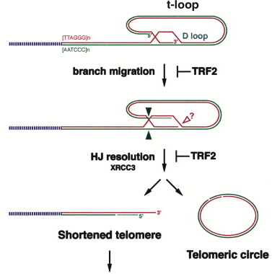
ECTR (T circle) formation
Wang et al, Cell, 2004

Slide 79
Presence of T-circles in late passage hTERT-L866Y-expressing cells suggest that trimming events are occurring
GM847 ALT cell
Ha5-hTERT-L866YF1
PD198
Ha5-hTERT
PD207

Slide 80
Regulation of telomere length and homeostasis by processivity
L866Y reconstituted telomerase exhibits increased processivity
Telomeres of hTERT-L866Y expressing cells are heterogeneous in length
T-circles indicative of telomere trimming is observed in late passage L866Y
Conclusion
We speculate that processivity is a regulator of telomere homeostasis
This would be the first report that trimming occurs physiologically in limited lifespan cells that require telomerase expression for cell survival versus in immortal telomerase-positive cells that overexpress both telomerase components
Notes:
Promyelocytic leukaemia nuclear bodies (PML-NBs) are one of numerous distinct subnuclear structures that are thought to compartmentalize the nucleus. They contain the PML protein and are associated with various nuclear functions, including transcriptional regulation, apoptosis and the maintenance of genome stability. Now, Stig Ove Bøe and co-authors report that PML-NBs are predetermined processing sites for damaged DNA

Slide 81
Acknowledgements
Collaborators and Colleagues
Kurt Dejgaard
Joachim Lingner
José-Arturo Londoño-Vallejo
Silvia Bacchetti
Lab members
Shusen Zhu
Yasmin D’Souza
Marie-Eve Brault
May Shawi
Catherine Lauzon
Sanjida Khondaker
Johanna Mancini
Josephine Chu
Nahid Golabi
Ricky Kwan

