Slide 1



INSTITUT LADY DAVIS DE RECHERCHES MÉDICALES / LADY DAVIS INSTITUTE FOR MEDICAL RESEARCH
Centre Bloomfield de
recherche sur le vieillissement
Cancer and Aging: Two Faces of the Same Coin
(3) Telomere Biology and Cancer-Part 1
The Bloomfield Centre
for Research in Aging

Slide 2
What is Cancer?
“Cancer is a group of diseases characterized by uncontrolled growth
and spread of abnormal cells. If the spread is not controlled, it can
result in death.”
The American Cancer Society
Peter Siegel, ANAT541B Molecular and Cellular Biology of Aging, McGill University

Slide 3
How does Cancer Arise?
- Through the accumulation of numerous genetic or epigenetic changes
within a cell, which together, impart a growth advantage
Currently, two models of cancer formation are considered
1) clonal evolution model
2) cancer stem cell hypothesis
Peter Siegel, ANAT541B Molecular and Cellular Biology of Aging, McGill University

Slide 4

Clonal Evolution Model
Normal somatic cell within a tissue
*
Over time, cell accumulates enough mutations to become cancerous
Increased proliferation of tumor leads to the clonal
expansion of cancer cells that harbor unique
mutations – which confer unique phenotypes onto
the cells that carry them. This accounts for the
heterogeneity that is characteristic of many cancers.
*
**
**
**
*
*
At some point, a certain population within the tumor could
acquire the ability for self-renewal – these cells would be
able to form a new tumor if transplanted into a new host.
**
**
*
Peter Siegel, ANAT541B Molecular and Cellular Biology of Aging, McGill University

Slide 5
Stem Cell Hypothesis for Cancer
Normal stem cell – gives rise to various cell types
within a tissue:
Capacity for
Self-Renewal
Accumulation of multiple mutations over time – Cancer Stem
Cell/Tumor Initiating Cell (considered a small proportion of
the tumor mass – these are the only cells capable of forming a
new tumor or giving rise to metastases)
*
The majority of the tumor is composed of cancer
cells that do not possess stem cell/tumor initiating
cell properties. They may acquire additional
mutations beyond those originally found in the
CSC that gave rise to them. However, none of these
cells can form a new tumor if transplanted into
another host.
*
*
*
Peter Siegel, ANAT541B Molecular and Cellular Biology of Aging, McGill University

Slide 6
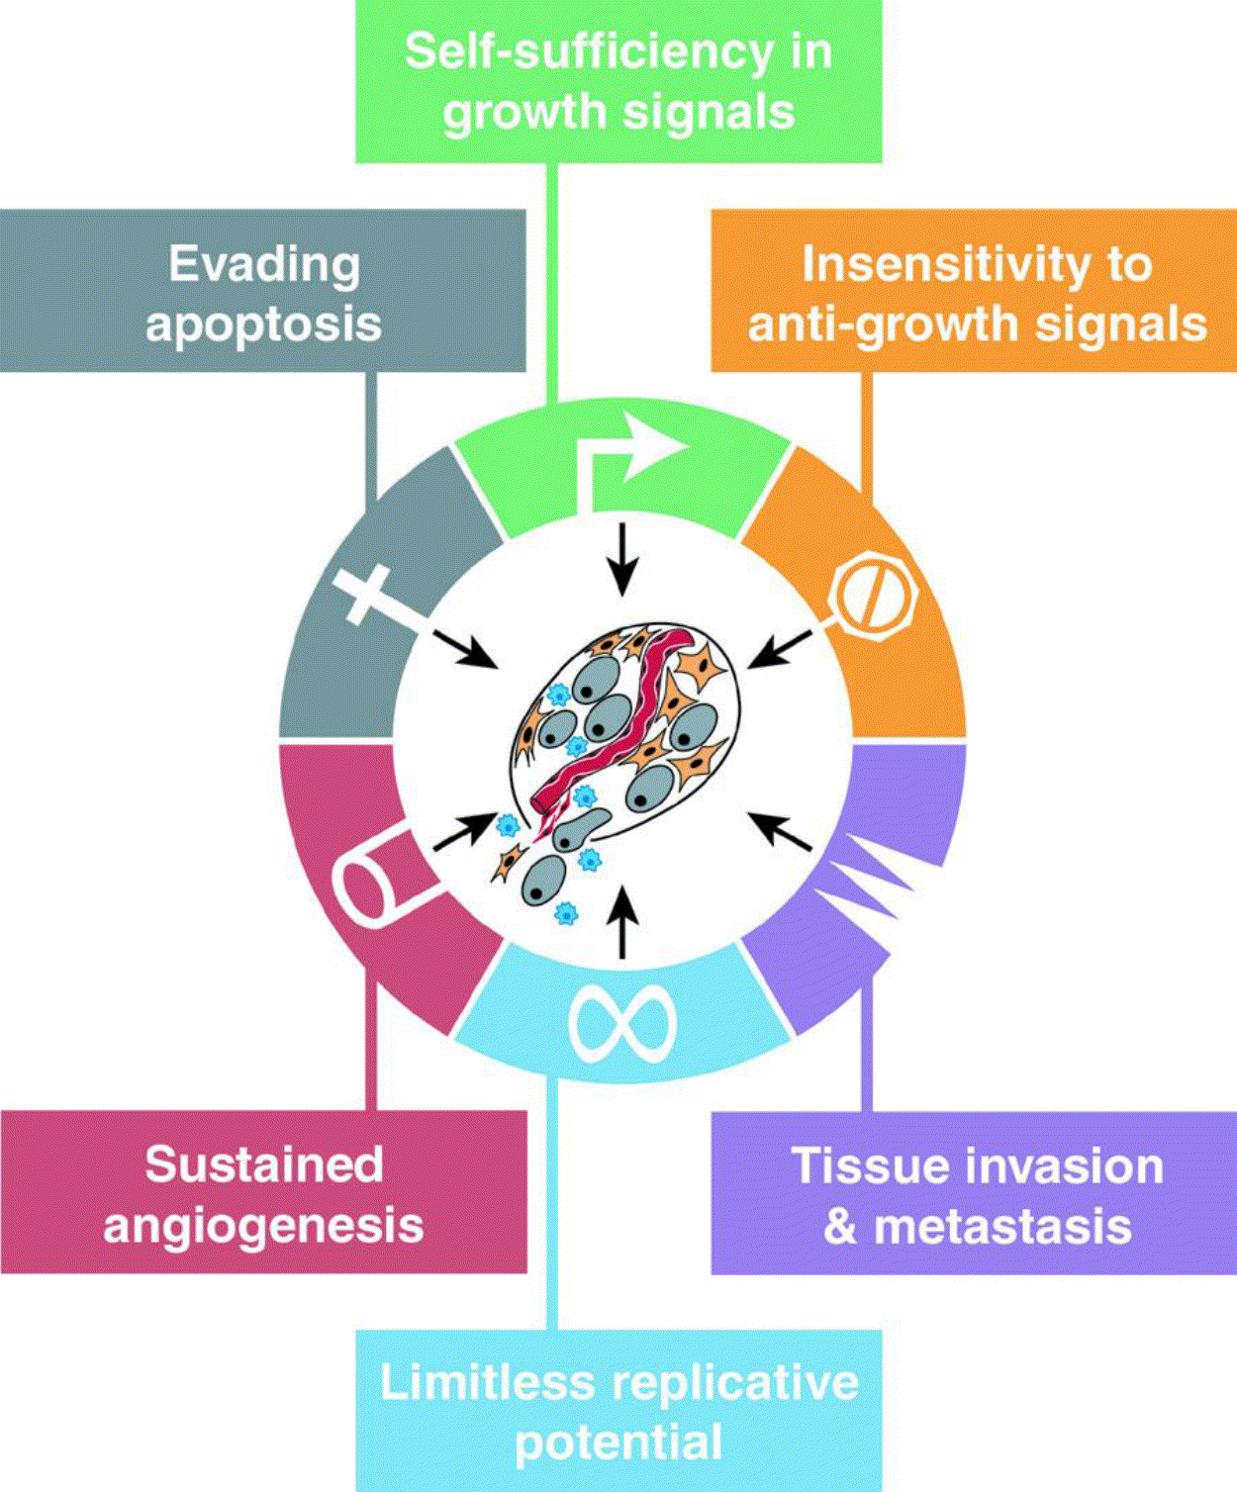
Phenotypic Characteristics of Cancer Cells
Most cancers must acquire several “functions”
in order to progress from their normal cellular
origins to invasive carcinoma
The molecular events (mutation, chromosome
loss/gain, translocations) that underlie these
functions can be different between different
types of cancer
The acquisition of these alterations within a
“prospective” cancer cell are sequential and
may account for the fact that many cancers
arise later in life
*
Critical Role for Telomere
Maintenance
Hanahan and Weinberg (2000). Cell 100(1), 57-70.
Peter Siegel, ANAT541B Molecular and Cellular Biology of Aging, McGill University

Slide 7
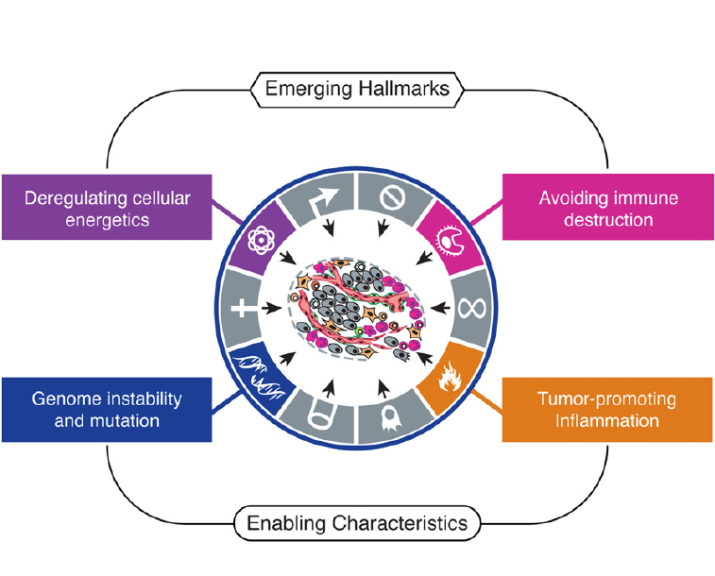
Emerging Hallmarks and Enabling Characteristics
Hanahan and Weinberg (2011). Cell. 144, 646-674.

Slide 8
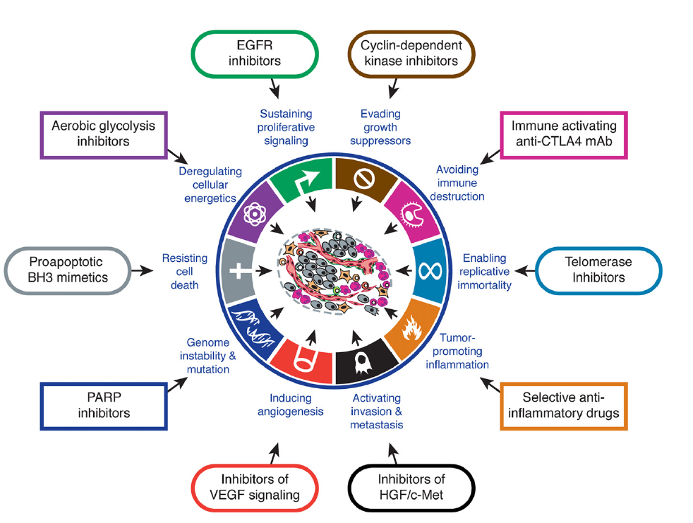
Therapeutic targeting of the hallmarks of cancer
Critical Role of Telomere
Maintenance
Hanahan and Weinberg (2011). Cell. 144, 646-674.

Slide 9
How Does Telomere Maintenance Affect
Replication Potential?
~ 8
Normal growth
Cellular Aging
Average Telomere
Length (kbp)
Senescence check-point
~ 5
Immortalized Cell
Cancer
~ 1-3
Crisis
*
0
0
~30-70
~70-90
Cell Doublings
Modified from Harley (2008). Nat Rev Cancer 8: 167-179
Peter Siegel, ANAT541B Molecular and Cellular Biology of Aging, McGill University

Slide 10
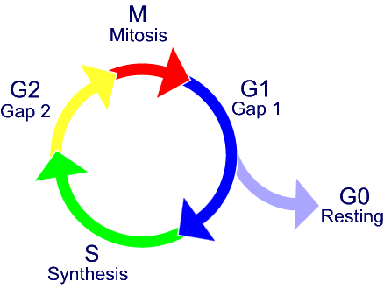
Checkpoints Controlling Cell Growth
DNA damage signal -
critically short telomere
Activate DNA damage response
Kinase (ATM/ATR)
Activate downstream substrates
Eg. p53
Cell Cycle Control
Transient Growth Arrest or Senescence
p21
Apoptosis
PUMA
Bax
Noxa
FAS
Cdk Inhibitors
p15
p16
p18
p19
p21
p27
p57
Cyclin A/B
Cdc2
Elimination of cells
that are beyond repair
Cyclin D/
Cdk4/6
Cyclin/Cdk
Cyclin A/
Cdk2
E2F
P
E2F
pRb
pRb
P
Peter Siegel, ANAT541B Molecular and Cellular Biology of Aging, McGill University

Slide 11
How Can Checkpoints be By-passed?
X
p53
Cell Cycle Control
p21
Apoptosis
PUMA
Bax
Noxa
FAS
p15
p16
p18
p19
p21
p27
p57
X
Cyclin A/B
Cdc2
Cyclin/Cdk
Cyclin D/
Cdk4/6
Cyclin A/
Cdk2
E2F
X
P
E2F
pRb
pRb
P
1) Loss of p53, pRb (tumor suppressor genes) X
2) Loss of Cdk inhibitors X
3) Overexpression of cyclin/Cdk complexes
4) Expression of Oncogenes (Ras, Myc)
Peter Siegel, ANAT541B Molecular and Cellular Biology of Aging, McGill University

Slide 12
Crisis
~ 8
Acquisition of mutations that by-pass
checkpoint
Cells can continue to proliferate until
their telomeres reach a critical length, at
which time chromosomal instability can
occur.
Average Telomere
Length (kbp)
~ 5
Abnormal Growth
Tumorigenesis
Crisis
~ 1-3
0
0
~30-70
~70-90
Cell Doublings
The majority of cells undergoing crisis due to critically short telomeres will undergo
apoptosis due to the fact that the chromosomal rearrangements are incompatible with
cell viability.
Cells must stabilize their telomeres in order to survive crisis. The period of genomic
instability can promote the emergence of malignant cells due to the accumulation of
mutations, gene amplifications, gene fusions or gene deletions
Peter Siegel, ANAT541B Molecular and Cellular Biology of Aging, McGill University

Slide 13
Telomere stability/Telomerase reactivation is a Key
Characteristic of Cancer Cells
~ 8
Activation of telomere maintenance
strategies
Average Telomere
Length (kbp)
~ 5
*
Immortalized Cell
Cancer
~ 1-3
Crisis
0
0
~30-70
~70-90
Cell Doublings
Dying Cells
Peter Siegel, ANAT541B Molecular and Cellular Biology of Aging, McGill University

Slide 14
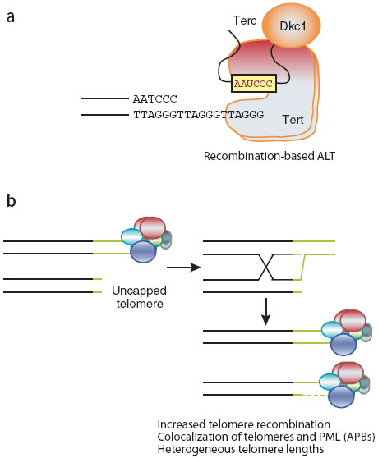
Strategies for Telomere Length Maintenance
ALT Mechanism
ALT- Alternative Lengthening of Telomeres
Characterized by heterogeneous telomere lengths, presence of PML-bodies
(regions in the nucleus that contain telomeric DNA, proteins involved in DNA repair
and recombination.)
Mechanism based on inter-chromosomal recombination
Results in telomeres that are very different in length
Cancers and cancer derived cell lines that display an ALT phenotype are typically
derived from mesenchymal tissues
Peter Siegel, ANAT541B Molecular and Cellular Biology of Aging, McGill University

Slide 15
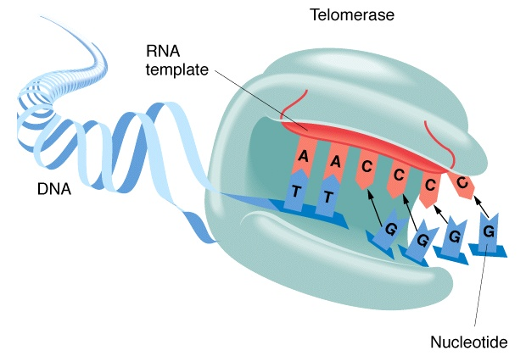
Strategies for Telomere Length Maintenance
Telomerase Activation
Telomerase mediated Telomere Maintenance
Activity of the Telomerase Complex – minimally composed of TERT (the telomerase reverse transcriptase) and the telomerase RNA template (TR, TER, TERC)
Upon activation, extends telomeric
repeats at chromosomal ends
(telomere lengths are more homogeneous)
Telomerase activation is typically observed in
epithelial cancers – represents the most common
cancer type in humans
Approximately 80-90% of human cancers display activation of telomerase compared to the remaining 10-20% that display features of ALT
Peter Siegel, ANAT541B Molecular and Cellular Biology of Aging, McGill University

Slide 16
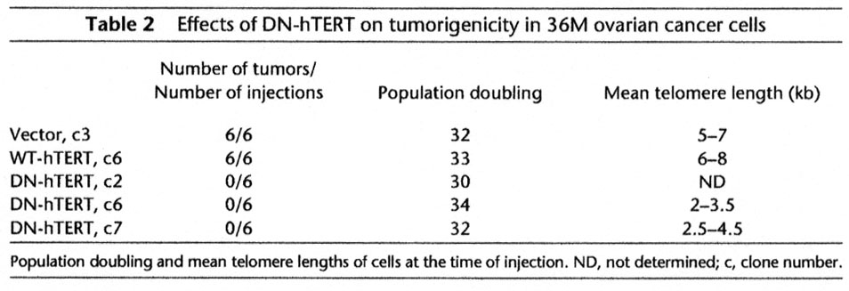
Is Telomerase Activity Required for Transformation?
Evidence from Cell Based Models
Inhibition of Telomerase (expression/function) in cancer cells using dominant-negative hTERT or inhibitors pharmacological inhibitors can induce telomere shortening in cancer cells
Suggests that telomerase activity/telomere integrity is required for the transformed
phenotype
Mutations in the reverse transcriptase domain – can function as a dominant-negative
Hahn et al., (1999). Nature Med 5, 1164-1170.
Peter Siegel, ANAT541B Molecular and Cellular Biology of Aging, McGill University

Slide 17
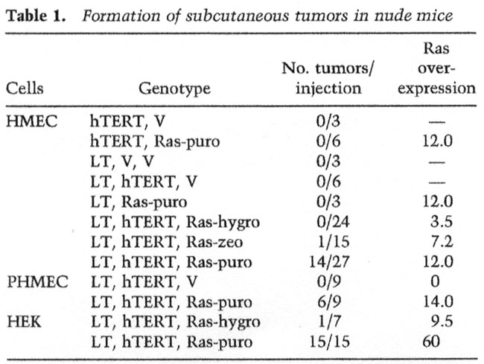
Is Telomerase Activity Sufficient for Transformation?
Evidence from Cell Based Models
Transformation of primary human
epithelial cells can be accomplished
by the introduction of hTERT,
SV40 Large T/small t, and Ras
hTERT expression alone is not
sufficient for transformation
Telomerase should not be
considered an oncogene!
Elenbaas et al., (2001). Genes Dev 15, 50-65.
Peter Siegel, ANAT541B Molecular and Cellular Biology of Aging, McGill University

Slide 18
Insights from Mouse Models Lacking Telomerase Function
Peter Siegel, ANAT541B Molecular and Cellular Biology of Aging, McGill University

Slide 19
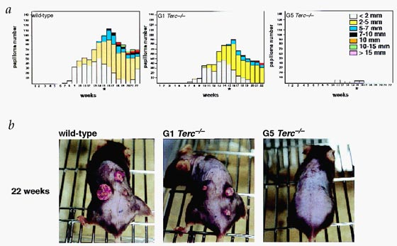
Telomerase Deficient-Mice (Late Generation) are Resistant to
Carcinogen-Induced Skin Tumorigenesis
140
Wild-type
140
G1 Terc -/-
140
G5 Terc -/-
130
130
130
120
120
120
110
110
110
100
100
100
90
90
90
80
80
80
papilloma number
papilloma number
papilloma number
70
70
70
60
60
60
50
50
50
40
40
40
30
30
30
20
20
20
10
10
10
1
2
3
4
5
6
7
8
9
10
11
12
13
14
15
16
17
18
19
20
21
22
1
2
3
4
5
6
7
8
9
10
11
12
13
14
15
16
17
18
19
20
21
1
22
2
3
4
5
6
7
8
9
10
11
12
13
14
15
16
17
18
19
20
21
22
weeks
weeks
weeks
Gonzalez-Suarez et al., (2000). Nature Genetics 26, 114-117.
These mice are in a wild-type genetic background – intact p53
Peter Siegel, ANAT541B Molecular and Cellular Biology of Aging, McGill University

Slide 20
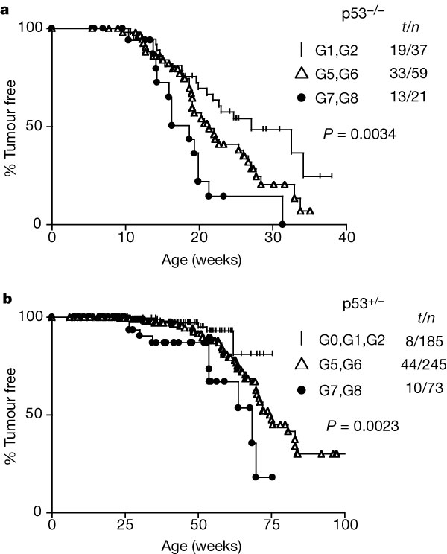
Telomerase-Deficiency (Late Generation) in the Context of p53 loss
Enhances Tumorigenesis
Majority Sarcomas, Lymphomas
No adenocarcinomas
Majority Sarcomas, Lymphomas
Emergence of Adenocarcinomas (9%)
Sarcomas, Lymphomas
No adenocarcinomas
Majority Adenocarcinomas (55%)
Remaining Sarcomas, Lymphomas (45%)
Majority of these tumors had lost the remaining p53 allele
Artandi et al., (2000). Nature 406, 641-645.
Peter Siegel, ANAT541B Molecular and Cellular Biology of Aging, McGill University

Slide 21
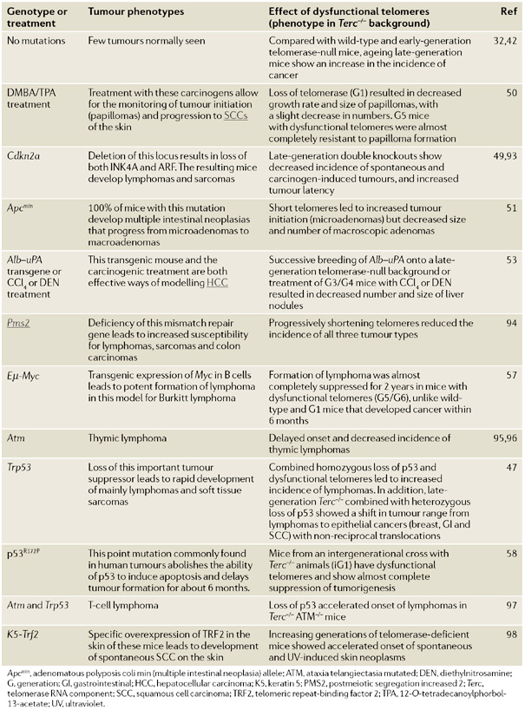
Intact checkpoint:
Loss of telomerase
results in impaired
tumorigenesis
Defective checkpoint:
Loss of telomerase
results in enhanced
tumorigenesis
Deng et al., (2008). Nat Rev Cancer; 8(6):450-458.
Peter Siegel, ANAT541B Molecular and Cellular Biology of Aging, McGill University

Slide 22
Potential Telomerase Functions?
Apoptosis
Stimulate Cell Proliferation
Active Telomerase Complex
DNA Damage
Promote Glucose Metabolism
?
?
Peter Siegel, ANAT541B Molecular and Cellular Biology of Aging, McGill University

Slide 23
Telomerase Functions in Apoptosis
Telomere Erosion
Critically Short Telomere
Activation of DNA Damage
Checkpoints – p53
Cell Death
However, numerous studies point to a role for hTERT in protecting cells from apoptosis that
is independent of its catalytic activity and telomere maintenance…
Cao et al., (2002). Oncogene 21:3130–3138.
Dudognon et al., (2004). Oncogene 23:7469–7474.
Rahman et al., (2005). Oncogene 24:1320–1327.
Xi et al., (2006). Apoptosis 11:789–798.
Del Bufalo et al., (2007). Cell Death Diff 12:1429–1438.
Peter Siegel, ANAT541B Molecular and Cellular Biology of Aging, McGill University

Slide 24
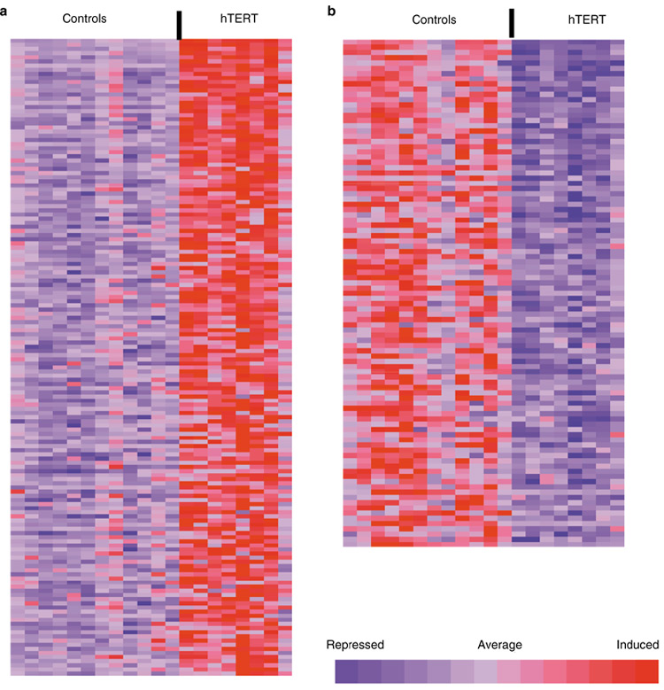
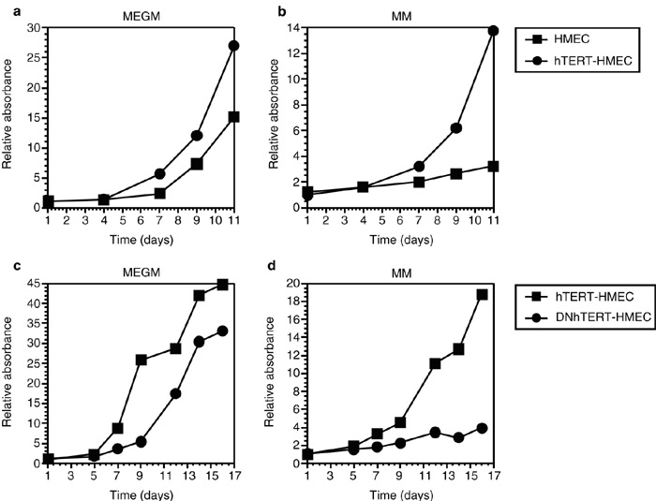
hTERT Induces Expression of Genes that Promote
Cell Proliferation
Smith et al., (2003). Nature Cell Biology 5, 474 - 479 (2003)
EGFR and bFGF where among the genes upregulated by hTERT expression – these
receptor tyrosine kinases have established roles in promoting cell proliferation
Peter Siegel, ANAT541B Molecular and Cellular Biology of Aging, McGill University

Slide 25
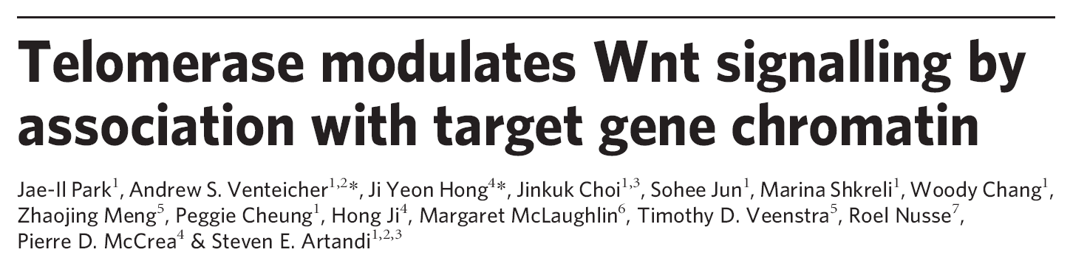
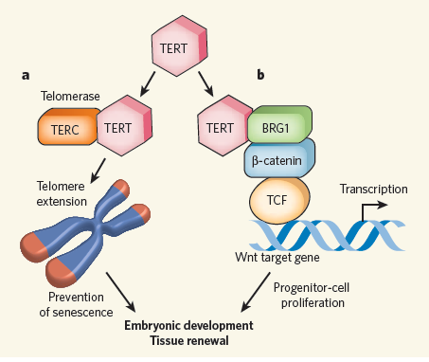
Millar, S.E. Nature 460, 44-45, 2009

Slide 26
Multiple Roles for Telomerase in Cancer
Peter Siegel, ANAT541B Molecular and Cellular Biology of Aging, McGill University

Slide 27
Therapeutic Opportunities
Peter Siegel, ANAT541B Molecular and Cellular Biology of Aging, McGill University

Slide 28
Why do Telomerase/Telomere Maintenance
Represent Good Targets?
Universal Target – estimated that 80-90% of all tumors are telomerase positive
Critical Target – we have seen that Telomerase activity/Telomere maintenance
is required for the transformed phenotype
Specificity – most normal human somatic cells have absent or very low telomerase
whereas cancer cells upregulate telomerase expression
Cancer Stem Cells – could afford the ability to target telomerase positive cancer
stem cells
Peter Siegel, ANAT541B Molecular and Cellular Biology of Aging, McGill University

Slide 29
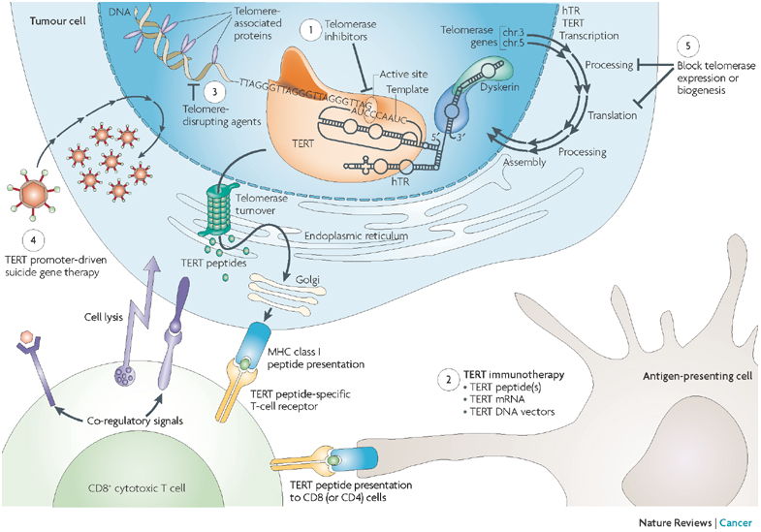
Intense Interest in Telomeres/Telomerase as a Clinical Target
Harley C (2008). Nat Rev Cancer 8: 167-179
Peter Siegel, ANAT541B Molecular and Cellular Biology of Aging, McGill University

Slide 30
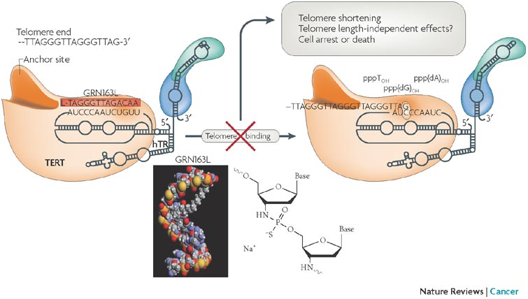
Strategies for Targeting Telomerase Activity
Telomerase RNA template antagonists
Telomerase RNA template antagonists:
These agents serve as competitive inhibitors that prevent the RNA component from
binding to telomeres (eg. GRN163L)
in clinical trials for chronic lymphocytic leukemia (CLL), multiple myeloma, lung cancer
Harley C (2008). Nat Rev Cancer 8: 167-179
Peter Siegel, ANAT541B Molecular and Cellular Biology of Aging, McGill University

Slide 31
Strategies for Targeting Telomerase Activity
Immunotherapy
Development of cytotoxic T cell (CTLs) responses against specific hTERT peptides
expressed on the surface of cancer cells. Phase I/II trials underway to assess toxicity
following immunization with hTERT - derived peptides
Furthest developed: GV1001 – 16mer hTERT peptide
(NSCLC, melanoma and pancreatic cancer trials)
ii) Stimulation of dendritic cells ex vivo (transfecting these cells with hTERT mRNA)
Dendritic cells process hTERT protein into multiple peptides – present multiple epitopes
Re-introduce the primed antigen presenting cells into the patient
facilitates CD8/CD4 T cell activation and anti-tumor immunity
Furthest developed: GRNVAC1 (mixture of mature autologous dendritic cells)
(renal cancer, advanced prostate cancer, AML)
Peter Siegel, ANAT541B Molecular and Cellular Biology of Aging, McGill University

Slide 32
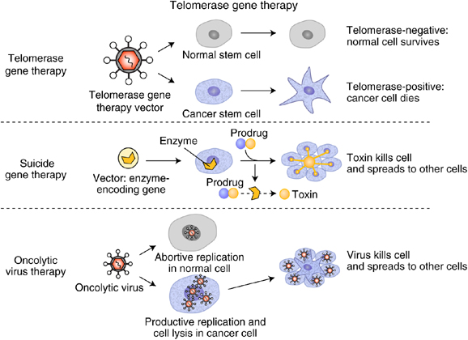
Strategies for Targeting Telomerase Activity
Gene Therapy
Delivery of anti-sense
RNA, siRNA, etc.
against Telomerase
Target Telomerase expression
hTERT promoter drives the
expression of a suicide gene
(NTR-nitroreductase)
Converts an inert drug into a
cytotoxic drug
hTERT promoter drives the
expression of a gene that is
essential for replication of an
adenovirus
(E1A and E1B)
Eg. OBP-301
Shay and Keith. British Journal of Cancer (2008). 98: 677-683
Peter Siegel, ANAT541B Molecular and Cellular Biology of Aging, McGill University

Slide 33
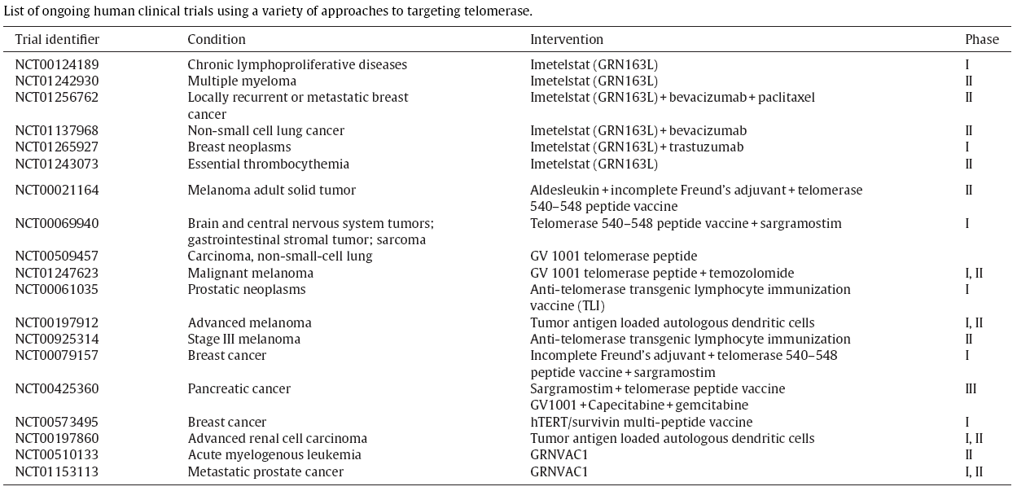
List of ongoing human clinical trials using a
variety of approaches to targeting telomerase
Buseman, C.M. et al. 2012. Is telomerase a viable target in cancer? Mutation Research 730, 90-97.

Slide 34
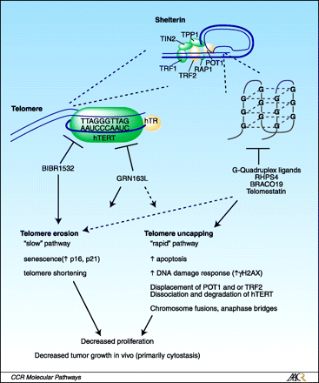
Strategies for Targeting Telomeres
“Telomere Uncapping”
“Uncapping” reagents that disrupt the
structure of telomere ends
G-quadruplex reagents
BRACO19
RHPS4
Telomestatin
Advantages – do not require telomere
erosion, no lag period
Kelland. Clin Cancer Res (2007). 13:4960-4963
Peter Siegel, ANAT541B Molecular and Cellular Biology of Aging, McGill University

Slide 35
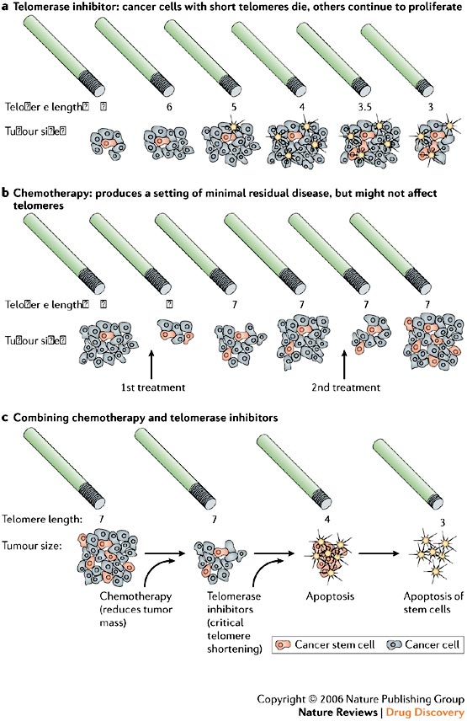
Anticipating outcomes of
Telomerase inhibitors on
Cancer Response
Telomerase inhibition as a single agent
may be ineffective – lag time allows
cancer cells to adapt. Leads to
recurrence.
Chemotherapy – de-bulk majority of tumor
cells – not effective against tumor stem
cells? Leads to recurrence.
Combination – Conventional chemotherapy
kills majority of tumor cells. Telomerase
inhibition can also target cancer stem cells?
In this way, reduce recurrence.
Shay and Wright. Nat Rev Drug Discov. 2006 5(7):577-584.
Peter Siegel, ANAT541B Molecular and Cellular Biology of Aging, McGill University

Slide 36
Issues to Consider When Targeting Telomerase Function
Although most normal tissues are telomerase negative – certain cell types do express
active telomerase (hematopoetic progenitor cells, stem cells, cells in tissues that are
subject to high turnover (epidermis, mammary epithelium, colonic epithelium).
Telomerase activity is low in these cells – and expression could be intermittent – thus,
this may not be a large concern
Many telomerase therapies (used in isolation) will be associated with a significant lag
while telomeres erode. Could be alleviated by using combination therapies.
Strategies that result in telomere uncapping could be useful – does not require telomere
erosion to occur.
Peter Siegel, ANAT541B Molecular and Cellular Biology of Aging, McGill University

Slide 37
Issues to Consider When Targeting Telomerase Function
3) The genotype of the tumor being treated – in the context of p53 positive tumors,
inhibiting telomerase could be beneficial. However, in, p53-/- tumors – is there a
danger in the induction of further genetic instability (could this lead to a more
aggressively metastatic tumor than the one initially treated?)
The observation that fewer genetic changes are observed going from DCIS to
invasive cancer (breast) may argue against this concern
4) Drugs targeting telomerase may result in the evolution of cancer cells that are
telomerase independent (drug resistance) through the upregulation of the ALT
pathway
However, some evidence exists that tumor cells using the ALT pathway are not as
aggressive as telomerase positive cancer cells
Peter Siegel, ANAT541B Molecular and Cellular Biology of Aging, McGill University

