Slide 1

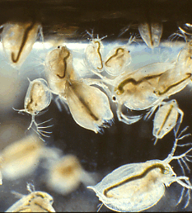
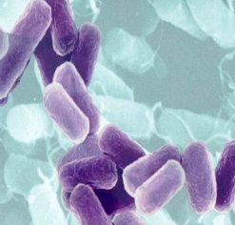
Ecotoxicological bioassays
Jakub Hofman & Klára Hilscherová

Slide 2
Introduction

Slide 3
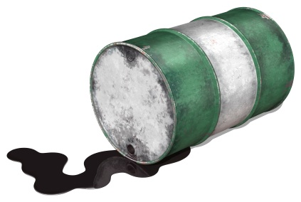
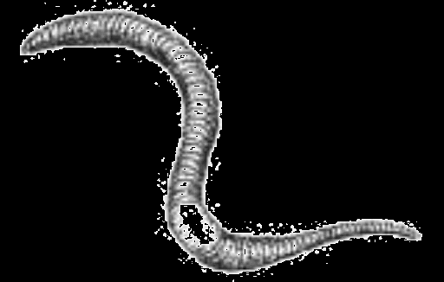
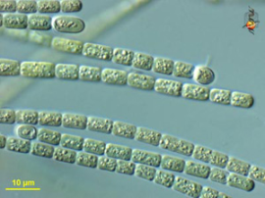
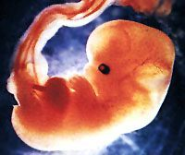
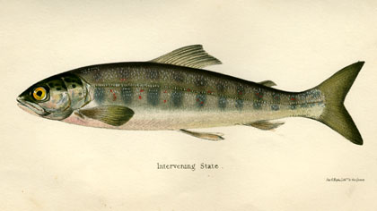
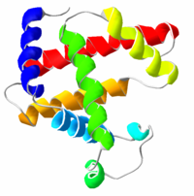
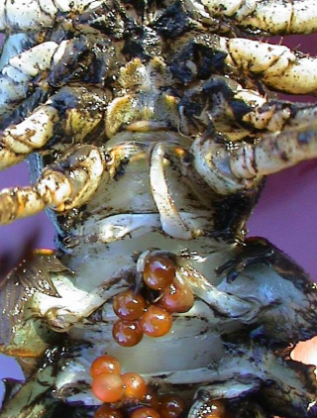
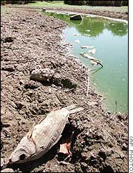

CHEMICAL ENTERS THE ENVIRONMENT
CHEMICAL ENTERS THE ORGANISM
LEVELS, FATE, PROCESSES
Toxikokinetics
biotransformation
bioactivation
excretion / sequestration
Bioavailable fraction
Target site
“EFFECTS”
?
?
“EXPOSURE”
acute
chronic

Slide 4
Role of ecotoxicology in environmental protection
FOCUS:
Investigate relationships between organisms and contaminants
ROLE:
Scientific basis of env. protection; know-how; rational env. protection
Activities:
Provide TOOLS for praxis:
  (Eco)toxicity testing = bioassays
  Chemical and pesticides
  Testing wastes, contaminated sites
  Environmental quality assessment
Research of:
Principles …
Mechanisms …
Fate and bioavailability
Mixture toxicity
Biodiversity …

Slide 5
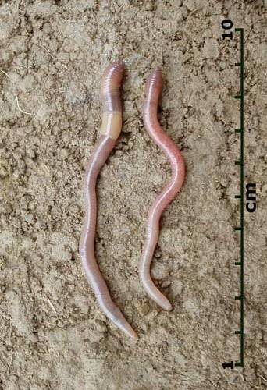
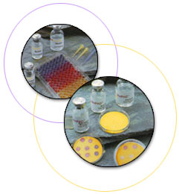
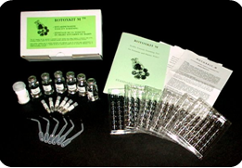
Bioassays, ecotoxicity tests
tools (methods) for ecotoxicological research and praxis – for environmental legislation and protection
biota (tissue, organism, population, ecosystem …) is exposed to chemicals (and/or other factors), in the lab (controlled conditions) or in the field (less controlled) and effects are evaluated and related to exposure
WHY? To understand the cause-effects relationships (causality, dose-response …)

Slide 6
Testing effects of chemicals and risk assessment
Time: NOW !
Risk assessment
PROSPECTIVE
RETROSPECTIVE
DISASTERS
PREDICTIONS for future
Risk assessment
Bioassessment
Field assessment
Monitoring
Bioassessment
Field assessment
Monitoring
MIXTURES OF CHEMICALS
CONTAMINATED ENVIRONMENT
Lab studies
Lab studies
MIXTURES OF
TOXICANTS
INDIVIDUAL
TOXICANTS
Most common in practice
Simulated small
ecosystems

Slide 7
Why bioassays?
Chemical analyses only are not able to identify risks properly because:
Real exposure is different – bioavailability in particular situation
Pollutant mixture - always in real ecosystems
Matrix itself has effects or interacts with effects of contaminants
Analytical methods are limited vs. wide spectrum of possibly toxic chemicals

Slide 8
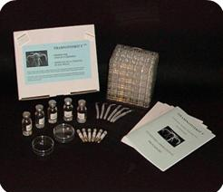
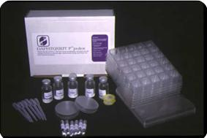
Bioassay development
old bioassays – acute, ecologically irrelevant, testing pure chemicals, pesticides
new bioassays – sublethal endpoints, ecological relevancy, chemical mixtures, miniaturization, simple to measure endpoints

Slide 9
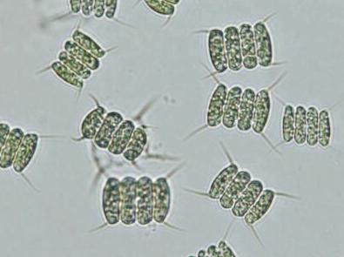
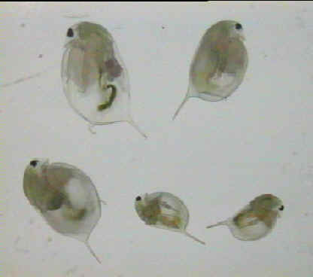
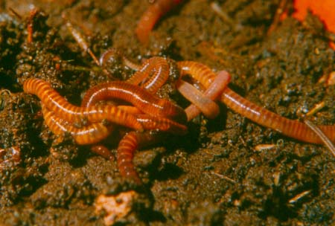
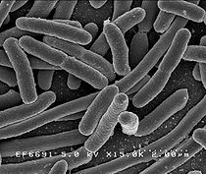
Differenciation of bioassays
major trophic levels
  producers
  consumers
  destruents
aquatic / soil
single / multiple species
acute / chronic effects
contact bioassays / eluate bioassays / TIE
legislative / standardized (practical) / experimental (research)
toxicity / bioaccumulation / biodegradation tests

Slide 10
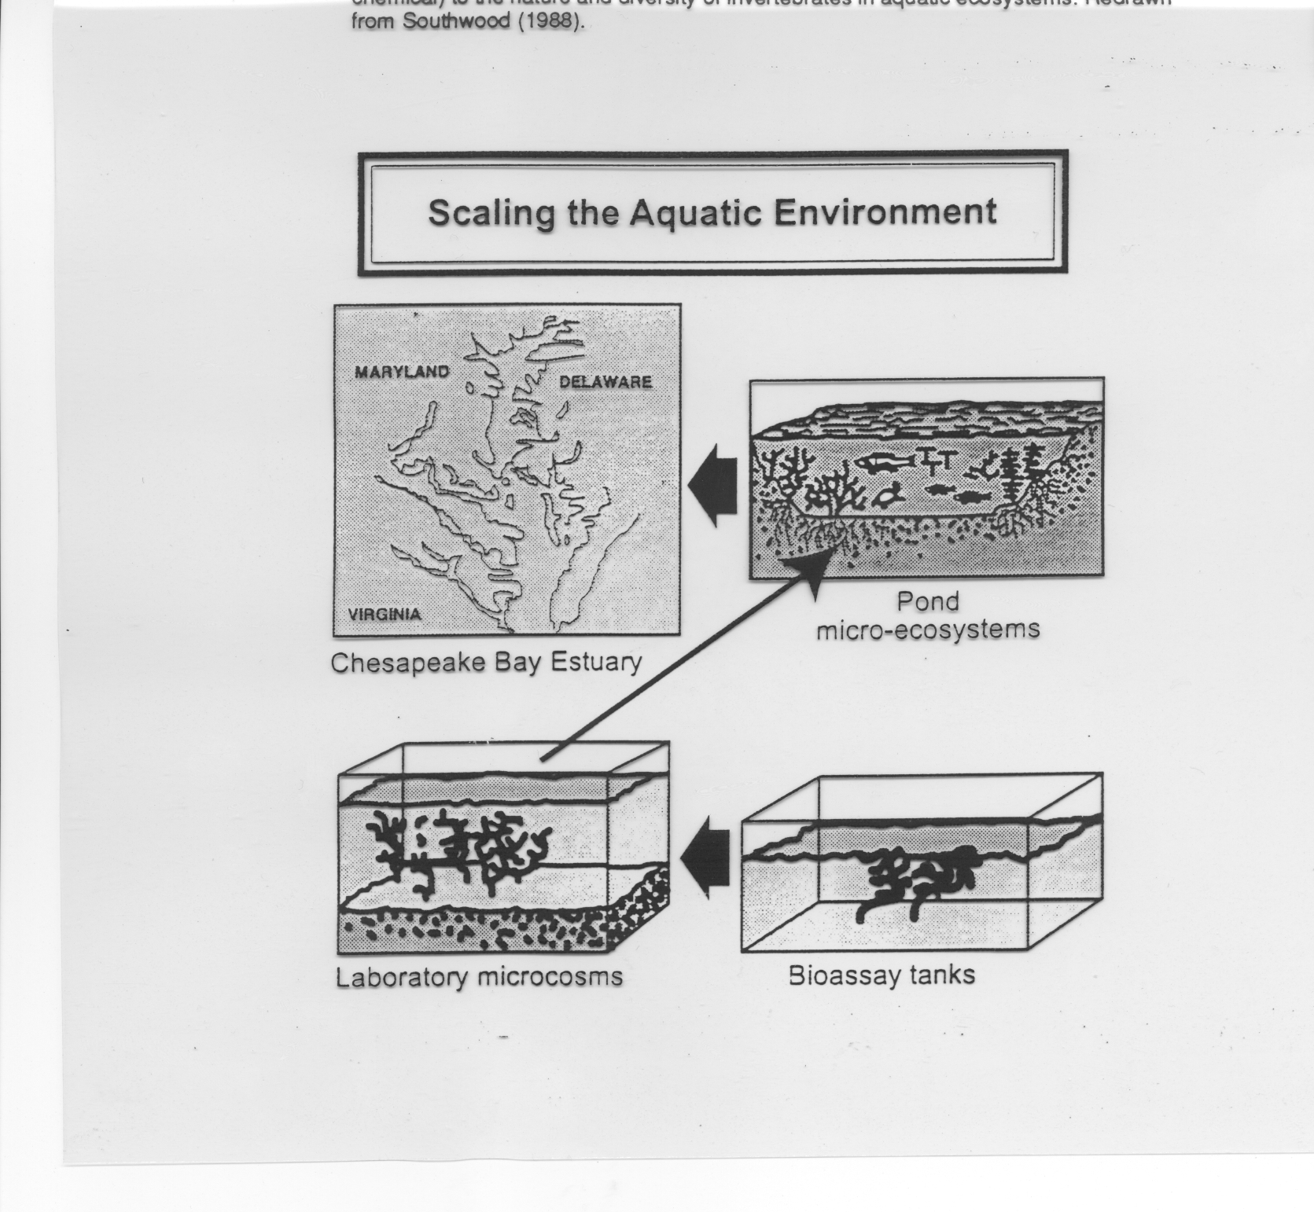
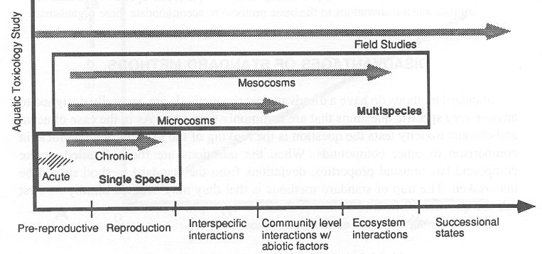
Differenciation of bioassays
size, complexity
ecological relevancy
controling the conditions
old / fresh contamination
no. of species
…
cell lines

Slide 11
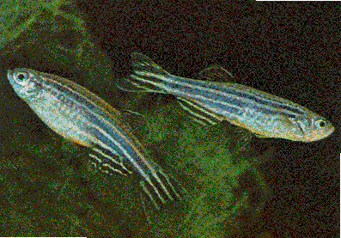
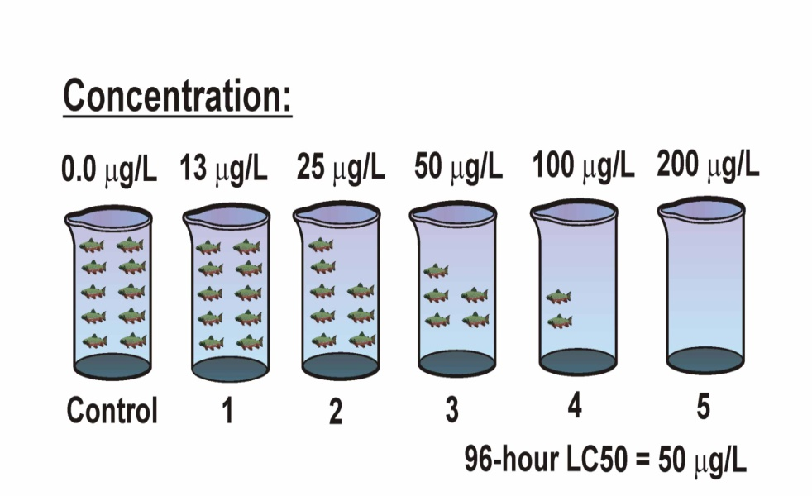
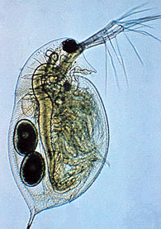
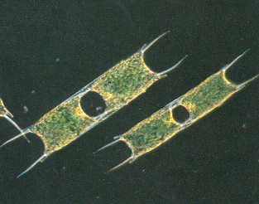
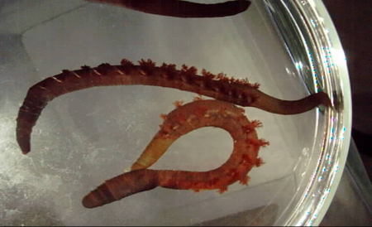
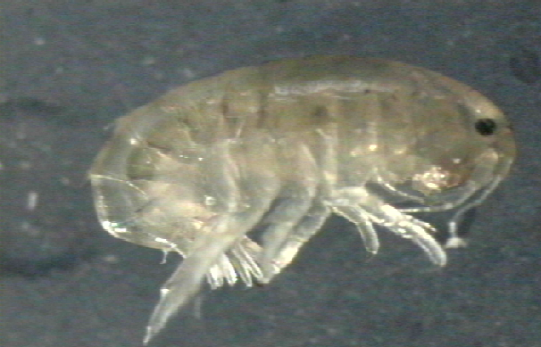
1 - Laboratory studies
Cu addition
Effect concentrations expressed in total/dissolved Cu
??? Safe concentrations ???

Slide 12
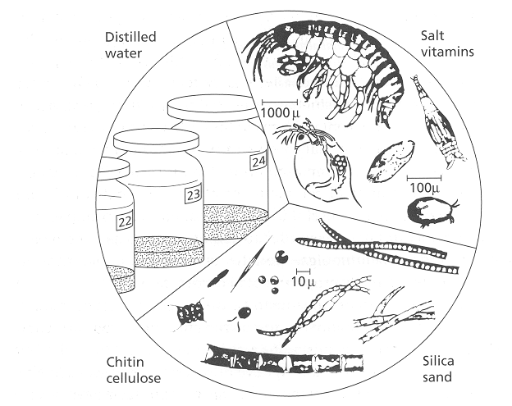
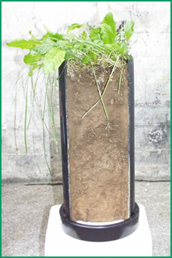
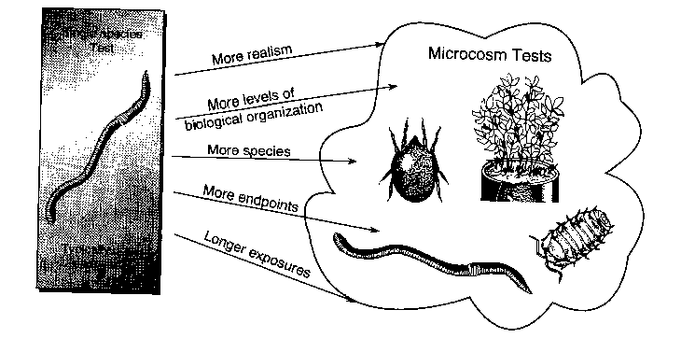
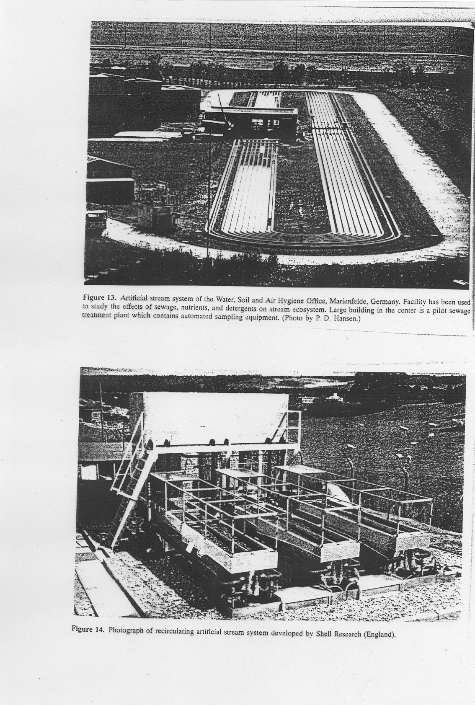
2 - Micro & Mesocosms
Expensive & time consuming (e.g. Pesticide testing)
Variable results (natural variability …)
Higher ecological relevancy

Slide 13
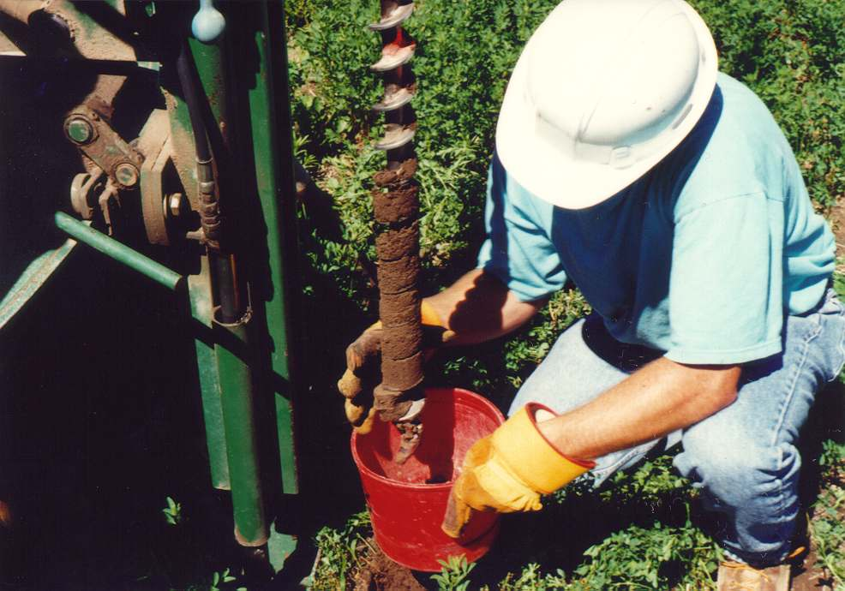
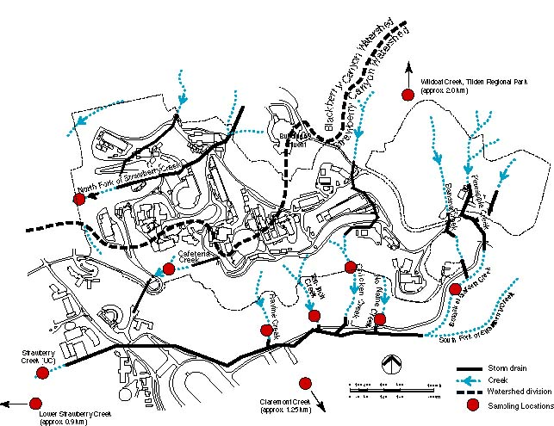
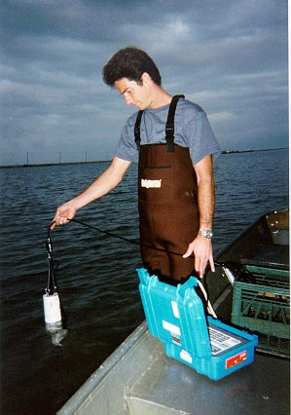
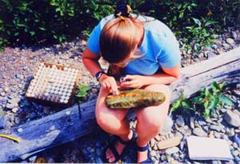
3 - Field assessment / biomonitoring
Complex issue (chemistry, biology, geology, climate, pedology ..)
Ecotoxicology + Ecology
Comparing „contaminated“ to „control“ sites

Slide 14
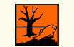
Use of bioassays
Testing chemicals
  Traditional / bioassays developed to assess individual chemicals
  Advantage: Standardized approaches
    OECD – Guideline methods - series „2“ Effects on biota
    ISO methods
      E.g. Fish tests - OECD 203 / ISO 7346
      E.g. D. magna - OECD 202 / ISO 6341
  Disadvantage: Limited ecological relevance
    often acute tests only
    „too standardized…“ (? Less representative ?)
    does not assess/consider bioavailability
    no consideration of mixture effects
    no consideration of specific modes of action
    no consideration of ecological situation

Slide 15
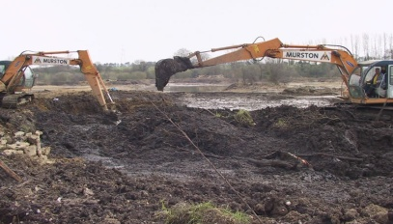
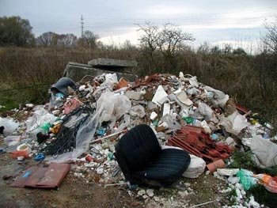
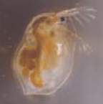
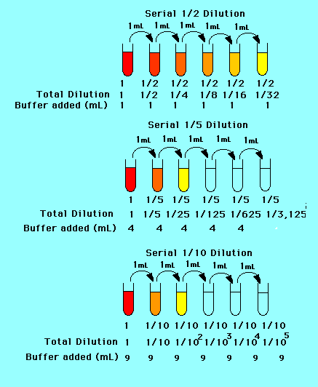
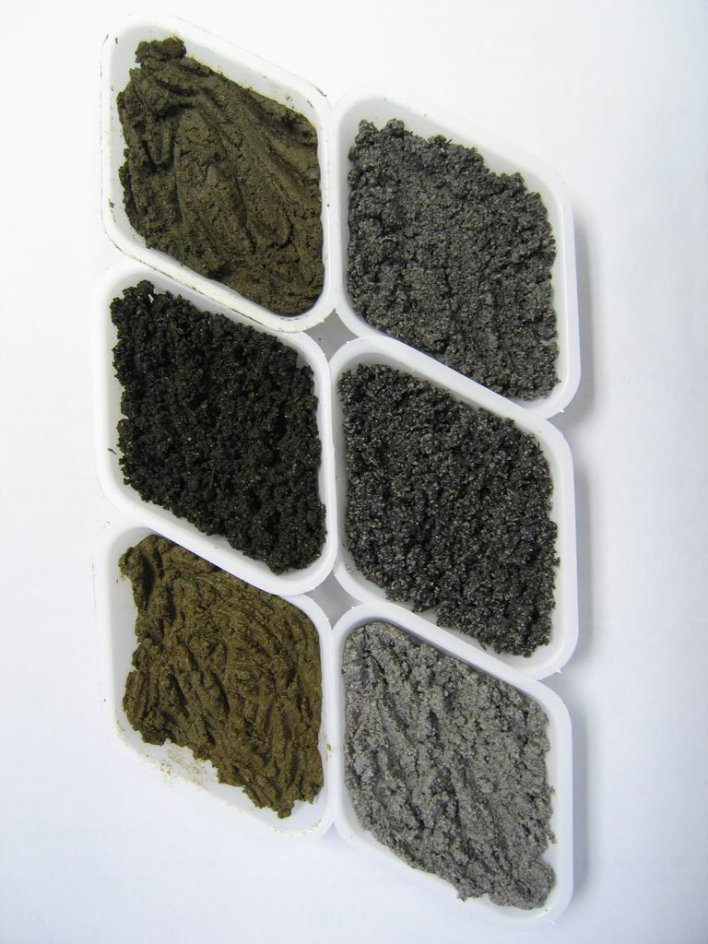
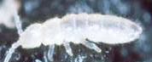
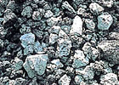
Use of bioassays
Testing toxicity of natural contaminated matrices
  Rather new in ecotoxicology – many open challenges
    Whole effluent toxicity testing (WET)
    Contact soil toxicity assays
  More complex and more complicated
    „cause-effects“ often not clear
      Natural variability in matrices
      Algal tests - nutrients (Nitrogen, Phosporus) >> Toxic compounds
eluate 1:10
Control soil
Mixture at different ratios
waste

Slide 16

OECD guidelines http://www.oecd.org/document/40/0,3746,en_2649_34377_37051368_1_1_1_1,00.html
Organization for Economic Cooperation Development
Aquatic organisms
Test No. 201: Alga, Growth Inhibition Test | 11 July 2006
Test No. 221: Lemna sp. Growth Inhabition Test | 11 July 2006
Test No. 202: Daphnia sp. Acute Immobilisation Test | 23 Nov 2004
Test No. 211: Daphnia magna Reproduction Test | 16 Oct 2008
Test No. 203: Fish, Acute Toxicity Test | 17 July 1992
Test No. 204: Fish, Prolonged Toxicity Test: 14-Day Study | 04 Apr 1984
Test No. 210: Fish, Early-Life Stage Toxicity Test | 17 July 1992
Test No. 212: Fish, Short-term Toxicity Test on Embryo and Sac-Fry Stages | 21 Sep 1998
Test No. 215: Fish, Juvenile Growth Test | 21 Jan 2000
Test No. 229: Fish Short Term Reproduction Assay | 08 Sep 2009
Test No. 230: 21-day Fish Assay | 08 Sep 2009
Test No. 231: Amphibian Metamorphosis Assay | 08 Sep 2009
Sediment organisms
Test No. 218: Sediment-Water Chironomid Toxicity Using Spiked Sediment | 23 Nov 2004
Test No. 219: Sediment-Water Chironomid Toxicity Using Spiked Water | 23 Nov 2004
Test No. 233: Sediment-Water Chironomid Life-Cycle Toxicity Test Using Spiked Water or Spiked Sediment | 23 July 2010
Test No. 225: Sediment-Water Lumbriculus Toxicity Test Using Spiked Sediment | 15 Oct 2007

Slide 17
OECD guidelines http://www.oecd.org/document/40/0,3746,en_2649_34377_37051368_1_1_1_1,00.html
Organization for Economic Cooperation Development
Soil organisms
Test No. 208: Terrestrial Plant Test: Seedling Emergence and Seedling Growth Test | 17 Aug 2006
Test No. 227: Terrestrial Plant Test: Vegetative Vigour Test | 17 Aug 2006
Test No. 207: Earthworm, Acute Toxicity Tests | 04 Apr 1984
Test No. 220: Enchytraeid Reproduction Test | 23 Nov 2004
Test No. 222: Earthworm Reproduction Test (Eisenia fetida/Eisenia andrei) | 23 Nov 2004
Test No. 228: Determination of Developmental Toxicity of a Test Chemical to Dipteran Dung Flies(Scathophaga stercoraria L. (Scathophagidae), Musca autumnalis De Geer (Muscidae)) | 16 Oct 2008
Test No. 232: Collembolan Reproduction Test in Soil | 08 Sep 2009
Test No. 226: Predatory mite (Hypoaspis (Geolaelaps) aculeifer) reproduction test in soil | 16 Oct 2008
Test No. 216: Soil Microorganisms: Nitrogen Transformation Test | 21 Jan 2000
Test No. 217: Soil Microorganisms: Carbon Transformation Test | 21 Jan 2000
Other tests
Test No. 213: Honeybees, Acute Oral Toxicity Test | 21 Sep 1998
Test No. 214: Honeybees, Acute Contact Toxicity Test | 21 Sep 1998
Test No. 205: Avian Dietary Toxicity Test | 04 Apr 1984
Test No. 206: Avian Reproduction Test | 04 Apr 1984
Test No. 223: Avian Acute Oral Toxicity Test | 23 July 2010

Slide 18

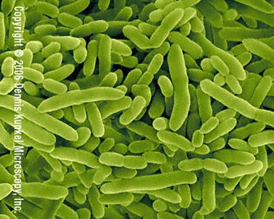
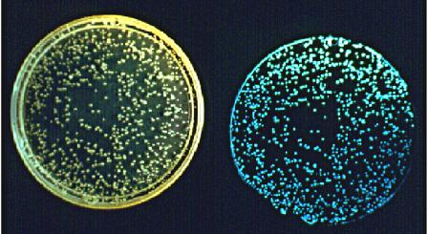
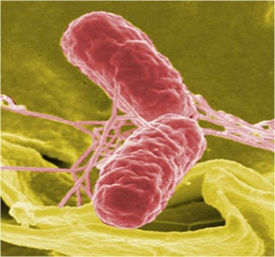

ISO guidelines
International Standardization Organization
International Standardization Organization
ISO guidelines
Aquatic microorganisms
ISO 10712:1995 | Water quality -- Pseudomonas putida growth inhibition test (Pseudomonas cell multiplication inhibition test)
ISO 11348-1:2007 | Water quality -- Determination of the inhibitory effect of water samples on the light emission of Vibrio fischeri (Luminescent bacteria test) -- Part 1: Method using freshly prepared bacteria
ISO 11348-2:2007 | Water quality -- Determination of the inhibitory effect of water samples on the light emission of Vibrio fischeri (Luminescent bacteria test) -- Part 2: Method using liquid-dried bacteria
ISO 11348-3:2007 | Water quality -- Determination of the inhibitory effect of water samples on the light emission of Vibrio fischeri (Luminescent bacteria test) -- Part 3: Method using freeze-dried bacteria
ISO 13641-1:2003 | Water quality -- Determination of inhibition of gas production of anaerobic bacteria -- Part 1: General test
ISO 13641-2:2003 | Water quality -- Determination of inhibition of gas production of anaerobic bacteria -- Part 2: Test for low biomass concentrations
ISO 13829:2000 | Water quality -- Determination of the genotoxicity of water and waste water using the umu-test
ISO 16240:2005 | Water quality -- Determination of the genotoxicity of water and waste water -- Salmonella/microsome test (Ames test)
ISO/DIS 11350 | Water quality -- Determination of the genotoxicity of water and waste water -- Salmonella/microsome fluctuation test (Ames fluctuation test)
ISO 15522:1999 | Water quality -- Determination of the inhibitory effect of water constituents on the growth of activated sludge microorganisms
ISO 21338:2010 | Water quality -- Kinetic determination of the inhibitory effects of sediment, other solids and coloured samples on the light emission of Vibrio fischeri (kinetic luminescent bacteria test)
ISO 8192:2007 | Water quality -- Test for inhibition of oxygen consumption by activated sludge for carbonaceous and ammonium oxidation
ISO 9509:2006 | Water quality -- Toxicity test for assessing the inhibition of nitrification of activated sludge microorganisms

Slide 19
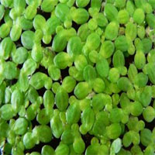
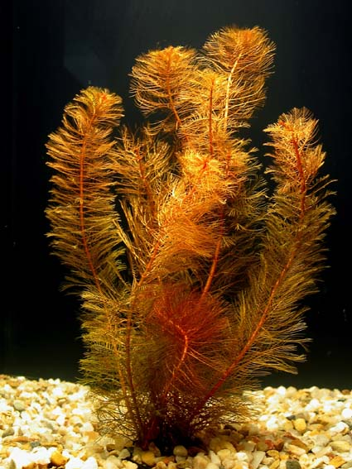
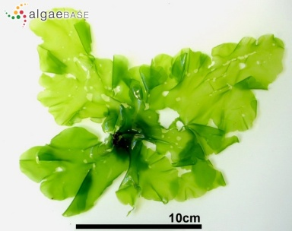
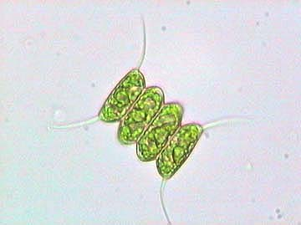
ISO guidelines
International Standardization Organization
International Standardization Organization
ISO guidelines
Aquatic plants
ISO 20079:2005 | Water quality -- Determination of the toxic effect of water constituents and waste water on duckweed (Lemna minor) -- Duckweed growth inhibition test
ISO 8692:2004 | Water quality -- Freshwater algal growth inhibition test with unicellular green algae
ISO/CD 16191 | Water quality - Determination of the toxic effect of sediment and soil on the growth behaviour of Myriophyllum aquaticum - Myriophyllum test
ISO 10253:2006 | Water quality -- Marine algal growth inhibition test with Skeletonema costatum and Phaeodactylum tricornutum
ISO 10710:2010 | Water quality -- Growth inhibition test with the marine and brackish water macroalga Ceramium tenuicorne
ISO 14442:2006 | Water quality -- Guidelines for algal growth inhibition tests with poorly soluble materials, volatile compounds, metals and waste water
ISO/DIS 13308 | Water quality -- Toxicity test based on reproduction inhibition of the green macroalga Ulva pertusa
ISO/TR 11044:2008 | Water quality -- Scientific and technical aspects of batch algae growth inhibition tests

Slide 20






ISO guidelines
ISO guidelines
International Standardization Organization
Aquatic invertebrates
ISO 6341:1996 | Water quality -- Determination of the inhibition of the mobility of Daphnia magna Straus (Cladocera, Crustacea) -- Acute toxicity test
ISO 10706:2000 | Water quality -- Determination of long term toxicity of substances to Daphnia magna Straus (Cladocera, Crustacea)
ISO/DIS 14380 | Water quality -- Determination of the acute toxicity to Thamnocephalus platyurus (Crustacea, Anostraca)
ISO/CD 16303 | Water quality -- Determination of toxicity of fresh water sediments using Hyalella azteca
ISO 10872:2010 | Water quality -- Determination of the toxic effect of sediment and soil samples on growth, fertility and reproduction of Caenorhabditis elegans (Nematoda)
ISO 16712:2005 | Water quality -- Determination of acute toxicity of marine or estuarine sediment to amphipods
ISO 20665:2008 | Water quality -- Determination of chronic toxicity to Ceriodaphnia dubia
ISO 20666:2008 | Water quality -- Determination of the chronic toxicity to Brachionus calyciflorus in 48 h
ISO 14669:1999 | Water quality -- Determination of acute lethal toxicity to marine copepods (Copepoda, Crustacea)
ISO/DIS 14371 | Water quality -- Determination of freshwater-sediment subchronic toxicity to Heterocypris incongruens (Crustacea, Ostracoda)
ISO 7828:1985 | Water quality -- Methods of biological sampling -- Guidance on handnet sampling of aquatic benthic macro-invertebrates
ISO 8265:1988 | Water quality -- Design and use of quantitative samplers for benthic macro-invertebrates on stony substrata in shallow freshwaters
ISO 8689-1:2000 | Water quality -- Biological classification of rivers -- Part 1: Guidance on the interpretation of biological quality data from surveys of benthic macroinvertebrates
ISO 8689-2:2000 | Water quality -- Biological classification of rivers -- Part 2: Guidance on the presentation of biological quality data from surveys of benthic macroinvertebrates
ISO/DIS 10870 | Water quality -- Guidelines for the selection of sampling methods and devices for benthic macroinvertebrates in fresh waters
ISO/WD 16778 | Water quality -- Calanoid copepod development test with Acartia tonsa

Slide 21

ISO guidelines
International Standardization Organization
ISO guidelines
Aquatic vertebrates
ISO 15088:2007 | Water quality -- Determination of the acute toxicity of waste water to zebrafish eggs (Danio rerio)
ISO 7346-1:1996 | Water quality -- Determination of the acute lethal toxicity of substances to a freshwater fish [Brachydanio rerio Hamilton-Buchanan (Teleostei, Cyprinidae)] -- Part 1: Static method
ISO 7346-2:1996 | Water quality -- Determination of the acute lethal toxicity of substances to a freshwater fish [Brachydanio rerio Hamilton-Buchanan (Teleostei, Cyprinidae)] -- Part 2: Semi-static method
ISO 7346-3:1996 | Water quality -- Determination of the acute lethal toxicity of substances to a freshwater fish [Brachydanio rerio Hamilton-Buchanan (Teleostei, Cyprinidae)] -- Part 3: Flow-through method
ISO 10229:1994 | Water quality -- Determination of the prolonged toxicity of substances to freshwater fish -- Method for evaluating the effects of substances on the growth rate of rainbow trout (Oncorhynchus mykiss Walbaum (Teleostei, Salmonidae))
ISO 12890:1999 | Water quality -- Determination of toxicity to embryos and larvae of freshwater fish -- Semi-static method
ISO 21427-1:2006 | Water quality -- Evaluation of genotoxicity by measurement of the induction of micronuclei -- Part 1: Evaluation of genotoxicity using amphibian larvae
ISO 21427-2:2006 | Water quality -- Evaluation of genotoxicity by measurement of the induction of micronuclei -- Part 2: Mixed population method using the cell line V79
ISO 23893-1:2007 | Water quality -- Biochemical and physiological measurements on fish -- Part 1: Sampling of fish, handling and preservation of samples
ISO/TS 23893-2:2007 | Water quality -- Biochemical and physiological measurements on fish -- Part 2: Determination of ethoxyresorufin-O-deethylase (EROD)
ISO/CD 23893-3 | Water quality -- Biochemical and physiological measurements on fish -- Part 3: Determination of vitellogenin

Slide 22
ISO guidelines
International Standardization Organization
ISO guidelines
Soil microorganisms
ISO 10381-6:2009 | Soil quality -- Sampling -- Part 6: Guidance on the collection, handling and storage of soil under aerobic conditions for the assessment of microbiological processes, biomass and diversity in the laboratory
ISO 14240-1:1997 | Soil quality -- Determination of soil microbial biomass -- Part 1: Substrate-induced respiration method
ISO 14240-2:1997 | Soil quality -- Determination of soil microbial biomass -- Part 2: Fumigation-extraction method
ISO 16072:2002 | Soil quality -- Laboratory methods for determination of microbial soil respiration
ISO 17155:2002 | Soil quality -- Determination of abundance and activity of soil microflora using respiration curves
ISO 15685:2004 | Soil quality -- Determination of potential nitrification and inhibition of nitrification -- Rapid test by ammonium oxidation
ISO 14238:1997 | Soil quality -- Biological methods -- Determination of nitrogen mineralization and nitrification in soils and the influence of chemicals on these processes
ISO 23753-1:2005 | Soil quality -- Determination of dehydrogenase activity in soils -- Part 1: Method using triphenyltetrazolium chloride (TTC)
ISO 23753-2:2005 | Soil quality -- Determination of dehydrogenase activity in soils -- Part 2: Method using iodotetrazolium chloride (INT)
ISO/DIS 11063 | Soil quality -- Method to directly extract DNA from soil samples
ISO/TS 29843-1:2010 | Soil quality -- Determination of soil microbial diversity -- Part 1: Method by phospholipid fatty acid analysis (PLFA) and phospholipid ether lipids (PLEL) analysis
ISO/PRF TS 29843-2 | Soil quality -- Determination of soil microbial diversity -- Part 2: Method by phospholipid fatty acid analysis (PLFA) using the simple PLFA extraction method
ISO/TS 10832:2009 | Soil quality -- Effects of pollutants on mycorrhizal fungi -- Spore germination test
ISO/TS 22939:2010 | Soil quality -- Measurement of enzyme activity patterns in soil samples using fluorogenic substrates in micro-well plates
ISO 11266:1994 | Soil quality -- Guidance on laboratory testing for biodegradation of organic chemicals in soil under aerobic conditions
ISO 15473:2002 | Soil quality -- Guidance on laboratory testing for biodegradation of organic chemicals in soil under anaerobic conditions
ISO 14239:1997 | Soil quality -- Laboratory incubation systems for measuring the mineralization of organic chemicals in soil under aerobic conditions

Slide 23





ISO guidelines
International Standardization Organization
ISO guidelines
Soil invertebrates
ISO 11268-1:1993 | Soil quality -- Effects of pollutants on earthworms (Eisenia fetida) -- Part 1: Determination of acute toxicity using artificial soil substrate
ISO 11268-2:1998 | Soil quality -- Effects of pollutants on earthworms (Eisenia fetida) -- Part 2: Determination of effects on reproduction
ISO 11268-3:1999 | Soil quality -- Effects of pollutants on earthworms -- Part 3: Guidance on the determination of effects in field situations
ISO 11267:1999 | Soil quality -- Inhibition of reproduction of Collembola (Folsomia candida) by soil pollutants
ISO 16387:2004 | Soil quality -- Effects of pollutants on Enchytraeidae (Enchytraeus sp.) -- Determination of effects on reproduction and survival
ISO 15952:2006 | Soil quality -- Effects of pollutants on juvenile land snails (Helicidae) -- Determination of the effects on growth by soil contamination
ISO 20963:2005 | Soil quality -- Effects of pollutants on insect larvae (Oxythyrea funesta) -- Determination of acute toxicity
ISO 17512-1:2008 | Soil quality -- Avoidance test for determining the quality of soils and effects of chemicals on behaviour -- Part 1: Test with earthworms (Eisenia fetida and Eisenia andrei)
ISO/DIS 17512-2 | Soil quality -- Avoidance test for determining the quality of soils and effects of chemicals on behaviour -- Part 2: Test with collembolans (Folsomia candida)
ISO 23611-1:2006 | Soil quality -- Sampling of soil invertebrates -- Part 1: Hand-sorting and formalin extraction of earthworms
ISO 23611-2:2006 | Soil quality -- Sampling of soil invertebrates -- Part 2: Sampling and extraction of micro-arthropods (Collembola and Acarina)
ISO 23611-3:2007 | Soil quality -- Sampling of soil invertebrates -- Part 3: Sampling and soil extraction of enchytraeids
ISO 23611-4:2007 | Soil quality -- Sampling of soil invertebrates -- Part 4: Sampling, extraction and identification of soil-inhabiting nematodes
ISO/DIS 23611-5 | Soil quality -- Sampling of soil invertebrates -- Part 5: Sampling and extraction of soil macro-invertebrates
ISO/DIS 23611-6 | Soil quality -- Sampling of soil invertebrates -- Part 6: Guidance for the design of sampling programmes with soil invertebrates

Slide 24



ISO guidelines
International Standardization Organization
ISO guidelines
Plants
ISO 11269-1:1993 | Soil quality -- Determination of the effects of pollutants on soil flora -- Part 1: Method for the measurement of inhibition of root growth
ISO 11269-2:2005 | Soil quality -- Determination of the effects of pollutants on soil flora -- Part 2: Effects of chemicals on the emergence and growth of higher plants
ISO 17126:2005 | Soil quality -- Determination of the effects of pollutants on soil flora -- Screening test for emergence of lettuce seedlings (Lactuca sativa L.)
ISO 22030:2005 | Soil quality -- Biological methods -- Chronic toxicity in higher plants
ISO/CD 29200 | Soil quality -- Assessment of genotoxic effects on higher plants -- Micronucleus test on Vicia faba

Slide 25
US EPA
US Environmental Protection Agency
http://www.epa.gov/ocspp/pubs/frs/home/draftguidelines.htm
850.1010 - Aquatic Invetebrate Acute Toxicity, Test, Freshwater Daphnids (PDF) (10 pp, 36K)
850.1020 - Gammarid Acute Toxicity Test (PDF) (11 pp, 36K)
850.1025 - Oyster Acute Toxicity Test (Shell Deposition) (PDF) (9 pp, 32K)
850.1035 - Mysid Acute Toxicity Test (PDF) (10 pp, 34K)
850.1045 - Penaeid Acute Toxicity Test (PDF) (9 pp, 32K)
850.1055 - Bivalve Acute Toxicity Test (Embryo Larval) (PDF) (7 pp, 27K)
850.1075 - Fish Acute Toxicity Test, Freshwater And Marine (PDF) (13 pp, 45K)
850.1085 - Fish Acute Toxicity Mitigated By Humic Acid (PDF) (10 pp, 35K)
850.1300 - Daphnid Chronic Toxicity Test (PDF) (12 pp, 42K)
850.1350 - Mysid Chronic Toxicity Test (PDF) (10 pp, 36K)
850.1400 - Fish Early-Life Stage Toxicity Test (PDF) (15 pp, 66K)
850.1500 - Fish Life Cycle Toxicity (PDF) (4 pp, 16K)
850.1710 - Oyster BCF (PDF) (14 pp, 50K)
850.1730 - Fish BCF (PDF) (25 pp, 74K)
850.1735 - Whole Sediment Acute Toxicity Invertebrates, Freshwater (PDF) (19 pp, 65K)
850.1740 - Whole Sediment Acute Toxicity Invertebrates, Marine (PDF) (14 pp, 50K)
850.1790 - Chironomid Sediment Toxicity Test (PDF) (16 pp, 57K)
850.1800 - Tadpole/Sediment Subchronic Toxicity Test (PDF) (15 pp, 49K)
850.1850 - Aquatic Food Chain Transfer (PDF) (4 pp, 16K)
850.1900 - Generic Freshwater Microcosm Test, Laboratory (PDF) (28 pp, 76K)
850.1925 - Site-Specific Aquatic Microcosm Test, Laboratory (PDF) (21 pp, 91K)
850.1950 - Field Testing For Aquatic Organisms (PDF) (7 pp, 21K)
850.4400 - Aquatic Plant Toxicity Test Using Lemna Spp., Tiers I and II (PDF) (10 pp, 36K)
850.4450 - Aquatic Plants Field Study, Tier III (PDF) (9 pp, 30K)
850.5400 - Algal Toxicity, Tiers I and II (PDF) (11 pp, 42K)
850.6800 - Modified Activated Sludge, Respiration Inhibition Test for Sparingly Soluble Chemicals (PDF) (9 pp, 37K)
Aquatic

Slide 26
US EPA
US Environmental Protection Agency
http://www.epa.gov/ocspp/pubs/frs/home/draftguidelines.htm
Soil
850.2450 - Terrestrial (Soil-Core) Microcosm Test (PDF) (19 pp, 123K)
850.4000 - Background-Nontarget Plant Testing (PDF) (15 pp, 50K)
850.4025 - Target Area Phytotoxicity (PDF) (15 pp, 51K)
850.4100 - Terrestrial Plant Toxicity, Tier I (Seedling Emergence) (PDF) (8 pp, 29K)
850.4150 - Terrestrial Plant Toxicity, Tier I (Vegetative Vigor) (PDF) (8 pp, 28K)
850.4200 - Seed Germination/Root Elongation Toxicity Test (PDF) (8 pp, 29K)
850.4225 - Seedling Emergence, Tier II (PDF) (10 pp, 36K)
850.4230 - Early Seedling Growth Toxicity Test (PDF) (9 pp, 33K)
850.4250 - Vegetative Vigor, Tier II (PDF) (10 pp, 35K)
850.4300 - Terrestrial Plants Field Study, Tier III (PDF) (8 pp, 27K)
850.4600 - Rhizobium-Legume Toxicity (PDF) (14 pp, 73K)
850.4800 - Plant Uptake and Translocation Test (PDF) (13 pp, 35K)
850.5100 - Soil Microbial Community Toxicity Test (PDF) (11 pp, 46K)
850.6200 - Earthworm Subchronic Toxicity Test (PDF) (13 pp, 43K)
Other
850.2100 - Avian Acute Oral Toxicity Test (PDF) (11 pp, 38K)
850.2200 - Avian Dietary Toxicity Test (PDF) (12 pp, 42K)
850.2300 - Avian Reproduction Test (PDF) (16 pp, 53K)
850.2400 - Wild Mammal Acute Toxicity (PDF) (5 pp, 18K)
850.2500 - Field Testing For Terrestrial Wildlife (PDF) (43 pp, 115K)
850.3020 - Honey Bee Acute Contact Toxicity (PDF) (8 pp, 27K)
850.3030 - Honey Bee Toxicity of Residues on Foliage (PDF) (6 pp, 23K)
850.3040 - Field Testing for Pollinators (PDF) (5 pp, 18K)

Slide 27
Testing strategy
Battery of assays
    Fast screening tests (Vibrio fisheri bioluminiscence, 30 min toxicity)
    Standardized acute toxicity tests
    Further studies with chronic assays
    Combine trophic levels! Combine exposure routes!
Various purposes -> guidelines and recommendations
    REACH (EU - Registration, Evaluation and Authorisation of Chemicals)
    Plant protection products + biocides
    Veterinary and human pharmaceuticals
    Waste materials …
The most common set ups
    algae / D. magna / fish for aquatic environment
    earthworm (enchytraeid/springtail) / plant for soil environment

Slide 28
Testing strategy
ISO 15799 (2003): Guidance on the ecotoxicological characterization of soils and soil materials
ISO 17616 (2008): Guidance on the choice and evaluation of bioassays for ecotoxicological characterization of soils and soil materials

Slide 29

General scheme of bioassay
1) Prepare the organism
  Culture media, standardized numbers, age, etc.
2) Prepare the sample
Dilution series
  water/culture media – direct organism exposure
    Include BLANK (medium only)
  solvent for organic compounds – minimum to be added
    Include SOLVENT CONTROL
3) Expose organisms
… for appropriate time, number of repetitions,
under specified conditions
4) Evaluate and report results
    measure the endpoint / count organisms
    validity criteria
    statistical evaluation (means, ANOVA, dose-response …)

Slide 30
Aquatic ecotoxicology bioassays

Slide 31




Algal growth inhibition test (ISO 8692)

Slide 32


Algal growth inhibition test (ISO 8692)
Miniaturization
Alternative: Algaltoxkit

Slide 33

Duckweed bioassay (ISO 20079)
Lemna minor
10 leaves per 1 beaker
pH 6.5; 10 000 lx; 24°C
96 hours
growth, biomass, no. of leaves
image analysis possible
validity:
  8x increase in control
  IC₅₀ for K₂Cr₂O₇ 10-60 mg/L

Slide 34







Aquatic consumers - invertebrates
Daphnia magna
Artemia salina
Chironomus riparius
Tamnocephalus platyurus
    Potamopyrgus antipodarum
Ceriodaphnia dubia
Gammarus
    Tubifex tubifex
Hyalella azteca
    Lumbriculus variegatus

Slide 35

Daphnia magna test (ISO 6341)
5 individuals per replicate (min 2 ml)
no food
20°C; dark or 16h light / 8h dark
24h, 48h
medium
    CaCl₂ · 2H₂O 11,76 g/l
    MgSO₄ · 7H₂O 4,93 g/l
    NaHCO₃ 2,59 g/l
    KCl 0,23 g/l
    25 ml each to 1 L
    pH 7.8
    aeration
no. of immobilized individuals
validity:
  O₂ > 80 % (2 mg/l)
  mortality in control 10 %

Slide 36


Daphnia magna chronic test (ISO 10706)
10 juveniles (24h old) per replicate
50ml medium
3 times per week medium change
21 days
20 ± 2°C
pH 7-9
disolved O₂ > 3mg/l
16 h light / 8 h dark
food - algae
week controls: O₂, T, pH
Mortality, survival
Reproduction
Juveniles
Behavior

Slide 37

Daphnia magna acute vs chronic test

Slide 38






Alternative: microbiotests

Slide 39





Chironomus riparius test (OECD 218)
10 larvae (cca 10d old) per beaker
OECD sediment
100 ml sediment / 175 ml water
20 ± 2°C; food, aeration
16h light / 8h dark; controled pH, O₂
10 d
survival and growth

Slide 40






Fish bioassays
Guppy, Poecilia reticulata
Zebrafish, Danio rerio (syn. Brachydanio rerio)
acute tests (96 h) prolonged tests embryolarval tests
chronic tests
- reproduction
- growth
Specific endpoints – genotoxicity, endocrine disruption
(Rainbow) trout
(Onchorhynchus sp.)
Fathead minnow, Pimephales promelas (USA)
Medaka, Oryzias latipes
Nile tilapia, Oreochromis niloticus

Slide 41






Fish bioassay acute (ISO 7346 1-3)
Brachydanio rerio, …
26°C
medium:
  pH 7,8 ± 0,2
  CaCl₂.2H₂O, MgSO₄.7H₂O, NaHCO₃, KCl
  disolved O₂ > 90%
24, 48, 72, 96 h
validity: mortality in control < 10%, O₂ etc.

Slide 42
Prolonged and chronic fish tests
Prolonged
OECD 204 – 14d, ISO 10229 - 21 d
semistatic or flow through
food; controled pH, O₂
endpoints: breathing, gills, behavior, orientation, mortality
14-21d LC₅₀, NOEC, LOEC
Chronic
OECD 210; US EPA OPPTS 850.1500
7 - 200 days
starting with eggs or embryos or juveniles
endpoints: survival, behavior, feeding, lenght, growth, weight, biochemical parameters, bioaccumulation

Slide 43
Embryolarval test (ISO 12890, OECD 210, 212)
100 embryos per replicate
6-7 days
no food
T, pH, O₂
Endpoints: hatching, survival, morphology, bahavior, weight, lenght, anomalies

Slide 44






FETAX – Frog Embryo Teratogenicity Assay Xenopus
Choriogonadotropin → eggs after 9-12h
25 embryos per Petri dish, 10 ml test solution
24°C; pH 6.5-9
96h
validity:
  6-aminonicotinamid
  LC50 2,23 mg/ml, EC50 0,005 mg/ml
mortality, growth, abnormalities
Atlas of Abnormalities – John A. Bantle

Slide 45



FETAX

Slide 46



Vibrio fisheri test (ISO 11348)
5-30 min
luminiscence inhibition
problem with particles and colour
➔ flash test

Slide 47


Specific mechanisms of toxicity
Cell lines (H4IIE.luc – diox.; MVLN, T47D.Luc – estrog.)
Nuclear receptors (AhR, ER, AR, RAR/RXR)
AhR/ER – luciferase reporter gene
CALUX (Chemical Assisted LUciferase eXpression)

Slide 48
Soil ecotoxicology bioassays

Slide 49



Exposure methods
Tested chemical mixed with soil
  Artificial soil (OECD, ISO)
  Real soil (LUFA 2.2 …)
Topic applications, injections, forced
feeding … not so relevant

Slide 50


What is artificial soil ?
OECD 1984. Guideline for testing chemicals 207. Earthworm acute toxicity test.
Is standard medium for many soil bioassays …
Is much more relevant than solution, agar, filter paper …
Should solve problem of high variability of natural soils …
Should resemble natural loamy soil …
Should enable the toxicity extrapolation to natural soils …

Slide 51

LUFA soil (http://lufa-speyer.de/)
Landwirtschaftliche Untersuchungs und Forschungsanstalt Speyer
4 EUR / 1 kg

Slide 52







Earthworm bioassays

Slide 53






Earthworm acute toxicity test
500 g soil + 10 adult Eisenia fetida
14 days
mortality and weight

Slide 54


Earthworm reproduction test
ISO 11268-1
56 days
500 g soil + 10 adult Eisenia fetida
horse manure as food
juveniles extracted using water bath

Slide 55






Eisenia fetida reproduction test
ISO 11268-2
Soil preparation
WHC measurement
Water added
Soil weighted to jars
10 adults to 1 jar
Weighting worms
10 adults from culture
Washed

Slide 56




E. fetida test – after 28 days
ISO 11268-2
Temperated room
Control of the jars, activity markers
Weighting the worms
Mortality assessment

Slide 57






E. fetida – 8 weeks
ISO 11268-2
After 20 min juveniles appear
Collecting and counting juveniles
Water bath, increasing temperature 40ºC - 60ºC
Sieving the soil
Hand sorting of cocoons
Counting

Slide 58



Avoidance test
ISO 17512-1
Guideline: ISO/DIS 17512 (draft)
Species: E. andrei
Substrate: LUFA St. 2.2 standard soil
Duration: 1 - 2 days
Parameter: Behaviour of the worms
Test vessels: Dual chamber

Slide 59


Bioaccumulation test

Slide 60








Enchytraeidae

Slide 61









Enchytraeidae
ISO 16387

Slide 62

Avoidance test with E. albidus
waste
Artificial soil
10 adults
1
2
3
Ø 8,4 cm
10 x
2 x 10 g
4
5
Counting of adults in halves
24 hrs

Slide 63





Folsomia candida

Slide 64











Folsomia candida
ISO 11267

Slide 65





Caenorhabditis elegans test

Slide 66

Caenorhabditis elegans test
ASTM: E2172-01 Standard Guide for Conducting Laboratory Soil Toxicity Tests with the Nematode Caenorhabditis elegans
ISO 10872

Slide 67






Mites
Hypoaspis
aculeifer
predator
cont. soil
prey

Slide 68






Lactuca sativa root growth
ISO 11269-1
Germination tests with plants – testing toxicity in the aquatic media (Sinapis alba) or in soil (Lactuca sativa)

Slide 69






Higher plants chronic toxicity
ISO 22030

Slide 70

Soil microbial assay according to OECD, ISO
Real uncontaminated agricultural soil with indigenous microflora:
pH_{KCl} = 7 – 7.5 C_{bio} = 400 – 700 µg.g_{d.w.-}¹
C_{org} = 1.5% BR = 0.5 – 0.7 µg CO₂-C.h⁻¹.g_{d.w.}⁻¹
sand = 70%
Soil sampling
10 g per replicate
aerobic conditions
60% WHC; 22°C; dark
Storage
Substance application
7th day
14th day
21st day
28th day
Pre-incubation
(7 days)
Microbial parameters
Negative
control
START
Positive
control

Slide 71


Effects on microbial respiration

Slide 72
Results of the bioassays and their use

Slide 73


Data from ecotoxicity tests
Response

Slide 74



Dose(concentration) - response relationship
Note
No Observed Effect Concentration (NOEC)
Lowest Observed Effect Concentration (LOEC)
ECx ( x % effects concentration)
LCx ( x % lethal concentration)

Slide 75










Bioassay vs real ecosystem
Bioassay is only simplified ecosystem model
species differs, matrix differs, single species vs multispecies, individuals vs populations
Aporrectodea caliginosa
Lumbricus terrestris
vs
Eisenia fetida – compost worm !!

Slide 76
Bioassay vs reality
Objective = to protect real ecosystems, safe concentration
➔ need to extrapolate bioassay results to be valid for ecosystems
how much information we have?
uncertainty factors, 1, 10, 100, 1000
Species sensitivity distribution (SSD)
Extrapolace
HC5 = 95% protection level
PNEC (limits, EQS)

Slide 77
Risk assessment with earthworms

Slide 78
Summary - Take home message
Bioassays are necessary addition to chemical analyses
Lot of standardized/experimental bioassays to choose from
Necessary know-how (lab tricks, weakpoints, when to use, interpretation, data evaluation …)
No single test gives all information - battery of bioassays

Slide 79


Thanks for your attention!!!!
Jakub Hofman
hofman@recetox.muni.cz
http://www.recetox.cz

