Slide 1
A case study on the effects of TRICLOSAN:
personal care products in the aquatic environment
Alice Hontela
University of Lethbridge
Water Institute for Sustainable Environments (WISE)
Lethbridge, Canada
Dann and Hontela. 2011. J. Applied Toxicology 31: 285
Hontela and Habibi. 2013. Fish Physiology, Chap.3
Masaryk University, April 2013

Slide 2
Outline:
Triclosan
Synopsis
1. Chemical and physical characteristics
2. Sources
3. Exposure
4. Fate in the environment
5. Effects
6. Risk and Remediation

Slide 3
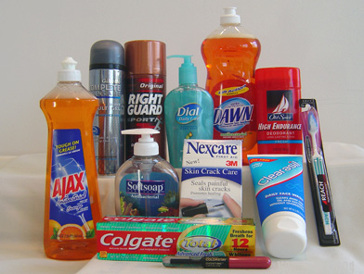
Triclosan – Synopsis (identity, use)
Broad spectrum antimicrobial
personal care products: Irgasan, Aquasept, …
EU Cosmetic Directive
(0.1-0.3%)
sport clothing:
Ultra-Fresh,
Microban,
Sanitized, …
food packaging

Slide 4
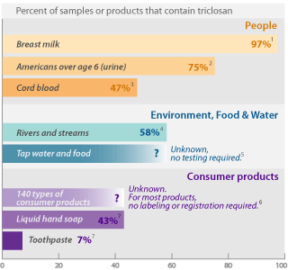
Triclosan – key issues
Detected in water,
human plasma,
breast milk
Bioaccumulation
By-product formation
Endocrine disruption
  Thyroid hormones
  Sex hormones
Antibiotic resistance,
efficacy
(Adolfsson-Erici et al. 2002; Queckenberg et al. 2010; Dann & Hontela, 2011)

Slide 5
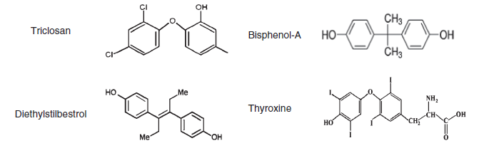
1. Identity and mode of action
Cl
Structural similarity of TCS to Bisphenol A,
to DES
to thyroxine
Antimicrobial action of TCS :
multiple sites in bacteria,
blocks synthesis of FFA

Slide 6
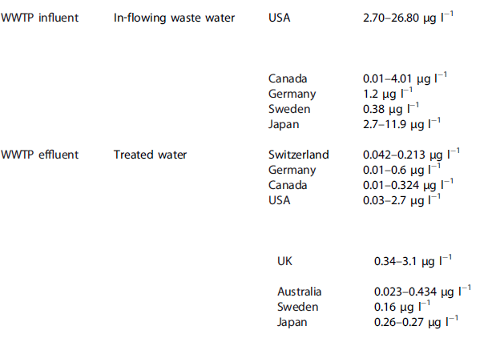
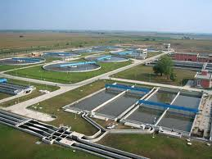
2. Sources
WWTP – Waste Water Treatment Plant

Slide 7
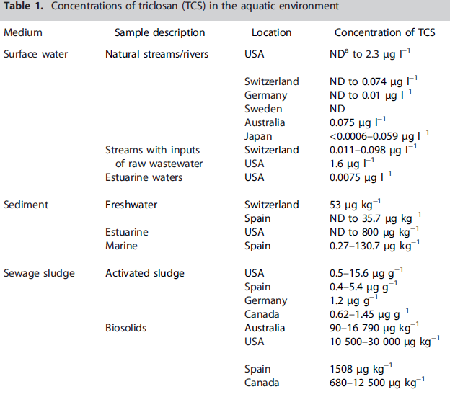
3. Exposure
link to experimental studies

Slide 8
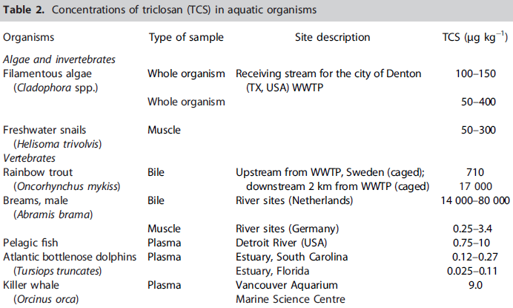
3. Concentrations of Triclosan in organisms
Bioaccumulation (?)

Slide 9
4. Fate in the environment
Degradation products of TCS
Methyltriclosan
biological methylation, K_{ow} = 5.2
(TCS K_{ow} = 4.7)
used as marker of exposure to WWTP effluent
more persistent than TCS
Dioxins
generated during photodegradation of TCS
at pH > 8
Chloroform and chlorophenols
generated in presence of chlorine or chloramine

Slide 10
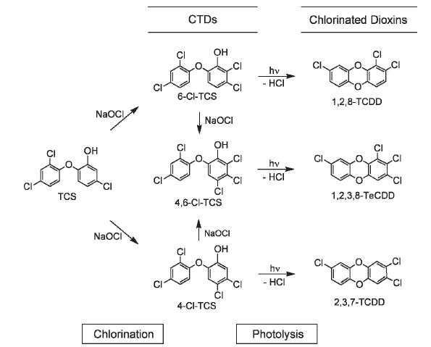
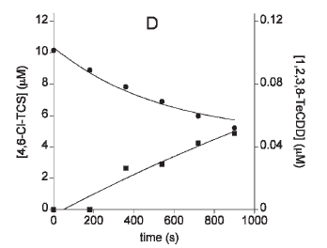
fate in the environment …
Buth et al. 2009 Environ Toxicology Chem 28: 2555, 2009

Slide 11
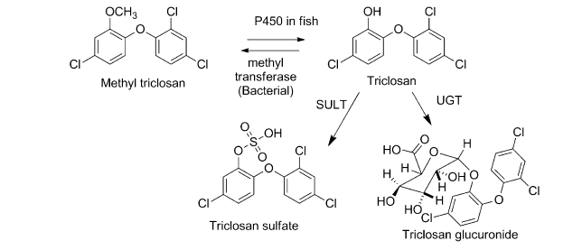
Biotransformation of Triclosan
catfish hepatocytes
James et al. 2012 Aquat Toxicol 124: 72

Slide 12
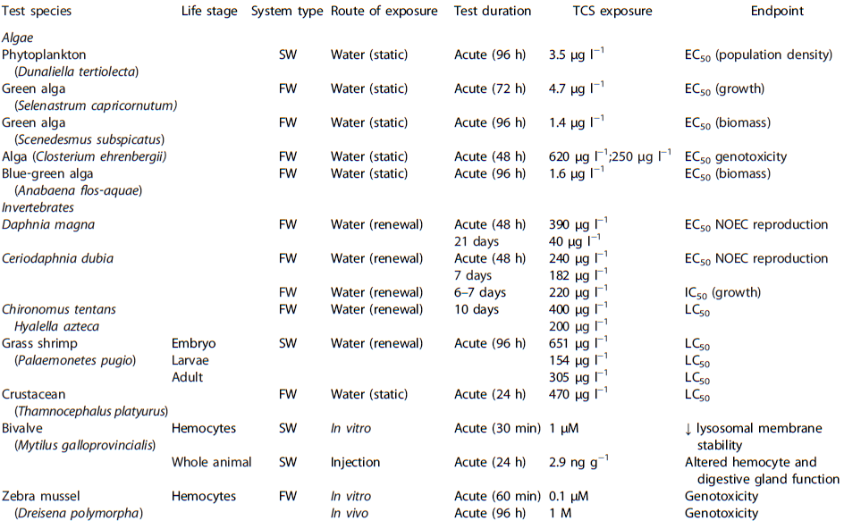
5. Effects of Triclosan on aquatic organisms

Slide 13
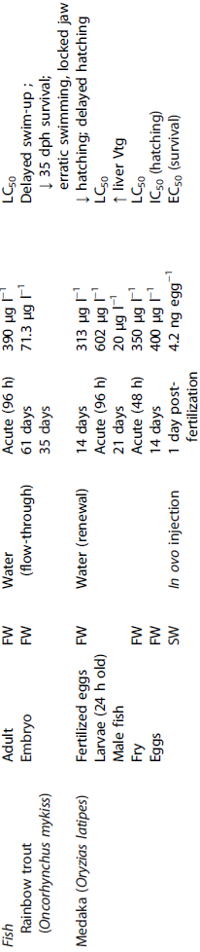
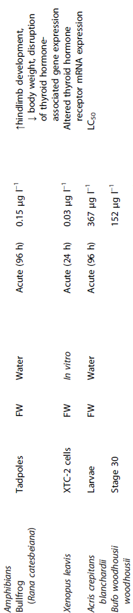

Slide 14
Toxicity of Triclosan
Algae are highly sensitive to TCS
LC50 96 hr = 1- 4 µg/L
Invertebrates and fish
average sensitivity
Amphibians - highly sensitive
effects in tadpoles at 0.15 µg/L
effects on thyroid status

Slide 15
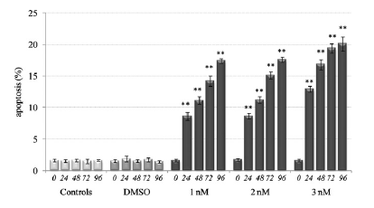
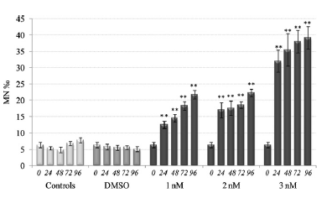


EFFECTS …
Zebra mussel hemocytes
genotoxic effects of Triclosan in vitro and in vivo
Micronuclei formation
Appoptosis
Binelli et al. 2009 Aquatic Toxicology, 2009

Slide 16
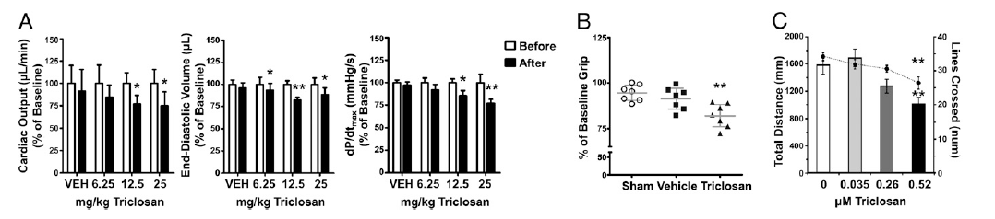
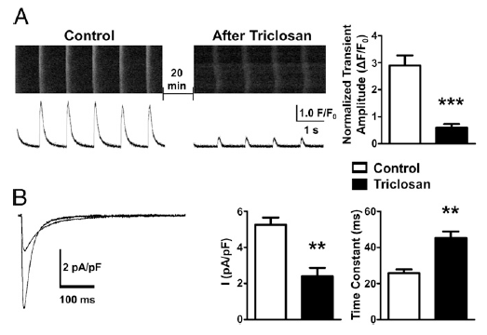
Reduction of cardiac function in mice treated with TCS in vivo
TCS impairs
excitation-contraction
coupling in isolated
cardiomyocytes
damage to Ca++
channels
Cherednichenko et al. 2012 PNAS 109:14159

Slide 17
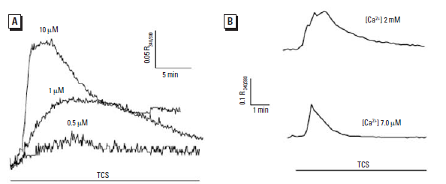
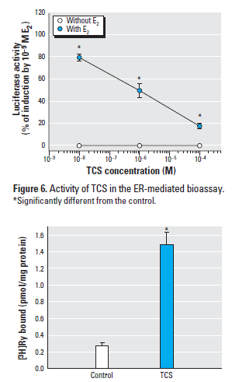


Effects of Triclosan
on intracellular Ca²⁺ homeostasis
in myotubes
Interaction with estrogen
Ahn et al. Environ Health Perspectives 2008

Slide 18
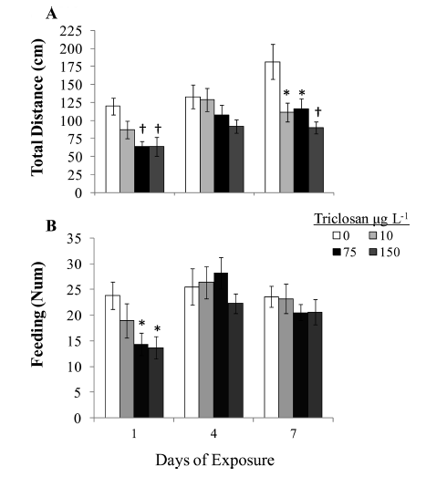
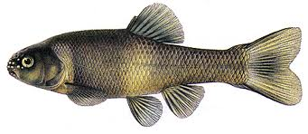
Triclosan alters DHPR and RyR protein expression in fish larvae
Effect of Triclosan on
swimming performance
feeding behaviour
Pimephales promelas, fathead minnow
Fritsch et al 2013 Env Science and Technology

Slide 19
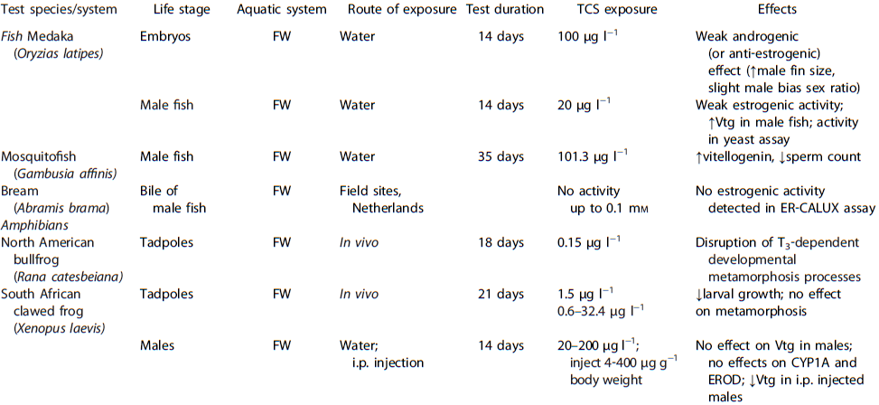

Slide 20
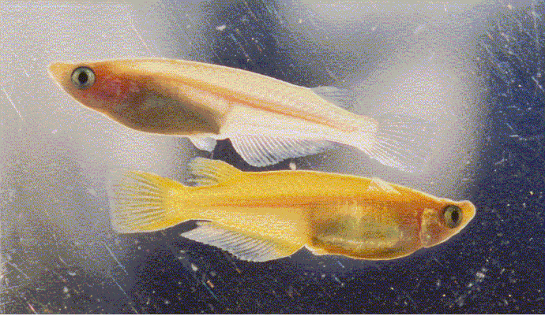
Medaka, Oryzias latipes
Japanese killifish

Slide 21
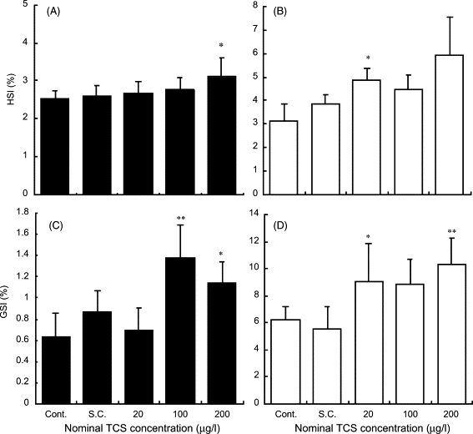
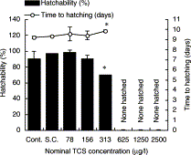
Isihibashi et al. 2004 Chemosphere
Increase in GSI in male Medaka
Lower hatchability of eggs in female
Raut and Angus 2010 Env Toxicol Chem
Decrease in sperm count in Mosquitofish Gambusia affinis

Slide 22
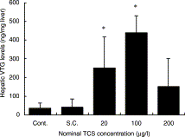
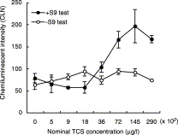
Estrogenic effects in male medaka
induction of Vtg
Estrogenic activity of TCS enhanced by S9 activation

Slide 23
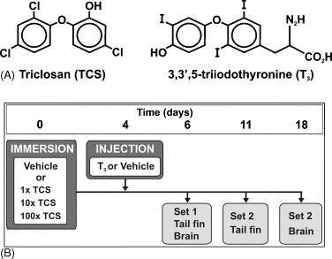
Veldhoen et al. 2006, Aquat Toxicol
Effects of Triclosan on amphibian metamorphosis
Effects of Triclosan on thyroid axis
In vivo
Exposure of tadpoles
(Rana catesbeiana)
In vitro
Exposure of XTC-2 cells
(Xenopus laevis cells)

Slide 24
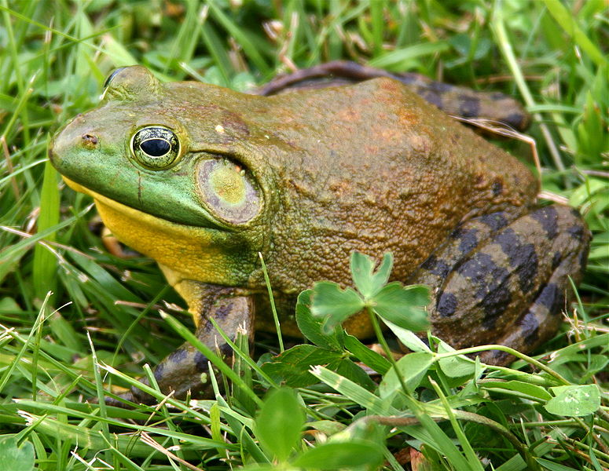
North American bullfrog
Rana catesbeiana

Slide 25
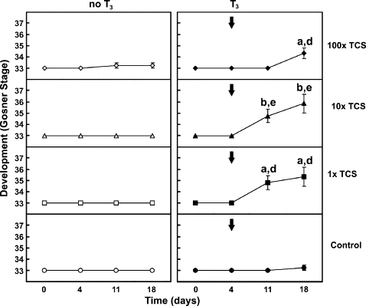
Acceleration of development in tadpoles exposed to
T3 and TCS
T3 alone has no effect

Slide 26
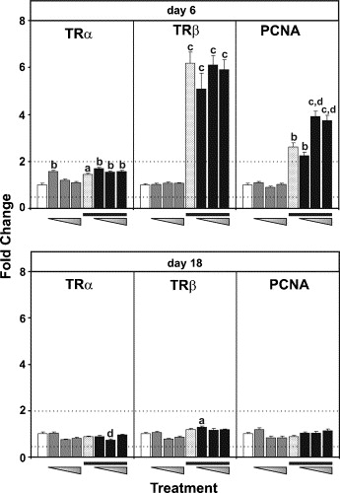
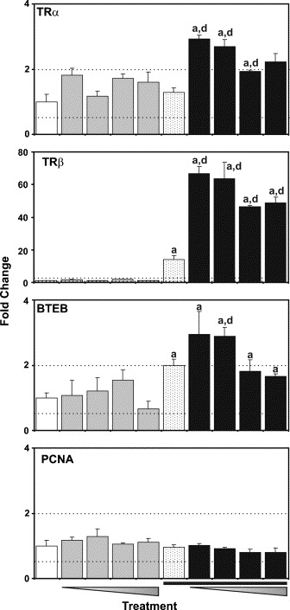
In vivo
In vitro
Relative mRNA expression of TH-regulated genes
Transcripts levels affected by Triclosan at a sensitive
life stage of anuran development
No evidence for estrogenic effects ( no VTG induction)

Slide 27
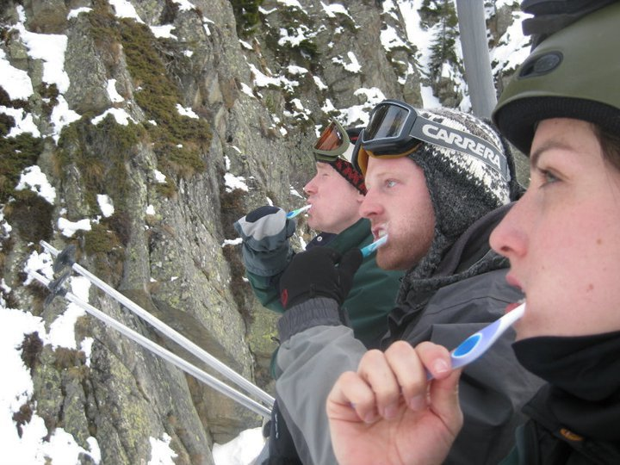
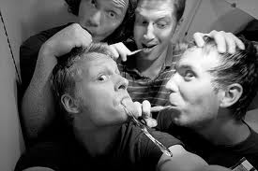
Effects of Triclosan
in human ?
Cell –based assays
estrogenic and
androgenic effects in MCF37
breast cancer cells
weak AhR activity
In vivo effects ???

Slide 28
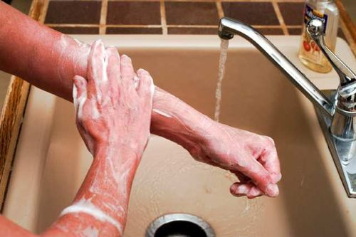
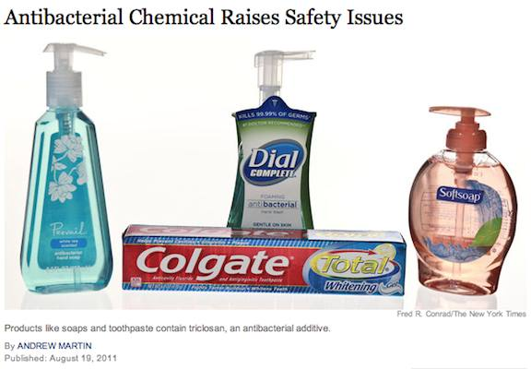
Efficacy of Triclosan
Use in oral hygiene +++
Use in clinical setting as soap +++
Use in personal care ?
Use in food wrapping ?
Use in sport clothing ?

Slide 29
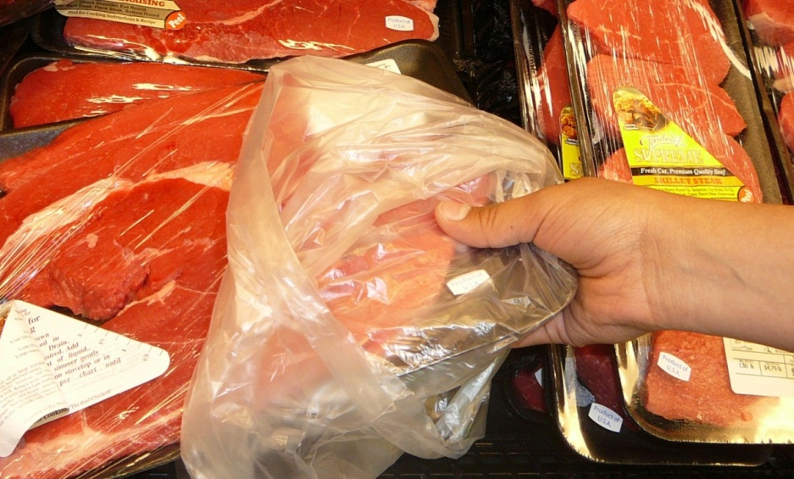
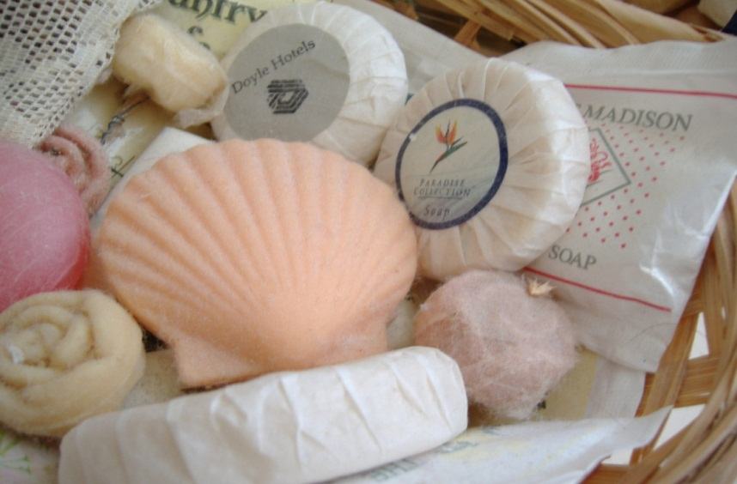

Risk assessment for Triclosan
Antibacterial control
hospitals
oral care
Ecosystem integrity
(algal populations)
Endocrine disruption
amphibians, fish
Antibacterial
resistance

Slide 30
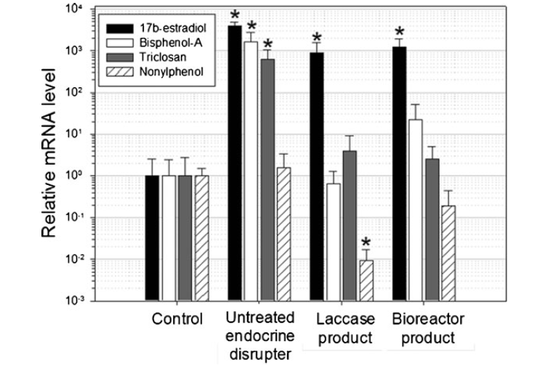
Remediation – inactivationl of Triclosan by enzymatic degradation
Vtg mRNA in zebrafish
ER activity
Torres-Duarte 2012 Appl Biochem Biotechnol 168: 864

Slide 31


