Slide 1
Kritická kartografie

Slide 2
Propagátoři
JB Harley, Deconstructing the map (1989)
Denis Wood, The power of maps (1992)
Jeremy Black, Maps and politics (1997) Jeremy Crampton, Maps as social constructions: power, communication and visualization (2001)
Paul Laxton, New nature of maps (2001)

Slide 3
Harley
maps express power
maps create power
maps are not neutral or objective maps are systems of power-knowledge
maps are subjective, selective distortions maps serve the interests of those that make them

Slide 4
Čtení mezi řádky
we should worry less about map design, accuracy standards,theories of information transfer, etc, etc (that’s a smoke screen)
examine more the social implications what are the ethics of the maps, the map-maker and their mapping practices

Slide 5
Co sledovat
Power: What are the economic structures in which the map is situated?
Consumption: How is the map presented, disseminated, andused? How does the map work as part of wider spacediscourses and how is it received by society?
Interests: What interests are served by making this map? Whowins and who looses? Where does power lie in the production ofthis map?
Closure: What maps were not made? How does this mapforeclose other representations and opportunities? What othermappings have been undertaken or alternative mappings couldbe imagined?
Authorship: What is the authorship of the map? Who is doing the showing and what are their explicit and implicit intentions? What is the relationship between the map and its author?
Objectives: Why was the map made? Are the objectives of themap stated explicitly? What are some possible secondary,implicit objectives?

Slide 6
Co sledovat
Contexts: What are the institutional contexts of the map? Who pays for the map to be made? What necessary practices andtechnical infrastructure was required to make the map? Wha tare some of the major social and cultural inspirations and influences on the map?
Subject: What is the subject of the map? What is shown andwhat is not shown?
Rhetoric: How is power encoded and expressed in bot thecontent and graphical form of the map? What conventionsunderlie the graphical symbols employed on the map?
Accuracy: How ‘accurate’ is the map? What are its standards ofaccuracy? Is it a workable map?
Space: What is the scale of the map? What conception of spaceis the map based upon? What is the maps worldview?
Ethics: Is it an ethical map? What are the wider social politicaland economic implications on the space being mapped? Howmight the map change nature and perceptions of the space thatit maps?

Slide 7
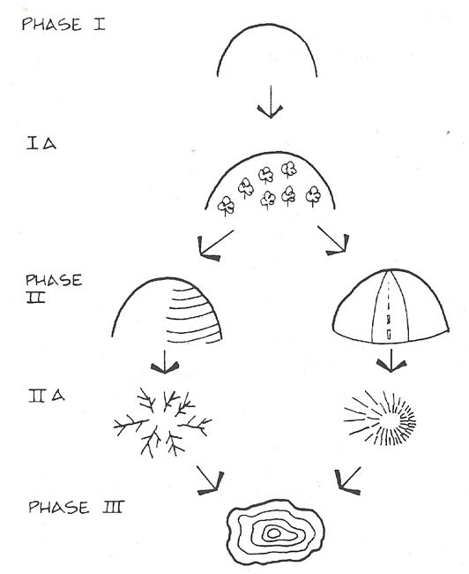
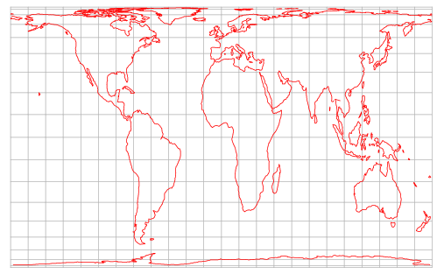
Aspekty
Propaganda
“Petersova” projekce
Historie symbolu
  Linie – povrch - objem

Slide 8
Kritika kritiky
Podsouvání úmyslů tam kde nejsou
  Mnoho oblastí kde mapa neslouží k demostraci
  Anachronismus
  Mnoho okolností nesouvisí se vznikem mapy
Přílišná generalizace

