Slide 1
Metagenomika- 454, Illumina, ionTorrent
Petra Vídeňská, Ph.D.

Slide 2
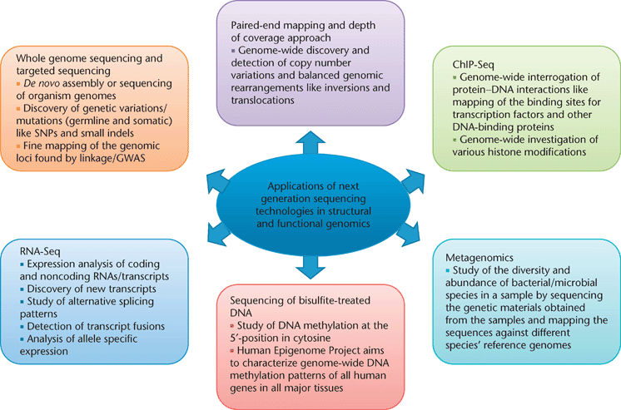
Využití next generation sekvenování

Slide 3
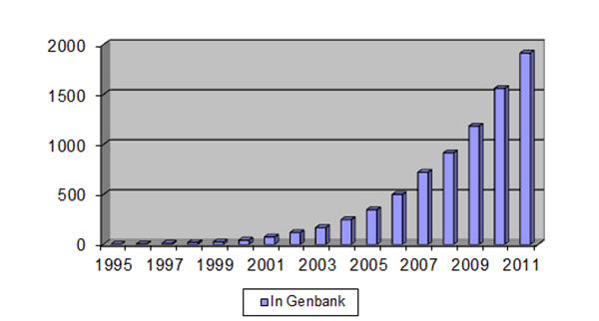
Počet kompletně osekvenovaných genomů
www.genomesonline.org

Slide 4
Náklady na sekvenování genomu

Slide 5
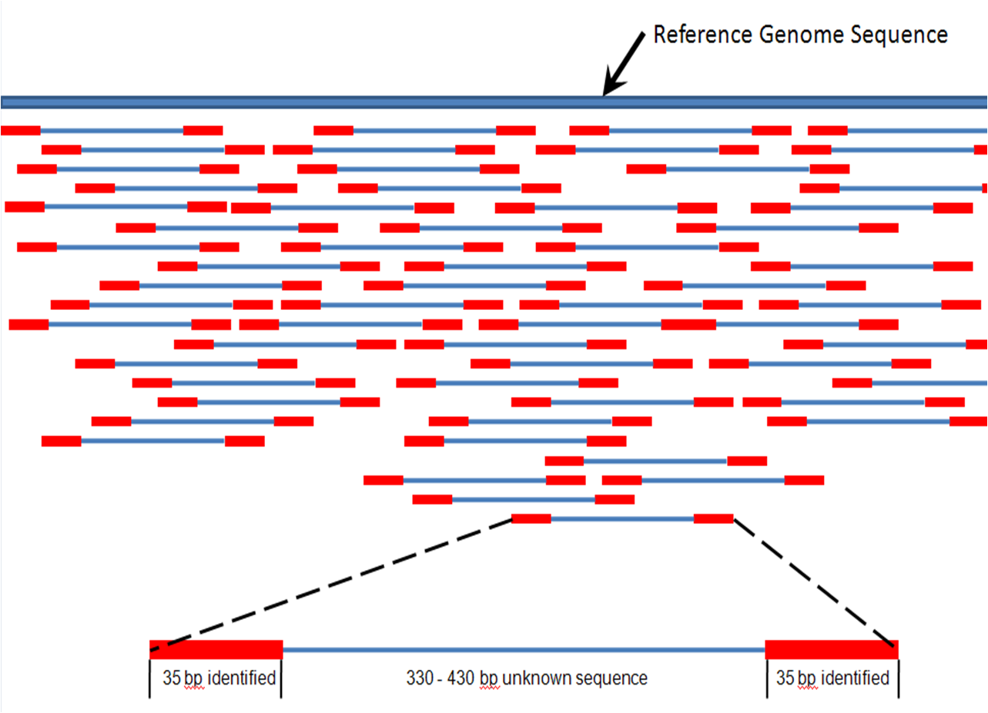
Next Generation Sequencing

Slide 6
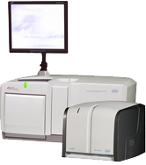
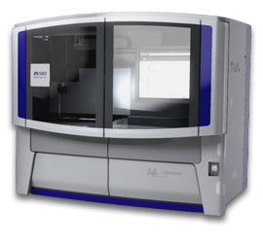
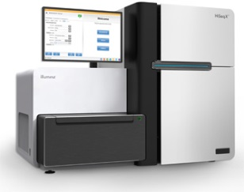
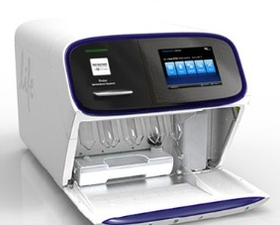
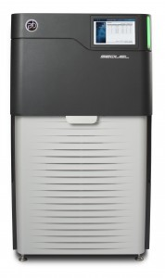
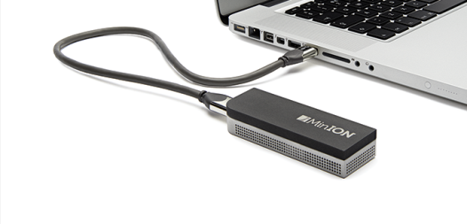
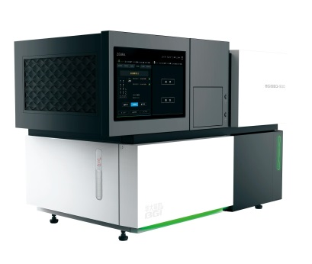
Dostupné platformy
454 (Roche)
SOLiD (Life Technologies)
Illumina (Illumina)
Ion Torrent (Life Technologies)
PACBIO, Sequel System (Pacific BioSciences)
MiniON (Oxford Nanopore Technologies)
BGISEQ-500 (BGI)
2 vs 3 generace

Slide 7
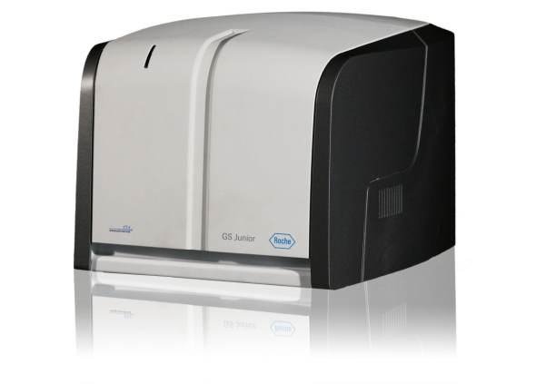
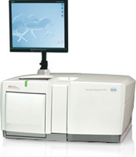
454
Roche
454 GS Junior (35 MB) x 454 GS FLX (700 MB)
Příprava templátu: EM PCR na kuličkách
Sekvenace syntézou
Detekce chemiluminiscenční - pyrosekvenování

Slide 8
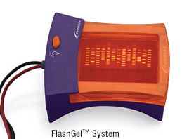
454 Shotgun – příprava knihovny
Nebulization
DNA End Repair
5’
3’
3’
5’
Adaptor Ligation (A&B)
5’
3’
3’
5’
A
B
DNA End Repair
5’
A
B
3’
3’
5’
Library Quantification, read lenght check

Slide 9
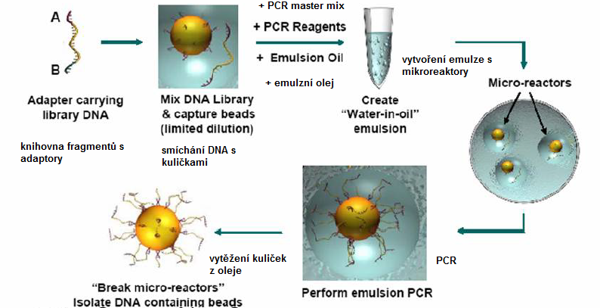
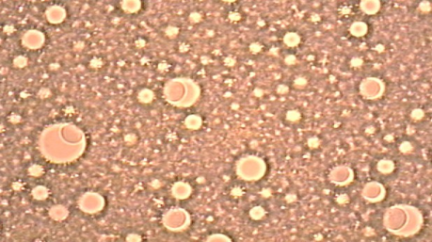
454

Slide 10
454
https://www.youtube.com/watch?v=nFfgWGFe0aA

Slide 11
454

Slide 12
454

Slide 14
454 – podrobný workflow
http://cfgbc.mf.uni-lj.si/people/damjana/teaching/fg-fkkt/4-GS-JuniorTechnology.pdf

Slide 15
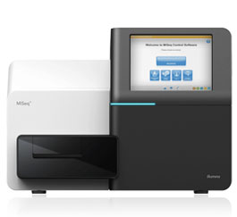
Illumina
Příprava templátu: hybridizace na sklíčku, tvorba klastrů
Sekvenace syntézou
Detekce fluorescence odštěpené značky z reverzního terminátoru (nukleotidu)

Slide 16
http://www.illumina.com/systems/sequencing.html

Slide 17
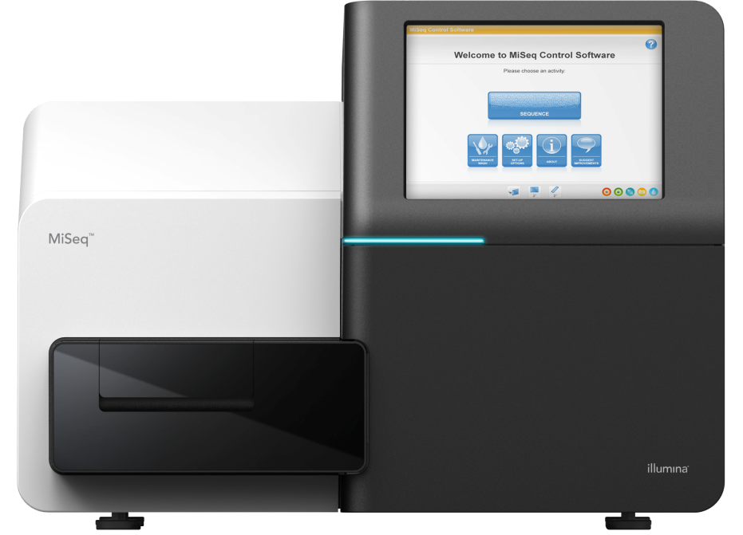
MiSeq specifications
READ LENGTH (BP) | TOTAL TIME* | OUTPUT
1 × 36 (V2) | ~4 hrs | 540-610 Mb
2 × 25 (V2) | ~5.5 hrs | 750-850 Mb
2 × 150 (V2) | ~24 hrs | 4.5-5.1 Gb
2 × 250 (V2) | ~39 hrs | 7.5-8.5 Gb
2 × 75 (V3) | ~20hrs | 3.3-3.8 Gb
2 × 300 (V3) | ~ 55hrs | 13.2-15 Gb
RUN TYPE | READS PASSING FILTER†
 | V2 | V3
Single Reads | 12-15 M | 22-25 M
Paired-End Reads | 24-30 M | 44-50 M
Notes:
Roche (13-3-2013) http://www.gsjunior.com/instrument-workflow.php

Slide 18
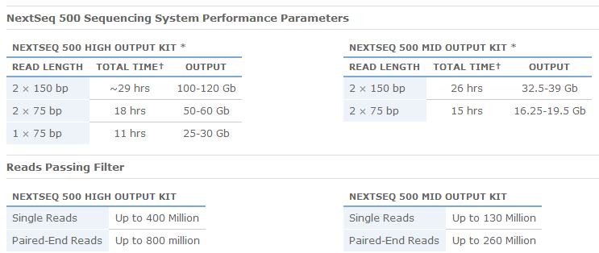
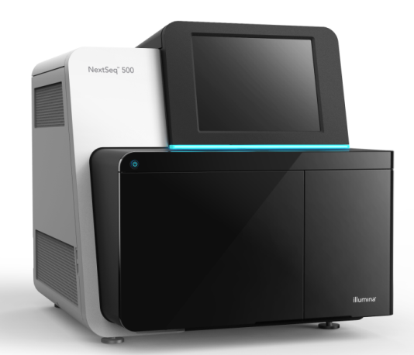
NextSeq specifications

Slide 19
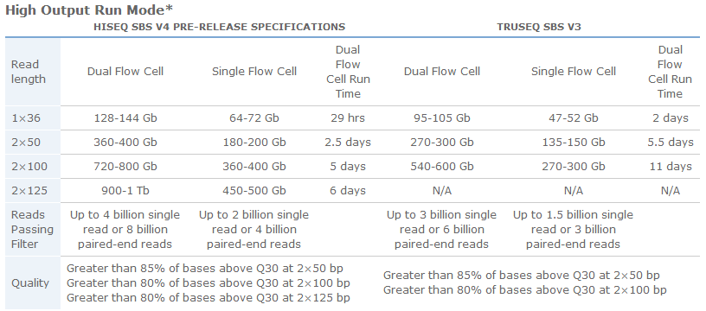
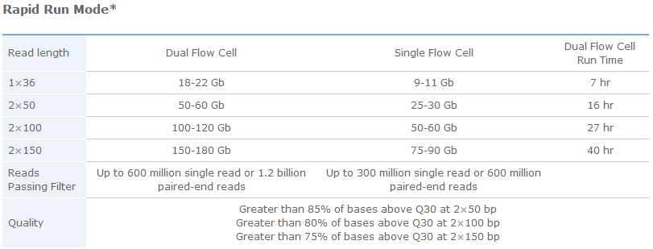
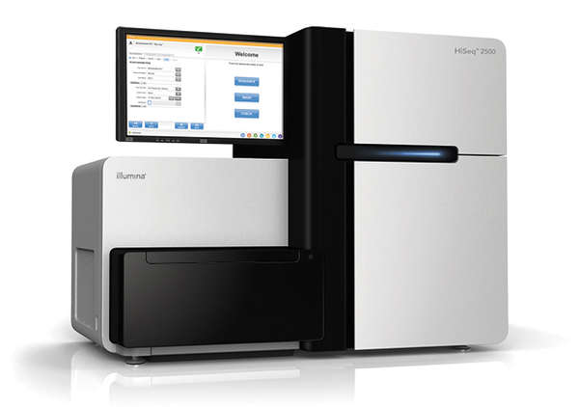
HiSeq 2500 specifications

Slide 20
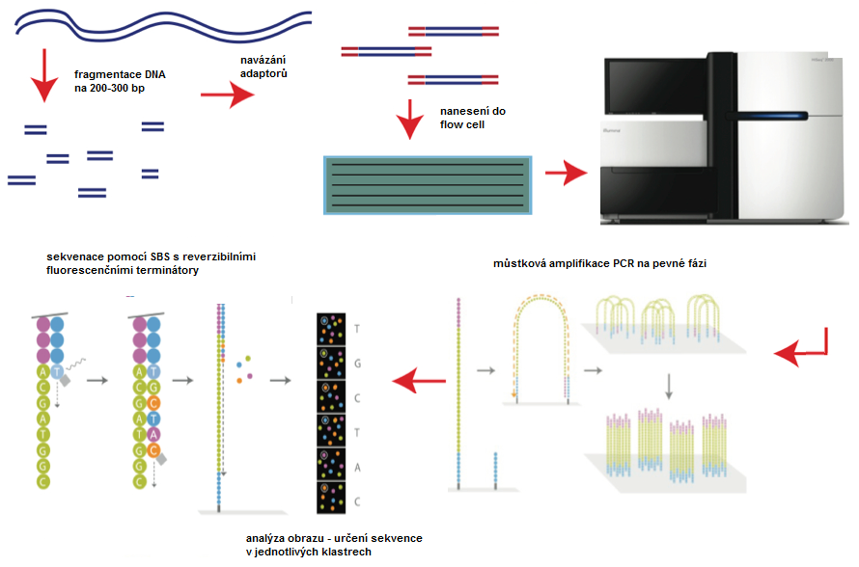
Illumina

Slide 21
Příprava knihovny
Enzymatic
Nextera
Fragmentation
Mechanical
TruSeq
Fragment
Amplification
Adapter
Notes:
The aim of the sample prep step is to obtain nucleic acid fragments with adapters attached on both ends
Same general template architecture regardless of application (gDNA, RNA, miRNA, ChIP-seq, exon pull-down, etc.)

Slide 22
Sekvenační technologie

Slide 23
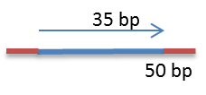
Single vs Pair End Ready
Single reads
Small RNA
Pair-End reads
DeNovo assembling

Slide 24
Sample Prep
Dual Index Library shown
The aim of the sample prep step is to obtain nucleic acid fragments with adapters attached on both ends
Notes:
Same general template architecture regardless of application (gDNA, RNA, miRNA, ChIP-seq, exon pull-down, etc.)

Slide 25
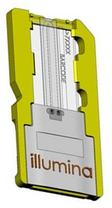
Cluster Generation
Amplify on surface
Bind single DNA molecules to surface
~1000 molecules per ~ 1 µm cluster
Skip Overview
Notes:
Script:
A flow cell is a glass slide sandwich with 1 channel. The channel is coated with oligos that are complementary to the adapters.
Flow cell hybridization and cluster generation is automated on the MiSeq.
First, single DNA molecules (the prepared samples) bind to the flow cell surface. Then, the samples are amplified to form clusters. Approximately 1,000 molecules are included in a cluster. The last step is the hybridization of the sequencing primer.

Slide 26
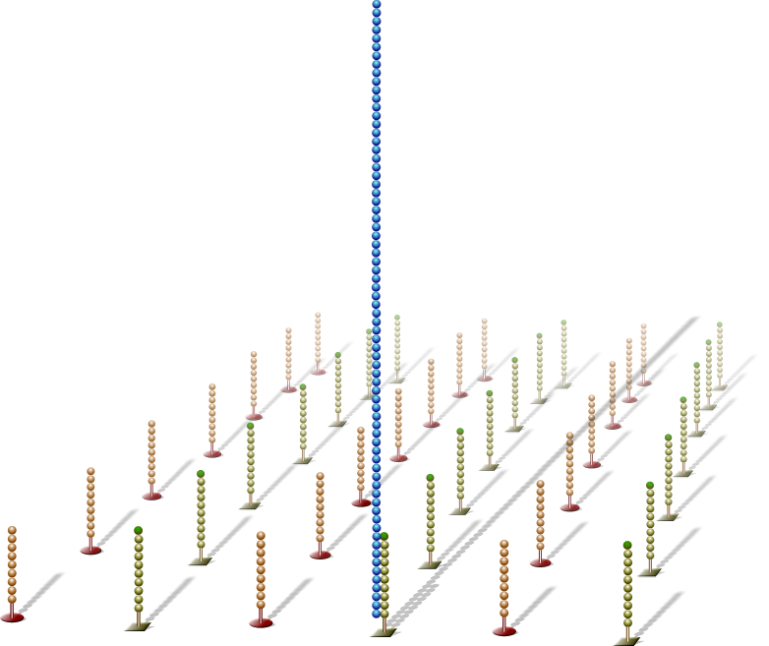
Hybridize Fragment & Extend
Adapter sequence
Single DNA libraries are hybridized to primer lawn
Denatured Library
Temp. Ramp: 96-40 °C
Wash Buffer HT2
Bound libraries then extended by polymerases
Surface of flow cell coated with a lawn of oligo pairs
3’ extension
Notes:
Schematic representation of cluster generation process

Slide 27
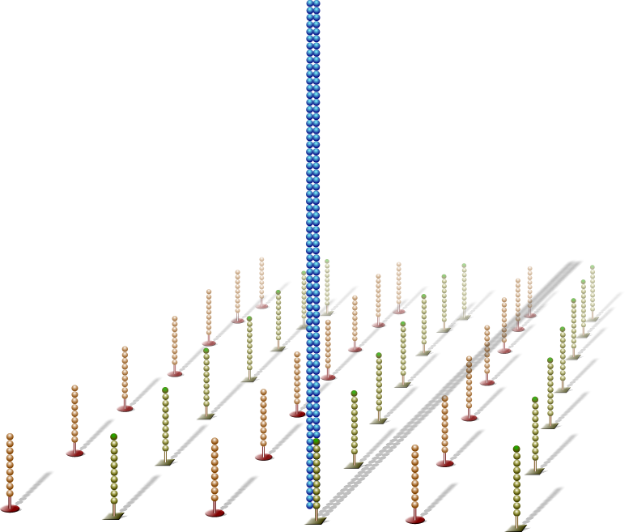
Denature Double-Stranded DNA
Newly synthesized strand
Double-stranded molecule is denatured
Original template
Original template washed away
discard
Newly synthesized strand is covalently attached to flow cell surface
AMP Premix AMP1
Phusion HFE 90 sec
Temp. Ramp: 20°C

Slide 28
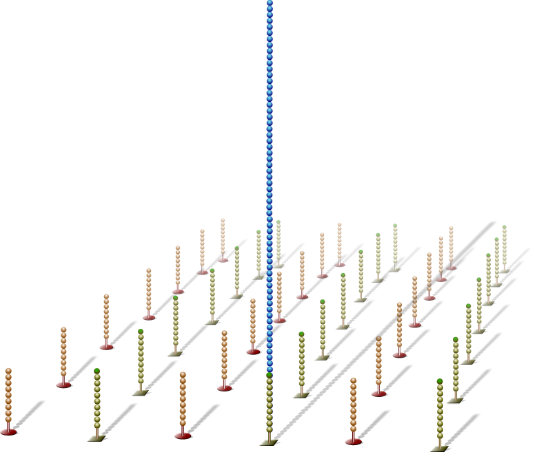
Hybridize Fragment & Extend
NaOH Wash
Wash Buffet HT2
NOTE:
Single molecules bind to flow cell in a random pattern

Slide 29
Hybridize Fragment & Extend
1st cycle denaturation
AMP Manifold
Ramp to 60°C
Formamide AT1

Slide 30
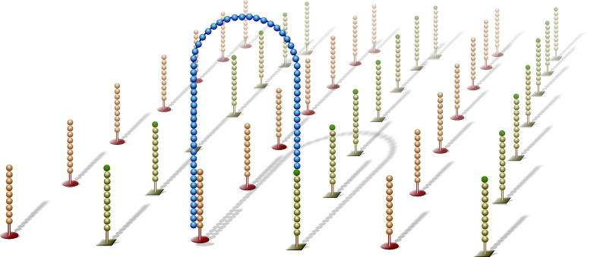
Bridge Amplification
Single-stranded molecule flips over and forms a bridge by hybridizing to adjacent, complementary primer
Hybridized primer is extended by polymerases
AMP Premix AMP1

Slide 31
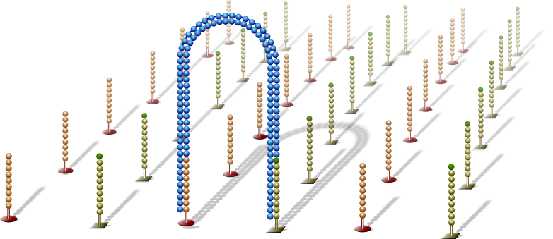
Bridge Amplification
Double-stranded bridge is formed
AMP Mix AMX1
Contains BST pol &
nucleotides

Slide 32
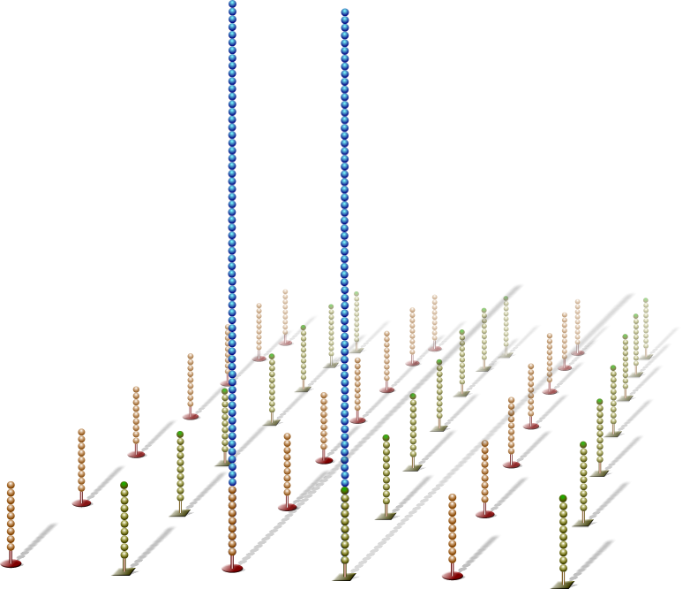
Denature Double-Stranded Bridge
Double-stranded bridge is denatured - 1st cycle denaturation
Result:
Two copies of covalently bound single-stranded templates
Formamide AT1

Slide 33
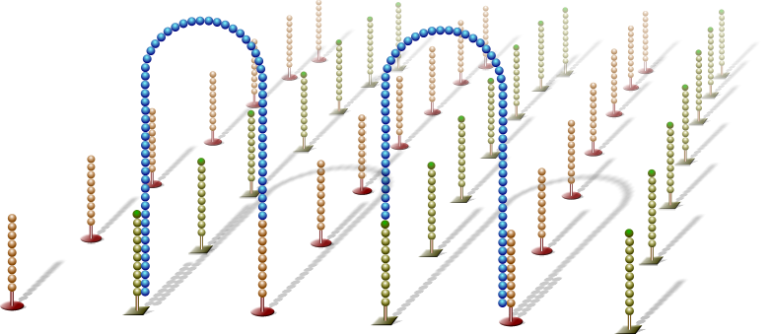
Bridge Amplification
Single-stranded molecules flip over to hybridize to adjacent primers
Hybridized primer is extended by polymerase
AMP Premix APM1

Slide 34
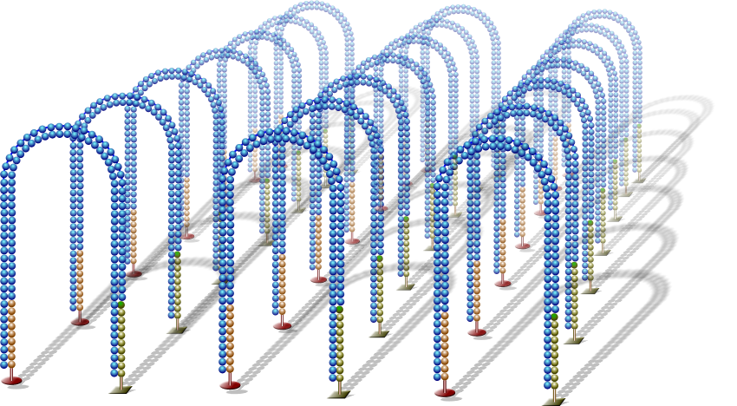
Bridge Amplification
Bridge amplification cycle repeated until multiple bridges are formed
AMP Mix AMX1
Contains BST pol &
nucleotides

Slide 35
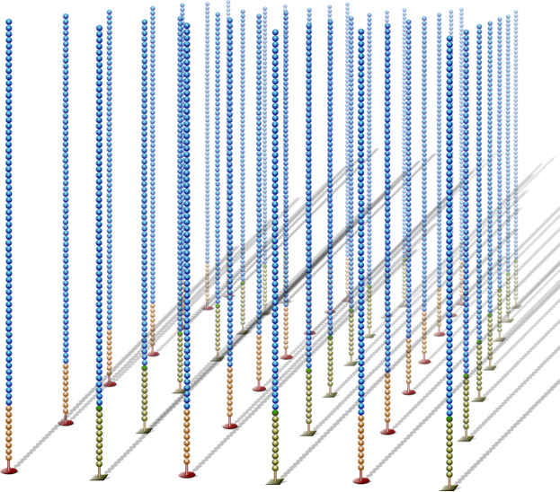
Linearization
dsDNA bridges are denatured
PE Linearization LMX1
Ramp 37.9 °C, 30 min
Temp Ramp: 20 °C

Slide 36
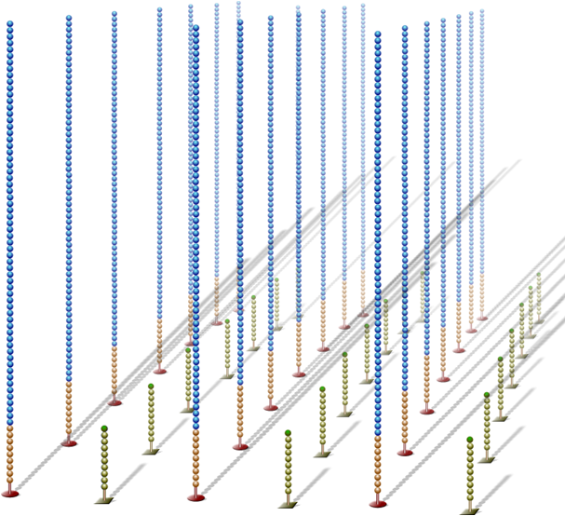
Reverse Strand Cleavage
Reverse strands cleaved and washed away, leaving a cluster with forward strands only
Wash Buffer HT2

Slide 37
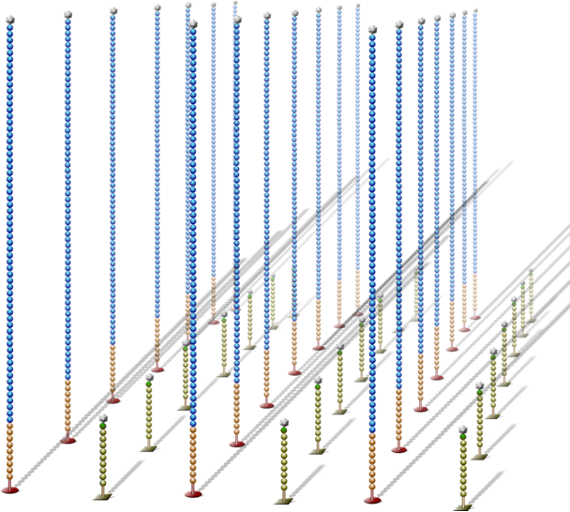
Blocking
Free 3’ ends are blocked to prevent unwanted DNA priming
Blocking Mix BMX
38 °C, 30 min
60 °C, 15 min
20°C, HT2, HT1 Washes

Slide 38
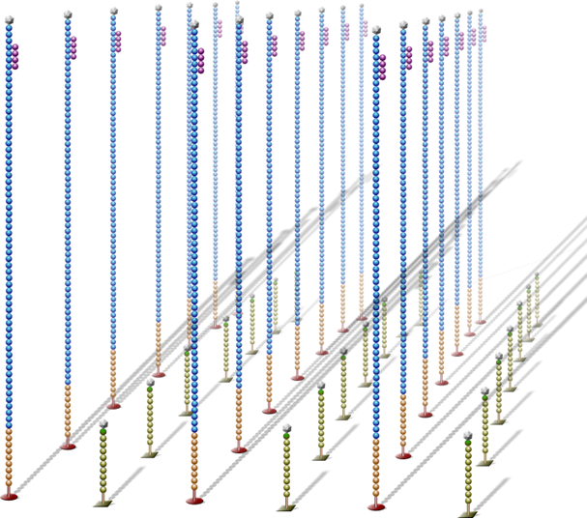
Read 1 Primer Hybridization
Sequencing primer is hybridized to adapter sequence
Sequencing primer
0.1 NAOH
Seq. Primer
60 °C, 5 min
20 °C, HT2, HT1 Washes

Slide 39
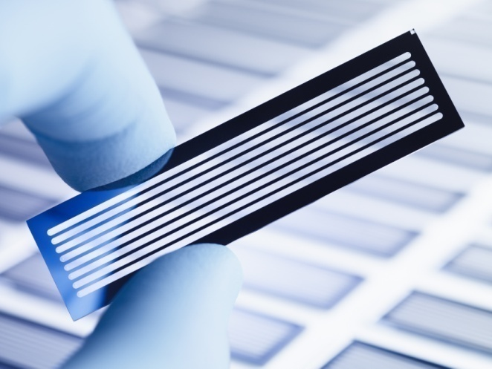
Sequencing by sythesis (SBS)
3’
T
DNA (1 ng – 1 µg)
G
C
Příprava knihovny
Tvorba klastrů
(3x10⁶ – 3x10⁹)
Single molecule array
T
n=100
A
5’
Notes:
1. Sample prep – paired ends, mate pairs and multiplexing.
2. Clusters – use of Phusion
3. SBS – improved reagents → greater accuracy by reducing background noise, improved polymerase reduces time and increases accuracy, increase read length.
4. Data density – improvements in cluster analysis → much higher densities and higher accuracy.

Slide 40
Sequencing
Clusters are images using LED and filter combinations specific for each fluorescently-labeled nucleotide
A image
C image
G image
After imaging is complete for one section (tile), the flow cell is moved to the next tile and the process is repeated
T image
Notes:
Script:
After Cluster Generation is complete, the clusters with the fluorescently labeled incorporated nucleotides are imaged using LEDs.
The MiSeq flow cell includes 12 tiles, arranged in a single lane. Imaging is performed 4 times for a single tile at a time. (This is a called a cycle.) The process repeats until all tiles in the lane have been imaged.

Slide 41
Pair - End Sequencing – Dual Indexed

Slide 50
Sekvenační technologie

Slide 51
Sekvenační technologie

Slide 52
Images Generated on the Instrument

Slide 53
BaseSpace
https://accounts.illumina.com/
Is a powerful website computing platform
for storing my genomics data on a cloud
for analyzing my sequences
for sharing my genetic data

Slide 54
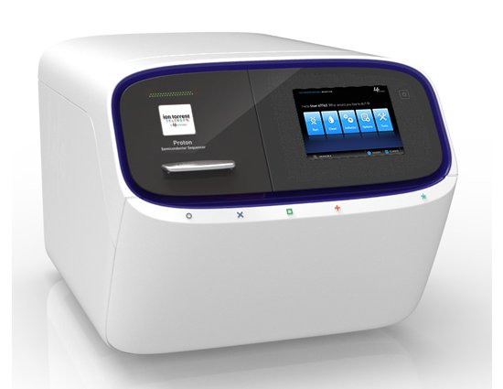
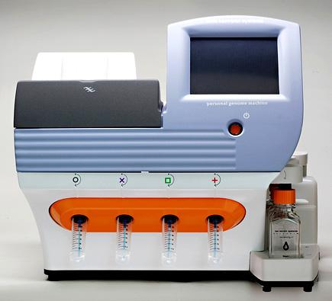
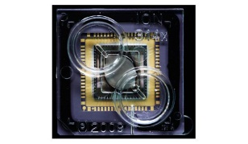
Ion Torrent
Ion PGM x Ion Proton
The chip is the machine
Příprava templátu: Em PCR
Sekvenace syntézou
Detekce uvolněných protonů – změna pH

Slide 55
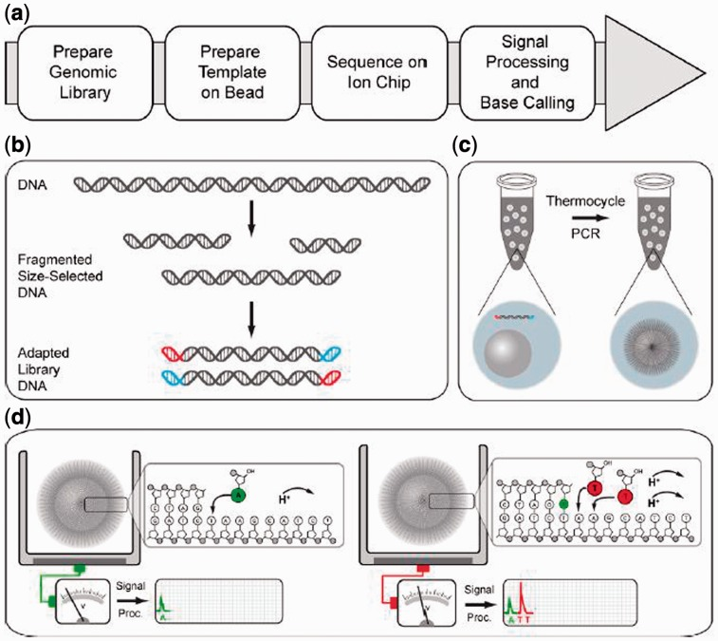
Ion Torrent

Slide 56
Product Name | SKU # | Product Size | Number of Wells | Platform | List Price (CZK)
Ion 314™ Chip Kit v2 | 4482261 | 1 kit | 1 million wells per chip | Ion Personal Genome Machine® (PGM™) System | 15.808,00
Ion 316™ Chip Kit | 4466616 | 4 pack | 6 million wells per chip | Ion Personal Genome Machine® (PGM™) System | 28.616,00
Ion 316™ Chip Kit | 4469496 | 8 pack | 6 million wells per chip | Ion Personal Genome Machine® (PGM™) System | 57.232,00
Ion 316™ Chip Kit v2 | 4483188 | 4 chips | 6 million wells per chip | Ion Personal Genome Machine® (PGM™) System | 28.616,00
Ion 316™ Chip Kit v2 | 4483324 | 8 chips | 6 million wells per chip | Ion Personal Genome Machine® (PGM™) System | 57.232,00
Ion 318™ Chip Kit (4 pack) | 4466617 | 4 pack | 11 million wells per chip | Ion Personal Genome Machine® (PGM™) System | 49.280,00
Ion 318™ Chip Kit (8 pack) | 4469497 | 8 pack | 11 million wells per chip | Ion Personal Genome Machine® (PGM™) System | 98.560,00
Ion 318™ Chip Kit v2 | 4484354 | 4 pack | 11 million wells per chip | Ion Personal Genome Machine® (PGM™) System | 49.280,00
Ion 318™ Chip Kit v2 | 4484355 | 8 pack | 11 million wells per chip | Ion Personal Genome Machine® (PGM™) System | 98.560,00
Ion PI™ Chip Kit v2 | 4482321 | 8 chips | 165 million wells per chip | Ion Proton™ System | 129.130,00

Slide 57
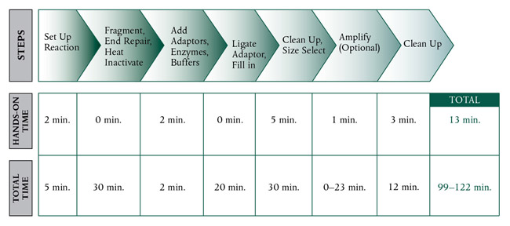
Ion Torrent

Slide 58
Ion Torrent

Slide 59
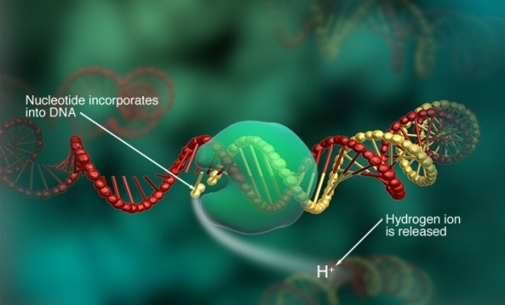
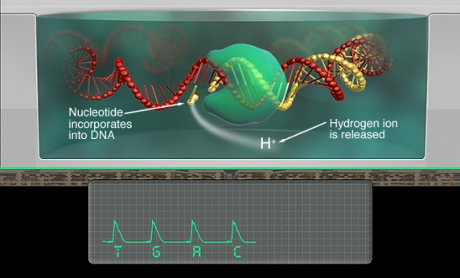
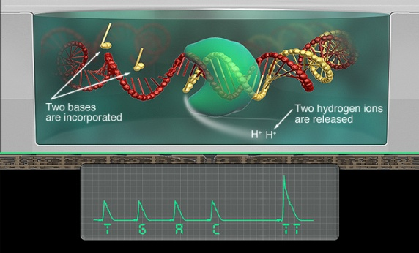
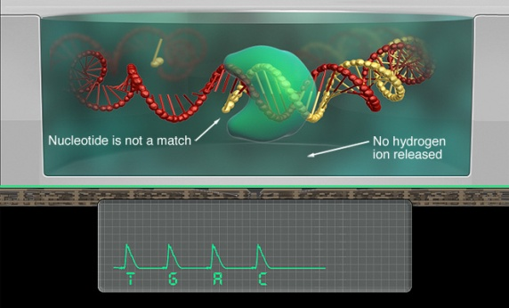
Ion Torrent
https://www.youtube.com/watch?v=WYBzbxIfuKs
https://www.thermofisher.com

Slide 60
Ion Torrent

Slide 61
Příprava knihovny – celogenomové sekvenování
(shot gun)

Slide 62
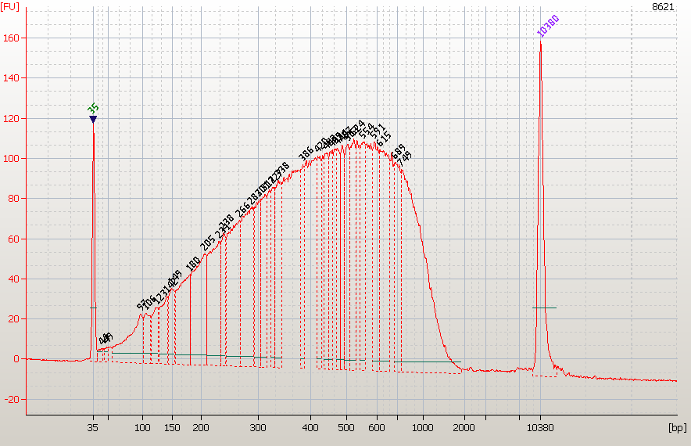
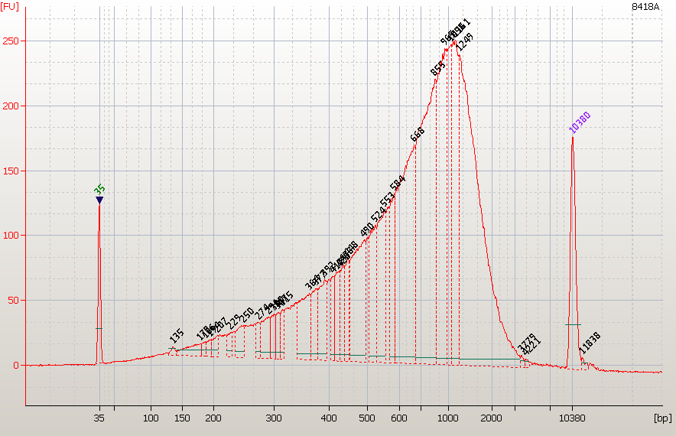
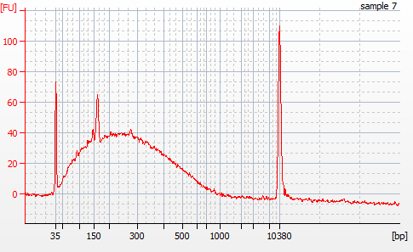
Příprava knihovny
FRAGMENTACE DNA Sonikace /enzymaticky

Slide 63
Příprava knihovny
END- REPAIR
↓
LIGACE ADAPTORŮ + NICK REPAIR
↓
SIZE SELECTION
- E-gel 2 %
4
50bp
ladder
5

Slide 64
Příprava knihovny
AMPLIFIKACE KNIHOVNY (?)
↓
KVANTIFIKACE KNIHOVNY
- qPCR / Agilent

Slide 65
Příprava knihovny
PŘÍPRAVA TEMPLÁTU
- Emulzní PCR
↓
ENRICHMENT
↓
SEKVENACE
Notes:
cena chipu???
314 – kolem 2000 Kč
316 – přes 7000
318 – vice jak 12 500Kč

Slide 66
Ion Torrent

Slide 67
Ion Torrent
(a) Schematic of a well on an ion sequencing chip. Clonal DNA immobilized on a bead is extended by polymerase in the presence of a pure solution of one nucleotide (here 'T'). Nucleotide incorporation releases a pyrophosphate (PPi) and a hydrogen ion. The change in pH caused by release of the hydrogen ion alters the surface potential of the ion-sensitive metal oxide layer. This is converted to a voltage signal by transistors. The wells are washed and exposed sequentially to pure solutions of other nucleotides. For comparison, in high-throughput pyrosequencing, the pyrophosphate is converted to chemiluminescence by an enzymatic cascade and optically imaged. The size of the well relative to the bead has been exaggerated, although each well contains a single bead. (b) Evolution of ion sequencing chips. Increases in sensors per chip can be achieved by increasing the physical area of the sensor array, reducing the number of transistors per chip, arranging the sensors in a hexagonal rather than rectilinear geometry and reducing the well and bead size. Sensors are drawn to scale, and gray indicates sensor area not accessible to fluid. The 13-million (M) sensor design was used by Rothberg et al.¹ to sequence DNA from both Escherichia coli and human. Data for a fixed ('key') DNA sequence was shown for the 165-million sensor design. The 1,100-million sensor design was proposed but its feasibility was not shown.

Slide 68
Ion Torrent
New Ion S5
„simplicity/speed/scalability/small sample input/service & support“
https://www.youtube.com/watch?v=jFCD8Q6qSTM&ebc=ANyPxKrMLmAe4Nmia2N3RFr_1QbGUsOzceI2sMqnIJ5gS09XPCofTb-0cUvJdbzQhD_gKRKTL-XBahDEvoV6uOnm_78yvaG-eA

Slide 70
O platformach
http://dnasequencing.yolasite.com/next-generation-sequencing.php

Slide 71
Srovnání:
 | 454 (Junior/FLX) | Illumina (MiSeq/HiSeq) | Ion Torrent (PGM/
Počet čtení/run | 100 tis/1 mil | 35-50 milionů PE/ 8 miliard PE | 5,5 mil/ 60-80 mil
Průměrná délka čtení [bp] | 450/700 | 2x300/ 2x250 | 400
Doba běhu | 6/24 hodin | 1/10 dní | 7/4 hodiny
Výhody | délka čtení, přesnost, rychlost, | snadná příprava, velké množství sekvencí, nejnižší cena | rychlost, relativně nízké náklady, různé čipy (outputy)
Nevýhody | pracnost, cena, chybovost v polymorfismech, nízké outputy - techynologie je tak drahá, že již není více konkurenceschopná | nižší přesnost na konci readů, interference u nízkodiverzních knihoven | chybovost v homopolymerech, EM PCR
Shotgun knihovny
Amplikony

