Slide 1
Characterization of carbon nanofibers by SEM, TEM, ESCA and Raman spectroscopy
V. Puchý1, P. Tatarko1*, J. Dusza1, J. Morgiel2, Z. Bastl3, J. Mihály4
1Institute of Materials Research, Slovak Academy of Sciences, Watsonova 47, 040 01 Košice, Slovak Republic
2Institute of Metallurgy and Materials Science of the Polish Academy of Sciences, Reymonta 25, 30 059 Krakow, Poland
3J. Heyrovský Institute of Physical Chemistry, Academy of Sciences of the Czech Republic,
Dolejškova 3, 182 23 Prague 8, Czech Republic
4Chemical Research Center, Hungarian Academy of Sciences, Pusztaszeri út 59-67, H-1025 Budapest, Hungary
By Preeti Kaushik

Slide 2
Aim of the work
Investigate the structure, morphology and composition of carbon nanofibers (CNFs) using different characterization techniques:
-Scanning electron microscopy (SEM)
-Transmission electron microscopy (TEM)
-High resolution electron microscopy(HRTEM)
-Electron spectroscopy for chemical analysis(ESCA)
-Raman spectroscopy

Slide 3
Introduction
Carbon nanofibers (CNFs) : cylindrical or conical structures, have diameters varying from a few to hundreds of nanometers and lengths ranging from less than a micron to millimeters.
Carbon nanotubes (CNTs) have graphene layers parallel to tube axis but in CNFs the orientation of graphene layers is not parallel to fiber axis.
CNTs are CNFs with graphene layers wrapped into perfect cylinders.
Like CNTs, CNFs also have good electrical, thermal and mechanical properties which make them suitable for many applications.

Slide 4
Characterization methods
SEM: Examination of length, diameter and morphology of CNFs.
TEM and HRTEM: Observe the crystal structure and graphite layer arrangement.
ESCA: Finding the chemical composition and carbon bonding in the material.
Raman scattering: To study the quality of the material and the microscopic structure of the CNFs.

Slide 5
SEM and TEM
SEM-
Image: Scanning with a focused beam of electrons
Source of electrons: thermionic emission, field emission
Electron gun operating voltage: 0 to 60 keV
Detected signals: Secondary electrons (SE), Backscattered electrons (BSE), X-rays, cathode - luminescence light
Resolution: Tens of nm
Penetration depth: upto 1 nm
TEM-
Image: By electrons transmitted through the ultra-thin sample
Electron beam: up to 300 keV (limited to 100 keV)
Penetration depth: upto 1 Aº

Slide 6
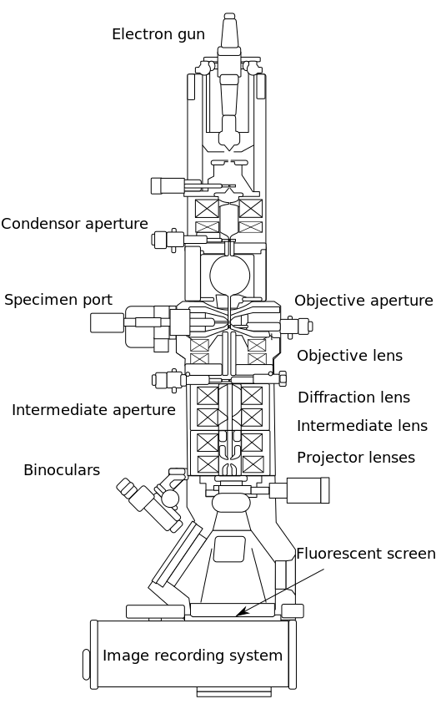
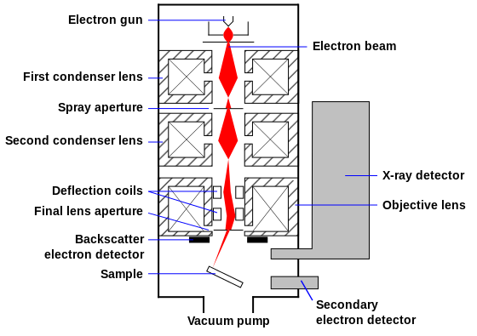
SEM
TEM

Slide 7
Raman Spectroscopy
Principle: Inelastic scattering of monochromatic radiation.
Energy is switched between the photon and the energy levels of molecule.
Raman spectra: G-band (1570 cm⁻¹)
D-band(1350cm⁻¹)
RBM (Radial Breathing mode < 200 cm⁻¹)
I_{D}:I_{G}: Defect density of the sidewall.

Slide 8
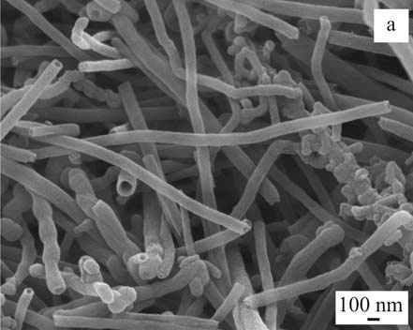
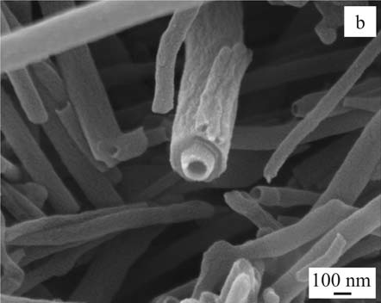
Results and discussion
SEM images -(a) Morphology of the carbon nanofibers, characteristic morphology with mix of cylindrical and bamboo-shaped nanofibers, (b) an example for smooth CNF of small diameter and rough CNF of large diameter

Slide 9
SEM Observations
Cylindrical hollow tubes, usually with free ends and smooth surface
Bamboo-shaped nanofibers with a waved surface.
Nanofibers with a straight-line shape and rough surface.
The outer diameter is 50–250 nm and inner diameter from 20 nm to 230 nm.
The length of the CNFs is up to several micrometers.
.

Slide 10
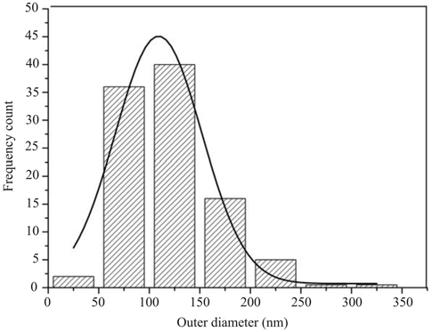
Histogram illustrating the distribution of the diameters of the fibers

Slide 11
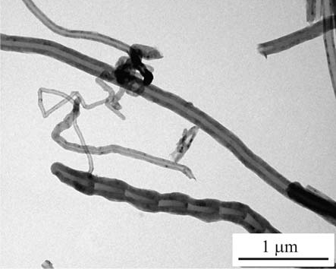
TEM Observations
In cylindrical hollow fibers the wall is smooth and uniform, graphite layers are parallel to the axes of the fibers.
The bamboo-shaped fibers are composed of multi-walled graphite structure. As the carbon diffusion was not continous during growth, there was a periodic variation of fiber diameter.
Characteristic morphology of CNFs by TEM, cylindrical and bamboo-like CNFs.

Slide 12
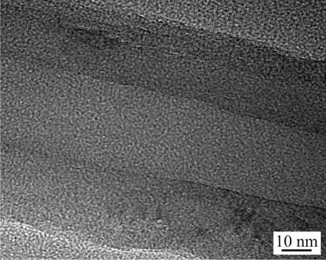
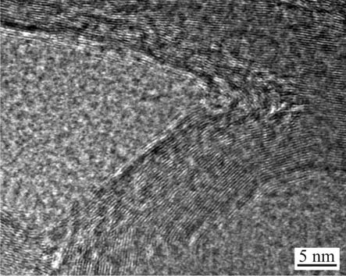
HRTEM of a cylindrical nanofiber with the wall thickness of approximately 28 nm and hole diameter of approximately 30 nm. The interlayer spacing of the graphite layers is approximately 0.35 nm.
HRTEM of a bamboo-shaped nanofiber with the wall thickness of approximately 18 nm. The interlayer spacing of the graphite layers in this wall is approximately 0.33 nm.

Slide 13
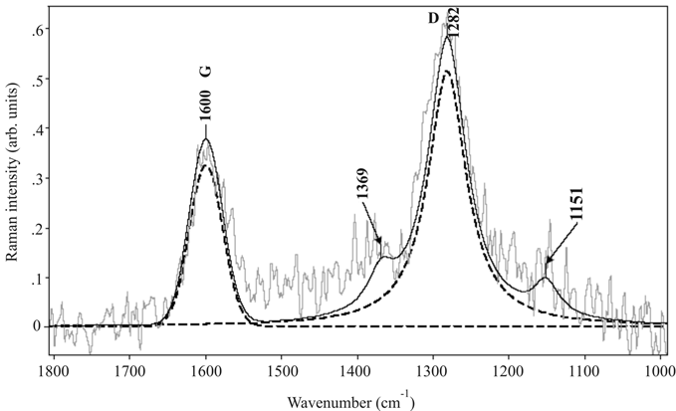
G-band at 1600 cm⁻¹ related to graphitic layer and the D-band at 1282 cm⁻¹ related to disordered structures in carbon materials.
Raman spectra of carbon nanofibers at 1064 nm excitation wavelength

Slide 14
The additional two weak noisy bands observed at around 1150 and 1370 cm⁻¹ can be assigned to the mixed bonds between sp² and sp³ carbon for amorphous carbon structures
The ratio of intensities of D-band to G-band (I_{D}/I_{G)} was 1.69.
An increase in relative intensity of the D-band near-infrared excitation (1064 nm) is related to a larger electron-phonon interaction for D-band with respect to G-band.

Slide 15
Conclusion
Cylindrical and bamboo shaped fibers identified.
Cylindrical fibers: defect-free, distinct graphite layers parallel to the fiber axis.
Bamboo-shaped fibers: contain defects at the nano-level.
Outer diameter of the fibers: 50 nm to 600 nm
Length of the fibers: several micrometers to several tens of micrometers.
The fibers contain 99.05 at.% carbon and 0.95 at.% oxygen with a binding energy of O(1s) electrons of 532.7 eV.
G-band at 1600 cm⁻¹ and D-band at 1282 cm⁻¹ are very similar to the positions of the same bands for carbon fibers and different carbon nanotubes

Slide 16
Thank you

