Slide 1
ToF-SIMS study of alternate polyelectrolyte thin films
Chemical surface characterization
Nikola Tulisová

Slide 2
Polyelectrolytes
Polymers – contents an electrolyte group
Dissociate in aqueous solution (water) – form polycations, polyanions
Elelectrolytical and polymer properties (polysalts)
Solutions – electrically conductive, viscous
Strong polyelectrolytes – dissociates completely in solution
Weak polyelectrolytes – dissociates partially – not fully charged
DNA, polypeptides, glycosaminglycans,...

Slide 3
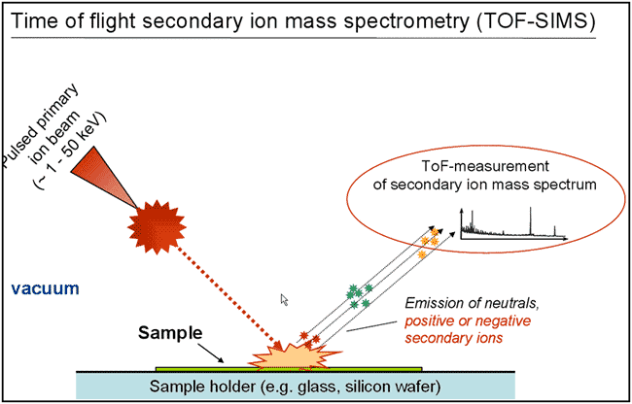
SIMS ( Secondary Ion Mass Spectrometry)
Chemical surface characterization
Compared with AES, XPS, ..
Secondary particles : electrons, neutrals, ions...
The ionization probability is strongly affected by the electronic properties of the sample matrix
Only a small portion of secondary particles (∼ 1% of total secondary particles) are ionized

Slide 4

ToF (Time of Flight)
Mass analyser - the most widely used analyser in static SIMS
Parameter for measurement: the flight time of ion
When ions are obtained with a constant kinetic energy from an acceleration potential (V ) of 3 – 8 kV, the flight time of ions through a distance (L) of flight tube to reach a detector is calculated.
Pulsed primary ions are used for precisely measure
Initial kinetic energy of secondary ions will affect the resolution of mass analysis

Slide 5
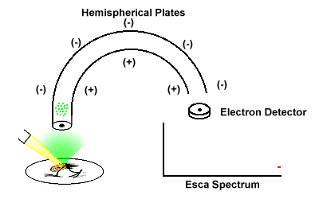
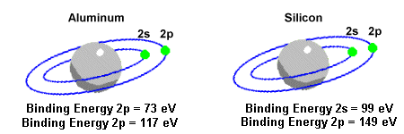
XPS (X-ray photoelectron spectroscopy)
Surface-sensitive quantitative spectroscopic technique
Can be applied to a broad range of materials and provides valuable quantitative and chemical state information from the surface of the material
Irradiates the sample surface with a soft (low energy) X-ray
X-ray excites the electrons of the sample atoms
if their binding energy is lower than the X-ray energy, they will be emitted from the parent atom as a photoelectron
The kinetic energy of the electron is the incident energy (1486 eV from the X-ray) minus the binding energy

Slide 6
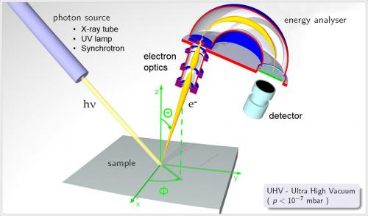

Slide 7
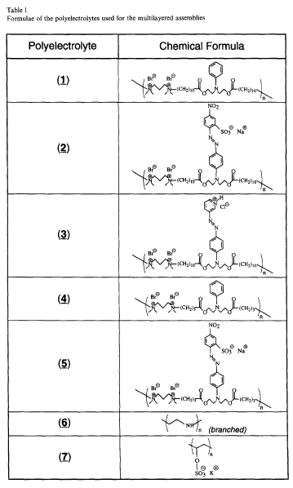
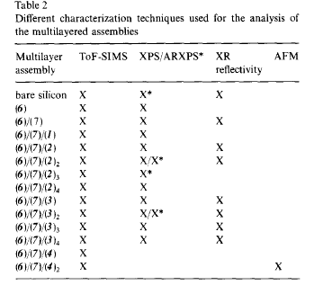
Experiment
3 types of multilayers with different thicknesses
Synthesize by dipping charged silicon wafers into solutions
of polyelectrolytes of opposite charge

Slide 8
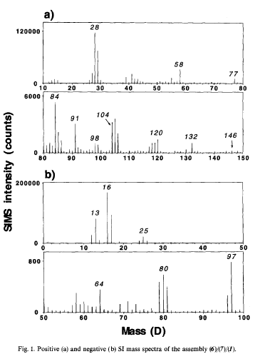

The positive secondary ion mass spectrum
The most intense peak in the spectrum corresponds to ${Si}^{+}$ (28 D)
Sillicon substrate is not completely covered
The thickness of multilayer assembly is not sufficient to mask the substrate ion emission
2 main series of ions:
  Main chain ( MC)- peaks of N (58 D, 84 D, 98 D, 104 D, 120 D, 132 D)
  Pedant group (PG) – phenyl ( carbohydrate) (41 D, 55 D, 77 D)
The negative secondary ion mass spectrum
${Br}^{−}$( 2 isotopes – 79 D, 80 D ) polyelectrolyte (1)
${SO}_{x}H_{y}^{−}$(64 D, 80 D, 97 D) from PG polyelectrolyte (7)

Slide 9
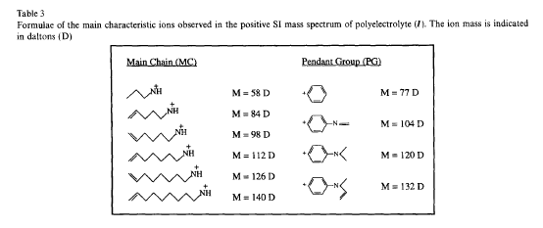

Slide 10
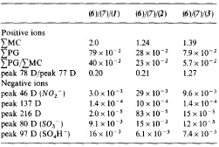
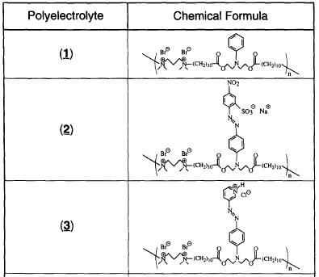

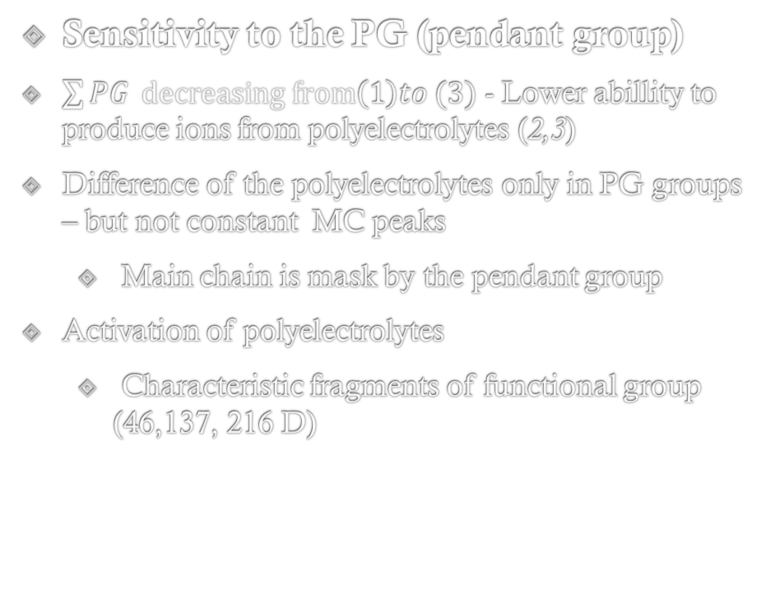
The sensitivity of ToF-SIMS
Sensitivity to the PG (pendant group)
$\sum{PG} decreasing from\left(1\right)to (3)$ - Lower abillity to produce ions from polyelectrolytes (2,3)
Difference of the polyelectrolytes only in PG groups – but not constant MC peaks
  Main chain is mask by the pendant group
Activation of polyelectrolytes
  Characteristic fragments of functional group (46,137, 216 D)

Slide 11

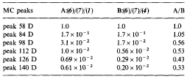


Sensitivity to the length of the alkyl chain contained in the polymer backbone
Compare (1) and (4) – very similar from ther chemical viewpoint – different MC peak intesities
Difference :
(1) - produc$e (C_{x}H_{y}N^{+})$ with 14 carbon atoms
(4) – produce $(C_{x}H_{y}N^{+})$ with 7 carbon atoms
Small changes in the chain structure
of the polyelectrolytes give rise marked
effect in their organization within coating

Slide 12
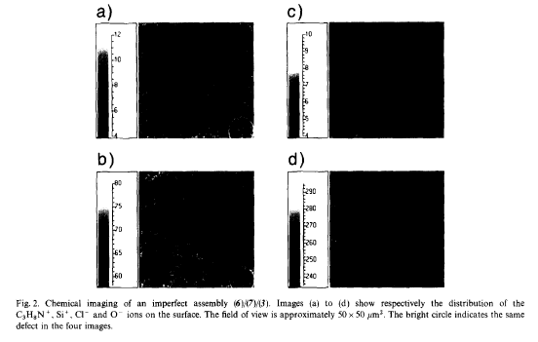

Chemical mapping of the surface
$(C_{3}H_{8}N^{+})$ – looks homogeneous
$\left({Si}^{+}\right)$(substrate ion) – strongly inhomogeneous
Inhomogenities – $\left({Cl}^{−},{Br}^{−},O^{−}\right)$
${Cl}^{−},{Br}^{−}$ - counterions of (3)
$O^{ −}$ - counterion of substrate
Contrast $C_{3}H_{8}N^{+}$ is weak – different emission depth
Conclusion:
(3) covers the whole area but thickness of layer varies from place to place

Slide 13
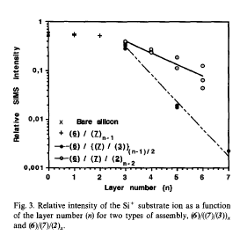

Effect of the multilayer build-up
b
(6)(7)(2) – thickness 30 Å
(6)(7)(3) – thickness 20 Å
Conclusion:
layers (2) are either less complete or that the arrangement is such that the pendant groups are not perpendicular to the surface – slower decay of the ${Si}^{+}$

Slide 14
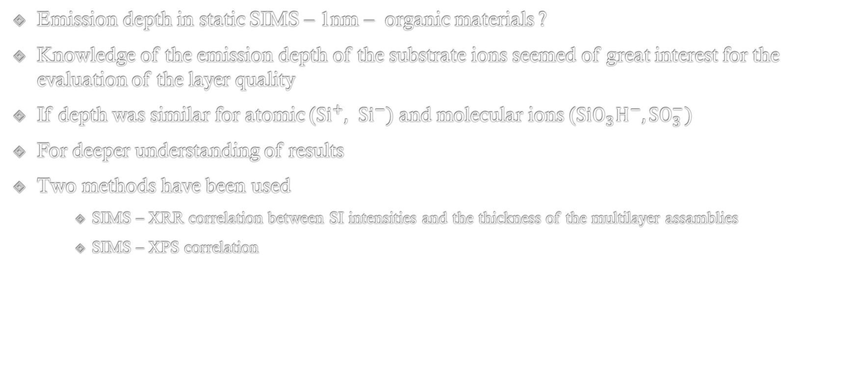
Information depth in SIMS
Emission depth in static SIMS – 1nm – organic materials ?
Knowledge of the emission depth of the substrate ions seemed of great interest for the evaluation of the layer quality
If depth was similar for atomic (${Si}^{+}, {Si}^{−})$ and molecular ions ($SiO_{3}H^{−}, SO_{3}^{−})$
For deeper understanding of results
Two methods have been used
    SIMS – XRR correlation between SI intensities and the thickness of the multilayer assamblies
    SIMS – XPS correlation

Slide 15
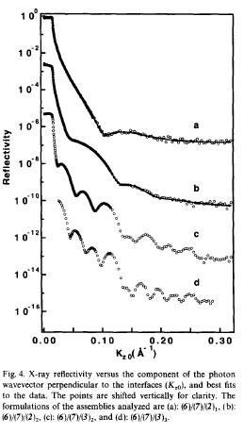
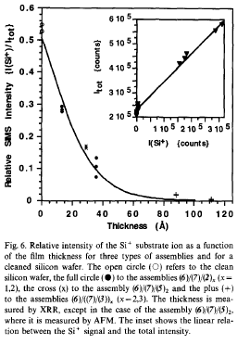
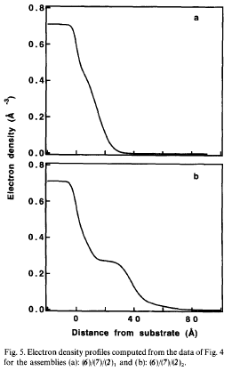
SIMS – XRR correlation

Slide 16
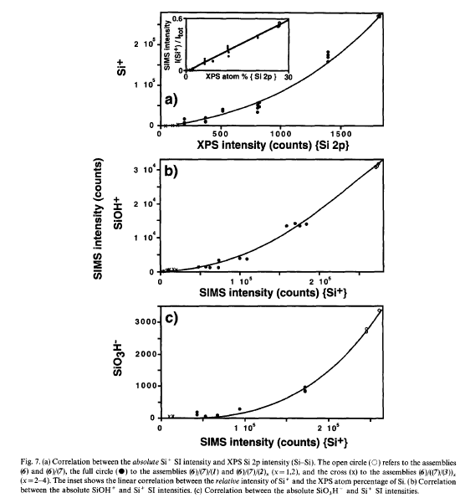
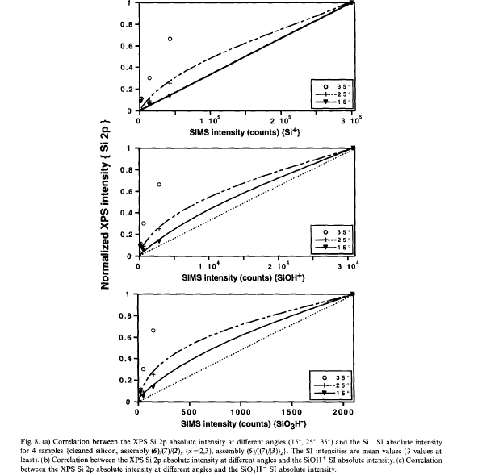
SIMS – XPS correlation

Slide 17
Conclusion
ToF SIMS offers valuable information about polyelectrolyte multilayeres assemblies
The sensitivity to the sample thickness in the case of very thin films – another tool to evaluate the sample quality
From correlation SIMS – XRR, XPS – atomic or small molecular ions are less surface sensitive than large molecular ions
Combination of several complementary techniques leading to a more fundamental understanding

Slide 18
THE END
Thank you for your attention

