Slide 1
ANILINE aminobenzene, aminophen, arylamine, benzenamine, aniline oil, and phenylamine
C6860 Modern Methods of Pollutant Analysis
Chimi Wangmo
454010

Slide 2
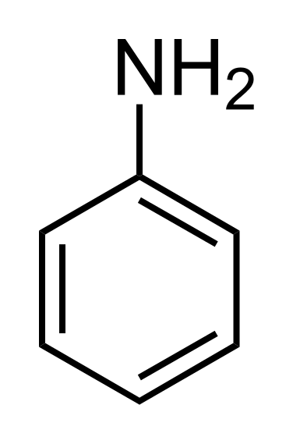
Introduction: basic characteristics
CAS No: 62-53-3
Molecular weight: 93.12 g/mol
Molecular formula: C6H5NH2
Vapor density: 3.22 (185 °C vs. Air)
The vapor pressure: 0.7 mmHg (25 °C)
log Kow: 0.90
Solubility: 36 mg/mL at 25°C
Oily liquid: Colorless to yellowish to brownish with a musty fishy odor

Slide 3
Introduction: Brief History
In 1826 Otto Unverdorben, isolated Aniline from the destructive distillation of indigo: crystallin
In 1834, Friedrich Runge isolated from coal tar, a substance that produced a beautiful blue colour on treatment with chloride of lime- kyanol or cyanol
In 1841, C. J. Fritzsche obtained an oil, by treating indigo with caustic potash- aniline
N. N. Zinin found that, on reducing nitrobenzene, a base was formed- benzidam
In 1855, August Wilhelm von Hofmann established these variously-prepared substances were identical - Aniline or phenylamine.

Slide 4
manufacturing process
Catalytic vapor phase reduction of nitrobenzene with hydrogen
reduction of nitrobenzene with iron filings using hydrochloric acid as catalyst
catalytic reaction of chlorobenzene and aqueous ammonia;
ammonolysis of phenol (Japan)

Slide 5
Uses
Methylene diphenyl diisocyanate (MDI)- used to produce polyurethane foam
Rubber accelerators and antioxidants to vulcanise rubber
Intermediates for herbicides and pesticides, and dyes and pigments.
Minor uses: textile and photographic chemicals, pharmaceuticals, amino resins and explosives.
Use | Percent
MDI(p,p1-methylene diphenyl dissocyanate and polymeric MDI | 73-85
Rubber processing Chemicals | 18
Pesticides and fibers | 9
Pharmaceuticals | 2
Dyes and pigments | 3
Miscellaneous(agricultural chemicals, specialty resins and photographic chemicals | 3

Slide 6
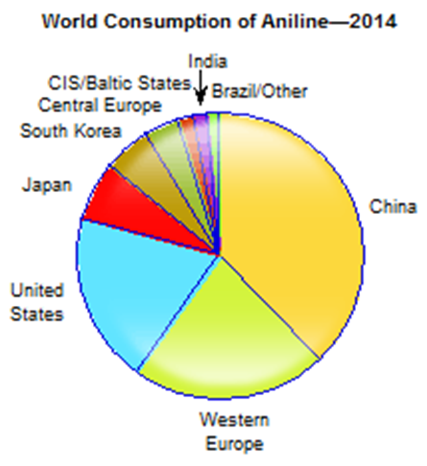
Aniline Production & Consumption
Supply and demand for Aniline in 2006
Region | Consumption Million tonnes/year | Production Million tonnes/year
Western Europe | 1.32 | 1.62
USA | 1.19 | 1.38
Eastern Europe | - | 0.316
Asia Pacific | 0.717 | 1.15
Japan | 0.32 | 0.474
Latin America | 0.073 | 0.07
Asia/Middle East | 0.098 | 0.064
Source: ICIS Chemical Business
Source: www.ihs.com/products/aniline-chemical-economics-handbook.html

Slide 7
Environmental releases
Production and processing
  1. Processing to MDI
  <0.013 to 78 ppm to wastewater
  0.014 to 105 ppm to atmosphere
  2. Processing to rubber chemicals
  0.44 to 75 ppm to wastewater
  24 to 380 ppm to atmosphere
as a degradation product of plant protection agents (biotransformation from phenylurea and carbamate derivatives)
microbial reduction of nitrobenzene

Slide 8
Environmental releases
rubber chemicals (degradation product)-tyres abrasion
  In new and used tyres, aniline was detected in concentrations near the detection limit of 100 mg/kg rubber- abrasion
  In distilled water,3.99-86.4 μg aniline/l were detected, while in artificial rain water (pH = 4), concentrations of 5.91-828 μg/l were found (Baumann and Ismeier, 1997)
thermal degradation of polyurethanes – in foundries manufacturing aluminum, Iron, Steel -occupational risks
  The highest 8-hour TWA of 6.4 mg/m3 exposure level- Swedish study
coal and oil industry
  At three shale oil manufacturing sites, aniline concentrations of 0.48 to 5.4 mg/l (Hawthorne and Sievers, 1984).
Landfills
  level of 9.9 μg/l was detected in Canadian landfills

Slide 9
Exposure routes and health concerns
Inhalation and/or oral uptake- odour can be detected at 1 ppm
Aniline vapor is heavier than air and may cause asphyxiation in enclosed, poorly ventilated, or low-lying areas
Aniline is rapidly absorbed from the gastrointestinal tract. Ingestion can lead rapidly to severe systemic toxicity, nausea and vomiting usually occur
Readily absorbed through the skin both from the liquid and gaseous phases

Slide 10
Exposure and health effects
Aniline is well absorbed after oral, dermal and inhalation exposure.
The extent of absorption after oral intake amounts 89-96% for rats. The corresponding figures for mice, sheep and pigs are lower (72%, 80% and 56%, respectively).
Dermal absorption in humans was estimated to amount up to 38%
Aniline is metabolised to different metabolites by N-acetylation (acetanilide), aromatic hydroxylation (2- and 4-aminophenol) and N-hydroxylation to N-phenylhydroxylamine which is responsible for the formation of methaemoglobin
The metabolites are predominantly excreted in the urine.

Slide 11
Exposure and health effects
Acute Exposure
Many health effects of aniline are due to formation of methemoglobinemia
Affects the heart, CNS, kidney, liver, skin, eyes
In humans 60 ml of orally administered aniline causes death.
0.4-0.6 mg/l air may be borne without much harm for 0.5-1 hour, but 0.1-0.25 mg/l for several hours produces slight symptoms.
Average lethal inhalation dose for humans 0.35-1.43 g/kg body weight.
With respect to methaemoglobin formation the no-effect dose of aniline in adult man is about 0.21 mg/kg body weight
Chronic exposure
Anemia, headaches, tremor, parathesia, pain, narcosis or coma, and cardiac arrhythmia. Heart, kidney, and liver damage may also occur, possibly as secondary effects of hemolysis
Considered a Non Threshold carcinogen :

Slide 12
Ecotoxicological impacts
Aniline is deposited in the soil from the atmosphere and via degradation of plant protection agents.
In soil, aniline will biodegrade and/or bound covalently onto the organic matter. The latter pathway leads to aniline-humic acid adducts which are immobile and only slowly degraded
Aniline found in food such as Rhubarb, black tea
Active trees were exposed for 3 hours at a temperature of 25-30°C to aniline
At 0.4 ppm, produced as much damage as higher concentrations (up to 10 ppm) - Cheeseman et al. (1980)
In vivo studies shows that aniline causes methemoglobinemia in animals
LC50 for dermal absorption in rats: 478 ppm
Oral LD50 in rats: 250 mg/kg
The LC50/96-hour values for fish -10 and 100 mg/L
EC50/ 48-hour values for daphnia - less than 1 mg/L

Slide 13
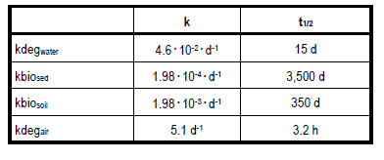
Environmental fate
Degradation rates
BIOACCUMULATION
A BCF of 2.6 ± 0.06.. Bioaccumulation potential due to the exposure of the organisms via water is very low. (Zok et al., 1991).

Slide 14
Assessment/measurement
NIOSH method 2002 (adsorption to silica gel, elution with ethanol, GC-FID)- measurements at workplace
Risk Modeling using EASE software for windows
Inhalation exposure:
  In vivo tests
  Measurement of mean Met-Hb in the blood of humans
Dermal exposure:
  An investigation of liquid aniline absorption through the skin and urine excretion of the metabolite 4-aminophenol in man was carried out (Piotrowski, 1957)- gauze test
  Absorption velocity: 0.18 to 0.72 mg/cm2 /h at skin temperatures from 29.8 to 35°C
  Dermal absorption in humans was estimated to amount up to 38%

Slide 15
Assessment/measurement
Zhu et al., 2004- used GC/MS method to determine aniline and related mono-aromatic amines in indoor air
  Thermal desorption in place of solvent extraction
  Smoking-source of aniline
  Increased concentration of aniline due to shoe polish: initial indoor air concentration of 0.016 Ag/m3 to 0.53 Ag/m
Delepee et al., used HPLC/MS/MS for real time monitoring of aniline in fresh water
  Used porous graphitic carbon (PGC) as stationary phase
Weiss & Angerer: Used GC/MS –urine samples
  liquid–liquid extraction at pH 6.2–6.4
Hanley et al., epidemiological study at a rubber manufacturing plant:
  Company exposure records from 1975–2004 showed a decreasing trend over time, and nearly all breathing zone TWA measurements were well below published occupational exposure limits, yet bladder cancer cases were still reported.

Slide 16
Monitoring data
Aniline is part of a regular monitoring program in the Rhine and its tributaries
No atmospheric monitoring data available

Slide 17
Regulatory status
In accordance to the EU criteria for classification and labelling of carcinogens, aniline is classified as carcinogenic, category 3 and labelled with R 40 “limited evidence of a carcinogenic effect”.
Reference Concentration (RfC) of 1 ug/m3 for aniline in air for the chronic, noncancer effects (U.S. EPA, 1993)
Priority Substances List (PSL1) under the Canadian Environmental Protection Act, 1988 (CEPA 1988).
The following occupational exposure limits apply in the EU (ILO, 1994):
- DK, S: 4 mg/m3 (1 ml/m3)
- FIN, B: 7.6 mg/m3 (2 ml/m3)
- D: 8 mg/m3 (2 ml/m3)
- UK, F: 10 mg/m3 (2 ml/m3)

Slide 18
Regulatory status
OSHA PEL (permissible exposure limit) = 5 ppm (skin) (averaged over an 8-hour workshift)
NIOSH IDLH (immediately dangerous to life or health) = 100 ppm
SCOEL
  8-hour TWA: 0.5 ppm [1.94 mg/m3]
  STEL (15 mins): 1.0 ppm [3.87 mg/m3]
  Biological Limit Value (BLV): 30 mg p-aminophenol / litre urine (sampling: 0-2 h after exposure/shift)
  SCOEL carcinogen group: C (carcinogen with a practical threshold)
  For inhalation aniline exposures at the workplace on the background of cancer risks air concentrations of 0.2 mg/m3 should not be exceeded
High production volume chemical according to European Chemical Substance information system
Aniline forming plant protection products come under the Council Directive 91/414/EEC

Slide 19
Conclusion
Sources of aniline is diverse and its presence in the environment ubiquitous
Easily biodegradable in certain conditions, low bio accumulation factor
The information available for aniline assessment is from early 2000s. Studies with more precise methods to quantify aniline especially in manufacturing and processing industries are crucial
Cohort studies to ascertain reproductive, carcinogenic, genotoxic effects needs to be under taken focusing on occupational hazards
long term tests with plants, earthworms and micro-organisms to assess risks on soil to be carried out
More rigorous monitoring program to evaluate the effects and releases

Slide 20
References
Zhu, J. & Aikawa, B. Determination of aniline and related mono-aromatic amines in indoor air in selected Canadian residences by a modified thermal desorption GC/MS method. Environ. Int. 30, 135–143 (2004).
Delépée, R., Chaimbault, P., Antignac, J. P. & Lafosse, M. Validation of a real-time monitoring method for aniline in freshwater by high-performance liquid chromatography on porous graphitic carbon/electrospray ionization tandem mass spectrometry. Rapid Commun. Mass Spectrom. 18, 1548–1552 (2004).
Hanley, K. W., Viet, S. M., Hein, M. J., Carreón, T. & Ruder, A. M. Exposure to o- Toluidine, Aniline, and Nitrobenzene in a Rubber Chemical Manufacturing Plant: A Retrospective Exposure Assessment Update. J. Occup. Environ. Hyg. 9, 478–490 (2012).
Assessment, R. European Union Risk Assessment Report. Heal. (San Fr. 77, 107–259

