Slide 1


Bisphenols
Jiří Palát
Modern Methods for Analyses of Organic Pollutants

Slide 2
Outline
Introduction
Applications of bisphenols
Bisphenol A and its alternatives
Exposure
Intrumental methods
Legislation
Conlusions

Slide 3

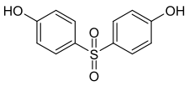



What are BISPHENOLS?
Ubiquitous organic compounds with 2 hydroxyphenyl groups
Bisphenol A – the most common
Other important bisphenols – B, F, S
Pseudo-persistent polutants
Endocrine disruptors
Bisphenol S
Bisphenol A
Bisphenol F
Bisphenol B

Slide 4
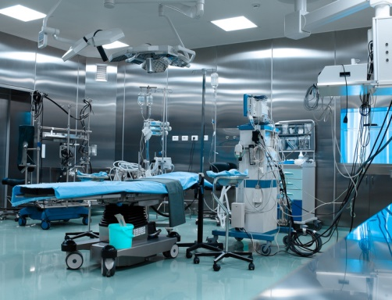
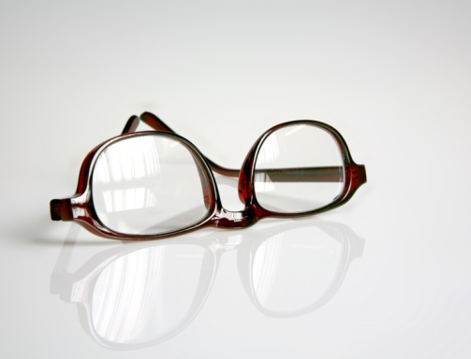
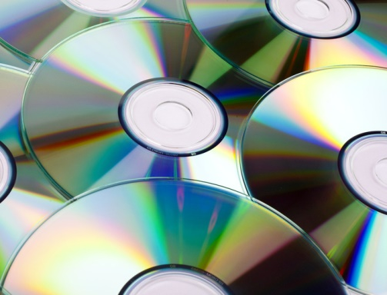
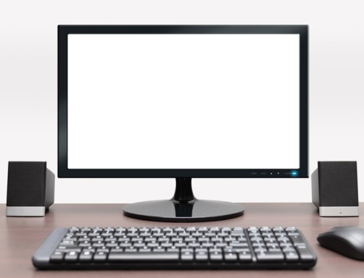
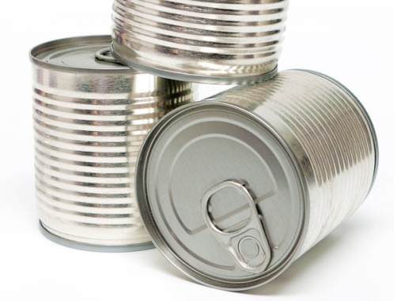
Applications of Bisphenols
Basic building blocks for polycarbonate plastics (70%) and epoxy resins (30%)
Polycarbonate plastics: returnable beverage bottles, infant feeding bottles, storage containers
Epoxy resins: coatings and linings for food and beverage cans

Slide 5
Bisphenol A
Use as monomer for plastic production since 1990s
Global Bisphenol A production volume 2011: over 5 million tons
Endocrine disruptor → estrogen activity
Estrogen activity 5 times lower than 17β-estradiol
Adverse effects: impact on sexual development, reproduction potency, health effect (especially cancers of sexual organs but also cardiovascular diseases and diabetes)
TDI by EFSA – 0,04 mg/kg of bodyweight per day
*TDI – tolerable daily intake
EFSA – European Food Safety Authority

Slide 6
Occurrence
Detected in several matrices:
water
  soils and sediments
  sewage
  indoor dust
  food samples
  beverages
  thermal paper
  human blood, breast milk, urine

Slide 7
Bisphenol A - concentrations
Country | Sample size | Detection freq. (%) | Range | Refs.
Canned food (ng/g)
US | 78 | 91 | <2-730 | Noonan et al. (2011)
US | 97 | 59 | <0,2-65 | Schecter et al. (2010)
Canada | 78 | 99 | <0,6-534 | Cao et al. (2010)
Japan | 48 | 92 | <1-842 | Sajiki et al. (2007)
Korea | 61 | 64 | <3-136 | Lim et al. (2009a)
Belgium | 21 | 100 | 0,2-169 | Geens et al. (2010)
Beverage cans (ng/ml)
Spain | 11 | 64 | <0,05-0,61 | Gallard-Ayala et al. (2010)
Canada | 69 | 100 | 0,03-4,5 | Cao et al. (2009a)
Belgium | 45 | 91 | <0,02-8,1 | Geens et al. (2010)
Portugal | 30 | 70 | <0,01-4,7 | Cunha et al. (2011)

Slide 8
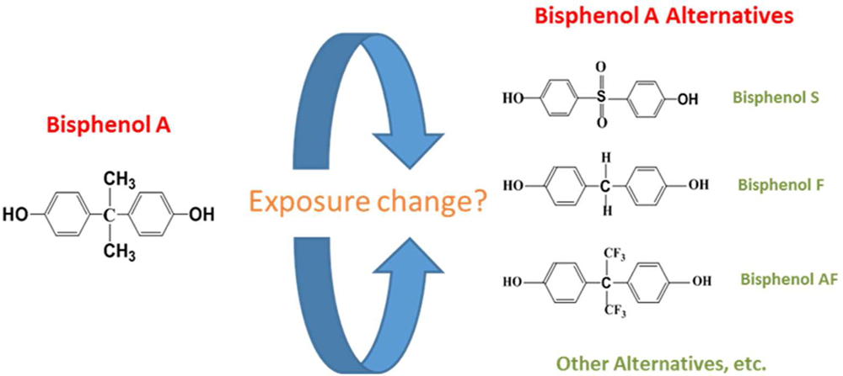
Bisphenol A alternatives

Slide 9
Bisphenol A alternatives
Bisphenol S
  Main alternative of bisphenol A
  Higher thermal stability than bisphenol A
  Use in production of baby bottles and thermal paper
Bisphenol B
Bisphenol F

Slide 10
How does BPA get into the body?
Primary source through the diet
  BPA in food and beverages accounts for the majority of daily human exposure
  Leach into food from coatings and other consumer products
Air, dust and water are other possible sources of exposure
TDI by EFSA – 0,04 mg/kg of bodyweight per day
*TDI – tolerable daily intake
EFSA – European Food Safety Authority

Slide 11
Instrumental methods
HPLC-MS
HPLC-MS/MS
GC-MS
GC-MS/MS
  With various ionization techniques

Slide 12
EU framework
Regulation EU 10/2011 on plastic materials and food contact materials
    BPA is permitted for use in food contact materials in the European Union (EU)
    a national restriction on the use of BPA in all food contact materials – France
    A national restrictions on the use of BPA in food contant materials for children – Sweden, Denmark, Belgium
Directive 2011/8/EU restricting the use of bisphenol A in plastic infant feeding bottles

Slide 13
Bisphenol A under REACH
Summer 2016 – demand to identify as an SVHC based on the reprotox 1B classification
August 2016 - reprotox 1B classification entered into force
March 2018 - reprotox 1B for BPA will apply
Not for BPA as an intermediate!
Not direct impact for manufacture uses of BPA (polycarbonate materials)
*SVHC – substances of very high concern

Slide 14
What can I do to prevent exposure of BPA?
Don’t microwave polycarbonate plastic food containers
Reduce your use of canned foods
Choose glass, porcelain or stainless steel containers
Use BPA free baby bottles

Slide 15
Conclusions
Widespread problem - BPA and its alternatives deserve special attention
Much more focus on analysis in human matrices
Focus on toxicological effects of bisphenols, especially on its alternatives
Really lack of data on toxicological informations of alternatives

Slide 16
Thanks for your attention!
Any questions?

