Slide 1
Cadmium and chromium
Kristýna Kroupová
Modern Methods of Pollutant Analysis
Research Centre for Toxic Compounds in the Environment

Slide 2
Outline
Cadmium and chromium in the environment
Compounds and human exposure
Toxicity
Methods
Legislation
Summary

Slide 3
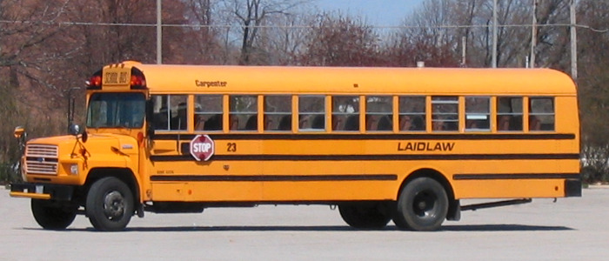
Cd and Cr in the environment
Naturally in Earth's crust
Natural sources: Volcanic eruptions, erosion
Anthropogenic sources:
  mining, industrial wastes, coal combustion, chemical industry, fossil fuels, transportation, fertilisers
Cadmium
Chromium
  Application:
    Batteries (Ni-Cd)
    Electroplating
    Pigments: Cadmium yellow, cadmium red, cadmium orange
  Application:
    stainless steel
    Electroplating
    Dyes and pigments
      Chrome yellow, green
      Chromium oxide (green) – main ingredient in infrared reflecting paints
    Wood preservative
    Tanning (leather)
    Catalyst (polyethylene production, water gas shift reaction, hydrogenation)

Slide 4
Compounds and human exposure
Cadmium
Chromium
Compounds:
Rare in pure state in nature
Mostly in oxidation state II+
Inorganic salts
Organic compound
microbial formation of monomethyl cadmium (significance not know)
Main sources of human exposure:
Eating, drinking, smoking, dust breathing
Retains in kidney and liver
Biological half-life: 10 – 30 years
Excretion: urine, hair, nails, breast milk
Compounds: oxidation states from –II to +VI. Cr^{III} and VI+ are relevant.
Cr^{II}, IV+, V+ - short lifetime, CrO₂ nontoxic
Main sources of human exposure:
Eating, drinking: Higher concentrations in food from stainless steel cans.
Dust breathing – small amounts, smoking
Household goods: wood preservatives, cement, textiles, leather products.
Retains mostly in kidneys and lungs.
Cr^{III} unable to cross cell membrane
Cr^{IV} cross cell membranes through phosphate and sulfate anion-exchange carrier pathway.
Biological half-life: varies from 15 days to 5 years (depend on form)
Excretion: urine, breast milk, hair, nails

Slide 5
Toxicity
Cadmium
Chromium
renal dysfunction
Long/high exposure – renal failure
Bone demineralization - osteoporosis
Neurotoxic, genotoxic, teratogenic
IARC carcinogen (Group 1)
  Lung
  Endometrium
  Bladder
  Breast
Cr^{III} essential for mammal's metabolism
Cr^{VI}: Toxic
irritation of upper respiratory tract and skin
nose bleeding
ulceration
kidney and liver problems
imunotoxic, neurotoxic
IARC carcinogen (Group1) only Cr^{VI}
  Lung
  Upper respiratory tract
Lack of appropriate data on effect of chromium during lactation.

Slide 6
Methods
Cadmium
Chromium
Total Cd: ICP-MS, ET-AAS, GF-AAS…
Cd speciation:
Separation:
  Gel permeation chromatography,
  Anion-exchange chromatography
  HPLC
Detection:
AAS
  ICP-MS
  Voltametry
Total Cr: UV/VIS photometry, AAS, ICP-MS
Cr speciation:
separation of species: ion pair chromatography
Detection: UV/VIS photometry, AAS, ICP-MS, chemiluminiscence methods…
Speciation:
Liquid samples – „easy“ to analyze
Solid samples – analytical challenge (for transformation of a solid sample into a liquid state extraction procedure has to be applied -> risk of species conversion)

Slide 7
Legislation
Cadmium – limits
Chromium
 | limit
Emission | 0,05 mg/m³
Imission (PM10), year average | 5 ng/m³
Water (for babies, surface water, waste water…) | 5 ug/l – 0,2 mg/l
Soil (different type) | 0,04 – 800 mg/kg (dry mater)
Food (different type) Commission Regulation (EC) No 1881/2006 | 0,05 – 1,0 mg/kg
Toys Directive 2009/48/EC of the European Parliament
Many more…
 | limit
Emission (suma of metals As, Co, Ni, Se, Tl, Cr) | 2 mg/m3
imission | -
Water | 0,025 – 0,5 mg/l
Soil | 0,29 – 90 mg/kg (dry mater)
Food | 0,2 – 4,0 mg/kg
…
Convention on Long-Range Transboundary Air Pollution (CLRTAP):
Protocol on Heavy Metals (1998) - The protocol addresses the reduction of cadmium, lead and mercury emissions

Slide 8
Summary
Presence of Cd and Cr in wide range of matrices – possible sources of human exposure
Toxicology data available (gaps – effects in small doses and mixtures)
Methods (mostly for total concentrations, speciation of Cd and Cr is hard to perform)
Legislation
Future plan:
Methods for speciation in solid samples (Cr)
Methods for speciation Cd and Cr in complex matrixes (content of fat and protein e.g. human tissues – milk, blood, muscles…)
Evaluation of effect during lactation (Cr)
Evaluation of effect in low doses and mixtures

