Slide 1
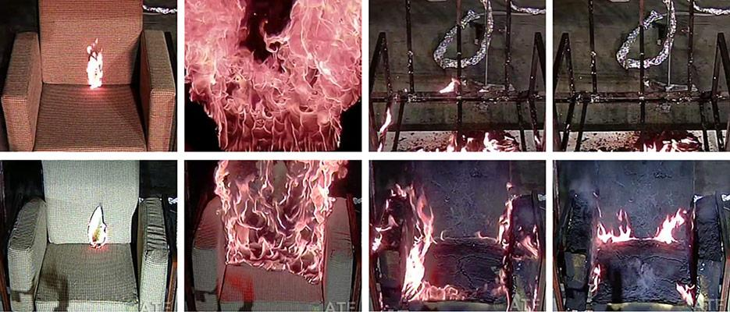
Flame retardants
Fig. 1: FR treated vs. untreated chair Source: www.nist.gov
„To burn or not to burn?“
Martin Kizovský

Slide 2
Flame Retardants (FRs)
Content of the presentation:
  Overwiev – what, where, how?
  Risk assessment – why do we care?
  Sampling and analyses
  Information gap
  Conclusion

Slide 3
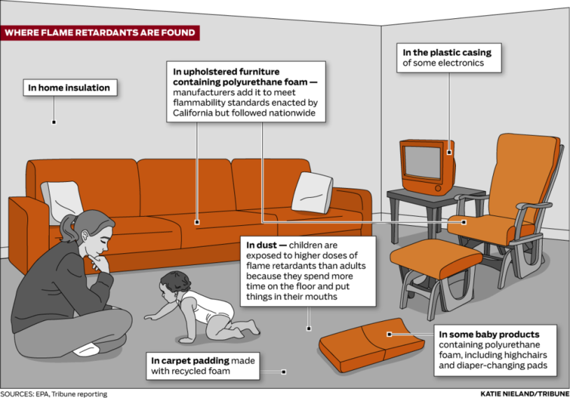
  FRs – Overview
  What?
    Chemicals that inhibit or delay the spread of fire
    Halogenated (Cl, Br), Organophosphorus, Nitrogen
  Where?
    Plastics, electronic circuit boards, building insulation materials, textiles, furniture
Fig. 2: Using of FRs
Source: www.sourcewatch.org

Slide 4
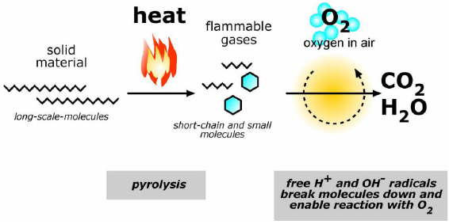
  FRs – Overview
  How?
    (C)BFRs: interruption of radical chain mechanism in gas phase of combustion process
    OPFRs: release of water in solid phase + coating
    NFRs: release of inert gases
Fig. 3: Combusting process
Source: www.garmentstech.com

Slide 5

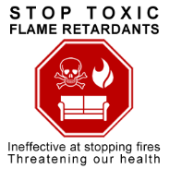
FRs – Risk assessment
  Why do we care?
    Persistency
    Long-range transport
    Bioaccumulation
    Endocrine disruption
    Carcinogenic
Fig. 5, Source: www.saferchemicals.org
Fig. 4, Source: www.bcaction.org

Slide 6
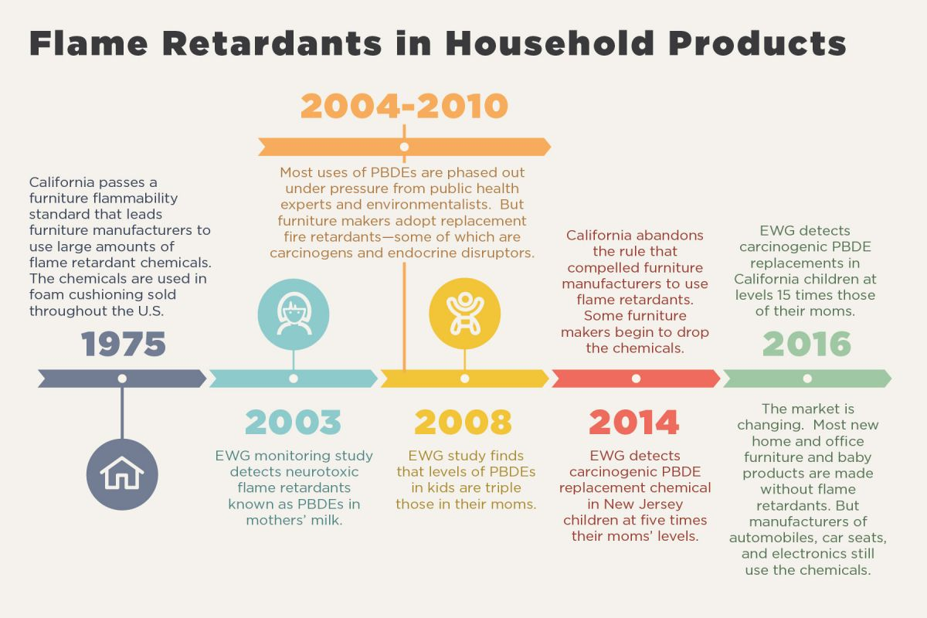
FRs – Risk assessment
  Why do we care?
    Chemicals of concern – PBDEs, HBCD, TBPH, TDCPP, TBB
Fig. 6: FRs Timeline
Source: www.ewg.org

Slide 7
FRs – Sampling and Analyses
  Sampling
    Dust collecting (vacuum cleaner)
  Extraction
    acetone, toluene, hexane, DCM
    Soxhlet, ultra-sonication, column with silicagel
  Analysis
    GC-MS
    LC-MS
    LC-MS/MS

Slide 8
FRs – Information gap
  Problem
    Not enough information about real functionality
    Not enough information about toxicity
  Ways to go
    Functionality – test with basic/random objects (are they needed?)
    Biomonitoring – long term (which & how are they toxic?)
    Update legislation as a result

Slide 9
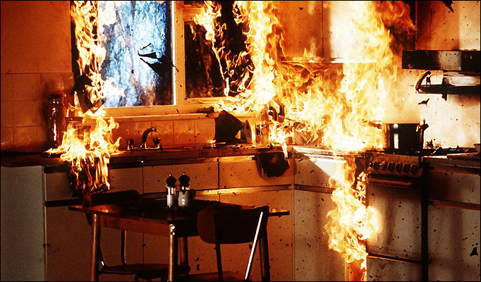
FRs – Conclusion
  "To burn or not to burn?"
    Depends on situation
    Consider risk on both sides
    Search for alternatives
Fig. 7,
Source: www.firebuddy.co.nz

Slide 10
FRs – Image Sources
  Fig. 1: https://www.nist.gov/sites/default/files/styles/1400_x_1400_limit/public/images/el/fire_research/15el003_burningchairs_lr.jpg?itok=OJhHNXY1
  Fig. 2: http://www.sourcewatch.org/index.php/Flame_Retardants
  Fig. 3: http://garmentstech.com/why-need-to-know-your-clothing-are-flame-retardants-free/
  Fig. 4: https://bcaction.org/site-content/uploads/2012/11/take-action-flame-retardants.png
  Fig. 5: http://saferchemicals.org/sc/wp-content/uploads/sites/3/typepad/times-sq-couch.png
  Fig. 6: http://www.ewg.org/enviroblog/2017/02/flame-retardant-roulette-swapping-one-toxic-compound-another
  Fig. 7: http://firebuddy.co.nz/wp-content/uploads/2015/04/chip-pan-fire.jpg
  Fig. 8: http://memes.com/img/1128020

Slide 11

FRs – End
Fig. 8, Source: www.memes.com

