Slide 1
Polycyclic aromatic hydrocarbons (PAHs) in the air
Barbora Nežiková

Slide 2
Outline
Polycyclic aromatic hydrocarbons (PAHs)
Air
Conclusion

Slide 3
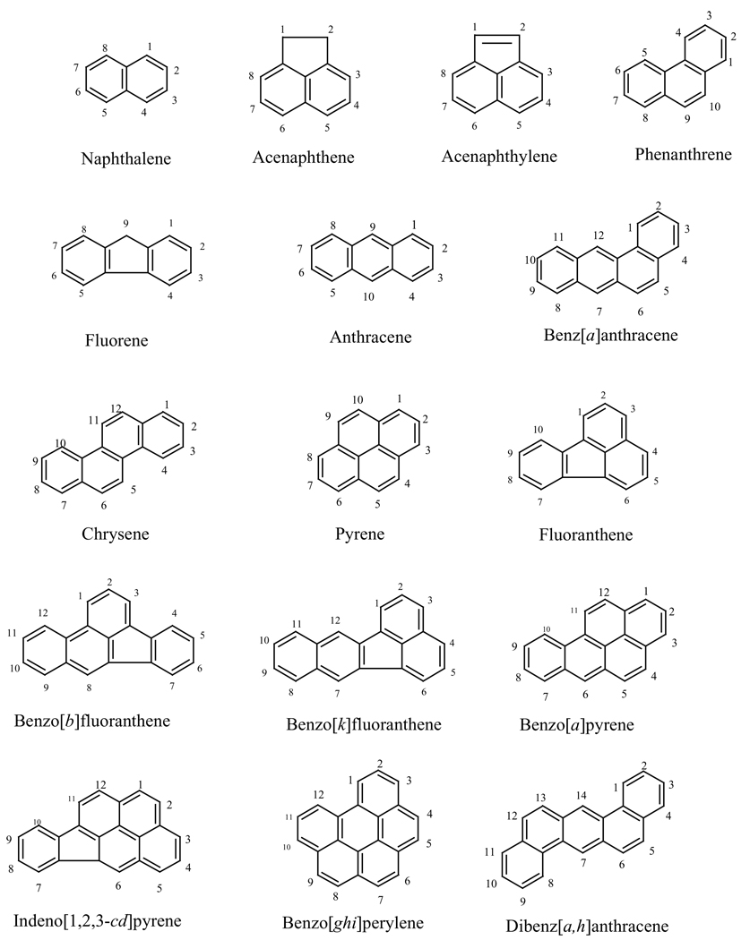
Polycyclic aromatic hydrocarbons (PAHs)
Organic compounds with two or more fused aromatic rings
Always in mixture, analysis only of few selected
  16 EPA priority
  + other depending on the study

Slide 4
PAHs
Sources – Burning processes
  Anthropogenic – generally byproduct
  Natural – forest fires, volcanos
Biggest jump in concentration in history
  Industrial Revolution
  More common use of cars
Pseudo-persistent
  Destruction on sun, biodegradation, reaction with other compounds

Slide 5
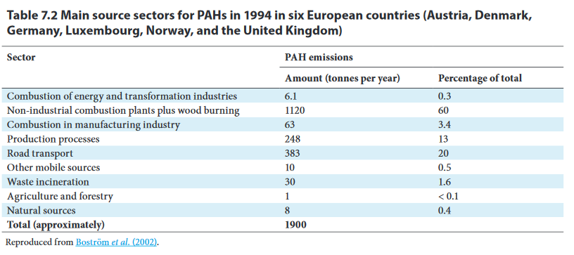
PAHs - Sources
520 000 tones per year globally
China, India and USA – biggest contributors

Slide 6
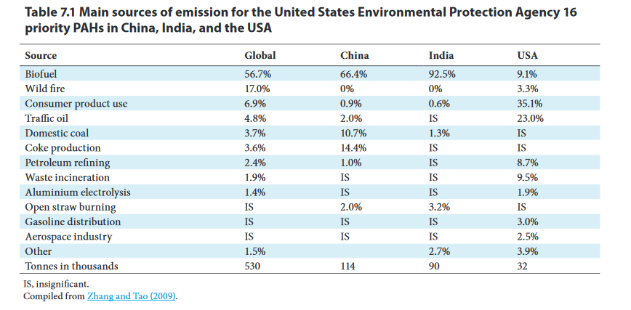
PAHs - Sources

Slide 7
PAHs
Toxicity – carcinogenic and mutagenic
  Benzo[a]pyrene – 1 IARC
  Dibenzo[a,h]anthracene – 2A IARC
  Benz[a]anthracene – 2B IARC
Number | Meaning
1 | Carcinogenic to humans
2A | Probably carcinogenic to humans
2B | Possibly carcinogenic to humans
3 | Not classifiable
4 | Probably not carcinogenic to humans

Slide 8
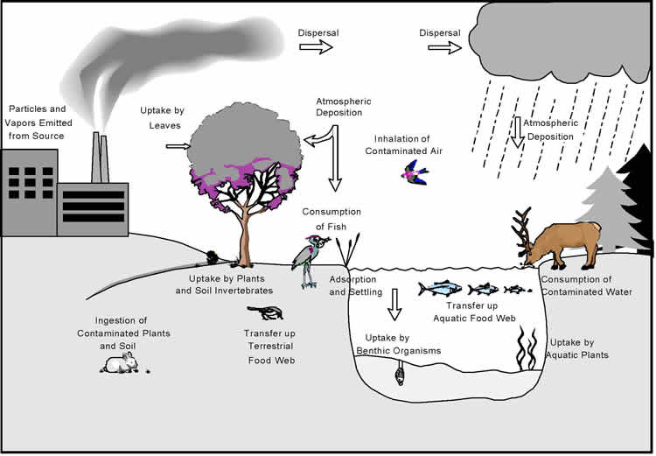
Fate in the air
Depending on properties of PAHs and meteorological factors
Most important – partitioning between gaseous and particulate phase
  Defined by partitioning constant Kp

Slide 9
Modelling of Kp
Different models, different approaches
  Single parameter
  Poly parameter

Slide 10
Transformations
Can transform
  NO₂-PAHs, OH-PAHs, Oxy-PAHs,…
Can be more toxic
Less information about them
Problems with methodology and lack of data

Slide 11
Air
Dynamic and homogenous matrix
Sampling
  Active x passive
  Gaseous x particulate phase
  Indoor x outdoor
Many different studies, lots of data
  Can we compare them?

Slide 12
Concentration
Strongly depending on locality and part of year
Differences in gaseous and particulate phase
Indoor
  Depending on smoking and cooking
  About dozens ng/m³
Outdoor
  Background locality – about units ng/m³
  Urban areas – even hundreds ng/m³

Slide 13
Legislation
Not part of Stockholm convention
Included in Convention on Long-range Transboundary Air Pollution
Emission limit for B[a]P – 1 ng/m³

Slide 14
Methodology
Very traditional pollutants in traditional matrix
Good analytical and sampling methods
  Careful about sampling artefacts!
  Problem with dibenz[a,h]anthracene and benzo[k]fluoranthen
No need for improvement

Slide 15
Connection to human
Biggest exposure of PAHs for humans is from food
Important source from air - smoking
Increased risk of cancer
  Mostly associated with PM_{2.5}

Slide 16
What now?
Educate public about health hazards associated with PAHs
Do one uniform method so we can compare and share data
Fill the gaps about toxicology and methodology of derivatives of PAHs

Slide 17
What then?
Impossible to ban (natural sources) → try to lower anthropogenic sources
  Improve our technologies and vehicles
Continue to monitor PAHs in the air
  But be careful about data and how they were „created“!
  Widen monitoring data to humans

Slide 18
Thank you for your attention!
Any questions?

