Slide 1
Toxic Mixtures
Affiefa Yawer
C6860 Modern Methods of Pollutant Analysis

Slide 2
TOXIC MIXTURES
What are toxic mixtures.
General principal or past approach to assess toxic mixture.
Modern approach to assess toxic mixture.
Methodology
Knowledge gaps
Conclusions

Slide 3
TOXIC MIXTURES
Products:Substances that are mixtures themselves multi-constituent substances, MCS; materials of unknown or variable composition, complex reaction products or biological materials, UVCB, Products that contain more than one chemical.
Emission:Chemicals jointly emitted from production sites, during transport processes, and consumption or recycling processes.
Imissions:Several chemicals that might occur together in environmental media (water, soil, air), food items, biota and human tissues, as a result of emission from various sources, via multiple pathways.

Slide 4
Groups
Metals zinc with other metals, such as copper, vanadium, nickel and iron
Dioxins, polychlorinated biphenyls and other chlorinated hydrocarbons
Long chained hydrocarbans with aromatic rings
Pesticides, herbicides, fungicides
Cosmatic products etc

Slide 5
General principles of mixture toxicology
More than 50 years ago, three basic types of action for combinations of chemicals were defined (Bliss 1939, Loewe and Muischnek 1926, Plackett and Hewlett 1948, Plackett and Hewlett 1952):
1-Dose/concentration addition (similarly acting chemicals)
2- independently acting chemicals
3-Interactions

Slide 6

General principles of mixture toxicology
Dose/concentration addition (similarly acting chemicals): the effects can be estimated directly from the sum of the doses/concentrations, scaled for relative toxicity

Slide 7
General principles of mixture toxicology
Independently acting chemicals: the effects can be estimated directly from the probability of responses to the individual components (response addition) or the sum of biological responses (effects addition).
pM = 1 – (1-p1) (1-p2) (1-p3)… (1-pn)

Slide 8
General principles of mixture toxicology
Interactions:Interaction describes the combined effect of two or more chemicals as stronger (synergistic, potentiating, supra-additive) or weaker (antagonistic, inhibitive, subadditive,infra-additive) than would be expected on the basis of dose/concentration addition or response addition. Interactions may therefore vary according to the relative dose levels, the route(s), timing and duration of exposure (including the biological
persistence of the mixture components), and the biological target(s).

Slide 9
General principles of mixture toxicology
Toxicokinetic interactions; these are a common cause of deviations from additivity. Examples are chemicals modifying the absorption of others e.g., skin penetration enhancing substances in cosmetics.
Metabolic interactions: chemicals modifying the metabolism of other mixture components.
Toxicodynamic interactions: interactions between the biological responses resulting from exposure to the individual chemicals, for example resulting from similar targets (e.g., ligand-receptor interaction)
Kortenkamp et al. (2009)

Slide 10
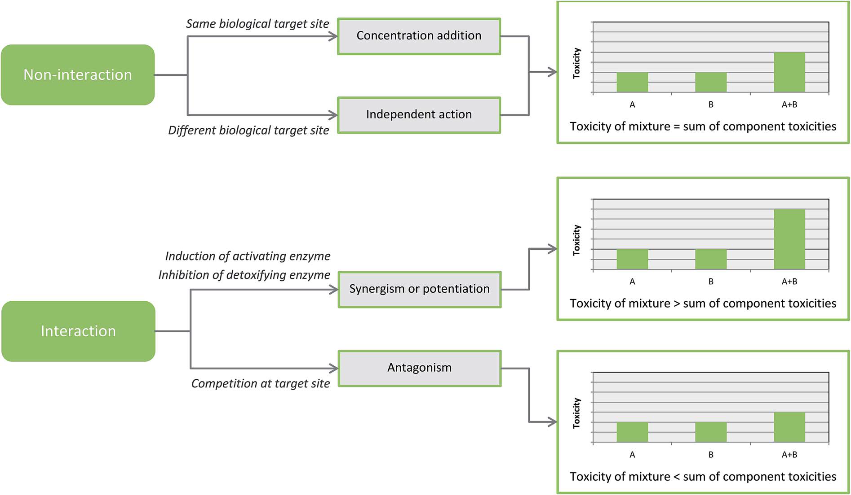
General principles of mixture toxicology
RSC Adv., 2016, 6, 47844
Fig. Schematic demonstrating the theoretical models of chemical mixture effects.

Slide 11
Modern approach for assessing toxic mixtures
Whole-mixture approaches: An assessment may also be based on data generated with a mixture of reasonably similar composition or a “surrogate mixture.
If a mixture cannot be assessed in its entirety, it may be possible to separate fractions (e.g., mixtures of petroleum hydrocarbons into aliphatic fractions of certain chain length ranges and aromatic fractions) and to assess the toxicities of the fractions e.g diesel exhaust (gaseous fractions and particulate matter fraction).
Limitation: Testing whole mixtures does however not provide specific information on interactions or the toxicity of individual mixture components.
Advantage: of accounting for any unidentified materials in the mixture and for any interactions among mixture components (Boobis et al. 2011).

Slide 12
Modern approach for assessing toxic mixtures
Component based approaches: If the components of a mixture are known, a component-based approach is usually
performed. Information on the mode of action should be used to assess the type of
combined action (independent action, similar action) applicable.

Slide 13
Modern approach for assessing toxic mixtures
Grouping of mixture components based on structural similarities: The chemicals in a mixture can be grouped into assessment groups or “blocks” on the basis of their chemical structure using tools such as the OECD (Q)SAR Application Toolbox (OECD 2009) and also according to ECHA and EFSA guidelines.

Slide 14
Modern approach for assessing toxic mixtures
Dose/concentration addition approaches: Methods for dose/concentration addition approaches most frequently used are the hazard index (HI), the reference point index (RfPI, also known as point of departure index (PODI), the relative potency factor (RPF), or the toxic equivalency factor (TEF).

Slide 15
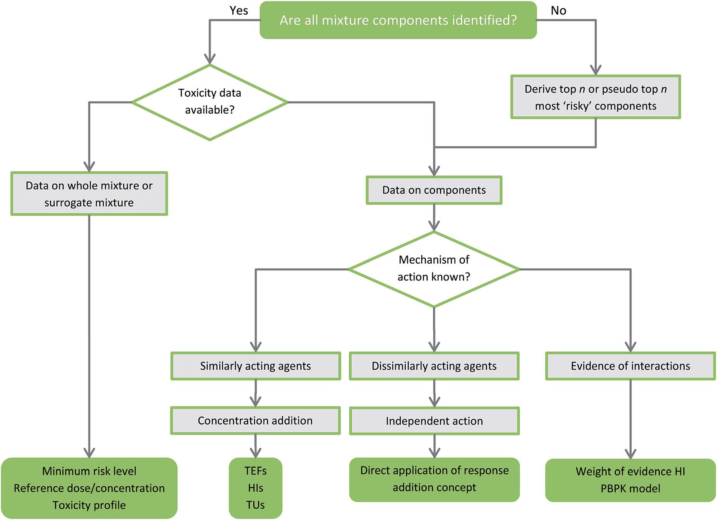
Modern approach for assessing toxic mixtures
RSC Adv., 2016, 6, 47844
Fig. Flow chart of general guidance on the depth of toxicity data available for chemical mixtures and appropriate risk assessment methods.

Slide 16
Methodology
According to WHO/IPCS 2009
Iterative process (exposure and hazard)
Several tiers of increasing data analysis for next step
Decision based analysis of relevant information at early stage
Early consideration of potential for exposure compared to TCC (Threshold of Toxicological Concern)
Public health concern

Slide 17
Methodology
Under REACH regulation, some complex substances of pesticide and biocidal formulations, and cosmetic products are considered for risk assessment.
At EU level there is currently no generally accepted approach for the methodology to conduct a risk assessment for chemical mixtures and a case-by-case approach is followed depending on the mixture under review.
Guidance for conducting cumulative risk assessments has been published by the Environmental Protection Agency of the USA (USEPA 2002), the UK Committee on
Toxicity of Chemicals in Food, Consumer Products and the Environment (COT 2002), the
Norwegian Scientific Committee for Food Safety (VKM 2008), and the German CVUA (CVUA 2007).

Slide 18
Knowledge gaps
With regard to the assessment of chemical mixtures a major knowledge gap at the present time is the lack of knowledge on where, how often and to what extent humans and the environment are exposed to certain chemical mixtures and how exposure may change over time.
There is a need to better understand human and environmental exposures, both through the use of monitoring and modeling (Tornero-Velez et al. 2011).
For many chemicals, there is no good information on mode of action. Currently there is neither an agreed inventory of modes of action, nor a defined set of criteria on how to characterize or predict a mode of action for data-poor chemicals or how to group chemicals into assessment groups.
Interactions of chemicals in mixtures are difficult to see, particularly for long-term effects.
Research is needed to define criteria that predict potentiation or synergy.

Slide 19
Knowledge gaps
In ecotoxicology, the problem is even more complex. A knowledge of all possible modes of action that may occur in the different types of organisms of a complex biological community is difficult (if not impossible) to be attained. On the other hand, it must be considered that ecologically relevant endpoints are generally broader and not so specific Toxicity and Assessment of Chemical Mixtures (e.g. toxicity on specific organs, etc.) as in human toxicology. A full review of the literature should be made to prepare a state-of-the-art on mixtures biodegradation modeling.

Slide 20
Conclusions
Is there scientific evidence that when organisms are exposed to a number of different chemical substances, these substances may act jointly in a way (addition, antagonism, potentiation, synergies, etc.) that affects the overall level of toxicity?
Yes, under certain conditions, chemicals will act jointly in a way that the overall level of toxicity is influenced.
Although Several approaches for the assessment of the mixture effects of chemicals already exist such as dose addition and independent action. And have their advantages and disadvantages of the different approaches but still sufficient knowledge is required to assess chemical mixtures in a more detailed way.

Slide 21
References
Carlson-Lynch H, Price PS, Swartout JC, Dourson ML, Keenan RE (1999). Application of Quantitative Information on the Uncertainty in the RfD to Noncarcinogenic Risk Assessments. Human and Ecological Risk Assessment 5(3), 527-546.
Charles GD, Gennings C, Tornesi B, Kan HL, Zacharewski TR, Bhaskar Gollapudi B,Carney EW (2007). Analysis of the interaction of phytoestrogens and synthetic chemicals: an in vitro/in vivo comparison. Toxicol Appl Pharmacol. 218(3), 280-288.
Charles GD, Gennings C, Zacharewski TR, Gollapudi BB, Carney EW (2002). An approach for assessing estrogen receptor-mediated interactions in mixtures of three chemicals: A pilot study. Toxicol Sci. 68(2), 349-360.
Chen CL, Hsu LI, Chiou HY, Hsueh YM, Chen SY, Wu MM et al. (2004). Ingested arsenic, cigarette smoking, and lung cancer risk: A follow-up study in arseniasisendemic areas in Taiwan. JAMA 292, 2984-2990.

Slide 22
References
Altenburger R, Boedeker W, Faust M, Grimme LH (1996). Regulations for combined effects of pollutants: consequences from risk assessment in aquatic toxicology. Foo Chem Toxicol 34, 1155-1157
Altenburger R, Walter H, Grote M (2004). What Contributes to the Combined Effect of a Complex Mixture? Environ Sci Technol. 38, 6353-6362
Ankley GT, Bennett RS, Erickson RJ et al. (2010) Adverse outcome pathways: a conceptual framework to support ecotoxicology research and risk assessment. Environ Toxicol Chem. 2010 Mar;29(3):730-41.
ATSDR (2004). Guidance Manual for the Assessment of Joint Toxic Action of Chemical Mixtures. US Agency for Toxic Substances and Disease Registry. Division of Toxicology. May 2004 Bliss CI (1939). The toxicity of poisons applied jointly. Ann Appl Biol. 26(3), 585-615.
Boobis AR, Ossendorp BC, Banasiak U, Hamey PY, Sebestyen I, Moretto A (2008). Cumulative risk assessment of pesticide residues in food. Toxicol Lett. 180, 137-150 Boobis AR, Budinsky R, Collie S, Crofton K, Embry M, Felter S, Hertzberg R, Kopp D, Mihlan G, Mumtaz M, Price P, Solomon K, Teuschler L, Yang R, Zaleski R (2011).

Slide 23


